Slide 1
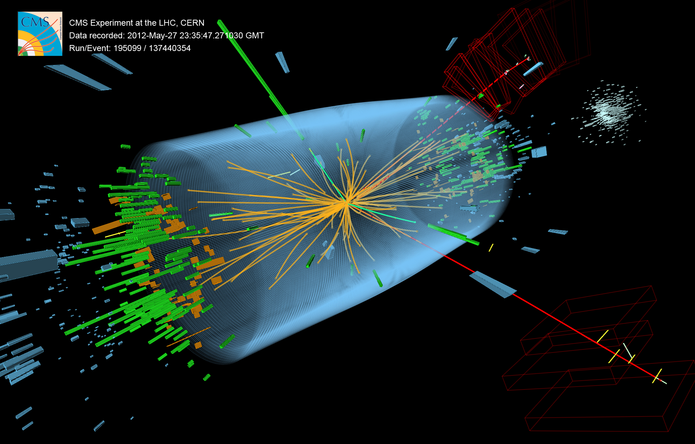

What's Next in Higgs Physics
2013 Nobel Prize for Physics, citing:
“the discovery of the predicted fundamental particle, by the ATLAS and CMS experiments at CERN's Large Hadron Collider.”

Slide 2
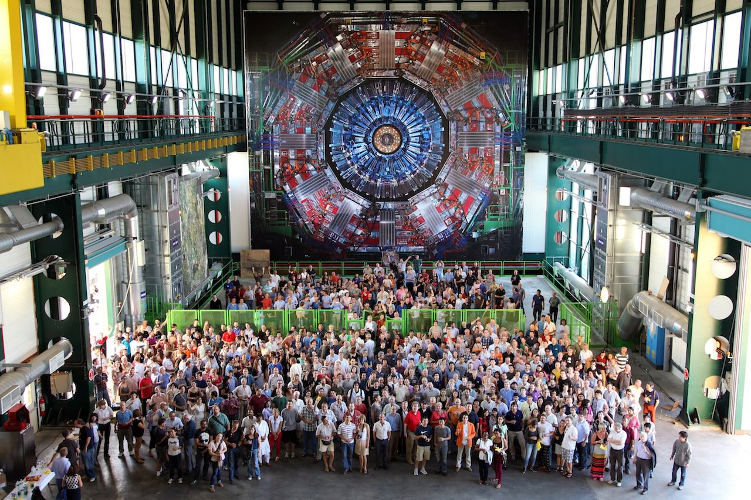
It Took The Global Village
& 50 years, after theoretical work!
~20% of CMS Shown. CMS is ~10% of HEP community.

Slide 3
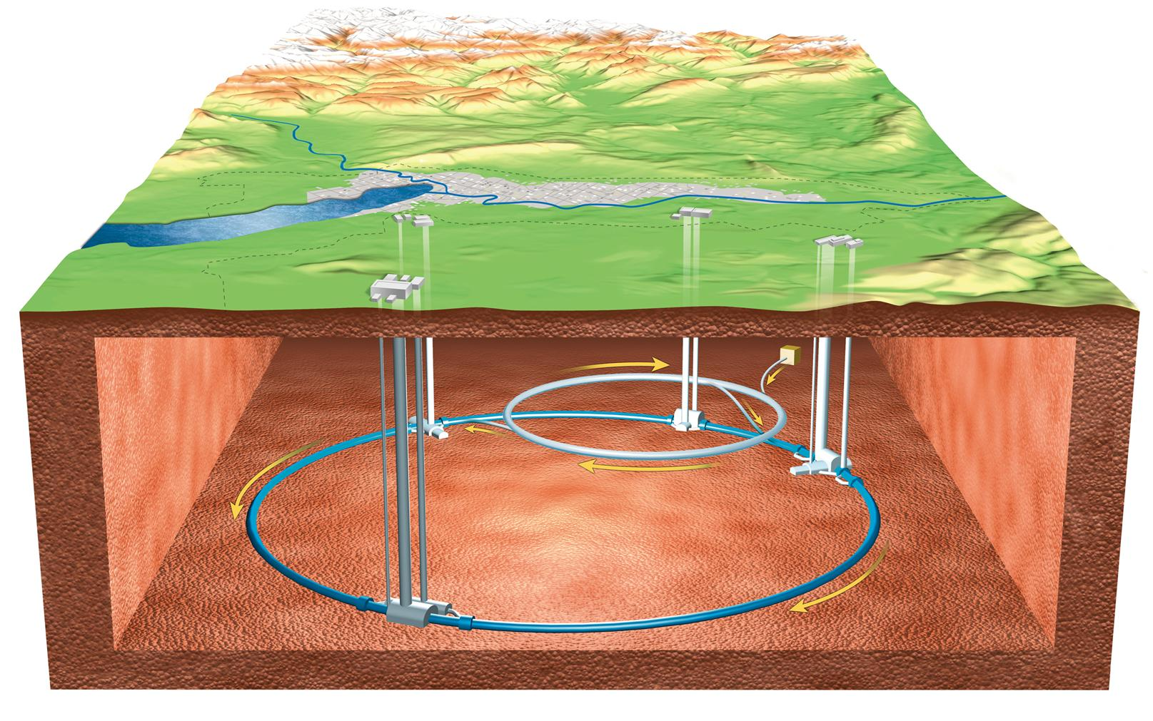
Large Hadron Collider

Slide 4

CMS : A Giga-Pixel Camera
Snaps ~40 million pictures of quantum interactions a second

Slide 5
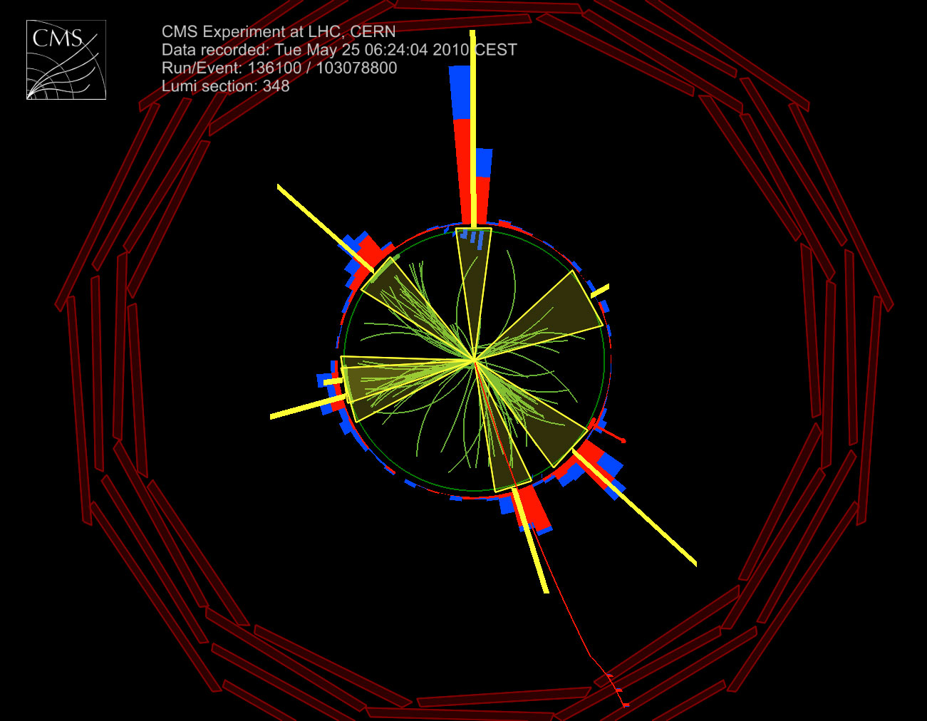
‘Picture’ of a Relativistic Collision
Particle collisions at very high energies produce many particles, some much more massive than initial particles
Many elementary and composite particles discovered & studied in great detail over the past 50 years
We discovered a new particle in 2012.
The Higgs Boson!
What do we know about the Higgs sector?

Slide 6
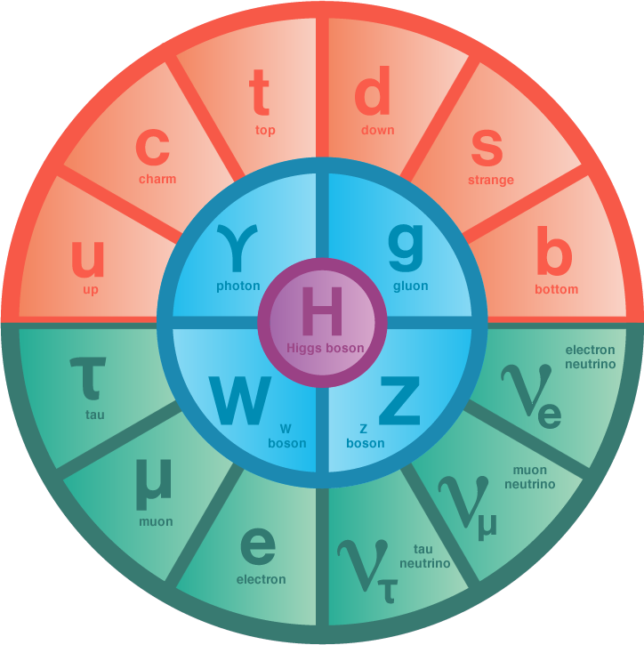
Relativistic Quantum World
Quantum Fields permeate all space-time
  EM vibrations → photons (light quanta)
Matter field vibrations create matter quanta
  Energy → matter-anti-matter pairs
Particles interactions exchanging gauge quanta
  Photons, Gluons, W and Z, (graviton)
Works beautifully for massless particles – QED, QCD
  But, W & Z quanta are massive – decay promptly
  Mass terms in lagrangian break gauge invariance
Higgs mechanism is central for accommodating massive quanta
  A new scalar quantum field with non-zero vacuum expectation value everywhere in the universe

Slide 7
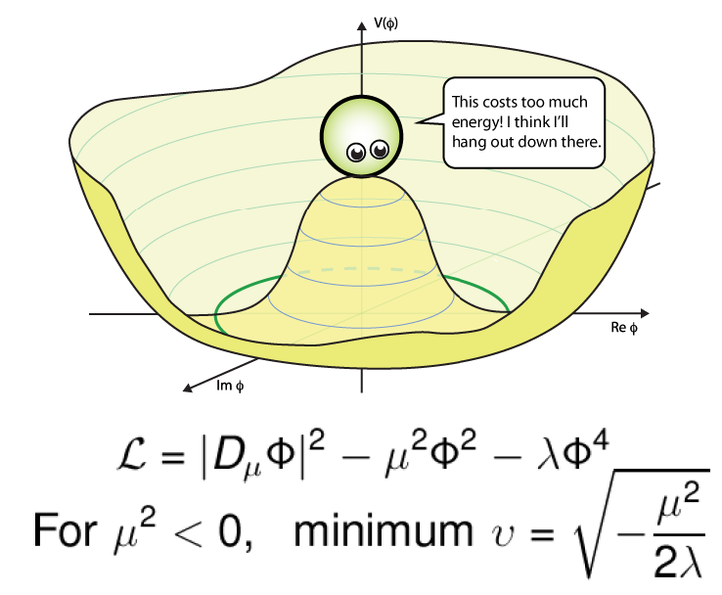
Higgs Field is Unique
Non-zero vacuum expectation value for the field

Slide 8
Electro-Weak Symmetry Breaking
3 field degrees of freedom
provide non-zero
masses for
W± & Z
Introduction of a doublet of complex scalar fields with peculiar potential provided masses for W± & Z and left γ massless!
Coupling to Higgs field provides masses to matter particles!!
The quanta of the remnant fourth field d.o.f. is the scalar Higgs boson!

Slide 9

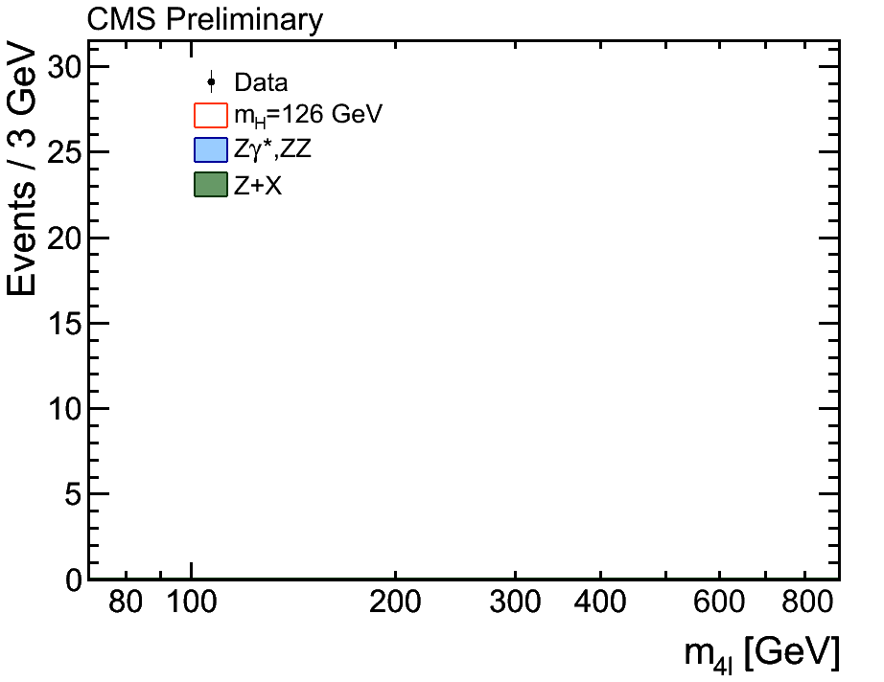
The Idea of the Higgs Field
→ The Higgs Boson Discovery
Higgs field permeates all space, particles interact with differing strengths with the higgs field. The higher the interaction the larger the particle’s mass.
The simplest theory with higgs fields results in a new self-interacting particle: the Higgs boson, which itself has a mass – but, theory doesn’t predict its mass.
50 year quest!

Slide 10
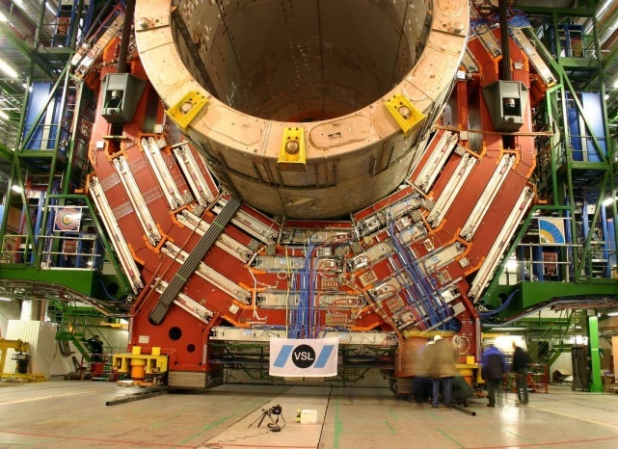
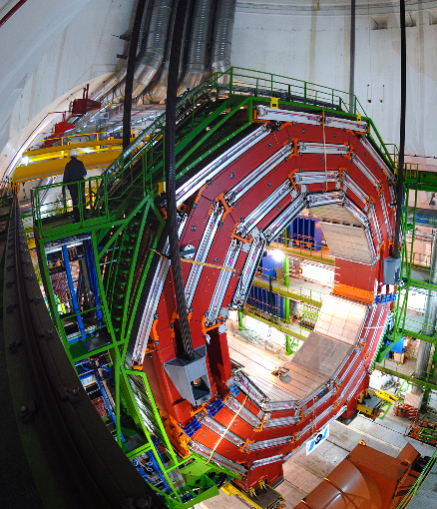
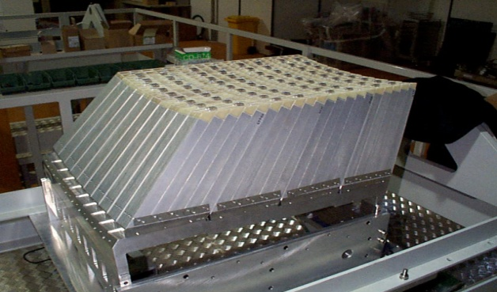
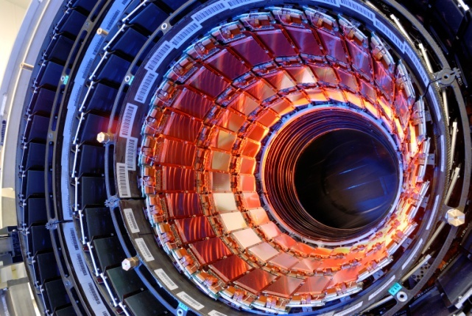
CMS
Solenoid 3,8 Tesla
Electromagnetic
Calorimeter
Muon system
Silcon tracker

Slide 11
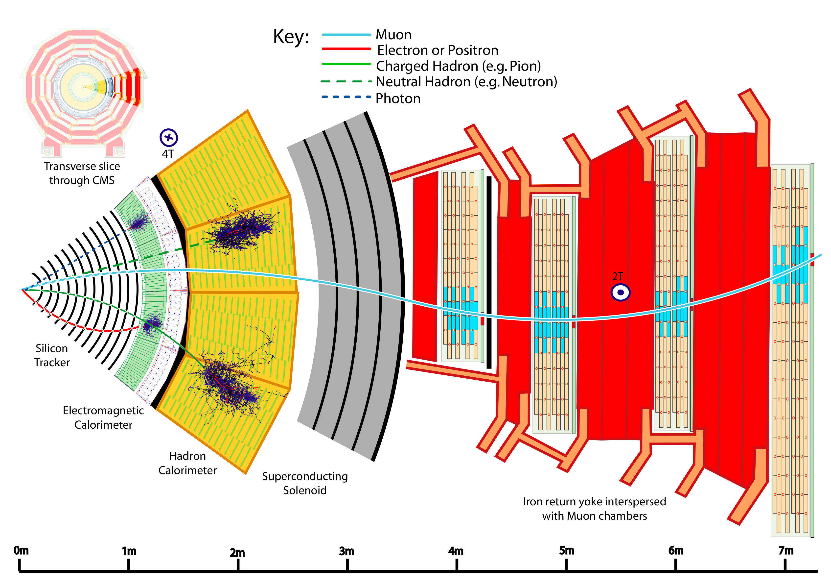
Particle Detection in CMS
Measure energy and momentum
Measure energy
Notes:
Transverse slice
Path of muon
---------------------------------------
Punch-through can make a high-pt muon look low
Muons are “gold-plated” since they suffer less radiative loss in the tracker, are better measured (Detector Paper, 128).

Slide 12
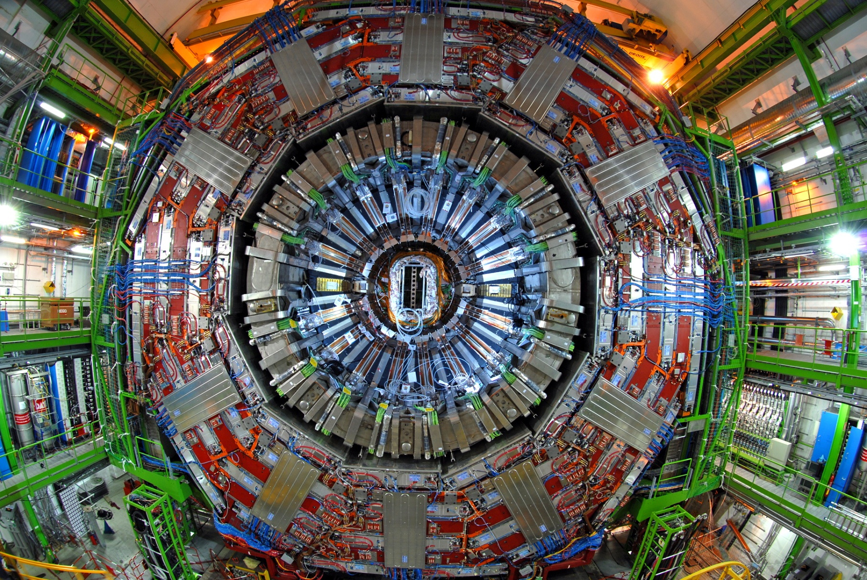

Slide 13
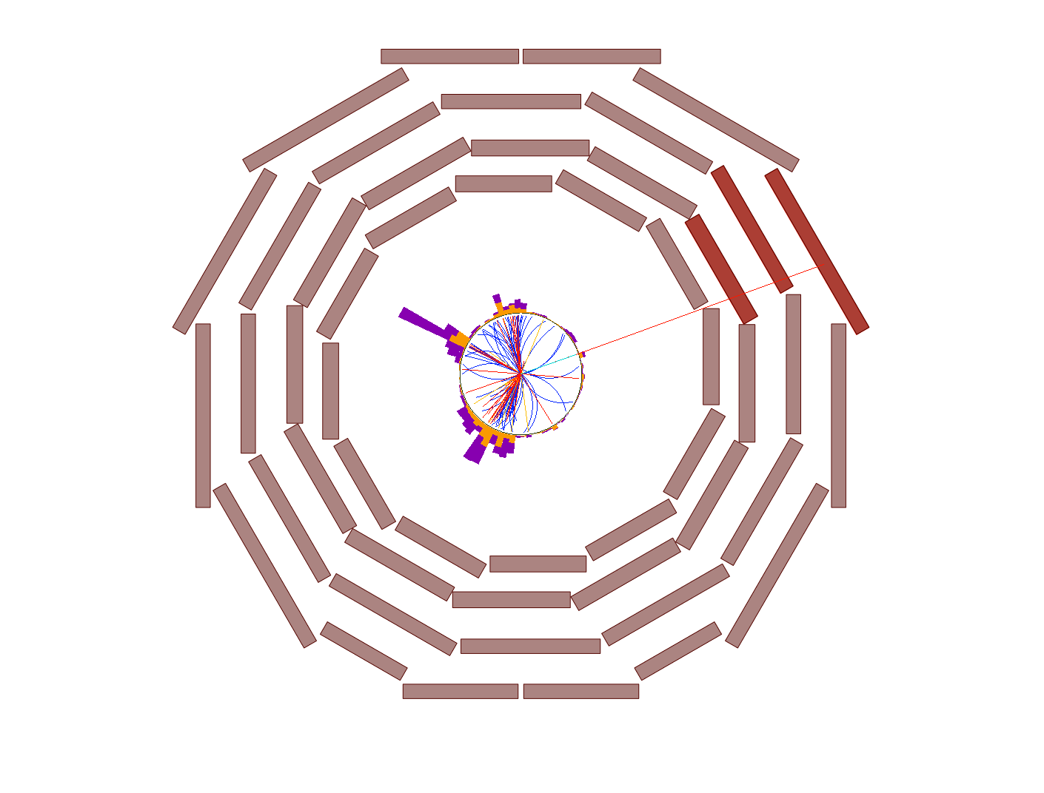
muon

Slide 14
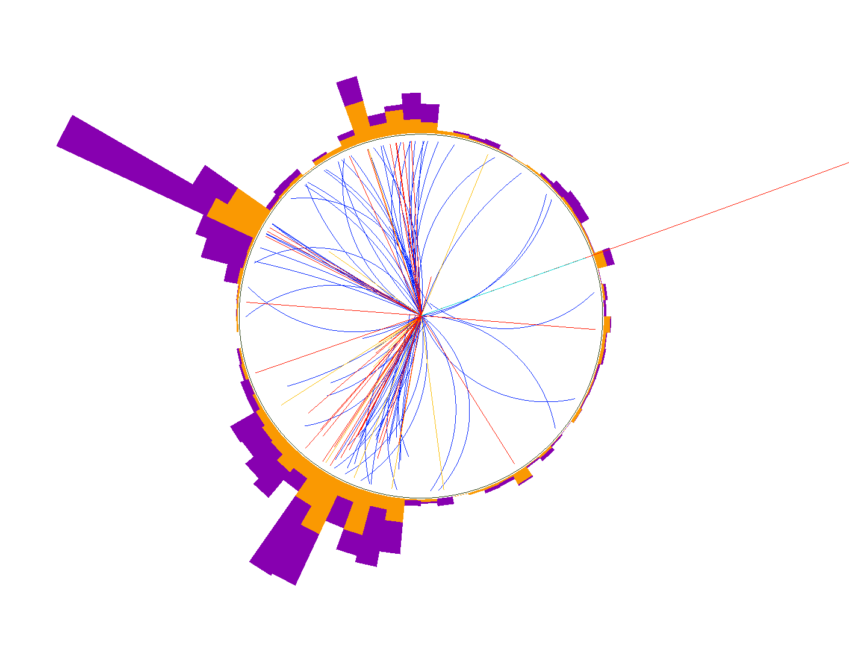
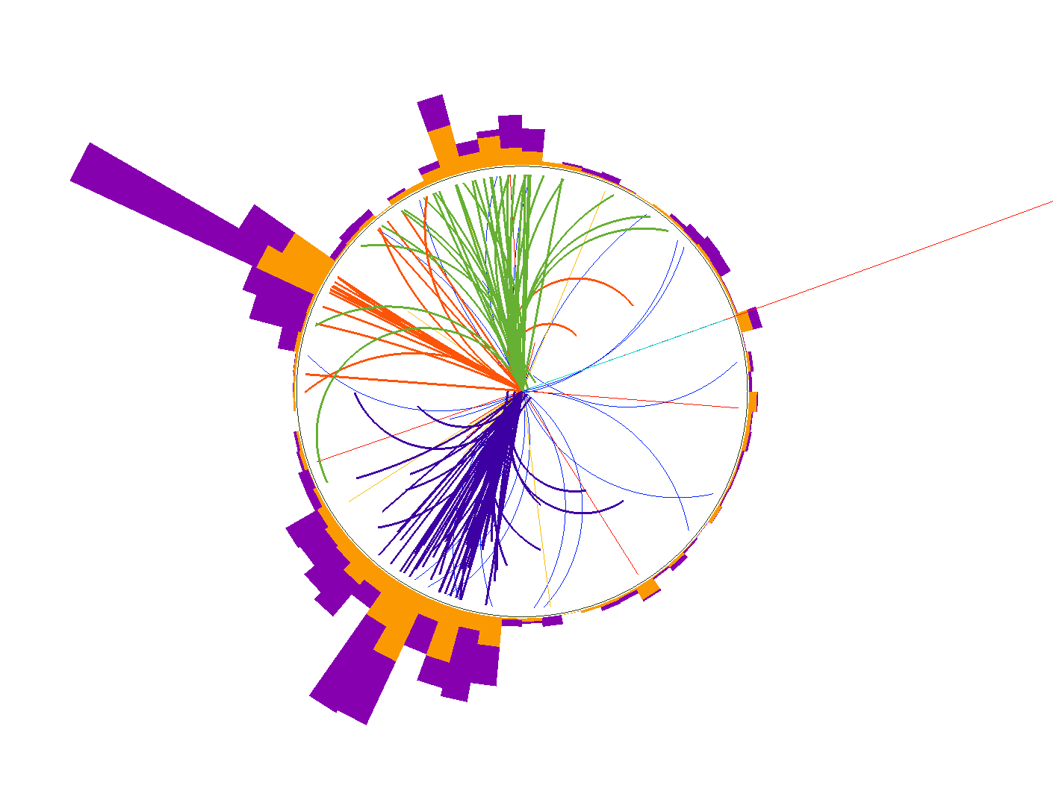

charged
hadron
hadronic
cluster
muon
electromagnetic
cluster
hadronic jets
(=quark or gluon)
transverse
missing
momentum
(=neutrino)
possible
interpretation :
W → μν + 3 “jets”
copyright: C. Bernet
photon
neutral
hadron

Slide 15
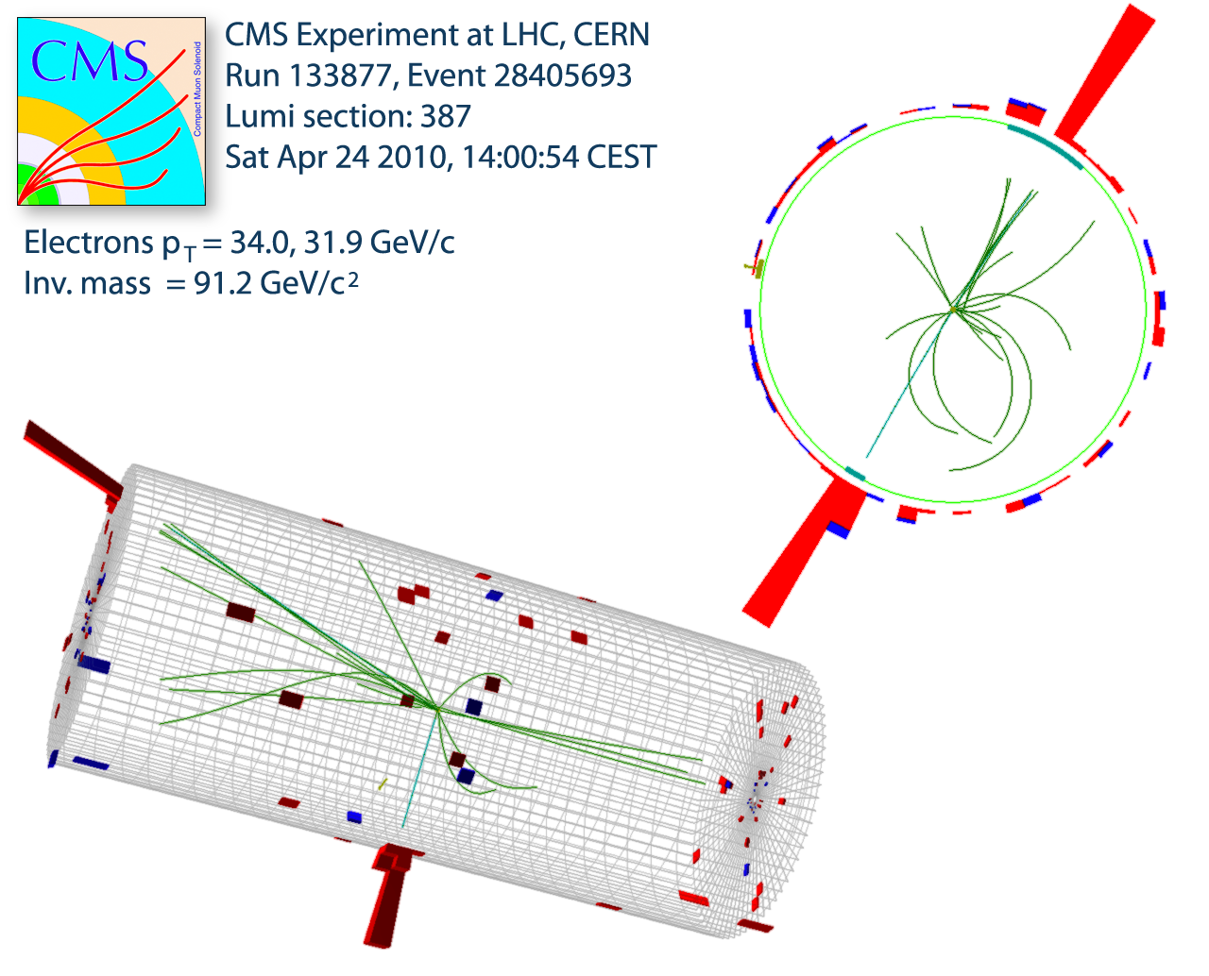
Example Event of Z Boson Decay
Z interacts with electrons and positrons
Event vertex (collision point) is measured using tracks
Note there are several low momentum tracks (underlying event)
Electron (–) and Positron (+)
Momentum (P_{x}, P_{y}, P_{z})
measured in tracker
Energy (E) measured in
the calorimeter

Slide 16
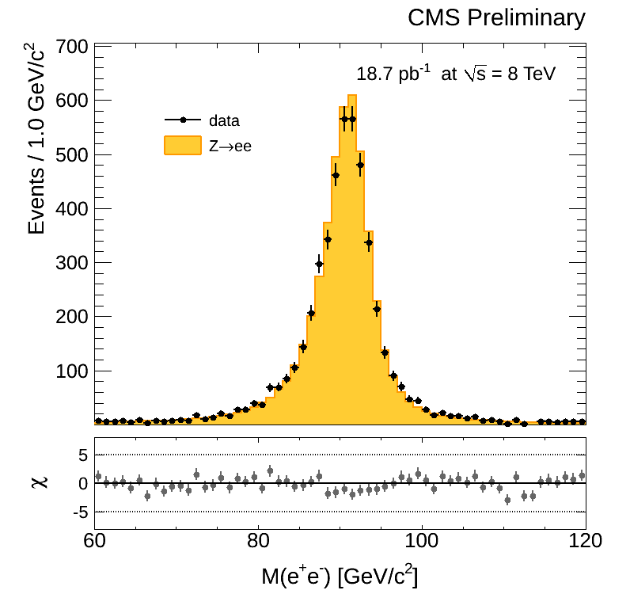
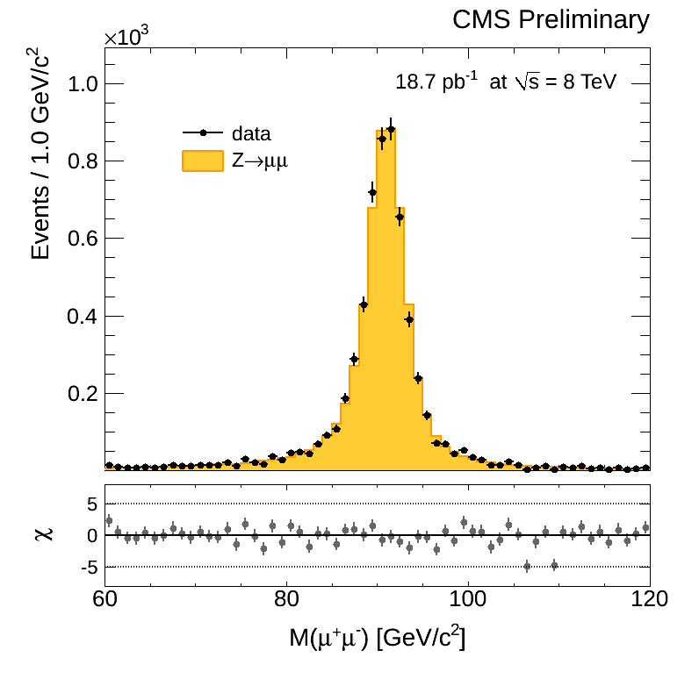
The Z Boson Invariant Mass Peak
Particles decaying close to the interaction point
  Histogram of “invariant mass” of the original heavy particle shows a sharp peak at the mass of the Z (91 GeV)
  ATLAS & CMS see 32M events second – about 15/s are Z events
Mass of Electron-Positron Pair
Mass of Muon⁺-Muon– Pair

Slide 17
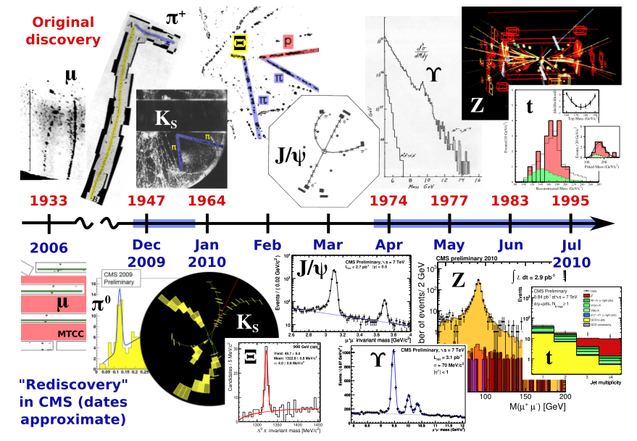
LHC Produces all Known Particles

Slide 18
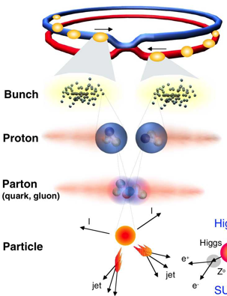
Proton-Proton Collisions at the LHC
 | 2015-16 | 2012 | 2011
Beam energy | 6.5 TeV | 4.0 TeV | 3.5 TeV
Bunches/ beam | 2556 | 1380 | 1380
Protons/ bunch | 2.5x10¹¹ | 2.2x10¹¹ | 1.5x10¹¹
N Collisions Created | ~10¹⁵ | 3.5 x 10¹⁴ | 2.5 x 10¹⁴
N Higgs Events | Few thousand | Few hundred | Few hundred
Fetch me my needle buried in those
hay stacks –
And, do it
As Soon As Possible
1 event in 10 000 000 000 000 !
Notes:
1 barn = 10⁻²⁴ cm-²
Proton c.s 40mb/110mb@7TeV

Slide 19
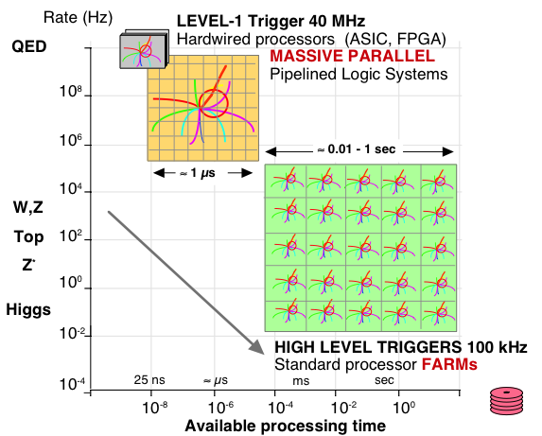
Processing LHC Data
QCD

Slide 20
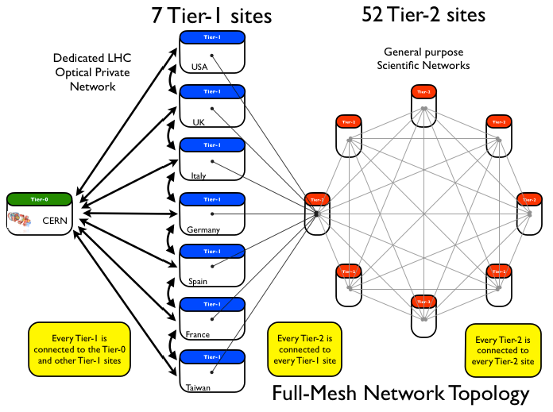
World-wide LHC Computing Grid
Tier | US | Total
T1 | 1 | 7
T2 | 7 | 52
T3 | 30 | 63
Raw Data Acquisition and Prompt Processing at Tier-0
Analysis takes places primarily at Tier-2 and Tier-3
Reconstruction takes place primarily at Tier-1

Slide 21
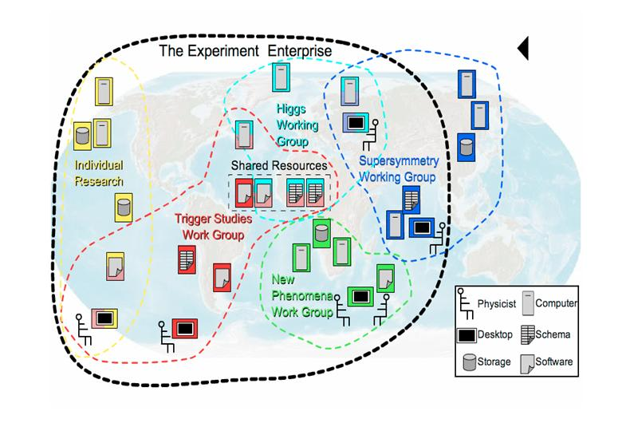
Virtual Organizations for Physics

Slide 22
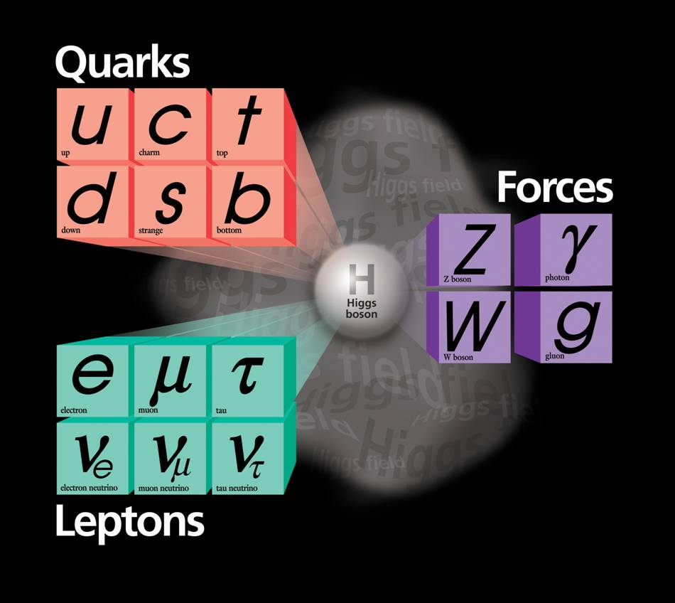
The Periodic Table of
Relativistic Quantum World
Elementary (point-size) Particles & Fields:
  Matter constituents
    Quarks
      up, down, charm, strange, top, bottom
    Leptons
      Electron, muon, tau, corresponding neutrinos
  Force carriers
    Electromagnetism: Photon
    Weak interactions: W±/Z
    Strong interactions: Gluons
  Higgs field – grand idea!
    Omnipresent → non-zero field strength everywhere!!
    Explains how elementary particles become massive
1300
170000
~5
91000
4500
100
0
106
125000
0
0.5
1776
80000
~10^{–5}
MeV
Wildly varying masses for matter particles

Slide 23
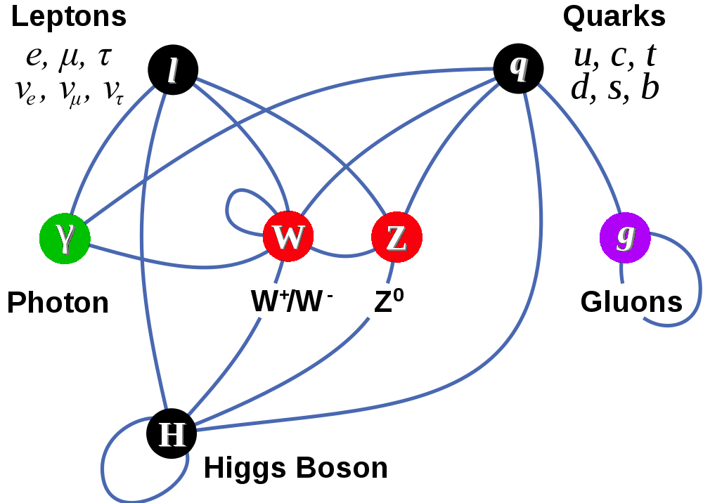
Completion of The Standard Model?
Matter Particles (fermions)
Interactions by exchange of vector bosons
The Standard Model is built on the edifice of the Higgs Mechanism

Slide 24
One of the Higgs Boson Candidates
H → Z Z → e⁺e– μ⁺μ–
Muon #2
Electron
Positron
Penetrating Muon #1

Slide 25
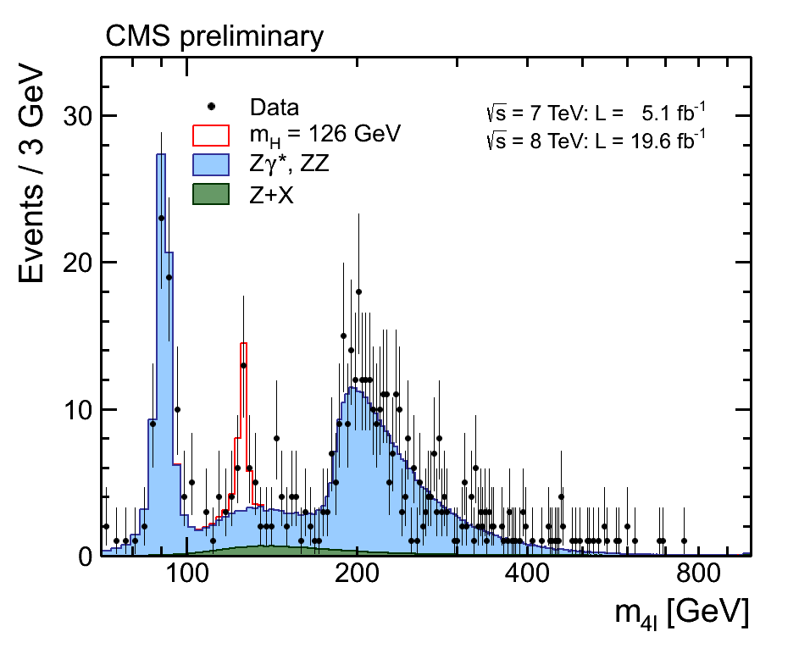
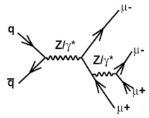
Decays to ZZ to 4-light leptons
CMS HIG-13-002
Cluster of events rising above the background consistent at
>4-sigma level with
SM Higgs signal
125.8 ± 0.5 ± 0.2 GeV
Clearly observe production of Z decay to 4 leptons
ZZ production for M_{4l} > 2M_{Z}
M_{Z} = 91 GeV

Slide 26
Run-2 : H to 4-light leptons

Slide 27

Candidate 2-Photon Event

Slide 28
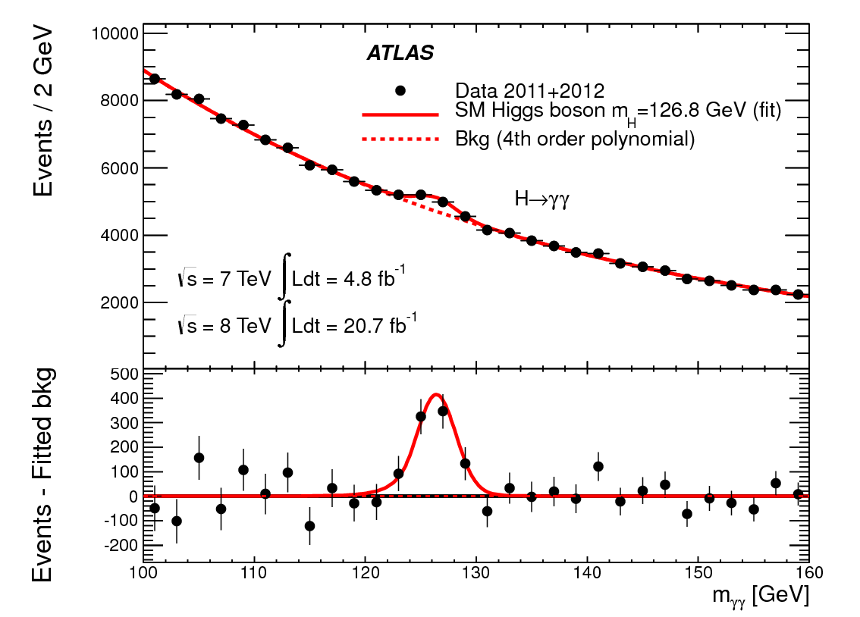
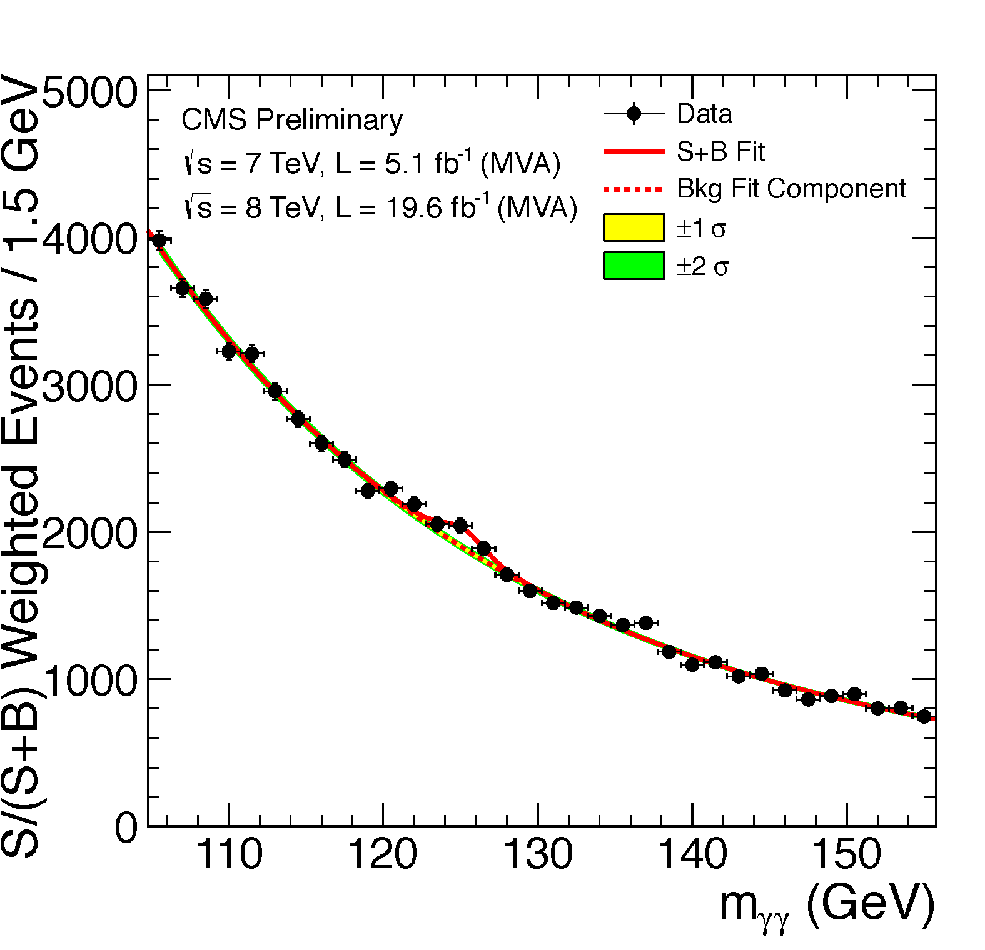
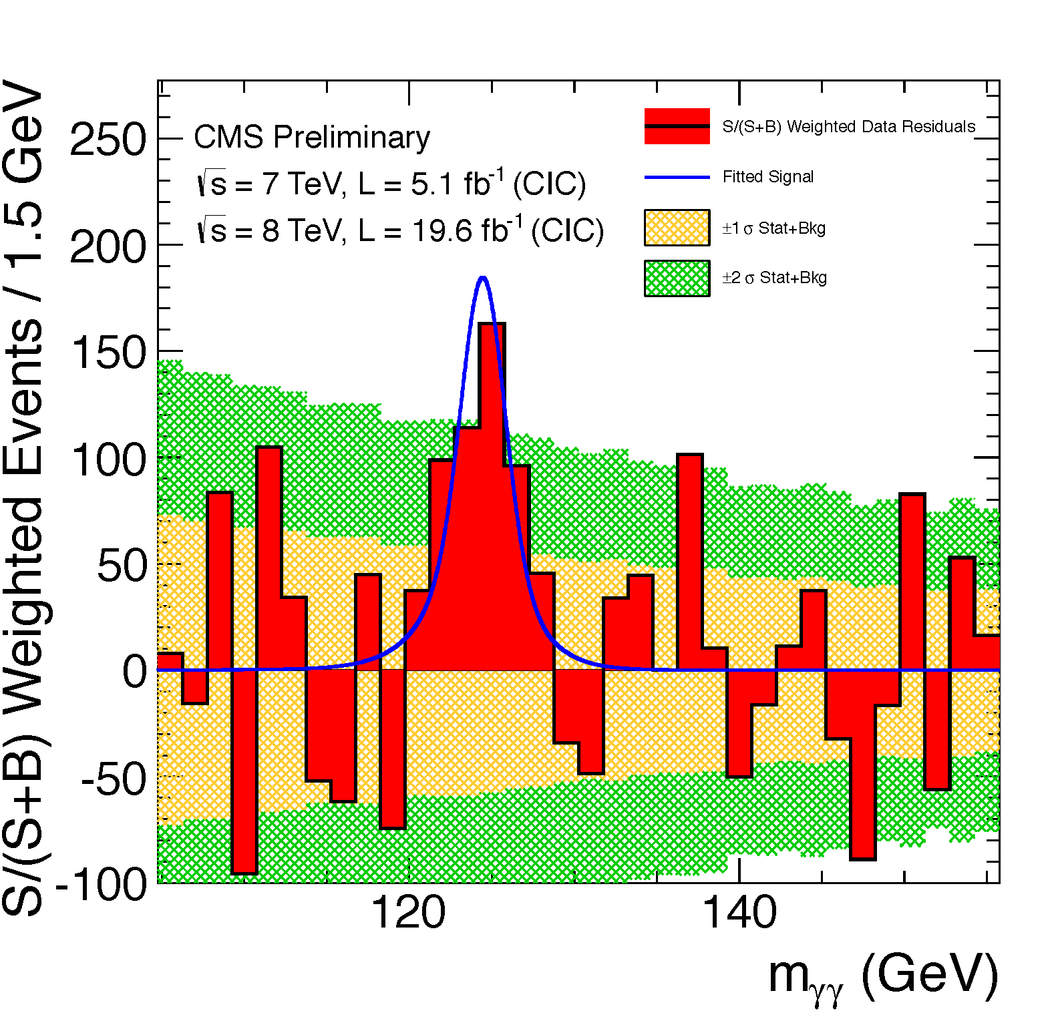
Two Photon Final State
PLB 726 (2013) 88-119
CMS-PAS-HIG-13-001
Significance (m_{H} = 126.5 GeV)
observed : 7.4 σ
expected: 4.1σ
Significance (m_{H} = 125.7 GeV)
observed : 3.9σ
expected: 4.2σ

Slide 29
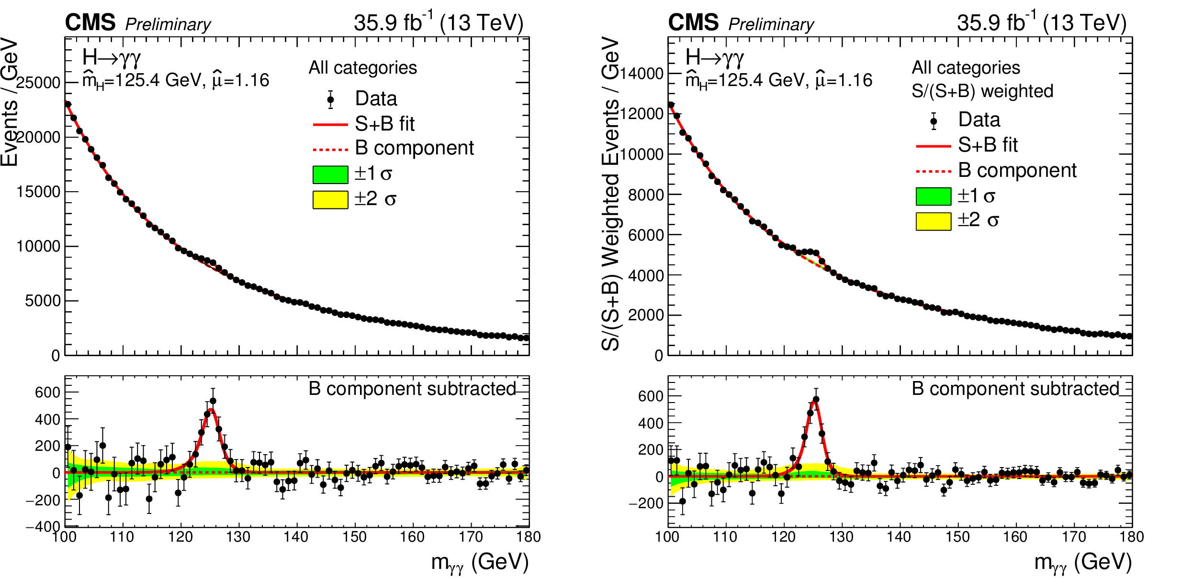
Run-2 : Two Photon Final State

Slide 30
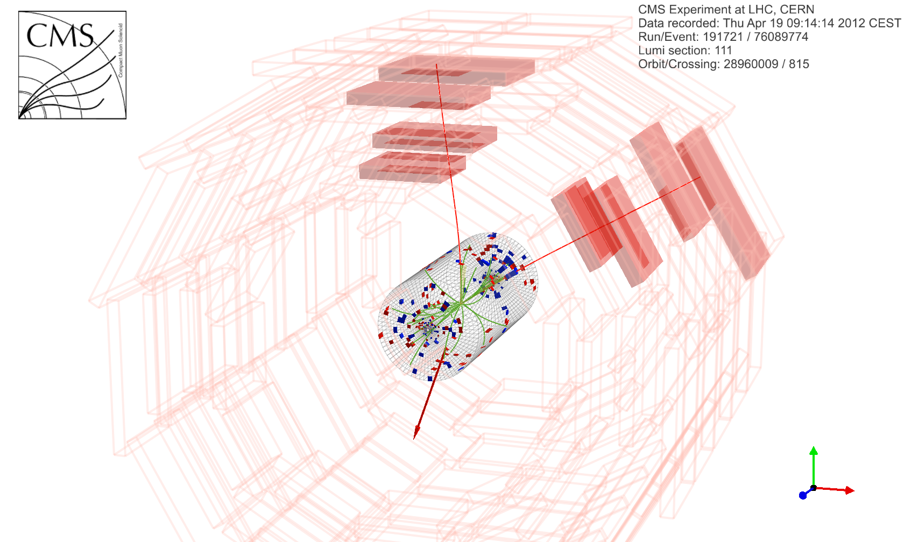
WW → l⁺ l– MET

Slide 31
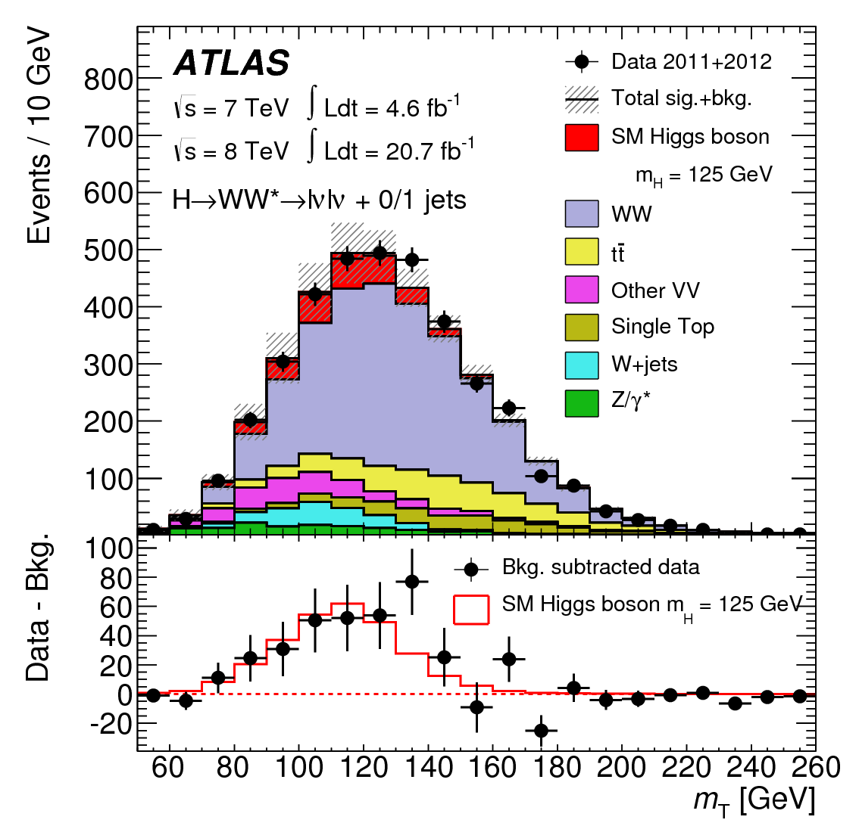
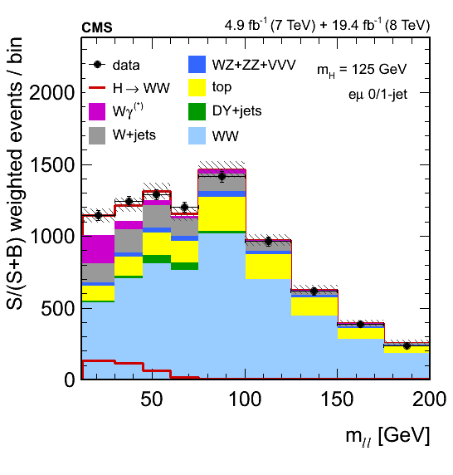
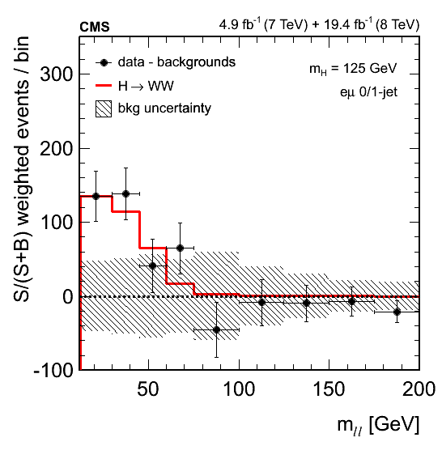
WW → l⁺ l– MET
Significance (m_{H} = 125.5 GeV)
observed : 3.8σ
expected: 3.8σ
Significance (m_{H} = 125.7 GeV)
observed : 3.9σ
expected: 5.6σ

Slide 32
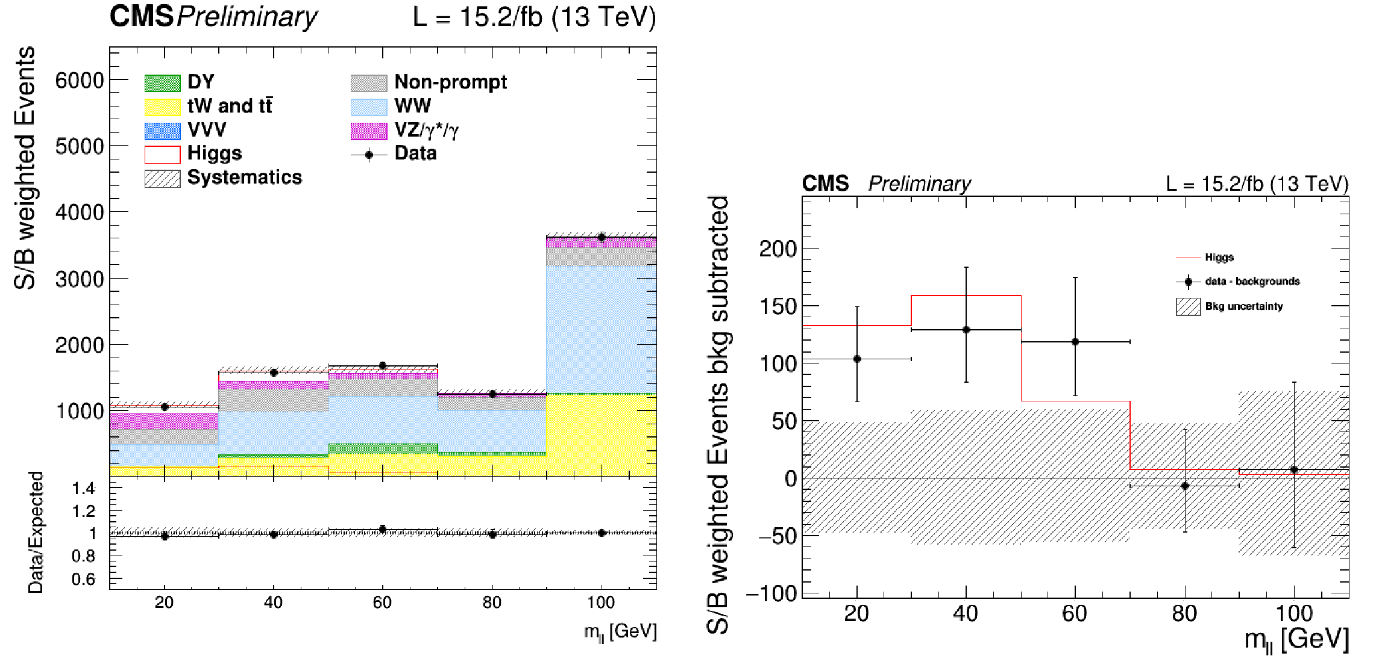
Run-2: WW → l⁺ l– MET
Significance (m_{H} = 125.5 GeV)
observed : 3.8σ
expected: 3.8σ
Significance (m_{H} = 125.7 GeV)
observed : 3.9σ
expected: 5.6σ

Slide 33
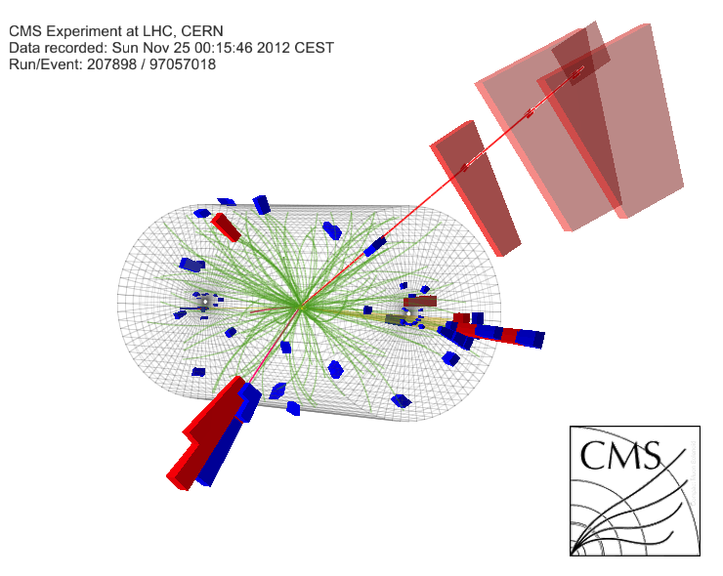
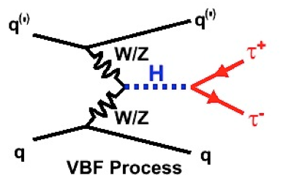
Higgs Decay to Tau Pairs
Taus with high branching fraction can probe in all production modes:
W and Z boson fusion; Gluon fusion and W, Z, top associated production
Final states VBF + GF:
eμ, μμ, eτ_{h}, μτ_{h}, τ_{h}τ_{h}
Also, VH (WH & ZH)
llτ_{h}, lτ_{h}τ_{h}, llτ_{h}τ_{h}

Slide 34
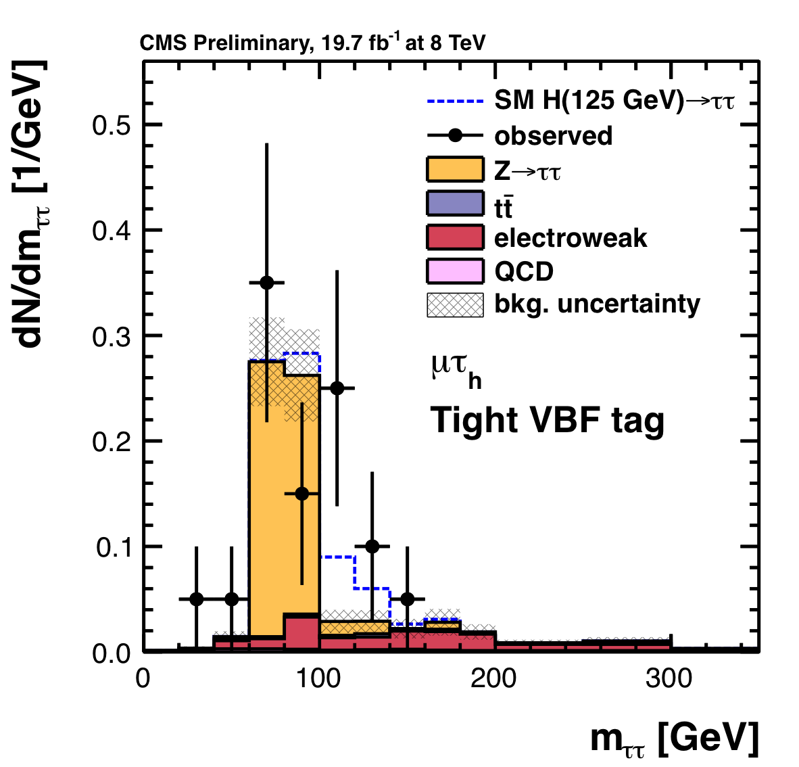
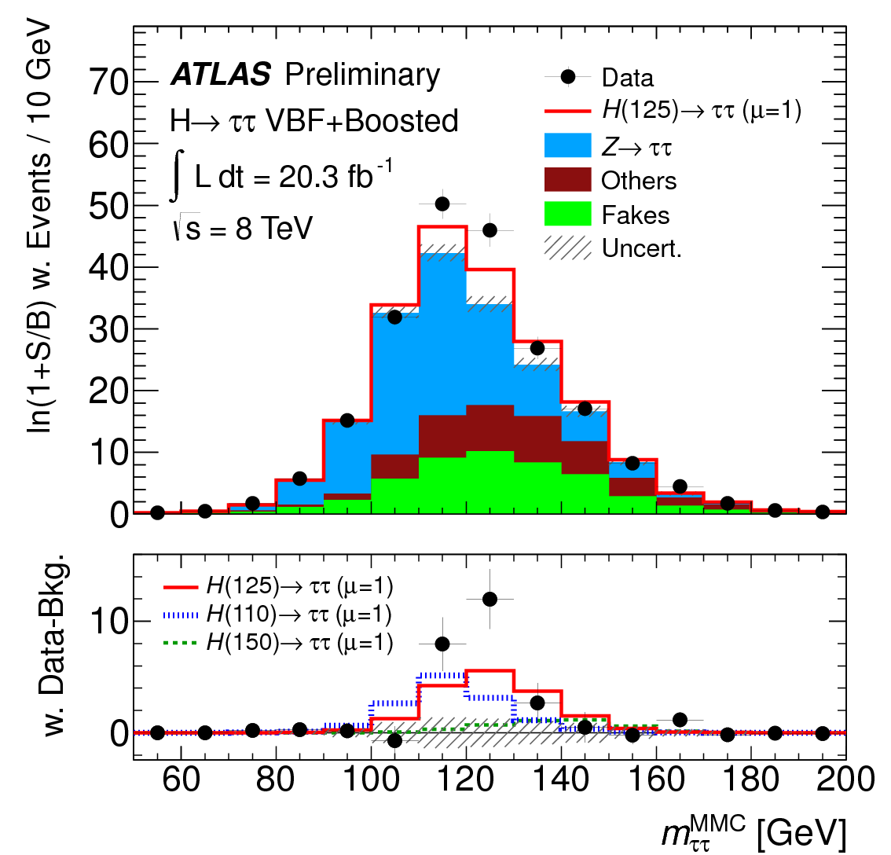
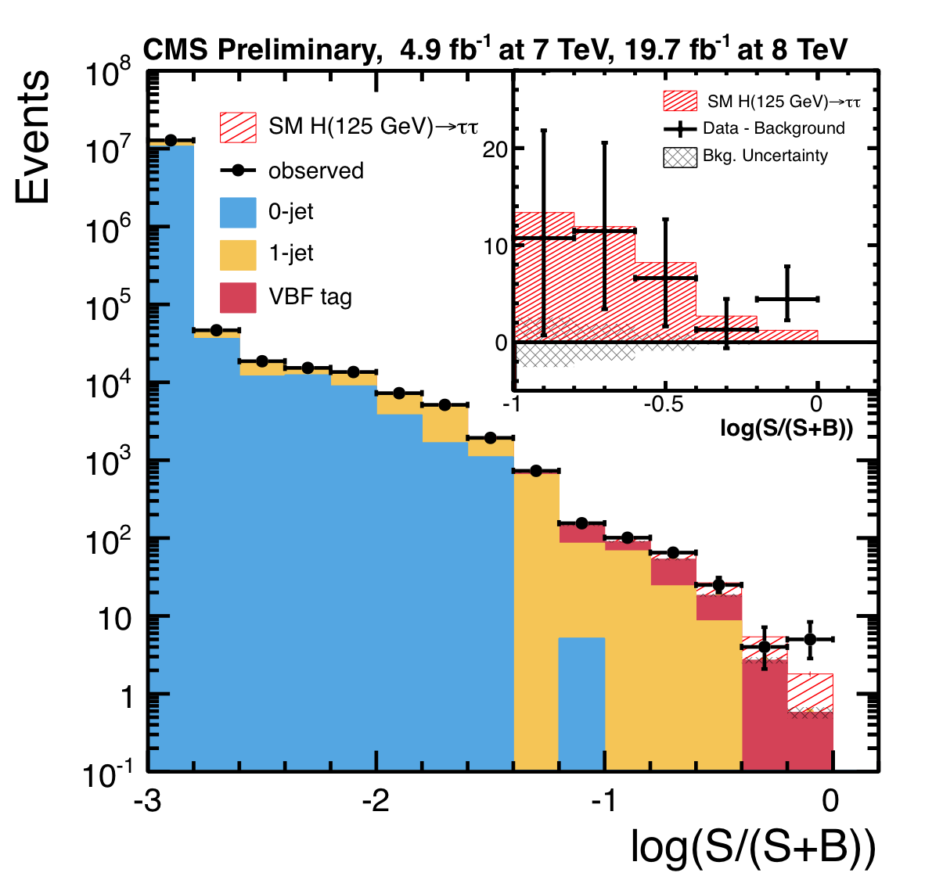
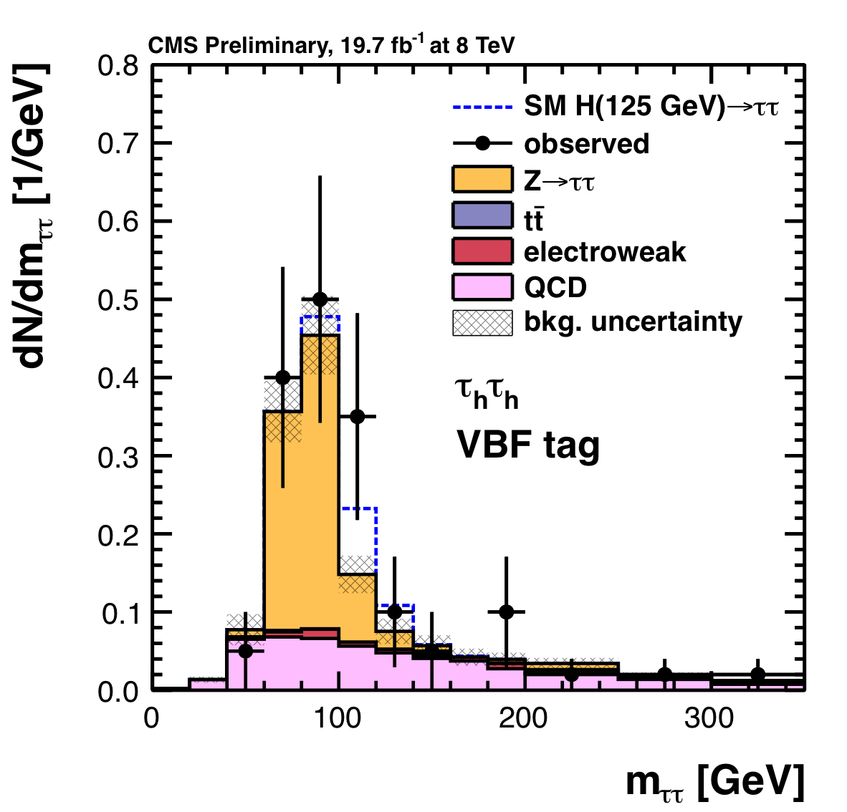
Higgs Decay to Tau Pairs
ATLAS-CONF-2013-108
CMS-PAS-HIG-13-004
Significance (m_{H} = 125 GeV)
observed : 4.1σ
expected: 3.2σ
Significance (m_{H} = 125 GeV)
observed : 3.4σ
expected: 3.6σ

Slide 35
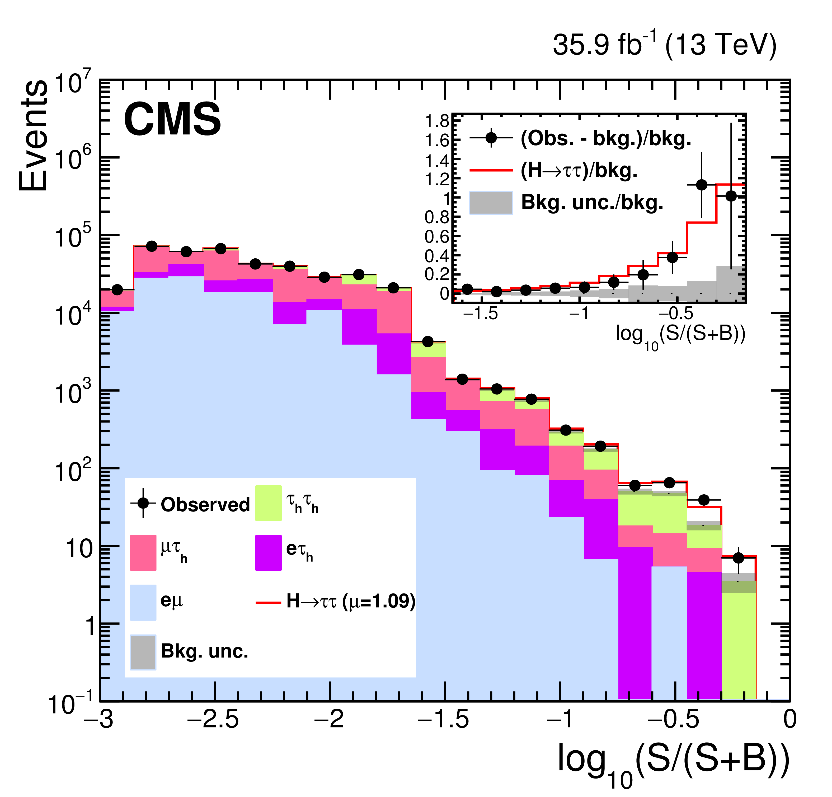
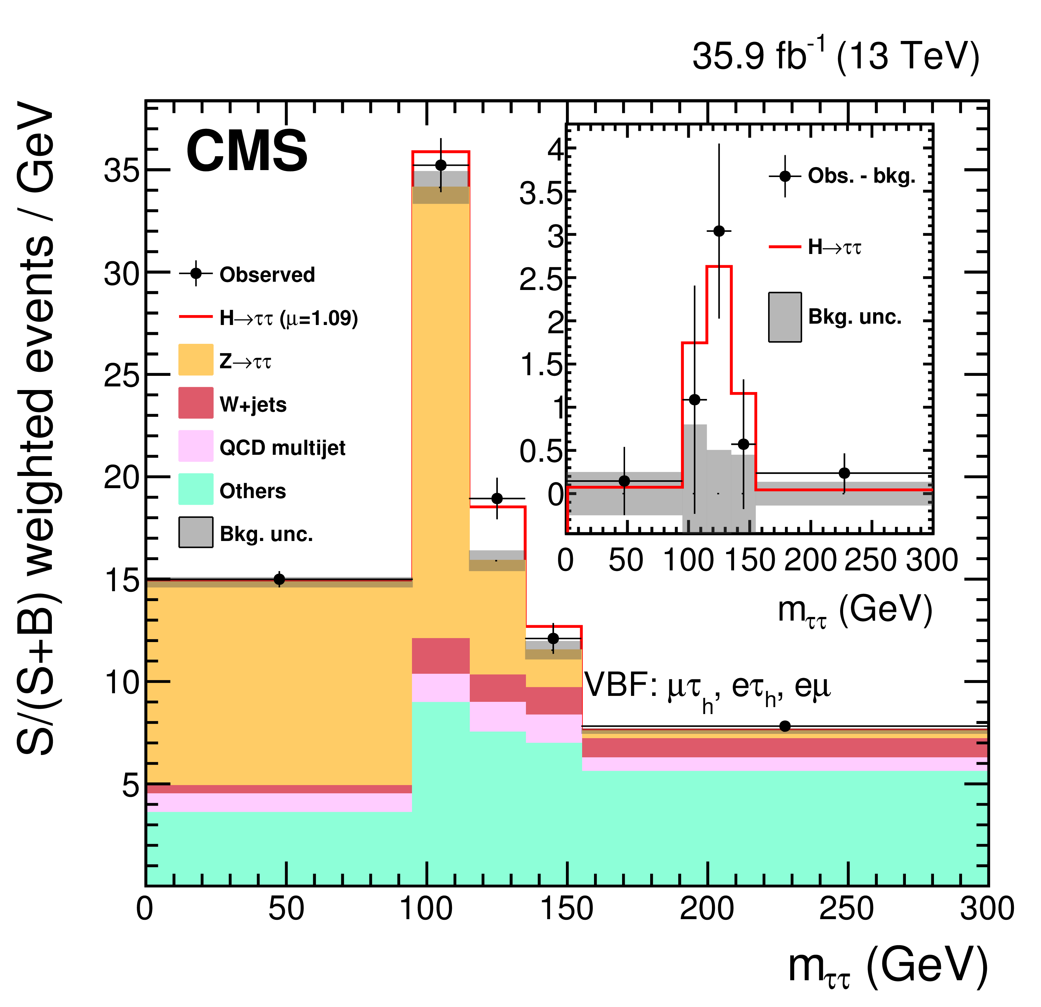
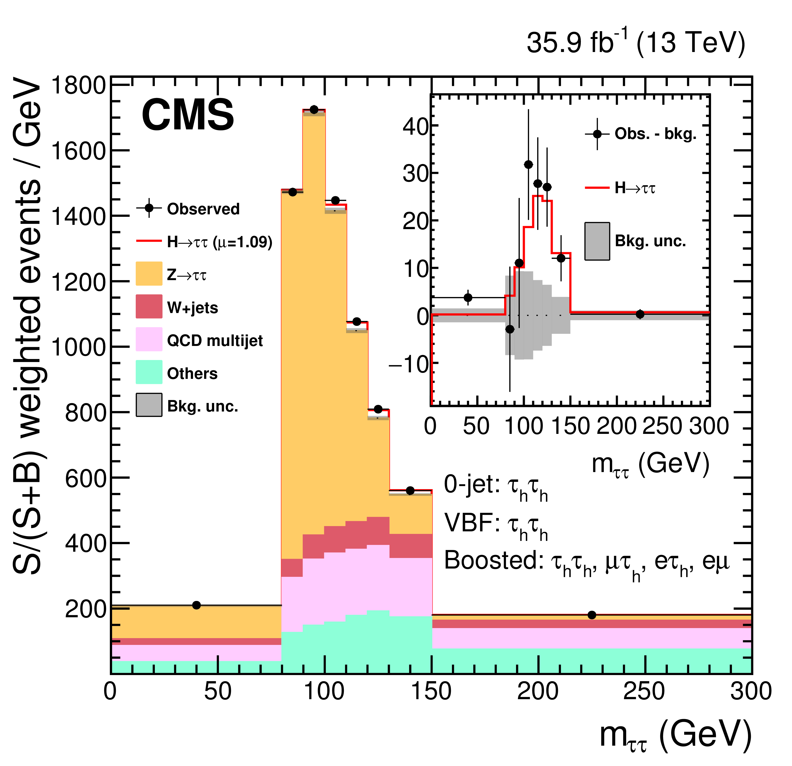
Run-2: Higgs Decay to Tau Pairs
Significance (m_{H} = 125 GeV)
observed : 5.2σ
expected: 5.2σ
On simple combination with Run-1

Slide 36
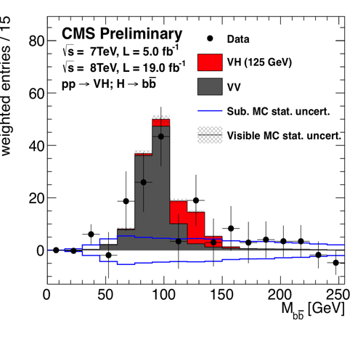
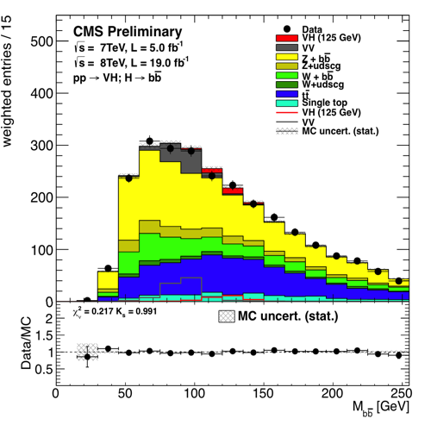
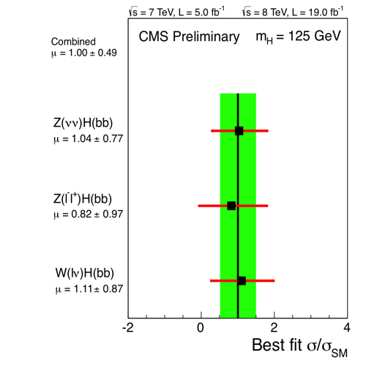
Higgs Decay to Bottom Quarks (VH)
CMS HIG-13-012
Gluon fusion signal is overwhelmed by QCD
Associated production with W (lν), Z(ll, νν) probed

Slide 37
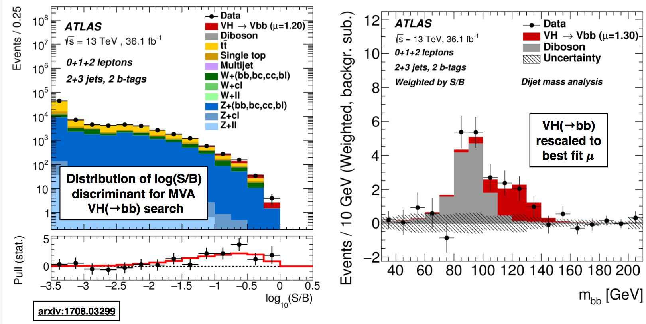
Current Evidence for
Higgs Decay to Bottom Quarks
ATLAS arXiv: 1708.03299
CMS HIG-16-044
Gluon fusion signal is overwhelmed by QCD
Associated production with W (lν), Z(ll, νν) probed
ATLAS sees 3.6 σ excess (exp. 4.0 σ) – combined with Run-1
CMS sees 3.8 σ excess (as expected) – combined with Run-1

Slide 38


Spin & Couplings
CMS HIG-13-005
Its spin is like that of SM Higgs (0⁺)
It couples like Higgs
So, is it the SM Higgs?
8-16% measurement of signal strength in τ,W,Z with x10 data

Slide 39
What's Next ?

Slide 40

Colliders @ the Energy Frontier!
FCC-hh
HE-LHC
HL-LHC
ILC
http://www.slac.stanford.edu/pubs/beamline/27/1/27-1-panofsky.pdf
We obviously need to invest more in machine R&D

Slide 41
What’s Next
@ The Energy Frontier
Exploring the Higgs sector (LHC and ILC)
  H(120 GeV) → measure ~30 GeV objects
  Cleaner environment, more sophisticated/dedicated (e.g., triggerable tracker, timing) detectors necessary for pileup mitigation at LHC
Continued searches for heavy BSM particles (LHC)
  More energy in the center mass the better
  High x parton distributions fall faster than we accumulate luminosity
  Shouldn’t we be accelerating HE-LHC?
Continued searches for light BSM particles (LHC and ILC)
  Particles produced only in the EWK processes
  Long-lived particles
  Dark particles
  Special-purpose (Mathusla / milliQan) detectors are necessary for better coverage of theoretical parameter space

Slide 42
Exploring the Higgs Sector
Does h(125) couple to the SM particles at appropriate level?
Is the signal strength, where seen, at the correct SM level? Is this a scalar?
Is this the only new non-vector boson, and not one of several?
Does it couple to itself ?
Fortuitously, its mass of about 125 GeV allows answers experimentally ☺
  Early results from Run-2 reconfirm the SM nature of the h(125)
  Self-coupling needs decades of work → HL-LHC
    Much better prospects with HE-LHC
  BSM higgs partners
    2HDM (MSSM) → heavy neutral and charged partners
      Incremental progress with HL-LHC, better with HE-LHC
    Beyond 2HDM (nMSSM) → light scalars with interesting properties
      Upgrades with clean environment at HL-LHC, and ILC
  BSM higgs decays to rare invisible or light (pseudo) scalar partners
    Could be a long term endeavor needing HL-LHC upgrades or ILC

Slide 43

Swarms of Particles!
HL-LHC environment is going to be harsh
  Goal of detector upgrades is to make HL-LHC events look like LHC events
  Higgs Physics @ HL-LHC is the most Demanding on Detector
25 interactions piled-up in an event.
200 interactions piled-up in an event.

Slide 44
CMS
Solenoid 3,8 Tesla
Electromagnetic
Calorimeter
Muon system
Silcon tracker

Slide 45





CMSupgrade
Continue with
Solenoid 3,8 Tesla
Improved
Barrel Calorimeter
Readout / Trigger
Additional Chambers
and η-coverage
Muon system
Triggerable and
extended η-coverage
Silcon tracker
In the works:
MIP Timing Detector
A new tool for PU mitigation and TOF for heavy stables
New High Granularity
Endcap Calorimeter

Slide 46

Trigger / DAQ Upgrade for CMS
Strategy :
Bringing Particle Flow to L1 Trigger
Plans:
Increased input data / processing @ L1 Trigger
Larger pipeline & throughput DAQ system
Notes:
Transverse slice
Path of muon
---------------------------------------
Punch-through can make a high-pt muon look low
Muons are “gold-plated” since they suffer less radiative loss in the tracker, are better measured (Detector Paper, 128).

Slide 47

Run-2 : H to 4-light leptons
Future: detailed angular analyses, P_{T,h} spectra, etc.
Upgraded η-coverage for tracker and muon systems → larger acceptance @ LHC
The mass is measured to be
m_{H}= 125.26± 0.20 (stat) ± 0.08 (syst) GeV &
the width is constrained to be Γ_{H}< 1.10 GeV at 95% cl

Slide 48


Run-2 : Two Photon Final State
Probes potential new particles in loops!

Slide 49
Run-2 Observation of
Higgs Decay to Tau Pairs
Significance (m_{H} = 125 GeV)
CMS observed : 5.9σ
CMS expected: 5.9σ
On simple combination with Run-1

Slide 50


Upgraded Tracker Performance
Relevant for VBF-H(ττ)
  The τ trigger and reconstruction
  VBF jets association with primary vertex

Slide 51
Current Evidence for
Higgs Decay to Bottom Quarks
ATLAS arXiv: 1708.03299
CMS HIG-16-044
Gluon fusion signal is overwhelmed by QCD
Associated production with W (lν), Z(ll, νν) probed
ATLAS sees 3.6 σ excess (exp. 4.0 σ) – combined with Run-1
CMS sees 3.8 σ excess (as expected) – combined with Run-1

Slide 52


Upgraded Tracker Performance
Relevant for Z(ll)H(bb)
  Lepton isolation
  Tagging b-jets

Slide 53



Couplings Projection
2σ HH coupling not shown
Most impressive ILC contribution
Note LHC (300 fb^{–1}), rather than HL-LHC

Slide 54
MSSM Higgs Sector
Higgs sector in MSSM is more complicated than SM case
  Need 2 higgs doublets each with 4 degrees of freedom
    Results in a Standard Model like Higgs (h⁰ in most cases)
    Plus, two neutral higgs (A⁰, H⁰) and charged (H±)
    Only 2 parameters (M_{A}, tanβ – ratio of the two doublets)
    Masses of higgses and Z related: Search in (M_{A}, tanβ) plane
  Neutral Higgs
    Look for ϕ=(h^{0,} A⁰, H⁰) in decays to tau-leptons
  Charged Higgs
    Look for H± in top decays, or vice-versa
Notes:
Add theory plot

Slide 55
MSSM Higgs Sector
Higgs sector in MSSM is more complicated than SM case
  Neutral Higgs
    Look for ϕ=(h^{0,} A⁰, H⁰) in decays to tau-leptons
  Charged Higgs
    Look for H± in top decays
Enhanced φ=(h⁰, A⁰, H⁰) coupling to b-quarks and τ-leptons
  Production rate compared to SM enhanced by tan²β
    Gluon fusion with b,t loops + associated b quark production
  Decays to b-quark and τ-lepton pairs enhanced
Notes:
Add theory plot

Slide 56

MSSM (2HDM) – Heavy Neutral H/A
Preferentially decays to
τ and b pairs at high tanβ
2.3 fb^{–1} expectation
projected to 0.3 and 3 ab^{–1}
12.9 fb^{–1} observed limit is
overlaid
Takes a lot of luminosity to
cover the wedge

Slide 57
Theoretically motivated BSM H Decays
Non-minimal Higgs Sector with exotic SM like h(125) decays – e.g., nMSSM
  Higgs decays to lighter pseudoscalar a-pair
Connection with dark matter WIMPs
  Neutralinos in SUSY models
  Graviscalars in models with extra dimensions
  Twin Higgs
  …
Higgs portal
  Higgs mediation with dark sector
Lepton Flavor Violating Decays
  Complicated Yukawa sector
How big should BSM contribution be to be interesting?
  Any amount is. At sufficient level cosmic consequences.

Slide 58

Experimentally allowed BSM Fraction
JHEP 08 (2016) 045
ATLAS & CMS
combination of measurements
Individually <25-26% 1σ
Combined <16% 1σ
<34% (39% exp) @ 95% cl
Presently a quarter of Higgs decays could be of BSM origin, including invisible and exotic modes, making this exploration important.

Slide 59

Summary of Invisible H Limits
ATLAS: JHEP 1511 (2015) 206
CMS-HIG-16-016
CMS-HIG-16-016
ATLAS VBF: JHEP 01 (2016) 172
ATLAS V_{jj}H: Eur. Phys. J. C (2015) 75:337
ATLAS V_{ll}H: Phys. Rev. Lett. 112, 201802 (2014)
ATLAS Combined: JHEP 1511 (2015) 206
ATLAS Dataset : Run-1
CMS Dataset: Run-1 + 2015
 | Expected |  | Observed
 | ATLAS | CMS | ATLAS | CMS
VBF | 0.31 | 0.30 | 0.28 | 0.45
V_{ll}H | 0.62 | 0.50 | 0.75 | 0.38
V_{jj}H | 0.86 |  | 0.78
ggH | 1.91 | 0.55 | 1.59 | 0.52
Combined | 0.27 | 0.23 | 0.25 | 0.24
ATLAS combination including fit to
visible modes
B(h→invisible)
< 23% observed
< 24% expected

Slide 60

Non-minimal Higgs Sector
Two-Higgs-doublet models with a singlet (2HDM+S)
  For example in nMSSM (type II)
  Light pseudoscalar boson : a
    2M_{a} < M_{h} leads to h(125)→aa
    Relevant modes dependent on M_{a}: a→bb, a→ττ, a→μμ, a→γγ
      Often use a→μμ to help with trigger and mass reconstruction
    Sensitivity also depends on type I-IV choice of H_{1,2} coupling, tanβ
    Must explore many modes
2HDM+S Classification
Type | I | II | III | IV
up | H₁ | H₁ | H₁ | H₁
down | H₁ | H₂ | H₁ | H₂
lepton | H₁ | H₂ | H₂ | H₁

Slide 61


2HDM+S Parameter Space, Type 1&2
CMS-PAS-HIG-15-011
Summarize CMS analyses in one plot by scaling branching fractions of decay modes.
Conversion of B(a→ττ) and B(a→bb) to B(a→μμ) using:

Slide 62

2HDM+S Type 3 tanβ Dependence
CMS-PAS-HIG-15-011
For large tanβ, a→ττ dominates.
For small tanβ, a→bb does better.
O(10) % branching fraction regime exploration requires much more data.

Slide 63
Summary
Our discovery of a Higgs boson completes the Standard Model
  2012 : Higgs Boson Discovered
  2013 : Physics Nobel Prize award!
  2015 : Detailed Higgs Physics Exploration Began
  2017 : h(125) continues to look like The SM Higgs Boson
However, the Standard Model is incomplete
  We do not fully understand the Higgs Boson yet
  No new TeV scale particles discovered yet
  EWK produced BSM parameter space beginning to be explored
  Exotic particles and their interactions continue to require innovation
  New physics theories are aplenty to explain
    Eagerly awaiting discoveries this decade ☺
    HL-LHC will carry us forward, ILC can provide needed precision
    HE-LHC is probably the machine to focus on first – then, FCC-hh !

Slide 64

Whither SUSY?

Slide 65


Exotica?

