Slide 1
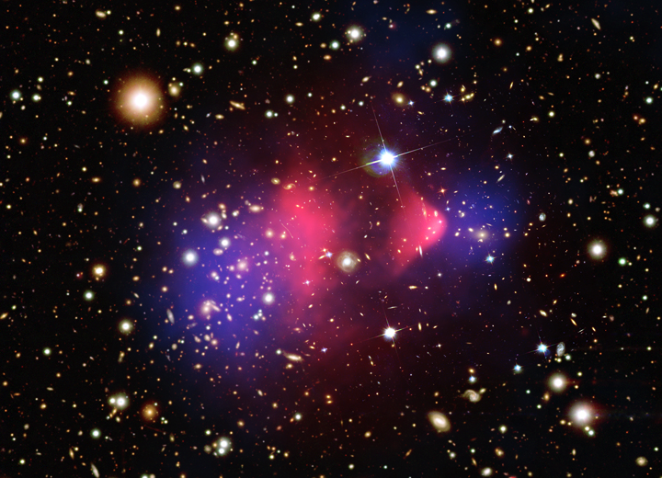
What’s Next @ LHC
Confronting
Dark & Unnatural Universe!
I focus on our Wisconsin Group Research, which is trying to shed some light on this matter!

Slide 2
Let´s start at the very beginning
A very good place to start!

Slide 3

A Brief History of Time
Universe expanding and cooling
Dark Matter
Key to this evolution
The Big Bang
– 454º F
String Theory
Big Bang Cosmology
LHC Phenomena
ATLAS & CMS
Quantum Gravity Era
Electro-weak Era
Proton & Neutron Era
Nuclear Era
Atoms and Light Era
Galaxies Formation
Grand Unification Era
Today
Driven by physicists’ reductionist philosophy – learn by getting to the core

Slide 4
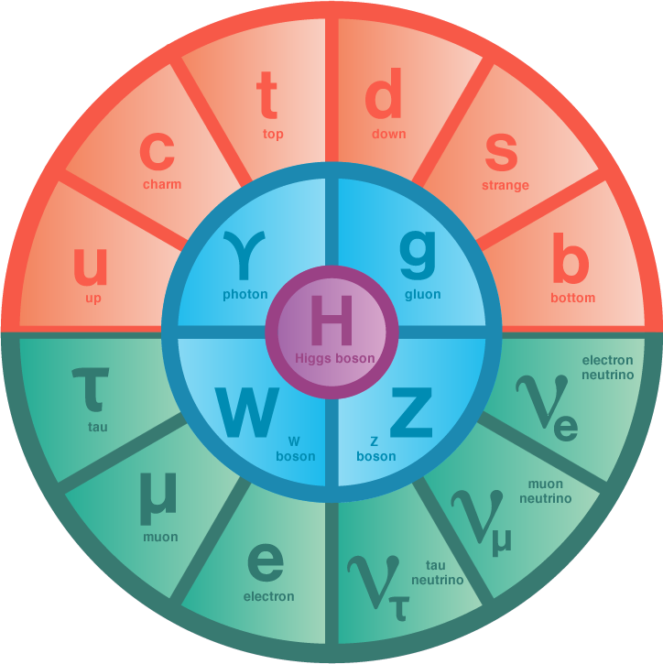
Relativistic Quantum World
Quantum Fields permeate all space-time
  EM vibrations → photons (light quanta)
Matter field vibrations create matter quanta
  Energy → matter-anti-matter pairs
Particles interactions exchanging gauge quanta
  Photons, Gluons, W and Z, (graviton)
Works beautifully for massless particles – QED, QCD
  But, W & Z quanta are massive – decay promptly
  Mass for particles (slowing them down) requires Higgs
Higgs mechanism is central for accommodating massive quanta
  A new scalar quantum field with non-zero contribution everywhere in the universe discovered!

Slide 5

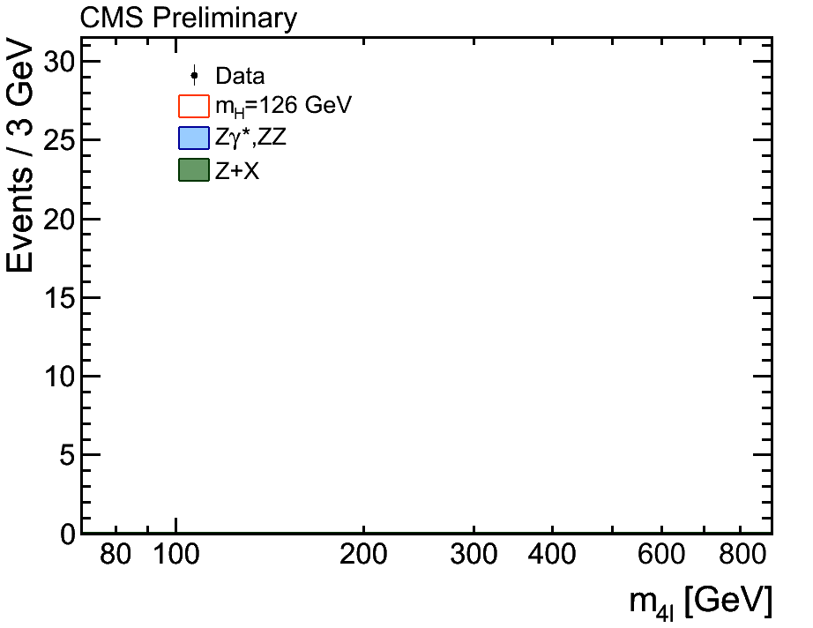
The Idea of the Higgs Field
→ The Higgs Boson Discovery
Higgs field permeates all space, particles interact with differing strengths with the higgs field. The higher the interaction the larger the particle’s mass.
The simplest theory with higgs fields results in a self-interacting particle: the Higgs boson, which itself has a mass – but, theory doesn’t predict its mass.
50 year quest!

Slide 6
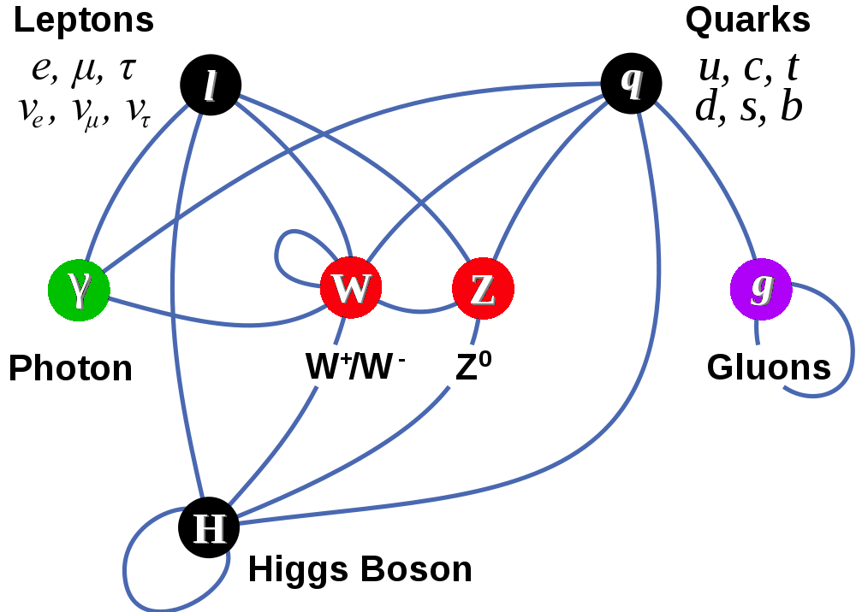
Completion of The Standard Model
Matter Particles (fermions)
Interactions by exchange of vector bosons
New fundamental scalar field non-zero value everywhere in universe >> new boson
Other particles attain mass by coupling to this new fundamental field

Slide 7
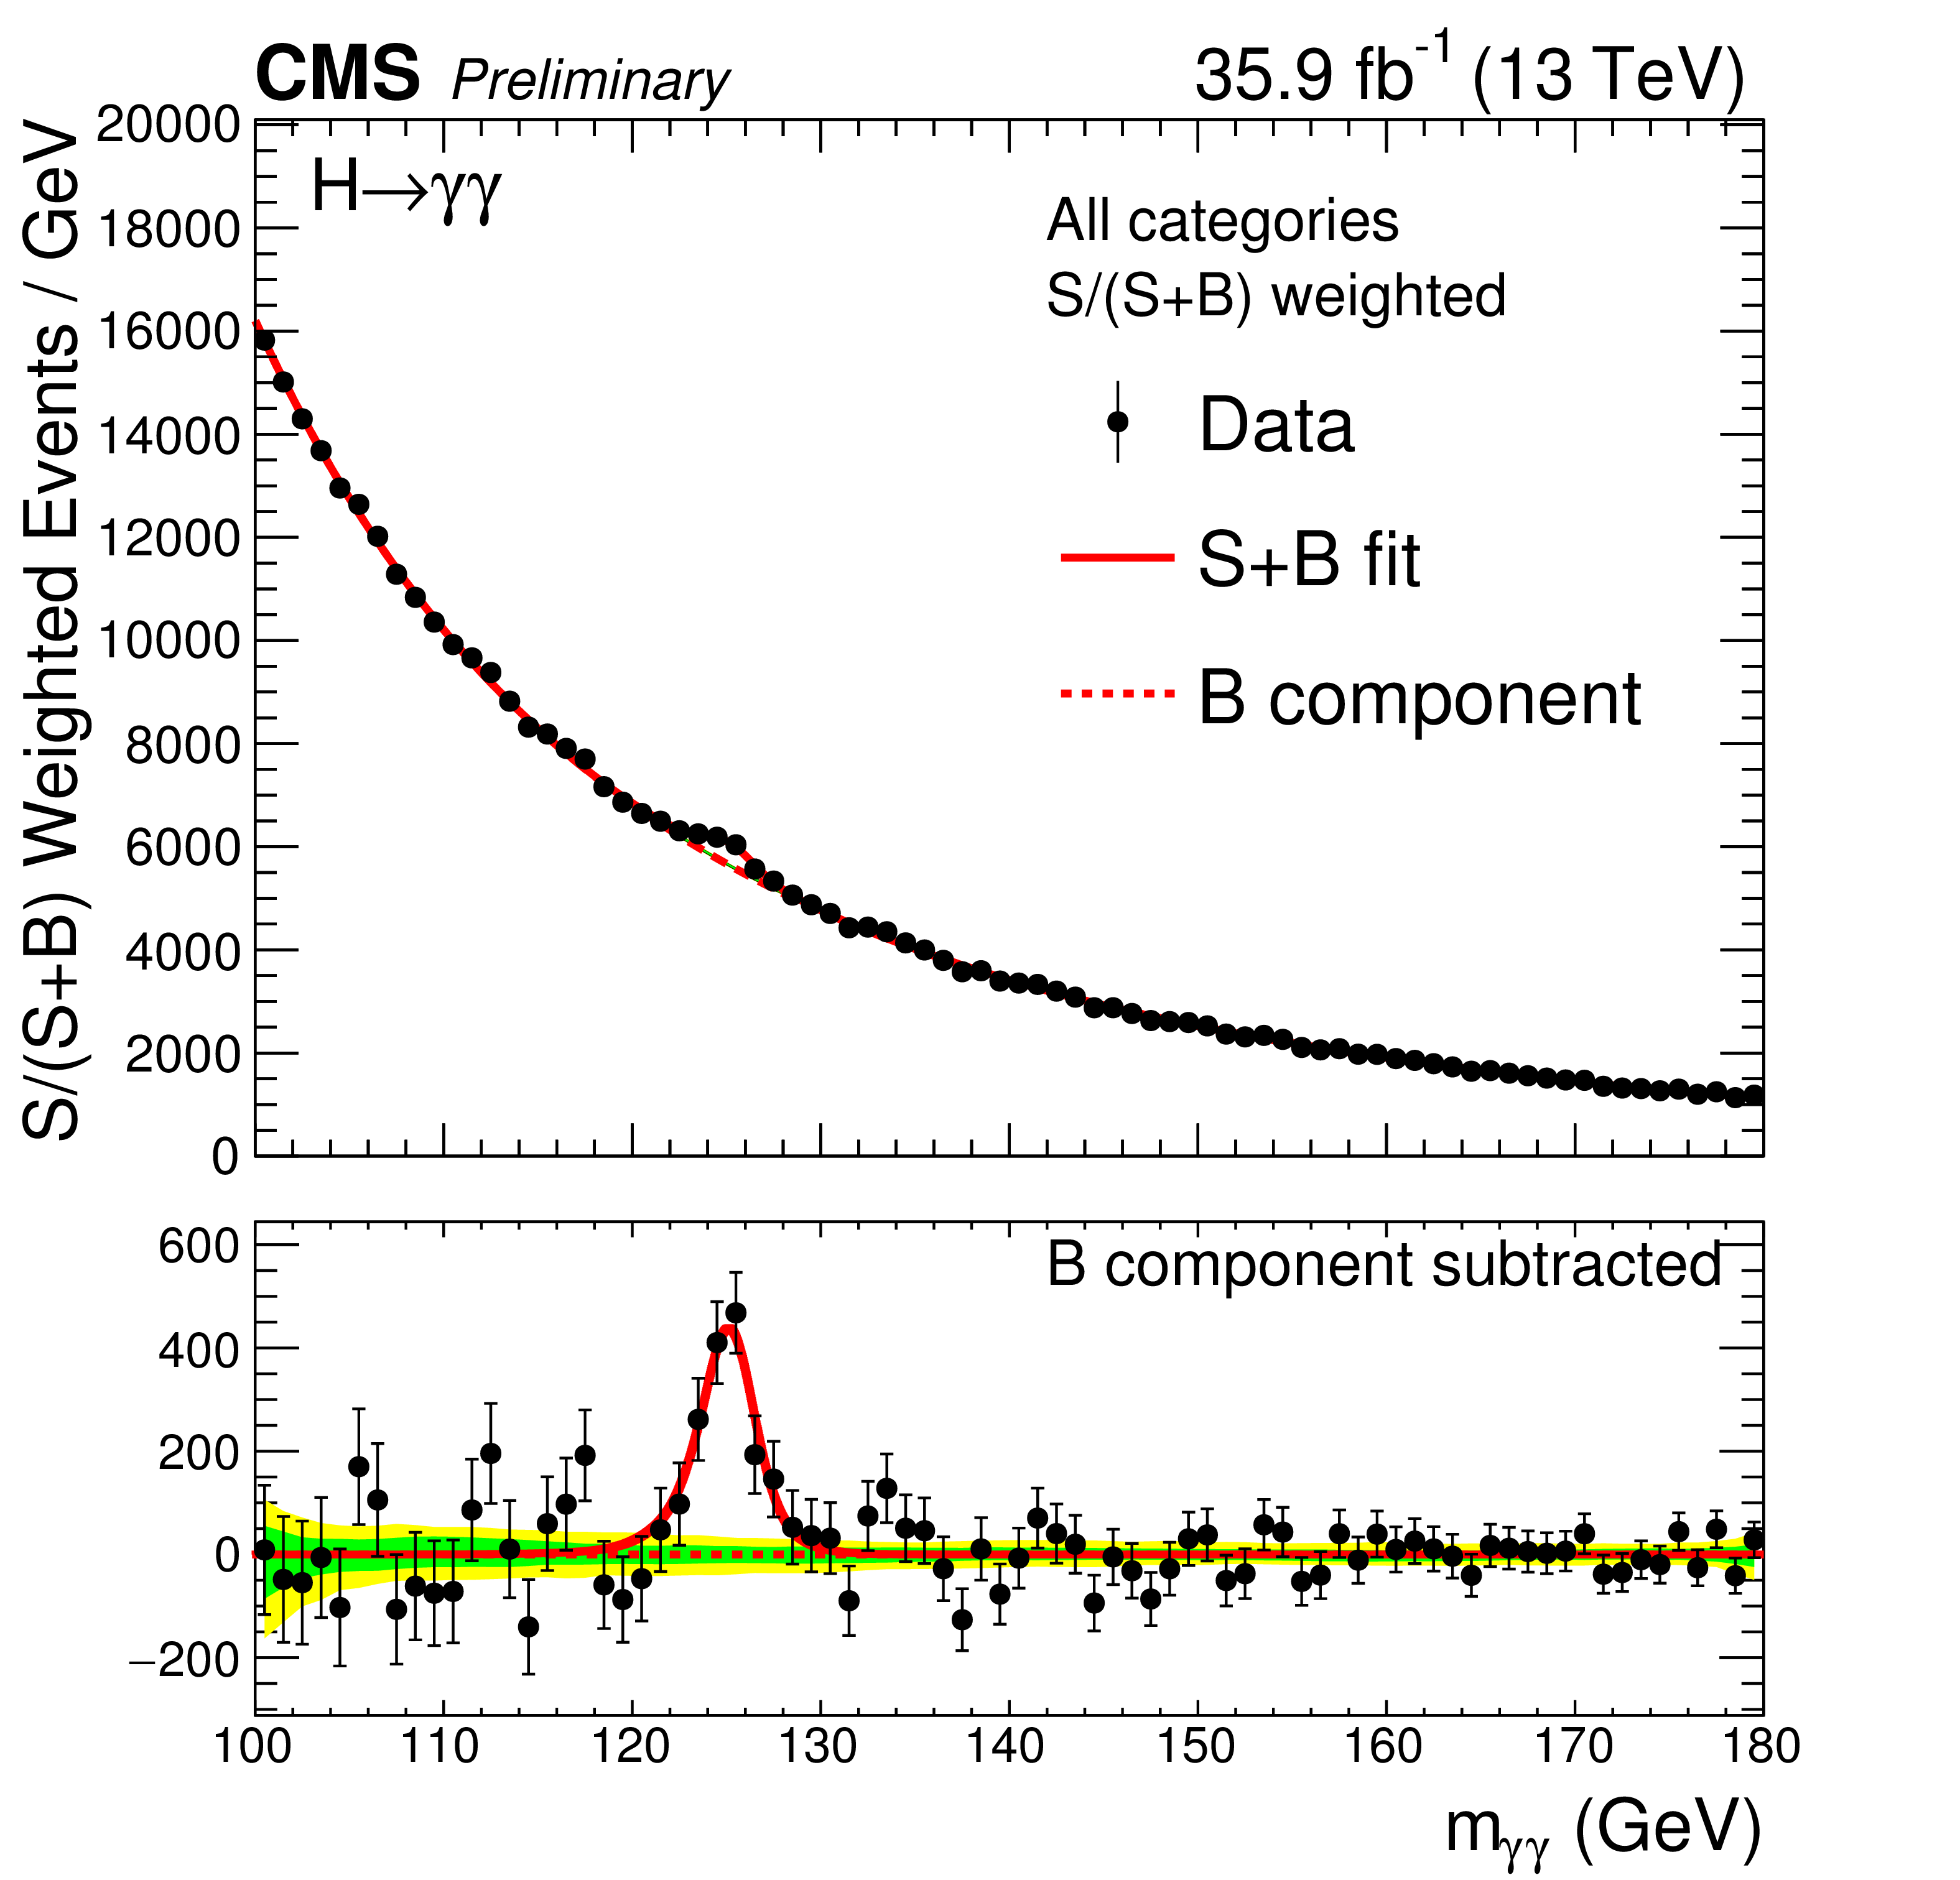
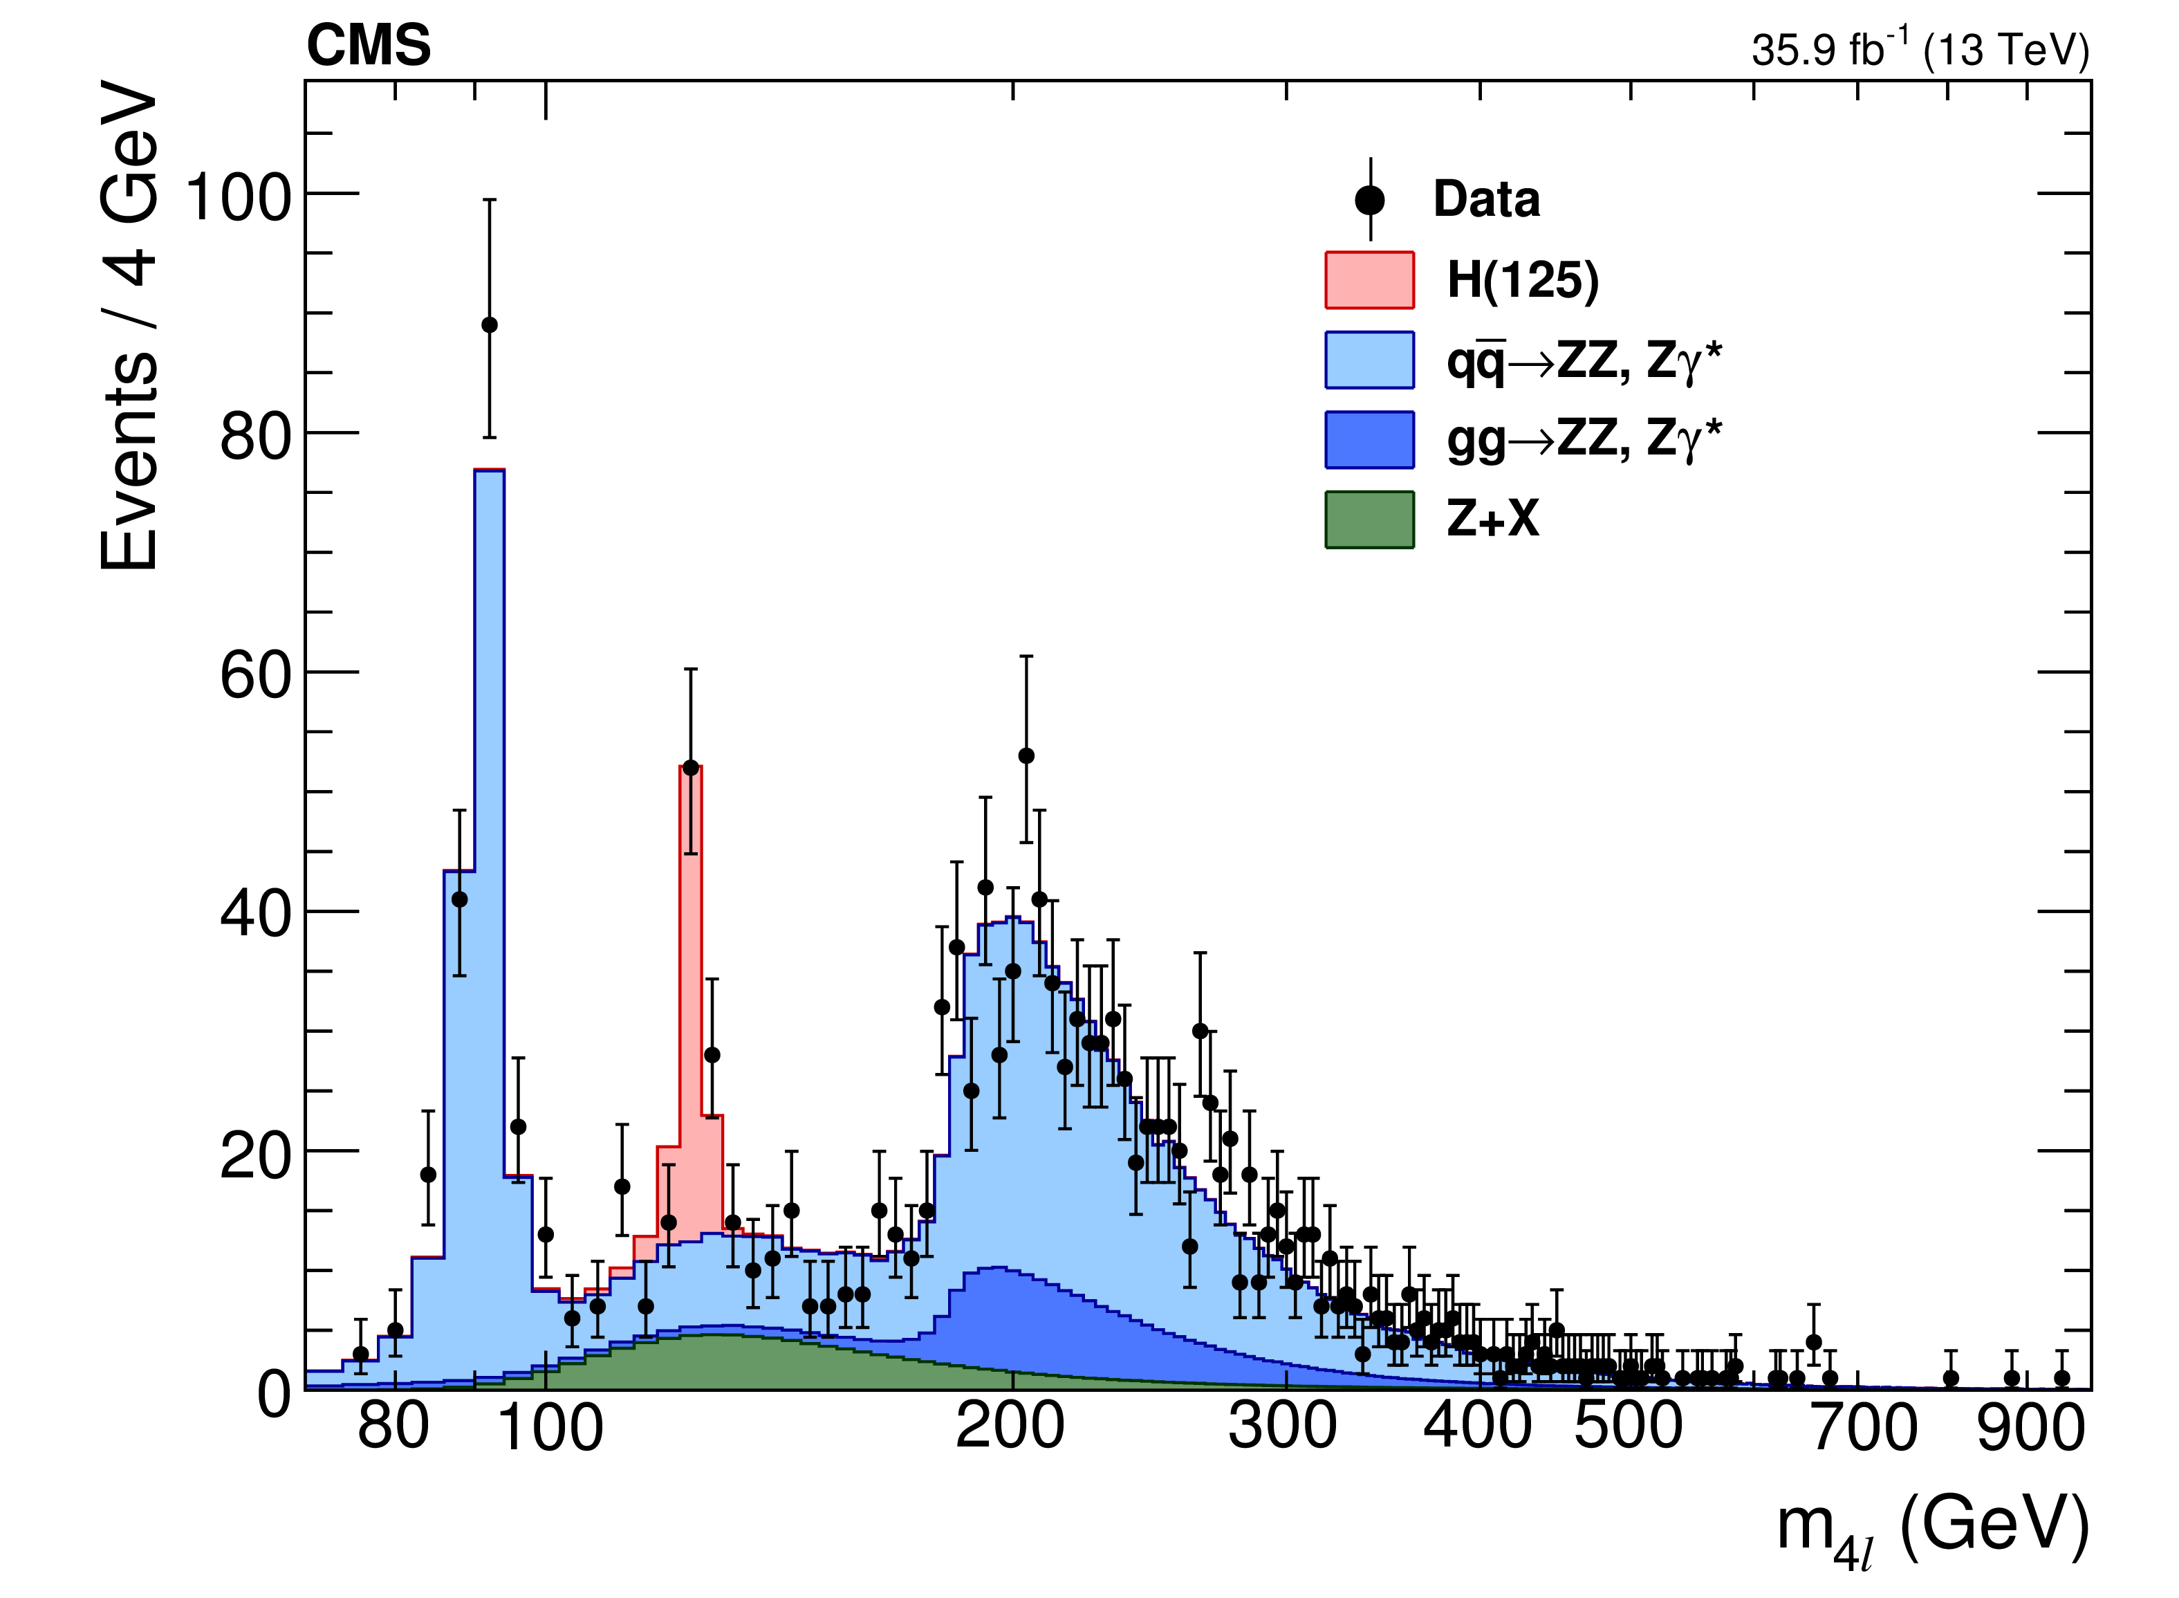
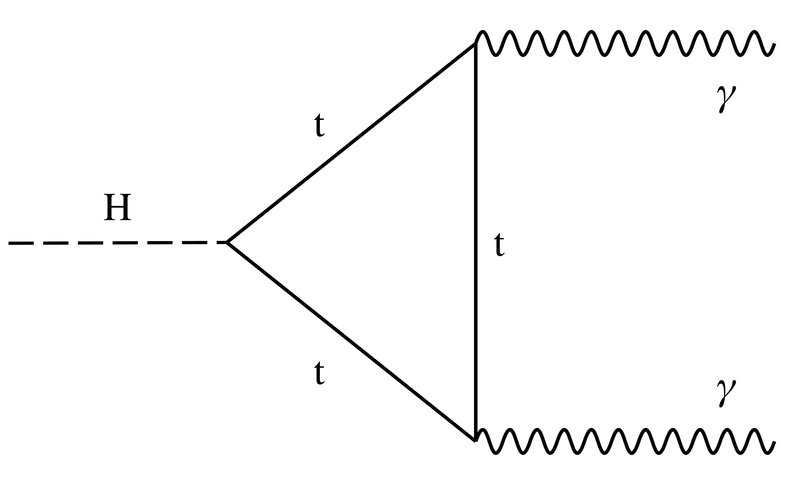
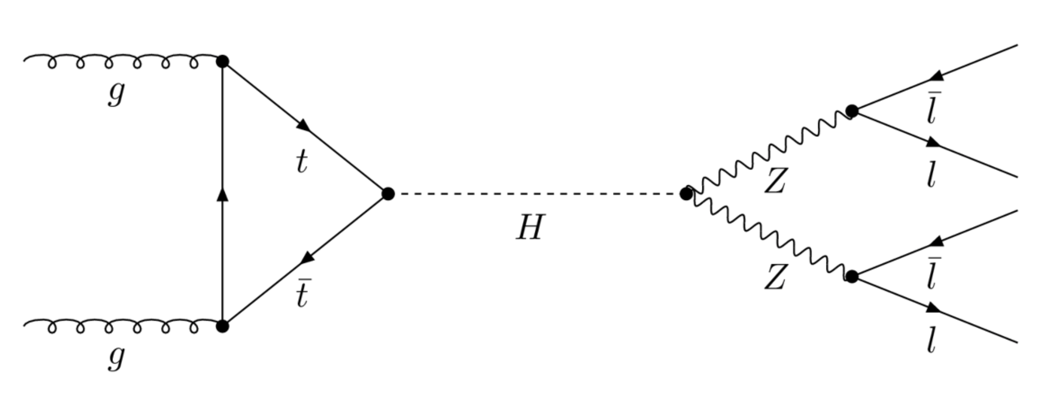
2018 Status
Our discovery of a Higgs boson completes the Standard Model
  2012 : Higgs Boson Discovered
  2013 : Physics Nobel Prize award!
  2015 : Detailed Higgs Physics Exploration Began
  2018 : h(125) continues to look like The SM Higgs Boson

Slide 8
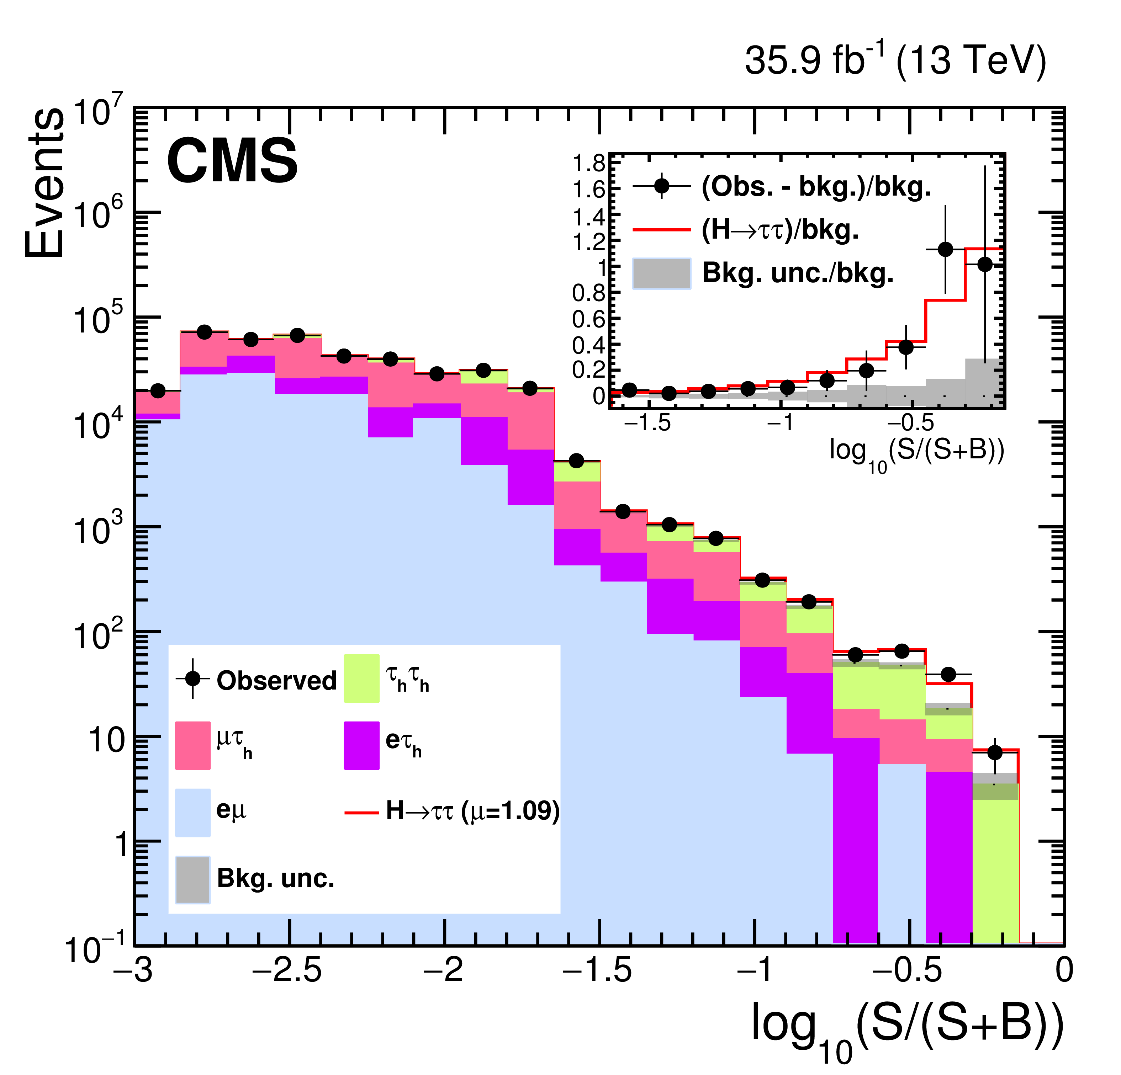
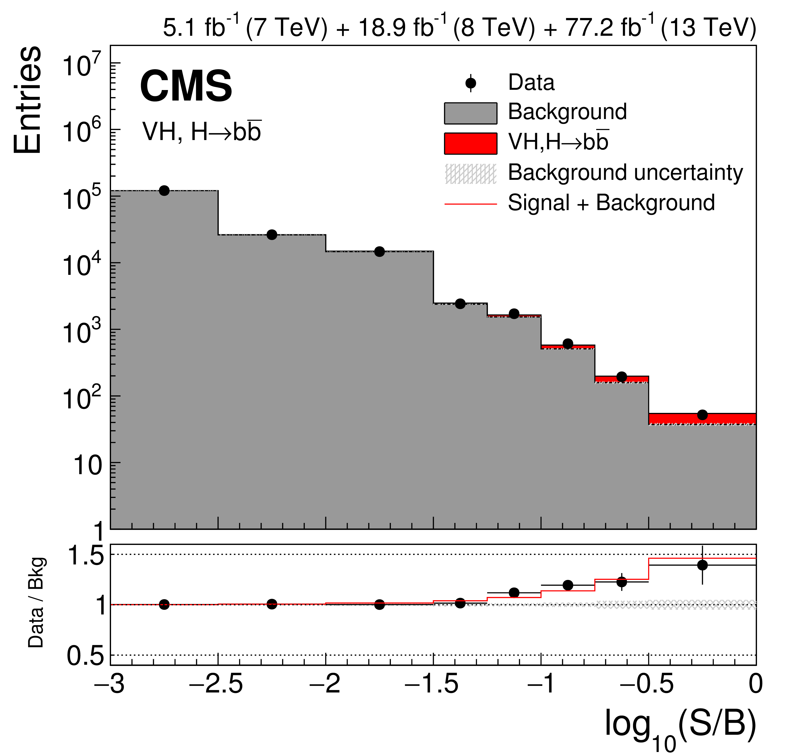
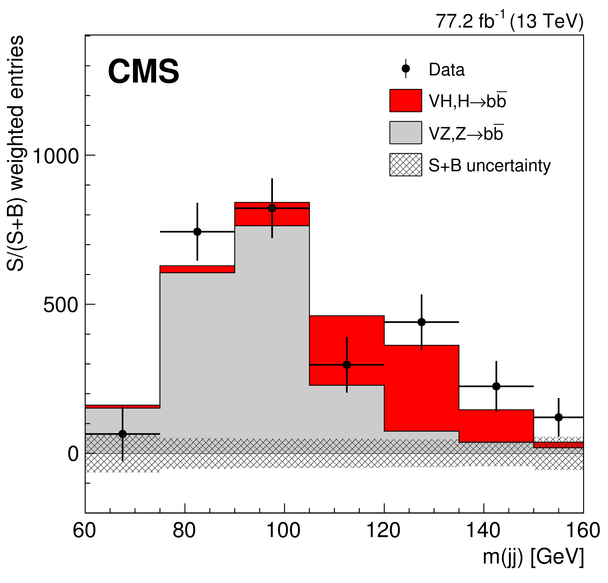
2018 Status : Higgs to Fermions
Our discovery of a Higgs boson completes the Standard Model
  2012 : Higgs Boson Discovered
  2013 : Physics Nobel Prize award!
  2015 : Detailed Higgs Physics Exploration Began
  2018 : h(125) continues to look like The SM Higgs Boson

Slide 9
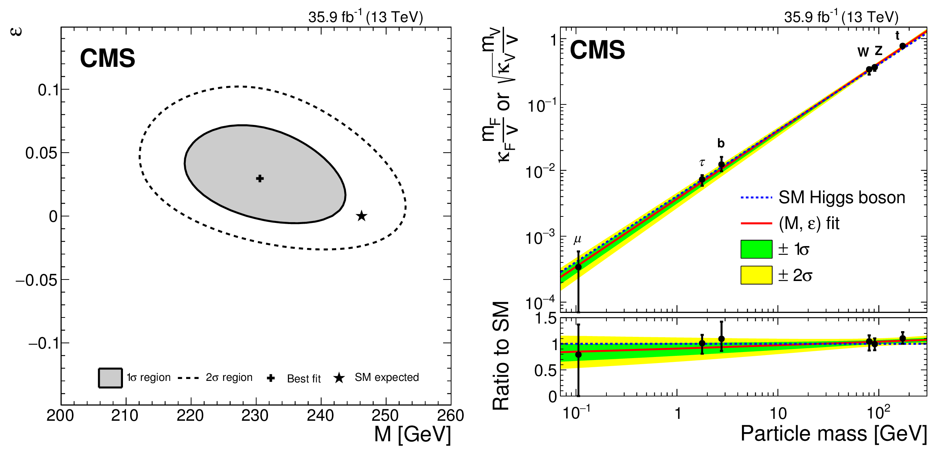
2018 Status : Higgs Couplings
Our discovery of a Higgs boson completes the Standard Model
  2012 : Higgs Boson Discovered
  2013 : Physics Nobel Prize award!
  2015 : Detailed Higgs Physics Exploration Began
  2018 : h(125) continues to look like The SM Higgs Boson
Deviation from SM EWK
κ_{F} = v m^{ε}_{f} / M^{1+ε}
κ_{V} = v m^{2ε}_{V}/M^{1+2ε}
Electroweak Scale

Slide 10
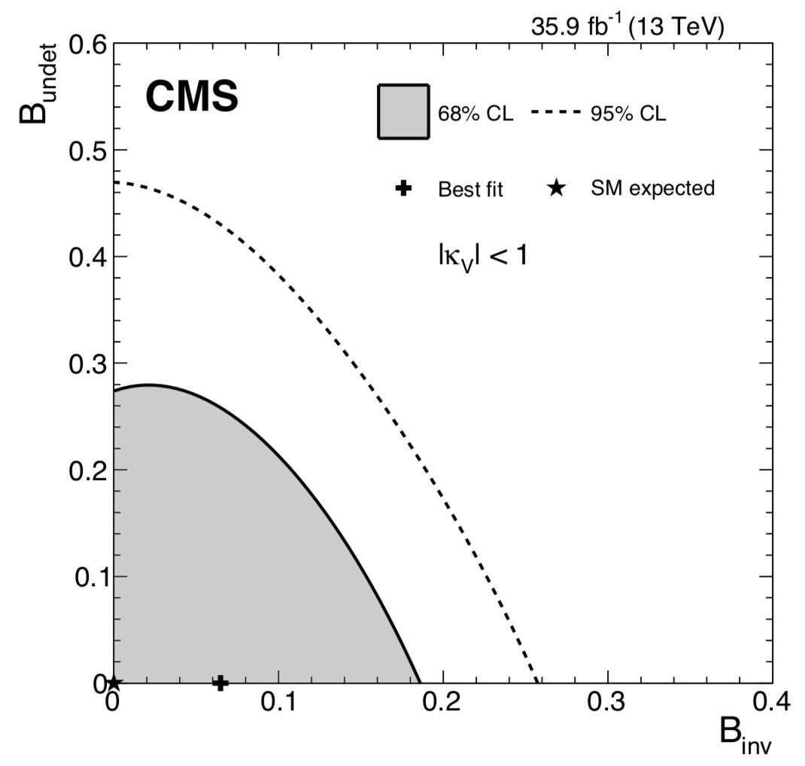
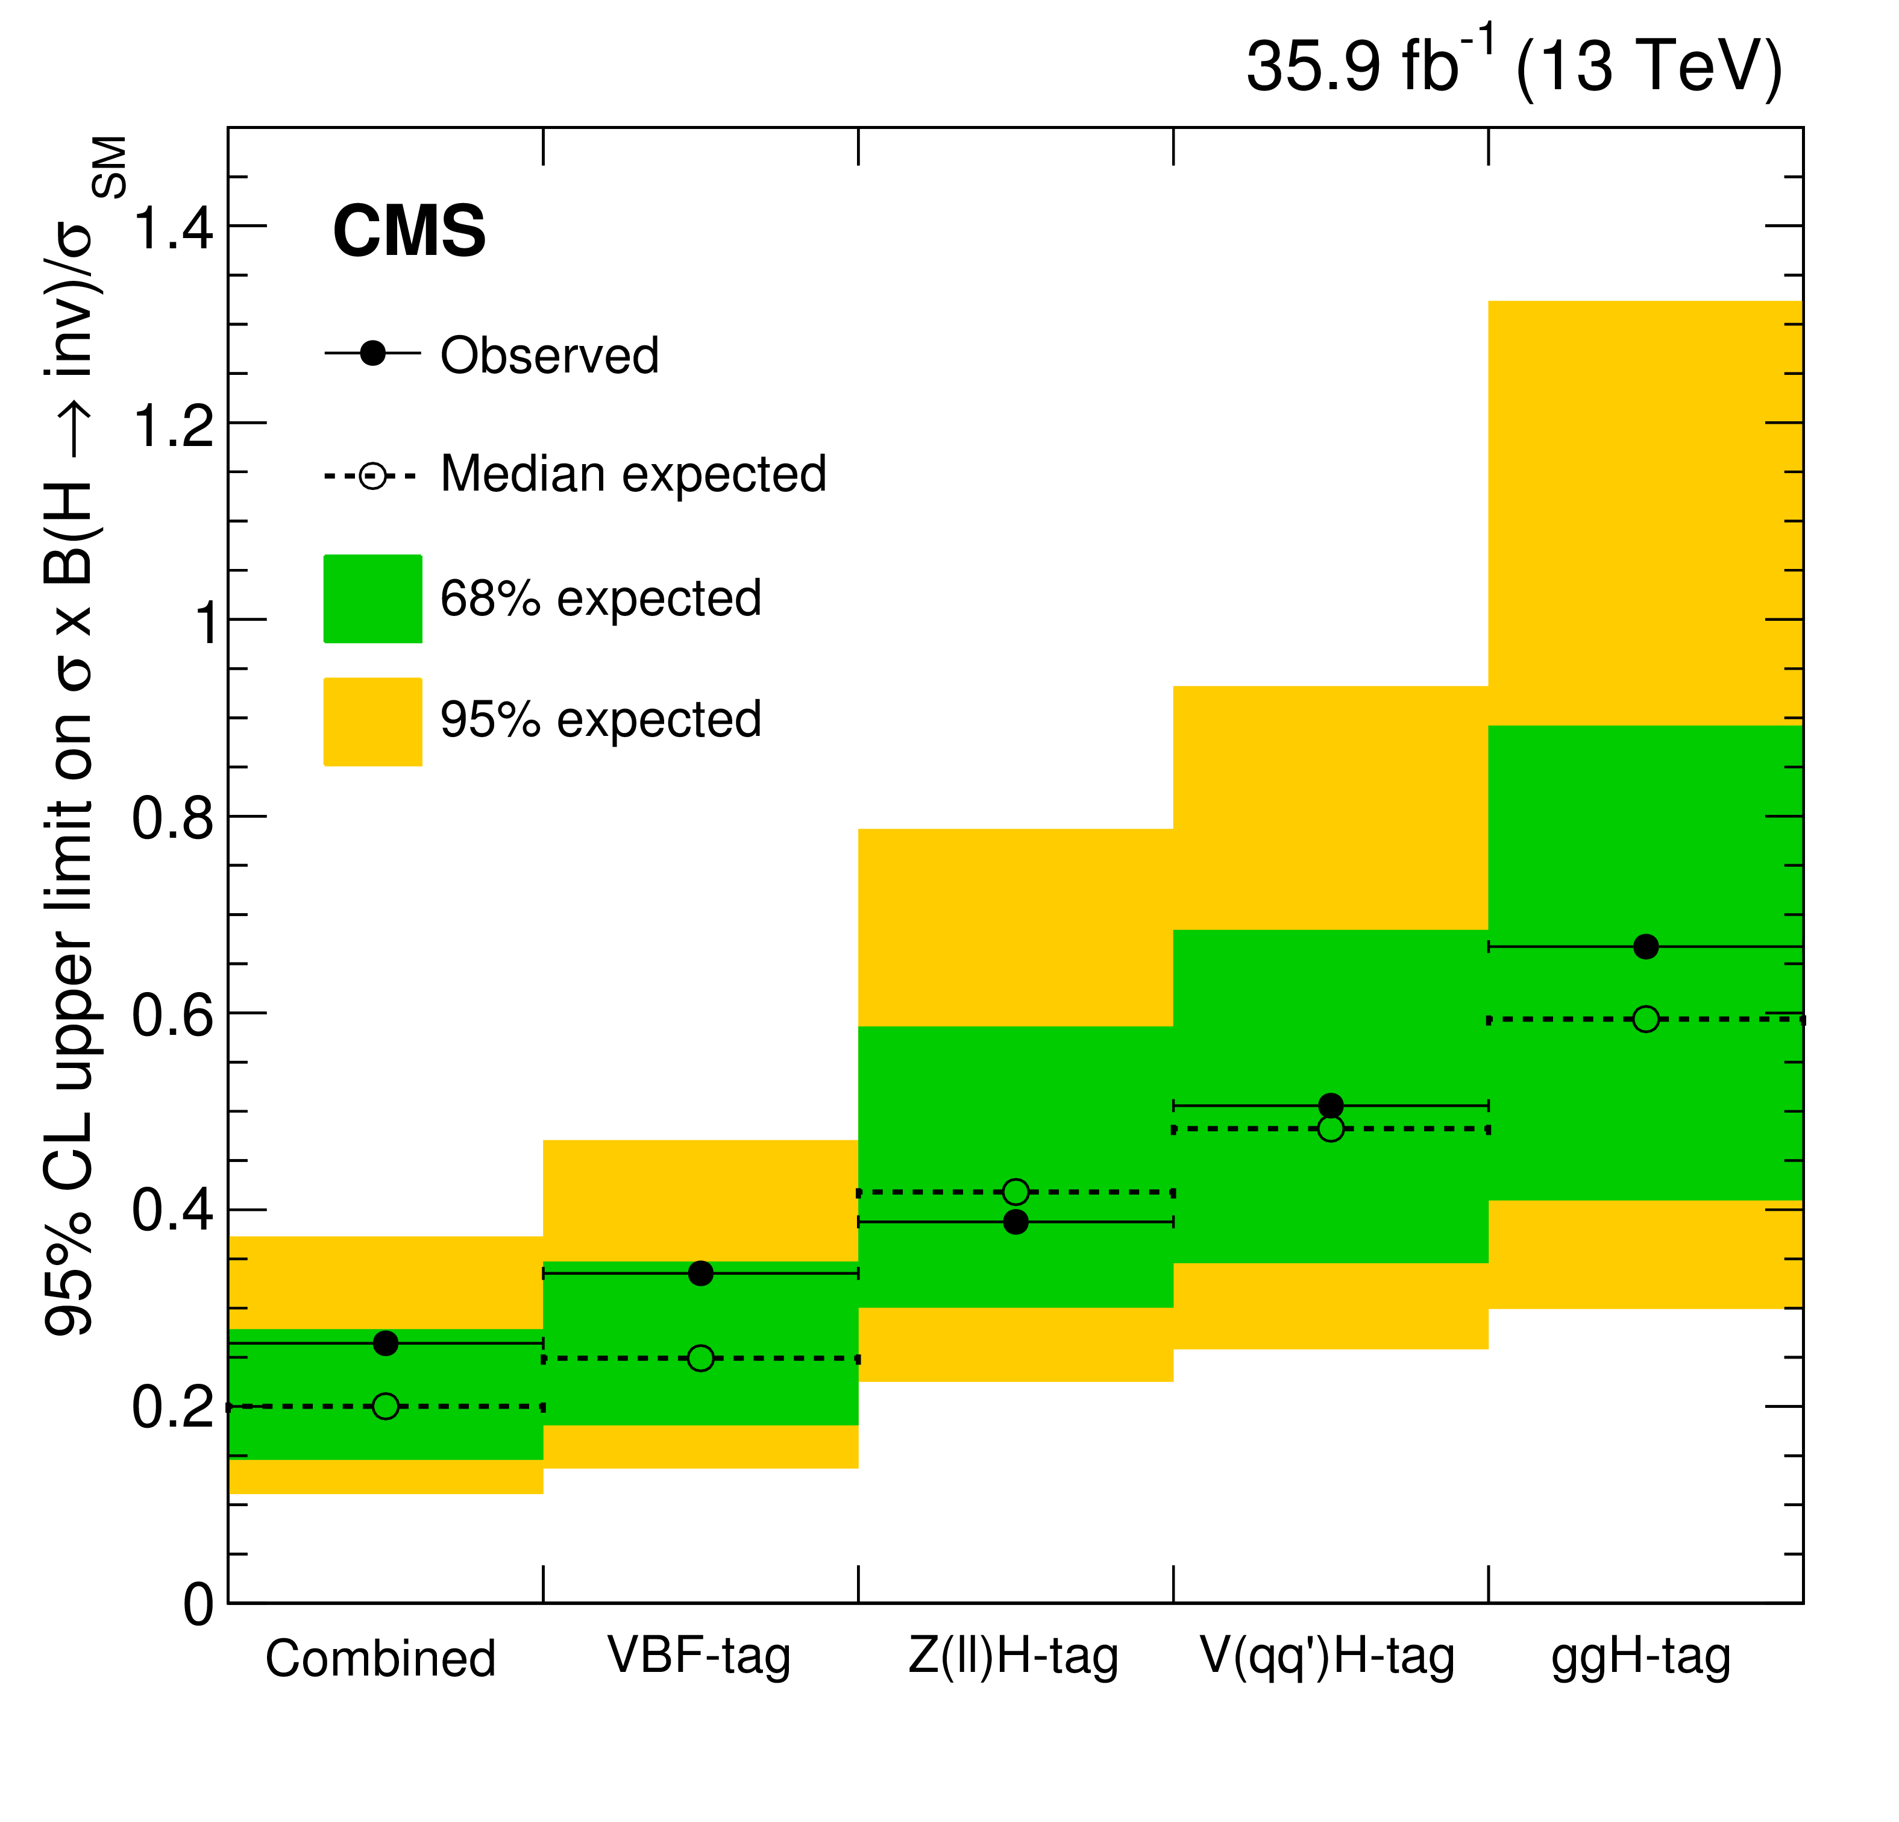
2018 Status : Invisible Higgs?
Our discovery of a Higgs boson completes the Standard Model
  2012 : Higgs Boson Discovered
  2013 : Physics Nobel Prize award!
  2015 : Detailed Higgs Physics Exploration Began
  2018 : h(125) continues to look like The SM Higgs Boson

Slide 11
2018 Status : So, What’s Next?
Our discovery of a Higgs boson completes the Standard Model
  2012 : Higgs Boson Discovered
  2013 : Physics Nobel Prize award!
  2015 : Detailed Higgs Physics Exploration Began
  2018 : h(125) continues to look like The SM Higgs Boson
However, the Standard Model is incomplete
  We do not fully understand the Higgs Boson yet (at 20% level)
  No new TeV scale particles discovered yet
  EWK produced BSM parameter space beginning to be explored
  Exotic particles and their interactions continue to be demanding
  Dark and Unnatural Universe confounds us
  New physics theories are aplenty to find loopholes
  Only experiment can shed light, i.e., precise SM measurements needed
    Eagerly awaiting discoveries this decade ☺

Slide 12
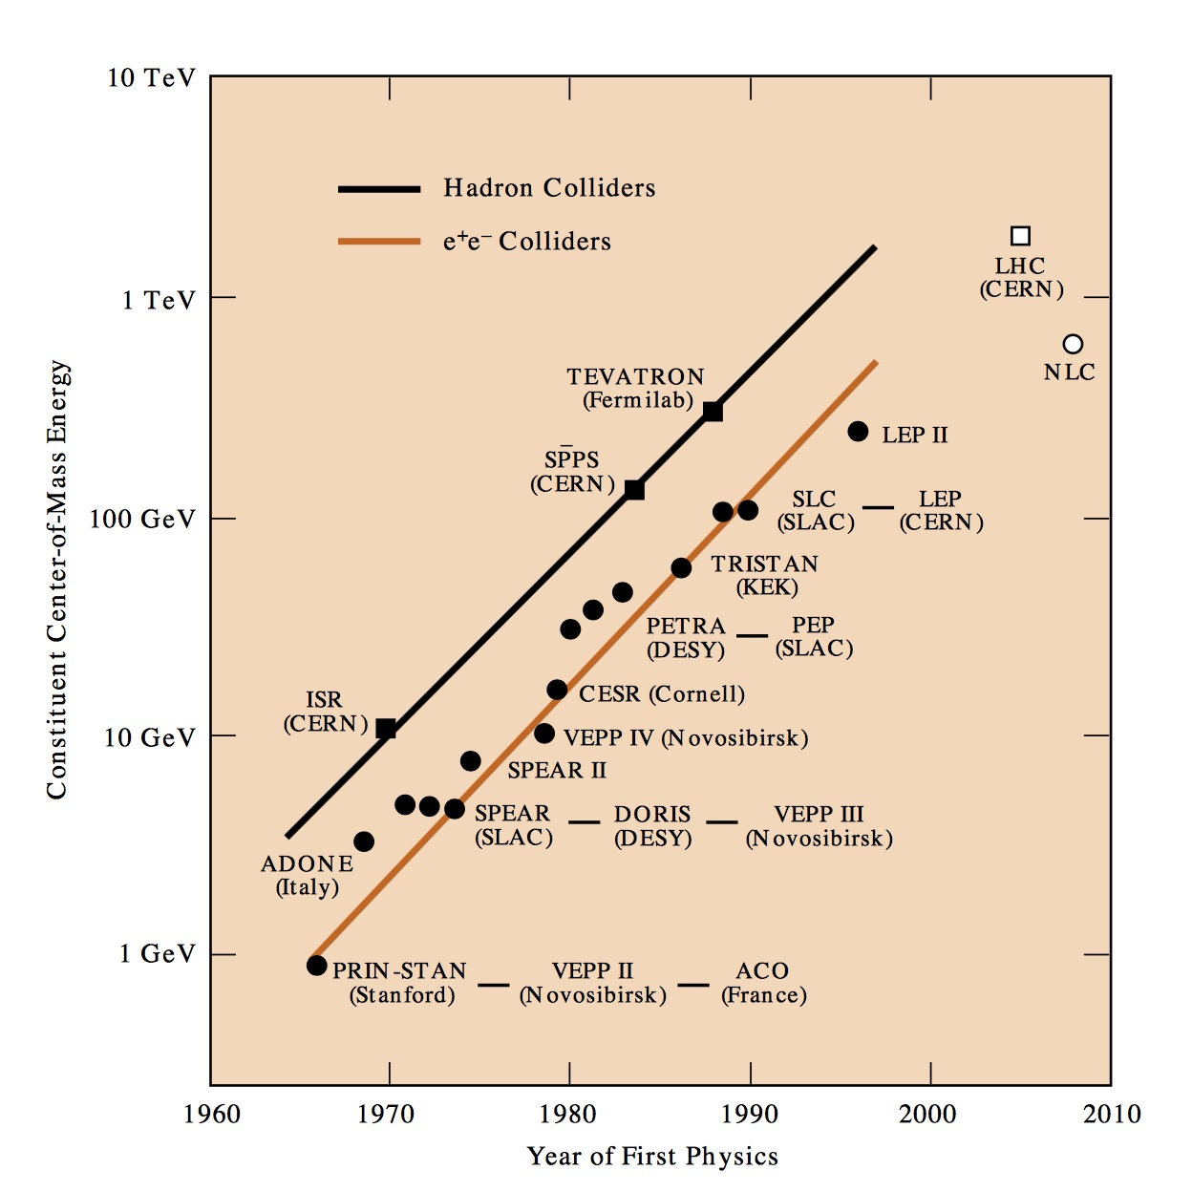
Colliders @ the Energy Frontier!
100-TeV
FCC-hh
HE-LHC
HL-LHC
ILC
http://www.slac.stanford.edu/pubs/beamline/27/1/27-1-panofsky.pdf
We obviously need to invest more in machine R&D

Slide 13
Beyond the Standard Model?
The Standard Model seems to work perfectly well…
...then why do we seek to go beyond the Standard Model?
SM can be convicted for incompleteness!
  Quantum field nature of Gravity is missing entirely ☹
    But, Planck scale is very high compared to EWK
    Dark Matter is 27% of Universe. SM has no DM candidate ☹
    Dark Energy is completely unexplained
  Why is the Higgs so light? Why not at Planck Scale?
    Various cures ➔ new physics at ~TeV scale incl. DM
  No explanation for three fermion generations ☹
  No explanation for hierarchy in fermion masses ☹
  Inadequate amount matter-anti-matter asymmetry for formation of our known Universe with matter galaxies, … ☹
  Strong and electroweak forces are not unified ☹

Slide 14
What’s Next
@ The Energy Frontier
Exploring the Higgs sector
  H(120 GeV) → measure ~30 GeV objects
  Precise measurements of SM decays, Non-standard decays
  Search for additional Higgs scalars
Continued searches for heavy BSM particles
  We are limited by the LHC energy
  More energy in the center mass the better
  Not all energy in proton-proton 14-TeV collisions available
  Rare for quarks and gluons in proton to carry most of that 7 TeV
  Quark-gluon momenta fall faster than we accumulate luminosity
Continued searches for light BSM particles
  Dark particles, which interact ultra-weakly with SM particles
  Particles produced only in the EWK processes
  Long-lived particles : special purpose detectors (Mathusla / milliQan)

Slide 15
The Galactic Motion → Dark Matter
In fact, most of the matter in the universe is dark
Why is this Matter Dark?

Slide 16
Structure Formation History
https://youtu.be/SY0bKE10ZDM
What is this Dark Matter?

Slide 17
What is Dark Matter?
Known particles in the Standard Model cannot be what dark matter is made of
Only neutrinos interact very weakly with other matter but they have very low mass
Super-symmetric theories can have weakly interacting massive particles (WIMPs), which are ideal dark matter candidates ☺

Slide 18
Dark Matter is Weakly Interacting
Collision of two clusters of galaxies
Collision reshaped the intergalactic gas (pink) into a distinctive “bullet” shape.
The dark matter (blue) needed
to explain rotation curves,
flies through normal matter
ending up light-years away
from the normal matter.
What is this Weakly Interacting Dark Matter?

Slide 19
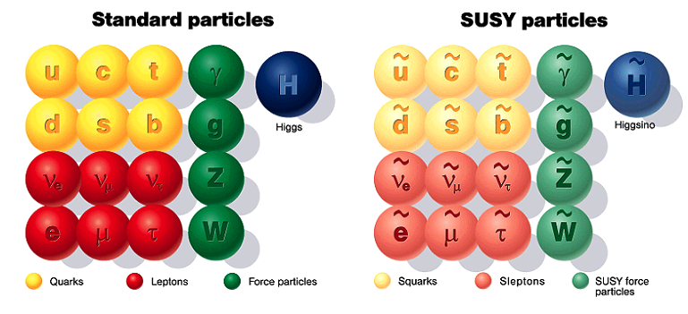
One High Scale Theory:
Supersymmetry
A BSM physics theory which doubles known particles again – but the new particles must have large mass
Hope remains that LHC may be able to produce them

Slide 20
Supersymmetry – WIMP Miracle
A BSM physics theory which doubles known particles again – but the new particles must have large mass
Hope remains that LHC may be able to produce them
Lightest SUSY Particle
Neutralino
Dark Matter
χ₀
χ₁
χ₃

Slide 21
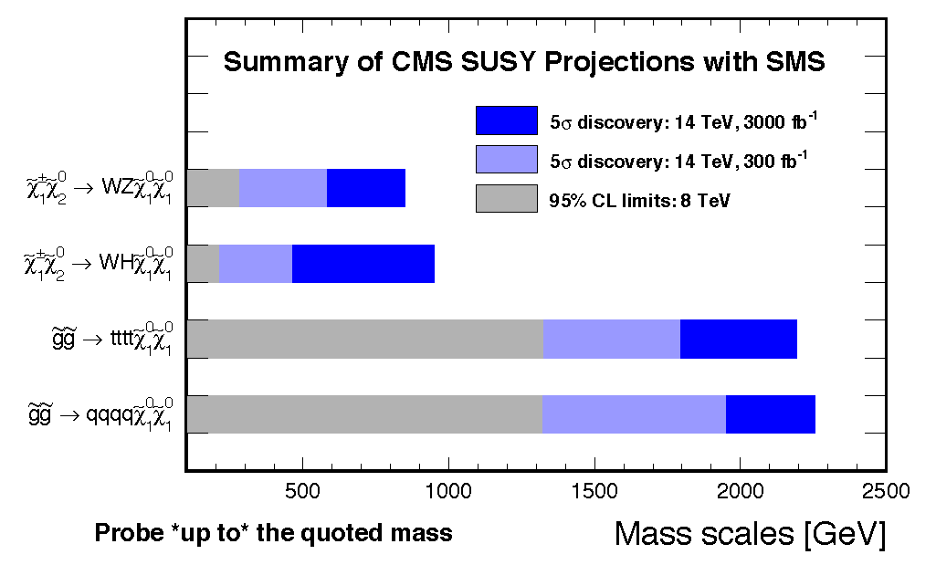
Whither SUSY?
Naturalness argument requires sparticle masses of order 1 TeV or less.

Slide 22
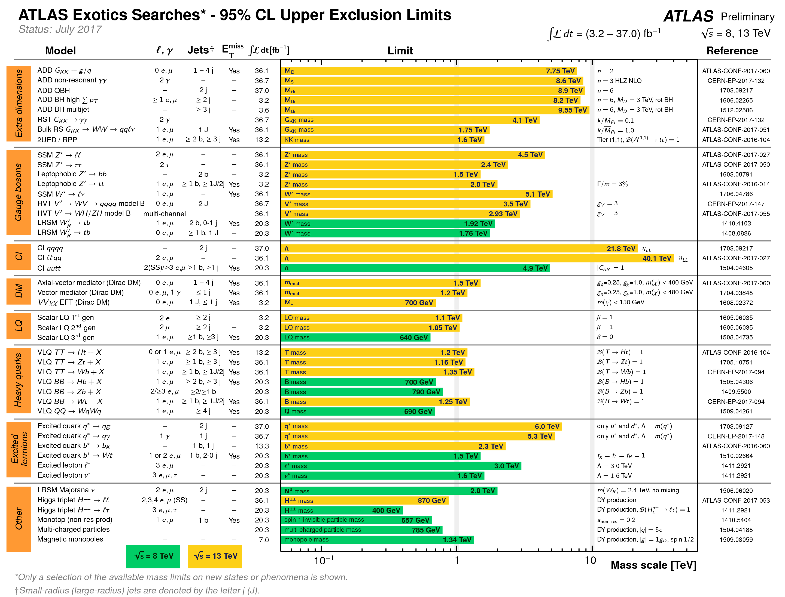
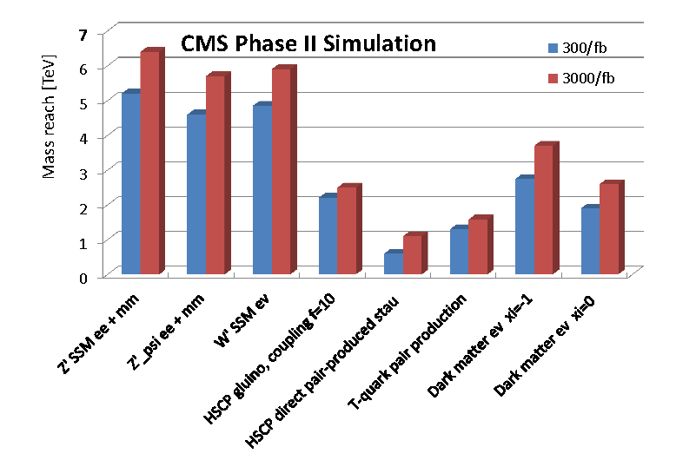
Exotica?

Slide 23
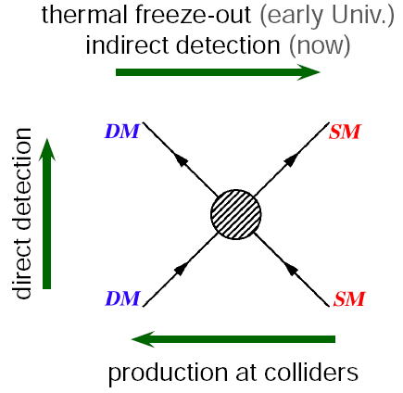
Finding WIMPs
Collider Search
  ATLAS / CMS
Direct Detection
  Underground
  experiments
    LZ, …
Indirect Detection
  IceCube
  Fermi LAT

Slide 24
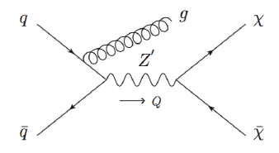
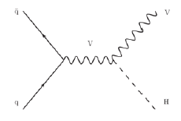
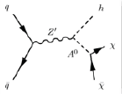
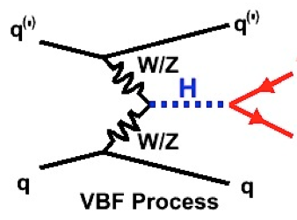
Collider Search – Some Samples
Recoil from Initial State Radiation of gluon/quark, photon, Z or H | Invisible Higgs Decay radiated from a Vector Boson
Multi-Higgs Doublet Models Invisible Heavy Higgs Decays | Invisible Higgs Decay produced in Vector Boson Fusion

Slide 25
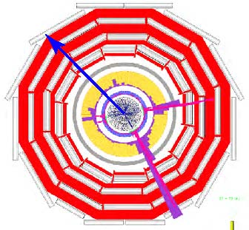
Missing Transverse Energy
Initial particles (protons) are going in and out of the screen in this picture
Net momentum initially is zero in this XY-plane
Remnants after the collision should also add up to zero momentum
Imbalance seen when there are non-interacting (dark) particles.

Slide 26
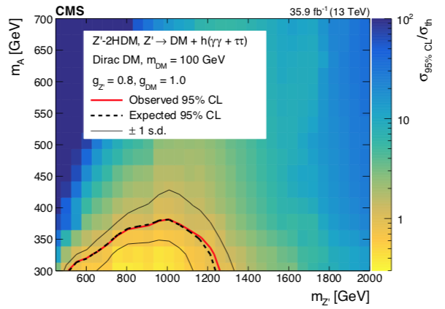
No MET Beyond that from νs yet ☹
M o n o - q g, γ | M o n o - q g, γ
Invisible Higgs Less than 20% of 125-GeV Higgs Branching Ratio is invisible to 95% cl | Mono H Wide range of masses already excluded for invisible A decay to DM

Slide 27
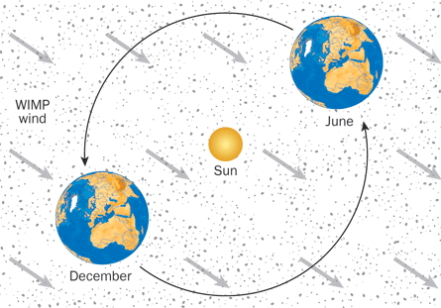
Dark Matter Is All Around Us

Slide 28
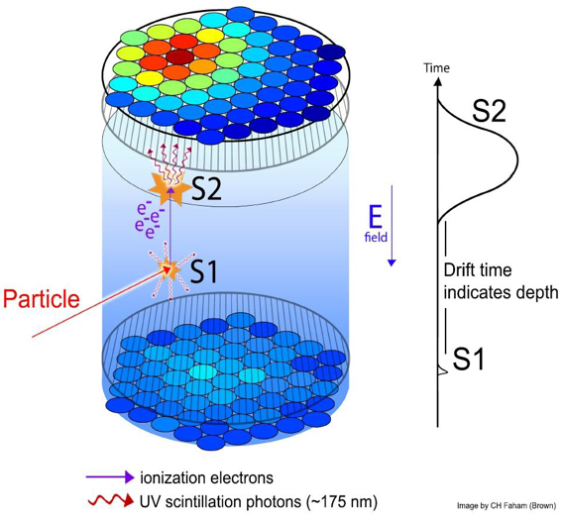
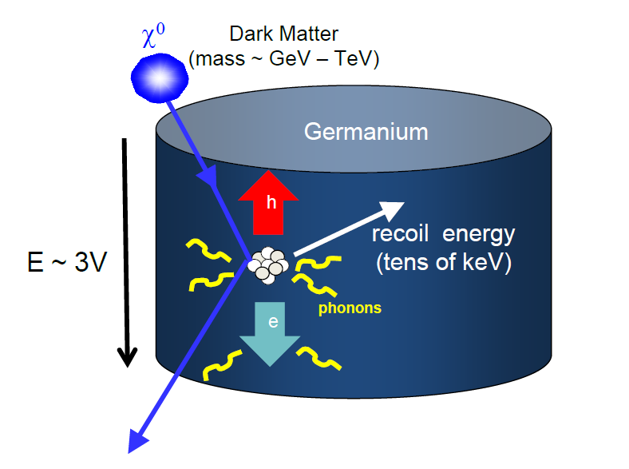
Direct Search
Two winning techniques to find galactic dark matter
Place largest possible detector (7000 kg) in deepest mine accessible (1.5 km)

Slide 29
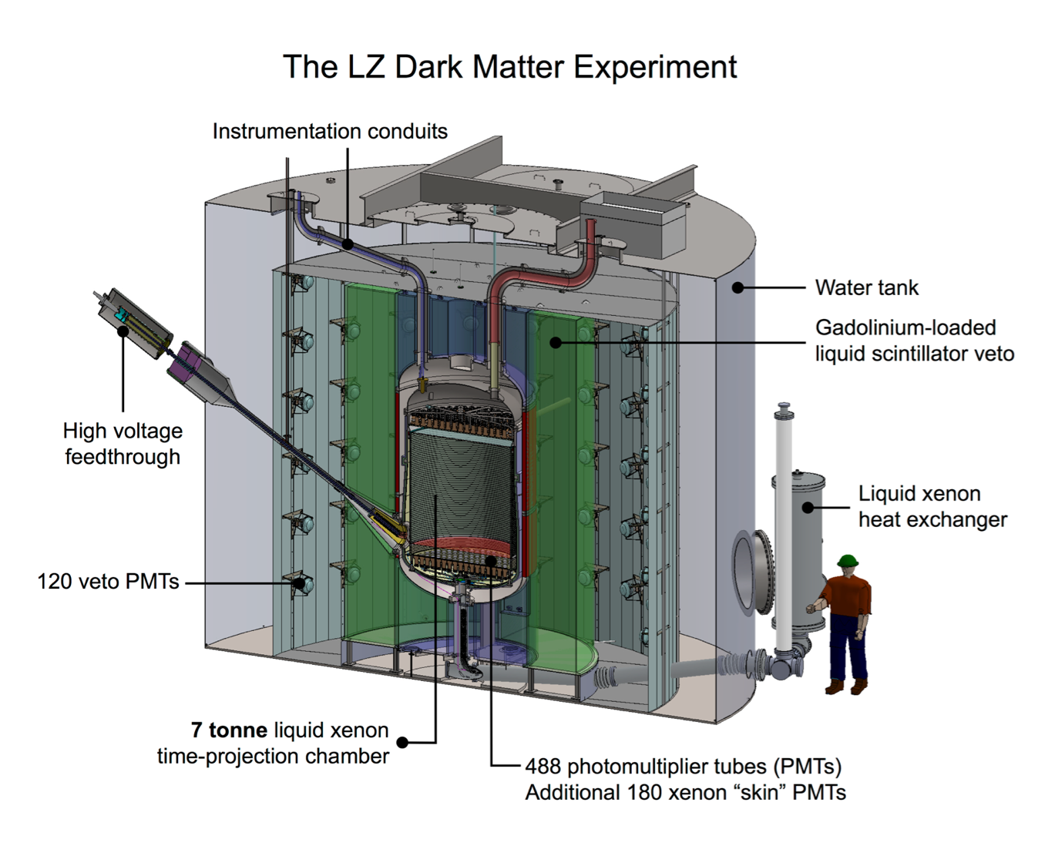
LZ Experiment in South Dakota
Recently approved
LZ experiment contains a record-sized 7 ton liquid xenon time projection chamber designed to push limits on direct dark matter detection.
Deep underground to filter out cosmic rays.
Careful material selection to reduce radioactivity
Wisconsin is helping build this experiment

Slide 30
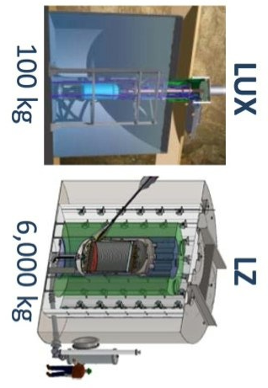

Dark Matter Search Summary
CMS
LZ

Slide 31
What if the WIMP-Nucleon cross section is spin dependent?

Slide 32
Summary
Higgs is the new kid on the block
  H(125 GeV) looks like the Standard Model Higgs
  No new Higgs bosons have been discovered yet
Weakly Interacting Massive Particles make good DM
  SUSY provides a natural DM candidate unlike the SM
  No SUSY or other heavy particles seen yet
  No evidence for WIMP dark matter has emerged yet
What next?
  Higgs, top and … may be portals to DM universe
  Lot left to do in WIMP explanation of DM
  LHC & Underground experiments will run 2020+
    Discovery of WIMPs?

