Slide 1
Digital Electronics & Firmware Development for High Energy Physics Today: Introduction to CMS Trigger Rest of the week: Hands-On Firmware Work
Sridhara Dasu, University of Wisconsin

Slide 2
The Large Hadron Collider

Slide 3
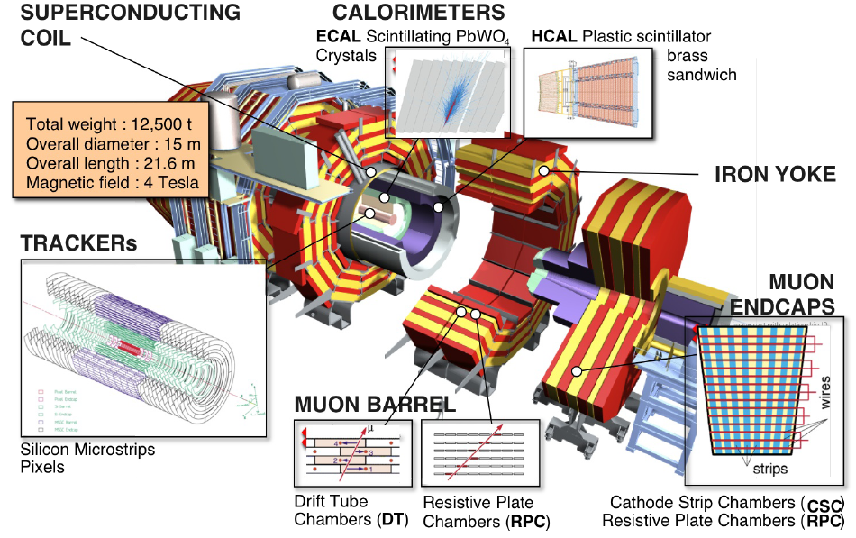
CMS Detector

Slide 4
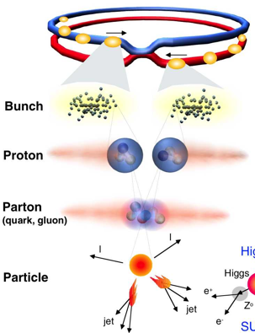
Proton-Proton Collisions at the LHC
 | 2015-16 | 2012 | 2011
Beam energy | 6.5 TeV | 4.0 TeV | 3.5 TeV
Bunches/ beam | 2556 | 1380 | 1380
Protons/ bunch | 2.5x10¹¹ | 2.2x10¹¹ | 1.5x10¹¹
N pp Collisions Created | ~10¹⁵ | 3.5 x 10¹⁴ | 2.5 x 10¹⁴
N Higgs Events | ~10³ | ~few 10² | ~10²
Fetch me my needle buried in those hay stacks –
And, do it As Soon As Possible
1 event in 10 000 000 000 000 !
Notes:
1 barn = 10⁻²⁴ cm-²
Proton c.s 40mb/110mb@7TeV

Slide 5
LHC Physics @ 13 TeV – Trigger Challenge
Low ≅ 40 GeV
Electroweak Symmetry Breaking Scale
Higgs discovery and higgs sector characterization
Quark, lepton Yukawa couplings to higgs
New physics at TeV scale to stabilize higgs sector
Spectroscopy of new resonances (SUSY or otherwise)
Find dark matter candidate
Multi-TeV scale physics (loop effects)
Indirect effects on flavor physics (mixing, FCNC, etc.)
B_{s} mixing and rare B decays
Lepton flavor violation
Rare Z and higgs decays
Planck scale physics
Large extra dimensions to bring it closer to experiment
New heavy bosons
Blackhole production
Low P_{T} γ, e, μ
Low P_{T} B, τ jets
Multiple low P_{T} objects
Missing E_{T}
~ Dedicated triggers (CMS) or experiment (LHCB)
Low P_{T} leptons
High P_{T} leptons and photons
Multi particle and jet events

Slide 6
Trigger Task – Complex Decision in few μs

Slide 7
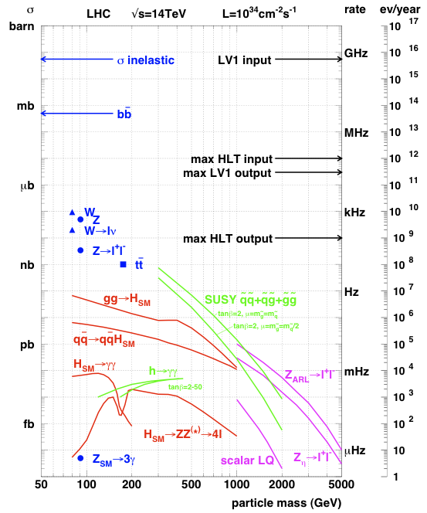
LHC Physics & Event Rates
L = 1.5 x10³⁴cm⁻²s⁻¹
40 pp events/25 ns xing
~ 1 GHz input rate
“Good” events contain ~ 40 background overlap
1 kHz W events
10 Hz top events
< 10⁴ detectable Higgs decays/year
Can store ~ 1000 Hz events
Select in stages
Level-1 Triggers
1 GHz (pp-interactions) to 100 kHz
High Level Triggers
100 kHz to 1000 Hz

Slide 8
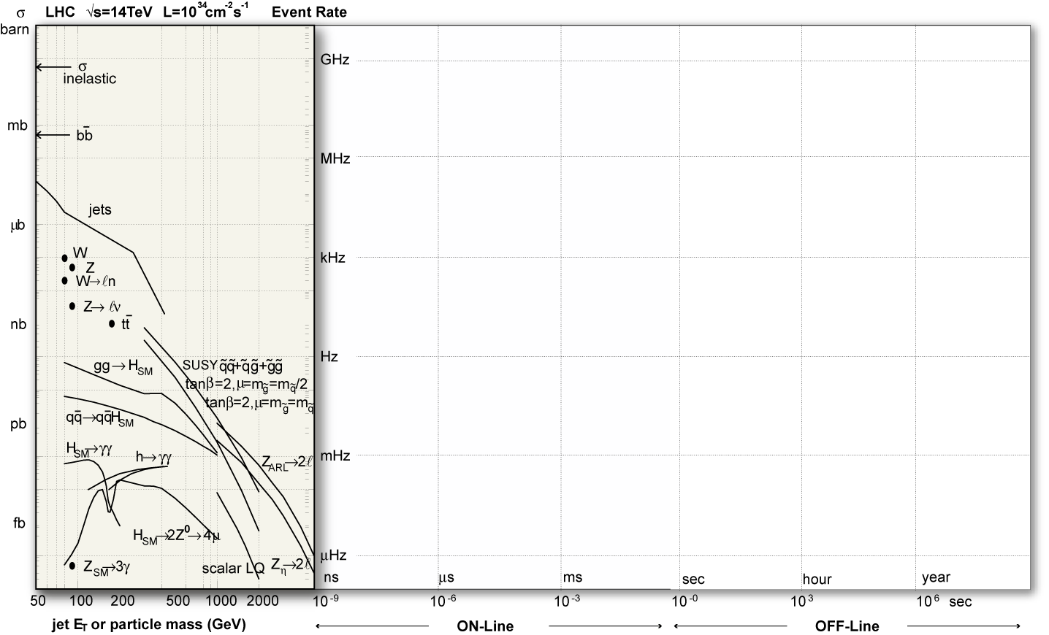
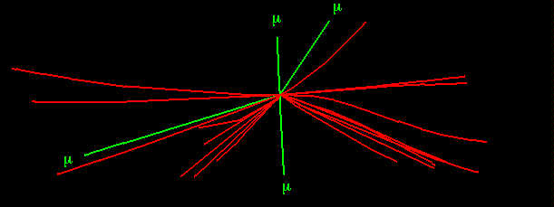
Collisions (p-p) at LHC
Operating conditions:
one “good” event (e.g Higgs in 4 muons )
+ ~40 minimum bias piledup events)
Event rate
All charged tracks with pt > 2 GeV
Reconstructed tracks with pt > 25 GeV
Event size: ~ 1 M bytes
Event Rate: ~ 30 M Hz

Slide 9
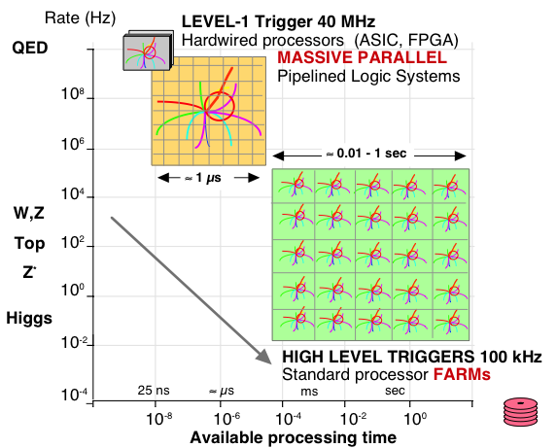
Processing LHC Data
QCD

Slide 10
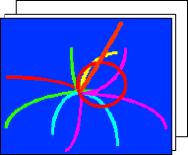
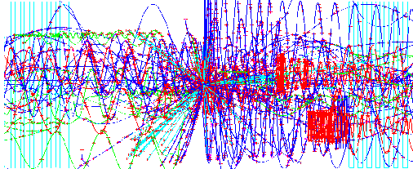
LHC Trigger & DAQ Challenges
Challenges:
1 GHz of Input Interactions
Beam-crossing every 25 ns with ~ 23 interactions produces over 1 MB of data
Archival Storage at about 300 Hz of 1 MB events
40 MHz
16 Million channels
COLLISION RATE
DETECTOR CHANNELS
3 Gigacell buffers
LEVEL-1
TRIGGER
Charge
Time
Pattern
Energy
Tracks
100 - 50 kHz
1 MB EVENT DATA
1 Terabit/s
200 GB buffers
READOUT
50,000 data
~ 400 Readout
memories
channels
EVENT BUILDER.
500 Gigabit/s
SWITCH NETWORK
A large switching network (400+400 ports) with total throughput ~ 400Gbit/s forms the interconnection between the sources (deep buffers) and the destinations (buffers before farm CPUs).
~ 400 CPU farms
EVENT FILTER.
300 Hz
A set of high performance commercial processors organized into many farms convenient for on-line and off-line applications.
FILTERED
5 TeraIPS
EVENT
Computing Services
Gigabit/s
Petabyte ARCHIVE
SERVICE LAN

Slide 11
Level 1 Trigger Data

Slide 12
L1 @ LHC: Only Calorimeter & Muon – No Tracker
High Occupancy in high granularity tracking detectors
New tracker and track trigger envisioned for HL-LHC
Complex Algorithms
Huge amounts of data
Simple Algorithms
Small amounts of data

Slide 13
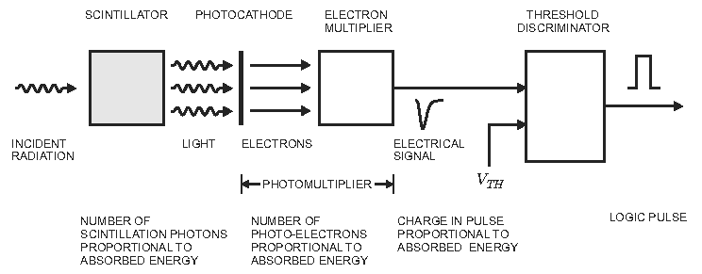
Example: Scintillator Signal
from H. Spieler “Analog and Digital Electronics for Detectors”
Photomultiplier serves as the amplifier
Measure if pulse height is over a threshold

Slide 14
Many Steps of Processing Before Readout!
Detector / Sensor
Amplifier
Filter
Shaper
clock
Sampling
Digital filter
Zero suppression
Range compression
L1 Trigger Logic
Buffer
Feature extraction
L2 Trigger Logic
Buffer
Format & Readout
to Data Acquisition System

Slide 15
Filtering & Shaping
Purpose is to adjust signal for the measurement desired
Broaden a sharp pulse to reduce input bandwidth & noise
Make it too broad and pulses from different times mix
Analyze a wide pulse to extract the impulse time and integral ⇒
Example: Signals from scintillator every 25 ns
Need to sum energy deposited over 150 ns
Need to put energy in correct 25 ns time bin
Apply digital filtering & peak finding
Will return to this example later

Slide 16
Sampling & Digitization
Signal can be stored in analog form or digitized at regular intervals (sampled)
Analog readout: store charge in analog buffers (e.g. capacitors) and transmit stored charge off detector for digitization
Digital readout with analog buffer: store charge in analog buffers, digitize buffer contents and transmit digital results off detector
Digital readout with digital buffer: digitize the sampled signal directly, store digitally and transmit digital results off detector
Zero suppression can be applied to not transmit data containing zeros
Creates additional overhead to track suppressed data
Signal can be discriminated against a threshold
Binary readout: all that is stored is whether pulse height was over threshold

Slide 17
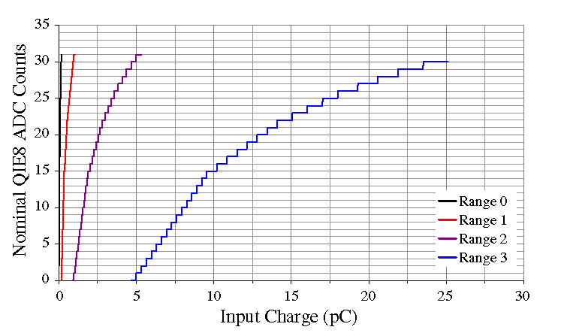
Range Compression
Rather than have a linear conversion from energy to bits, vary the number of bits per energy to match your detector resolution and use bits in the most economical manner.
Have different ranges with different nos. of bits per pulse height
Use nonlinear functions to match resolution

Slide 18
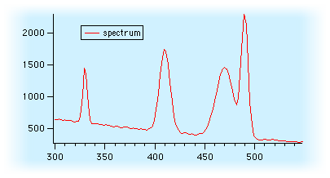
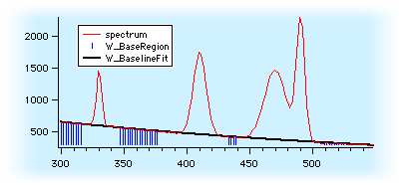
Baseline Subtraction
Wish to measure the integral of an individual pulse on top of another signal
Fit slope in regions away from pulses
Subtract integral under fitted slope from pulse height

Slide 19
EM Calorimeter Trigger/DAQ Processing
OD
TTC
TCS
Trigger Tower
25 Xtals (TT)
L1
Level 1 Trigger (L1A)
CCS
(CERN)
@100 kHz
Calo TRIGGER
Layer-1,2, DMUX
SLB (LIP)
TCC
(LLR)
Global TRIGGER
Trigger Tower Flags (TTF)
Trigger primitives @800 Mbits/s
Trigger Concentrator Card
Synchronisation & Link Board
Clock & Control System
Selective Readout Processor
Data Concentrator Card
Timing, Trigger & Control
Trigger Control System
SRP
(CEA
DAPNIA)
Selective Readout Flags (SRF)
Data path
@100KHz (Xtal Datas)
DCC
(LIP)
DAQ
From : R. Alemany LIP

Slide 20
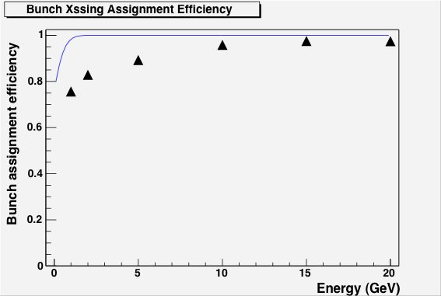
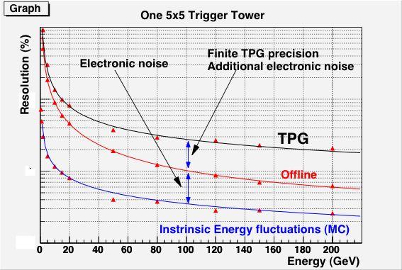
ECAL Trigger Primitives
Test beam results (45 MeV per xtal):

Slide 21
Level 1 Trigger Organization

Slide 22
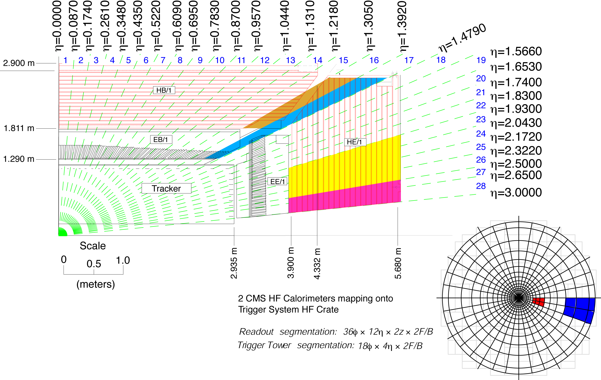
CMS Calorimeter Geometry
Channel Count Full granularity: ~81000
Trigger level: ~5000
EB, EE, HB, HE map to 18 RCT crates
Provide e/γ and jet, τ, E_{T} triggers

Slide 23
Xilinx Field Programmable Gate Arrays

Slide 24
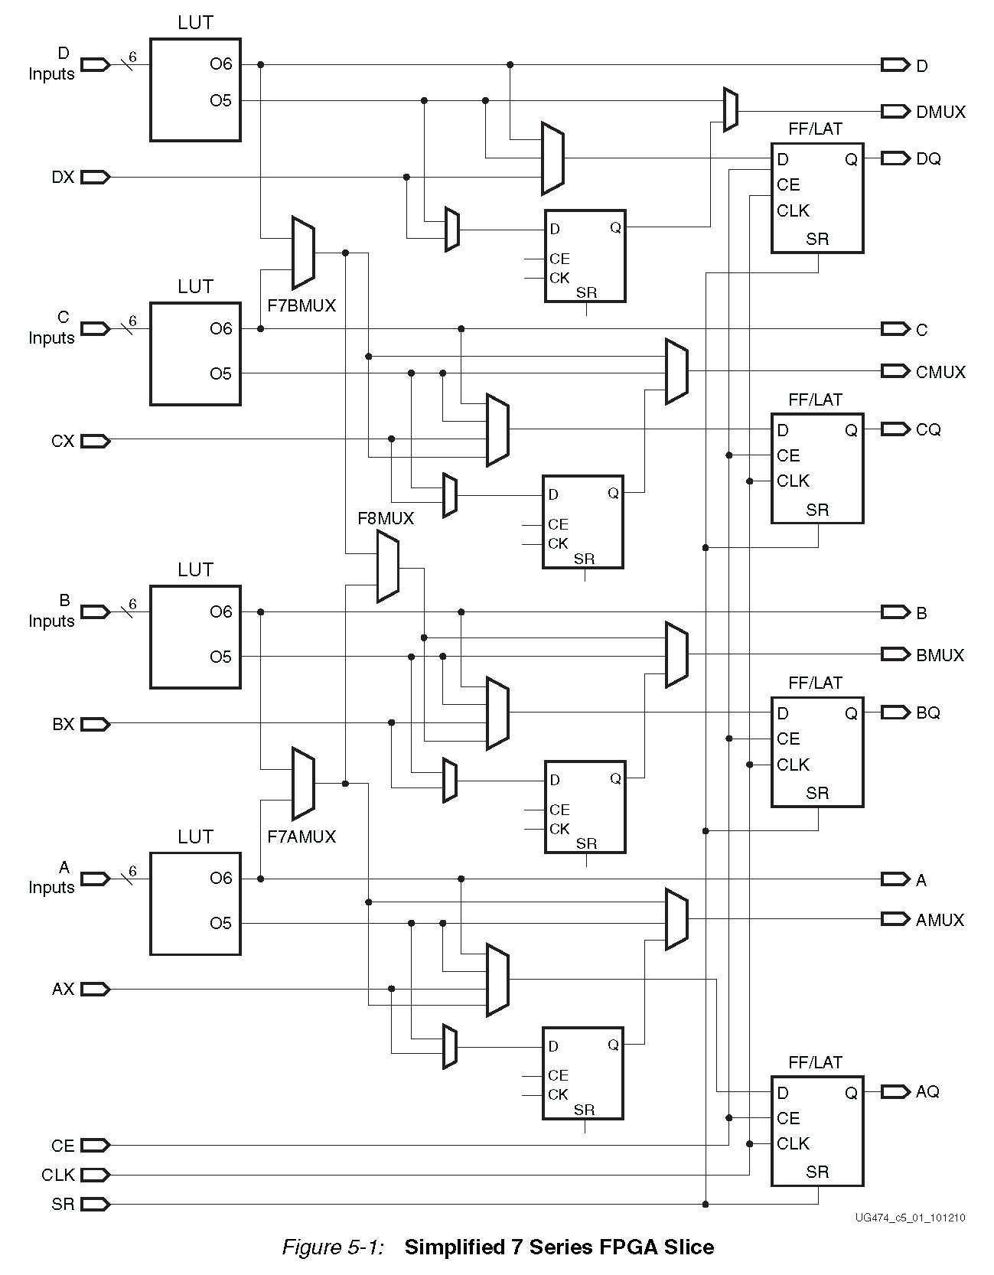
FPGA Slice
Array of well defined logic cells, driven by LUTs
Software configured connections
Cleverly organized
Preconfigured digital logic elements

Slide 25
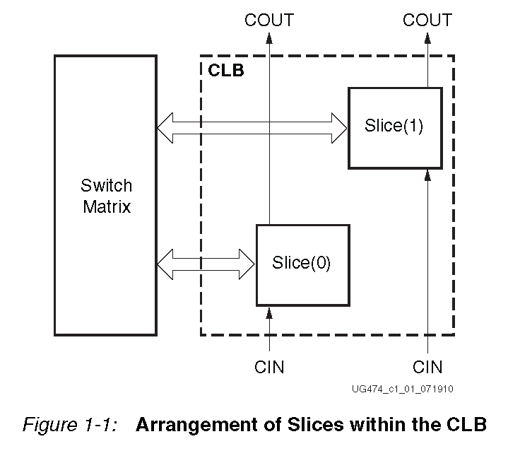
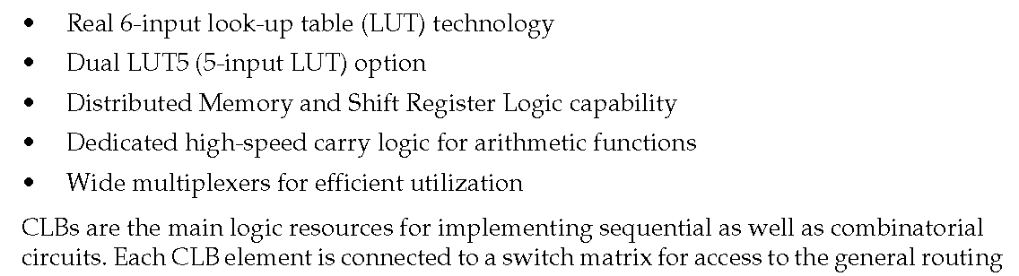
Configurable Logic Block
Firmware developer uses programming languages to define “connections”
Firmware tools create the “bit file” which defines the switch matrix / LUTs

Slide 26
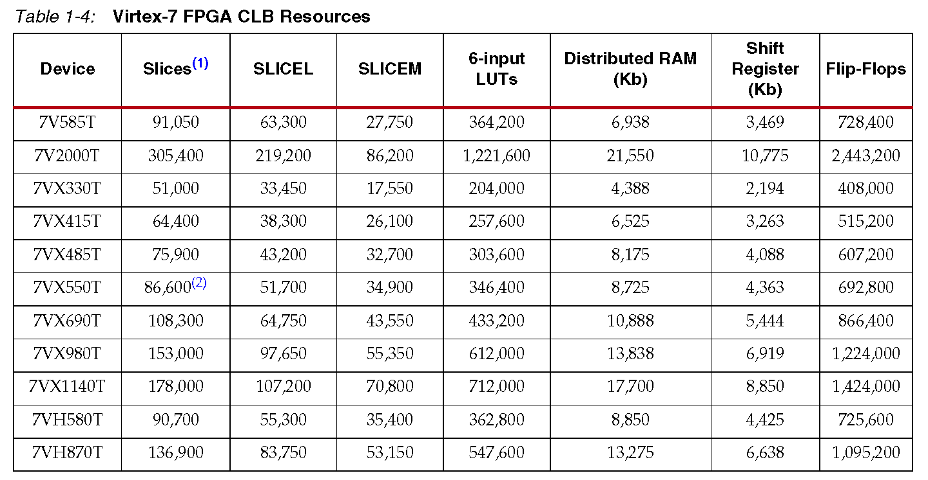
Abundant Logic Resources in Virtex-7 Family

Slide 27
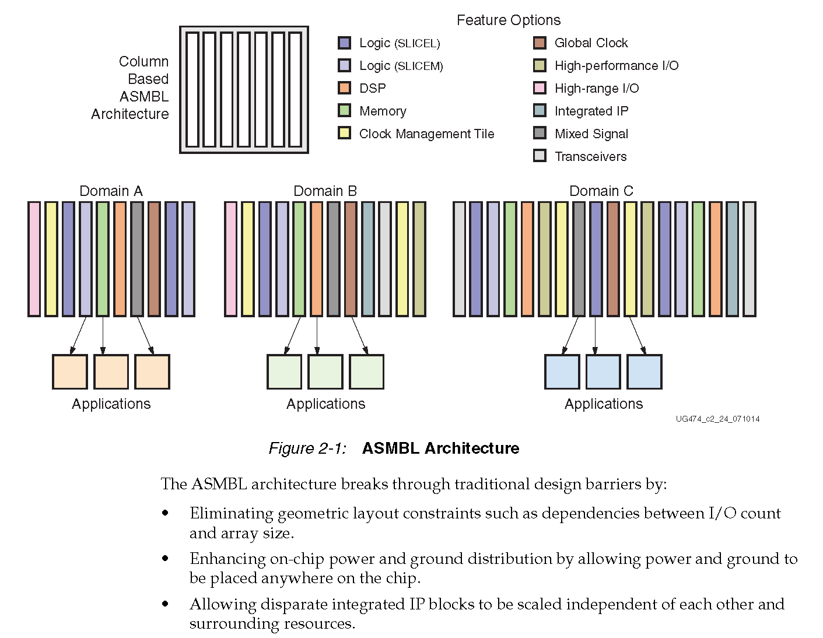
Scaling: Modular Blocks of Various Resources

Slide 28
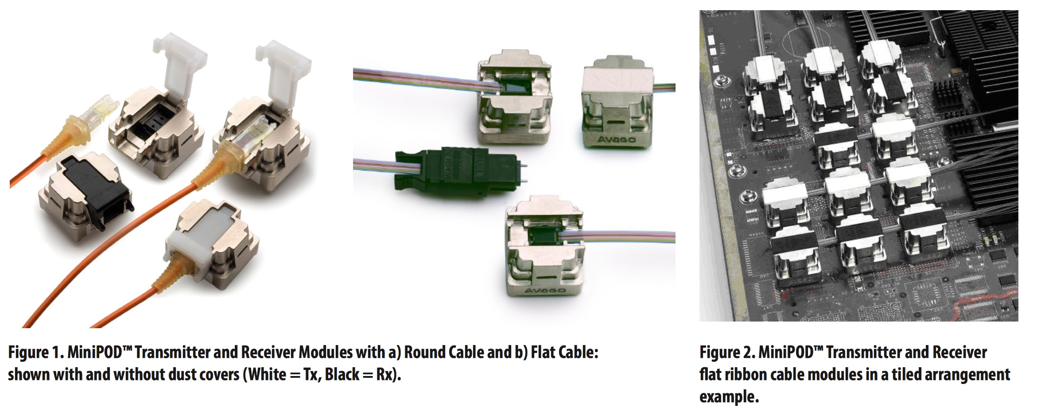
Key element - Multi-gigabit Opto-electronics

Slide 29
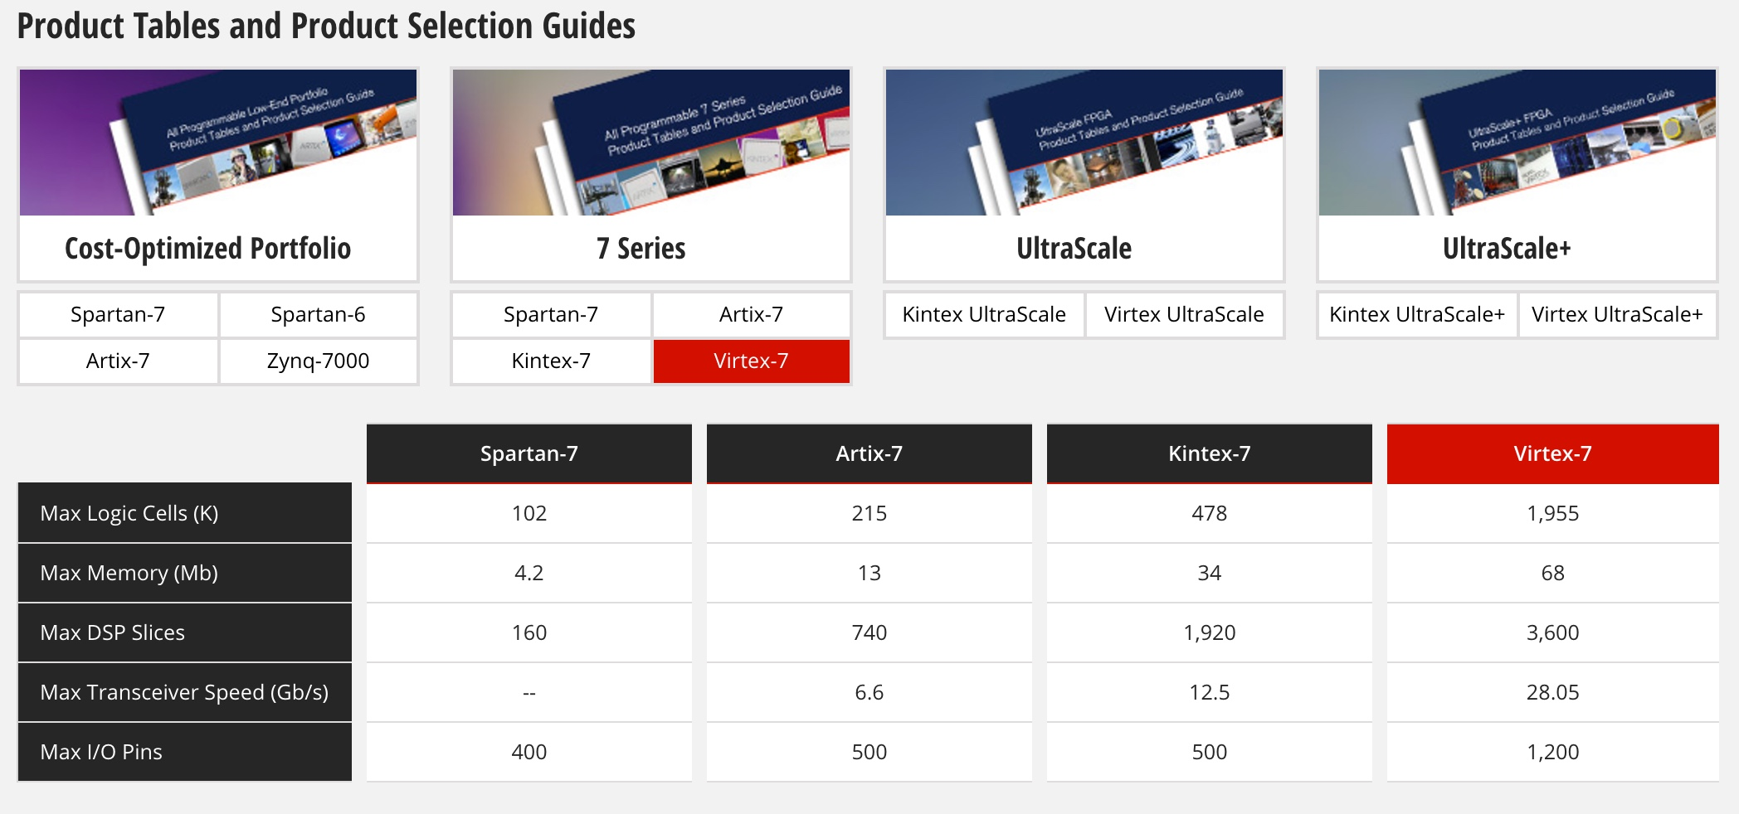
Xilinx FPGAs – Phase-1 Choice: V7 690T
Phase-1 Choice
Phase-2 Target

Slide 30
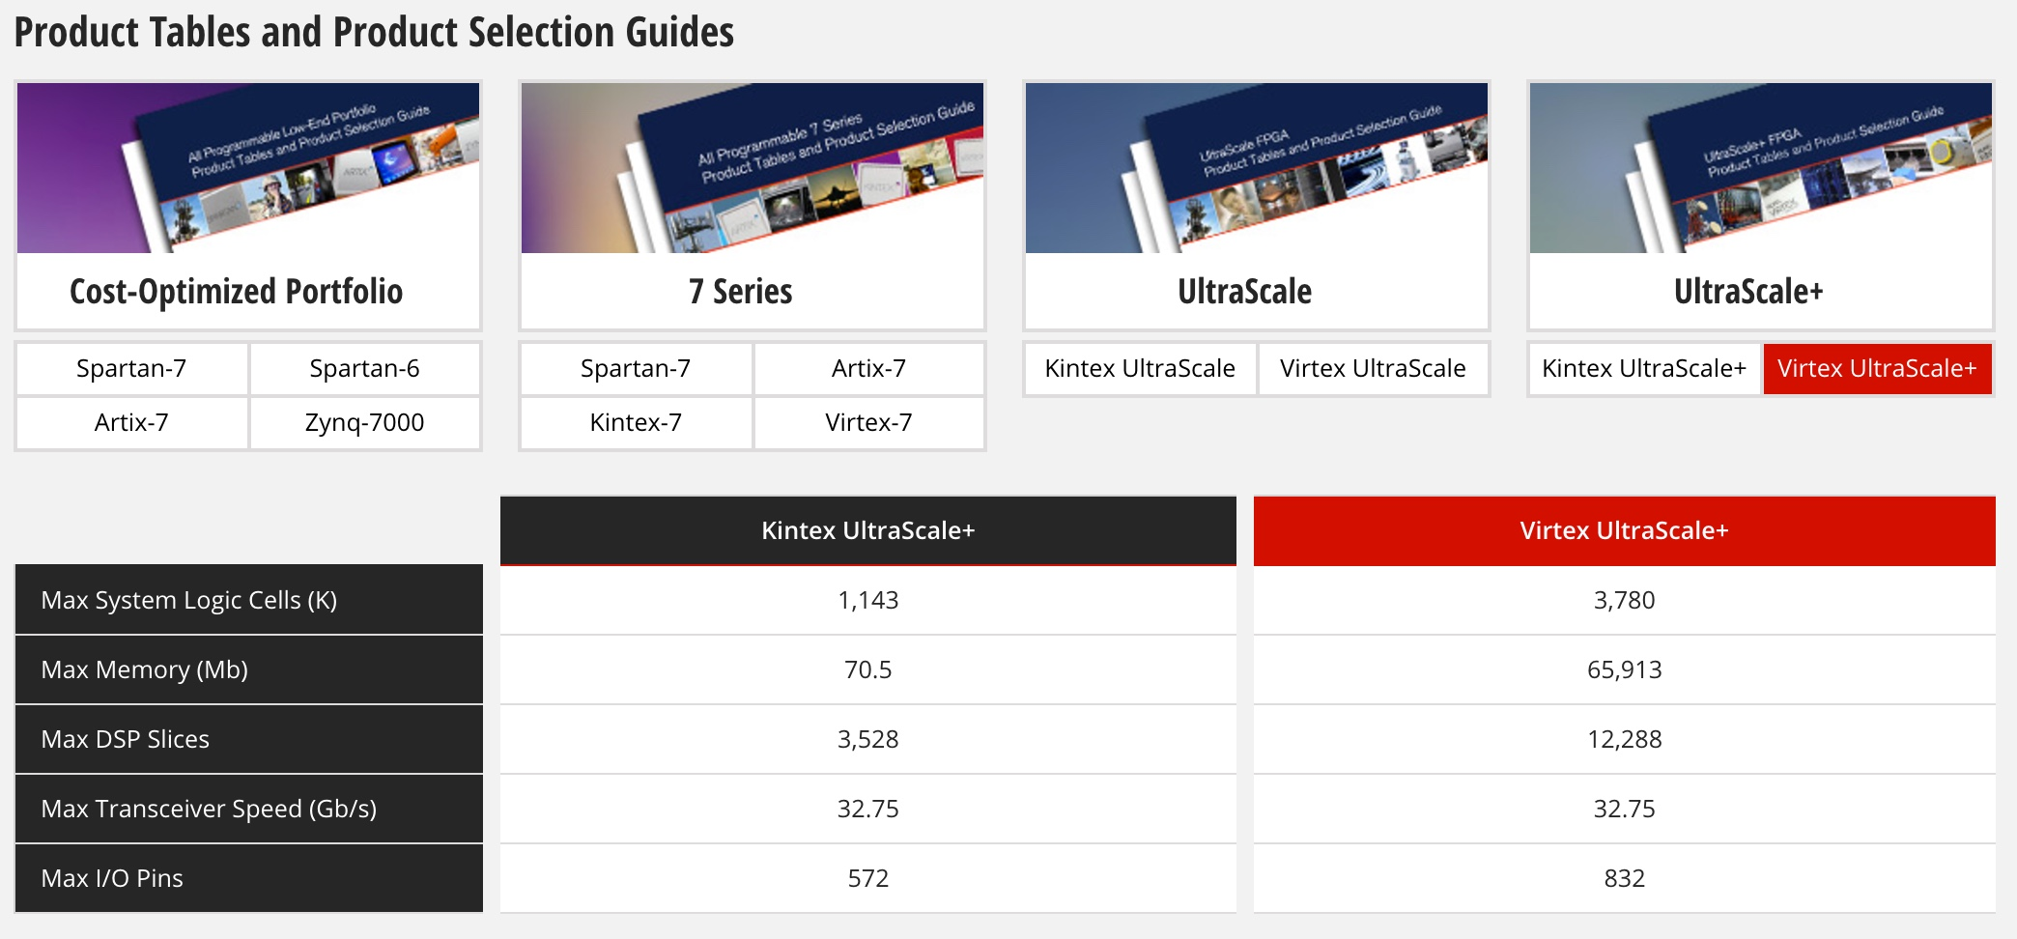
Xilinx – Ultrascale+ for Phase-2

Slide 31
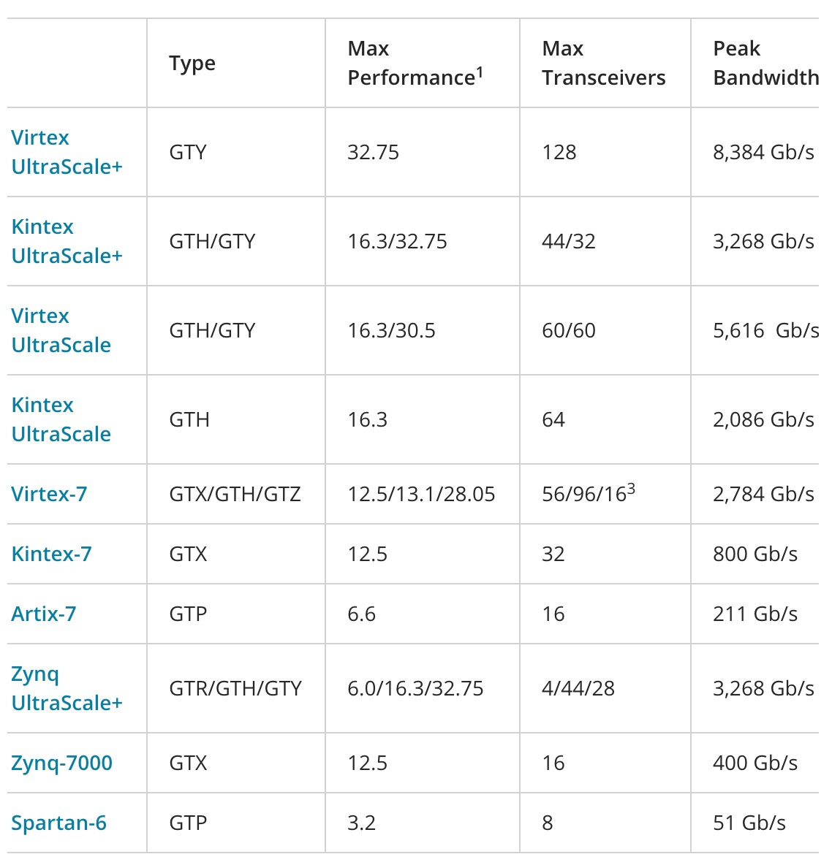
Multi-gigabit-per-second serial links
Phase-2
16 Gbps
Phase-1
10 Gbps

Slide 32
Channels – Channels - Channels
Calorimeter Trigger Input from ECAL and HCAL (Phase-1)
Geometry | η-divisions | φ-divisions | Bits/E,H-tower ET, feature | Bandwidth (Gbps) | Fiber Count 4.8 – 6.4 Gbps
Barrel +/- | 17+17 | 72 | 8+1+8+6 | 2252 | 324 + 306
Endcap +/- | 11+11 | 72 | 8+1+8+6 | 1457 | 198 + 198
Total | 56 | 72 | 23 | 3609 | 1026
18 cards, 1 FPGA/card, ~56 4.8-6.4-Gbps inputs per card
Barrel Calorimeter Trigger Input from ECAL and HCAL (Phase-2)
Geometry | η-divisions | φ-divisions | Bits/E-crystal Bits/H-tower | Bandwidth (Gbps) | Fiber Count 16 Gbps
ECAL Crystals | 17x5 | 72x5 | 10 | 208080 | 3060
HCAL Towers | 16 | 72 | 8+6 | 645 | 144
Total | - | - | - | 208745 | 3204
36 cards, 1 FPGA/card, 89 16-Gbps inputs per card

Slide 33
Technologies of Choice → LHC Schedules
FPGA & Telecom technology advances (VME → μTCA)
Ubiquitous >10 Gbps links
FPGAs with O(100) rx/tx links with built in serdes
Xilinx Kintex / Virtex-7 → Ultrascale platforms
Gigantic cores
DSP units, BRAM and Embedded processors (ZYNQ)
Fiber optic components
Avago mini-pods with 12x → 25 Gbps capable units
LHC long shutdown 1: 2013-2014 (Phase-1 Upgrades)
Virtex-7 family cards
CTP7 (Wisconsin), MP7 (Imperial), MTF7 (Florida)
10 Gbps optics
LHC long shutdown 3: 2023-2025 (Phase-2 Upgrades)
Ultrascale family card(s): APDs Wisconsin
14-16 Gbps optics

Slide 34
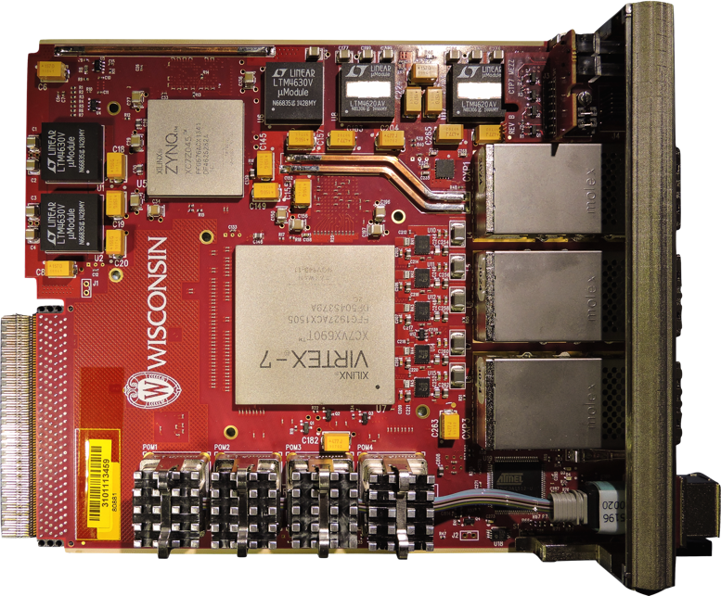
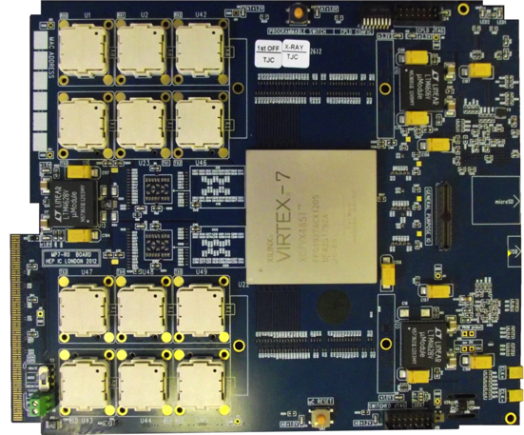
Phase-1 Calorimeter Trigger Electronics
JTAG
USB
Interface
Power Supplies
Rx
Tx
ZYNQ
2V5
3V3
μSD
3 CXP modules
1V5
1V8
2xQDR
(Bottom)
FPGA
FPGA
USB
Rx
Tx
μC
(Bottom)
MiniPODs
MMC
MiniPod modules
1V0
Calorimeter Trigger Processor(CTP7 – left), and Master Processor (MP7 - right)
CTP7 (Layer-1) – μTCA Single Virtex 7 FPGA, 67 optical inputs, 48 outputs, 12 RX/TX backplane
Virtex 7 allows 10 Gb/s link speed on 3 CXP(36 TX & 36 RX) and 4 MiniPODs (31 RX & 12 TX)
ZYNQ processor running Xilinx PetaLinux for service tasks, including virtual JTAG cable
MP7 (Layer-2) – μTCA Single Virtex 7 FPGA, up to 72 input & output links
Virtex 7 has 72 input and output links at 10 Gb/s
Dual 72 or 144MB QDR RAM clocked at 500 MHz
Notes:
oRSC – optical Receiver Summary Card
CTP7 – Calorimter Trigger Processor
MP7 ?

Slide 35
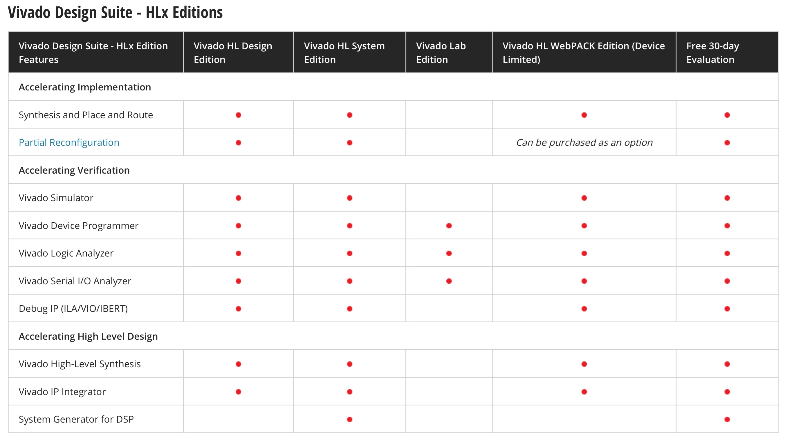
Xilinx Software – Vivado → Firmware

Slide 36
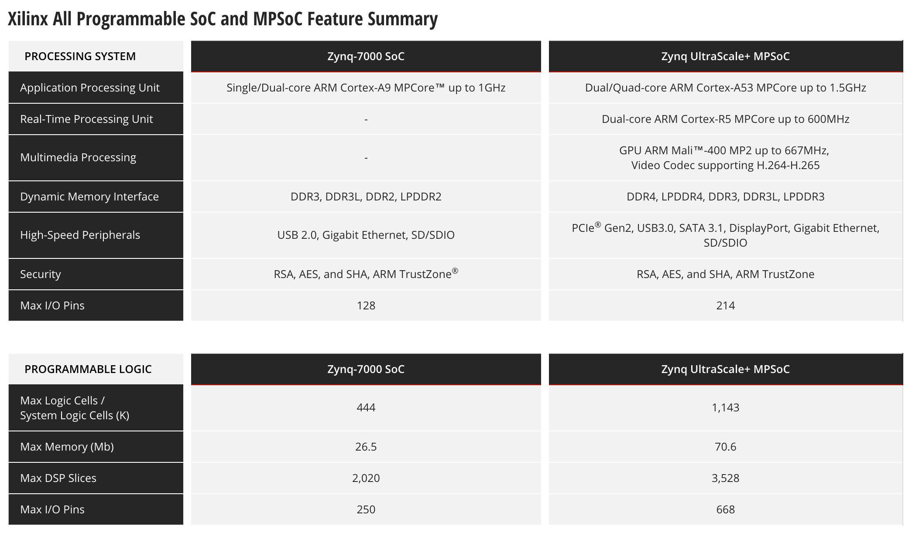
Xilinx ZYNQ – System on a Chip → Controls

Slide 37
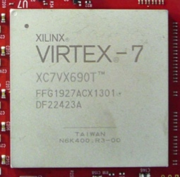
2016 CMS Trigger
CMS was built for a maximum sustainable trigger rate of 100 kHz
To increase this requires major detector upgrades (e.g. tracker)
CMS wanted to keep its sensitivity to EWK physics, TeV scale searches, Heavy-Ion phenomena
Solution: increase level-1 trigger granularity, processing capacity, flexibility
CMS upgraded the trigger (including the muon trigger system)
Kept thresholds low, efficiencies high, and controlled the rates
Commissioned in parallel to existing trigger
Took advantage of new technology
Used modern FPGAs with high-speed links
Fast links and increased data throughput
Improved the algorithms
Used modern μTCA format
Compact (fits in spare rack space), hot swappable, redundant power supplies, high-speed backplane, control via LAN, and more…

Slide 38
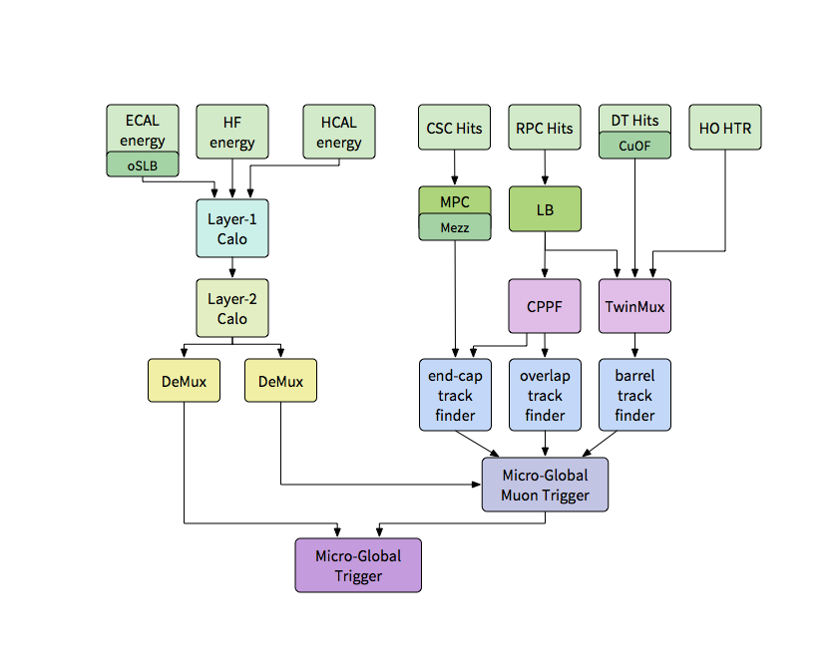
Level-1 Trigger Block Diagram (2016)

Slide 39
Phase-1 Cal Trigger Stage-1 Upgrade in 2015
Layer-1
RCT 0
RCT 1
RCT 2
…
RCT 17
Existing RCT
18 crates
oRSC 0
oRSC 1
oRSC 2
…
oRSC 17
18 oRSCs (w/Kintex)
USCMS
Layer-2
MP7 (new)
Algorithm Card(s) (1-3)
Imperial HW + Core FW/SW
USCMS Algorithm FW/SW
CTP7
Single Readout Card
In Situ RCT Test / Monitor
USCMS HW/FW/SW
Global Trigger (existing)
GT Inputs remain unchanged
DAQ – AMC 13 (new)

Slide 40
Phase-1 Cal Trigger Stage-2 Upgrade in 2016
Layer-1
CTP–0
CTP–1
CTP–2
…
CTP–17
18 CTP7s
USCMS
DAQ – AMC 13
Layer-2
MP7 Algorithm Cards (9+1)
Imperial HW + FW/SW
USCMS Algorithm FW/SW
Full flexibility for traditional or time-multiplexed architecture
TMT – in use now.
Highest precision location of objects with dynamic clustering
μTCA Global Trigger
DAQ – AMC13

Slide 41
VME Hardware (2015) for Calorimeter Trigger

Slide 42
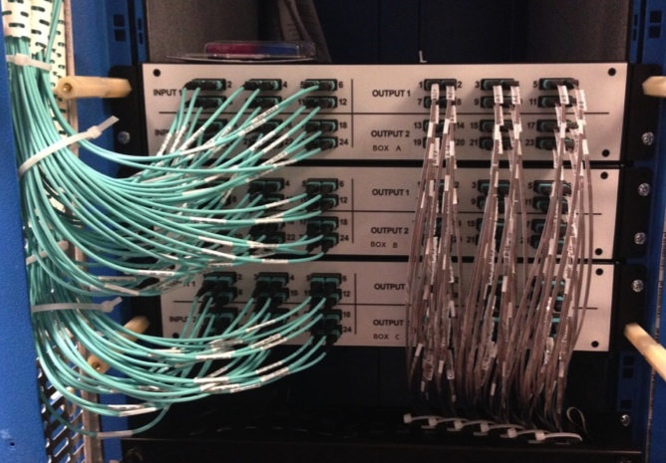
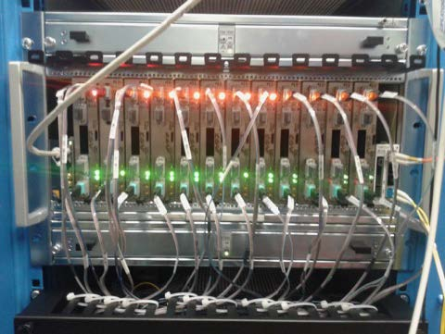
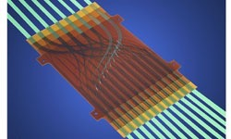
CMS Calorimeter Trigger 2016
Installed and commissioned in 2015, fully operational in 2016
Connections to CTP7 from Layer-1 patch panels completed in 2015
Connections from Layer-1 to Layer-2 via compact patch panel
3 “pizza box” sized patch panels instead of full 56U rack with LC connectors
Layer 2 to demux to new μGT connected
Layer-1 CTP7
Layer-2 MP7
Layer-1 to Layer-2 Patch Panel
MOLEX
FlexPlane

Slide 43
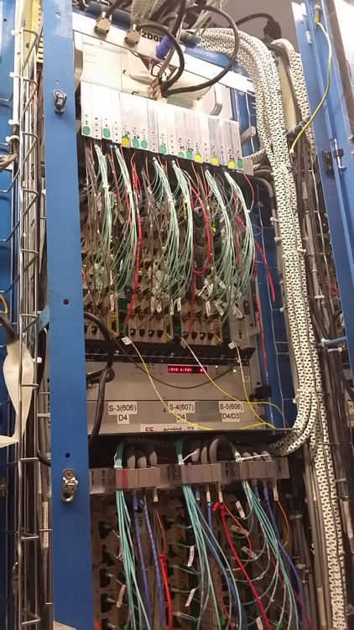
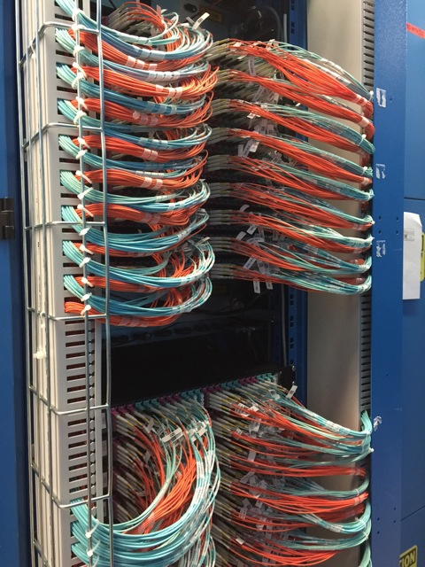
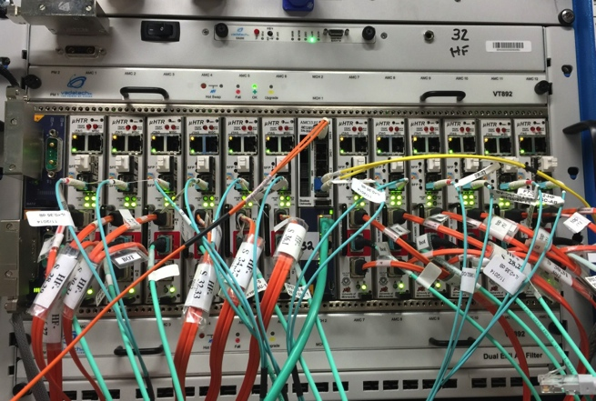
CMS Calorimeter Trigger 2016
Installed and commissioned in 2015, fully operational in 2016
ECAL Back End (BE) has been converted to optical (from Cu) with Mezzanines
2 x 4.8 Gbps links each, one for 2015 operation, one to Layer-1 Patch Panels
HF and HCAL BE has been replaced with optical back end (μHTR)
6.4 Gbps links, up to 6 per μHTR
All optical connections to Layer-1 complete
1152 fibers to 18 patch panels for conversion to MPO fiber ribbons
ECAL
New HCAL and HF BE
BE to Layer1
Patch Panels

Slide 44
Calorimeter Trigger Algorithms
Overall
Use full calorimeter tower granularity
Previously 14η x18φ now 56η x 72φ
Better energy & position resolution
Cluster dynamically
Mitigate pileup
e/γ
Cluster shape and electromagnetic energy fraction discriminates e/γ from jets
Energy weighted position to potentially use for invariant mass triggers
Tau
Clustering and position similar to e/γ, optimized for tau
Merge neighboring clusters to recover multi-prong tau decays
Jet
Sliding window, search for seed (central tower) energy above threshold
Remove duplicates, sum 9 by 9 trigger towers for ~R=0.4 as used offline
2010 to 2015
2016 onwards

Slide 45
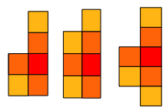
e/γ Algorithm
Dynamic Clustering
Improved energy containment Showing electrons, photon conversions Minimize effect of pile-up Improved energy resolution
Cluster Shape Veto
Discriminate using cluster shape and electromagnetic energy fraction between e/γ and jets
Calibration
e/γ cluster energy calibrated as a function of ET, η and cluster shape
Energy Weighted Position
Potential use in correlating objects e.g. invariant mass
Cluster Building
Cluster Shapes
Jet like
e/γ like

Slide 46
Tau Algorthm
Clustering, shape, and position
Very similar to e/γ — optimised for τ
Merging
Merge neighbouring clusters (~15% of clusters) Recover multi-prong τ decays
Calibration
τ cluster energy calibrated as function of ET, η, merging and EM fraction
Isolation
Very similar to e/γ — optimised for tau including merging as input – two working points

Slide 47
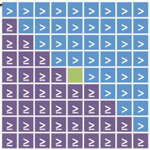
Jet Algorithm
Input Granularity
Access to higher granularity inputs than Run I
Sliding window jet algorithm
Search for seed energy above threshold Apply veto mask to remove duplicates Sum 9x9 trigger towers to approximate R=0.4 used offline
Pile-Up Subtraction
Consider four areas around jet window Subtract sum of energy in lowest three from jet energy
Calibration
Correct jet energies as a function of jet ET and η
Pile-up Subtraction Areas
Seed Tower
Veto Mask

Slide 48
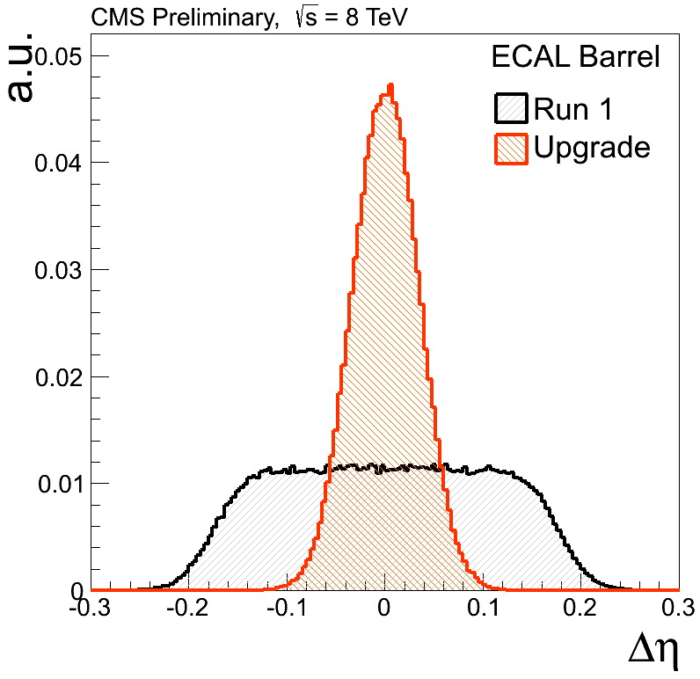
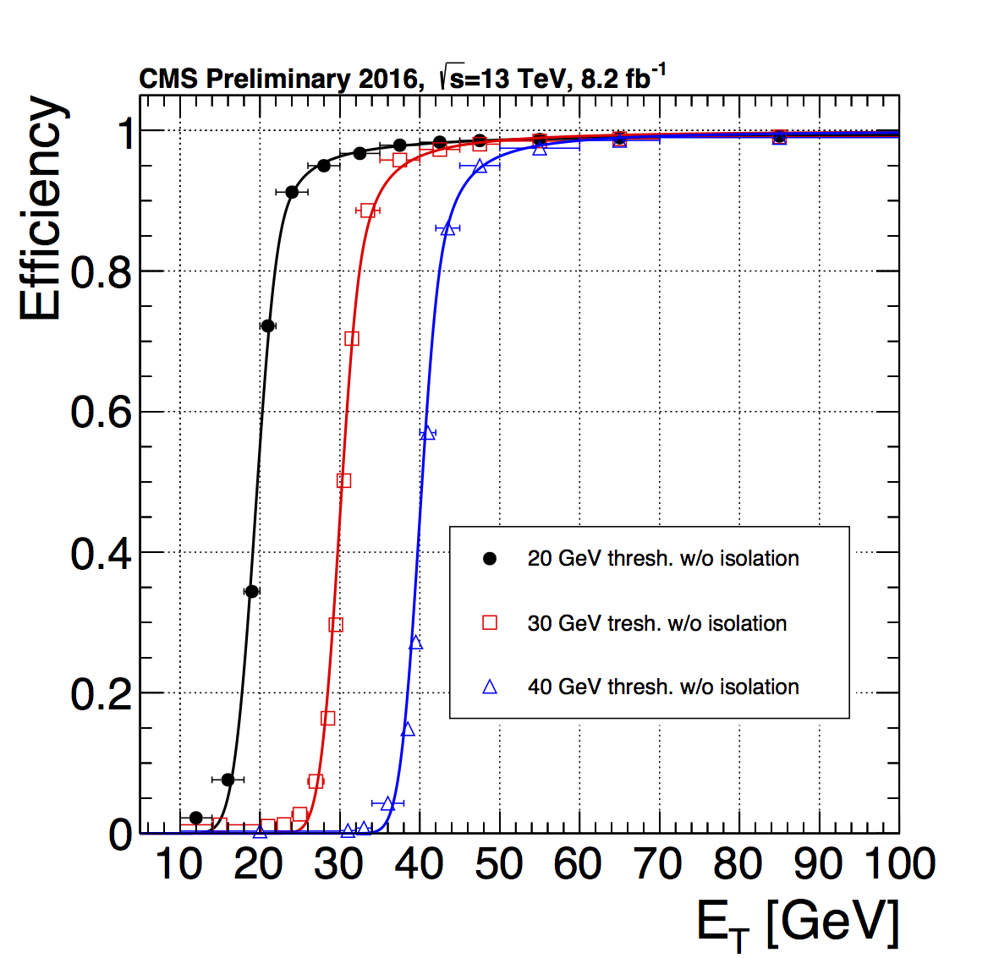
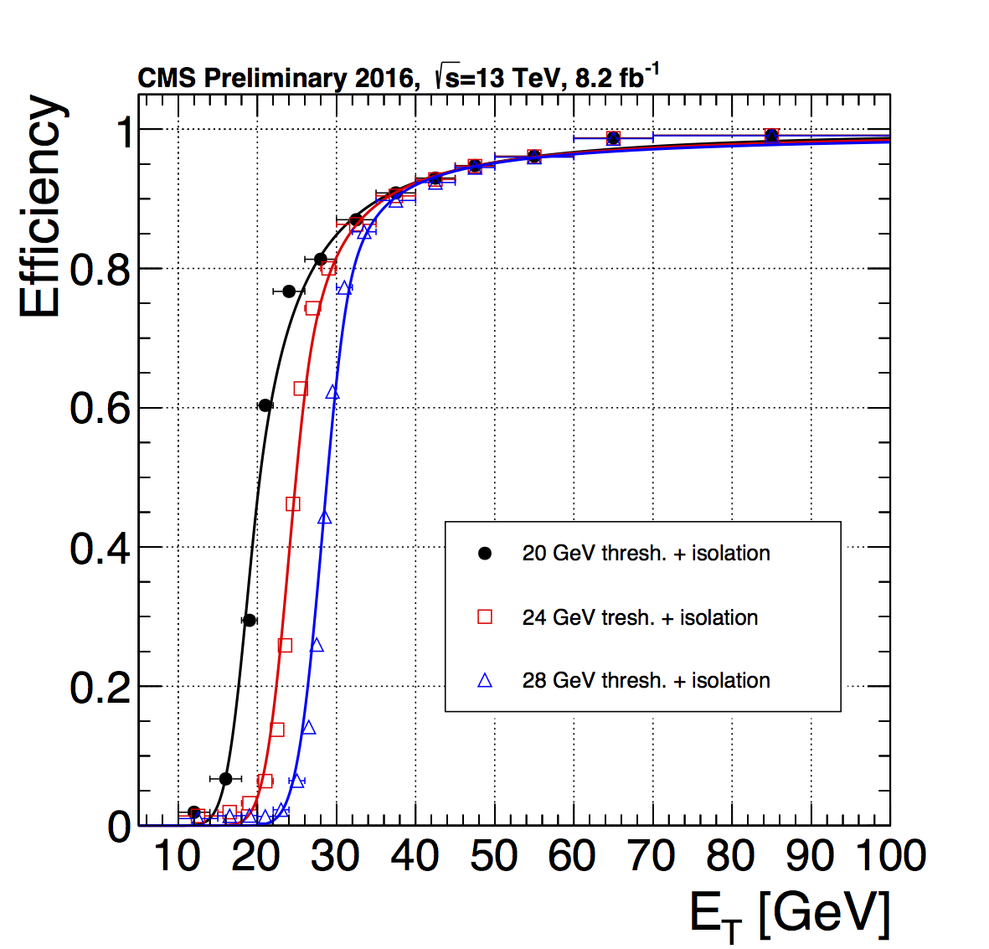
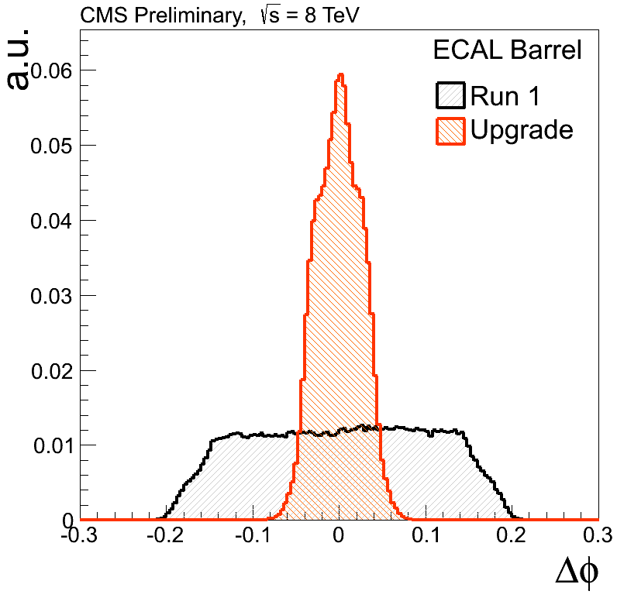
e/γ Performance
Efficiency for single e/γ with E_{T} > L1 threshold vs offline E_{T}
Tag and probe method with Z→ee dataset
As LHC conditions change, isolation adapted
Isolated e/γ reduces rate with modest reduction in efficiency
Combined with higher-threshold non-iso triggers
Non-Isolated e/γ
Isolated e/γ
Better Position Resolution

Slide 49
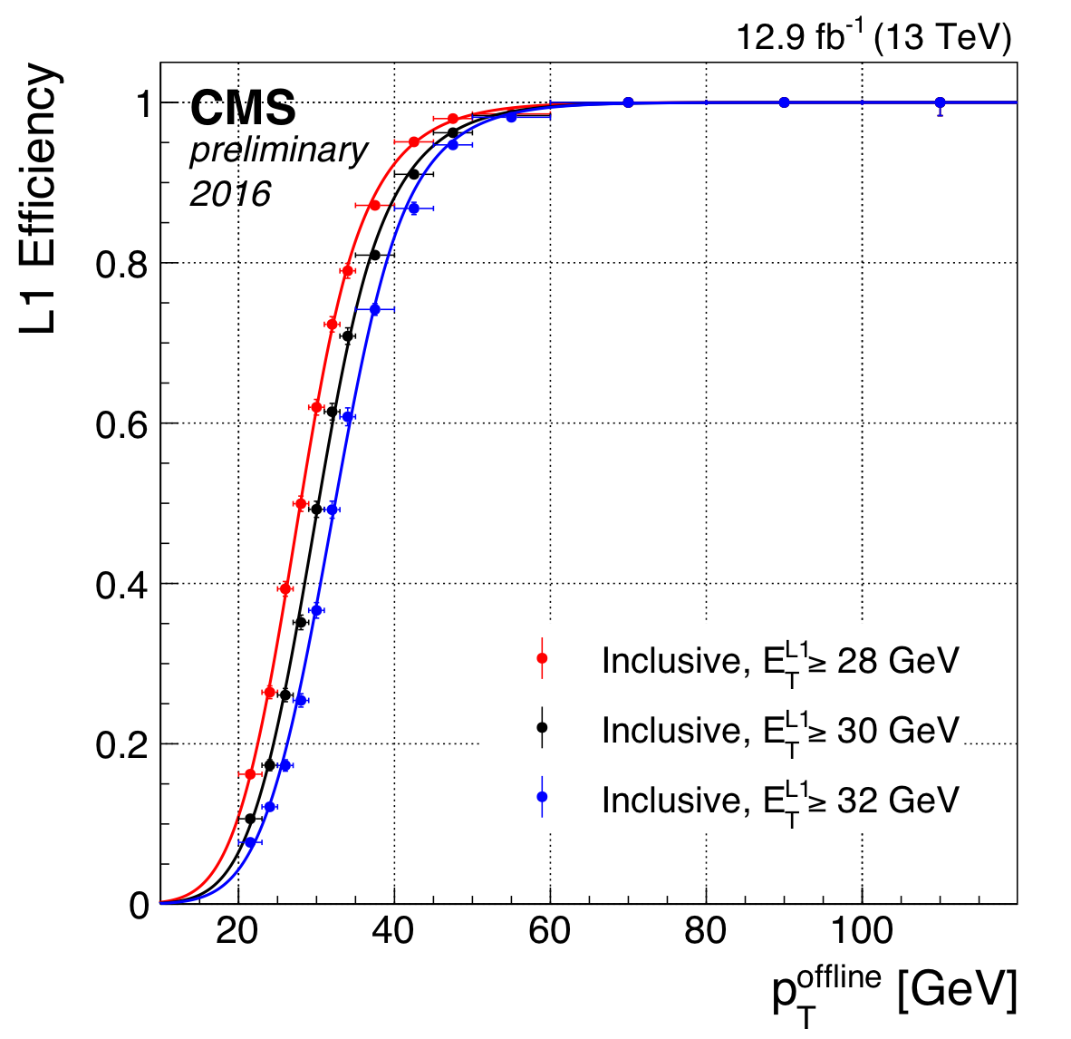
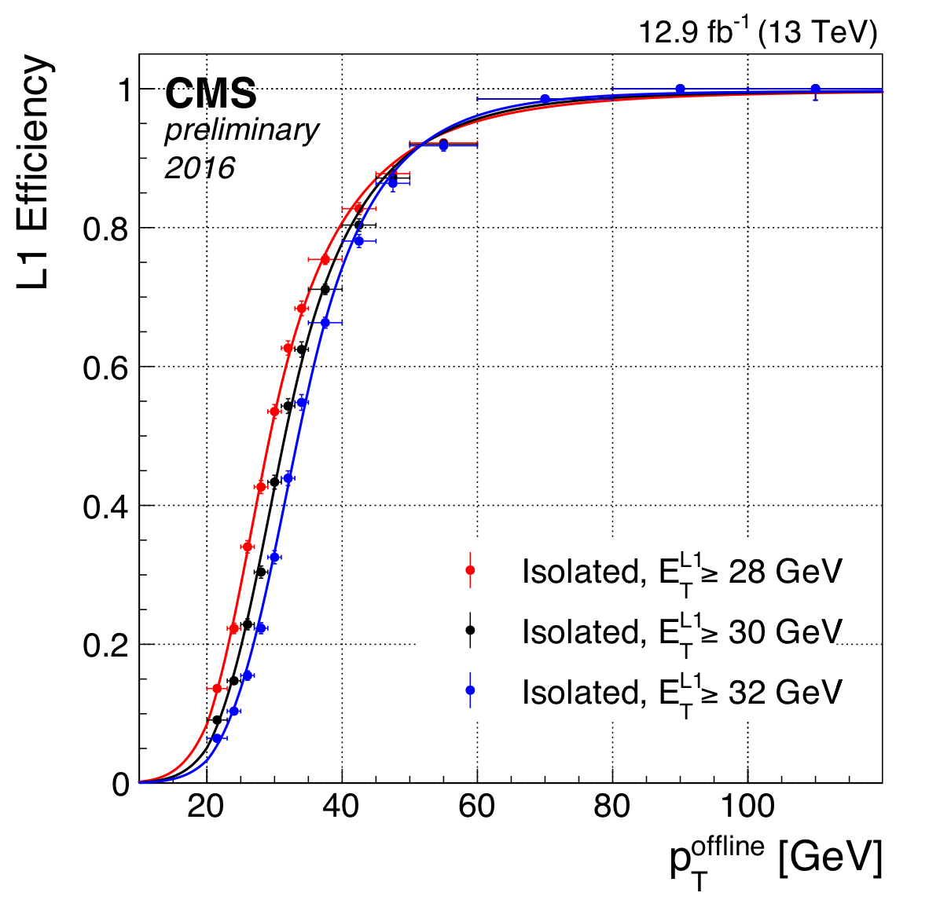
Tau Performance
Efficiency for a single tau for E_{T}> L1 threshold vs offline tau p_{T}
Tag and probe for Z→μτ
Adapt isolation as LHC conditions change
Isolated reduces rate with modest impact on efficiency
Can be combined with higher-threshold relaxed tau trigger
Relaxed tau
Isolated tau

Slide 50
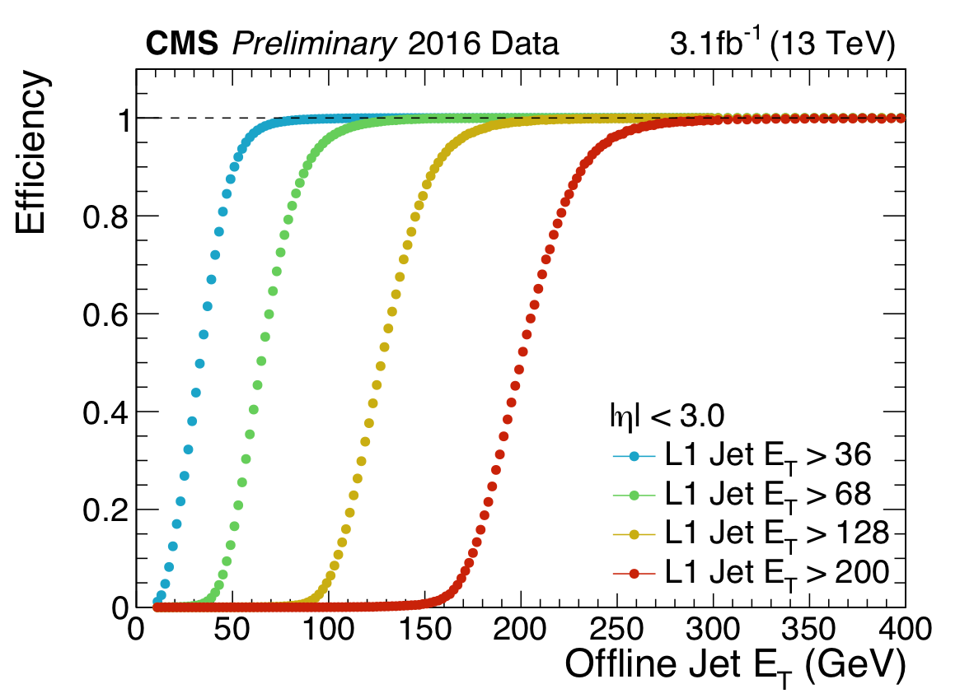
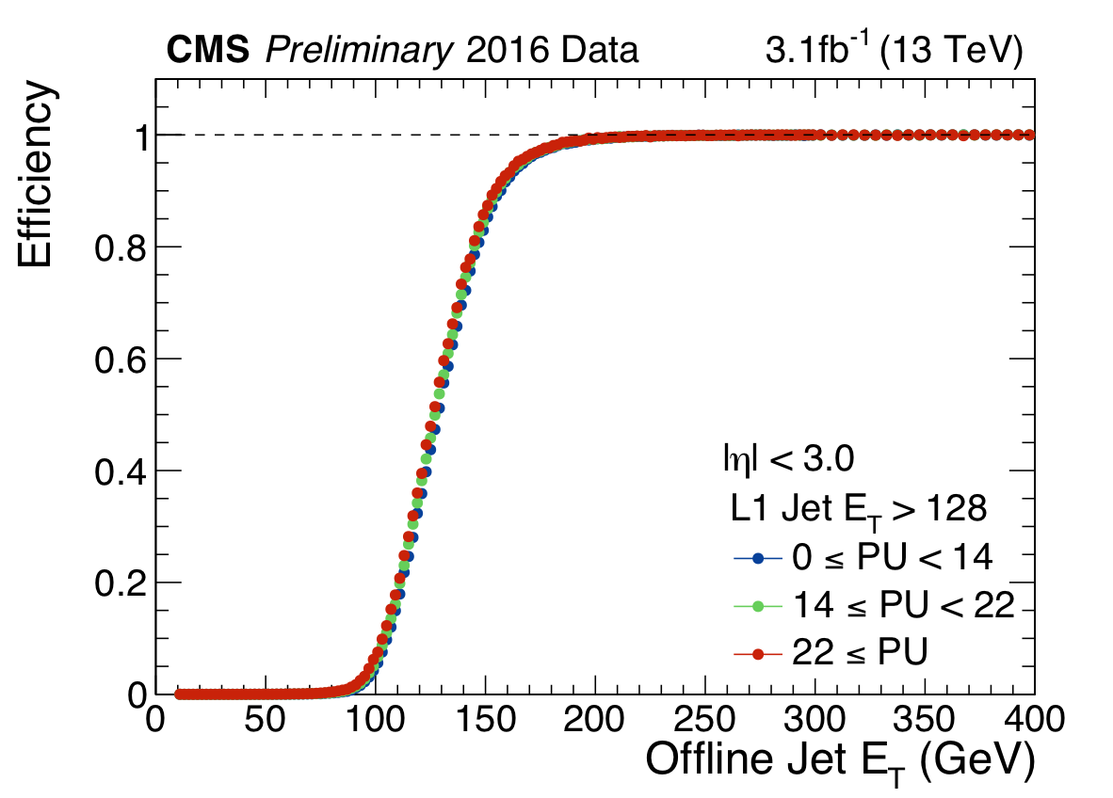
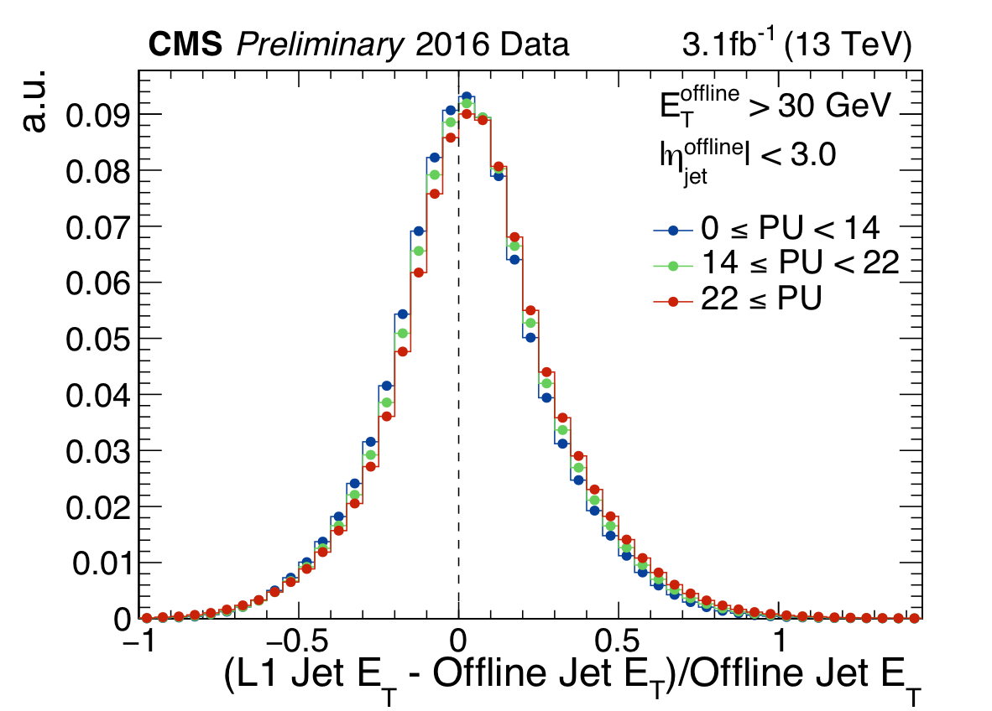
Jet Performance
Level-1 jets are matched to offline jets (ΔR < 0.25)
Single muon data sample (unbiased)
Sharp turn on for different L1 Jet E_{T} (upper left)
No pile up dependence (upper right)
Good resolution (right)

