Slide 1
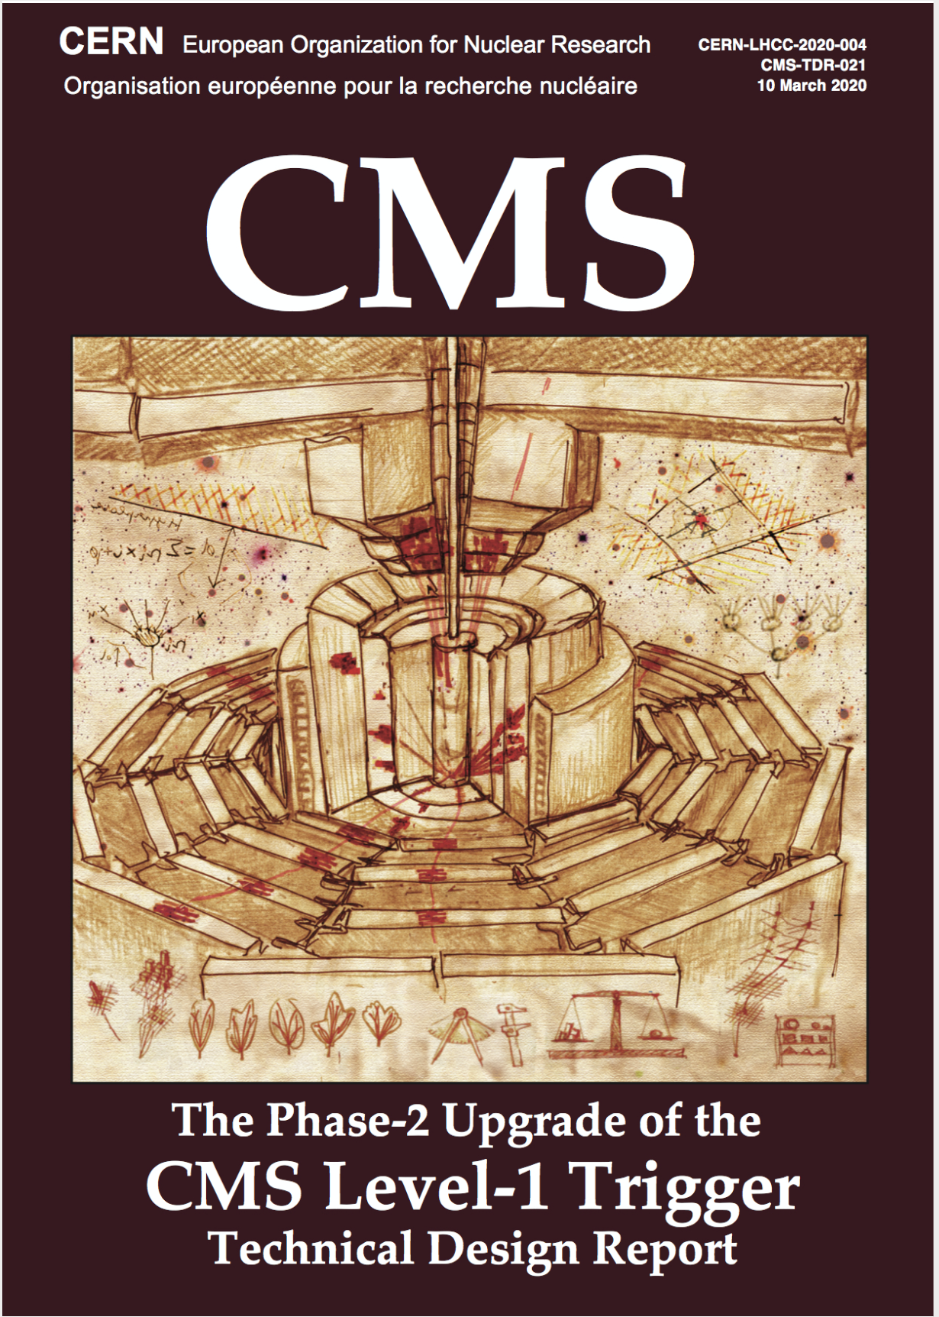
Triggering CMS Physics in the HL-LHC environment
12 August 2020

Slide 2
LHC Overview
with every bunch crossing
~25 Minimum Bias events
with ~2000 particles produced
Notes:
10 Trillion

Slide 3
HL-LHC Overview
2x
7.5x
with every bunch crossing
~200 Minimum Bias events
with ~10000 particles produced
Notes:
10 Trillion

Slide 4
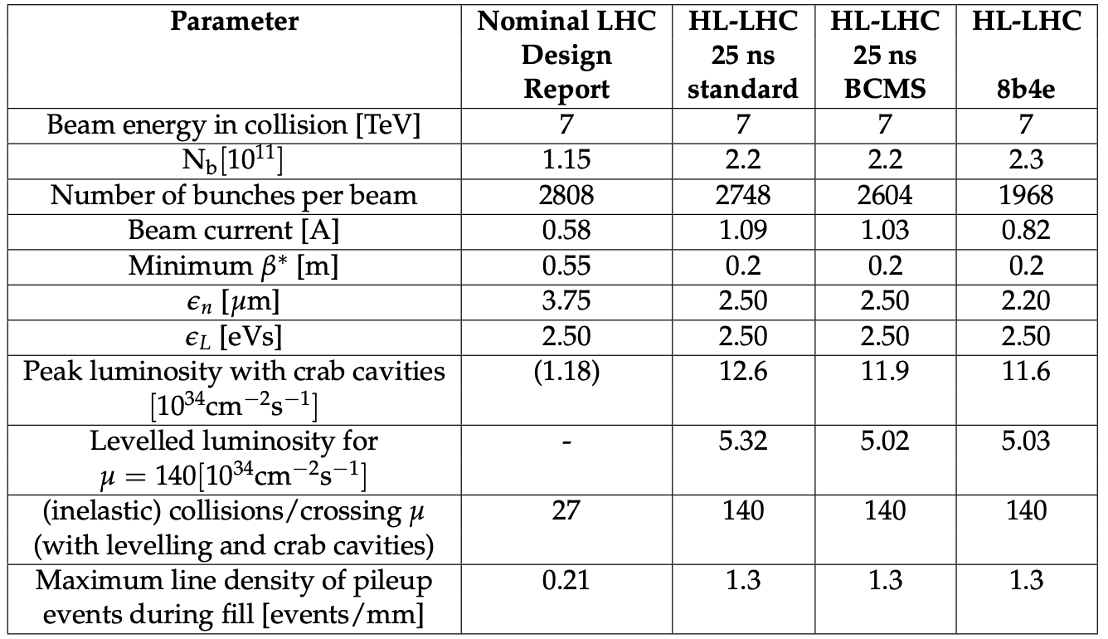
HLLHC Parameters
Operating at 2x now
Expect Operating at 7.5x ultimately

Slide 5
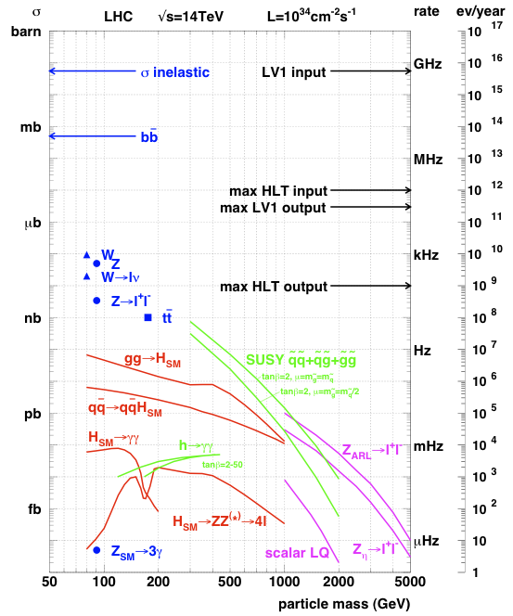
HLLHC Physics & Event Rates
At L = 7.5 x 10³⁴ cm⁻² s⁻¹
200 events per beam crossing (BX)
~ 7.5 GHz pp collision rate
“Interesting” events contain ~ 200 pileup events
EWK rate: 7.5 kHz W & Z
Top rate: 75 Hz
Higgs: 1 Hz, H_{4l}: 10^{–4} Hz
Select in stages
Level-1 Triggers
7.5 GHz (32 MHz BX ) to 750 kHz
High Level Triggers
750 kHz to ~10 kHz
Event store: ~10 kHz events
Scale shifts up by 7.5x

Slide 6
(HL) LHC Physics – Trigger Challenge
Electroweak Symmetry Breaking Scale
Higgs (125 GeV) studies and higgs sector characterization
Quark, lepton Yukawa couplings to higgs
New physics at TeV scale to stabilize higgs sector
Spectroscopy of new EWK produced resonances (SUSY or otherwise)
Find dark matter candidate
Multi-TeV scale physics (loop effects)
Indirect effects on flavor physics (mixing, FCNC, etc.)
B_{s} mixing and rare B decays
Lepton flavor violation
Rare Z and higgs decays
Planck scale physics
Large extra dimensions to bring it closer to experiment
New heavy bosons
Blackhole production
Low ≅ 30 GeV
Low P_{T} γ, e, μ
Low P_{T} B, τ jets
Multiple low P_{T} objects
Missing E_{T}
~ Dedicated triggers (CMS) or experiment (LHCB)
Low P_{T} leptons
High P_{T} leptons and photons
Multi particle and jet events

Slide 7
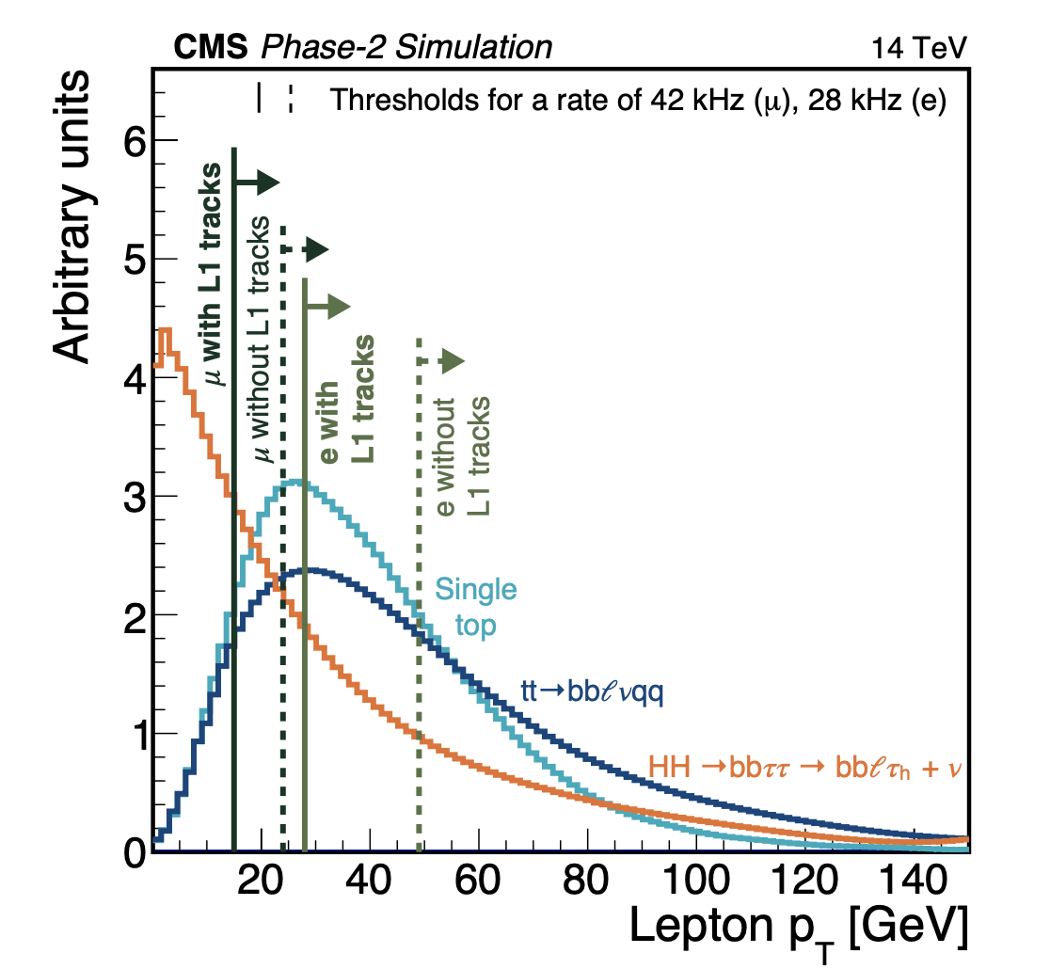
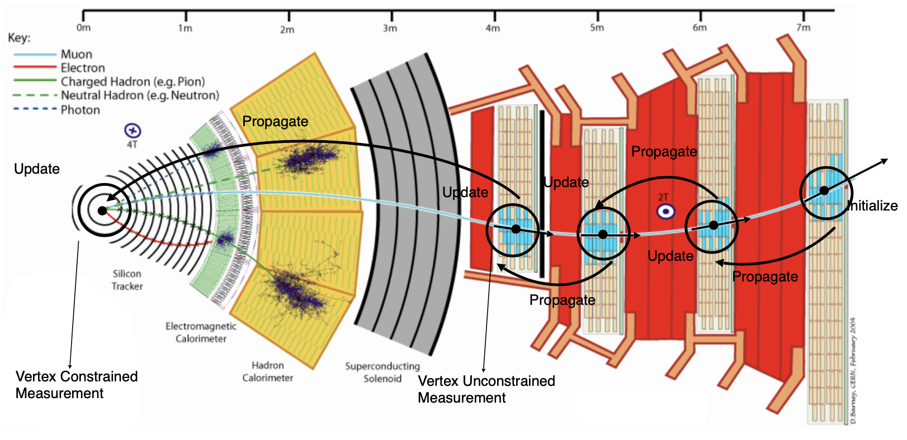
Collisions (p-p) at HLLHC
Can not afford to go any higher in thresholds!
Selecting high P_{T} clusters and tracks

Slide 8
Requirements (my slide from Feb 2004)
Track trigger !
Crystal readout !!

Slide 9
Planning ahead (my slide from July 2005)

Slide 10
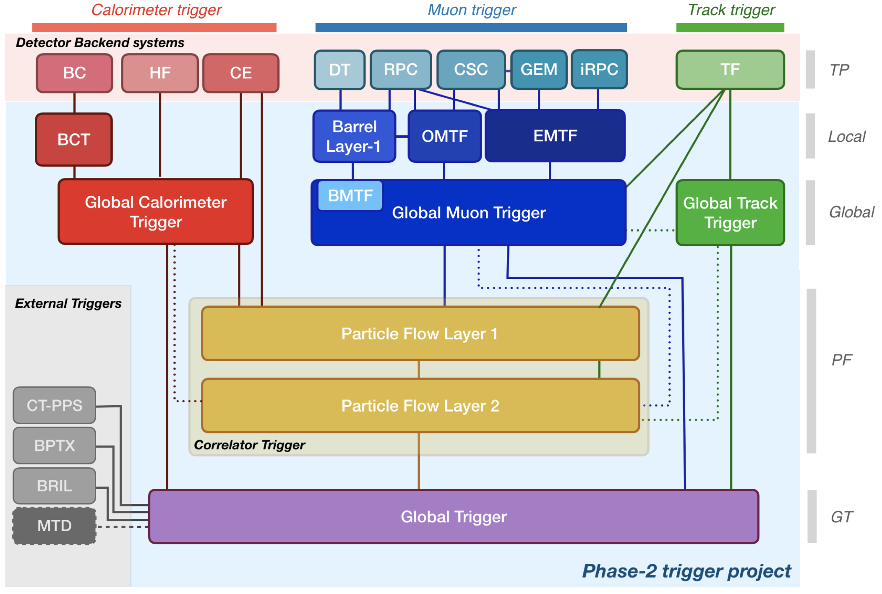
CMS HLLHC Level-1 Trigger 2020
New for HLLHC

Slide 11
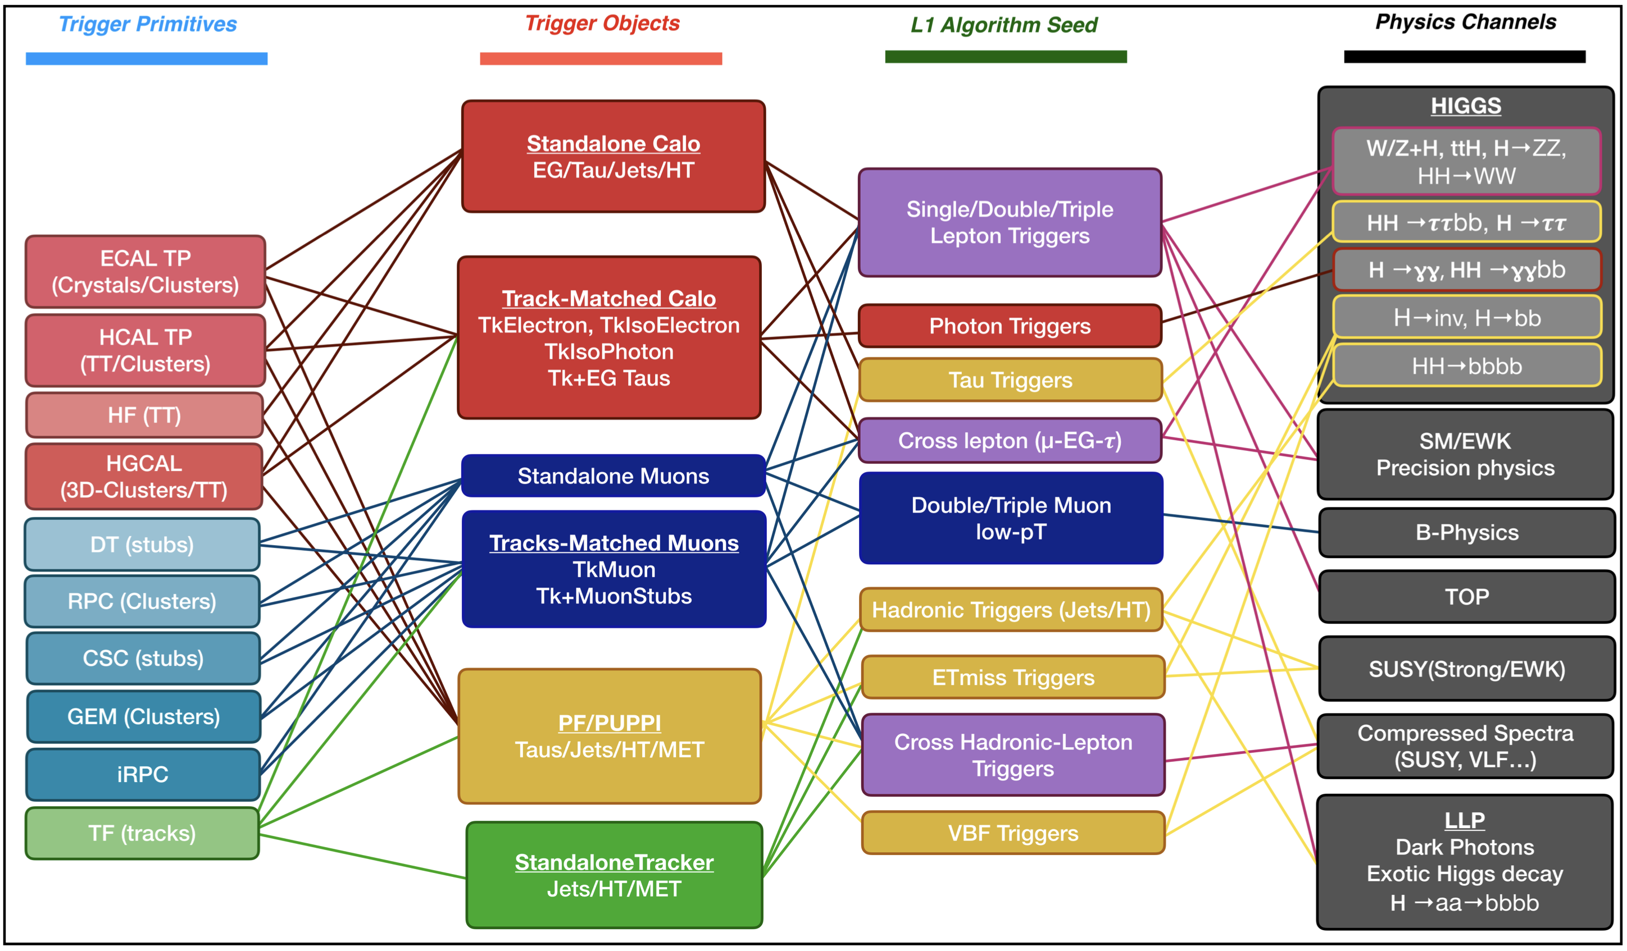
Triggers → Physics

Slide 12
Getting the crystal data out (New for HLLHC)
There are 61200 crystals to be processed – packing 25 crystals per link out of BCP you still have 2448 links at 16 Gbps to contend in the calorimeter trigger path!

Slide 13
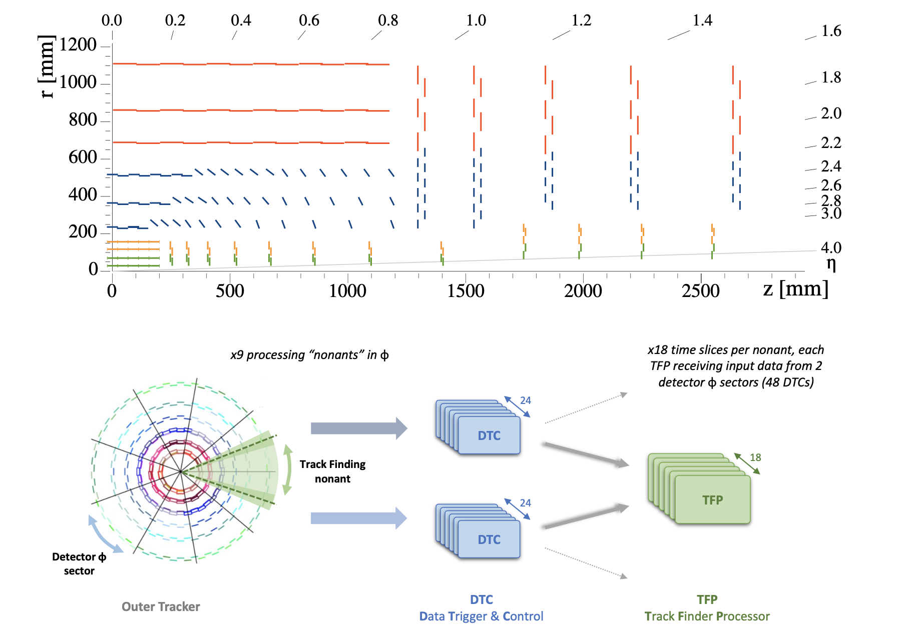
Getting the tracks out (New for HLLHC)
Divide and conquer
In space and time
Outer tracker double layers allow track stub readout
Tracklets formed in TFP consistent with >2GeV P_{T} propagated in-out, matched to form track candidates
Tracklets are then fit to make a track

Slide 14
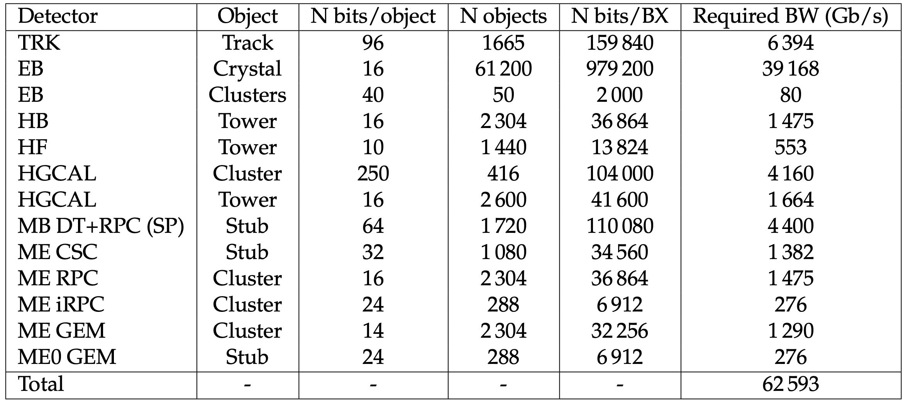
Bits and Pieces from Everywhere

Slide 15
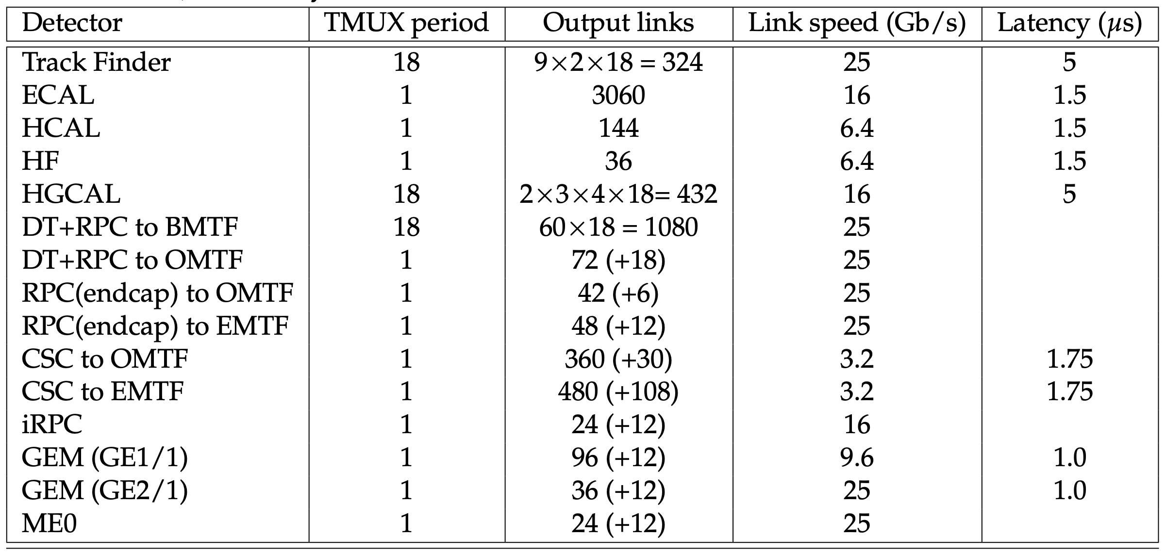
Many Multi-gigabit Optical Links

Slide 16
Challenges: Pile-up
Redoing frontend electronics for faster response

Slide 17
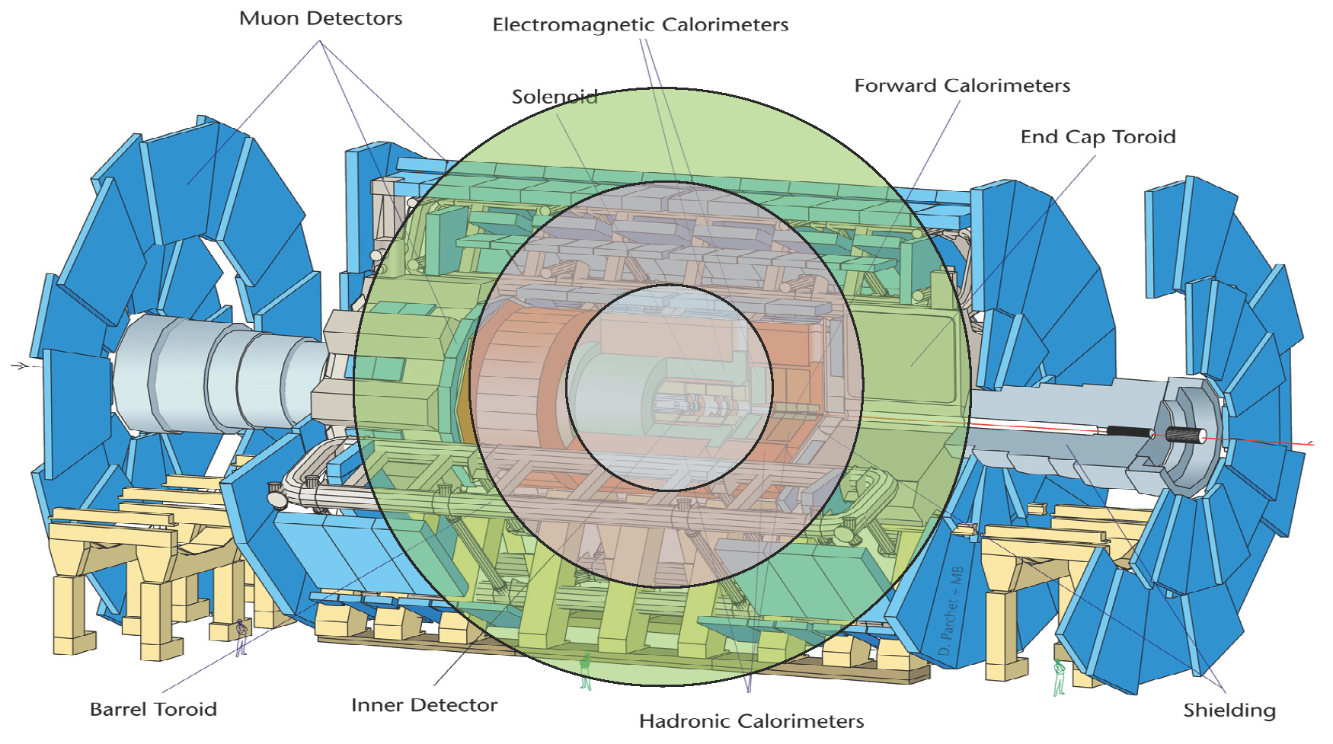
Challenges: Time of Flight
c = 30 cm/ns → in 25 ns, s = 7.5 m
Building in TDCs to exploit timing information to mitigate pileup

Slide 18
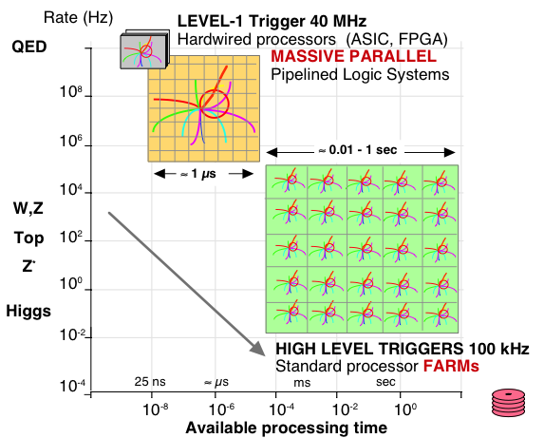
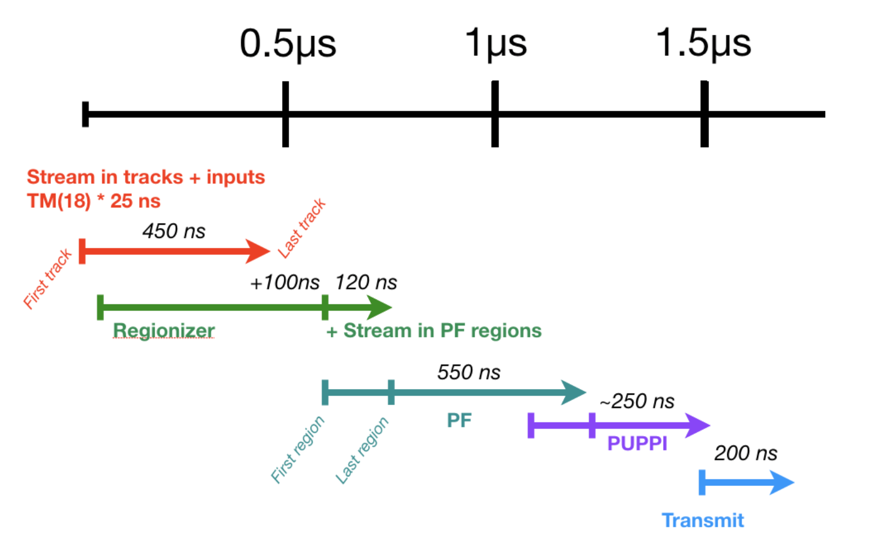
Processing HLLHC Data
Custom Processors (μs)
QCD
Commercial Processors (600ms – 1s)

Slide 19
Xilinx Field Programmable Gate Arrays

Slide 20
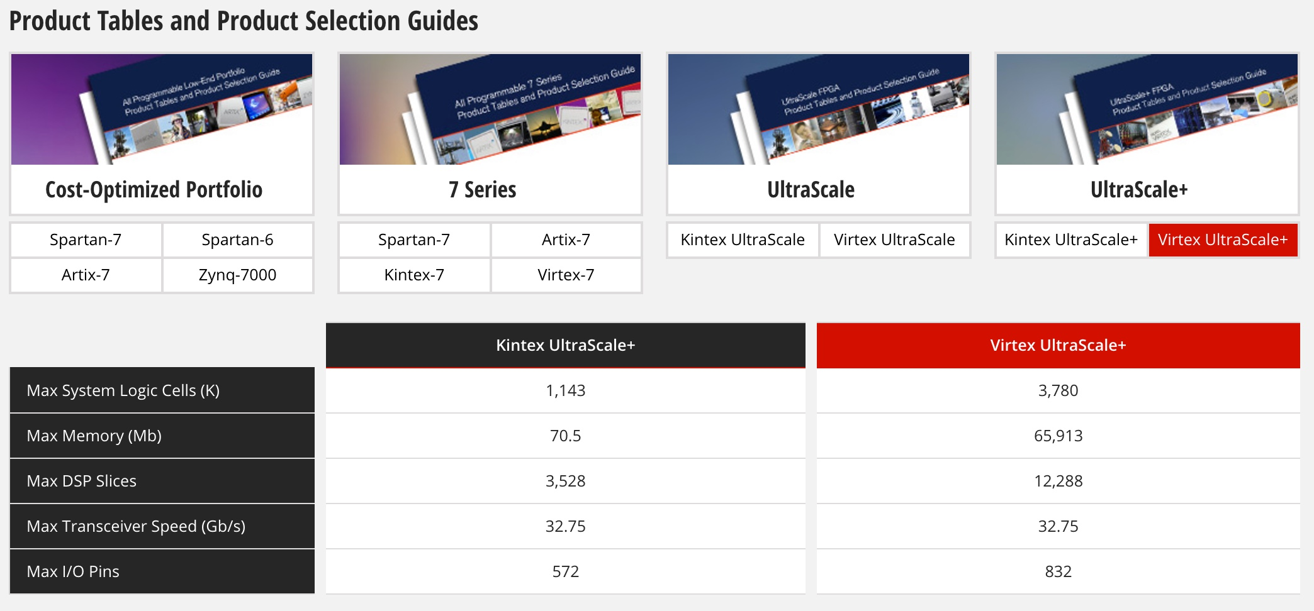
Xilinx – Ultrascale+ for Phase-2
In Use Now
For HLLHC

Slide 21
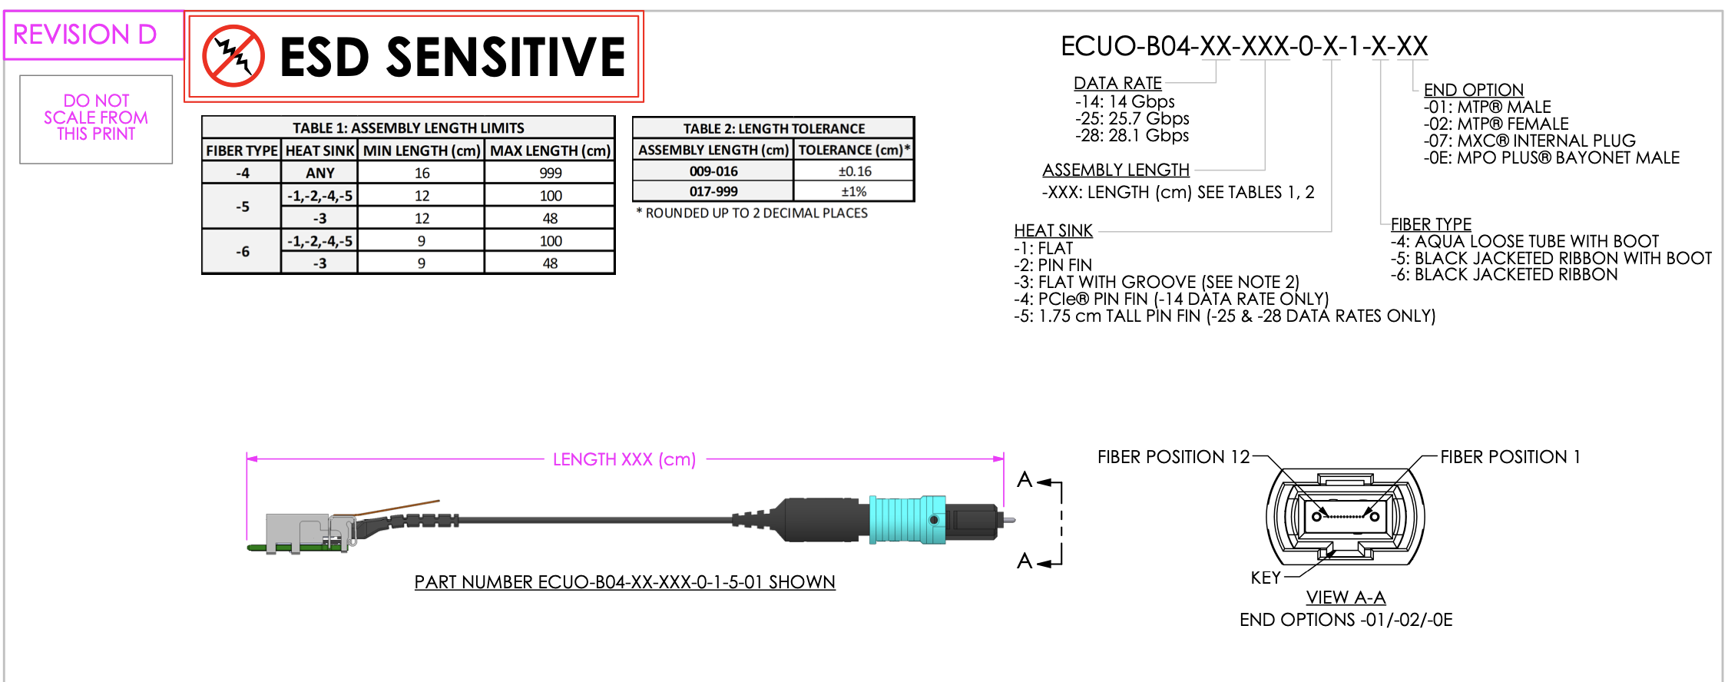
Key element - Multi-gigabit Opto-electronics

Slide 22
The APx Consortium
Pooling of efforts in ATCA Processor hardware, firmware and software development
Multiple ATCA processors and mezzanine board types
Modular design philosophy, emphasis on platform solutions with flexibility and expandability
Reusable circuit, firmware and software elements

Slide 23
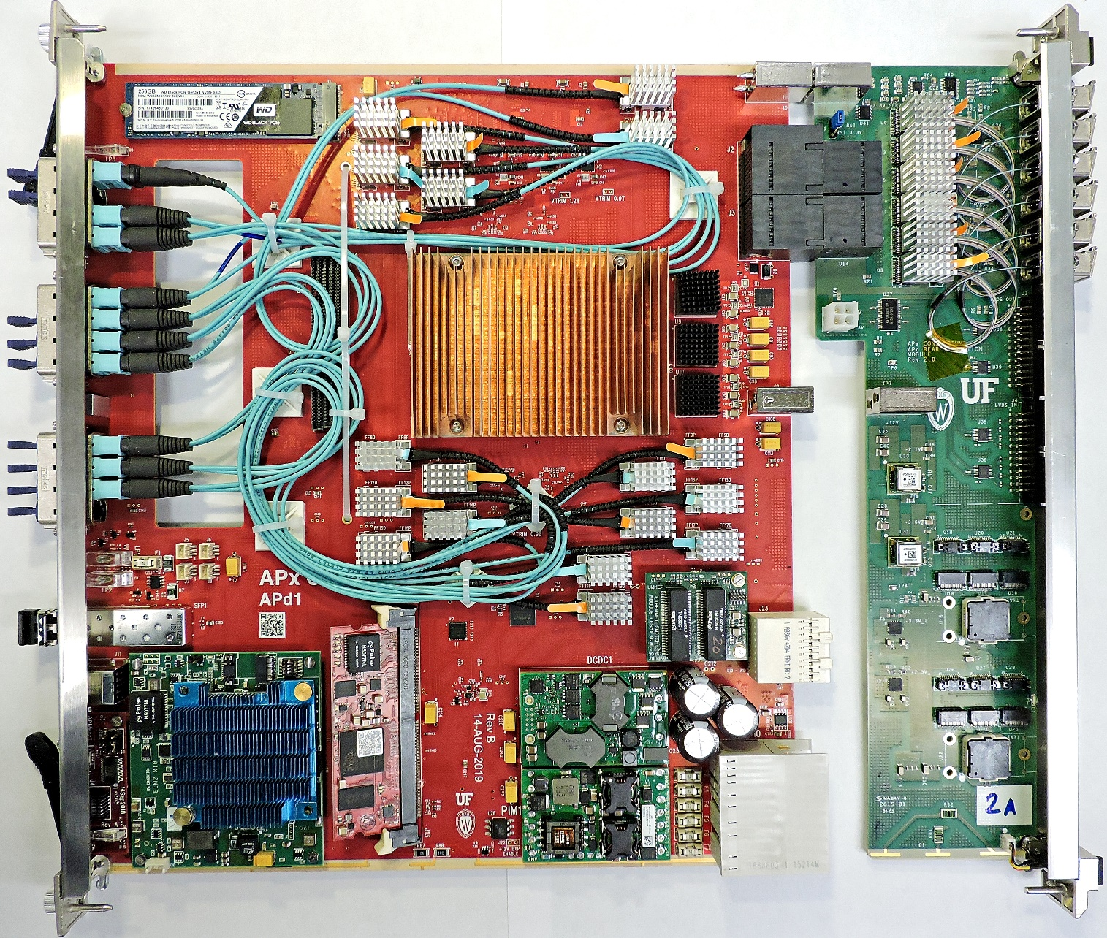
APd1 Rev B
Eight APd1 RevB boards built
Boards setup to make a significant communication protocol test.
APd1: 100 28 G optical links each
76 on main board
24 on Rear Transition Module
40.08 MHz Clock + BC0
Via “ersatz TCDS” (3.2 G link)
Sourced from AMC13 + CTTP7
Delivered via front panel SFP
Linux Hostname: ”SparrowX”
ELM ZYNQ mezzanine
TIFR built IPMC & ESM mezzanines

Slide 25
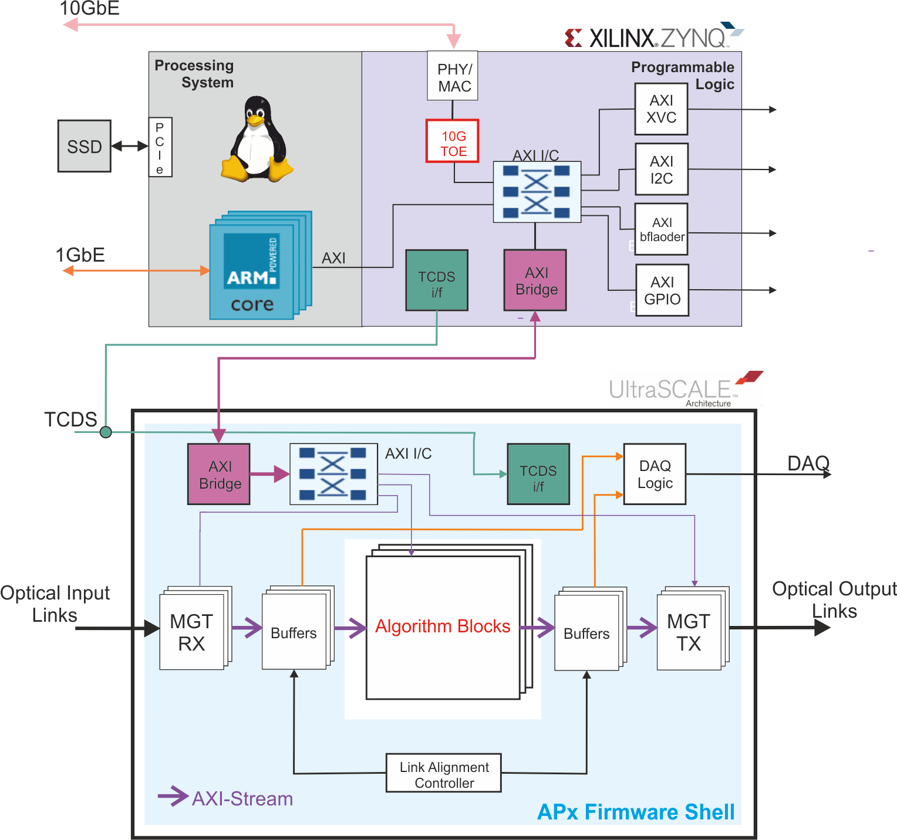
APx – Firmware/Software
A new paradigm for firmware development
Core firmware written in VHDL by engineers
Gigabit link support
Data exchange between SLRs within chip
Test buffers
Clock and control
Physics
Algorithmic firmware in high-level languages like C++ written by physicists
ELM:
Control endpoint,
providing complete
board overhead
functionality
Processing FPGA:
I/O
data processor
DAQ

Slide 26
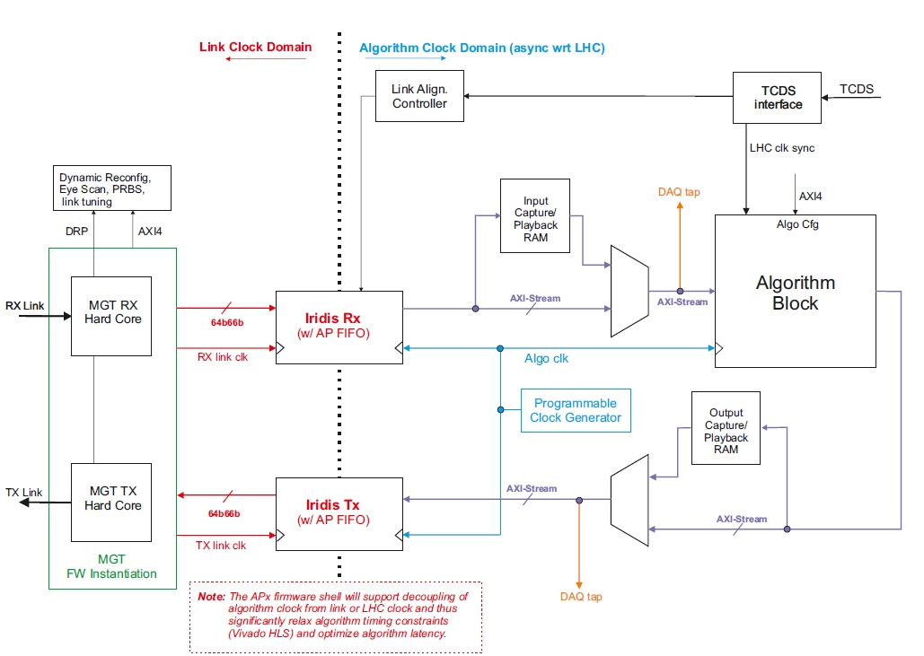
APx Firmware Shell

Slide 27
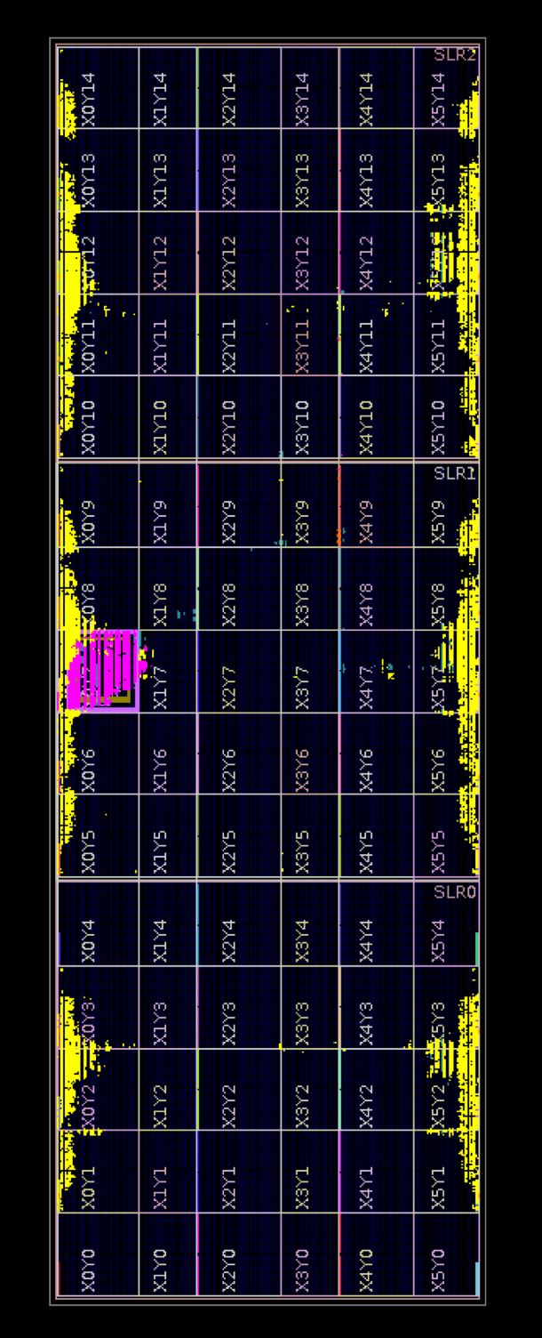
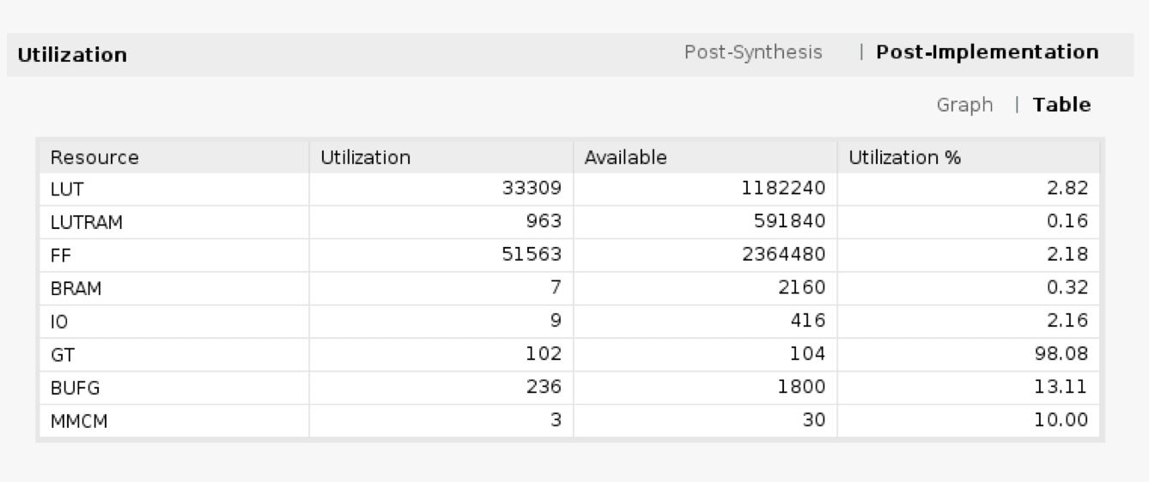
APx-FS Resource Utilization
VU9P build
100x 25G GTY links w/ support infra
Central AXI infra with MGT-based Chip2chip core
APd1 VU9P FPGA floorplan

Slide 28
Multi-Card HLS Demonstrators
Gen-0 (in operation at UW and CERN)
CTP7-based (3 cards, 96 total active links @ 10.0G available)
HLS interface grafted onto Phase 1 8b10b link infrastructure
64-bit link interfaces
Gen-1 (in operation at UW)
APd1 single card setup
Iridis-style 64b66b transport
Early APx shell functionality
Asynchronous processing clock
Gen-2 (in operation at UW)
Multicard test setup (Several 100 25 Gbps links)
Iridis-style signaling and APx shell environment
Common emulated TCDS timebase in ATCA/MicroTCA crates using CTP7

Slide 29
Gen-1 Demonstrator Firmware
Algorithm block interface standardized on AXI-stream for input and output data
Build time configurable number of input and output links
Designed such to allow direct instantiation of HLS IP block (option A)
Also an option to include HDL wrapper inside the algo block (option B)
Option A
Option B
Algo Block
Algo Block
HLS
H
D
L
HLS
H
D
L

Slide 30
Example Algorithm - from U of Hyderabad

Slide 31
Use of C++ & High Level Synthesis

Slide 32
Timing & Latency

Slide 33
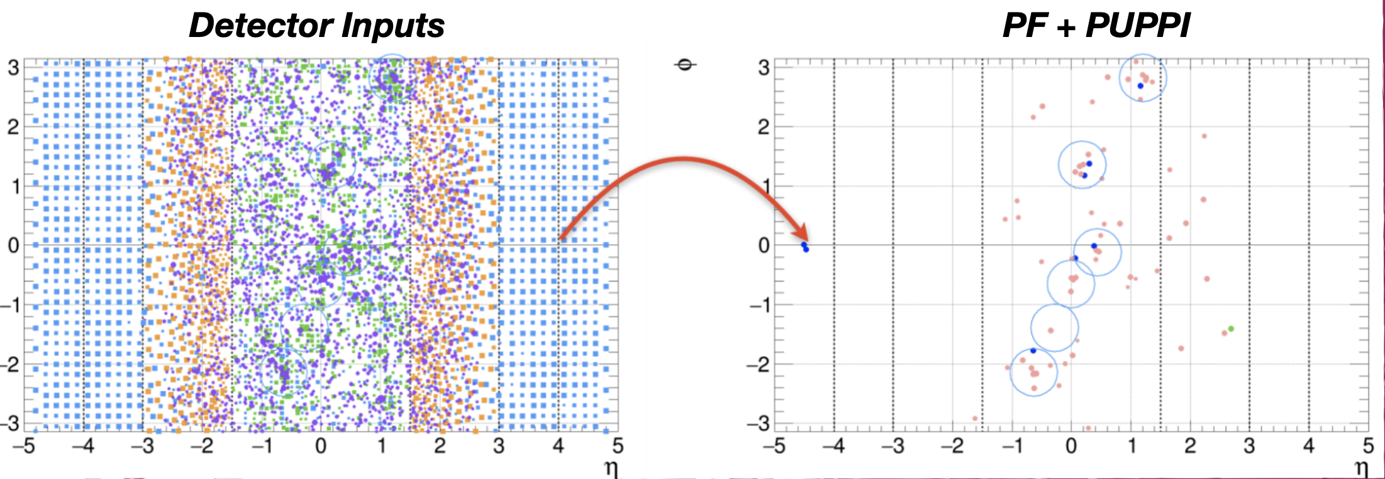
Particle Flow Reconstruction on FPGAs

Slide 34
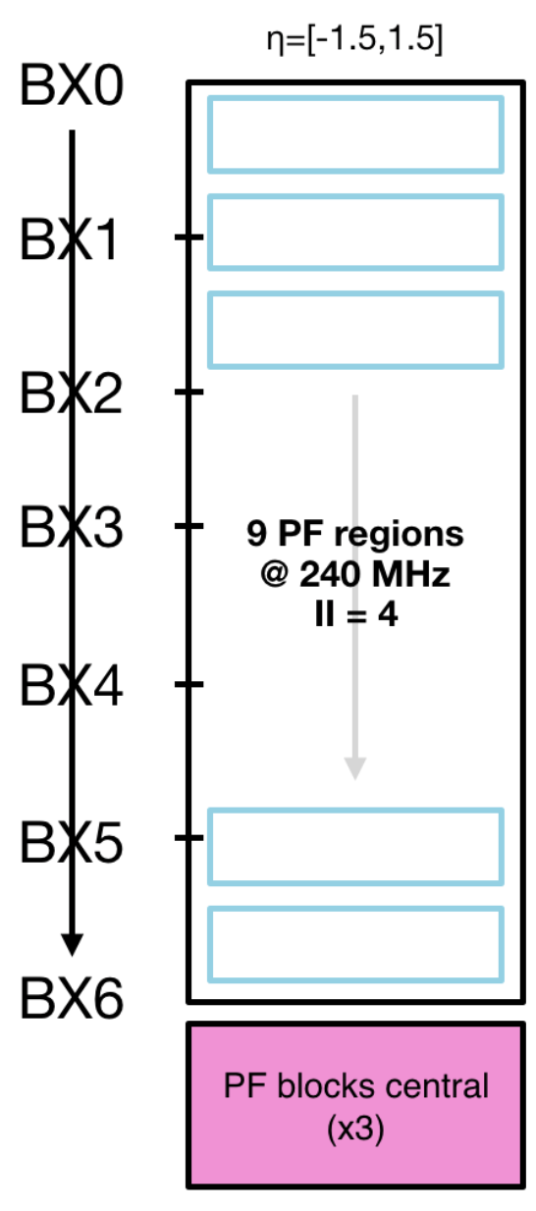
Particle Flow Implementation in Barrel

Slide 35
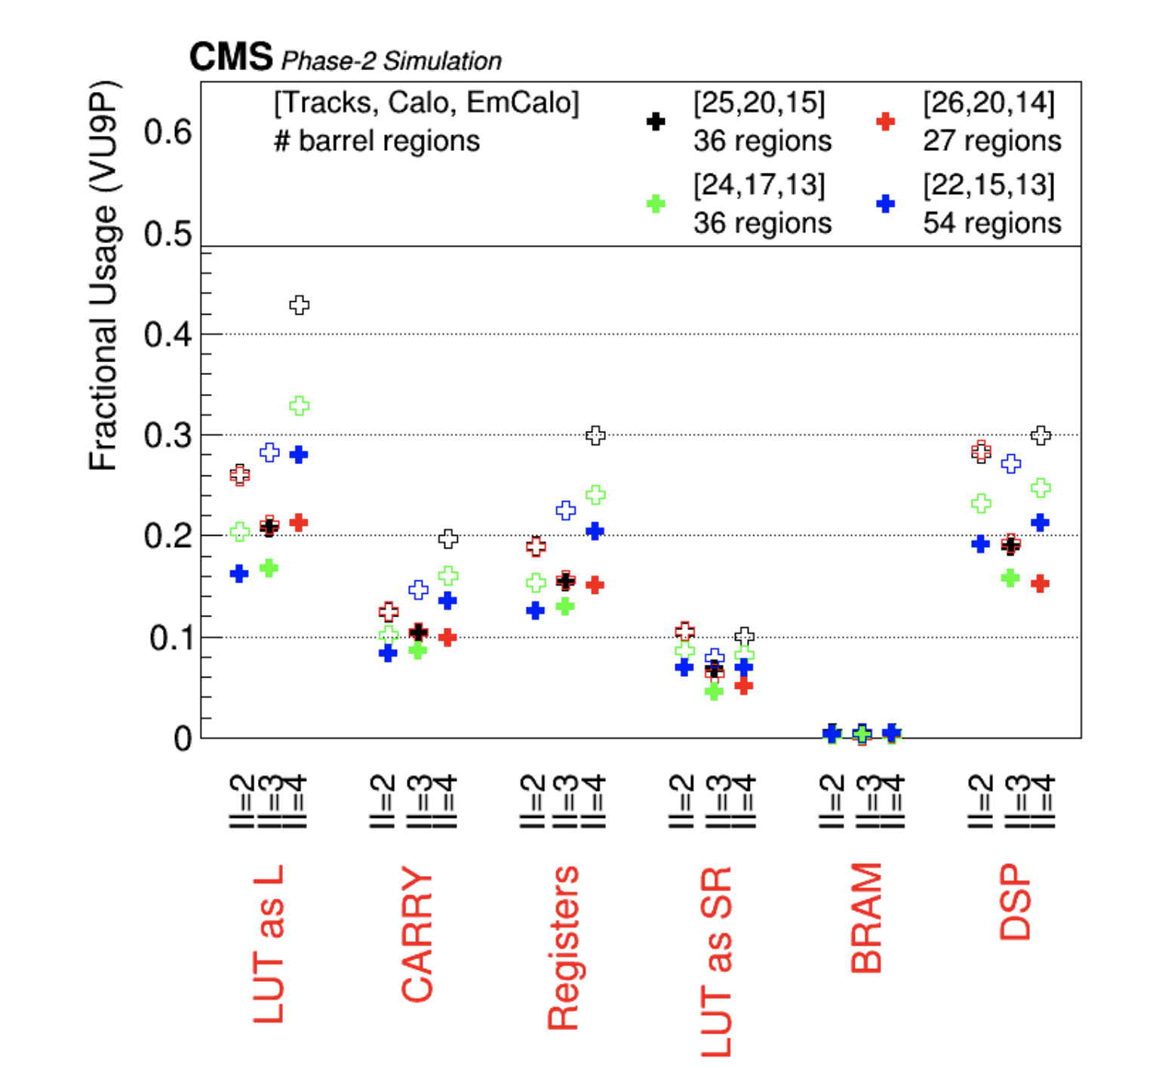
Particle Flow Resource Utilization on VU9P

Slide 36
Concluding Thoughts
A team of engineers and physicists are taming the LHC data deluge with intelligent use of communications technologies to enable fundamental physics discoveries.
Advances in telecommunications technologies are continually adapted to track increasing data streams.
Students and postdocs are getting good training, especially in writing algorithmic firmware, for potential careers in both academia and industry.
Sincere Thanks to: Engineering Team: Tom Gorski, Ales Svetek, Jesra Tikalsky, Robert Fobes (UW), Luis Morena (Princeton), Mandakini Patil, Kushsal Bhalerao (TIFR) Physics Collaborators: Wesley Smith, Sascha Savin, Isobel Ojalvo, Bhawna Gomber, Varun Sharma, Kajari Mazumdar, Jeff Berryhill, Rick Cavanaugh, Dylan Rankin

