Slide 1
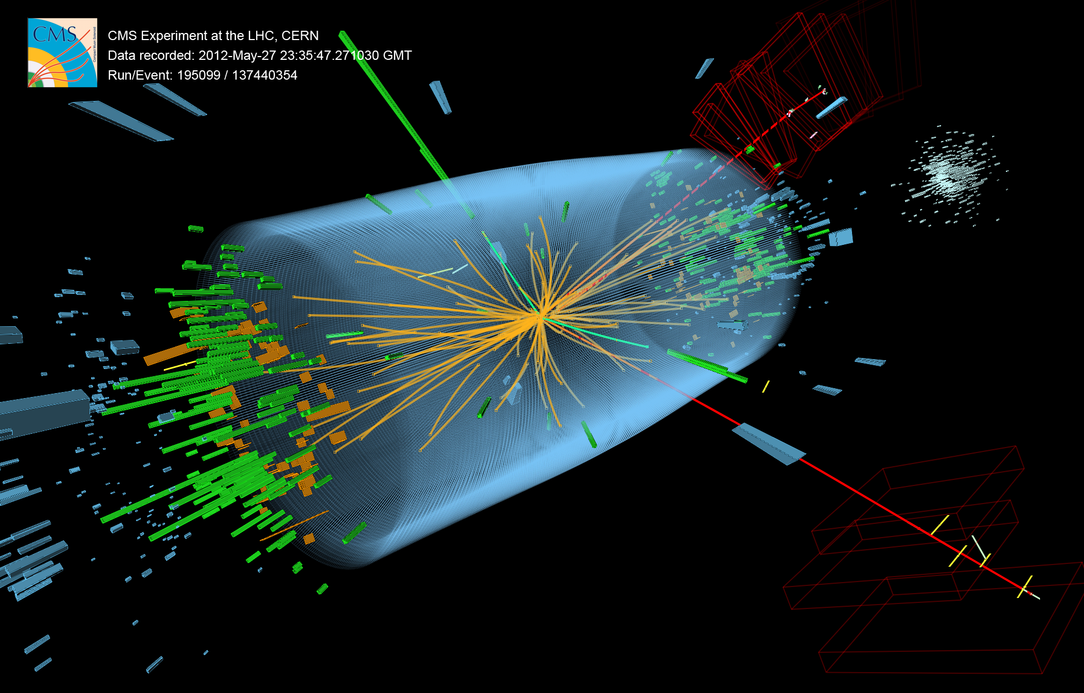
Discovering the Higgs Boson
@CERN Director: "I Think We Have It" (@HIGGS) !
Twitter Level Summary of the Higgsteria
Lecture for Science Enthusiasts – Scientific American version next ~hour

Slide 2
CERN Press Release
CERN experiments observe particle consistent with long-sought Higgs boson
Geneva, 4 July 2012. At a seminar held at CERN¹ today as a curtain raiser to the year’s major particle physics conference, ICHEP2012 in Melbourne,
the ATLAS and CMS experiments presented their latest preliminary results in the search for the long sought Higgs particle. Both experiments observe a new particle in the mass region around 125-126 GeV.

Slide 3
Higgsteria!
The Best of Times
for particle physics!
This is only a good
beginning!
Is the new boson
the Higgs Particle?
We have x2 data now,
and good future
ahead ☺

Slide 4
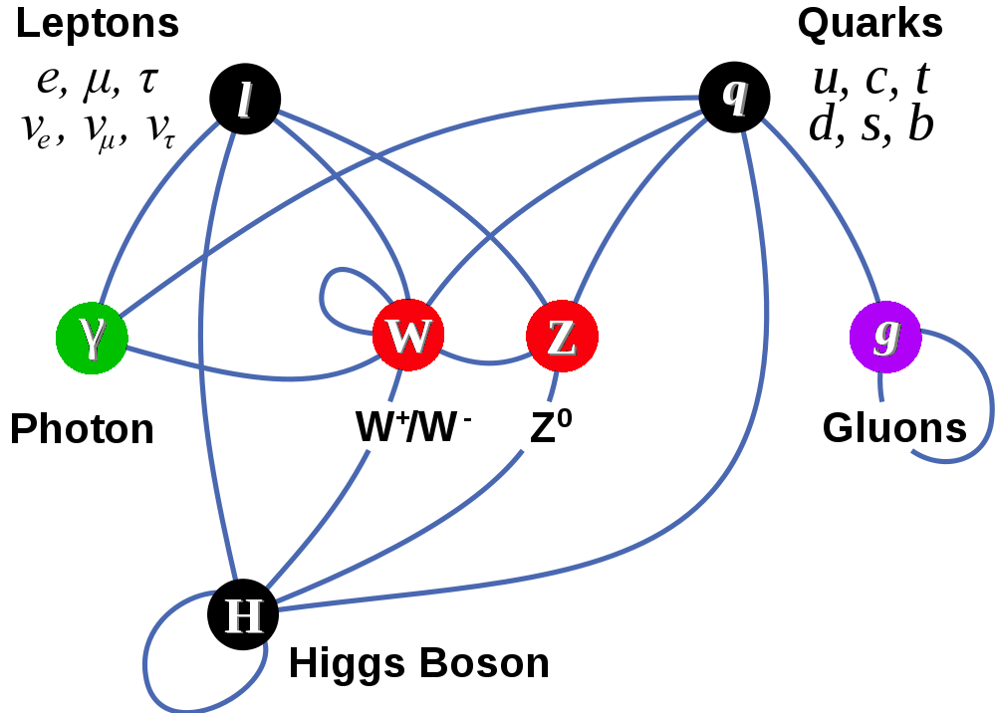
Completion of The Standard Model?
Matter Particles (fermions)
Interactions by exchange of vector bosons
New fundamental scalar field non-zero value everywhere in universe >> new boson
Other particles attain mass by coupling to this new fundamental field

Slide 5

A Brief History of Time
Universe expanding and cooling
The Big Bang
– 454º F
LHC Probes
Experimentally
Quantum Gravity Era
Electro-weak Era
Proton & Neutron Era
Nuclear Era
Atoms and Light Era
Galaxies Formation
Grand Unification Era
Today
Driven by particle physicists reductionist philosophy – learn by getting to the core

Slide 6
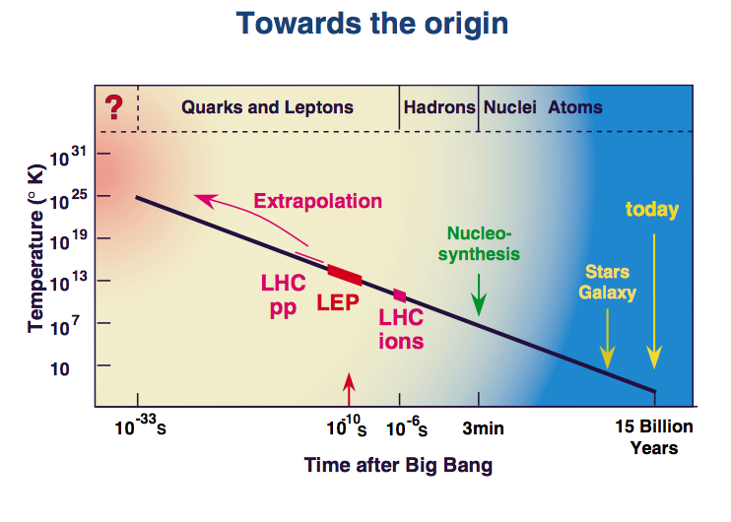
CERN Accelerators & The Universe
Particle physics experiments (physics of very high energy collisions of particles) are needed for understanding our microcosm, and thereby the cosmos itself
  Probing closer needs larger and larger energy !
  Probe by colliding particles and studying scattered remnants

Slide 7

A Cartoon Movie on Higgs
Given high energies particles manifest from vacuum
  Higgs particles can be created in LHC collisions
    They are ephemeral – The LHC detectors look for its remnants

Slide 8
Higgsteria & Media
Keeping up appearances? ☹
Let’s try to do better than that in the next 40 minutes! ☺

Slide 9
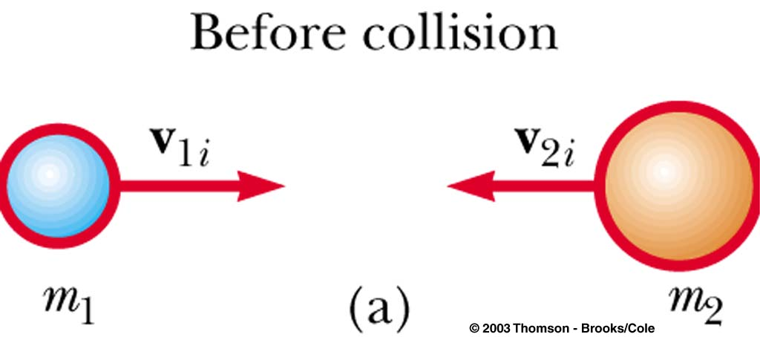
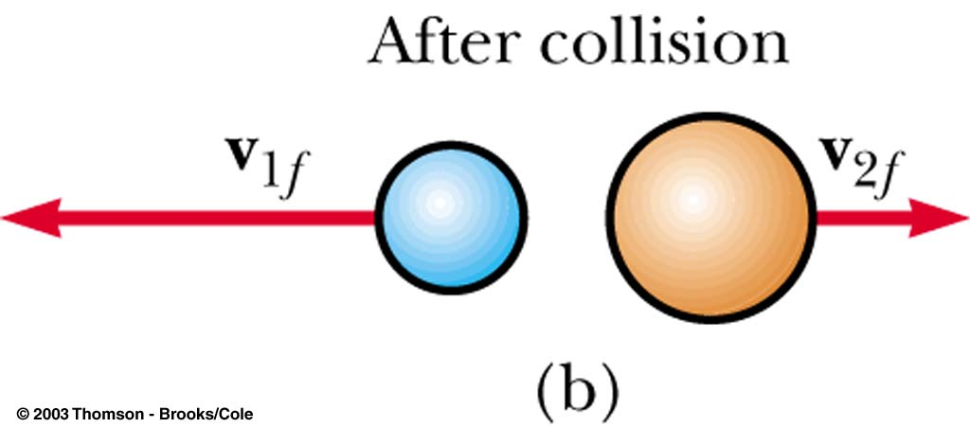
Classical Colliding Balls
Collisions that we perceive with naked eye
Total momentum (p=mv) before and after collision is the same
Total kinetic energy (E=mv²/2) before and after is the same
Increasing the speeds
Momentum is conserved
Kinetic energy is NOT
Some of the energy goes to break
up the objects – create heat, sound …
Total energy conserved

Slide 10
Relativistic World
How about when we get close to the speed of light?
Einstein’s famous equation: E = M
The collision energy can manifest as mass!
For particles in motion: E² – P_{x}² – P_{y}² – P_{z}² = M²
Energy-Momentum is conserved in collisions
Relativity and Natural Measurement Units
Speed of light, c = 1
Instead of using kg, kilo-watt-hour …
we can use a common unit for mass, energy and momentum called eV
A common AA battery cell accelerates electrons to 1.5 eV
LHC accelerates protons (x1835 electron mass) to 3.5 trillion eV

Slide 11
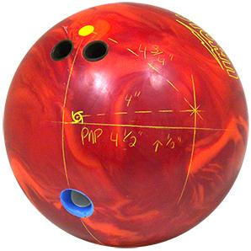
Relativistic Collisions
Particle collisions at very high energies produce many particles, some much more massive than initial particles
(unlike in this cartoon, collisions obey specific quantum rules)
Elementary and composite particles studied in great detail over the past 50 years

Slide 12
Relativistic Quantum World
Quantum Fields of various type permeate the space
  Electromagnetic field → photons (light quanta)
Given sufficient energy these fields create quanta (particles), that can be long lived or ephemeral
  Matter-anti-matter pairs manifest out of vacuum
Particles interact with each other exchanging quanta
  Photons, Gluons, W and Z
Works beautifully for massless quanta – needs higgs field for providing mass to the elementary particles
  W, Z quanta are massive – decay quickly

Slide 13
What is a Boson?
Spin of fundamental particle
  Chemical properties led Mendeleev to organize the periodic table
  The structure of periodic table can be explained by electron configuration in an atom
    Pauli exclusion principle – one electron per energy state
    But, only if one assumes that electron has a new quantum number spin which can take two values +1/2 or –1/2
    Electrons (and other matter particles) are fermions
    Statistical behavior of half-integral spin particles studied by Fermi
Photon (and other force particles are of spin 1)
  There is a direction to the electric and magnetic fields
  Statistical behavior of integer spin particles studied by S.N.Bose
  Photon, W+, W–, Z and gluons are vector bosons
Higgs is the only spin-0 particle in the Standard Model (Scalar Boson)

Slide 14
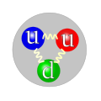

Particle Interactions @ Low Energy
1
  Quarks bound in hadrons via strong interactions
    Baryons (spin-1/2)
      3-quark states
        Protons, neutrons
    Mesons (scalars, vectors …)
      quark-antiquark states
        pions, kaons
  Atoms bound together via electromagnetic interactions
  Weak force responsible for radioactive decay
    BUT, weak force is only active at short distances
    W and Z should be massive and decay quickly
10⁻²
Proton
Pion
10⁻⁷
Relative
force
strength

Slide 15
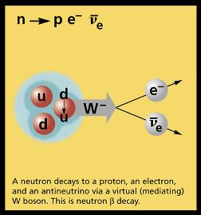
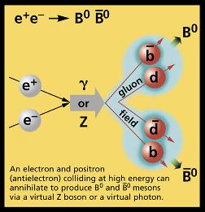
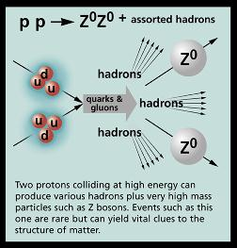
Particle Interactions

Slide 16
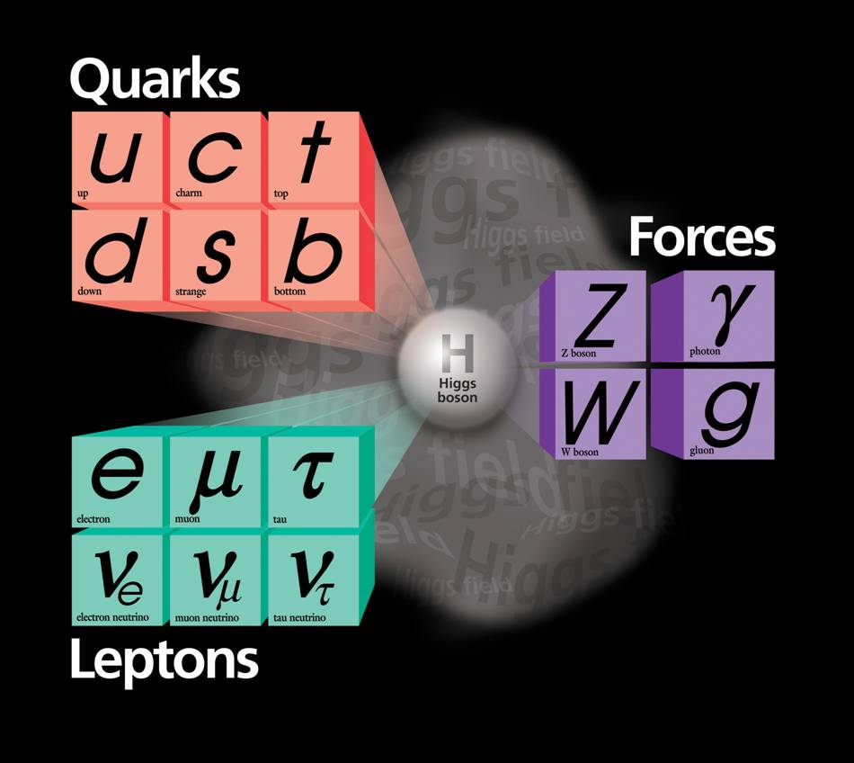
The Periodic Table of
Relativistic Quantum World
Elementary (point-size) particles:
  Matter constituents
    Quarks
      up, down, charm, strange, top, bottom
    Leptons
      Electron, muon, tau, corresponding neutrinos
  Force carriers
    Electromagnetism: Photon
    Weak interactions: W±/Z
    Strong interactions: Gluons
  Omnipresent higgs field
    Omnipresent → non-zero field strength everywhere!!
    Explains how elementary particles become massive
1300
170000
~5
91000
4500
100
0
106
?
0
0.5
1776
80000
~10^{–5}
MeV
Wildly varying masses for matter particles
Very troublesome: masses for force carriers

Slide 17
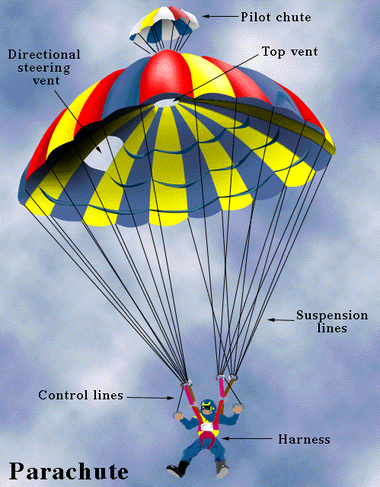
Interactions with
Higgs Field
Which of these falls slower safely?
  An unopened parachute
  Fully opened parachute
The more interaction with the medium (air) the lower the speed of the drop
Higgs field permeates all space, particles interact with differing strengths with the higgs field. The higher the interaction the larger the particle’s mass.
The simplest theory with higgs fields results in a new self-interacting particle: the Higgs boson, which itself has a mass – but, theory can’t predict its mass.

Slide 18
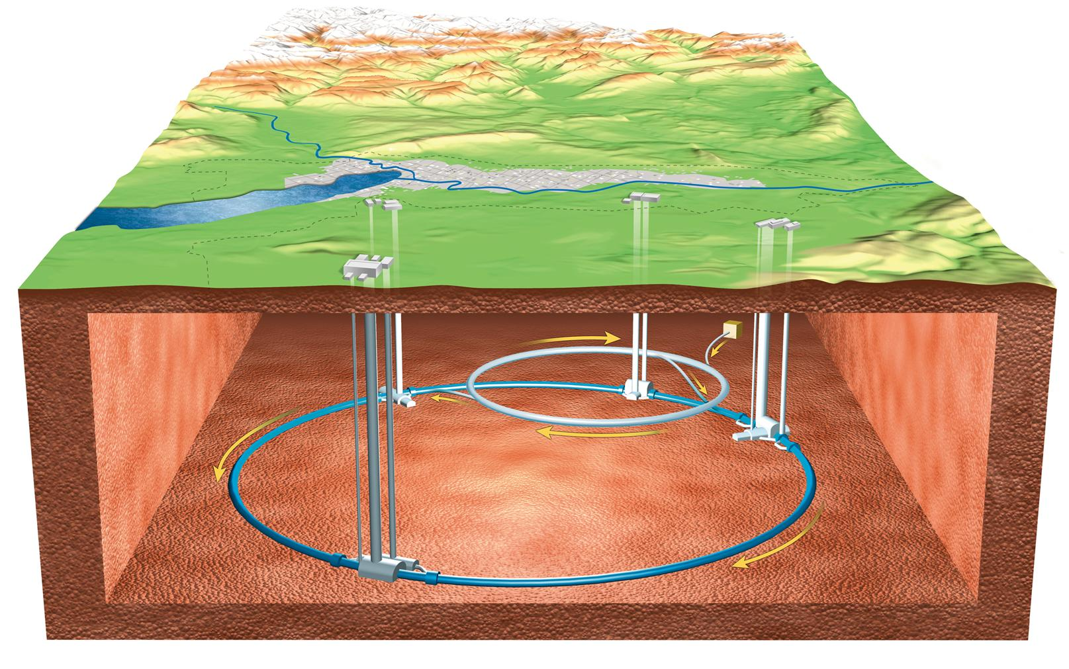
Large Hadron Collider

Slide 19
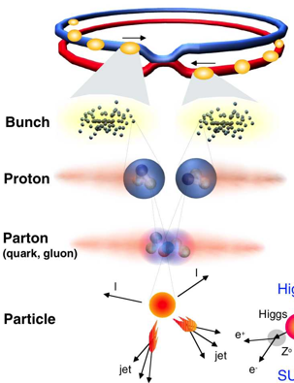
Proton-Proton Collisions at the LHC
 | Design | 2011 | 2012
Beam energy | 7 TeV | 3.5 TeV | 4.0 TeV
Bunches/ beam | 2835 | 1380 | 1380
Protons/ bunch | 1.15x10¹¹ | 1.5x10¹¹ | 2.2x10¹¹
N Collisions Created |  | 2.5 x 10¹⁴ | 3.5 x 10¹⁴
N Higgs Events |  | Few hundred | Few hundred
Notes:
1 barn = 10⁻²⁴ cm-²
Proton c.s 40mb/110mb@7TeV

Slide 20

CMS : A Giga-Pixel Camera
Snaps a billion pictures of quantum interactions a second

Slide 21
What do we observe with CMS?
Photons
  Light quanta
Electrons
  Lightest electrically charged lepton
Muons
  Heavier cousin of electron (interacts minimally)
Charged hadrons (π, K, protons)
  Composite charged particles made of quarks
Neutral hadrons (neutrons, K_{L})
  Composite neutral particles made of quarks

Slide 22
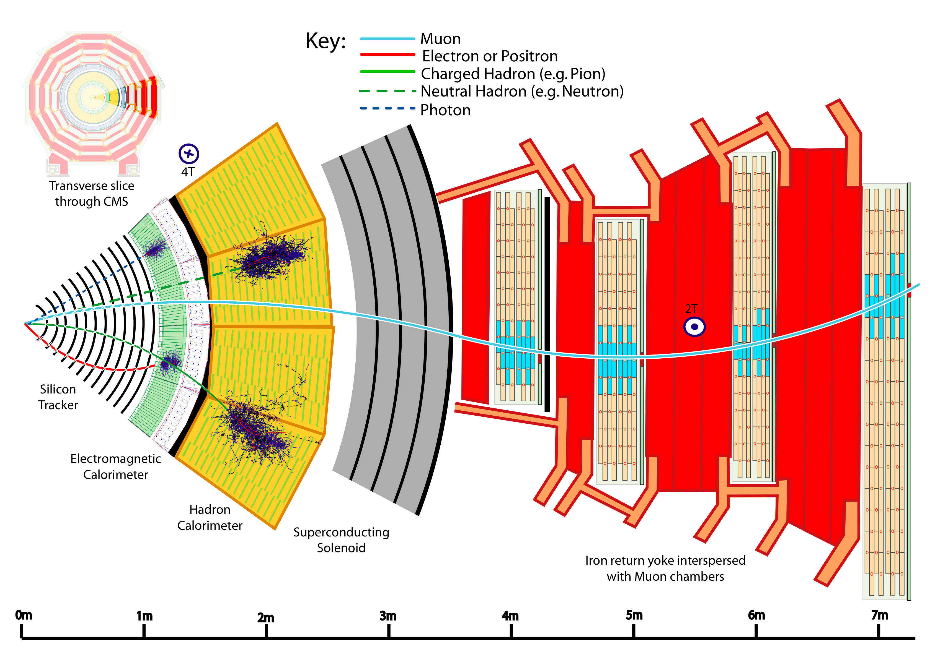
Particle Detection in CMS
Measure energy and momentum
Measure energy
Notes:
Transverse slice
Path of muon
---------------------------------------
Punch-through can make a high-pt muon look low
Muons are “gold-plated” since they suffer less radiative loss in the tracker, are better measured (Detector Paper, 128).

Slide 23
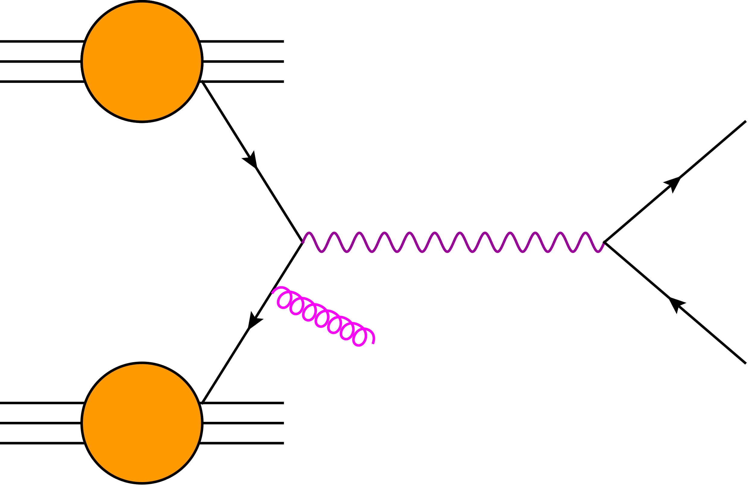
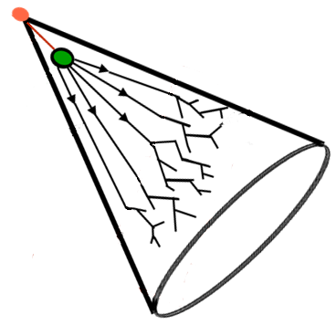
Vector Bosons @ pp Collider
What do we observe?
proton
e⁺
q
Z
Low Energy Particles
Pileup & multi-parton
Electrons
Underlying Event color connection
q
g
e⁺⁻
proton
Jets

Slide 24
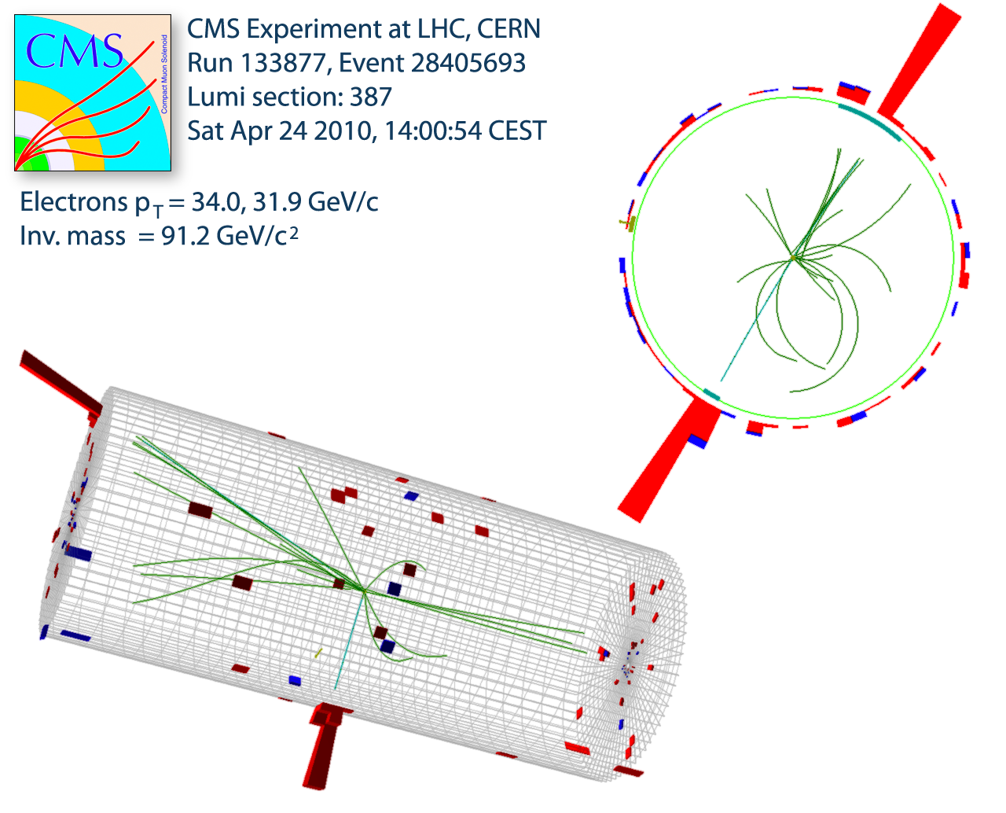
What about heavier particles?
Reconstructing a Z Boson
Most decay close to the interaction point
Event vertex (collision point) is measured using tracks
Note there are several low momentum tracks (underlying event)
Electron (–) and Positron (+)
Momentum (P_{x}, P_{y}, P_{z})
measured in tracker
Energy (E) measured in
the calorimeter

Slide 25
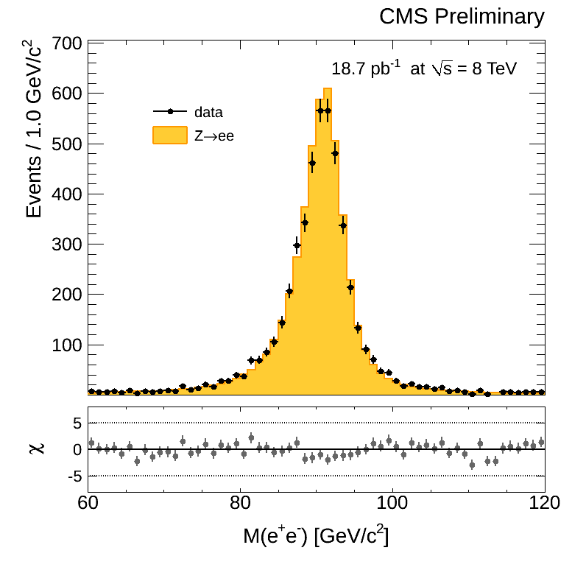
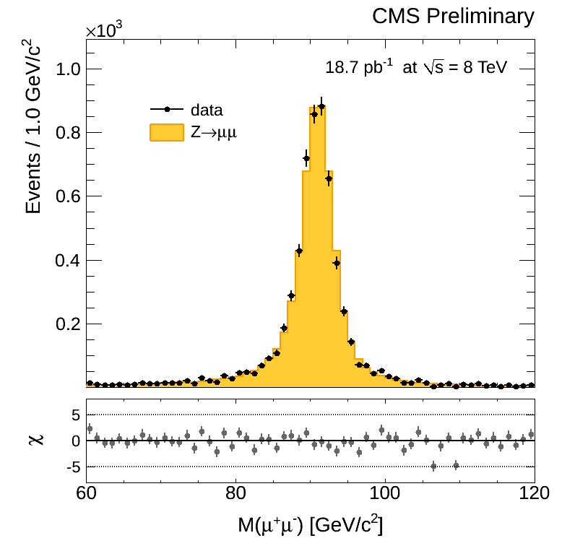
What about heavier particles?
The Z Boson Invariant Mass Peak
Particles decaying close to the interaction point
  Histogram of “invariant mass” of the original heavy particle shows a sharp peak at the mass of the Z (91 GeV)
  ATLAS & CMS see 20M events second – about 10/s are Z events
Mass of Electron-Positron Pair
Mass of Muon⁺-Muon– Pair

Slide 26
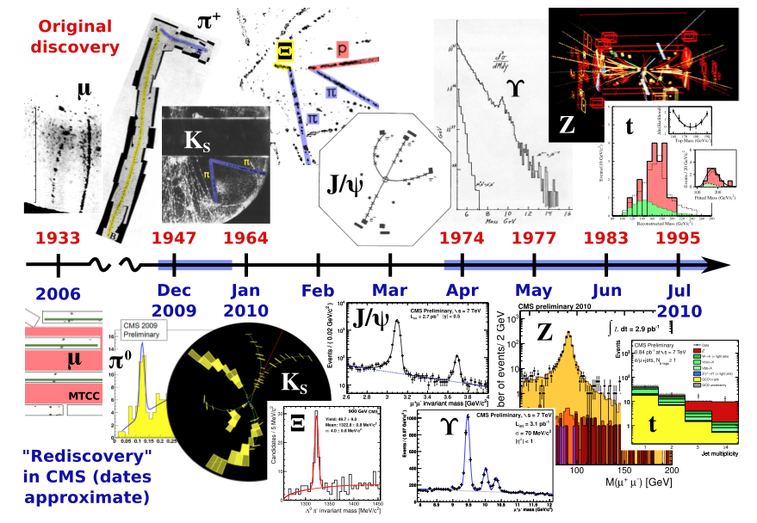
Established the Standard Model at 7 TeV

Slide 27
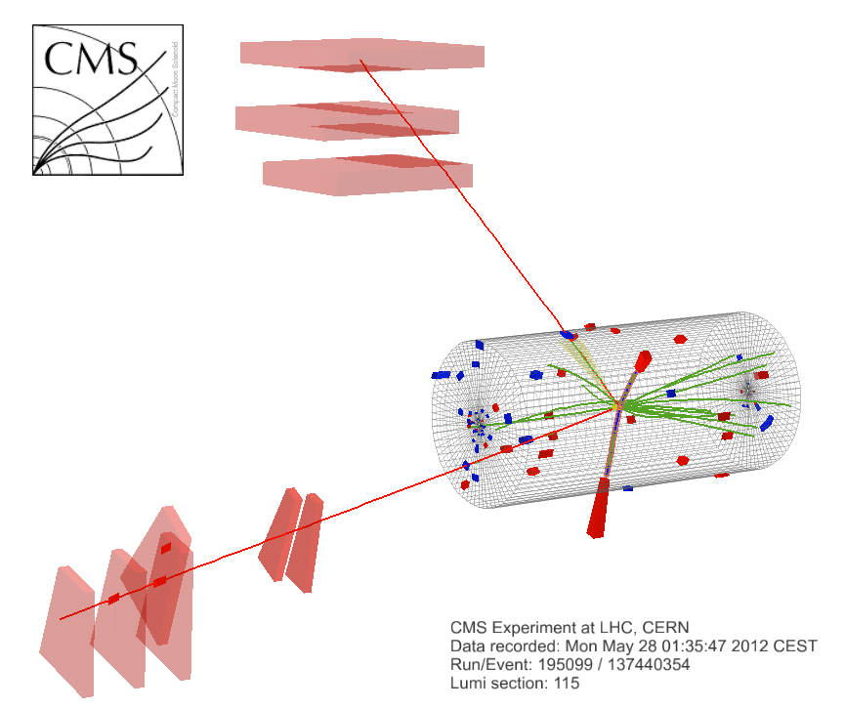
Candidate 4 Lepton Event
μ⁺(Z₁) p_{T} : 43 GeV
e⁻(Z₂) p_{T} : 10 GeV
8 TeV DATA
4-lepton Mass : 126.9 GeV
μ⁻(Z₁) p_{T} : 24 GeV
e⁺(Z₂) p_{T} : 21 GeV

Slide 28
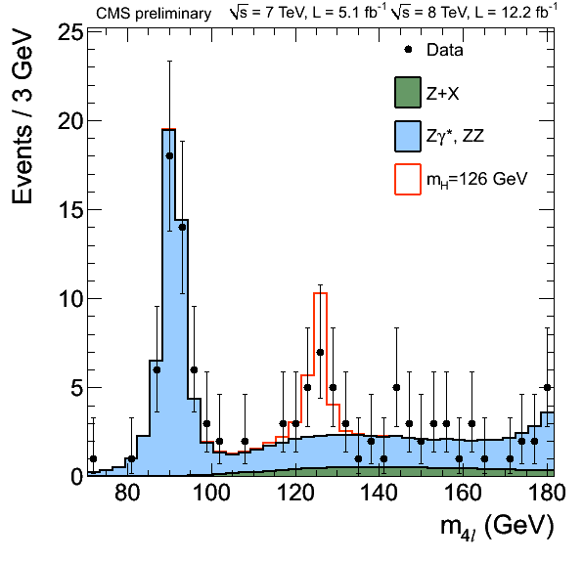
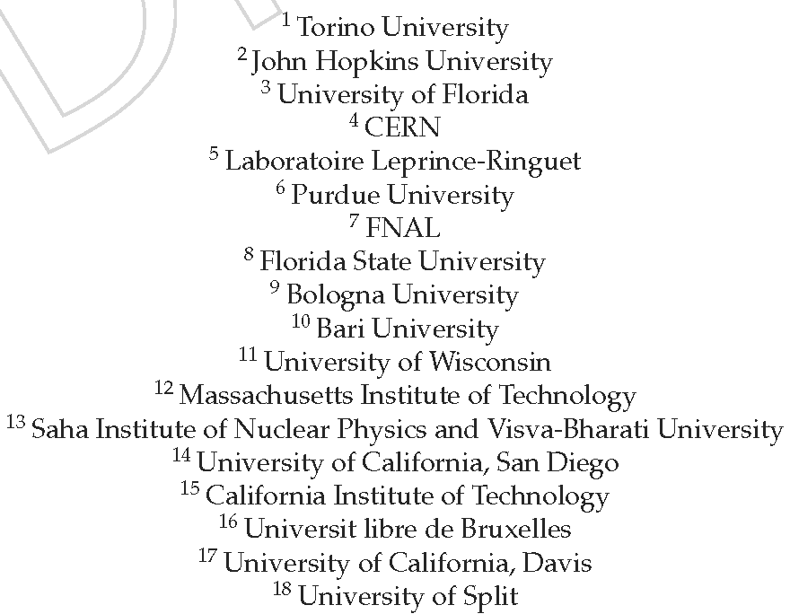
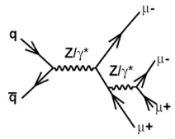
Decays to ZZ to 4-light leptons
CMS HIG-12-041
Golden mode – Zoom of loss 4L mass region
Clearly observe production of Z decay to 4 leptons
125.8 ± 0.4 ± 0.4 GeV
Cluster of events rising above the background consistent at
3-sigma level with
SM Higgs signal
M_{Z} = 91 GeV

Slide 29
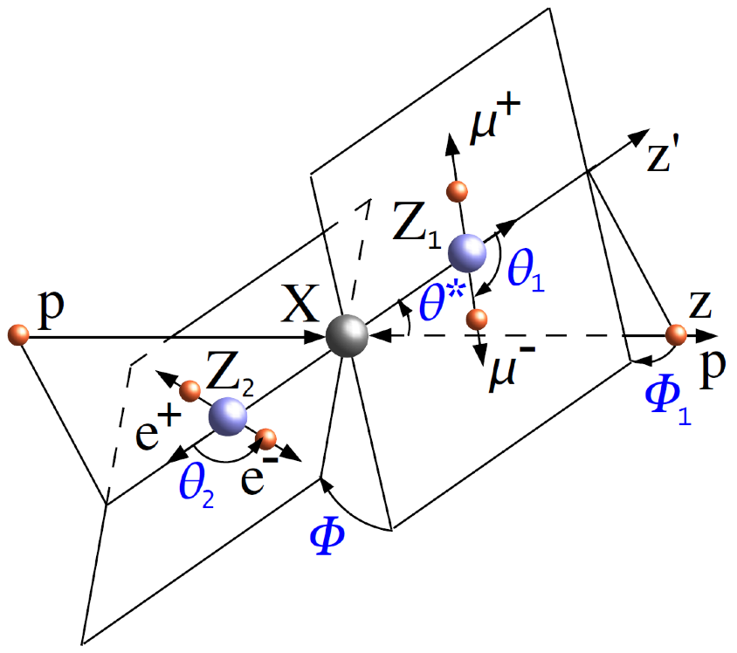
Use Angular Information
Study additional properties of these events
  Angles shown carry information of scalar (SM H), pseudo-scalar vs spin-2 decay versus ZZ production

Slide 30
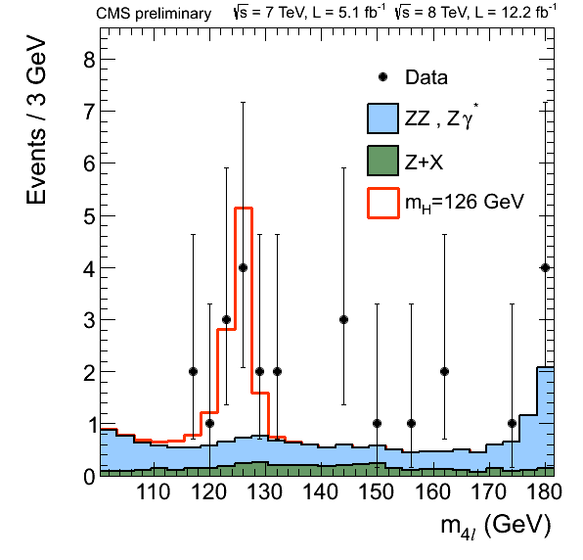
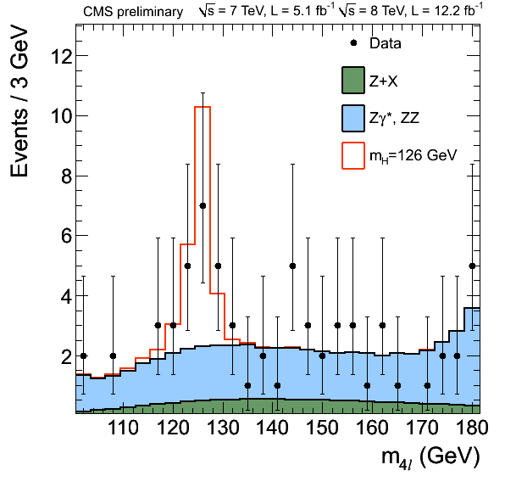
Strong Evidence in decays to ZZ
CMS HIG-12-041
Boost using angular information from 3 to 4.5 sigma
  Reduce background, while keeping signal-like events

Slide 31
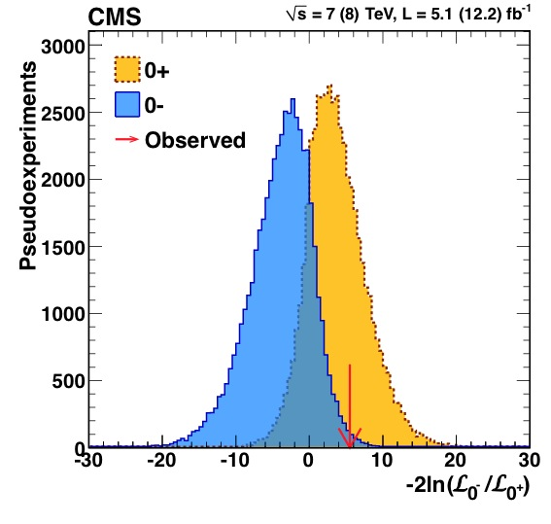
Is the new boson a scalar?
CMS HIG-12-041
Not yet significant, but favors 0⁺ over 0– by ~2sigma

Slide 32
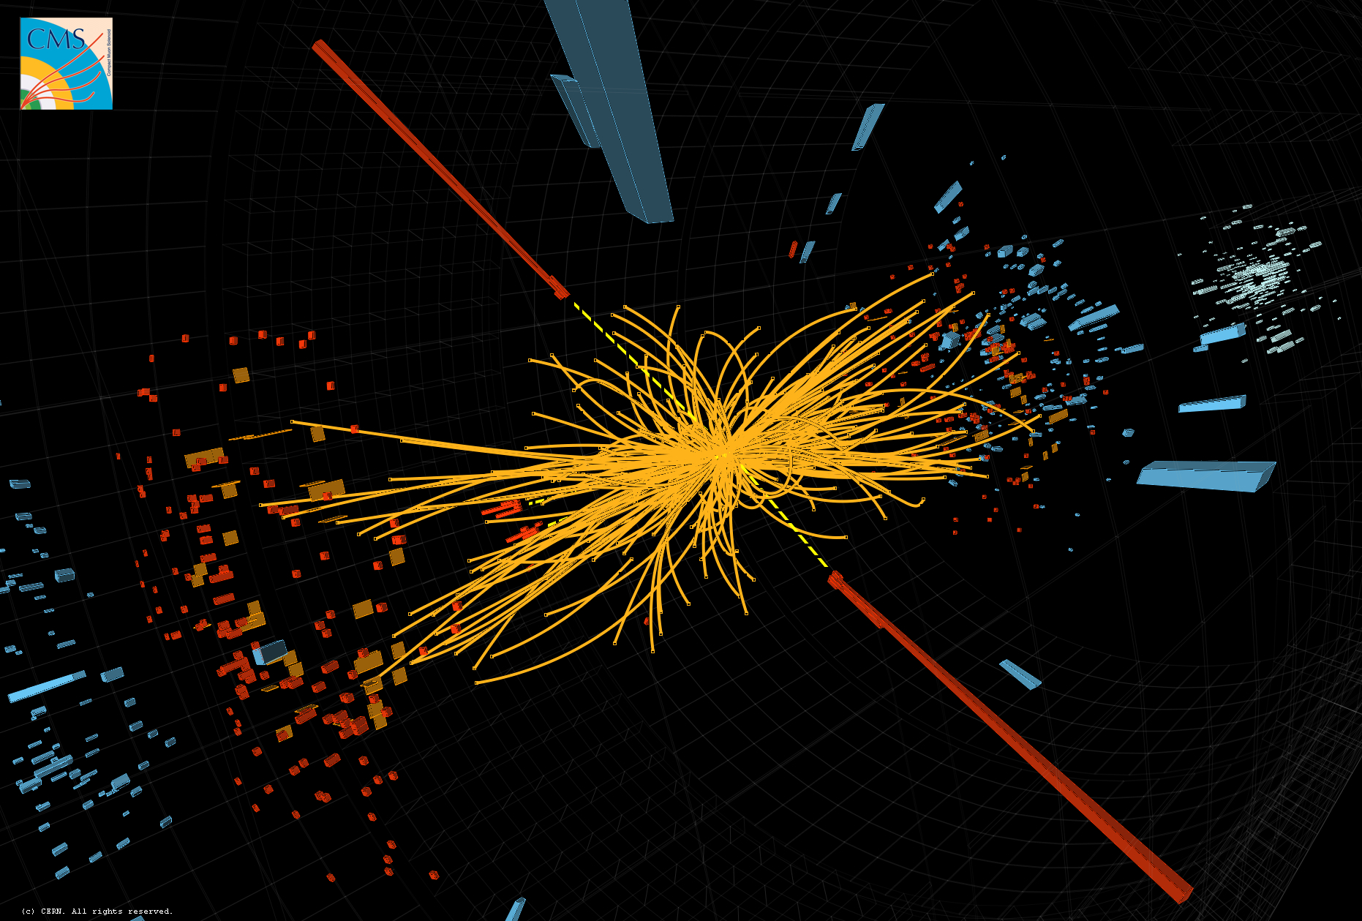
Candidate Di-photon Event

Slide 33
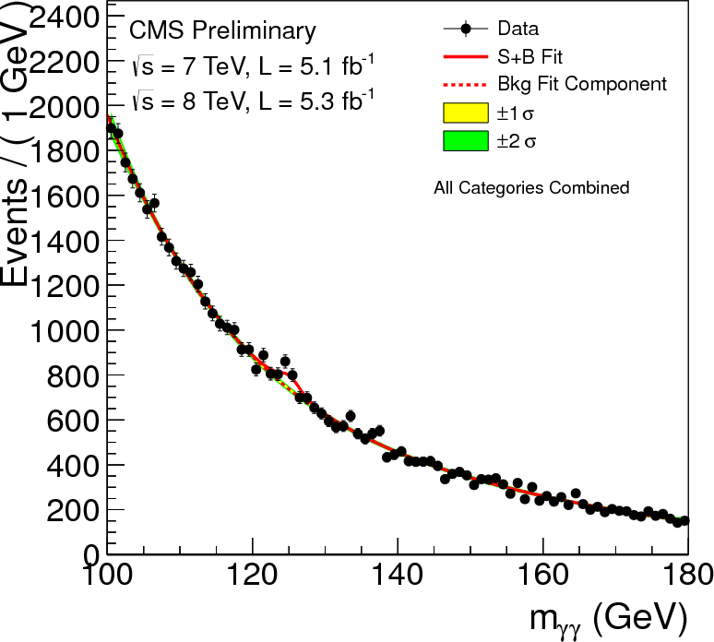
CMS Search in
Di-photon Invariant Mass
Photon background is large – look for a peak on a falling smooth spectrum
4.1 sigma significance at M=125 GeV when analysis is done in various categories of photon reconstruction quality

Slide 34
CMS : Weakest Category 7 TeV
Divide data into four categories by mass resolution
Separate reduced background di-jet category
2011 (7 TeV)
2012 (8 TeV)

Slide 35
CMS : Weakest Category 8 TeV
Divide data into four categories by mass resolution
Separate reduced background di-jet category
2011 (7 TeV)
2012 (8 TeV)

Slide 36
CMS : Good Category 7 TeV
Divide data into four categories by mass resolution
Separate reduced background di-jet category
2011 (7 TeV)
2012 (8 TeV)

Slide 37
CMS : Good Category 8 TeV
Divide data into four categories by mass resolution
Separate reduced background di-jet category
2011 (7 TeV)
2012 (8 TeV)

Slide 38
CMS : Better Category 7 TeV
Divide data into four categories by mass resolution
Separate reduced background di-jet category
2011 (7 TeV)
2012 (8 TeV)

Slide 39
CMS : Better Category 8 TeV
Divide data into four categories by mass resolution
Separate reduced background di-jet category
2011 (7 TeV)
2012 (8 TeV)

Slide 40
CMS : Best Category 7 TeV
Divide data into four categories by mass resolution
Separate reduced background di-jet category
2011 (7 TeV)
2012 (8 TeV)

Slide 41
CMS : Best Category 8 TeV
Divide data into four categories by mass resolution
Separate reduced background di-jet category
2011 (7 TeV)
2012 (8 TeV)

Slide 42
CMS : Low BG Category 7 TeV
Divide data into four categories by mass resolution
Separate reduced background di-jet category
2011 (7 TeV)
2012 (8 TeV)

Slide 43
CMS : Low BG Category 8 TeV
Divide data into four categories by mass resolution
Separate reduced background di-jet category
2011 (7 TeV)
2012 (8 TeV)

Slide 44
CMS : Best Low BG Category 8 TeV
Divide data into four categories by mass resolution
Separate reduced background di-jet category
2011 (7 TeV)
2012 (8 TeV)

Slide 45
Combined Weighted γγ Spectrum
4.1 sigma significance at M=125 GeV combining all categories and both years

Slide 46
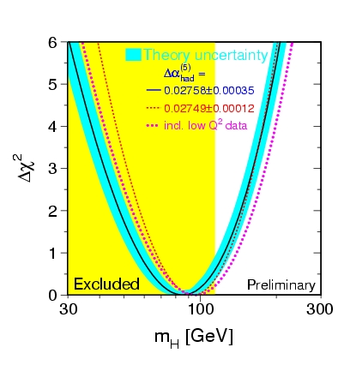
Is it the Standard Model Higgs?
Indirect constraints from other SM measurements indicate that the higgs should be where we found this new particle!
Exluded by LHC 2011
M_{H} = 125 GeV
LEP 2000

Slide 47
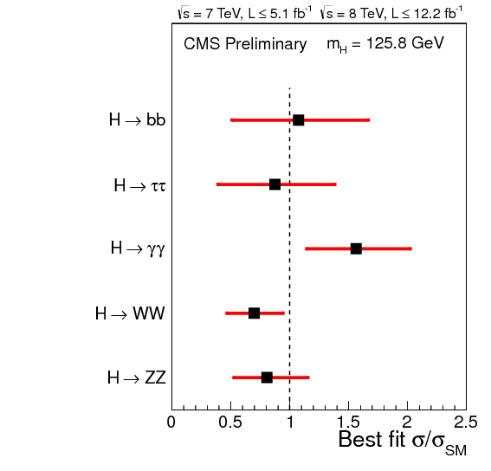
SM Higgs?
CMS HIG-12-045
Signal strength consistent with SM Higgs
Excesses seen in γγ, ZZ and WW in both experiments
Does it couple to fermions?
Answers, beginning to emerge
Self-coupling?
Must wait for several hundred fb^{–1}
Statistical and systematic errors included

Slide 48
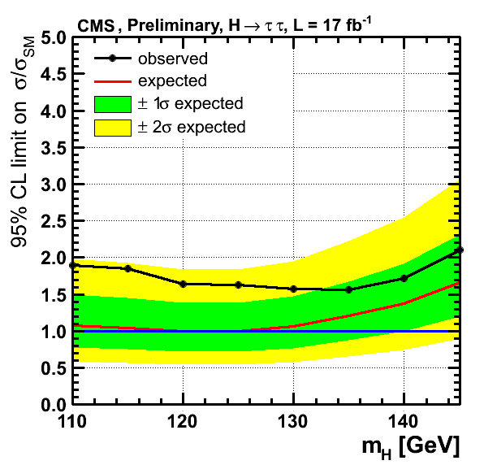
Does the New Boson
Couple to Fermions?
Look at heaviest two fermions (τ lepton and b quark)
Small excess, but within systematic uncertainty bands

Slide 49
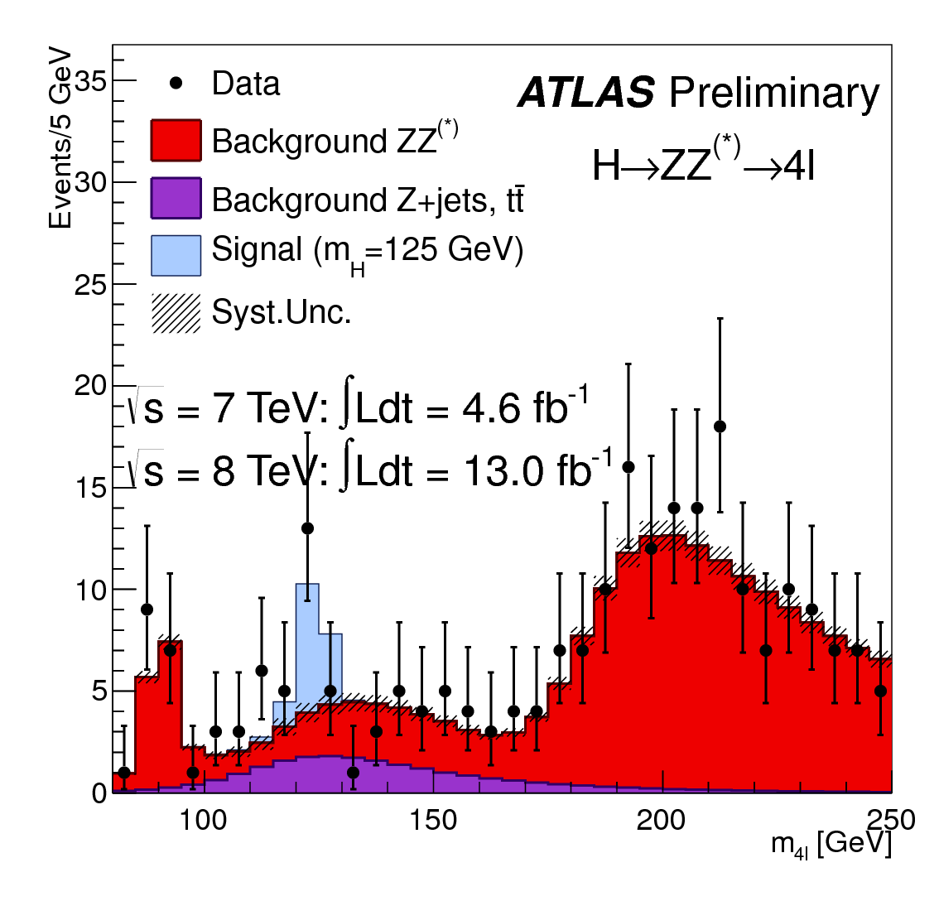
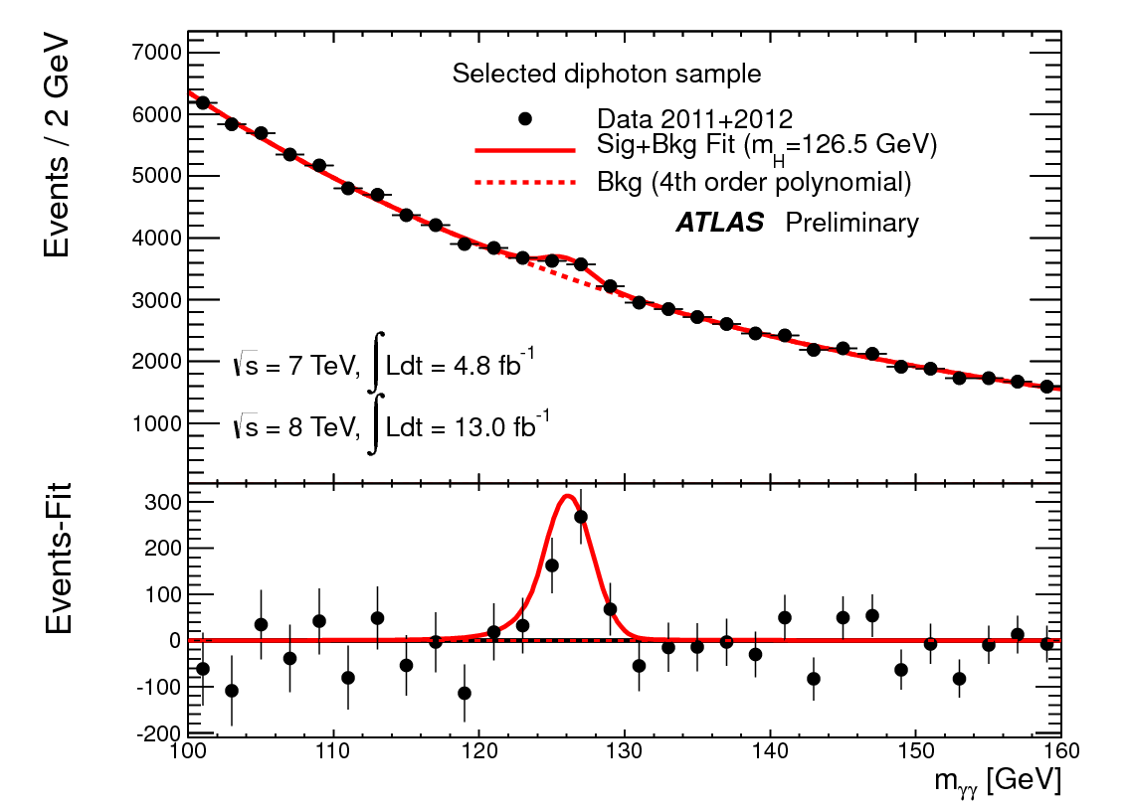
Latest ATLAS Update (after HCP)
ATLAS sees larger signals than CMS
  ZZ (M_{ZZ} = 123.5GeV)
  Gamma,Gamma (M_{γγ} = 126.5 GeV)

Slide 50
Summary
LHC discovered a new particle
  Both ATLAS & CMS see the same thing at the same mass
  ~4σ evidence in photon-pair decay mode
  >3σ evidence in Z-pair decay mode
Is it the Standard Model Higgs Boson?
  It is a boson – because it decays to bosons
  Its mass is in the right window – consistency with SM
  However, its properties are yet to be determined to confirm that it is the SM Higgs Boson
LHC is performing well and further updates are expected soon
  There is more data expected in the coming years
  If it is not SM like Higgs, it will be even more exciting!

