Slide 1
The Large Hadron Collider @ CERN
Physics of the Energy Frontier
The Quantum Universe (20’) – the physics
Quarks, Leptons and Bosons
New Physics @ LHC
Probing the Quantum Universe – the Instruments
The LHC Machine and The CMS Experiment
Slide show of engineering LHC/CMS (10’)
2010 Results (20’)
Establishing Standard Model @ LHC

Slide 2
A Brief History of Time
Quantum Gravity Era
Electro-weak Era
Proton & Neutron Era
Nuclear Era
Atoms and Light Era
Galaxies Formation
Grand Unification Era
Today

Slide 3
Particles & The Universe
Particle physics experiment results are needed for understanding our microcosm and the cosmos itself
What is mass? Where has all the Anti-matter gone?
What is dark matter? …

Slide 4
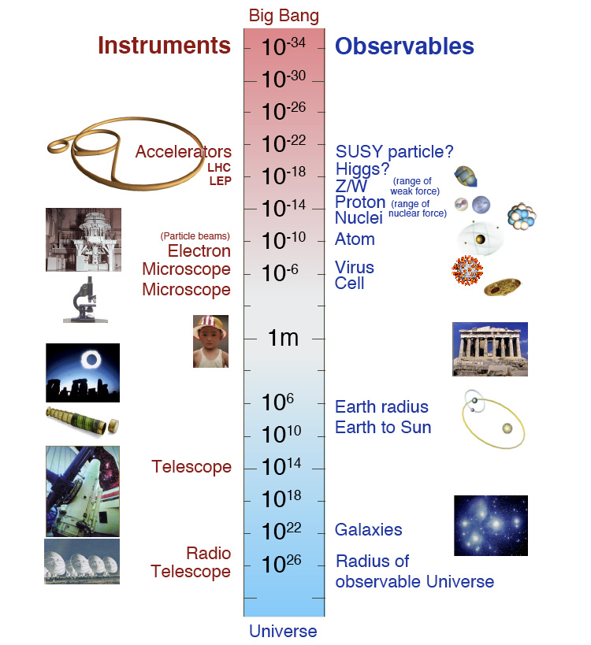
Probing Deeper
As you probe deeper – i.e., reach higher energies – new worlds open up – quantum relativistic world!

Slide 5
The smallness of the electron
At the end of 19th century
Physicists pondered about the electron
Electron is point-like
Radius smaller than 10⁻¹⁷ cm
Like charges repel
Hard to keep electric charge in a small pack
Need a lot of energy to keep the electron small!

Slide 6
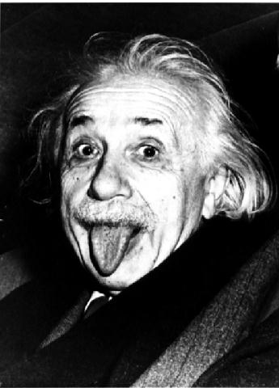
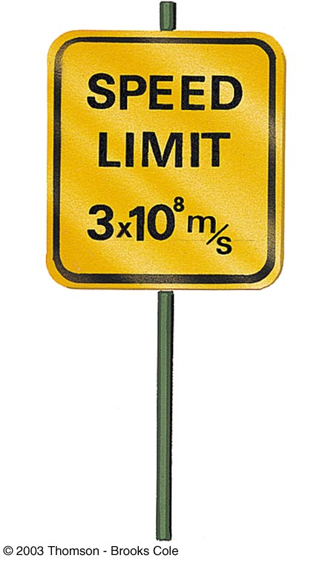
Special Relativity
Space and time treated on equal footing
Energy and matter are related
Energy can be transformed to mass and vice versa
Conservation of mass-energy
Measured energy of the electron is only 0.5 MeV
Can explain a size of 10⁻¹⁰ to 10⁻¹³ cm
Cannot explain < 10⁻¹⁷ cm as measured
Need LOTS of energy to pack charge tightly inside the electron
Breakdown of theory of electromagnetism

Slide 7
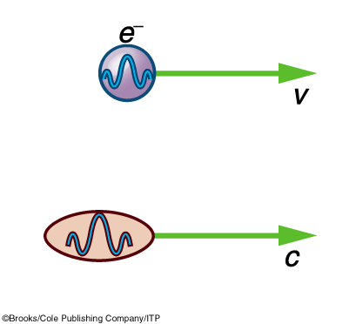
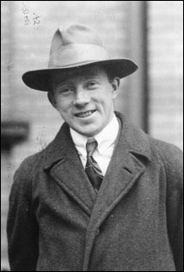
Quantum Mechanics
Uncertainty Principle:
You can violate energy conservation but only for a short time
You can create more massive objects than you have energy - but they are virtual
i.e., they disappear promptly and rematerialize in particle states that conserve mass-energy
γ
Werner Heisenberg

Slide 8
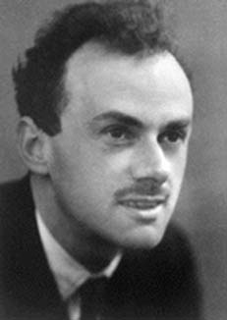
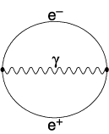
Relativistic Quantum world
Dirac formulated Relativistic Quantum Mechanics
Space and time symmetric quantum equation
Describes infinite number of particles unlike Schrodinger equation
Describes negative electrons and its positive charged cousins – positrons
Photons couple them together
Predicted antimatter
Anderson discovered positron
Vacuum is full of quantum bubbles!
Paul Adrian Maurice Dirac

Slide 9
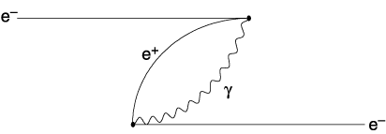
Anti-Matter Helps
Electron creates a force to attract “portions of itself”
Vacuum bubble of matter anti-matter creation/annihilation
Electron annihilates the positron in the bubble
⇒ Size of the electron is no longer a relevant parameter - the closer you probe, the more you see the structure of vacuum … matter and antimatter pairs

Slide 10
Anti-Matter Helps
“Anti-matter attraction” cancels “Like-charge repulsion”
It does not cost too much energy to tightly pack the electric charge inside the electron
All we needed was anti-matter:
We doubled the #particles in the universe
Quantum electrodynamics (QED) now works at very short distances (12 digits accuracy!)

Slide 11
Matter vs Antimatter
All elementary particles come in matter- antimatter pairs
Opposite electric charge
Identical in almost all other respects
Electron-Positron
Proton-Antiproton
Neutron-Antineutron
Up quark - Anti up quark
Energy conservation can be violated for short periods of time to generate particle-antiparticle pairs in vacuum
Relativistic Quantum Mechanics
Given energy new kinds of particles pop out ☺

Slide 12
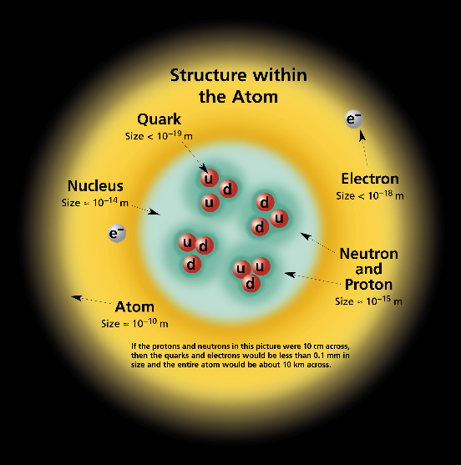
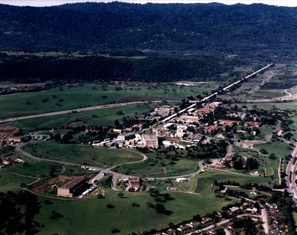
Down to Quarks
Rutherford Scattering with high energy electrons
Stanford Linear Accelerator Center

Slide 13
Mesons and Baryons
Strong interactions between quarks bind them together
Mesons are quark – anti-quark bound states
Pions, Kaons, …
Baryons are three quark bound states
Protons, neutrons, …
The strong force gets stronger at large distances
Free quarks have not been seen – they hadronize
Also explains lack of fractionally charged particles
There may be more exotic bound states
Strong forces gets weaker at short distances
With high energy one can knock out quarks
Which promptly hadronize into a plethora of hadrons ☺

Slide 14
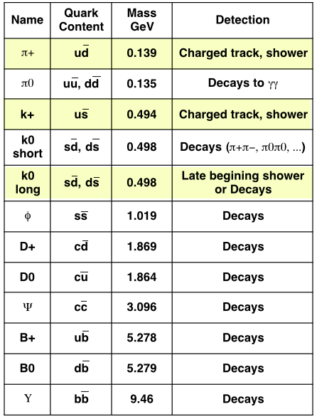
The Particle Zoo
Many types and decays
Detection
Interactions with matter
Measure momentum by bending tracks in magnetic fields
Combinations of measured momenta

Slide 15
Elementary particles
e⁻
c
γ,Z
b
b
t
e⁻
e⁺
W⁻
W⁺
Heavier elementary particles decay - only the first generation (e,u,d), photons (γ) and neutrinos (ν) are stable.
ν

Slide 16
Flavor Changing Interactions
Charged W± particles (like photons but massive - 80 GeV) change flavor of quarks
Mass of W makes the interaction weak
For short period energy conservation can be violated to create virtual heavy W± particles
Heavier quarks, leptons decay to lighter generations (u, d, e, ν)
Cross generational coupling exists
b quark decays to c quark + W (virtual)
There are no flavor changing neutral interactions
But, there is a neutral heavy boson Z
Neutrinos do not have electric charge
So, they don’t interact via photon
They interact only weakly
c
b
e⁻
W⁻
ν

Slide 17
Matter Particles
As Dirac Predicted all of these matter particles also have corresponding antimatter particles

Slide 18
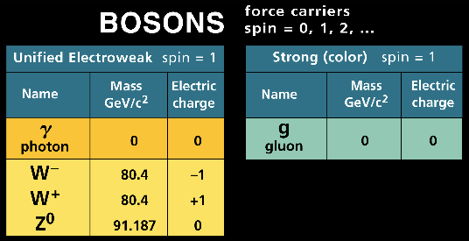
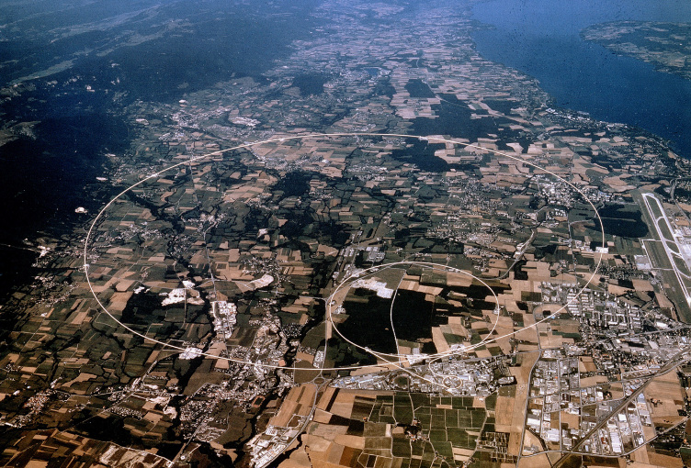
Interactions Between Particles
CERN - Geneva

Slide 19
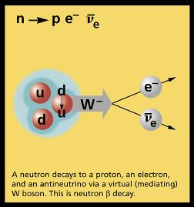
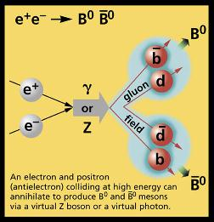
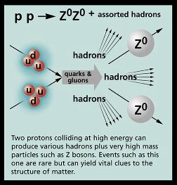
Particle Interactions

Slide 20
The Elusive Higgs
Weak force is weak because W and Z bosons are heavy
Relativistic quantum theory does not work with simple mass terms in the theory
Higgs Mechanism was invented to provide mass for weak bosons by adding a new field with four degrees of freedom
Three of those degrees of freedom are equivalent to having masses for W and Z
The left over degree of freedom is the scalar higgs boson in the Standard Model
Higgs couplings to leptons and quarks provide them masses
The hunt is on to find the Higgs since the 80s!
The higgs bosons of masses up to 114 GeV are excluded
For theory to make sense higgs mass should be < ~1 TeV
The LHC is designed to find the higgs if it exists

Slide 21
The Problems of Standard Model
Higgs self energy corrections
Higgs couples to itself
However, these self energy corrections are divergent
Up to about 1 TeV energy scale this is not a problem
Therefore, new physics should show up at ~few TeV
Super-symmetry
Corrections due to loops of fermions (leptons and quarks) and bosons (W, Z) come with opposite sign
What if there are equal number of fermions and bosons in the real theory at high masses (~few TeV)?
This could solve the problem of higgs divergences ☺

Slide 22
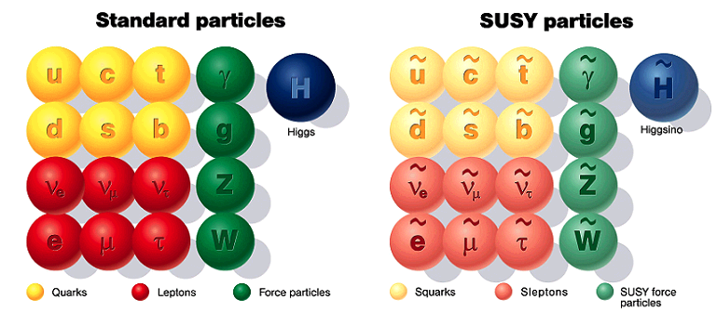
Supersymmetry
A new physics theory which doubles known particles again – but the new particles have very large mass
LHC may be able to produce them

Slide 23
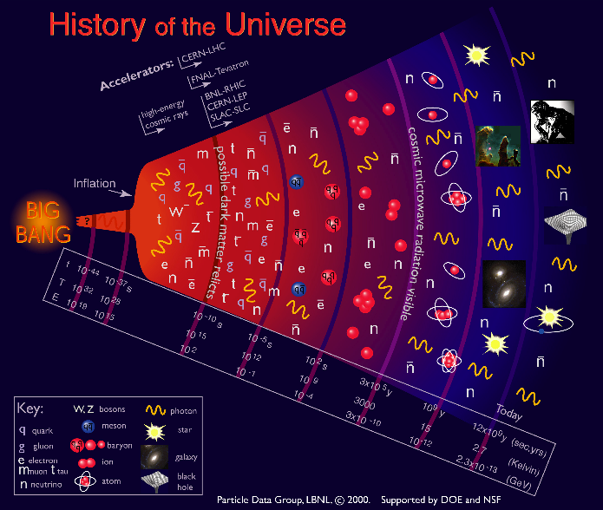
From Quarks to Cosmos

Slide 24
The Galactic Motion
In fact, most of the matter in the universe is dark

Slide 25
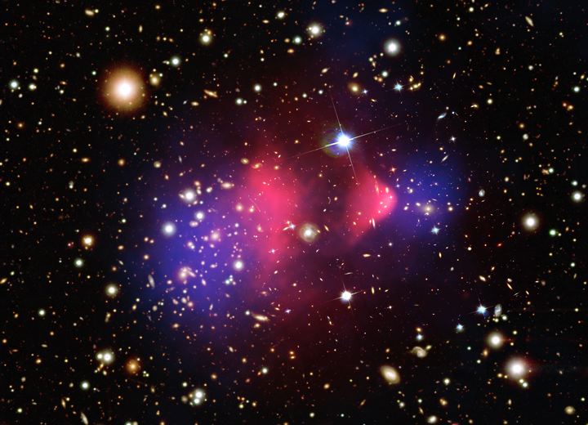
Dark Matter
Collision of two clusters of galaxies showing definitive proof of the existence of Dark Matter.
Collision reshaped the intergalactic gas (pink) of one into a distinctive “bullet” shape.
The dark matter (blue) barely interacts with other matter
Flies through normal matter ending up light-years away from the normal matter.

Slide 26
What is Dark Matter?
Known particles in the Standard Model cannot be what dark matter is made of
Only neutrinos interact very weakly with other matter but they have very low mass
Super-symmetric theories have weakly interacting massive particles (WIMPs), which are ideal dark matter candidates ☺

Slide 27
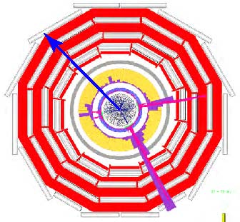
Missing Transverse Energy
Initial particles (protons) are going in and out of the screen in this picture
Net momentum initially is zero in this XY-plane
Remnants after the collision should also add up to zero momentum
Imbalance seen when there are non-interacting (dark) particles.

Slide 28
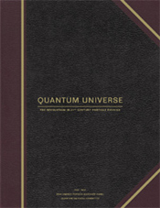
Quantum Universe
http://interactions.org/quantumuniverse/
Unified Forces
Are there undiscovered principles of nature: new symmetries, new physical laws?
How can we solve the mystery of dark energy?
Are there extra dimensions of space?
Do all forces become one?
The Particle World
Why are there so many kinds of particles?
What is dark matter? How can we make it?
What are neutrinos telling us?
The Birth of the Universe
How did the Universe come to be?
What happened to the antimatter?

Slide 29
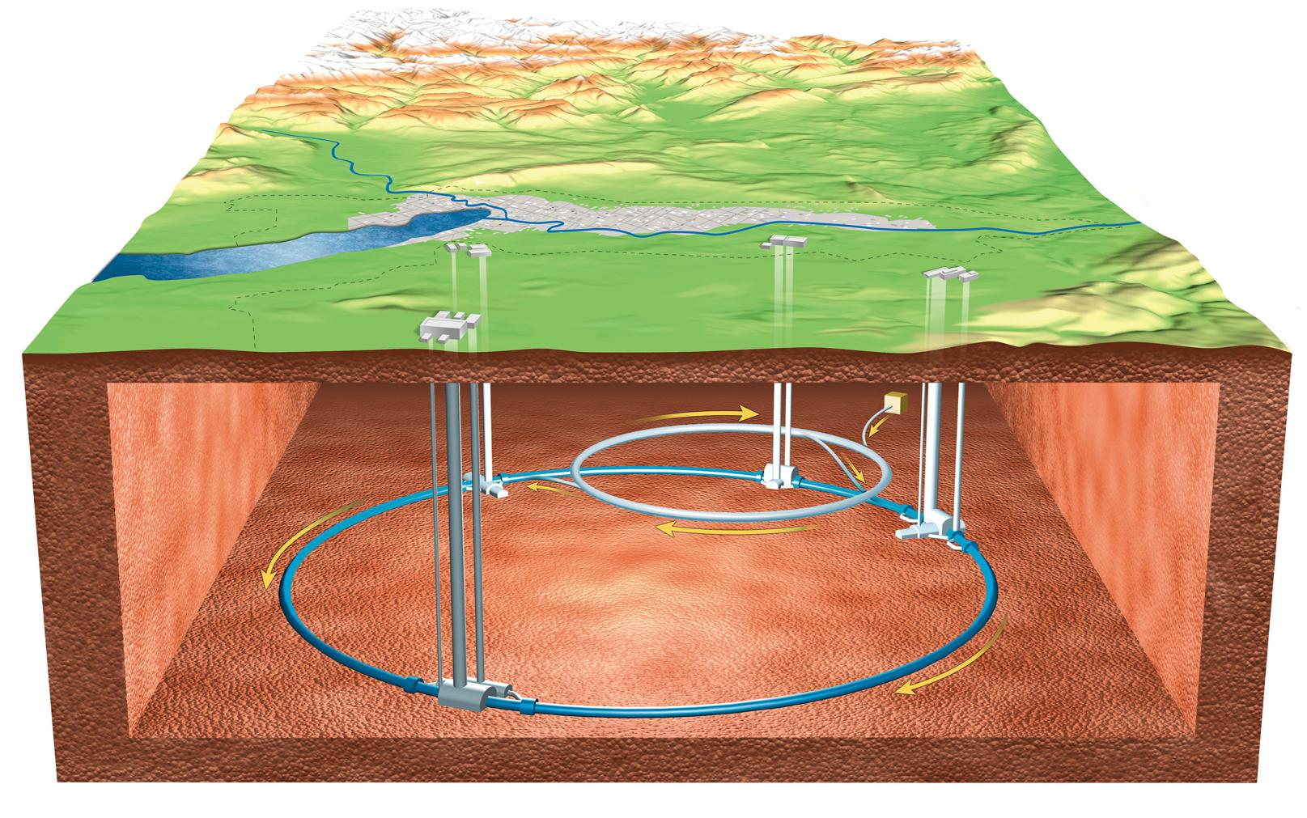
Large Hadron Collider

Slide 30
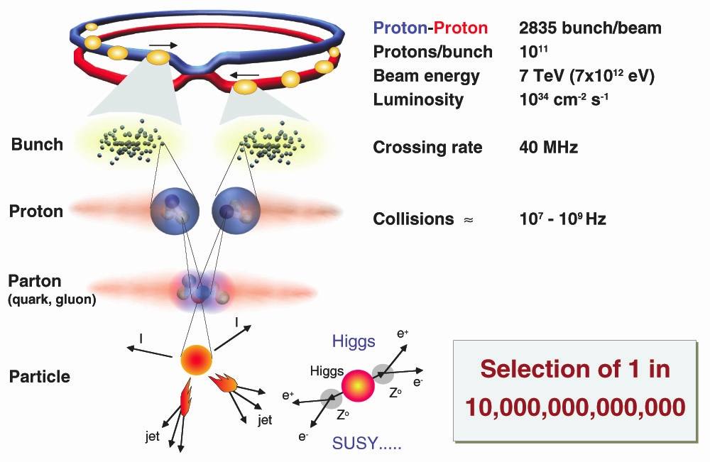
The Large Hadron Collider

Slide 31
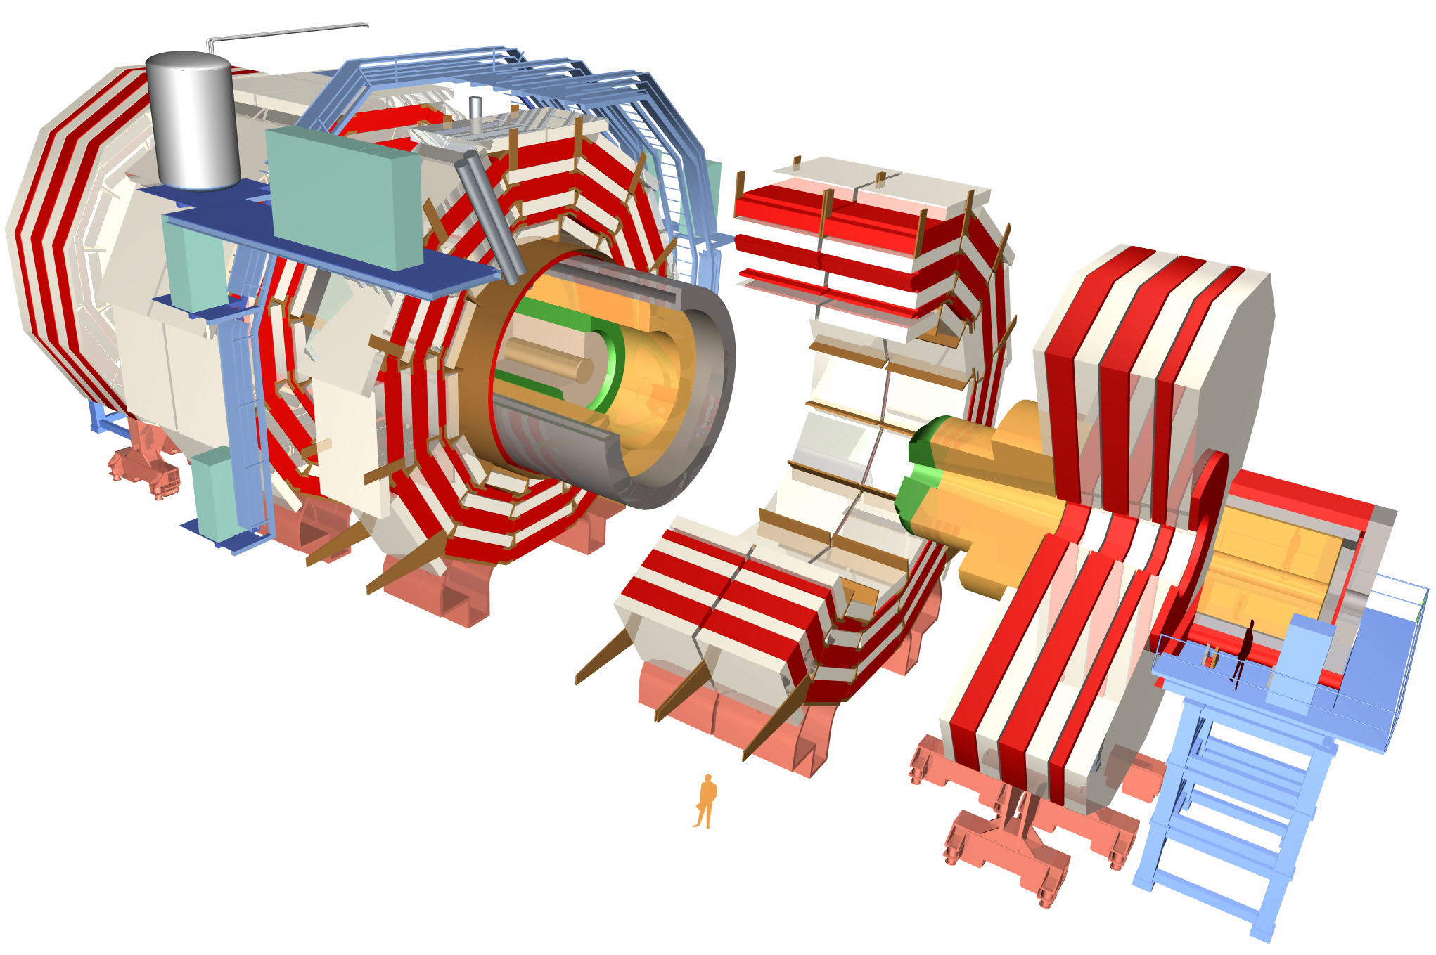
CMS : A Giga-Pixel Camera
Snaps a billion pictures of quantum interactions a second

Slide 32
Particle Detection in CMS
Notes:
Transverse slice
Path of muon
---------------------------------------
Punch-through can make a high-pt muon look low
Muons are “gold-plated” since they suffer less radiative loss in the tracker, are better measured (Detector Paper, 128).

