Slide 1
Compact Colliders Of Tomorrow: The Cool Copper Collider & The Muon Collider
Precision Electroweak to Discoveries at the Energy Frontier
based on US Snowmass 2021-22 + 2023 Particle Physics Project Prioritization Panel (P5) discussions
https://www.muoncollider.us/ https://muoncollider.web.cern.ch/
https://web.slac.stanford.edu/c3/

Slide 2
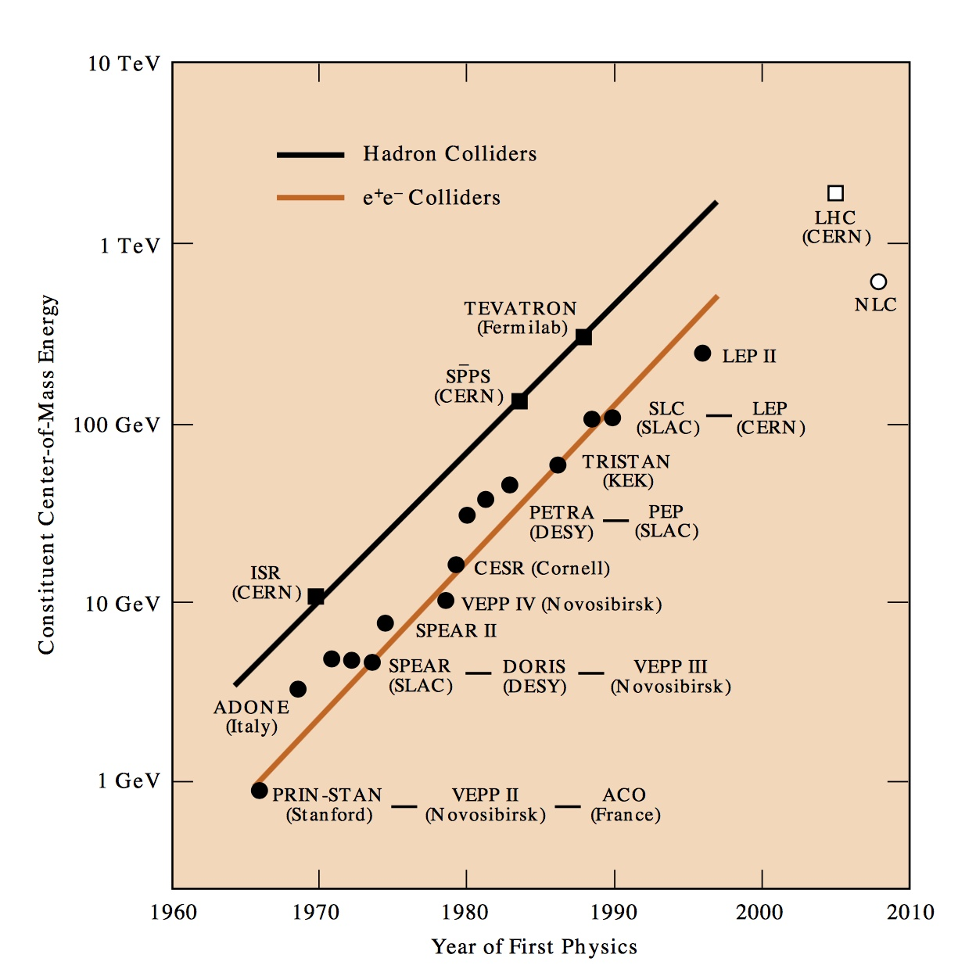
Colliders @ the Energy Frontier!
CERN Plan A
FCC-hh
MuCol?
HL-LHC
C³?
CERN Plan A
FCC-ee
http://www.slac.stanford.edu/pubs/beamline/27/1/27-1-panofsky.pdf
Strong desire to start new colliders early
2020
2030
2040
2050
2060
2070
We obviously need to invest more in machine R&D; more people

Slide 3
gravity effects significant
Why go to new Colliders?
desert
Standard model of particle physics works well at the LHC scales, although some key aspects of observed cosmological phenomena are left unexplained.
LHC
Yes, we are in the dark.
electroweak symmetry-breaking
baryon masses : flavour physics
nuclear energy levels
atomic energy levels

Slide 4
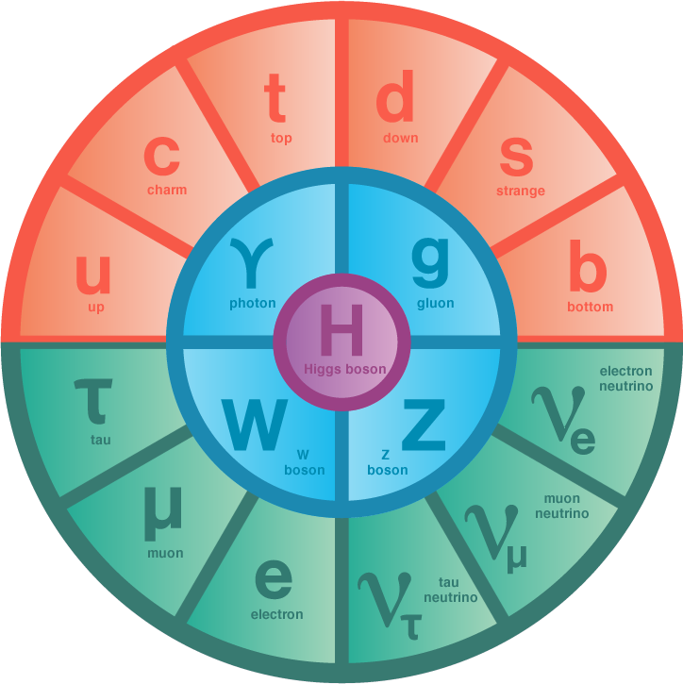
Higgs is Central
CERN
Large Hadron Collider
Geneva, Switzerland
First Fermions discovered were electrons in 19th century
First Scalar boson
discovered, the Higgs, was in 2012!
Higgs is Edifice on which the Standard Model is built.
Higgs Will Likely Play a Central Role in guiding us out of this Darkness
First Vector-bosons discovered were photons also in 19th century

Slide 5
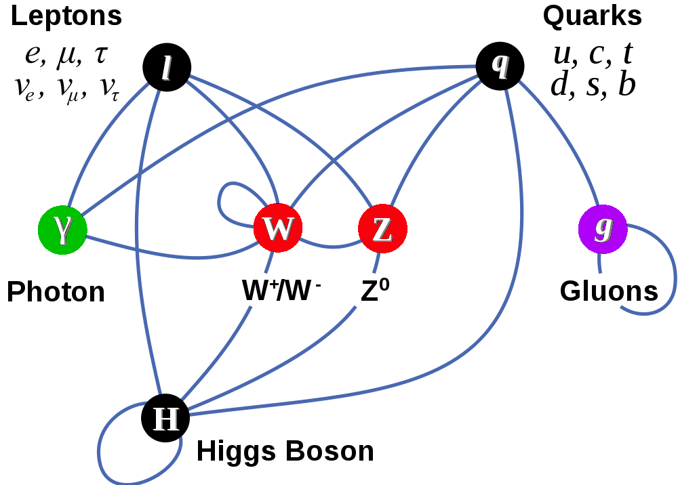
Particles & Interactions of The Standard Model
Matter Particles (fermions)
Interactions by exchange of vector bosons
The edifice on which SM is built: The complex scalar doublet, with non-zero VEV, results in masses for W⁺/W– and the Z & massive Higgs. Fermions also get mass interacting with H.

Slide 6
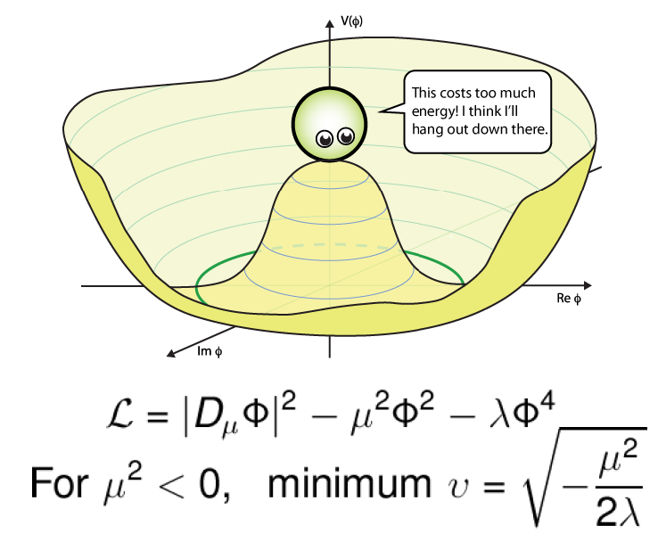
Higgs Field is Special Electro-Weak Symmetry Breaking
50 years ago, gauge theory unified electro-weak interactions, but could not accommodate non-zero masses for W± & Z
$$φ=\left(\begin{matrix}φ_{1}+iφ_{2} \\ φ_{3}+iφ_{4}\end{matrix}\right)$$
Introduction of a doublet of complex scalar fields with peculiar potential provided masses for W± & Z and left γ massless!
The remnant fourth field degree of freedom is the Higgs Boson discovered in 2012
Coupling to Higgs field provides masses to matter particles!!
Confirming the form of the potential requires measuring di-higgs production

Slide 7
Sneak Peek into the Desert
In the language of quantum field theory...
Flavor sector → new physics
virtual states
Higgs sector → new physics?
LHC
...our window into the desert
Scalar Higgs boson mass corrections would be very large with only the particle content of the Standard Model

Slide 8
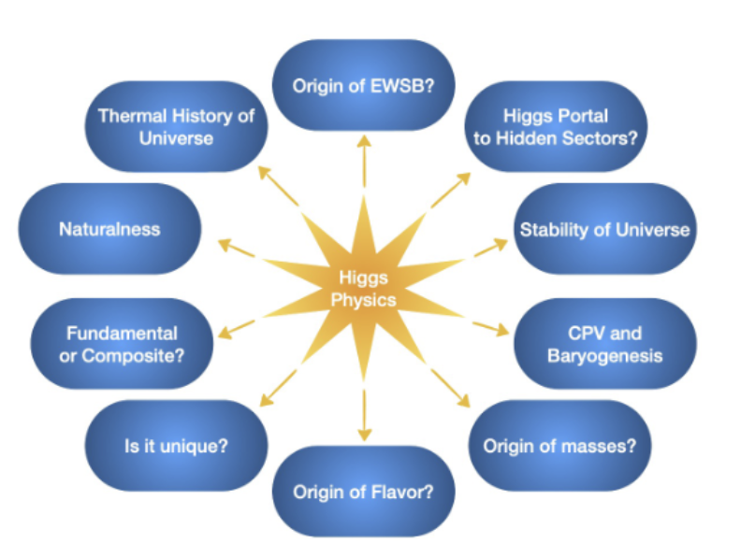
Higgs Central to Many Fundamental Topics
Percent level Higgs couplings deviations from SM values ➔ BSM physics at 10 TeV
e⁺ e– Higgs Factory ➔ Energy Frontier (10 TeV) Muon Collider

Slide 9
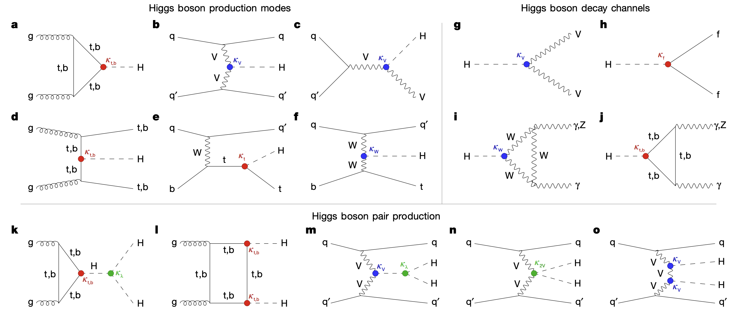
Higgs Boson Couplings, Production and Decays
(At the LHC)
μ⁺
ν_{μ}
e⁺
μ⁻
ν_{μ}
e⁻
(At Muon Colliders)
(At e+e- factories)
μ⁺
ν_{μ}
μ⁻
ν_{μ}
(At Muon Colliders)

Slide 10
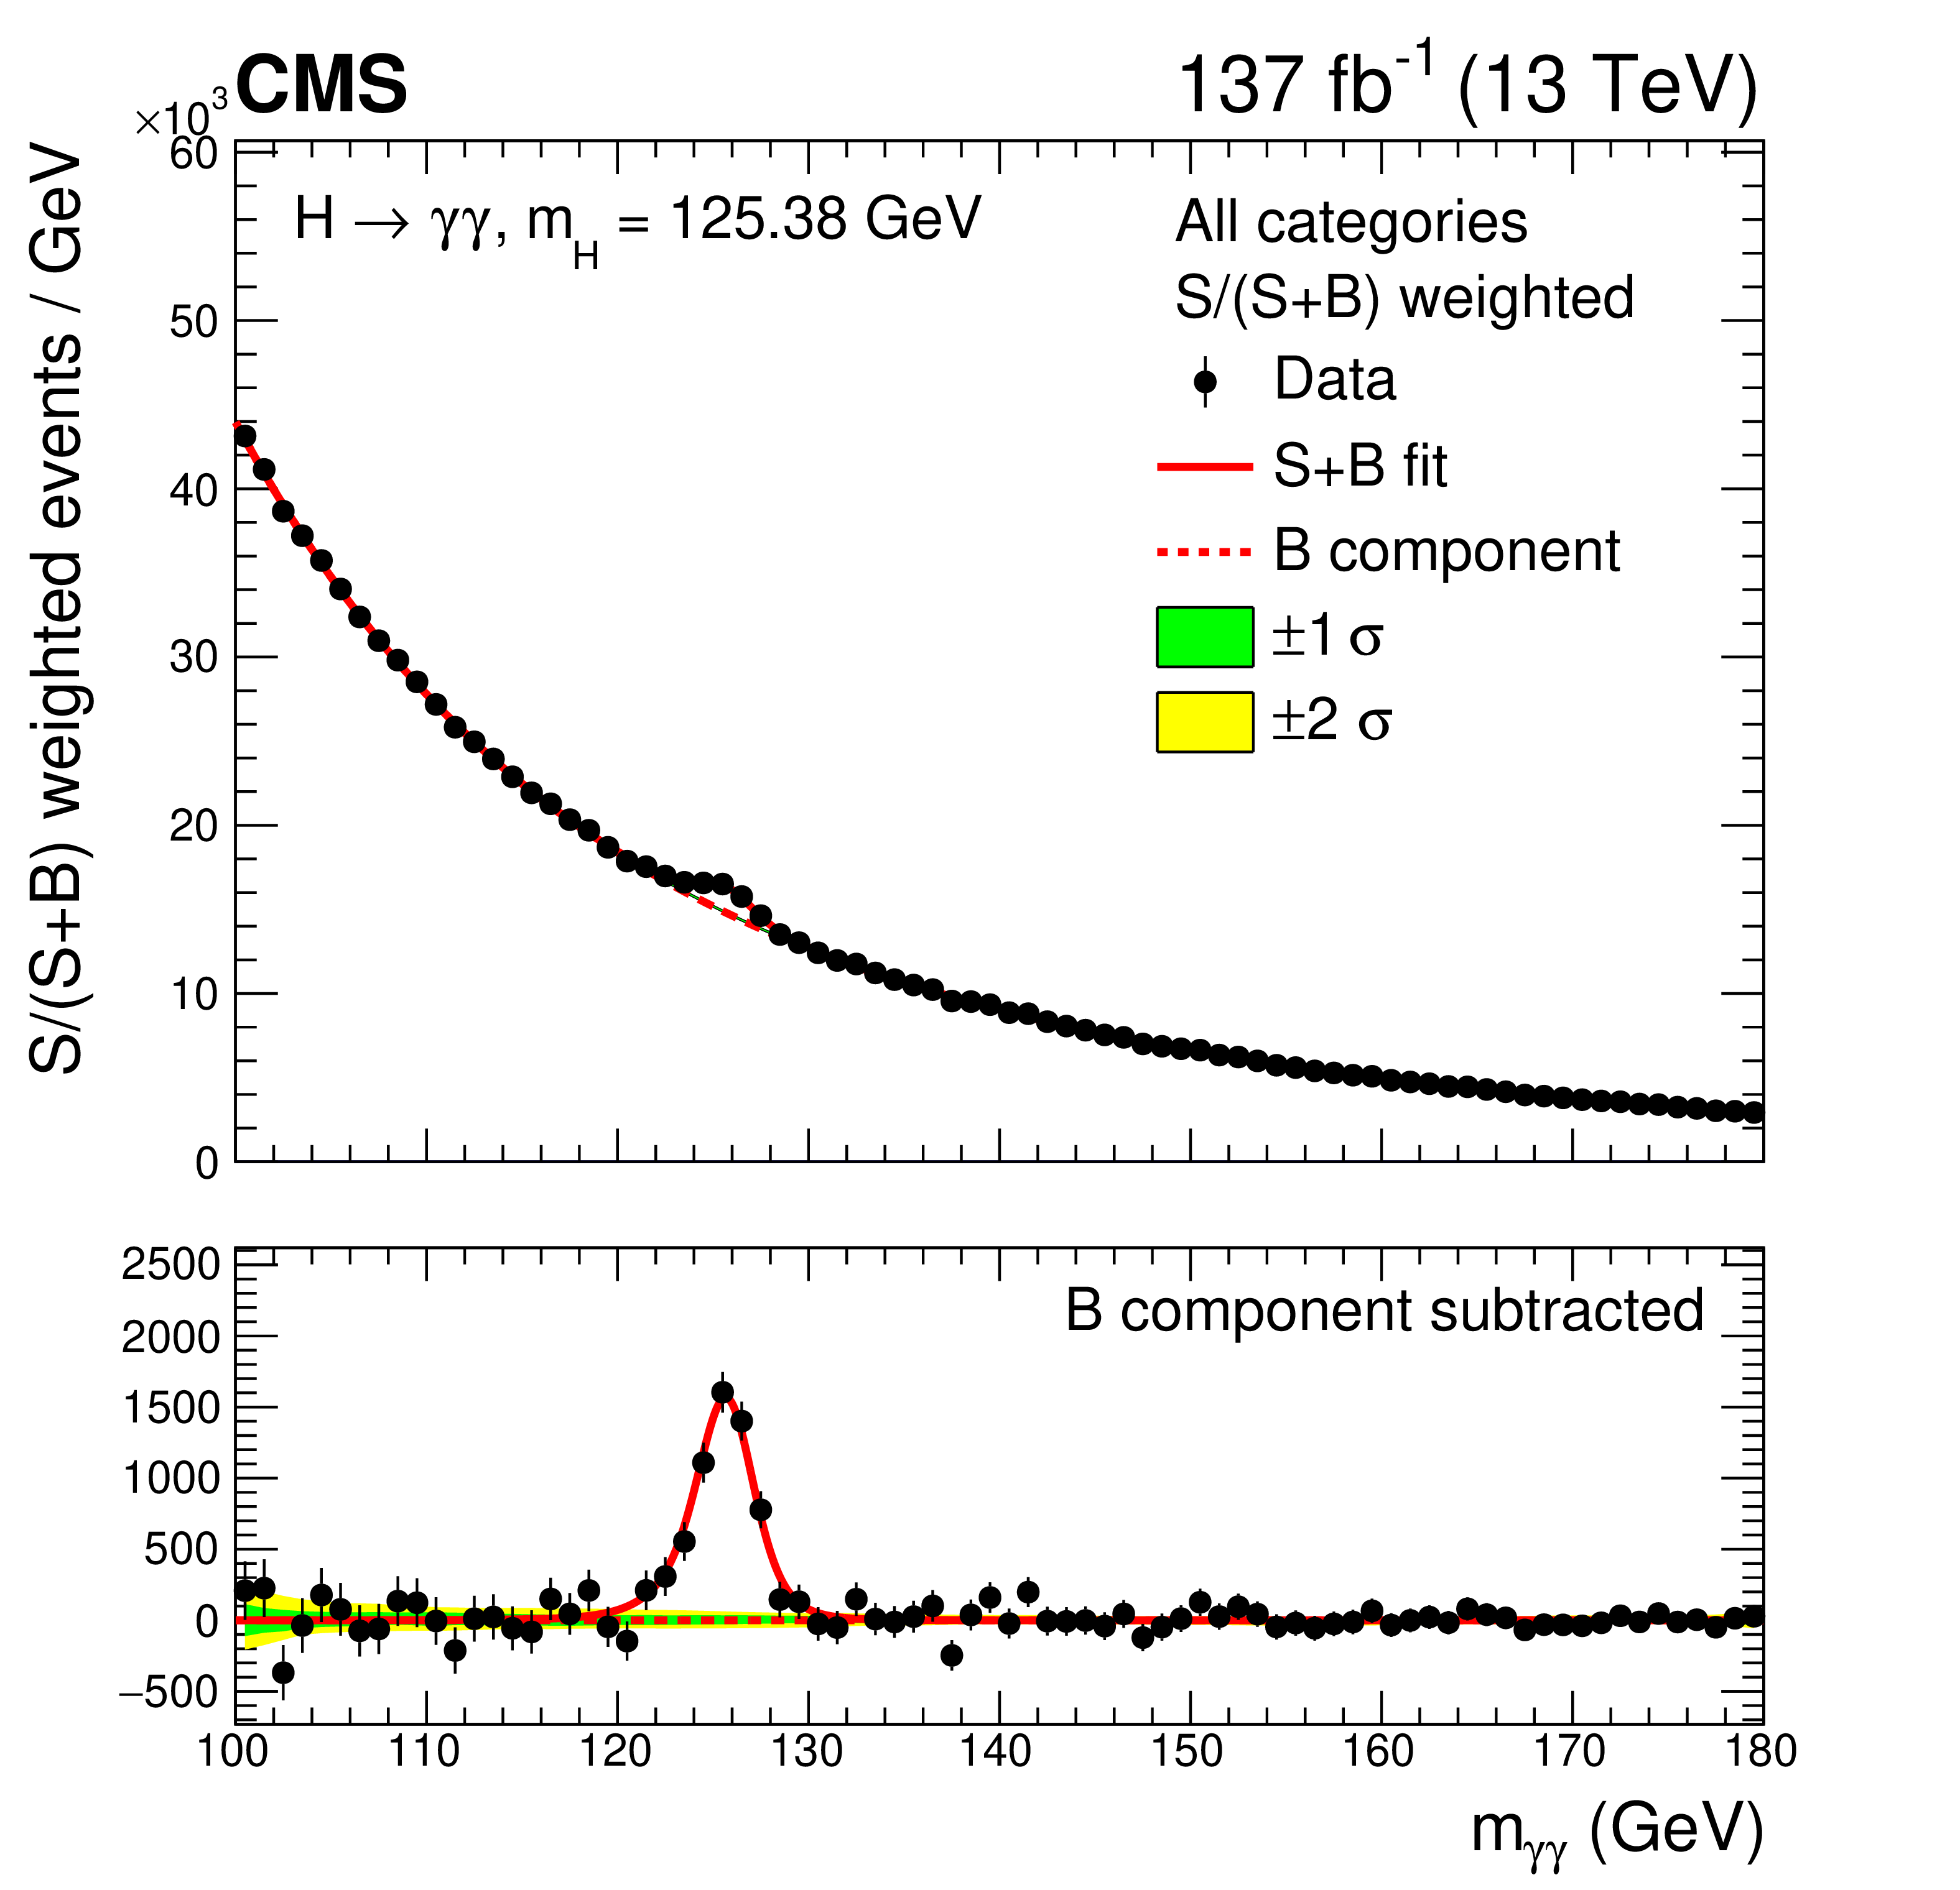
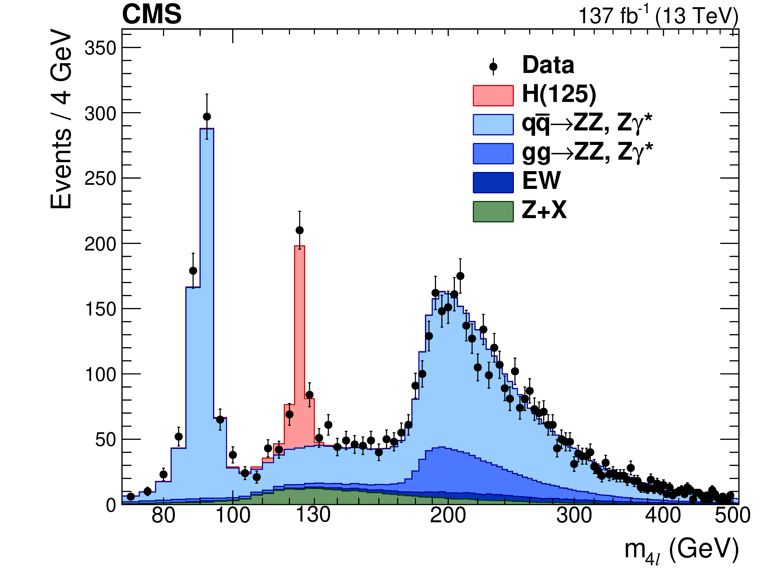
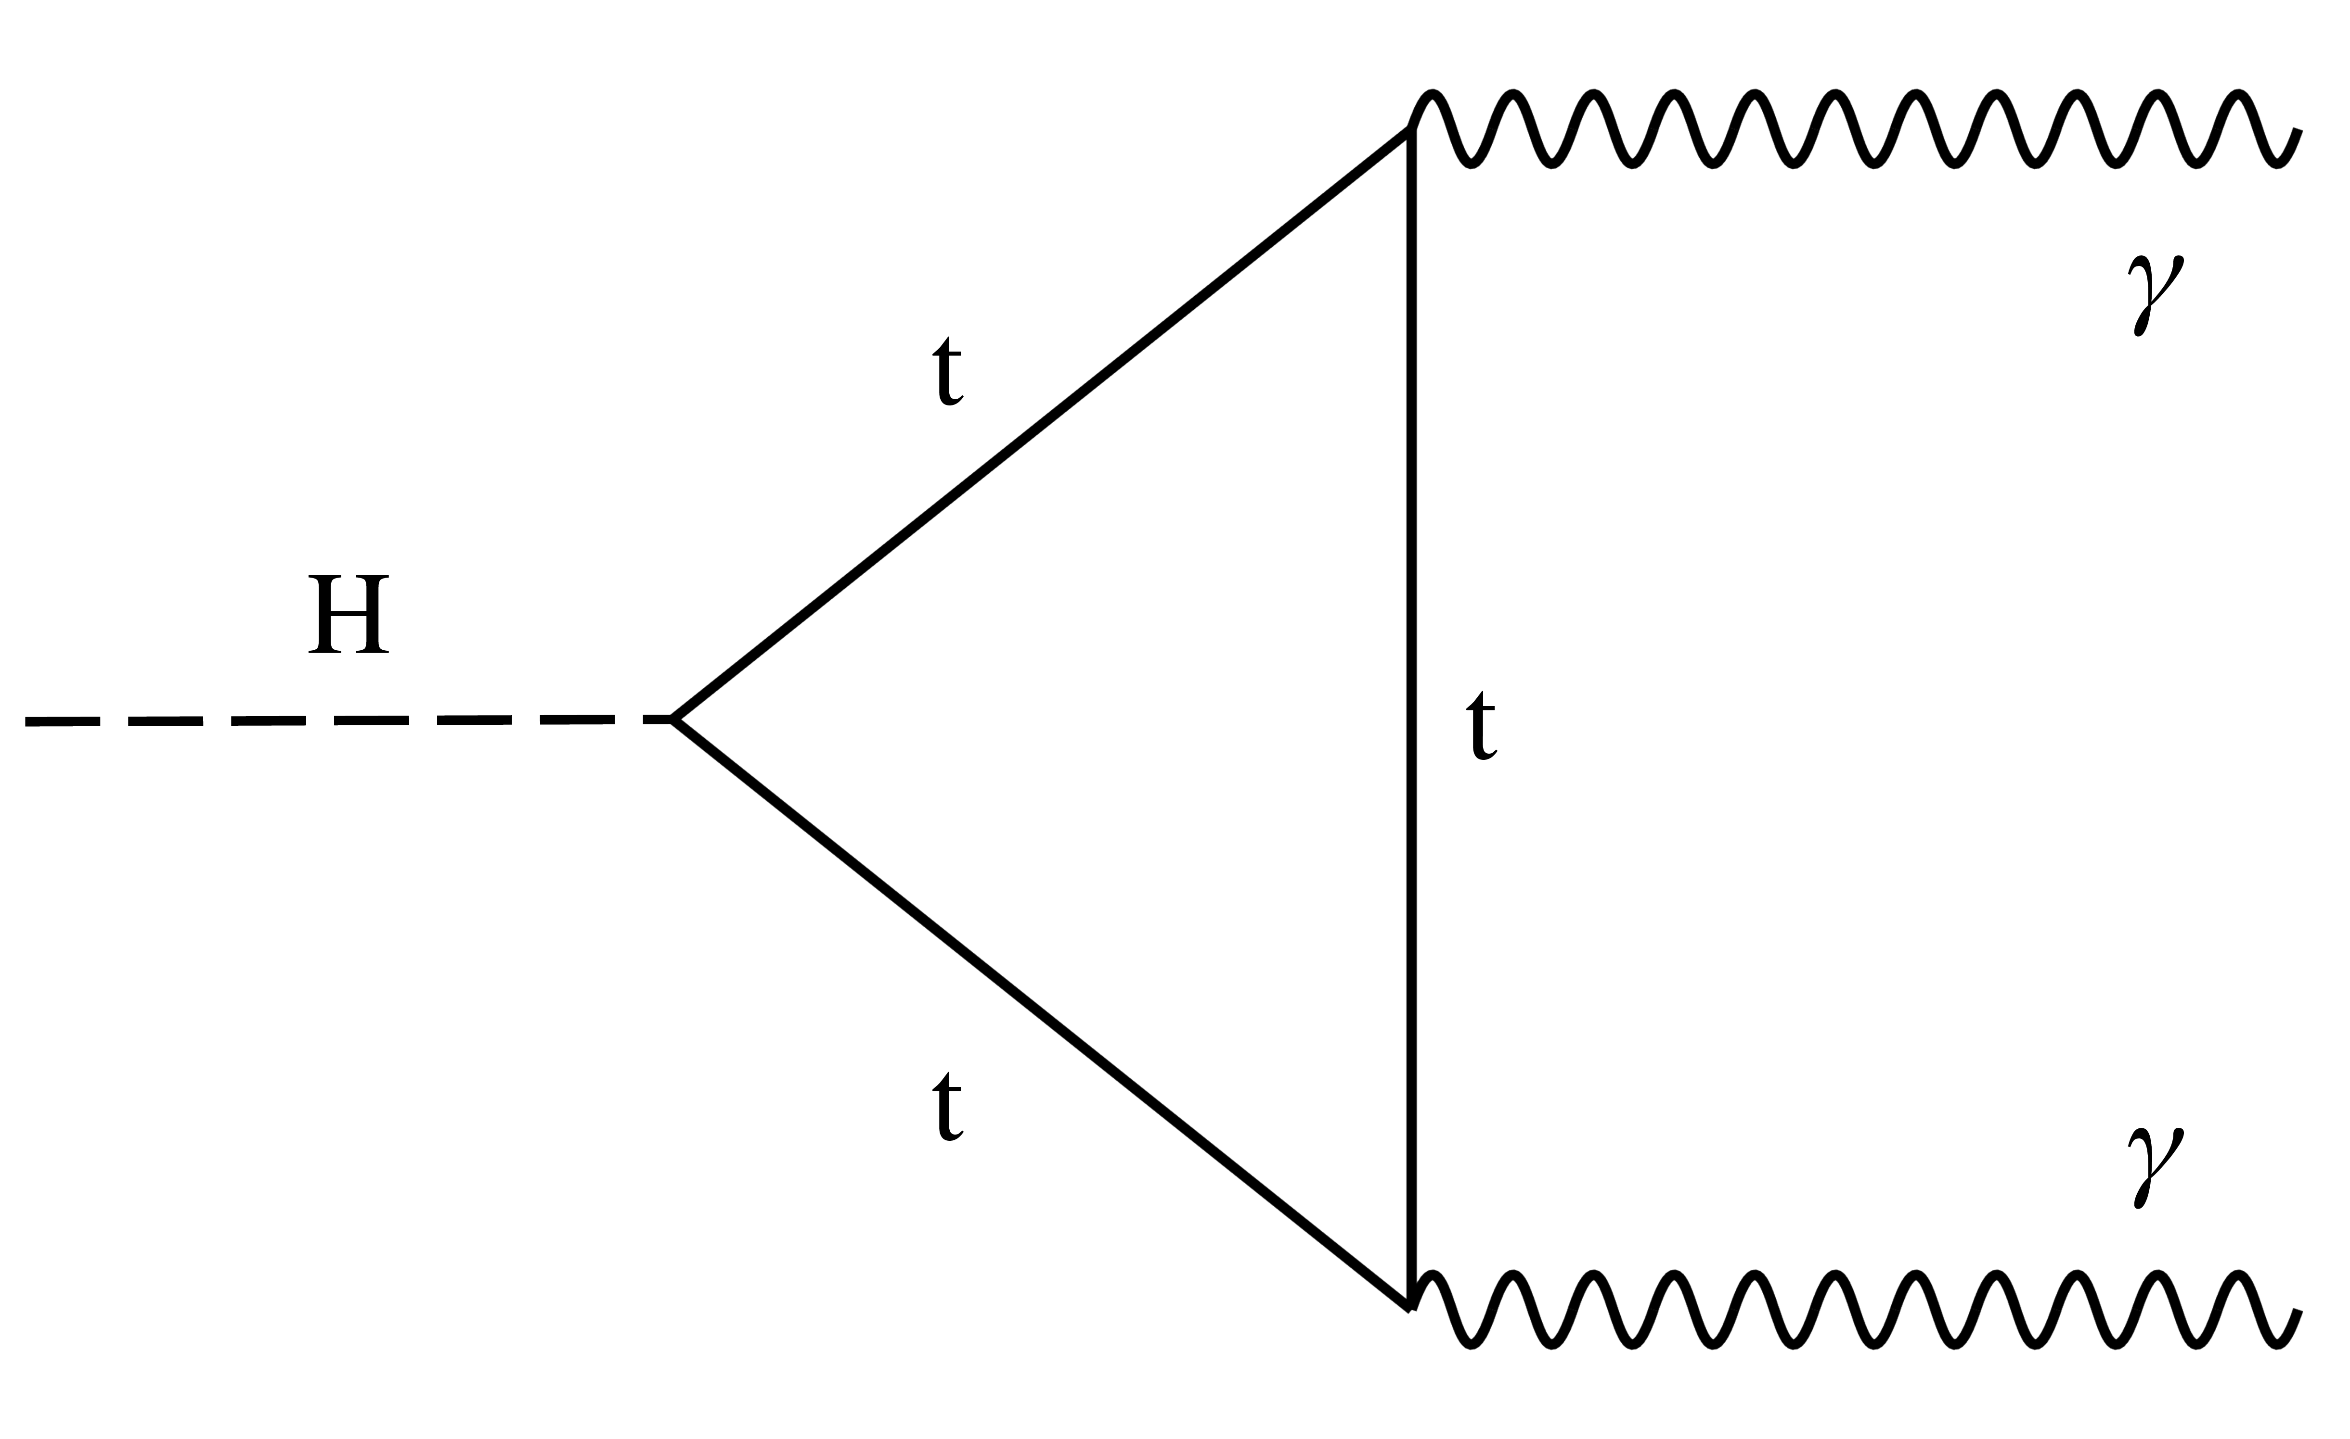
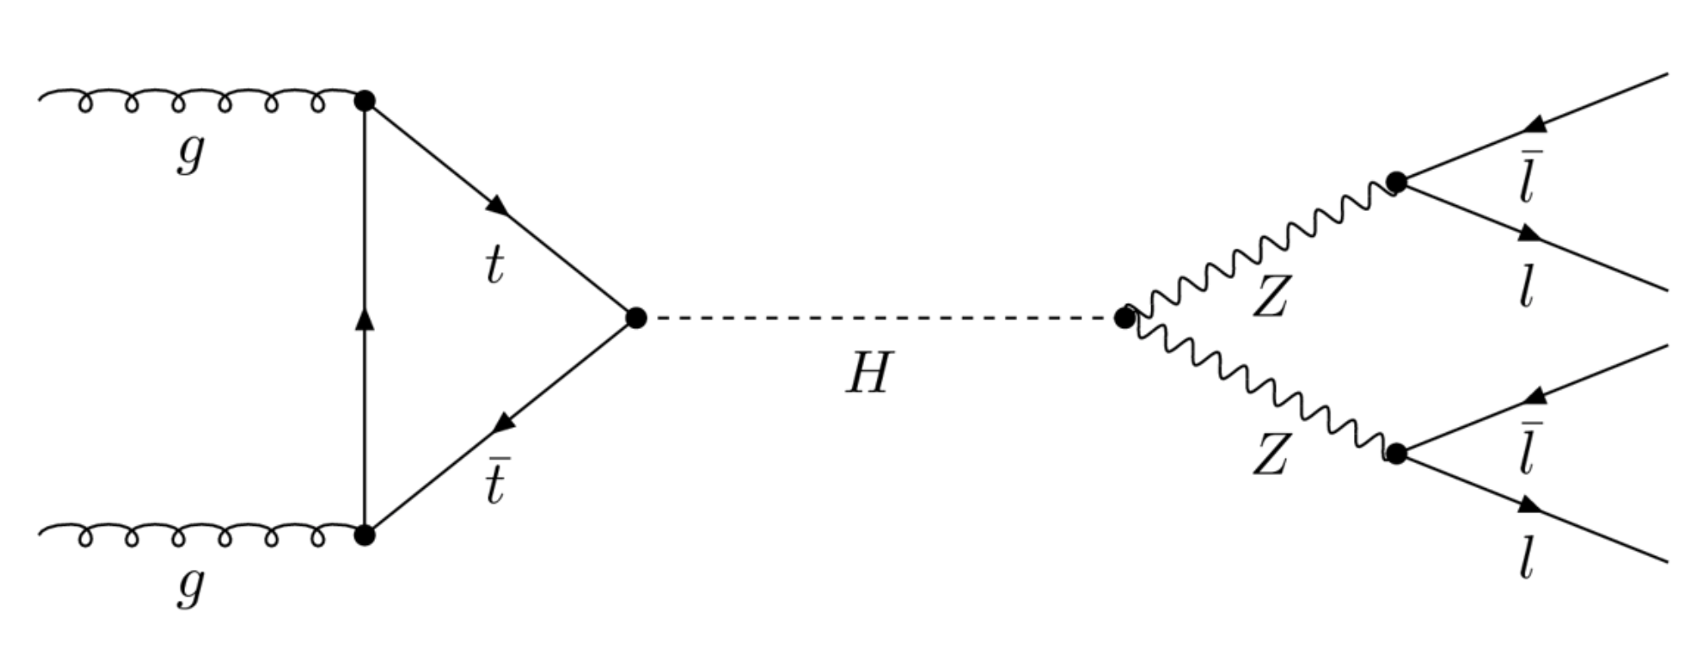
Current Status of Golden Channels @ LHC
Our Higgs boson data sets are enabling detailed studies of the SM

Slide 11
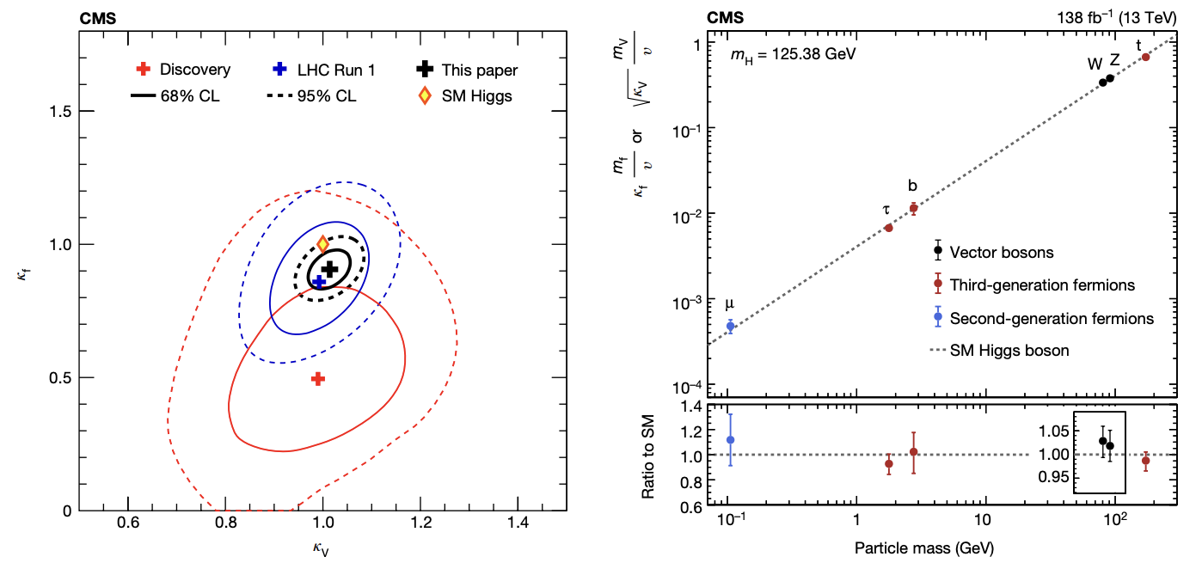
Current Status of Higgs Couplings
Discrepancies at this level if any would imply <1 TeV scale new physics – we did not see either

Slide 12
What’s Next? Sub-percent Level Higgs Couplings → 10 TeV BSM
Couplings Deviations found at C³ e⁺e–Higgs Factory → BSM @ 10 TeV Muon Collider
Adapted from Patrick Meade

Slide 13
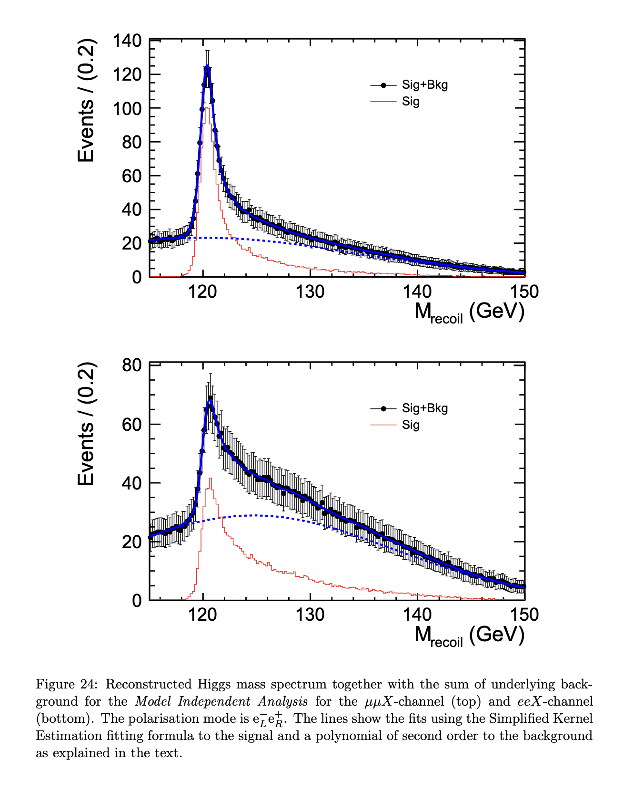
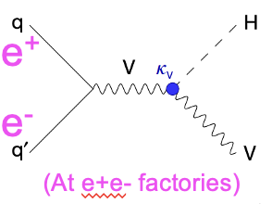
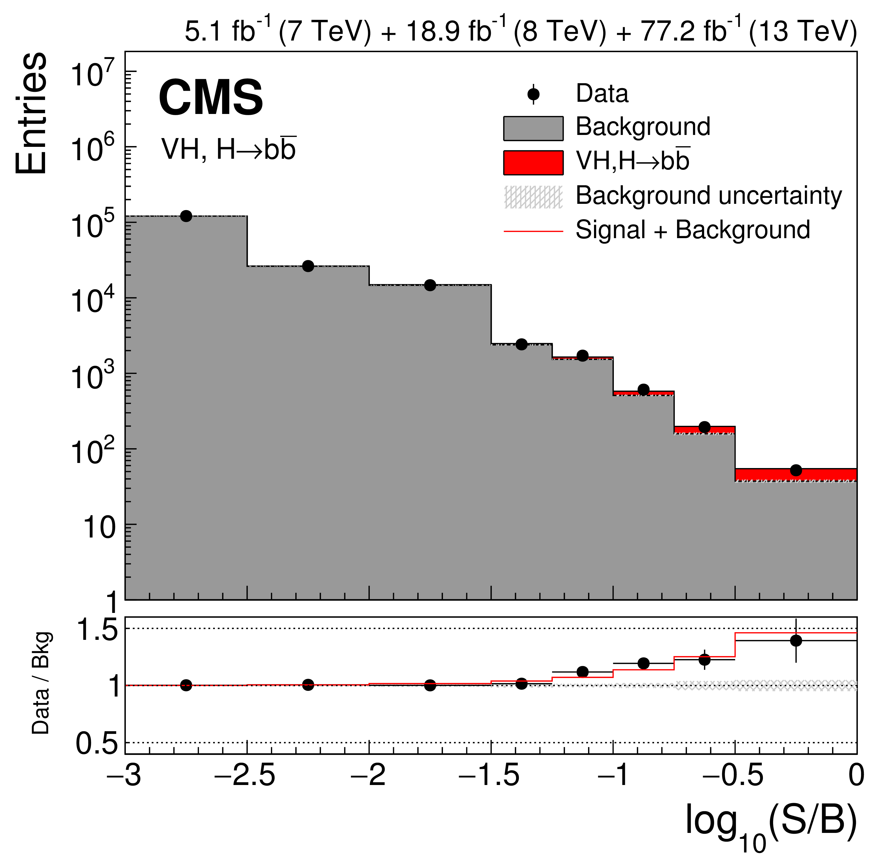
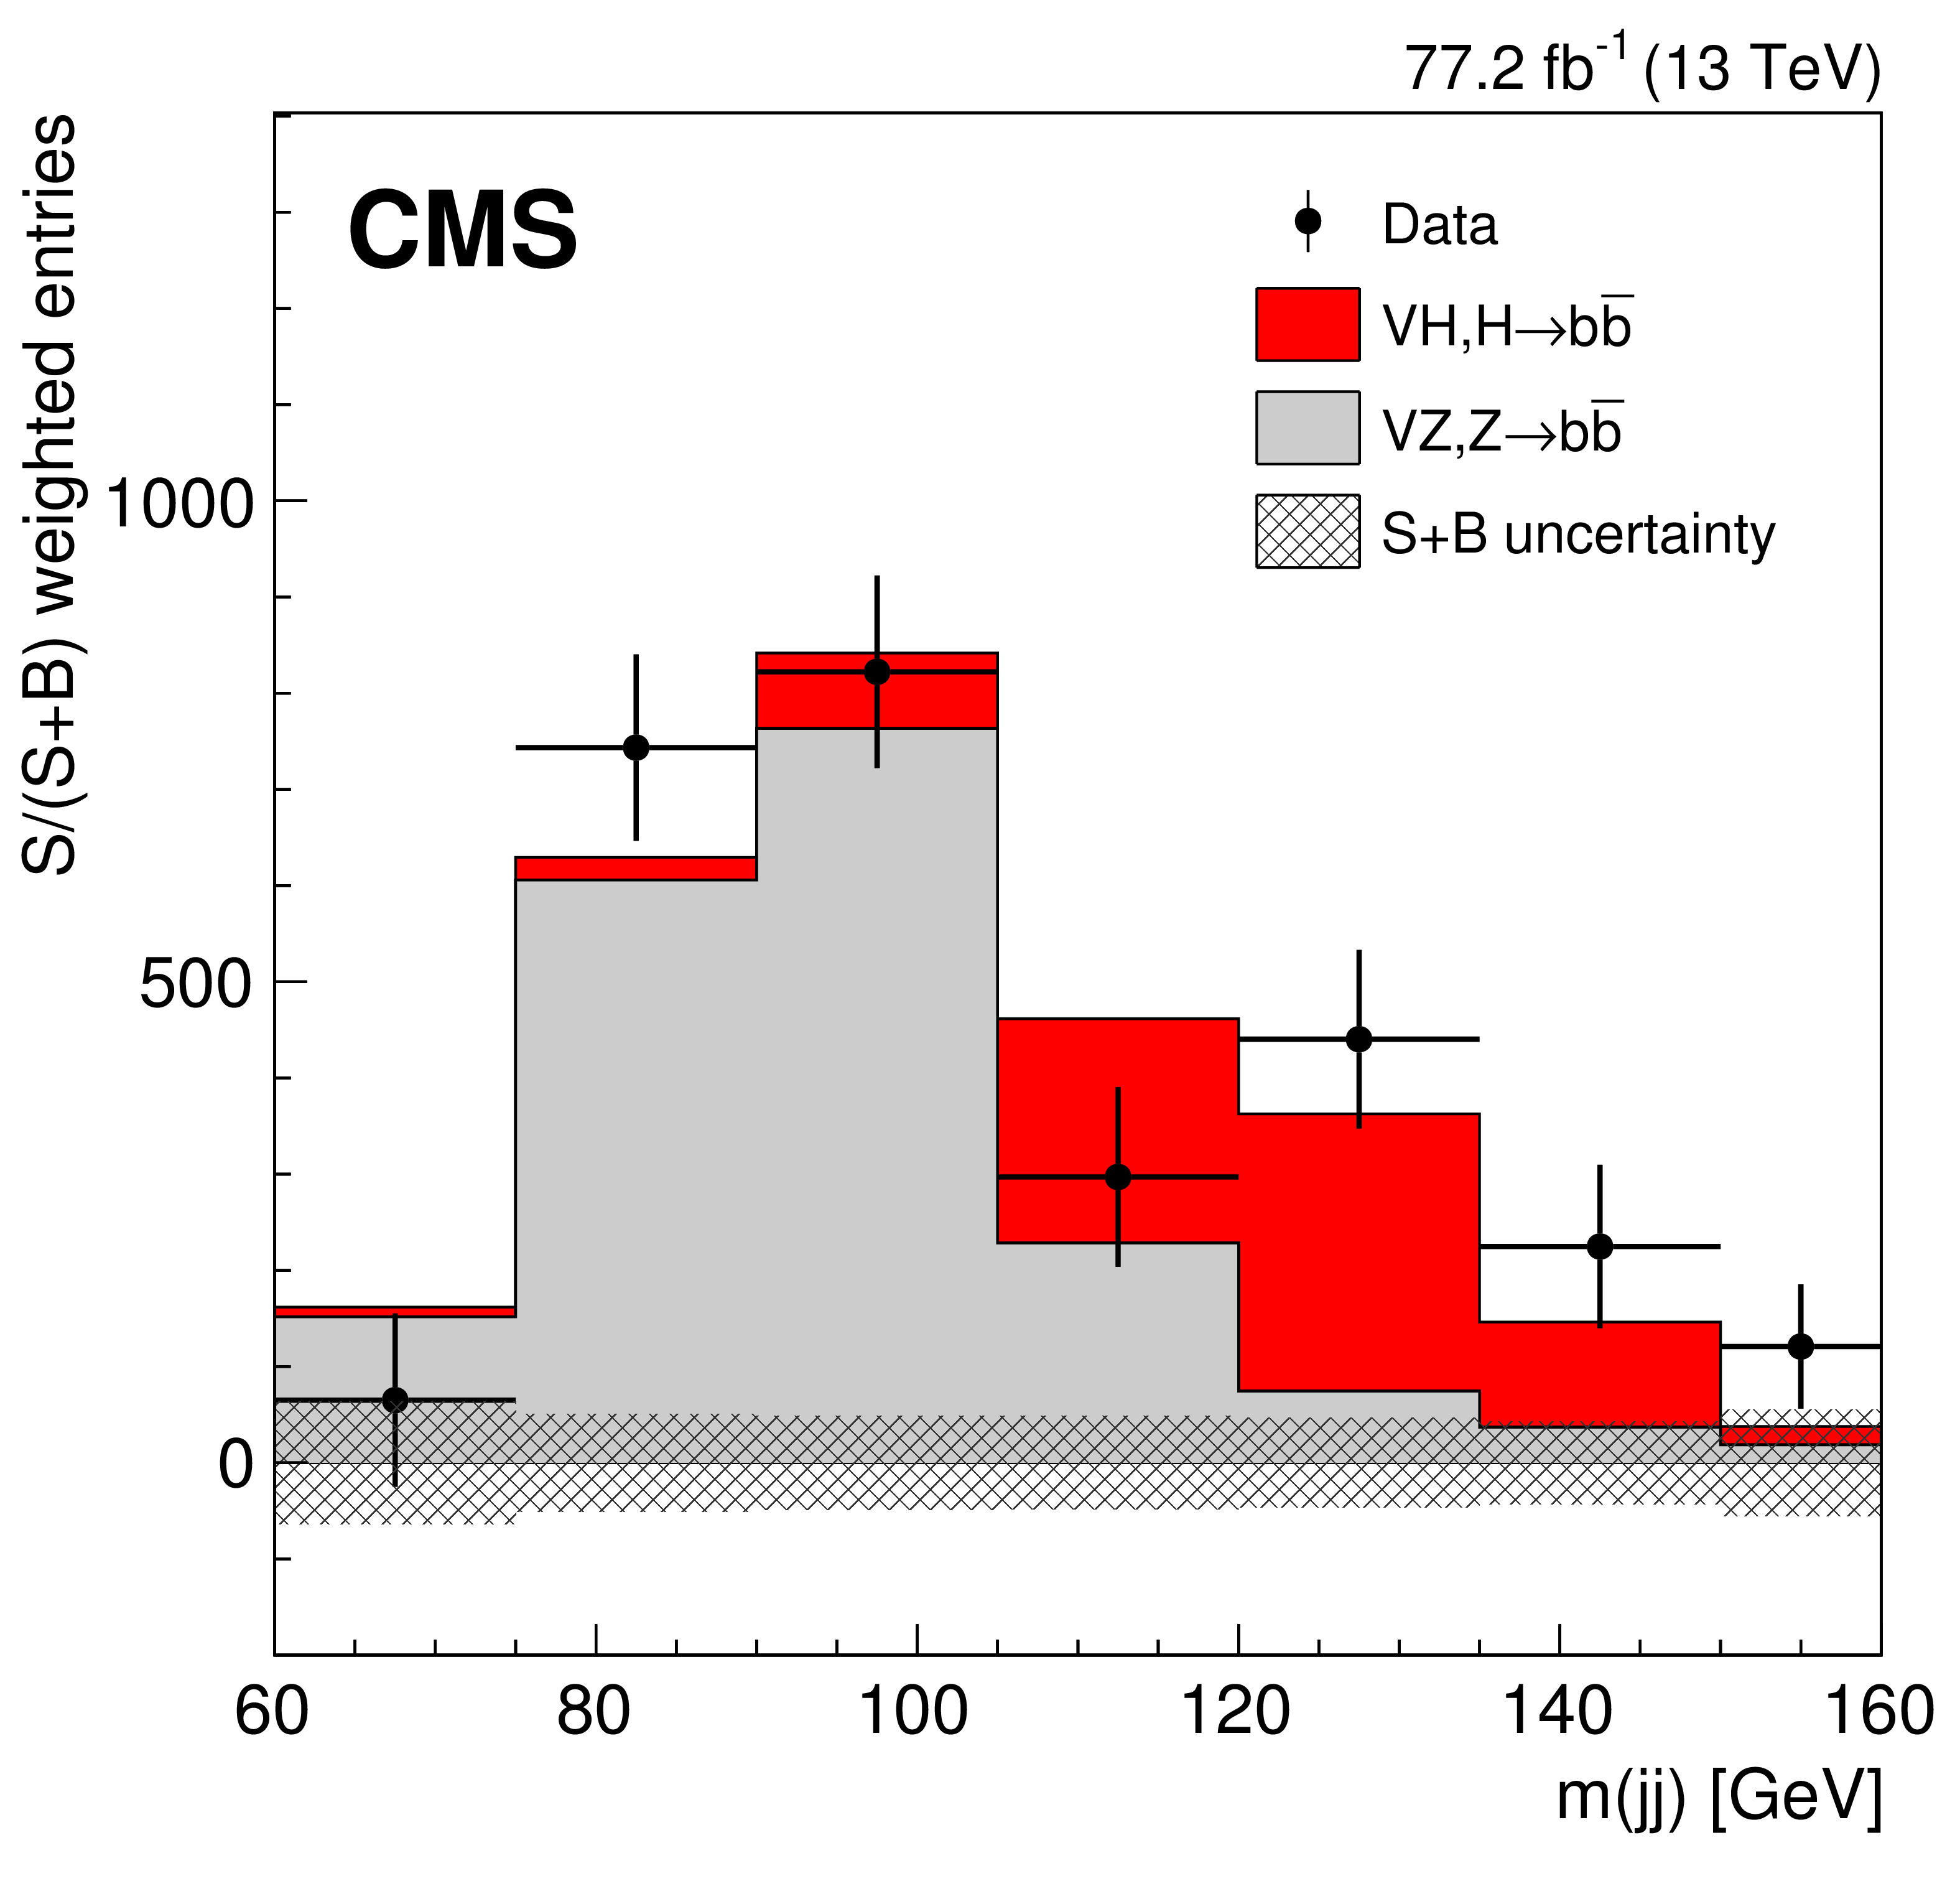
Why an electron-positron collider?
Recoil mass at electron positron collider Higgs to anything over background

Slide 14
Colliders Of Tomorrow
Many Opportunities at the Energy Frontier
FCC-pp, SPPS 100 km 100 TeV ~ E_{qq}~15 TeV 500 - 3000 fb⁻¹sy⁻¹
FCC-ee, CEPC 100 km 240, 365 GeV 850, 155 fb⁻¹sy⁻¹
CLIC-ee 50 km 0.38,1.5, 3 TeV 150, 370, 590 fb⁻¹sy⁻¹
ILC-ee 31 km 250, 500 GeV 75, 180 fb⁻¹sy⁻¹
C³-ee 7 km 250, 550 GeV 100, 200 fb⁻¹sy⁻¹
HL-LHC 27 km 14 TeV ~ E_{qq}~ 2 TeV 200 - 500 fb⁻¹y⁻¹
μCol ~27 km 10, 15 TeV 1000 - 2000 fb⁻¹sy⁻¹
μCol 6 km 3, 6, 10 TeV 200, 500 fb⁻¹sy⁻¹
snowmass year = 10⁷s

Slide 15
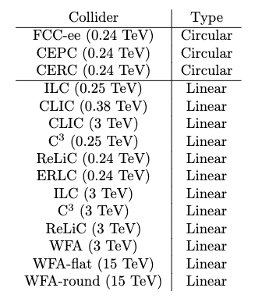
Implementation Task Force Evaluated Collider Types
Circular Colliders e⁺e–
From $\sqrt{s}=M_{Z}→M_{WW}→M_{Z+H}→M_{tt}$
Tera-Z, millions of H – very high luminosity
”Upgrade” to pp-machine for high energy
Proton Colliders (FCC-hh, SPPS/China ~100 TeV, 10s ab^{–1} )
Linear Colliders e⁺e–
Polarization, Energy Reach
From $\sqrt{s}=M_{Z}→M_{WW}→M_{Z+H}→550 \text{GeV}$
Upgraded / Expanded facilities: $\sqrt{s}→3 \text{T}\text{eV}$
Advanced technologies: $\sqrt{s}→15 \text{TeV}$ (much R&D needed)
Muon Colliders (10 TeV, 10 ab^{–1})
Revived interest in high-energy option due to recent advances

Slide 16
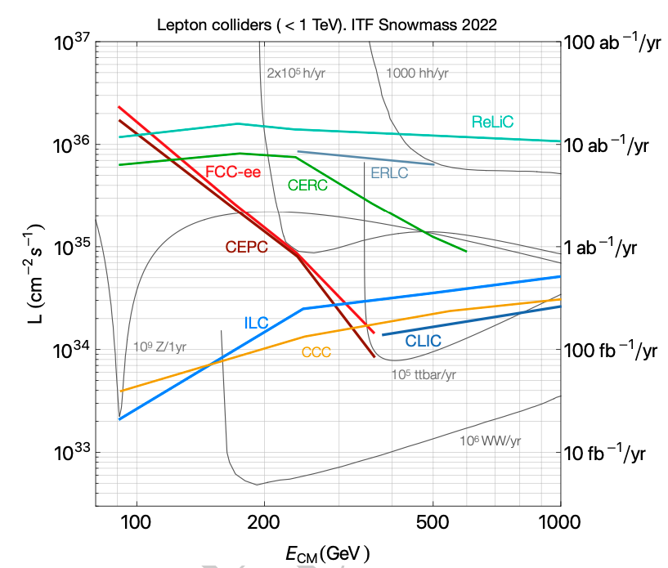
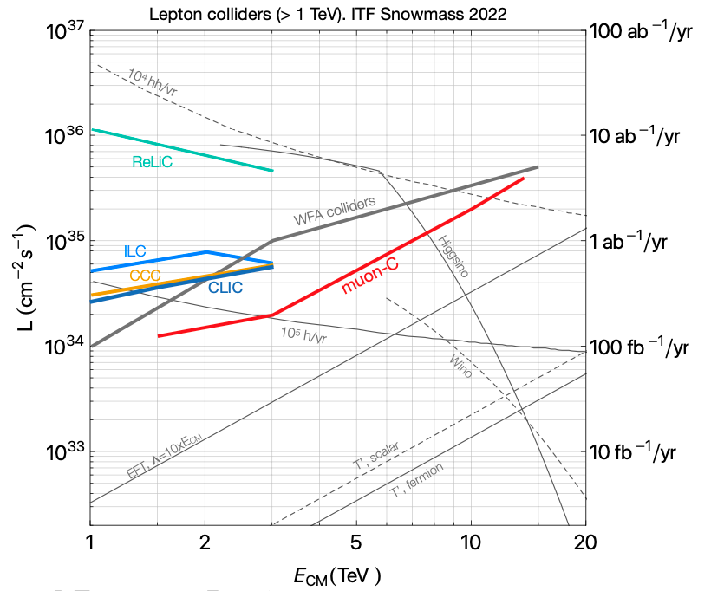
Lepton collider Luminosity vs $√s$ Landscape

Slide 17
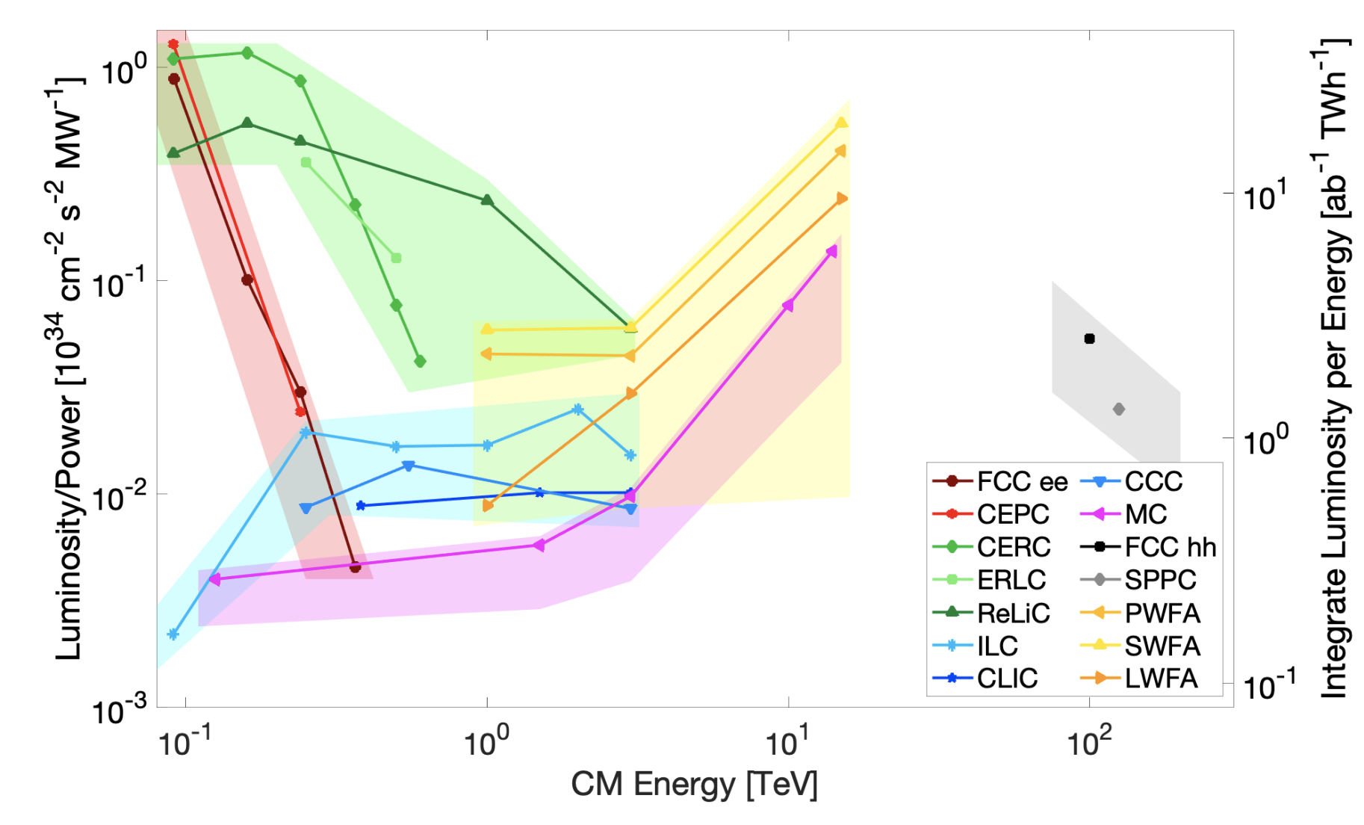
Luminosity / Power vs Energy from ITF
Points computed from proponent submitted parameters table
Uncertainty band is ITF judgement based on many considerations: technical design status, risk assessment, …

Slide 18
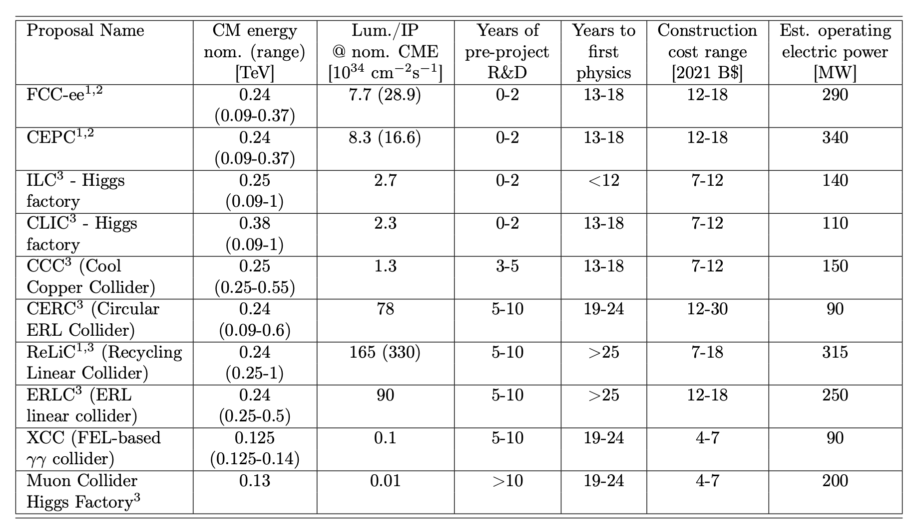
Higgs Factories
With 5 y R&D could get physics rolling by 2040 for ~$10B

Slide 19
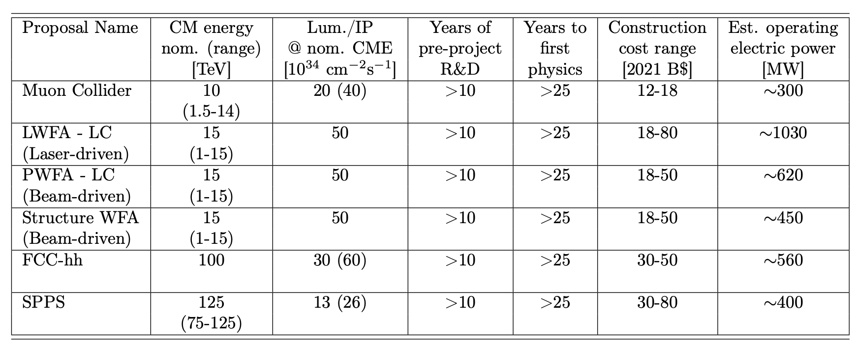
Energy Frontier Machines
With 10 y R&D could get physics rolling by 2050 for ~$18B

Slide 20
Higgs Factory Physics Timeline vis-à-vis Integrated Luminosity
Caveat – run plans are adjustable; start of physics times are different
Technically feasible times: ILC < 12y, FCC-ee, CLIC, CEPC, C3 : 13-18y
ILC “shovel ready” + C3 Short R&D –potential for earliest start
FCC-ee, CLIC – post HL-LHC
Circular colliders have shorter runs, higher luminosity
Linear collider runs have access to polarization and higher energy
Both provide good precision on Higgs Couplings & EWK

Slide 21
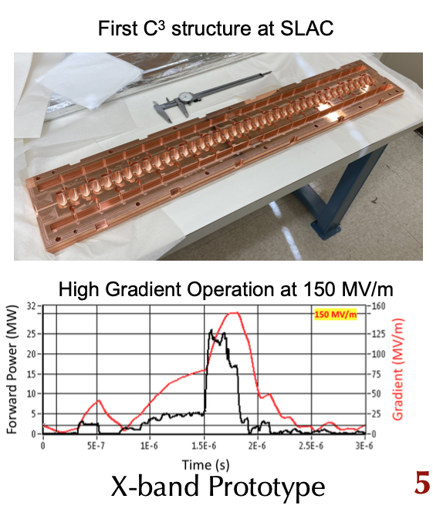
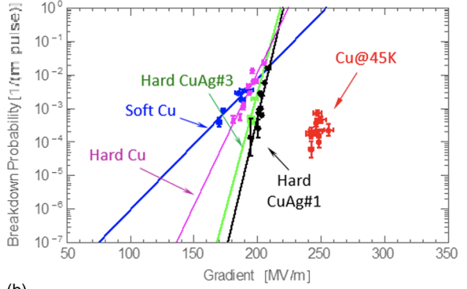
C3 – Cool Copper Collider – New Option
Cryogenic operation improves performance
Cahill et al, PRAB 21.10 (2018): 102002
Bane et al, arXiv 1807.10195

Slide 22
Synergies With X-Ray Photon Sources
The vast majority of ~30,000 currently operating accelerators globally are electron accelerators.
Electron accelerator R&D ranges from industrial applications to the cutting-edge development of ultimate storage rings and linear accelerator based XFELs.
This fortunate situation allows e⁺e– colliders to leverage these global efforts to provide a viable path to a collider reducing the R&D costs to the HEP budget.

Slide 23
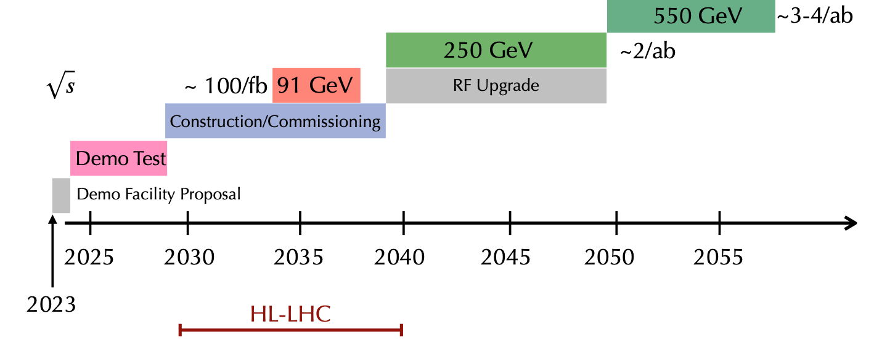
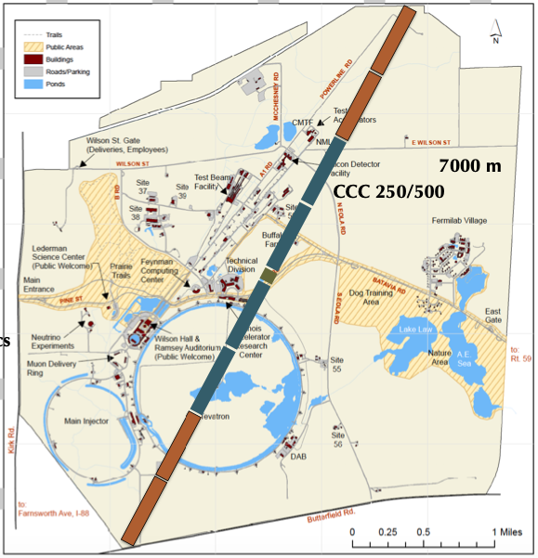
C³ – $\sqrt{s}=250−550$GeV – Potential Coordinates
O(10)% Higgs Self Coupling
1% H couplings - precision
Optional
LINAC 2km
BDS ~3km
BDS – similar to ILC design for 1-TeV – redesign optimally.
LINAC 2km
Can fit in FNAL site with BDS improvements

Slide 24
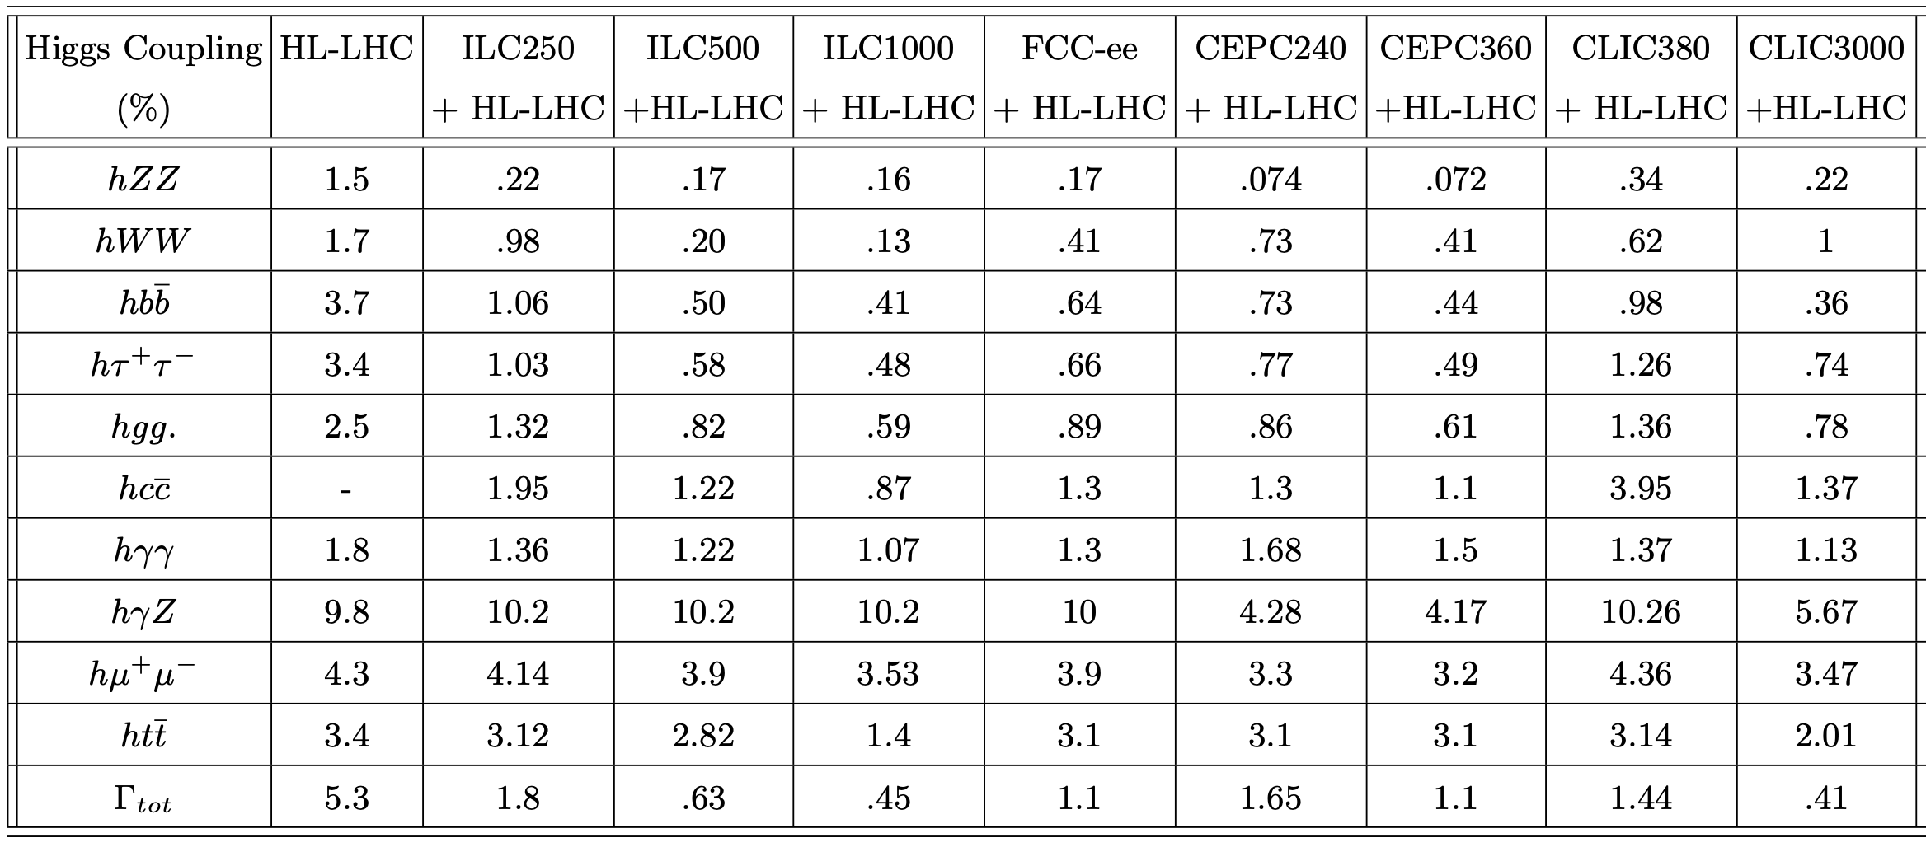
Higgs Couplings from Factories

Slide 25
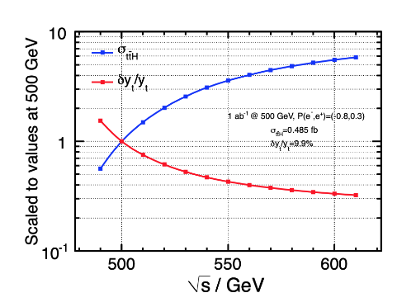
Top-Yukawa and Higgs Self-Coupling
Advantages of Energy Reach
Double Higgs production
E_{CM} (TeV) | Precision of λ_{HHH}
HL-LHC | 50%
ILC 0.5, C3 0.55 | 20%
CLIC 1.5 | 36%
CLIC 3 | 9%
μC10, FCC-hh | 4%

Slide 26
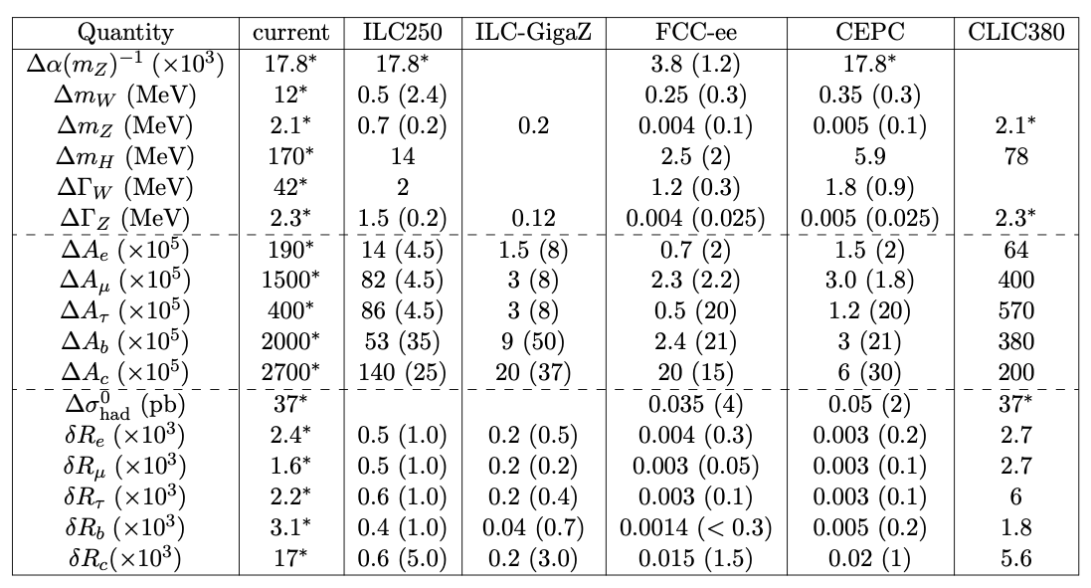
Electroweak Observables
GigaZ is a big improvement over current status
FCC-ee TeraZ suggests even bigger leap forward in precision

Slide 27
Oh! Lord of Rings!! Can’t we get to 10 TeV in one swoop?

Slide 28
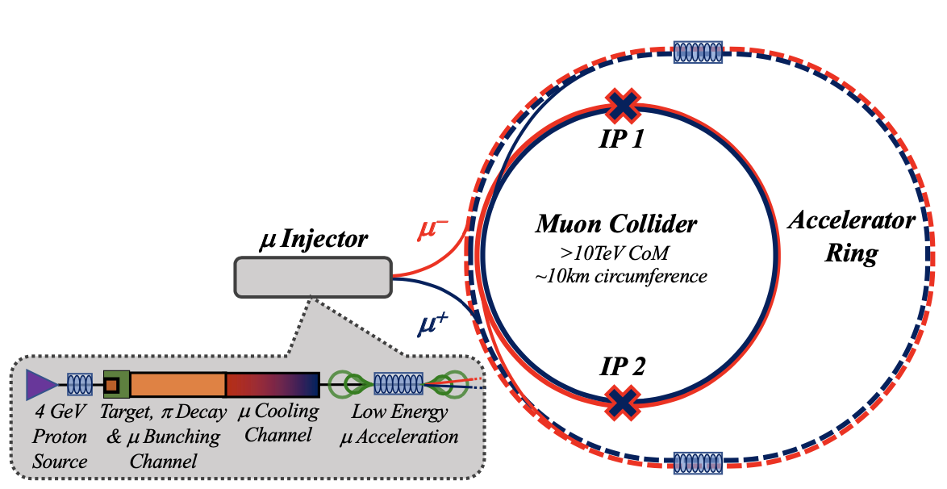
Innovative Muon Collider Concepts Energy Efficient Path to O(10)-TeV Colliders

Slide 29
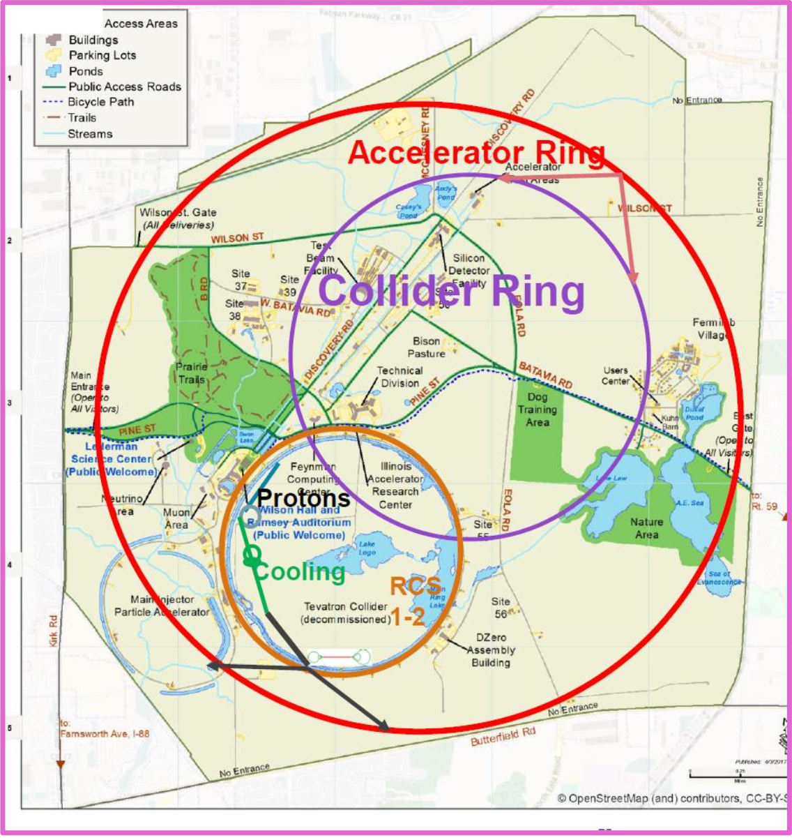
Muon Collider Advantages
arxiv:1901.06150
6-10 TeV muon collider can fit on FNAL site
Reduced civil engineering costs compared to pp-machines
Accelerator ring would be a FNAL site filler

Slide 30
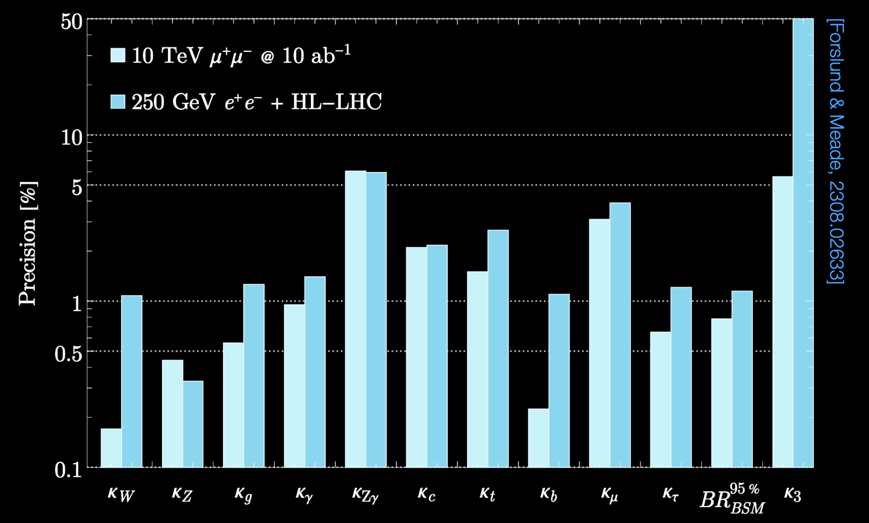
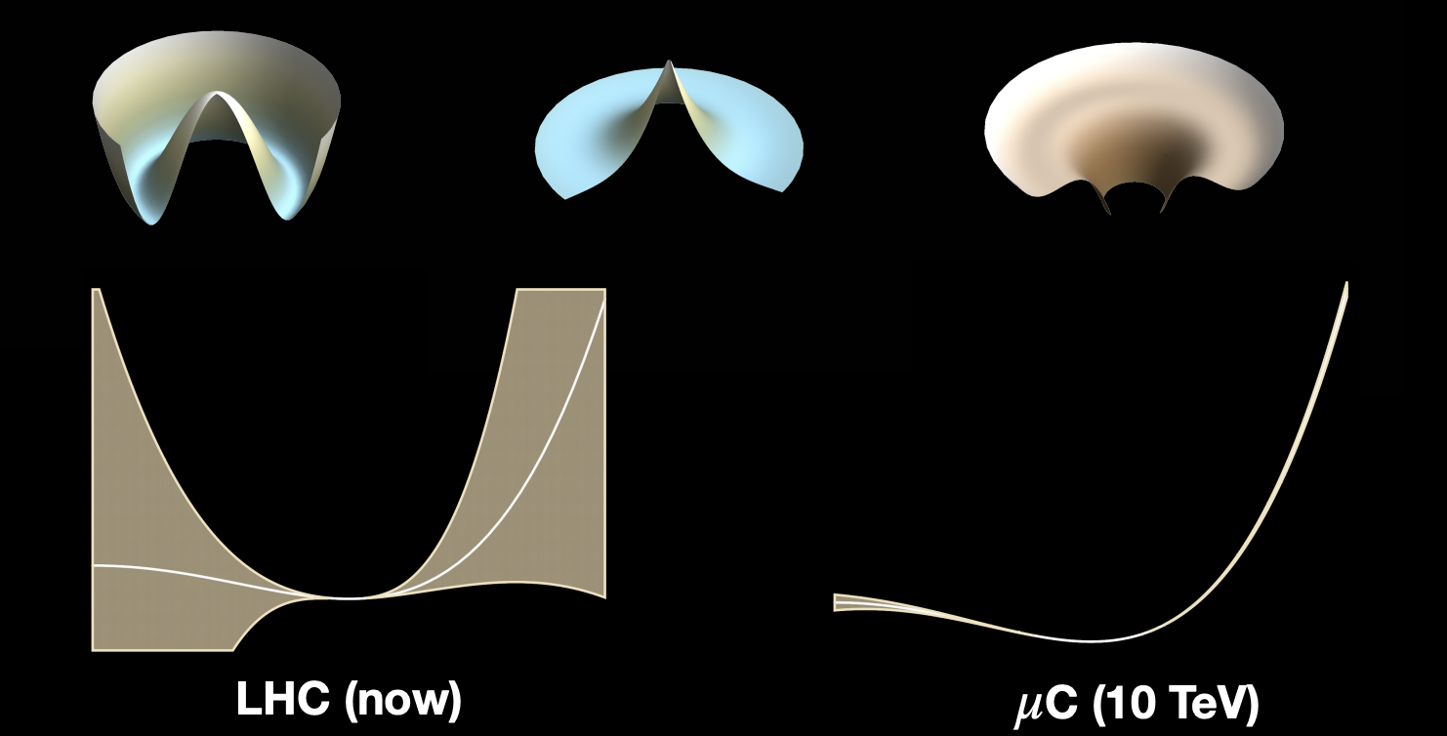
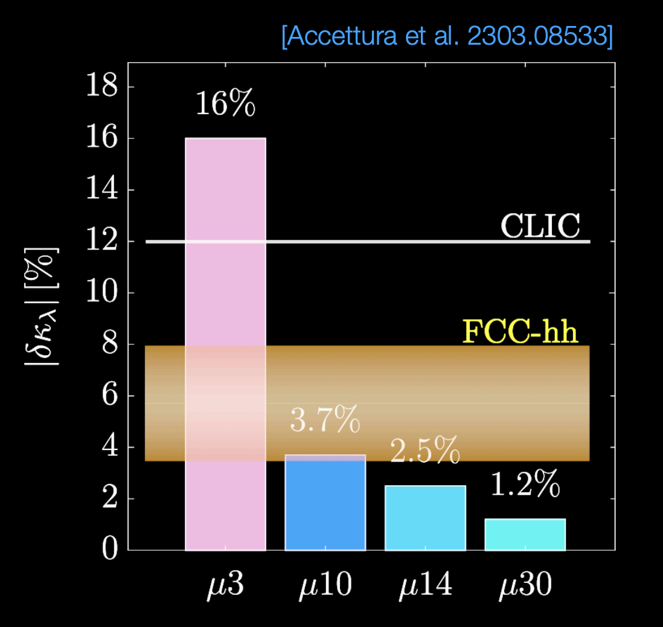
Higgs Precision & Di-Higgs Potential
Sub-percent deviations of Higgs couplings will be observable at muon collider too

Slide 31
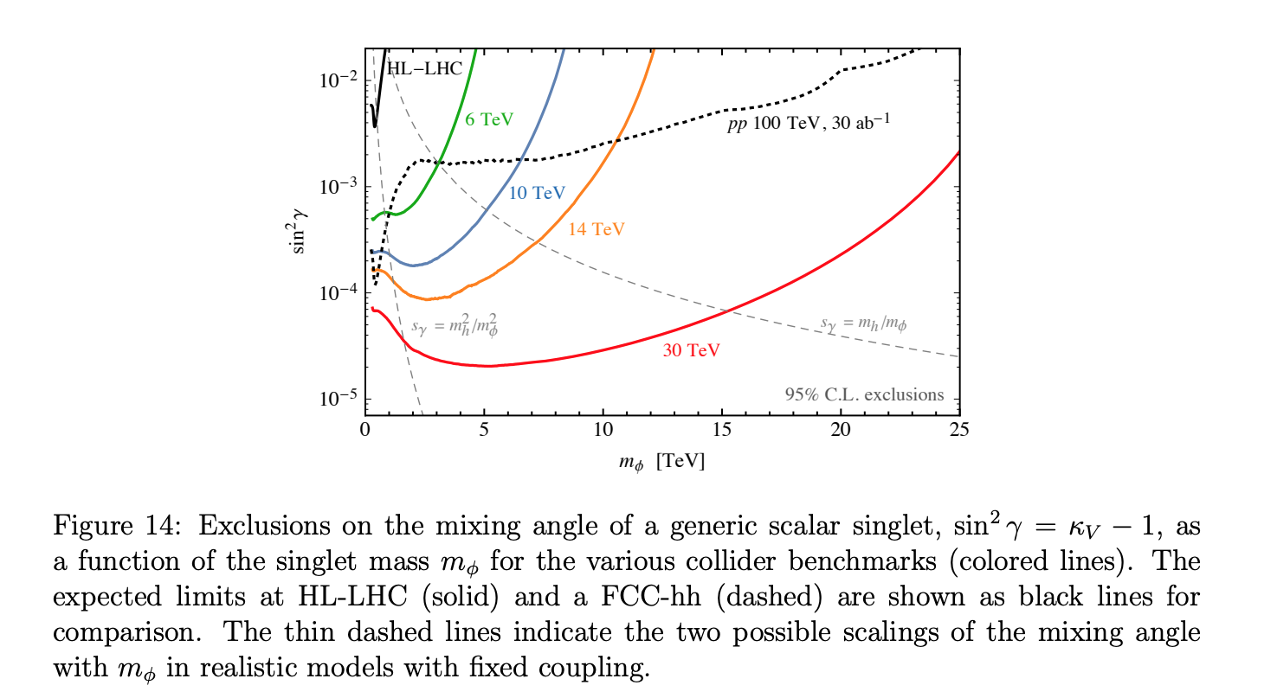
Muon Collider Prospects: Heavy Scalar Singlet
Higgs Smashers Guide, arXiv: 2103.14043

Slide 32
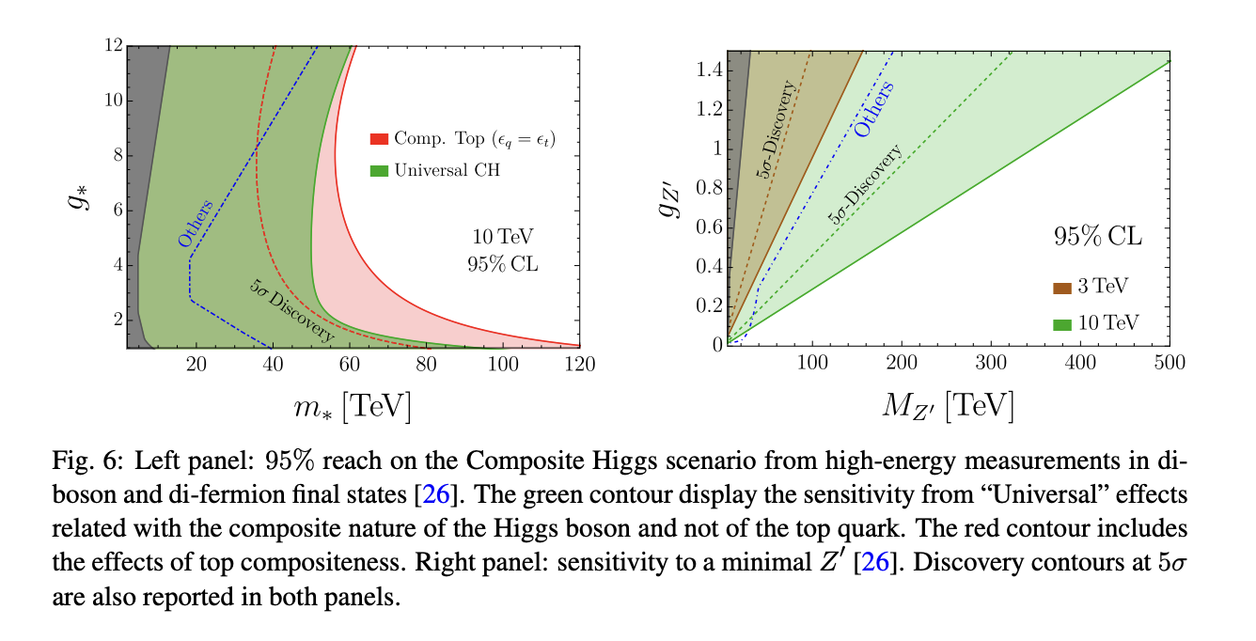
Higgs Compositeness & Minimal Z’ – Another place where Muon Collider Shines

Slide 33
Dark Matter Reach
Higgs Smashers Guide, arXiv: 2103.14043
Discovery potential for 10-TeV scale WIMPs for a variety of color/ew/hypercharge multiplets
Conservative == 10ab^{–1}

Slide 34
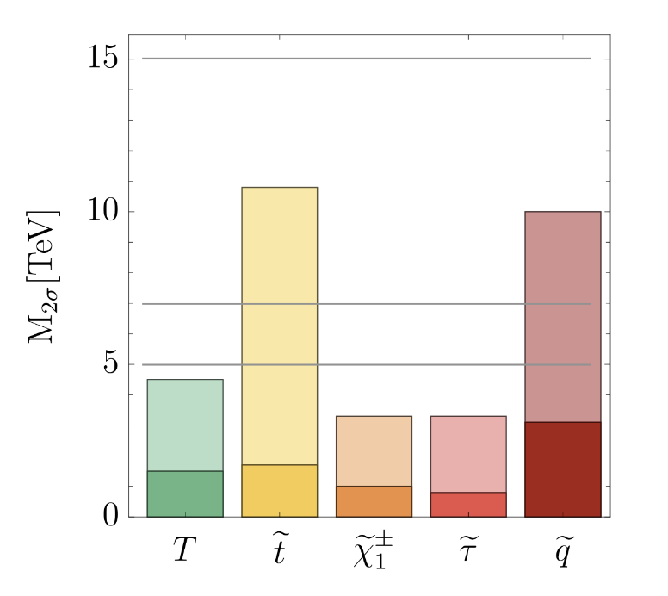
SUSY sparticle Searches
E_{cm}= 30 TeV
E_{cm}= 14 TeV
FCC-hh
E_{cm}= 10 TeV
Of course, FCC-hh wins in colored particle case over 10 TeV μCol
HLLHC

Slide 35
Towards Muon Collider
Critical concepts to demonstrate
Target Solenoid
Similar Low Temp Superconductor parameters to ITER Central Solenoid
Performance can be improved with a radiation resistant HTS or Cu insert
Muon 6D Cooling
MICE Demonstration of Emittance Cooling
High gradient demonstration of RF operating in Tesla-class magnetic fields
Cooling channel concepts and detailed simulation consistent with operational targets
Muon Final Cooling
Advances in HTS conductor/cable/magnet technology
High Field User Magnet program operationally demonstrating magnet parameters that are rapidly approaching the MC requirements

Slide 36
Towards Muon Collider …
Critical concepts to demonstrate
Muon Acceleration
Significant recent advancement in HTS-based fast-ramping magnets
Focused effort on studying the integrated magnet/power supply efficiency issues for TeV-scale acceleration
Collider and Detector
Detailed studies of backgrounds that may impact physics
Detector performance studies now demonstrate the ability to successfully measure key processes
Concepts in development to manage off-site neutrino radiation issues
See dedicated JINST Volume for key references: Muon Accelerators for Particle Physics (MUON)

Slide 37
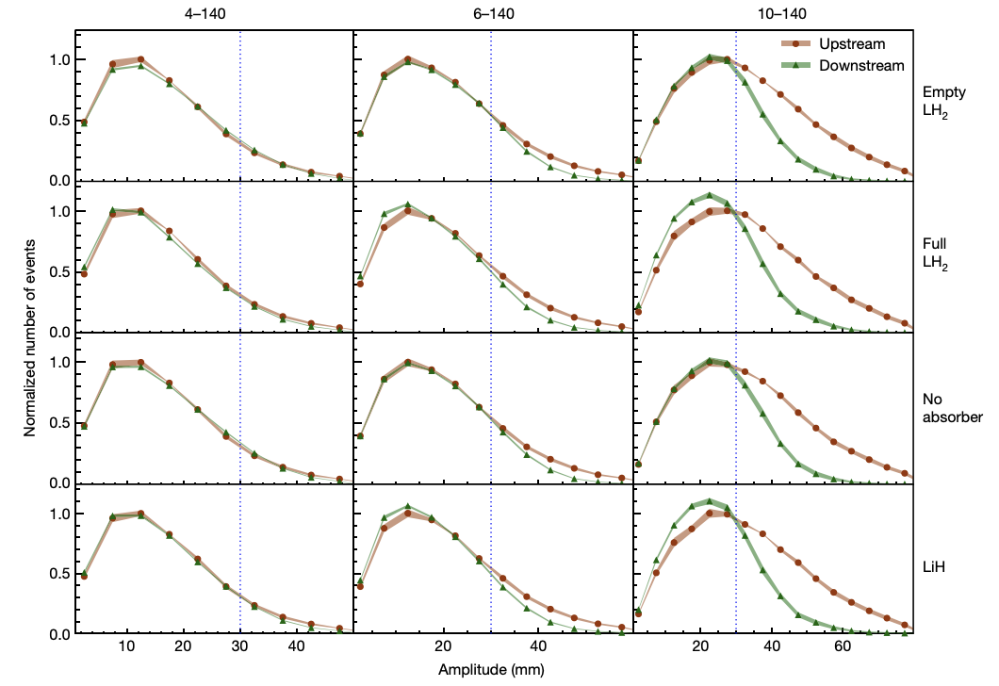
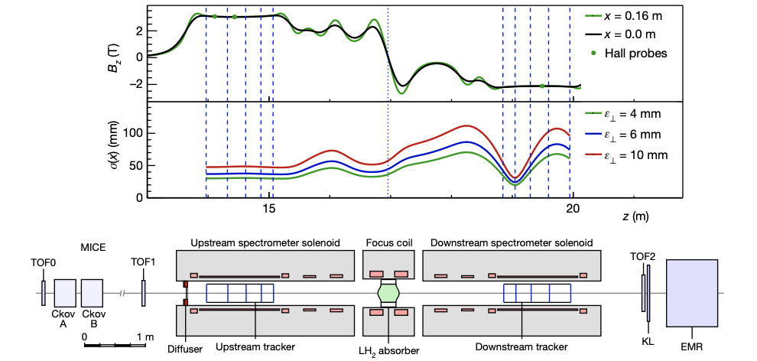
Muon Collider Accelerator Challenges Beam Production : Demonstration of Ionization Cooling
Nature, Vol 578, P53
MICE
Increase in particle counts at smaller amplitude with low-Z absorber in place

Slide 38
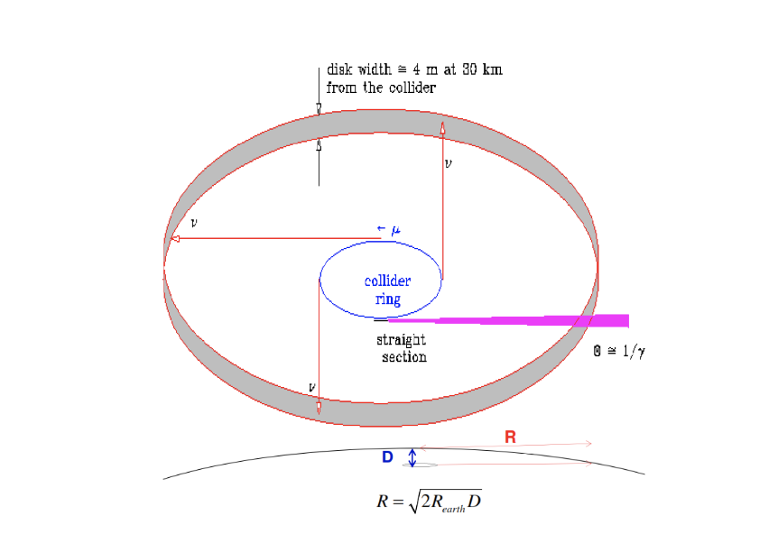
Neutrino Background?

Slide 39
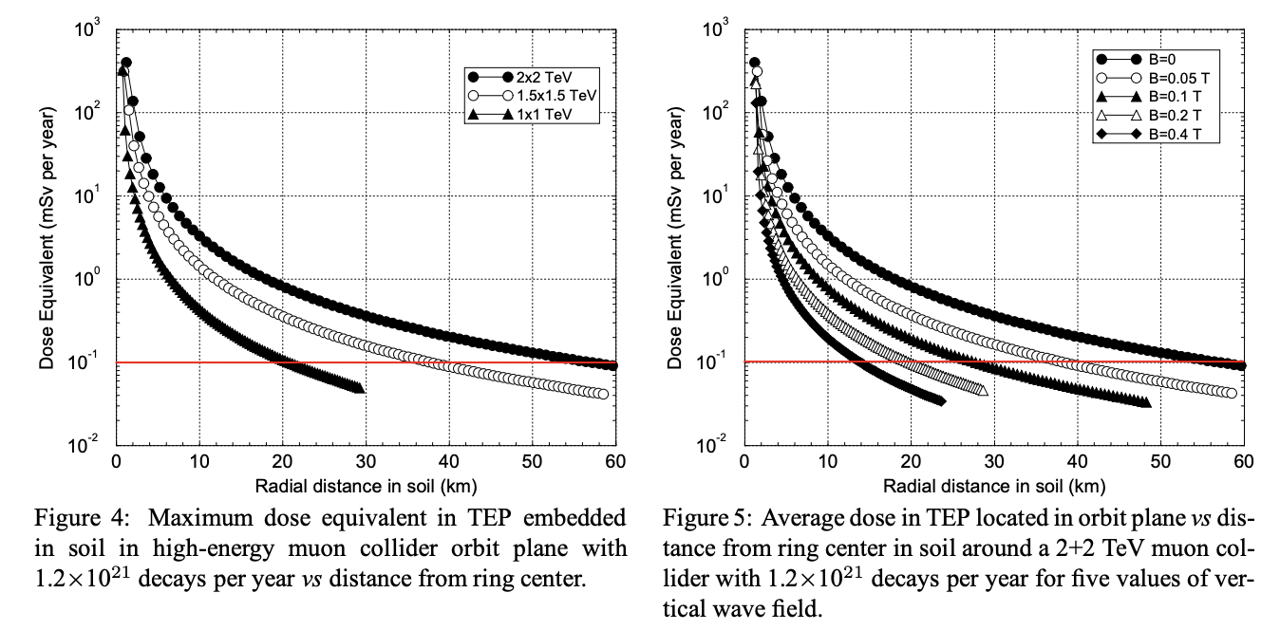
Muon Collider Accelerator Challenges Neutrino Radiation Mitigation
Mokhov & Van Ginneken
Higher the collider energy the deeper the ring needs to be. Magnetic field to dither the orbit also helps.
LHC Tunnel is 100m deep.

Slide 40
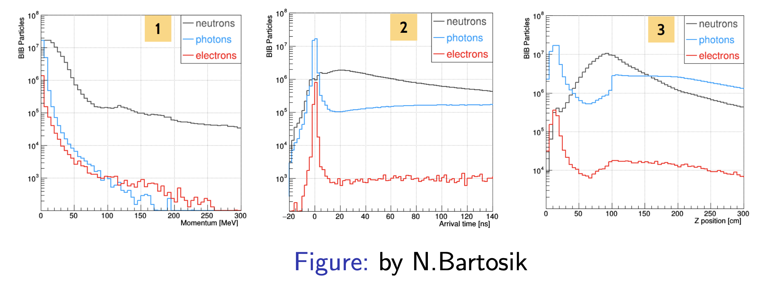
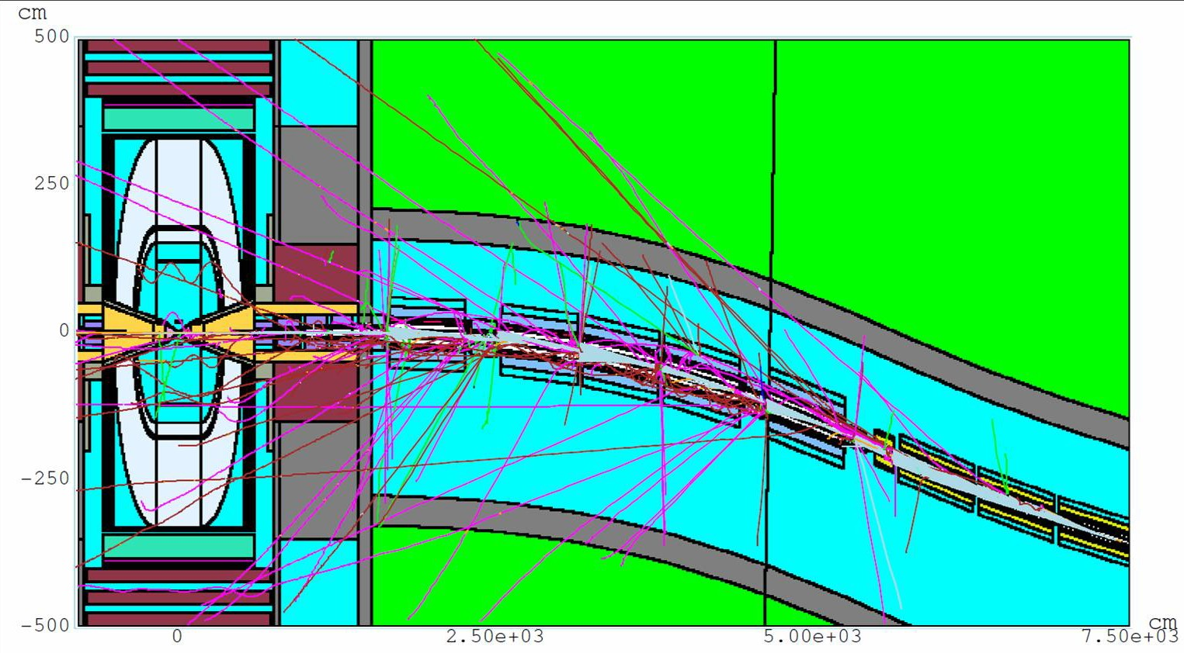
Muon Collider Challenges – Beam Induced Background
Mitigation Strategies needed in spite of the optimized conical absorber
Highly segmented detectors
Timing cuts and energy cuts
Doublet tracker design a la CMS tracker

Slide 41
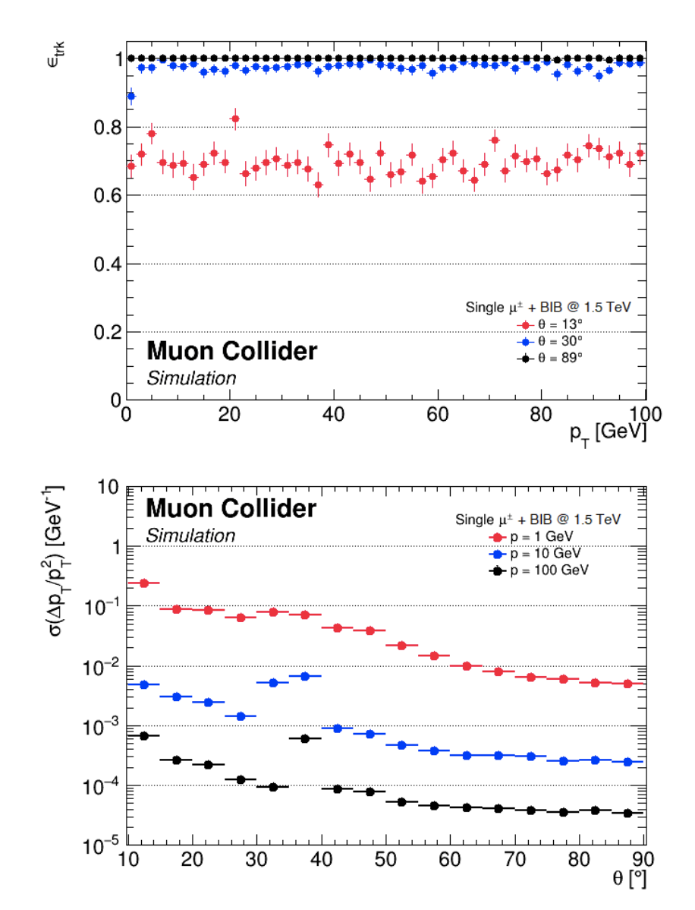
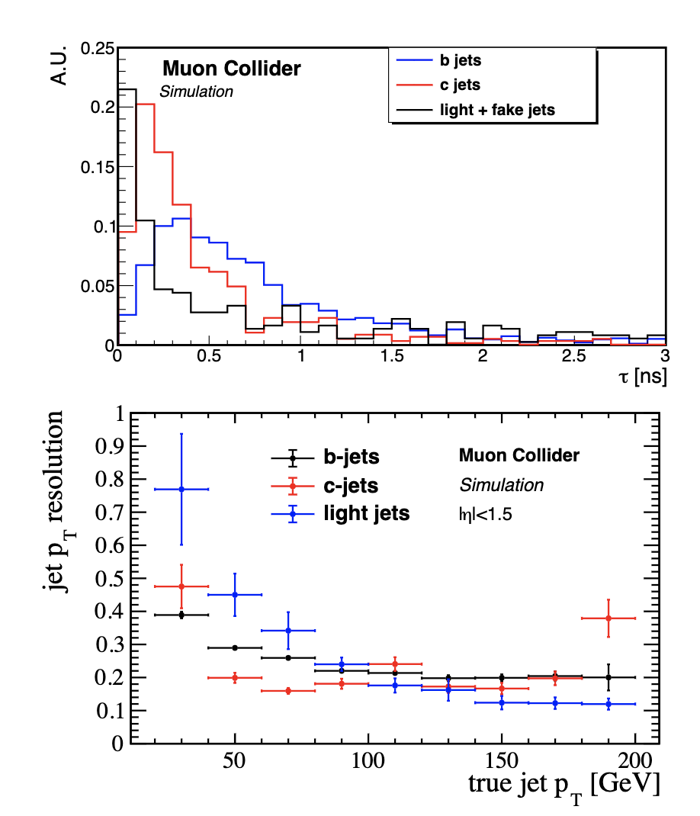
Can we reconstruct stuff?

Slide 42
Muon Collider Challenges Increased Accelerator R&D is the Key
10+ TeV is NEW Territory a Key Areas of Investigation:
Evaluation of physics potential (including detector technology)
Impacts of beam induced background
Neutrino Flux Mitigation
Straight accelerator sections produce intense ν beam - safety
High Energy Systems
Acceleration sections can impact the energy reach due to cost, power, technical risk, and impact on beam quality
10+ TeV Collider designs must be developed and fully evaluated
Cooling string demonstration to verify high brightness μ beam delivery

Slide 43
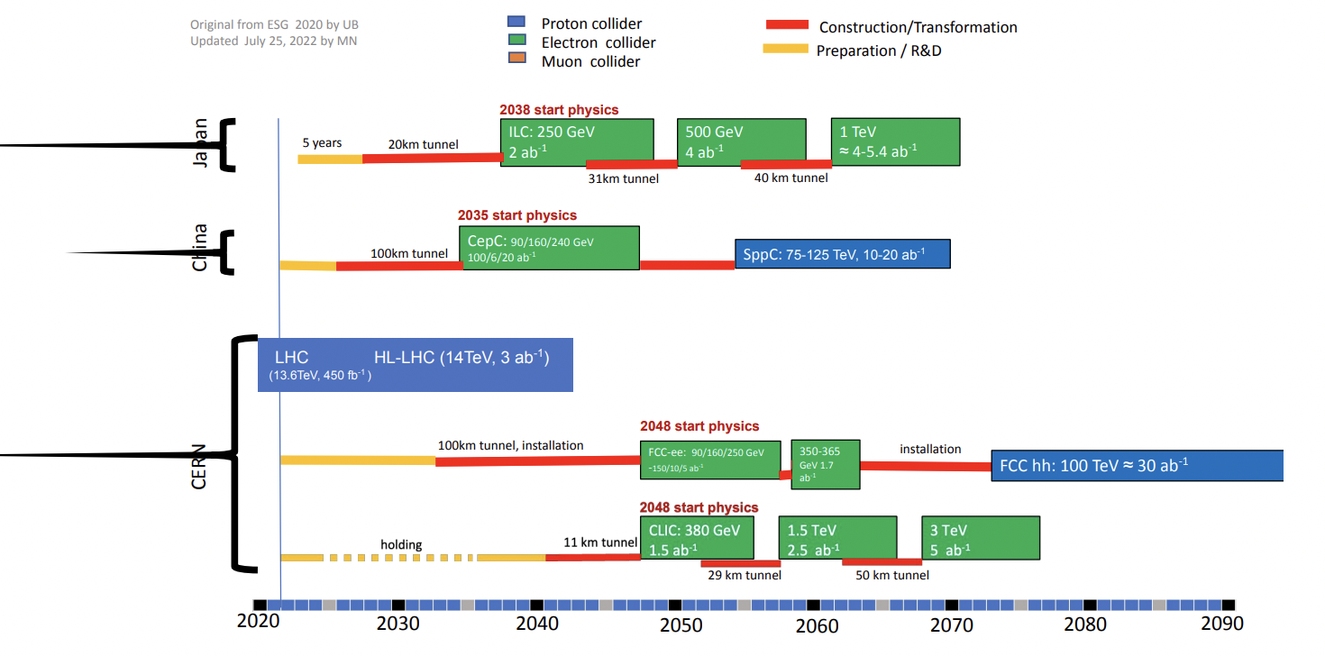
Summary – Asia & Europe
International Negotiations?
5-year plan approval?
FCC Feasibility study

Slide 44
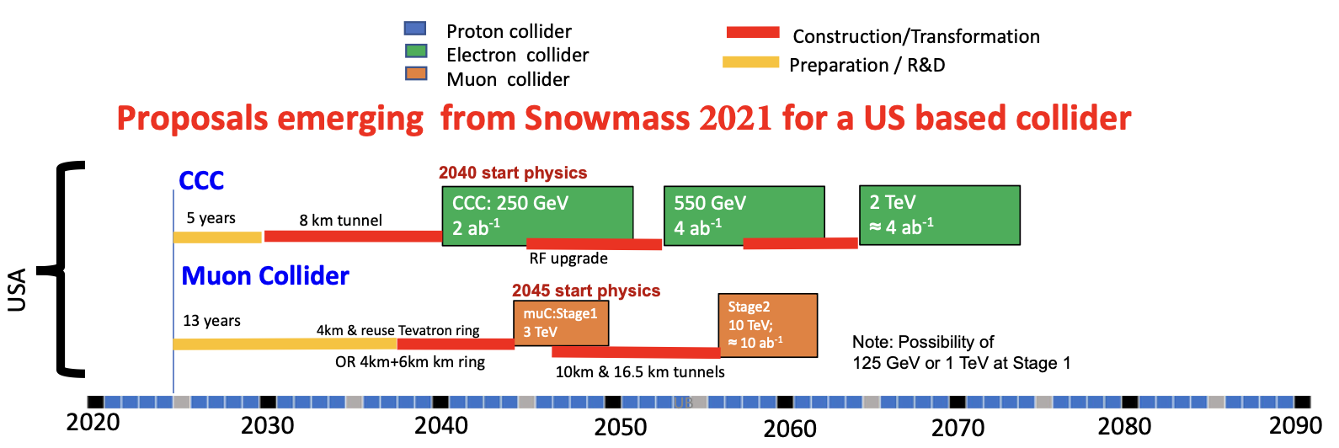
Summary + Invitation
P5
C3 → Do Minimal R&D Prioritize Off-shore Higgs Factory
MuCol → Resume R&D with gusto
Welcome your participation in studies – starting with simulations
Accelerators, detector technologies, machine-detector interface …
Biggest need is accelerator workforce – ideal place for our young to start

Slide 45
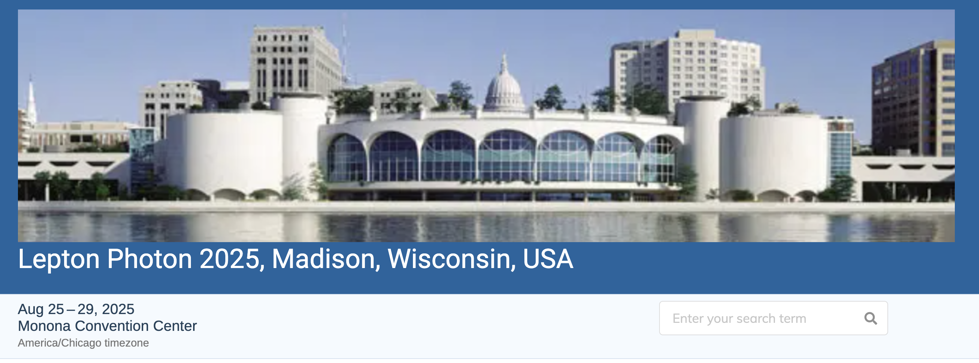
Another Invitation!
https://agenda.hep.wisc.edu/event/2188/
Please ask for US Visa letter ~now if you need one

