Slide 1
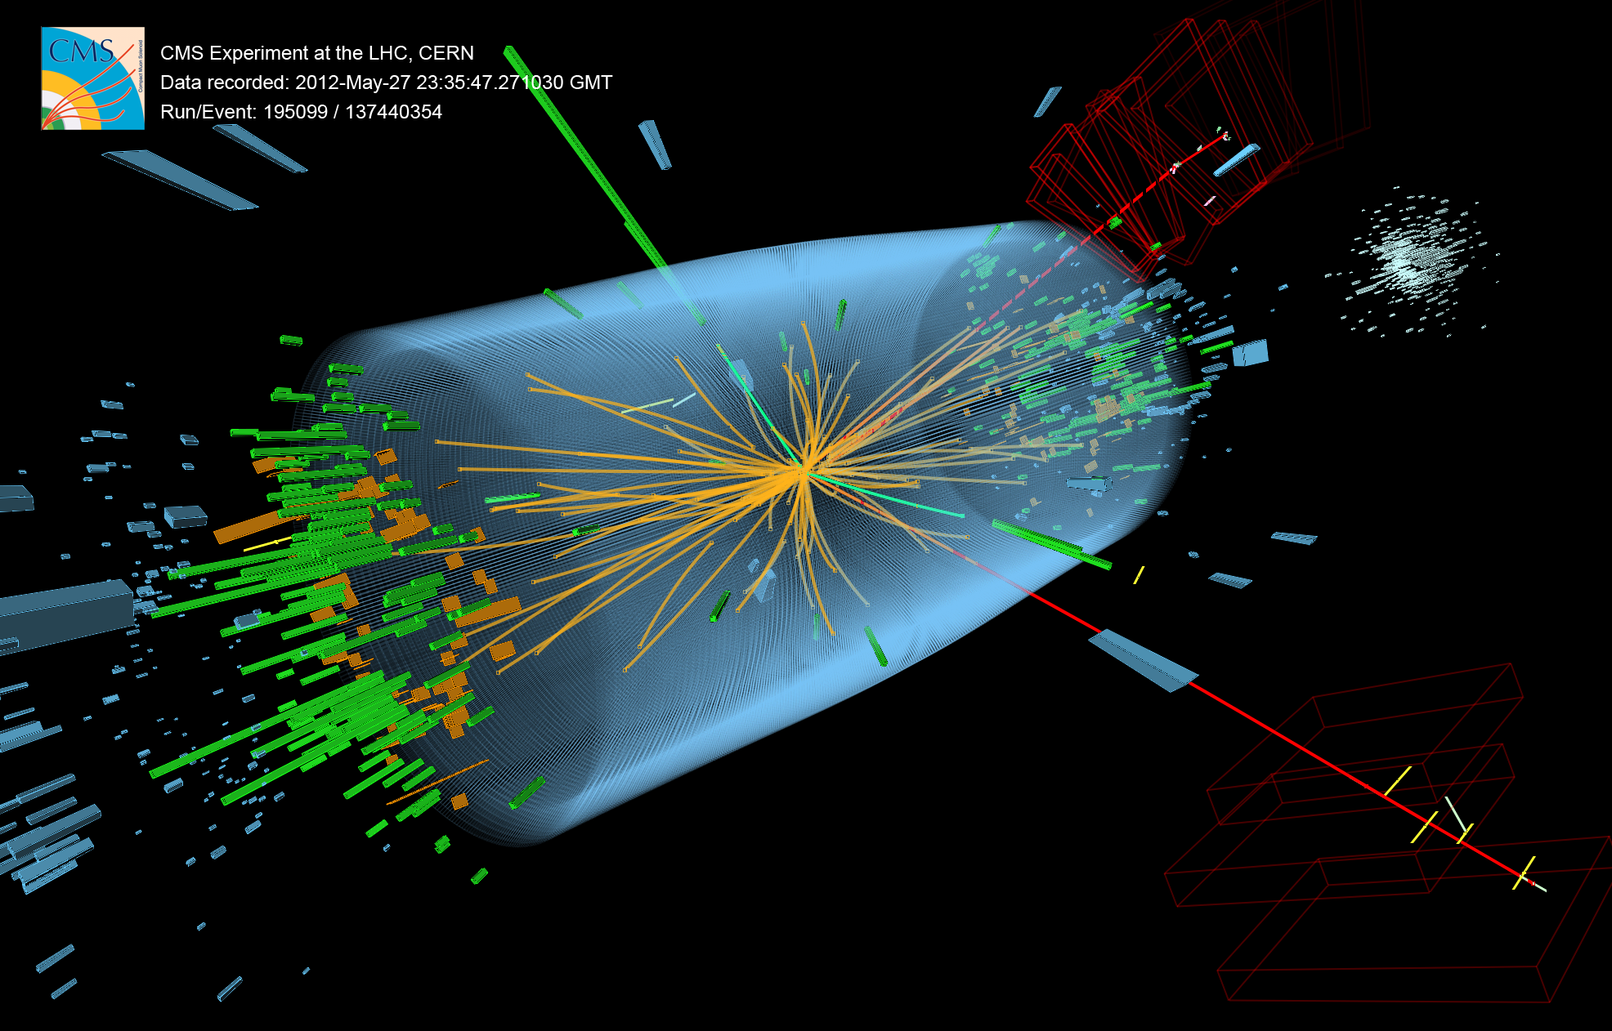
The Hunt for the Higgs Boson
@CERN Director: "I Think We Have It" (@HIGGS) !
Twitter Level Summary of the Higgsteria
Executive Summary – the newspaper version first (15 minutes)
Lecture for Science Enthusiasts – Scientific American version next (30 minutes)

Slide 2
Wisconsin People @ LHC

Slide 3
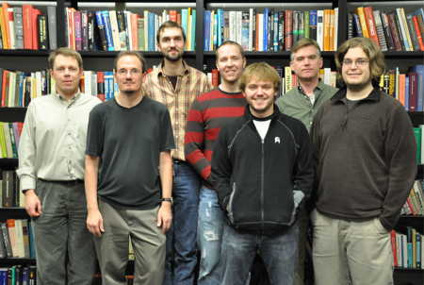
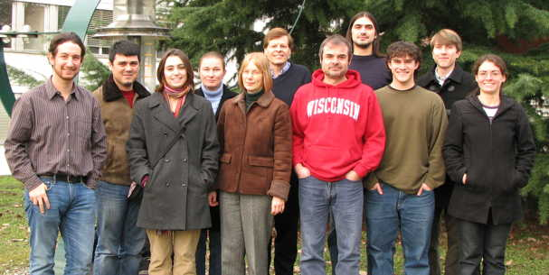
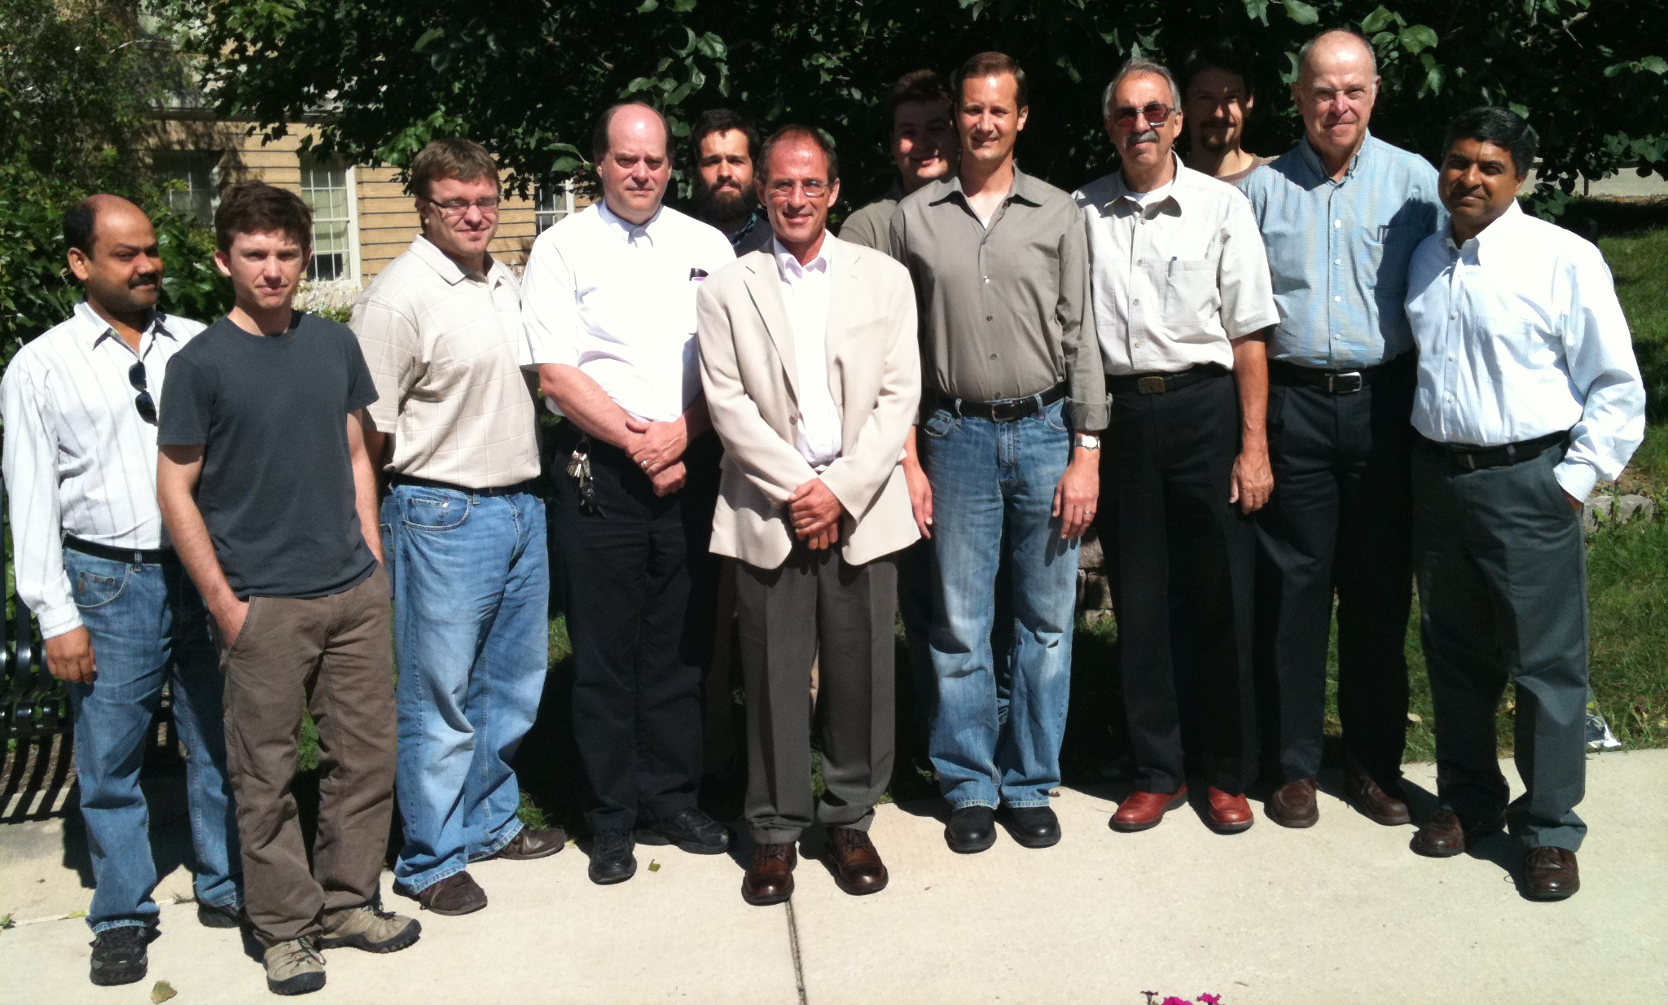



Wisconsin CMS People 2010-2012
4 Faculty, 1 Emeritus
6 Scientists, 2 Alumni
2 Postdocs, 1 Alumnus
5 Students, 7 Recent Ph.D.s
4 Support Staff, 2 Alumni

Slide 4
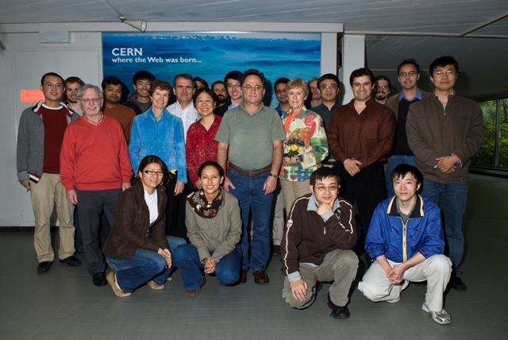
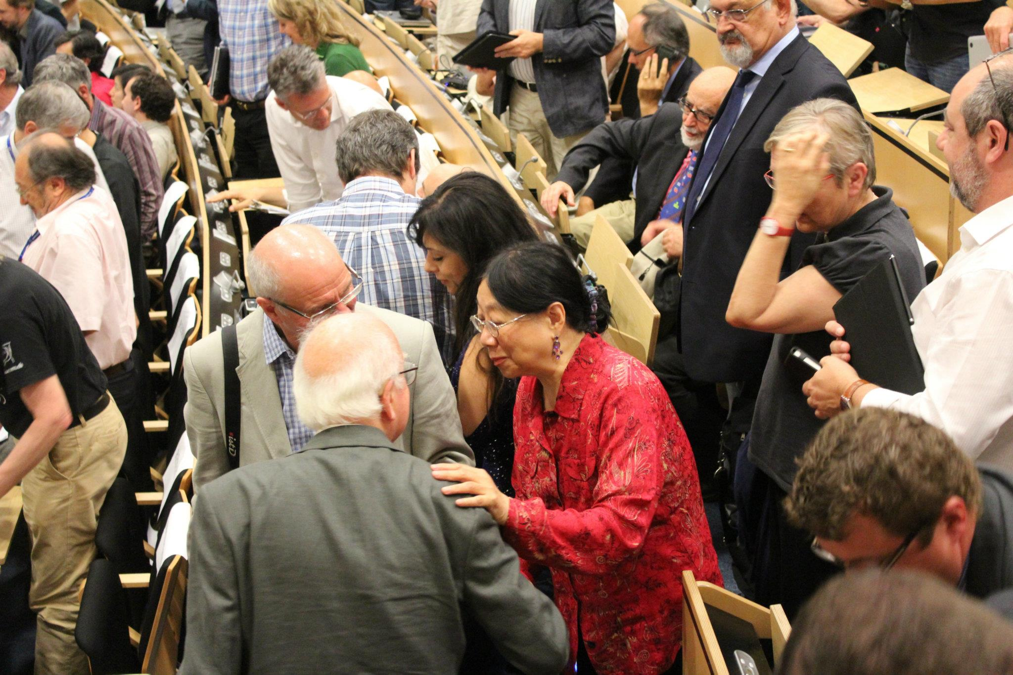
Wisconsin ATLAS People
Professors Sau Lan Wu and Miron Livny
at CERN, 2010
Professors Sau Lan Wu and Peter Higgs
at CERN, July 4 2012
Prof. Wu: "I have been looking for you for over 20 years”
Prof. Higgs: "Now you have found me!”

Slide 5

A Brief History of Time
Universe expanding and cooling
The Big Bang
– 454º F
LHC Probes
Experimentally
Quantum Gravity Era
Electro-weak Era
Proton & Neutron Era
Nuclear Era
Atoms and Light Era
Galaxies Formation
Grand Unification Era
Today
Driven by particle physicists reductionist philosophy – learn by getting to the core

Slide 6
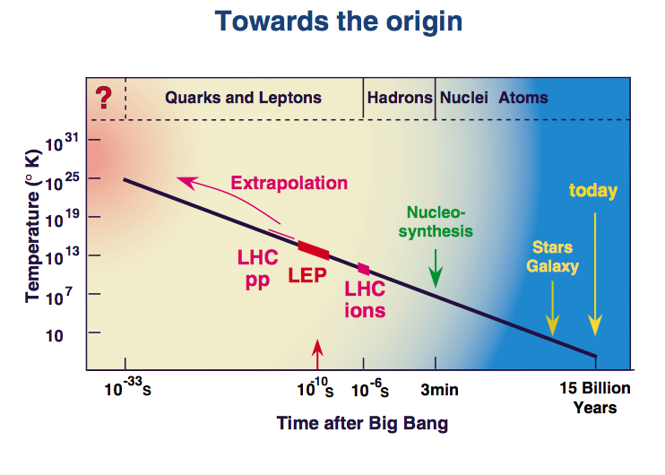
CERN Accelerators & The Universe
Particle physics experiments (physics of very high energy collisions of particles) are needed for understanding our microcosm, and thereby the cosmos itself
  Probing closer needs larger and larger energy !
  Probe by colliding particles and studying scattered remnants

Slide 7
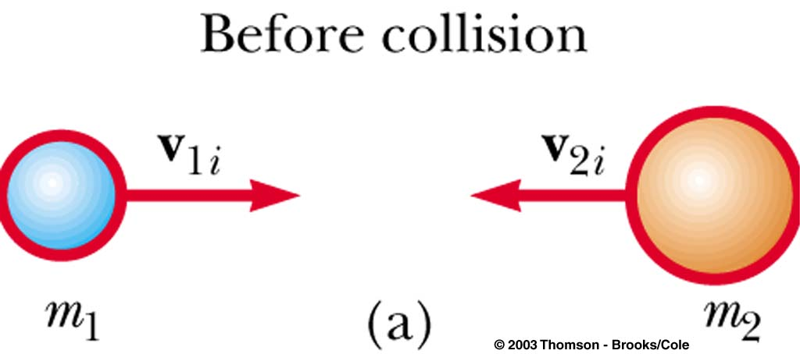
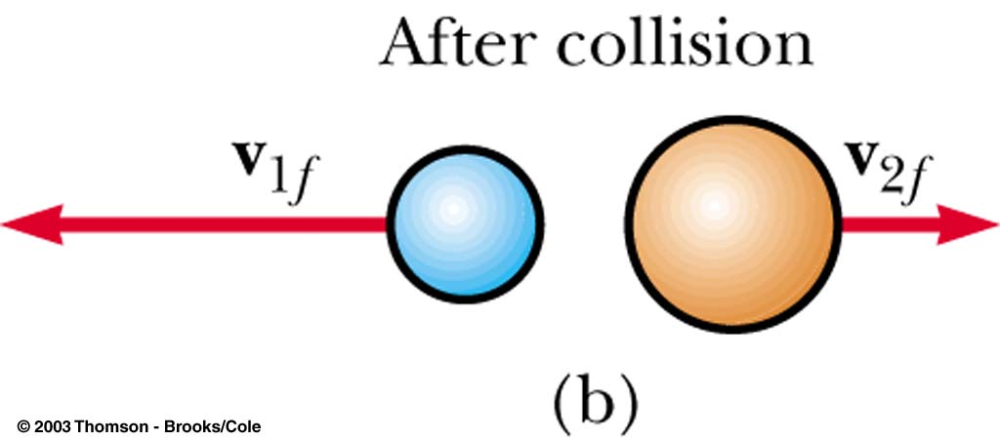
Classical Colliding Balls
Collisions that we perceive with naked eye
Total momentum (p=mv) before and after collision is the same
Total kinetic energy (E=mv²/2) before and after is the same
Increasing the speeds
Momentum is conserved
Kinetic energy is NOT
Some of the energy goes to break
up the objects – create heat, sound …
Total energy conserved

Slide 8
Relativistic World
How about when we get close to the speed of light?
Einstein’s famous equation: E = M
The collision energy can manifest as mass!
For particles in motion: E² – P_{x}² – P_{y}² – P_{z}² = M²
Energy-Momentum is conserved in collisions
Relativity and Natural Measurement Units
Speed of light, c = 1
Instead of using kg, kilo-watt-hour …
we can use a common unit for mass, energy and momentum called eV
A common AA battery cell accelerates electrons to 1.5 eV
LHC accelerates protons (x1835 electron mass) to 3.5 trillion eV

Slide 9
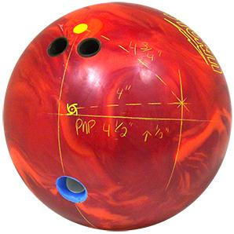
Relativistic Collisions
Particle collisions at very high energies produce many particles, some much more massive than initial particles
(unlike in this cartoon, collisions obey specific quantum rules)
Elementary and composite particles studied in great detail over the past 50 years

Slide 10
Relativistic Quantum World
Quantum Fields of various type permeate the space
  Electromagnetic field → photons (light quanta)
Given sufficient energy these fields create quanta (particles), that can be long lived or ephemeral
  Matter-anti-matter pairs manifest out of vacuum
Particles interact with each other exchanging quanta
  Photons, Gluons, W and Z
Works beautifully for massless quanta – needs higgs field for providing mass to the elementary particles
  W, Z quanta are massive – decay quickly

Slide 11
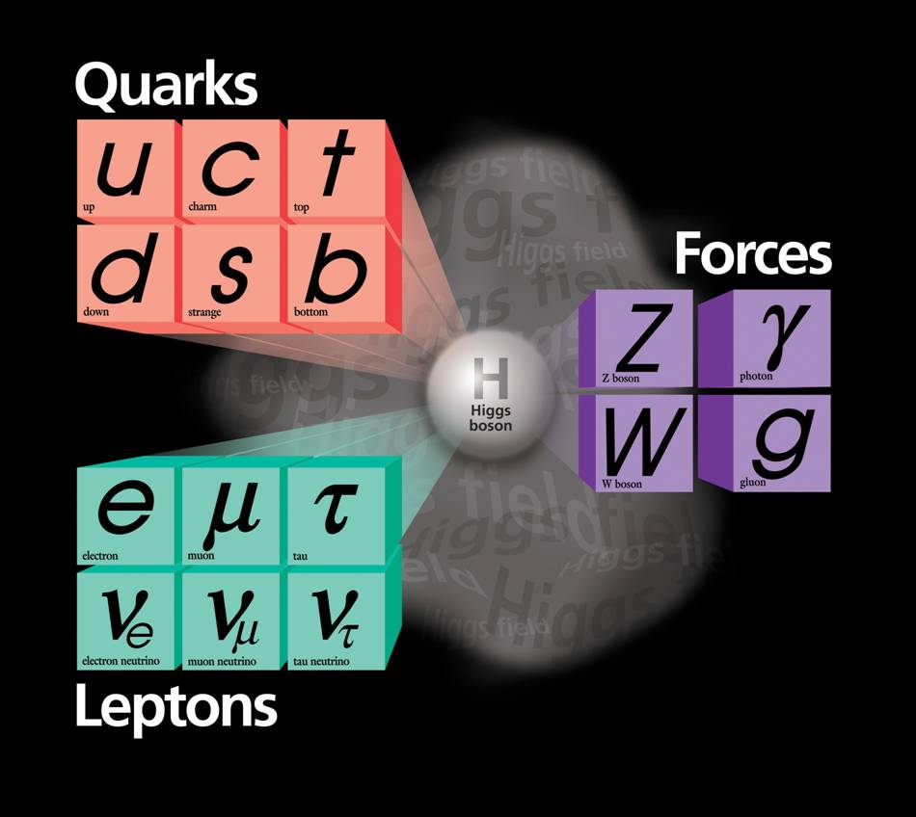
The Periodic Table of
Relativistic Quantum World
Elementary (point-size) particles:
  Matter constituents
    Quarks
      up, down, charm, strange, top, bottom
    Leptons
      Electron, muon, tau, corresponding neutrinos
  Force carriers
    Electromagnetism: Photon
    Weak interactions: W±/Z
    Strong interactions: Gluons
  Omnipresent higgs field
    Explains how elementary particles become massive
1300
170000
~5
91000
4500
100
0
106
?
0
0.5
1776
80000
~10^{–5}
MeV
Wildely varying masses for matter particles
Very troublesome: masses for force carriers

Slide 12
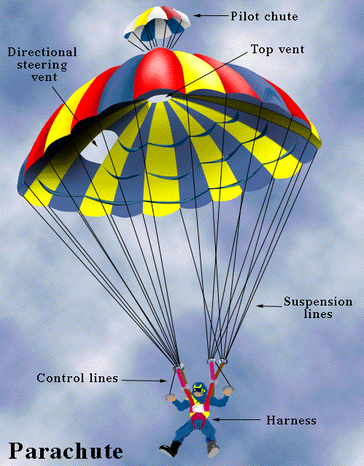
Interactions with
Higgs Field
Which of these falls slower safely?
  An unopened parachute
  Fully opened parachute
The more interaction with the medium (air) the lower the speed of the drop
Higgs field permeates all space, particles interact with differing strengths with the higgs field. The higher the interaction the larger the particle’s mass.
The simplest theory with higgs fields results in a new self-interacting particle: the Higgs boson, which itself has a mass – but, theory can’t predict its mass.

Slide 13

A Cartoon Movie on Higgs
Given high energies particles manifest from vacuum
  Higgs particles can be created in LHC collisions
    They are ephemeral – The LHC detectors look for its remnants

Slide 14
The Standard Model Higgs
- HOT NEWS
CERN experiments observe particle consistent with long-sought Higgs boson
Geneva, 4 July 2012. At a seminar held at CERN¹ today as a curtain raiser to the year’s major particle physics conference, ICHEP2012 in Melbourne,
the ATLAS and CMS experiments presented their latest preliminary results in the search for the long sought Higgs particle. Both experiments observe a new particle in the mass region around 125-126 GeV.

Slide 15
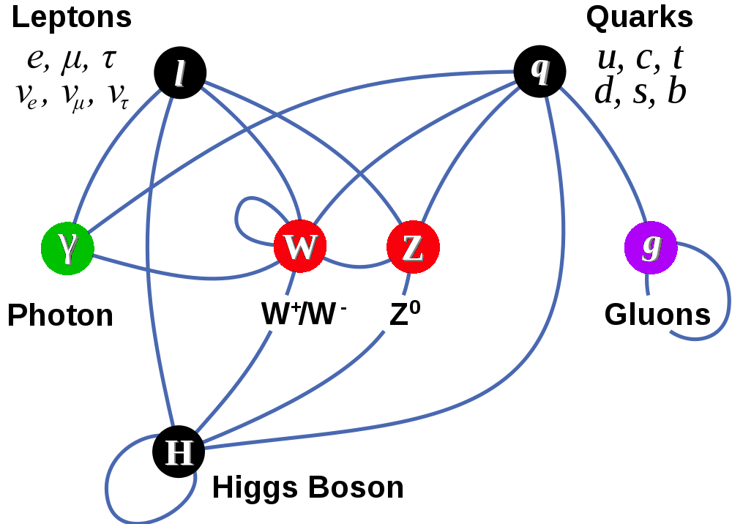
Completion of The Standard Model?
Gauge Interactions
QED → Electroweak
QCD – confinement & asymptotic freedom
Spontaneous symmetry breaking
New fundamental scalar
Yukawa couplings to fermions

Slide 16
Higgsteria & Media
Keeping up appearances? ☹
Let’s try to do better than that in the next 30 minutes! ☺

Slide 17
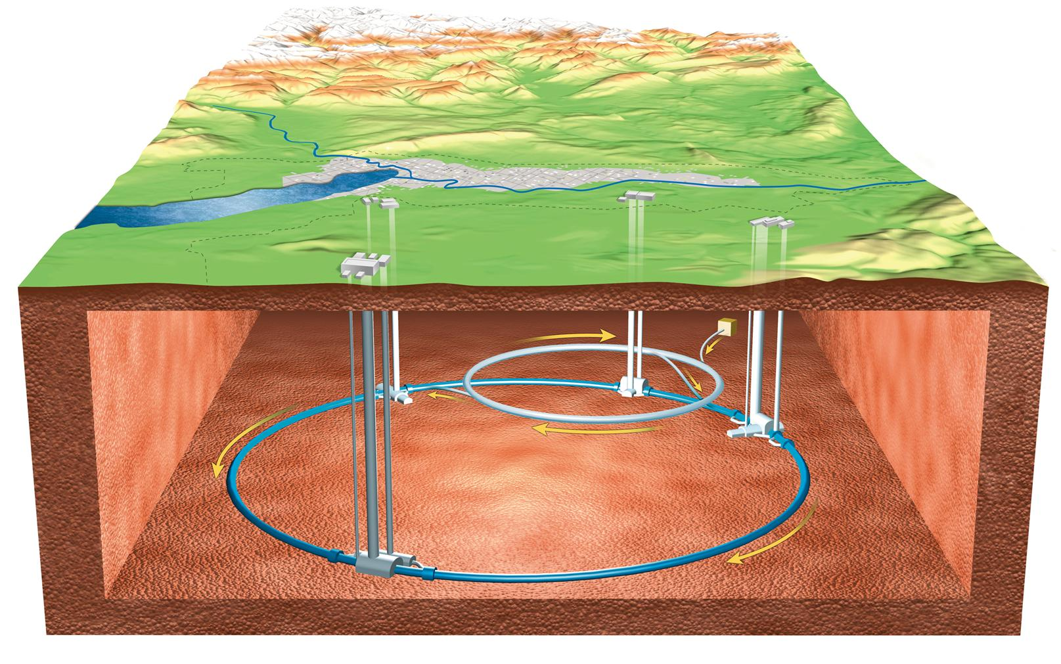
Large Hadron Collider

Slide 18
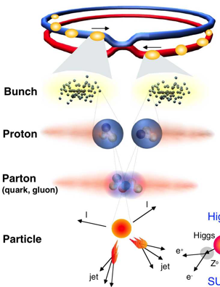
Proton-Proton Collisions at the LHC
 | Design | 2011 | 2012
Beam energy | 7 TeV | 3.5 TeV | 4.0 TeV
Bunches/ beam | 2835 | 1380 | 1380
Protons/ bunch | 1.15x10¹¹ | 1.5x10¹¹ | 2.2x10¹¹
N Collisions Created |  | 2.5 x 10¹⁴ | 3.5 x 10¹⁴
N Higgs Events |  | Few hundred | Few hundred
Notes:
1 barn = 10⁻²⁴ cm-²
Proton c.s 40mb/110mb@7TeV

Slide 19
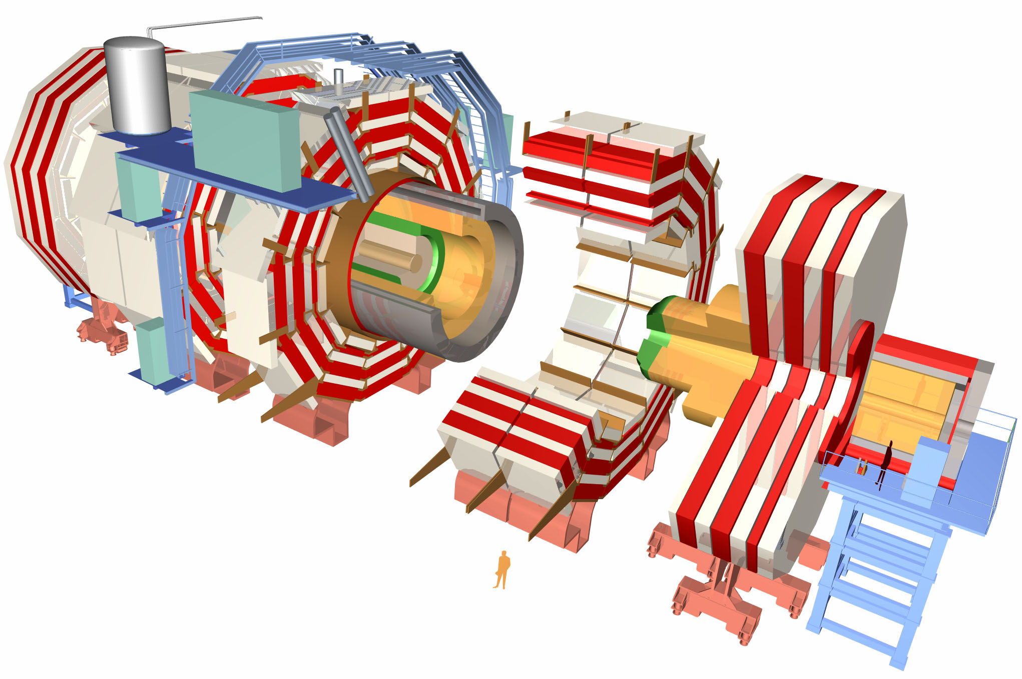
CMS : A Giga-Pixel Camera
Snaps a billion pictures of quantum interactions a second

Slide 20
What do we observe with CMS?
Photons
  Light quanta
Electrons
  Lightest electrically charged lepton
Muons
  Heavier cousin of electron (interacts minimally)
Charged hadrons (π, K, protons)
  Composite charged particles made of quarks
Neutral hadrons (neutrons, K_{L})
  Composite neutral particles made of quarks

Slide 21
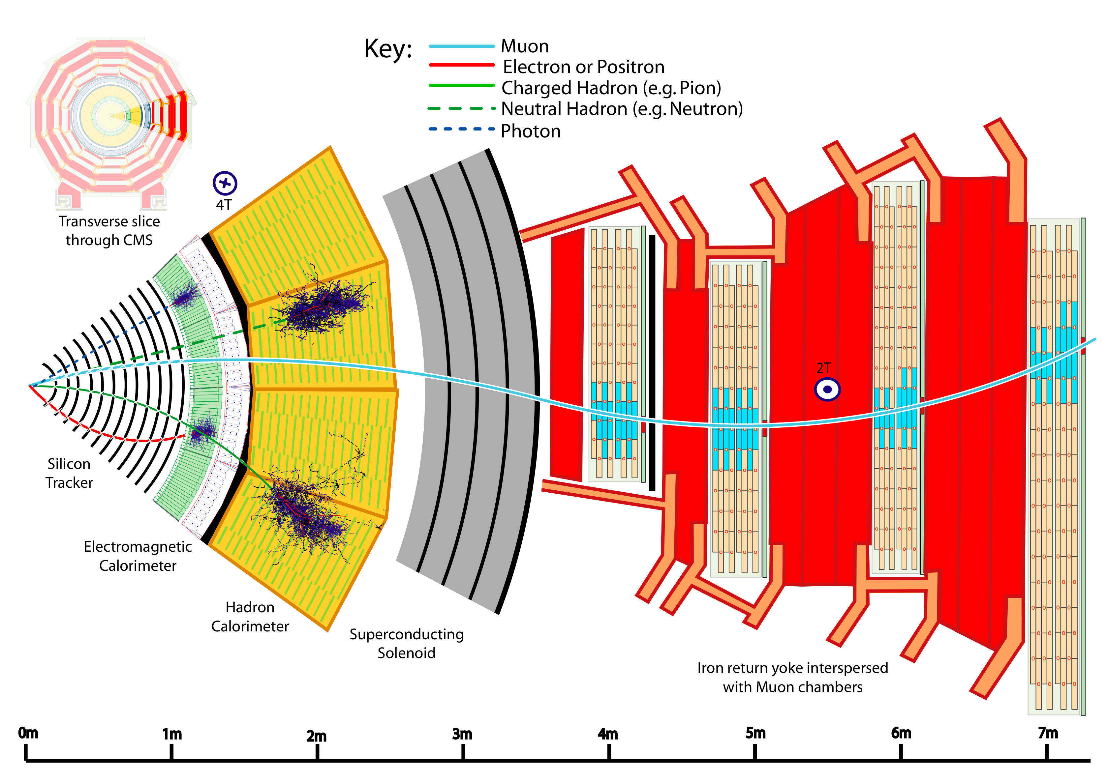
Particle Detection in CMS
Measure energy and momentum
Measure energy
Notes:
Transverse slice
Path of muon
---------------------------------------
Punch-through can make a high-pt muon look low
Muons are “gold-plated” since they suffer less radiative loss in the tracker, are better measured (Detector Paper, 128).

Slide 22
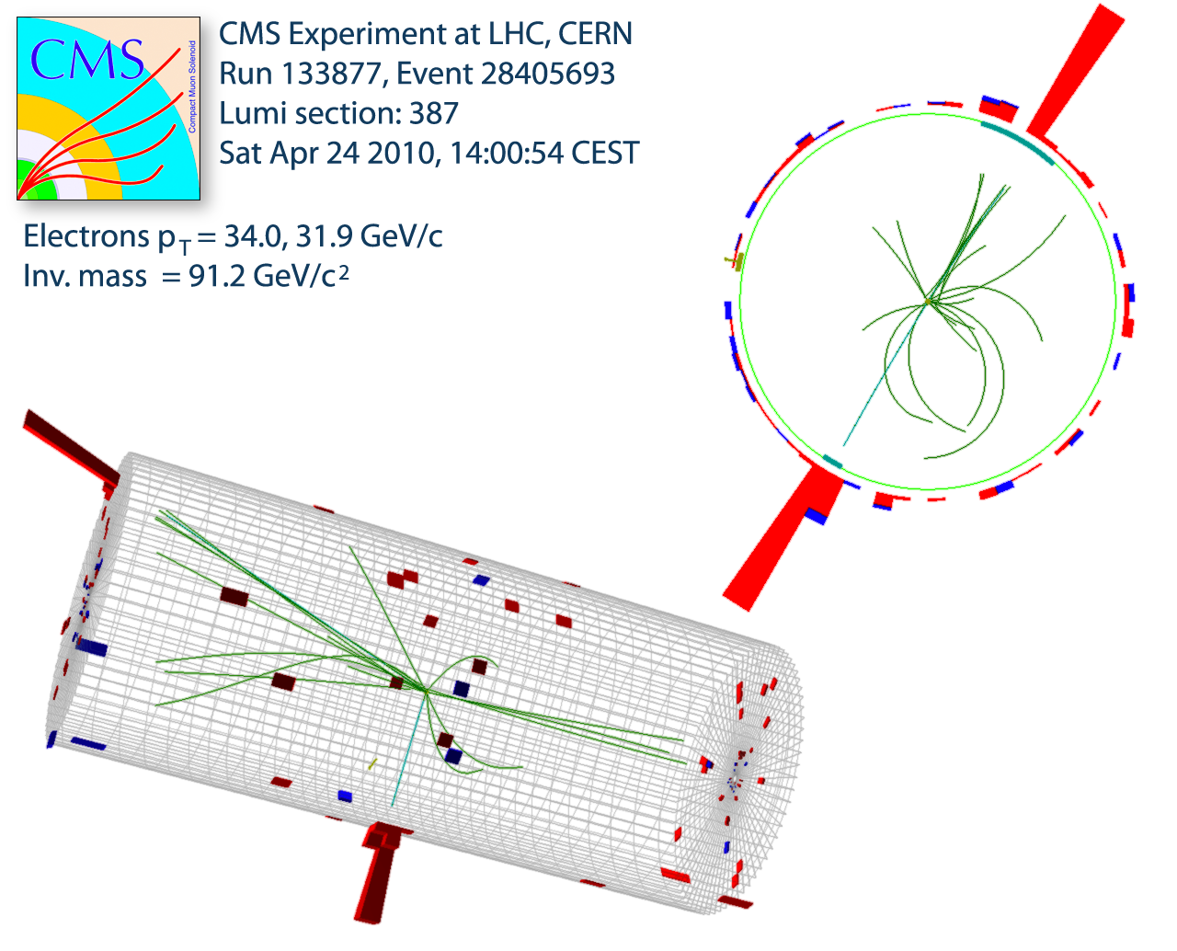
What about heavier particles?
Reconstructing a Z Boson
Most decay close to the interaction point
Event vertex (collision point) is measured using tracks
Note there are several low momentum tracks (underlying event)
Electron (–) and Positron (+)
Momentum (P_{x}, P_{y}, P_{z})
measured in tracker
Energy (E) measured in
the calorimeter

Slide 23
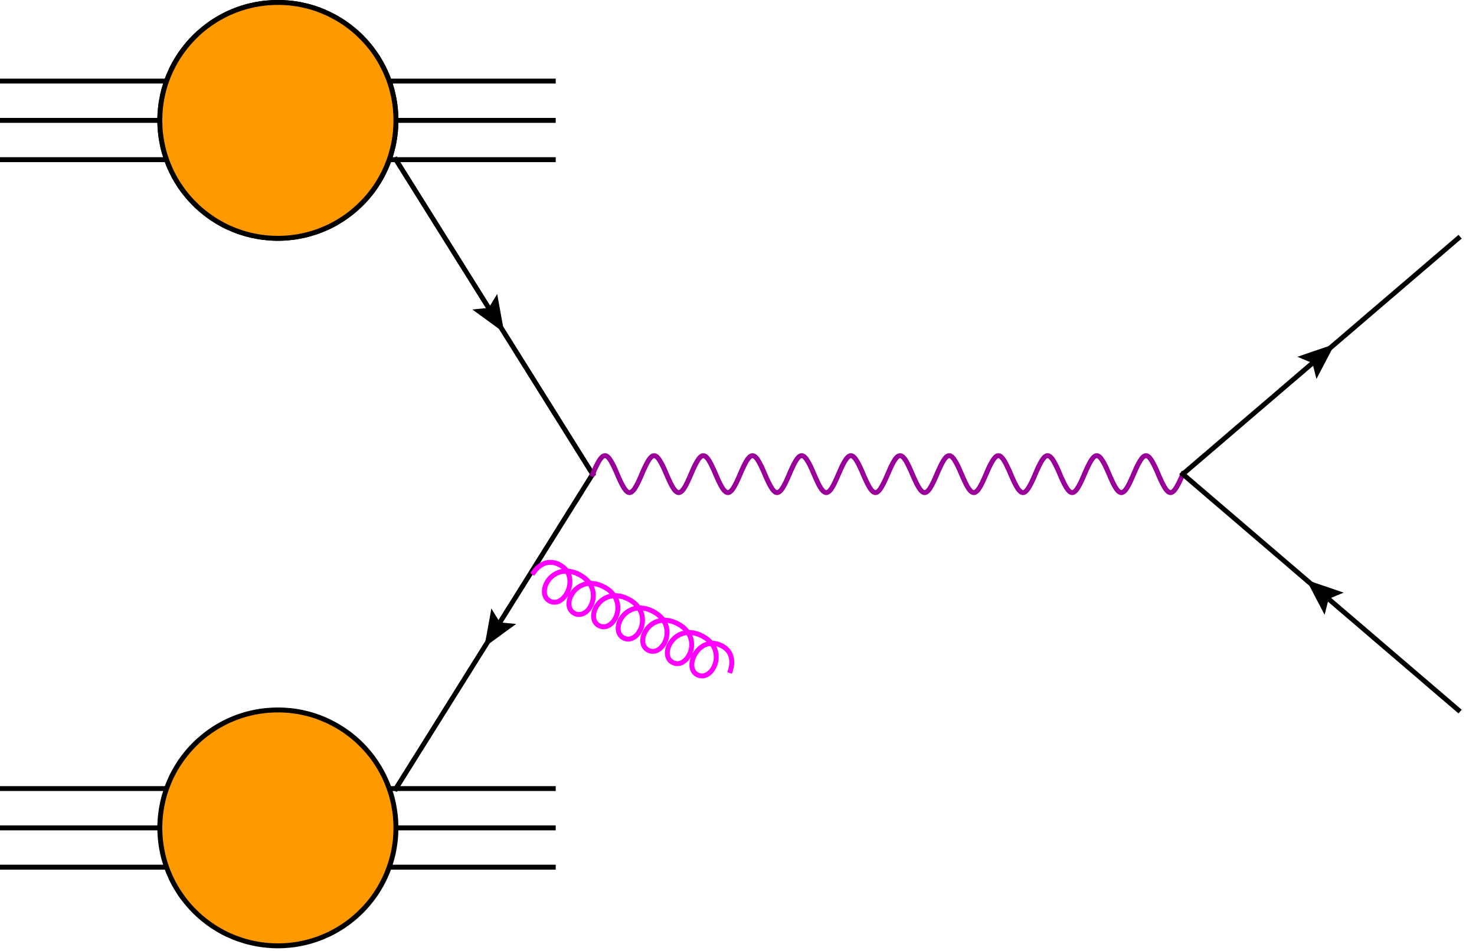
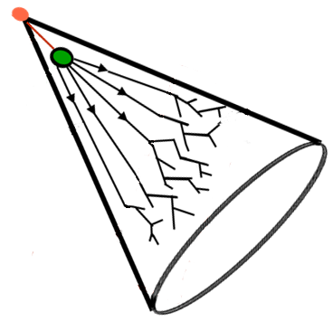
Vector Bosons @ pp Collider
What do we observe?
proton
e⁺
q
Z
Low Energy Particles
Pileup & multi-parton
Electrons
Underlying Event color connection
q
g
e⁺⁻
proton
Jets

Slide 24
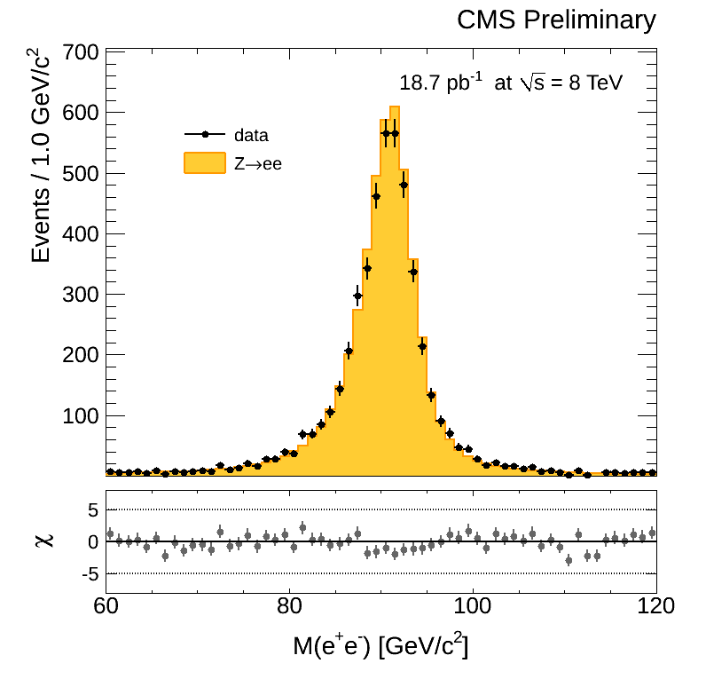
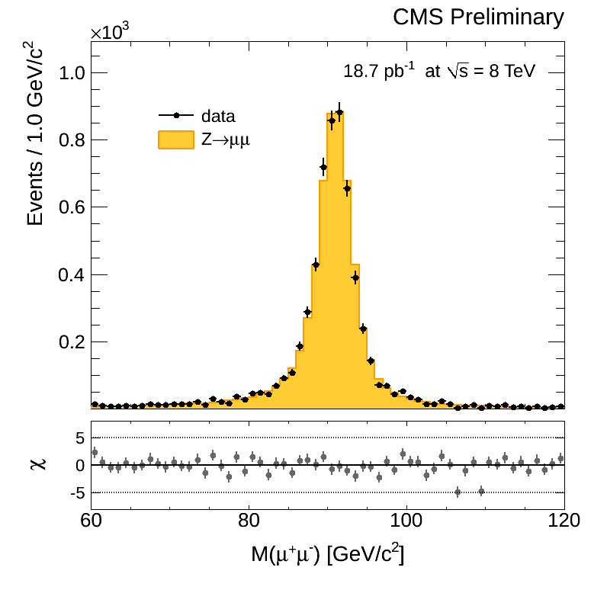
What about heavier particles?
The Z Boson Invariant Mass Peak
Particles decaying close to the interaction point
  Histogram of “invariant mass” of the original heavy particle shows a sharp peak at the mass of the Z (91 GeV)
  ATLAS & CMS see 20M events second – about 10/s are Z events
Mass of Electron-Positron Pair
Mass of Muon⁺-Muon– Pair

Slide 25
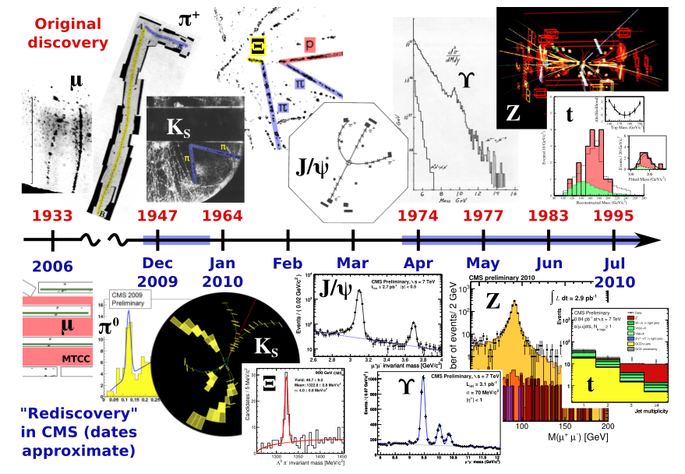
Established the Standard Model at 7 TeV

Slide 26
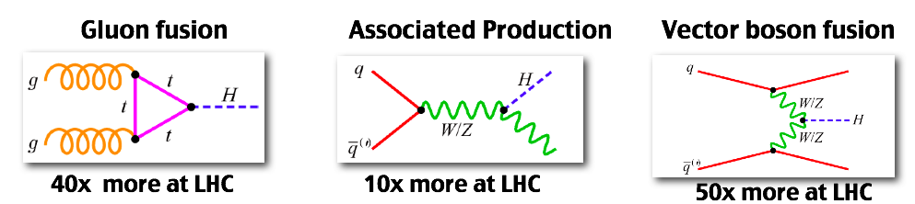
Standard Model Higgs Production
compared to the Tevatron, in the USA, which is the last experiment that looked for higgs boson

Slide 27
Standard Model Higgs Decay
We search for several Higgs decay channels.
H → bb
H → ττ
H → γγ
H → WW
H → ZZ

Slide 28
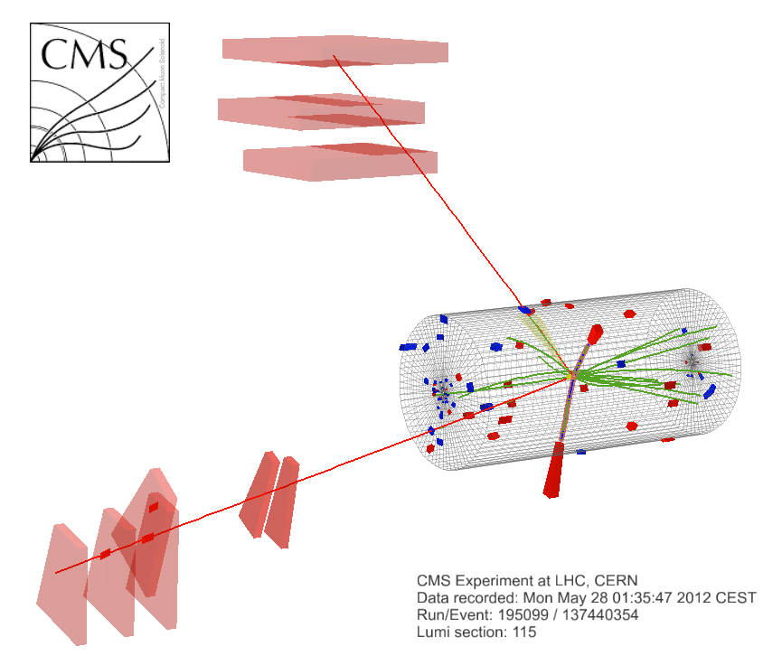
Candidate 4 Lepton Event
μ⁺(Z₁) p_{T} : 43 GeV
e⁻(Z₂) p_{T} : 10 GeV
8 TeV DATA
4-lepton Mass : 126.9 GeV
μ⁻(Z₁) p_{T} : 24 GeV
e⁺(Z₂) p_{T} : 21 GeV

Slide 29

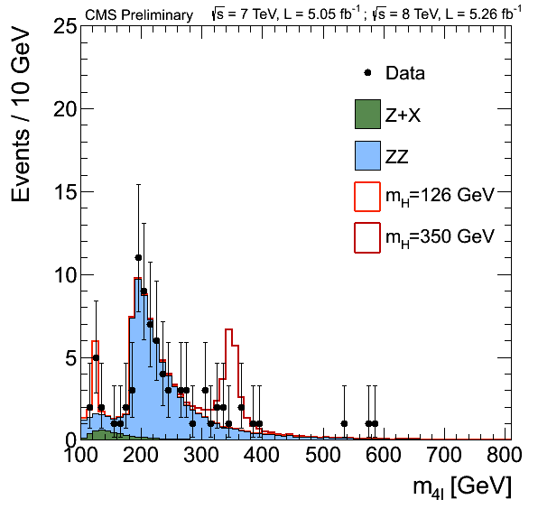
Invariant Mass of 4 light leptons
Golden mode – Muons & Electrons are well measured
Less than 200 events out of trillions detected survive selection
No clustered excess of events indicates exclusion of heavy SM Higgs
Clearly observe production of two Z bosons
as predicted

Slide 30
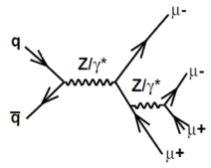
Higgs to ZZ to 4-light leptons?
Golden mode – Zoom of loss 4L mass region
Clearly observe production of Z decay to 4 leptons
Small cluster of events rising above the background indicates
2-sigma level
SM Higgs signal
M_{Z} = 91 GeV

Slide 31
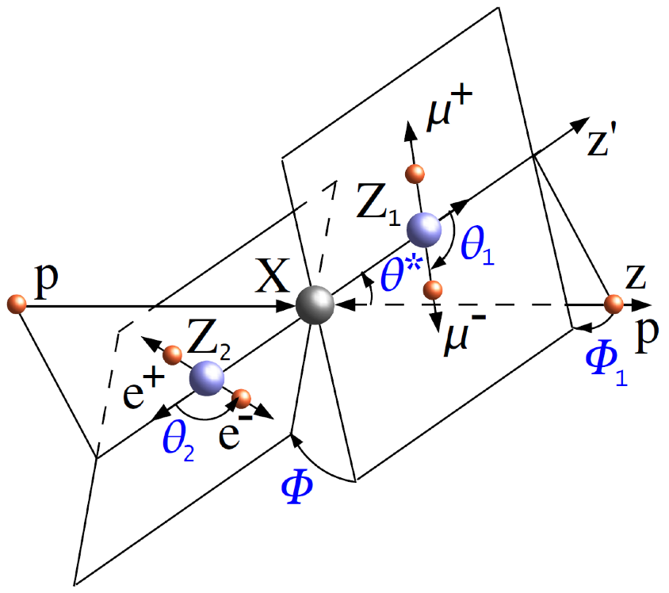
Use Angular Information
Study additional properties of these events
  Angles shown carry information of H decay versus ZZ production

Slide 32
Evidence of Higgs to ZZ to 4l?
Boost using angular information from 2 to 3.2 sigma
  Reduce background, while keeping signal-like events

Slide 33
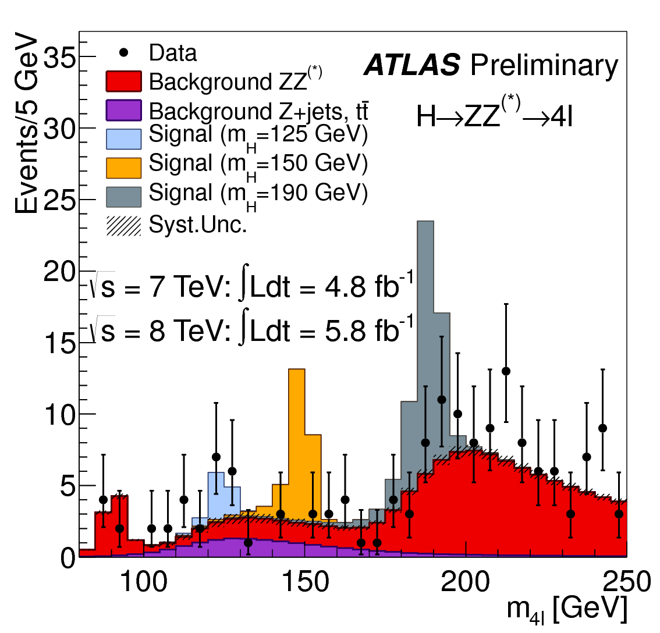
ATLAS ZZ Evidence
3.4 sigma excess seen at ~125 GeV

Slide 34
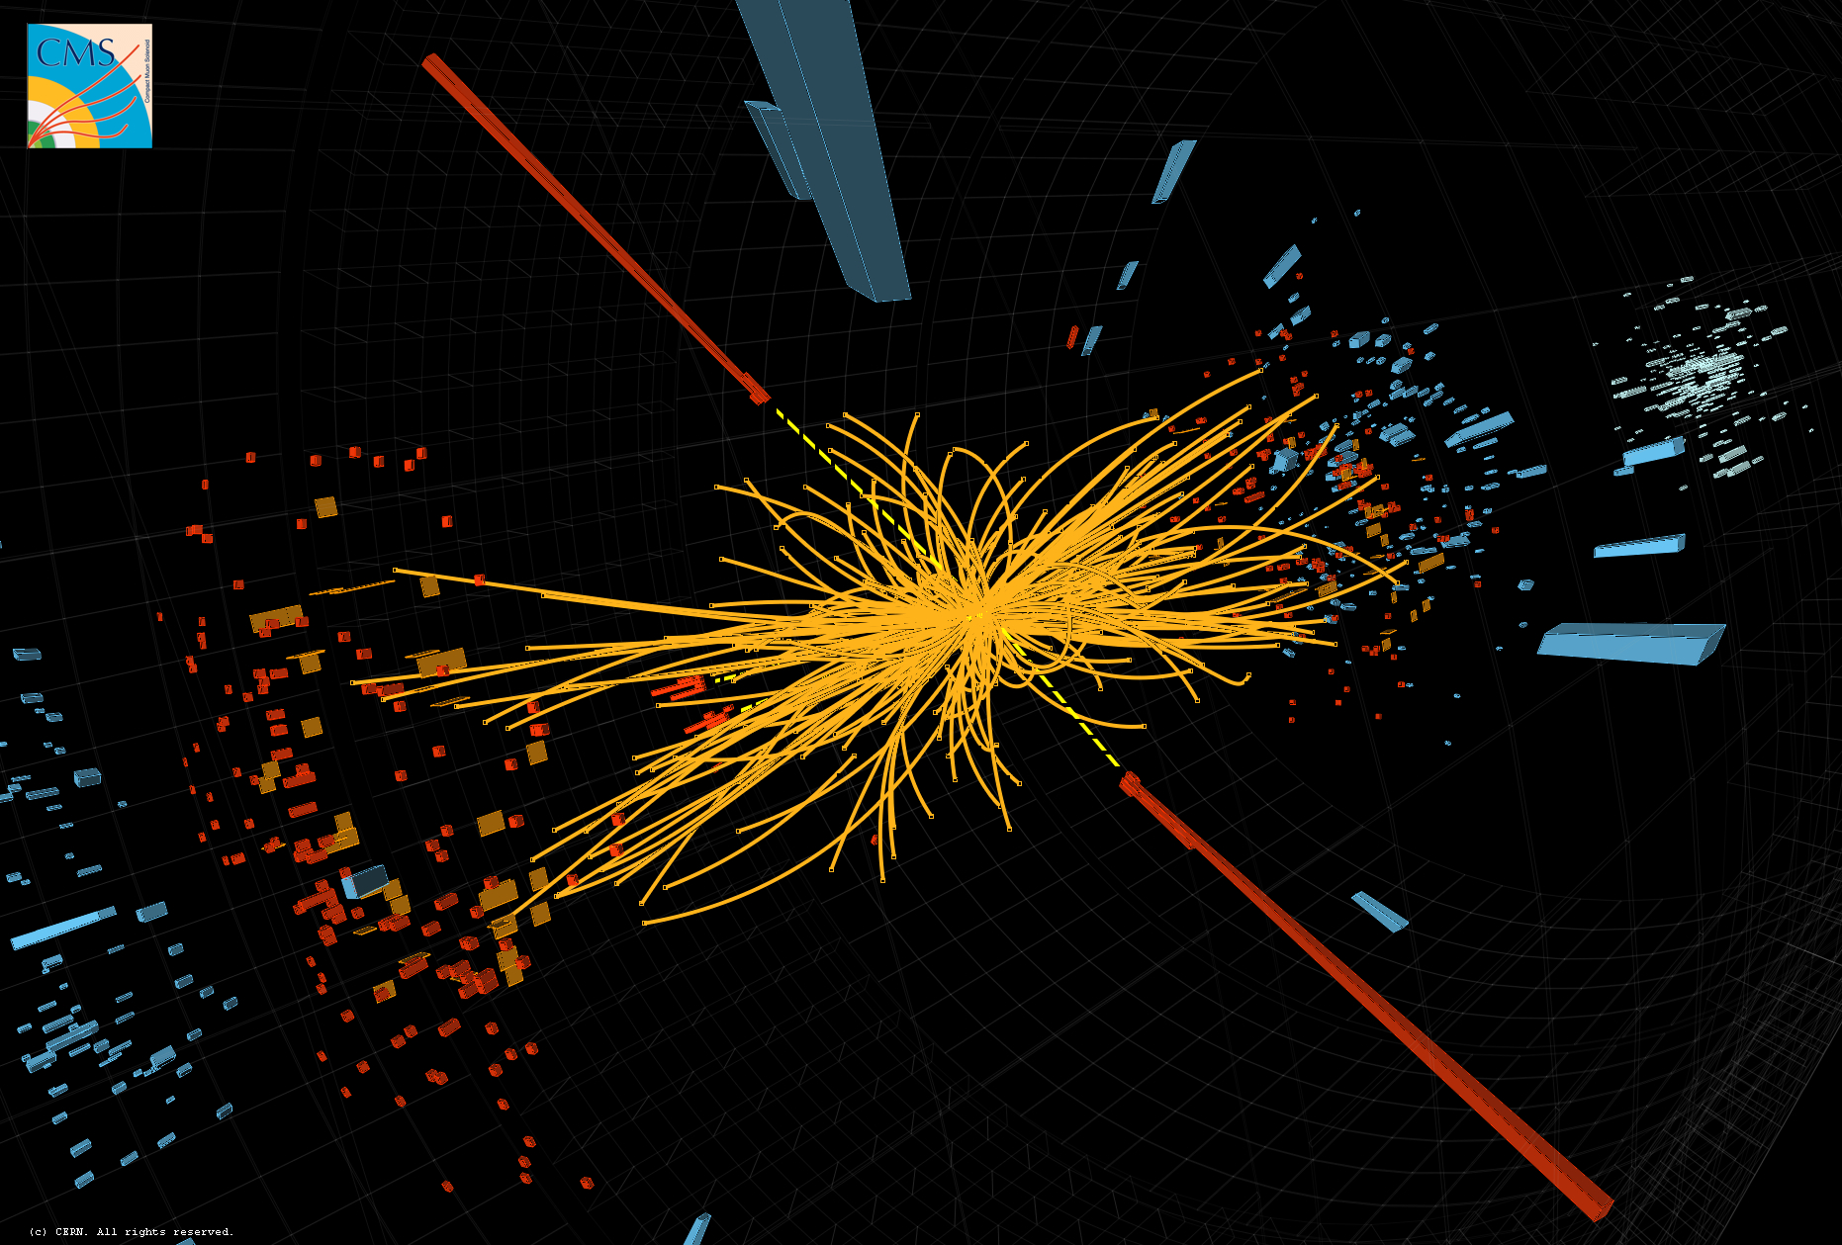
Candidate Di-photon Event

Slide 35
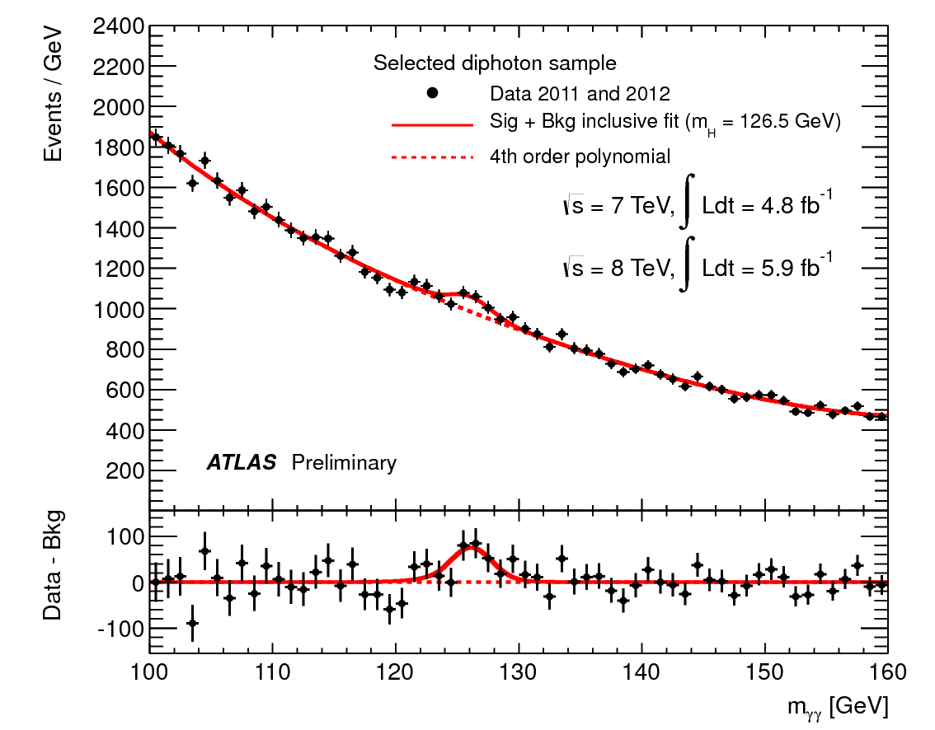
ATLAS Search in
Di-photon Invariant Mass
Photon background is large – look for a peak on a falling smooth spectrum
4.5 sigma significance at M=126.5 GeV when analysis is done in various categories of photon reconstruction quality

Slide 36
CMS : Weakest Category 7 TeV
Divide data into four categories by mass resolution
Separate reduced background di-jet category
2011 (7 TeV)
2012 (8 TeV)

Slide 37
CMS : Weakest Category 8 TeV
Divide data into four categories by mass resolution
Separate reduced background di-jet category
2011 (7 TeV)
2012 (8 TeV)

Slide 38
CMS : Good Category 7 TeV
Divide data into four categories by mass resolution
Separate reduced background di-jet category
2011 (7 TeV)
2012 (8 TeV)

Slide 39
CMS : Good Category 8 TeV
Divide data into four categories by mass resolution
Separate reduced background di-jet category
2011 (7 TeV)
2012 (8 TeV)

Slide 40
CMS : Better Category 7 TeV
Divide data into four categories by mass resolution
Separate reduced background di-jet category
2011 (7 TeV)
2012 (8 TeV)

Slide 41
CMS : Better Category 8 TeV
Divide data into four categories by mass resolution
Separate reduced background di-jet category
2011 (7 TeV)
2012 (8 TeV)

Slide 42
CMS : Best Category 7 TeV
Divide data into four categories by mass resolution
Separate reduced background di-jet category
2011 (7 TeV)
2012 (8 TeV)

Slide 43
CMS : Best Category 8 TeV
Divide data into four categories by mass resolution
Separate reduced background di-jet category
2011 (7 TeV)
2012 (8 TeV)

Slide 44
CMS : Low BG Category 7 TeV
Divide data into four categories by mass resolution
Separate reduced background di-jet category
2011 (7 TeV)
2012 (8 TeV)

Slide 45
CMS : Low BG Category 8 TeV
Divide data into four categories by mass resolution
Separate reduced background di-jet category
2011 (7 TeV)
2012 (8 TeV)

Slide 46
CMS : Best Low BG Category 8 TeV
Divide data into four categories by mass resolution
Separate reduced background di-jet category
2011 (7 TeV)
2012 (8 TeV)

Slide 47
Combined Weighted γγ Spectrum
4.1 sigma significance at M=125 GeV combining all categories and both years

Slide 48
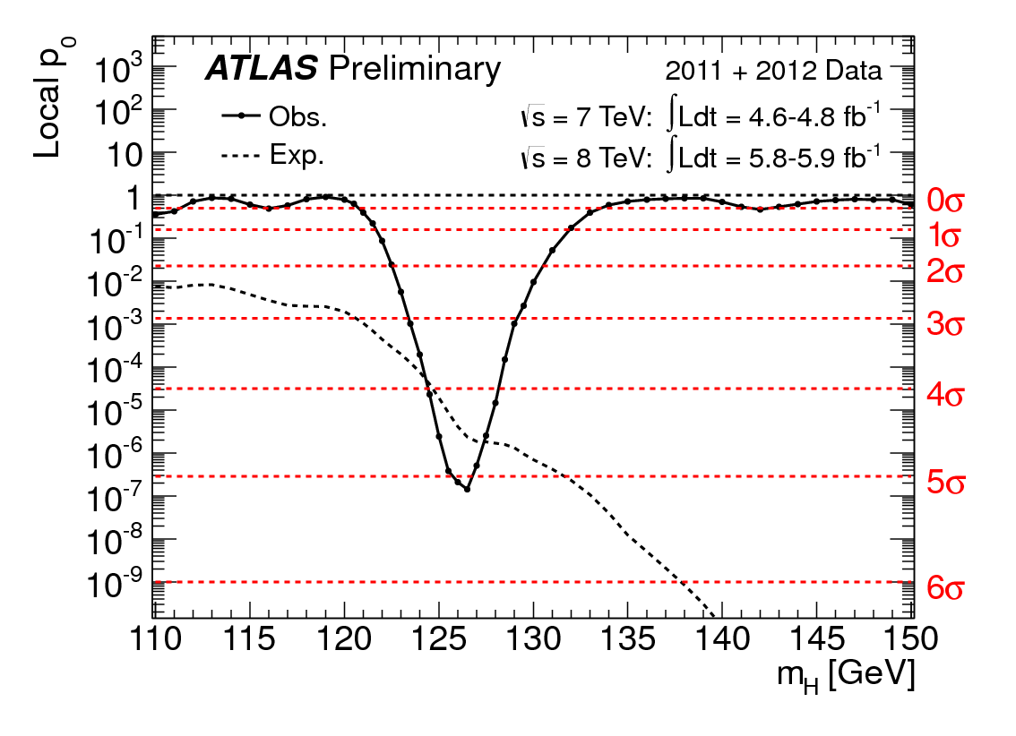
ATLAS: Combination of ZZ and γγ

Slide 49
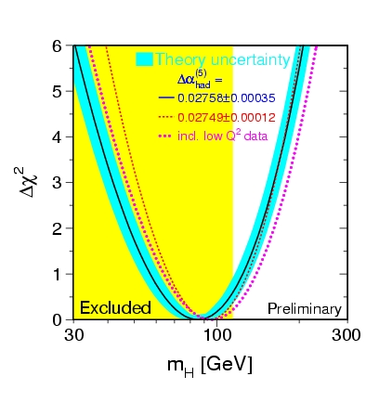
Is it the Standard Model Higgs?
Indirect constraints from other SM measurements indicate that the higgs should be where we found this new particle!
Exluded by LHC 2011
M_{H} = 125 GeV
LEP 2000

Slide 50
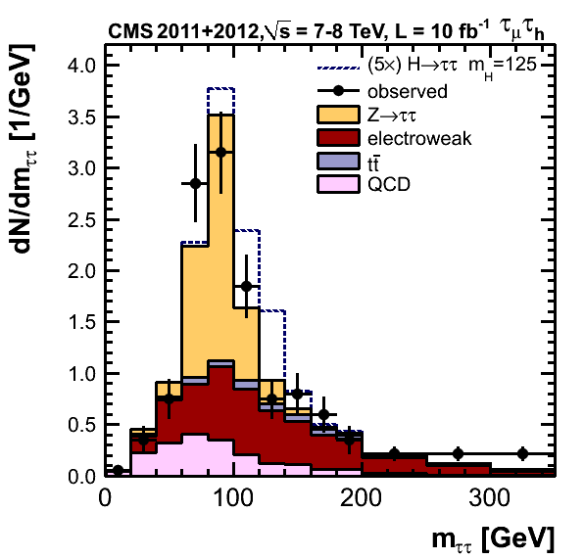
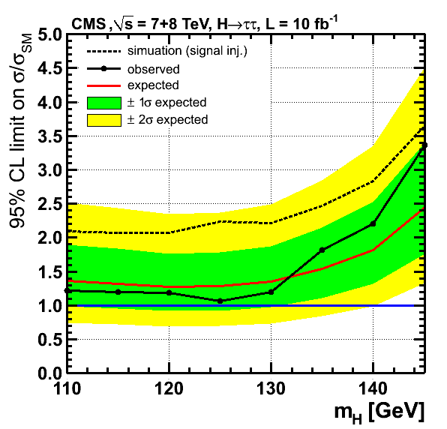
SM Higgs Interactions with Other Particles
SM Higgs interactions and other properties are fully determined theoretically
  Need more data to be certain that what is found is the SM Higgs
  For instance, we haven’t seen the new particle decay to tau pairs yet

Slide 51
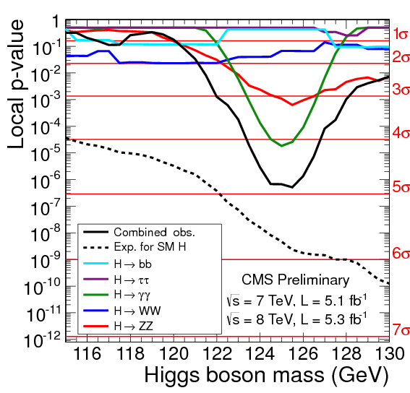
CMS: Grand Combination
CMS also looked at
other SM channels
  W-boson pair
  b-quark pair
  τ-lepton pair
No evidence yet in
these less sensitive
modes at this time

Slide 52
Summary
LHC discovered a new particle
  Both ATLAS & CMS see the same thing at the same mass
  4σ evidence in photon-pair decay mode
  3σ evidence in Z-pair decay mode
Is it the Standard Model Higgs Boson?
  It is a boson – because it decays to bosons
  Its mass is in the right window – consistency with SM
  However, its properties are yet to be determined to confirm that it is the SM Higgs Boson
LHC is performing well and the run is extended
  Both experiments will more than double their data in 2012
  Should be able to provide a confirmation with 2012 data
  If it is not SM like Higgs, it will be even more exciting!

