Slide 1

Department of Physics
Some Facts &
Research Highlights

Slide 2
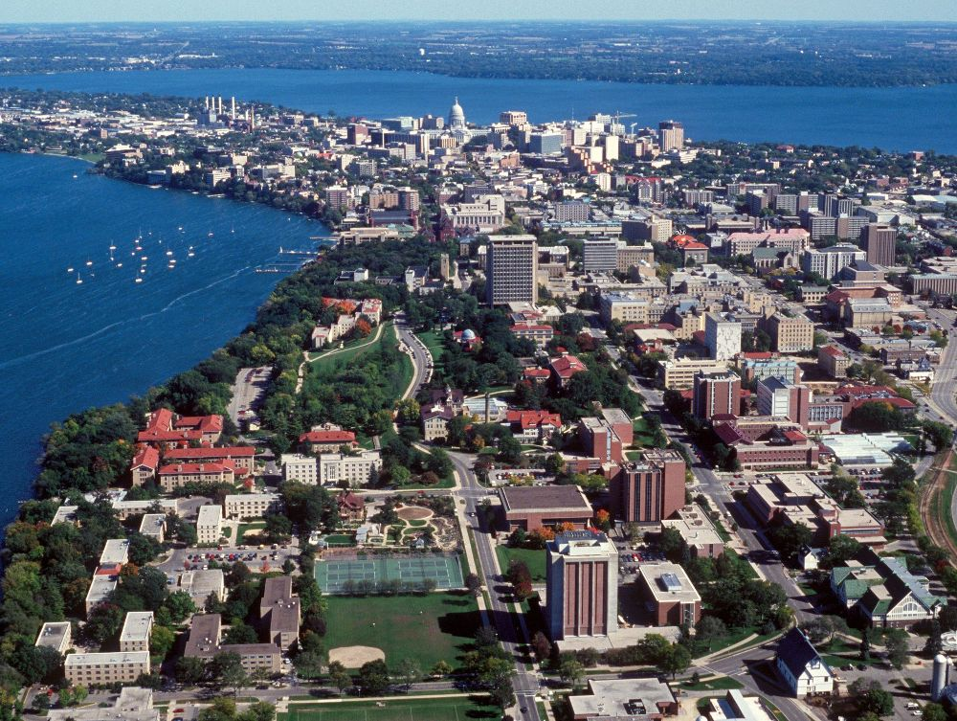

Welcome To Madison
State Capitol Building
Sorrounded by 2 lakes
(Mendota and Monona)

Slide 3
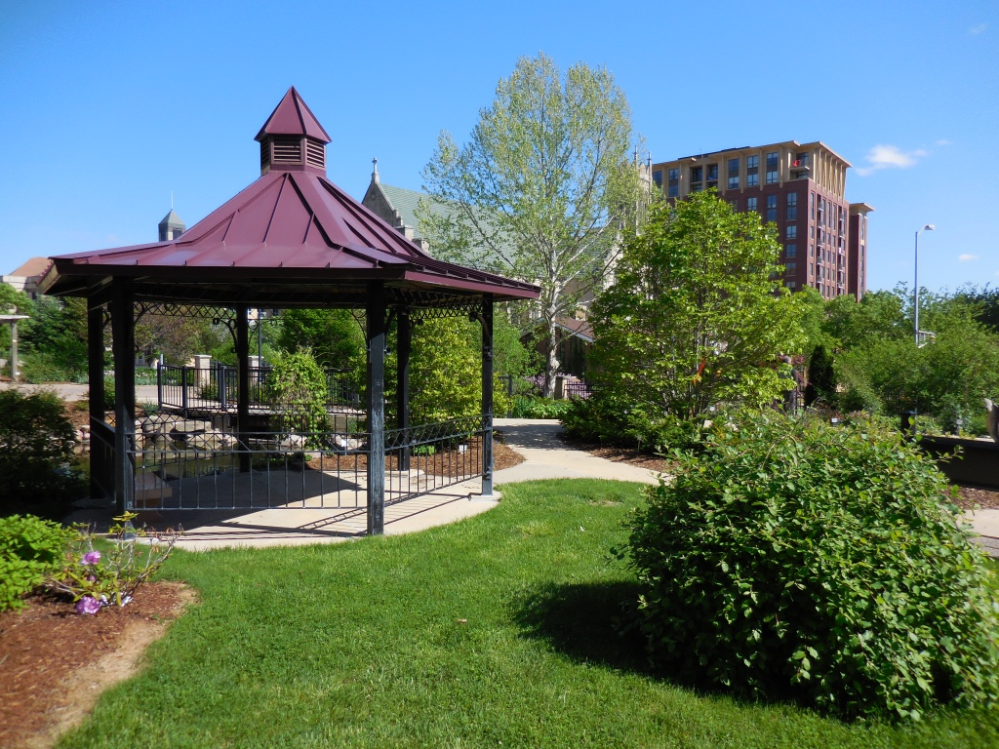
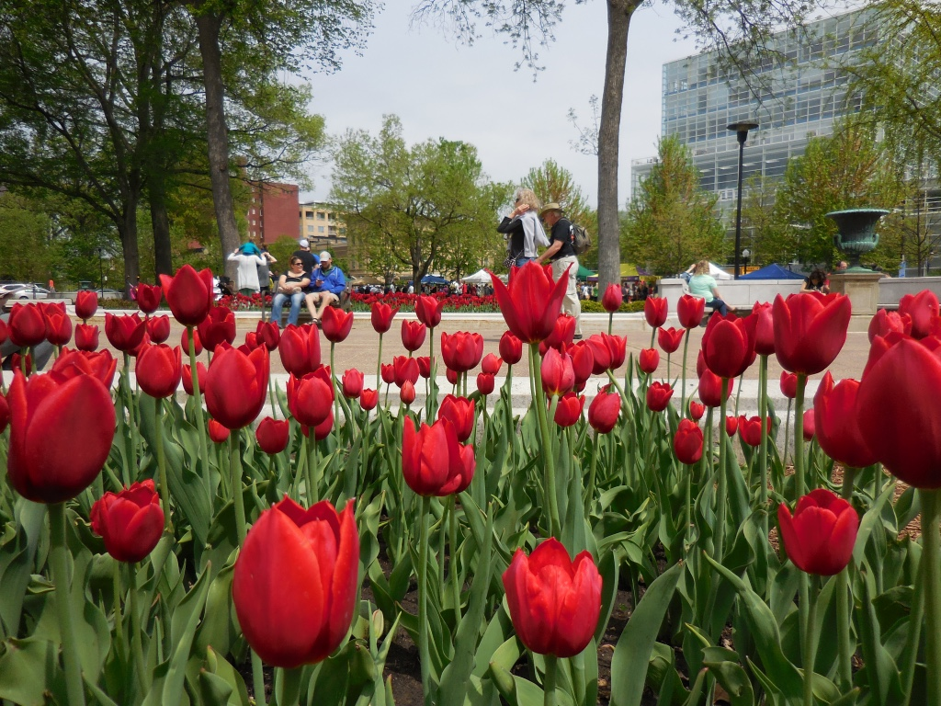
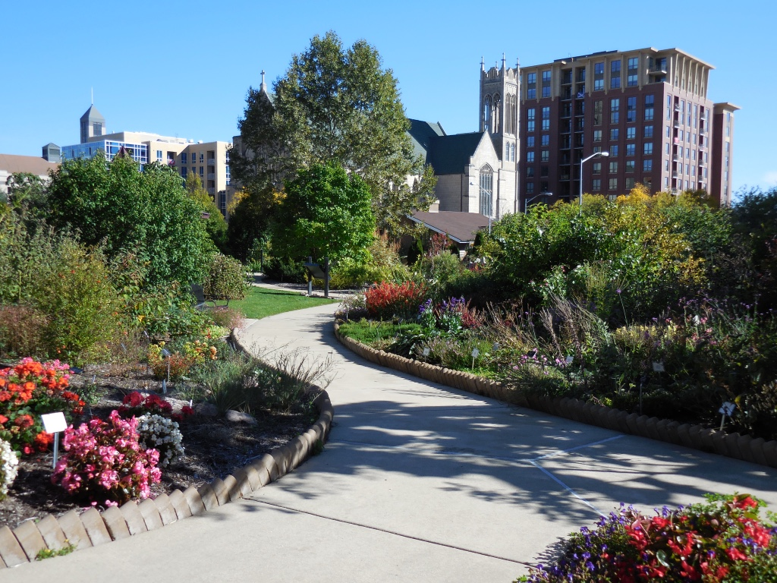


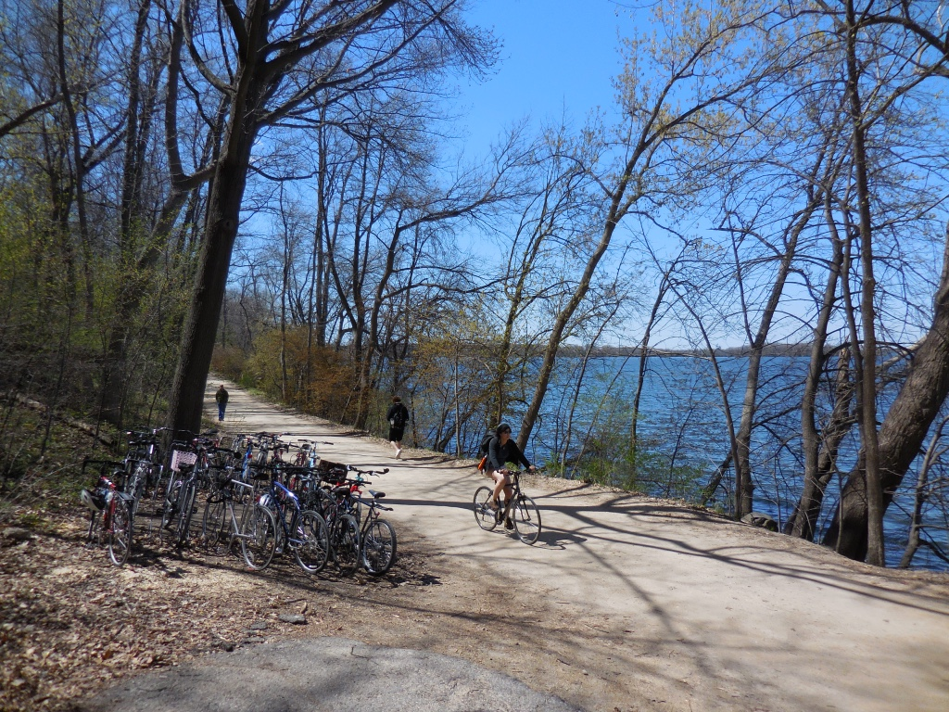
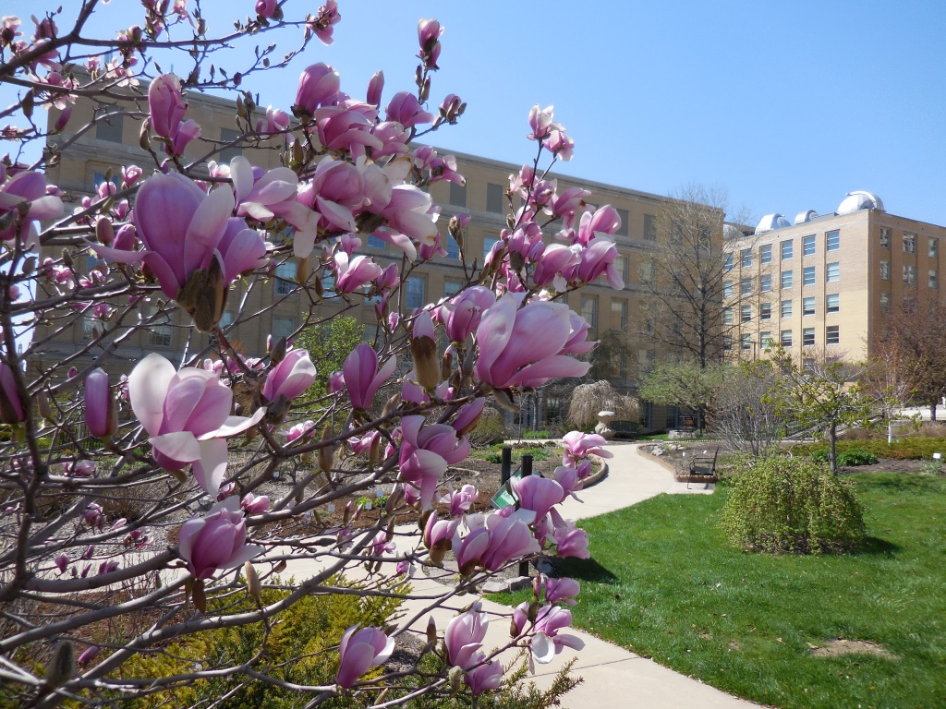
Spring is here on Campus

Slide 4
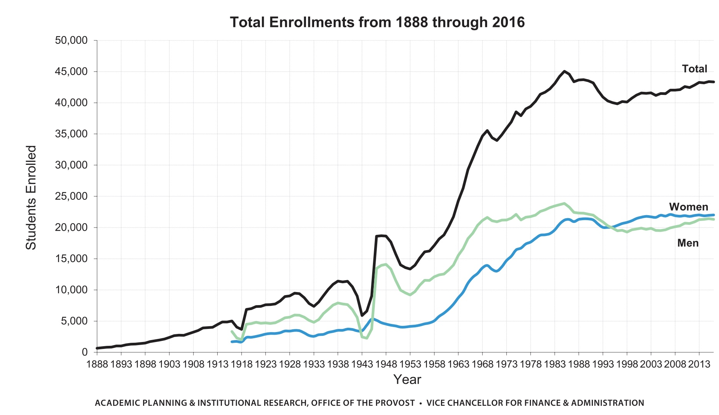
UW-Madison Student Population
Sifting and Winnowing since 1849
  Research and teaching in all disciplines (but dentistry)
    44000 students
    Top 10 in Federal research funding for decades
  A land grant college

Slide 5
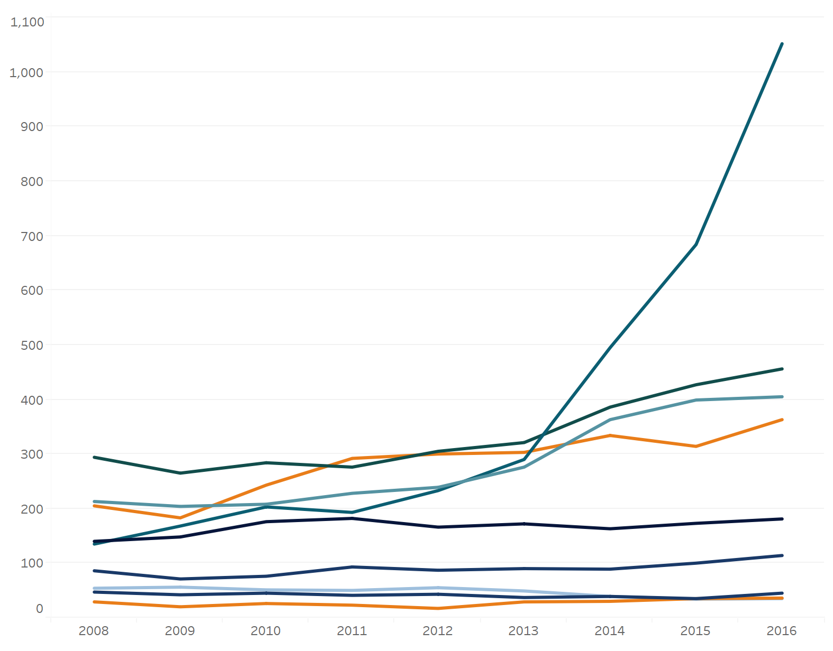
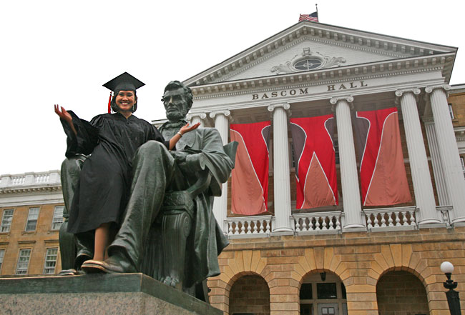
Graduation is Done
The Physics Department teaches:
  25% of them in Service Courses
  ~150 Undergraduate Physics Majors
  ~175 Graduate (Ph.D.) Students
Computer Science
Physics

Slide 6
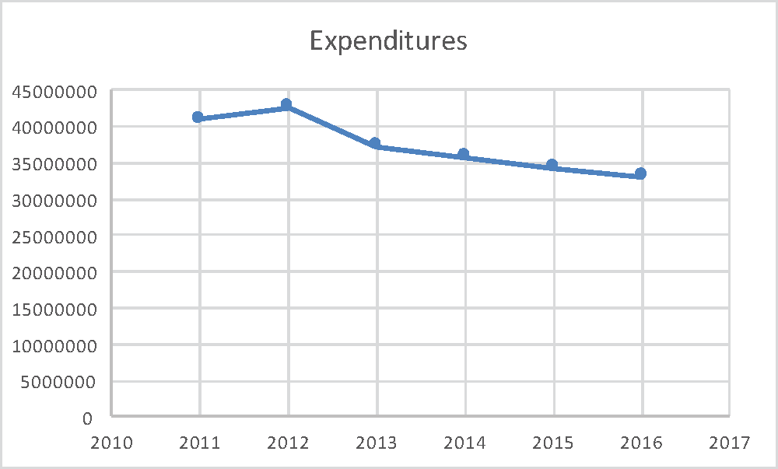
Size of Physics Faculty vs Research Expenditures

Slide 7
Physics Department Focus is Research
We Train Researchers
UW Base Support
Extramural Research Funds
Best Researchers Start Early

Slide 8
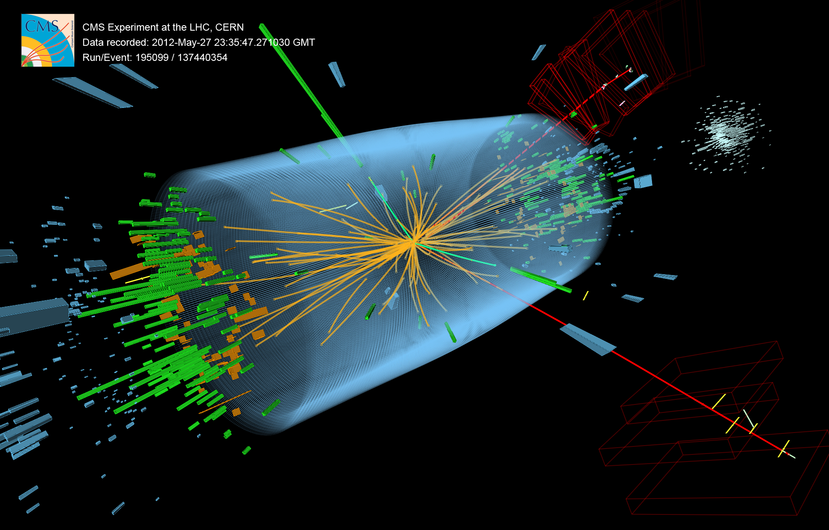
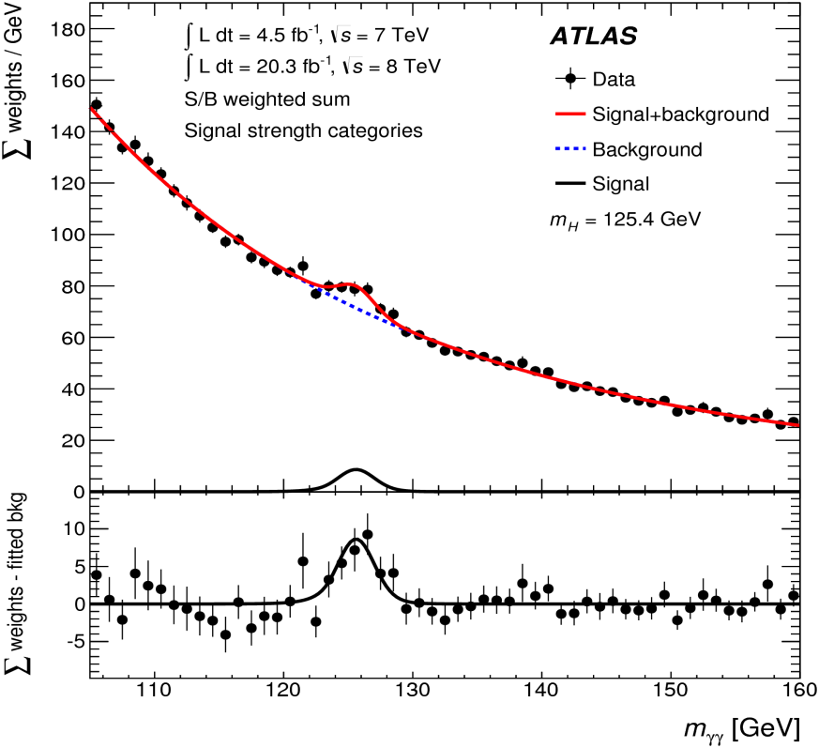
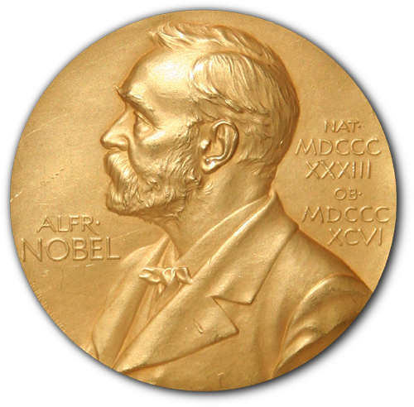
Higgs Particle Discovery
From Physics of Sizeless Particles …
There are two major experiments, ATLAS and CMS, at the Large Hadron Collider at CERN, which is currently the most powerful accelerator in the world.
The University of Wisconsin has made major contributions to both experiments and to the discovery of the Higgs particle with 6 faculty making fundamental contributions to detectors and analysis.
Strong theoretical particle group of 6 faculty.
Electron
Higgs discovered after analyzing
billions of collisions
Muon +
Electron
H → e⁺ e– μ⁺ μ–
Higgs
Positron
Muon –
H → γ γ
2013 Nobel Prize for Physics, citing:
“the discovery of the predicted fundamental particle, by the ATLAS and CMS experiments at CERN's Large Hadron Collider.”
Dasu | Herndon | Smith | Wu

Slide 9
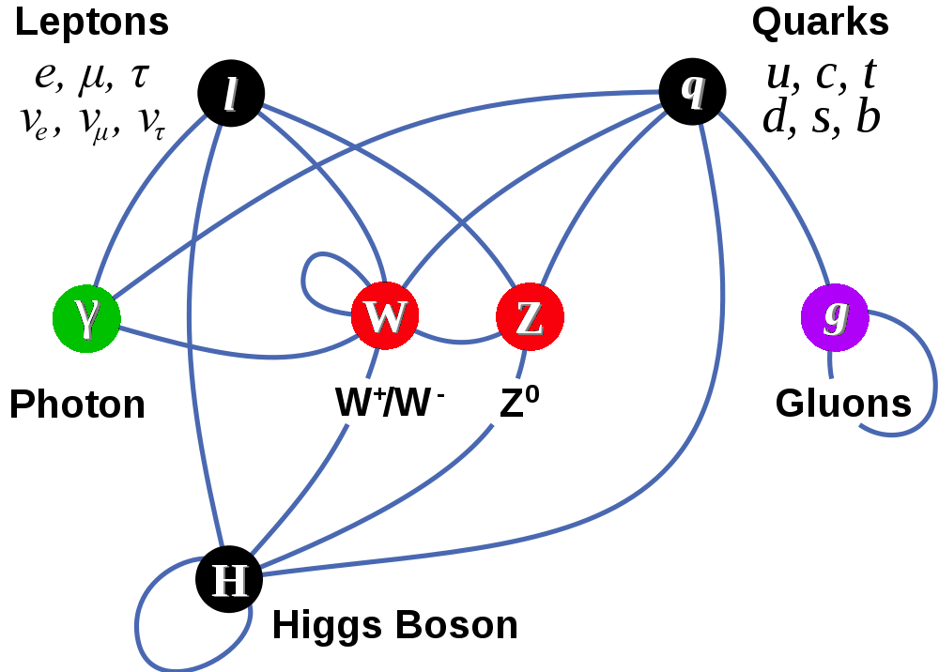
The Standard Model
From Physics of Sizeless Particles …
Matter Particles (fermions)
Interactions by exchange of vector bosons
New fundamental field present everywhere in universe >> The Higgs boson
Other particles attain mass by coupling to this new fundamental field
Theory: Bai | Balantekin | Barger | Chung | Everett | Halzen | Hashimoto | Shiu
Experiment: Carlsmith | Dasu | Herndon | Pan | Smith | Wu

Slide 10
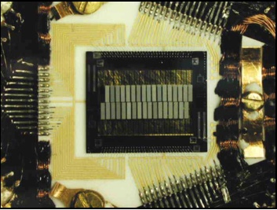
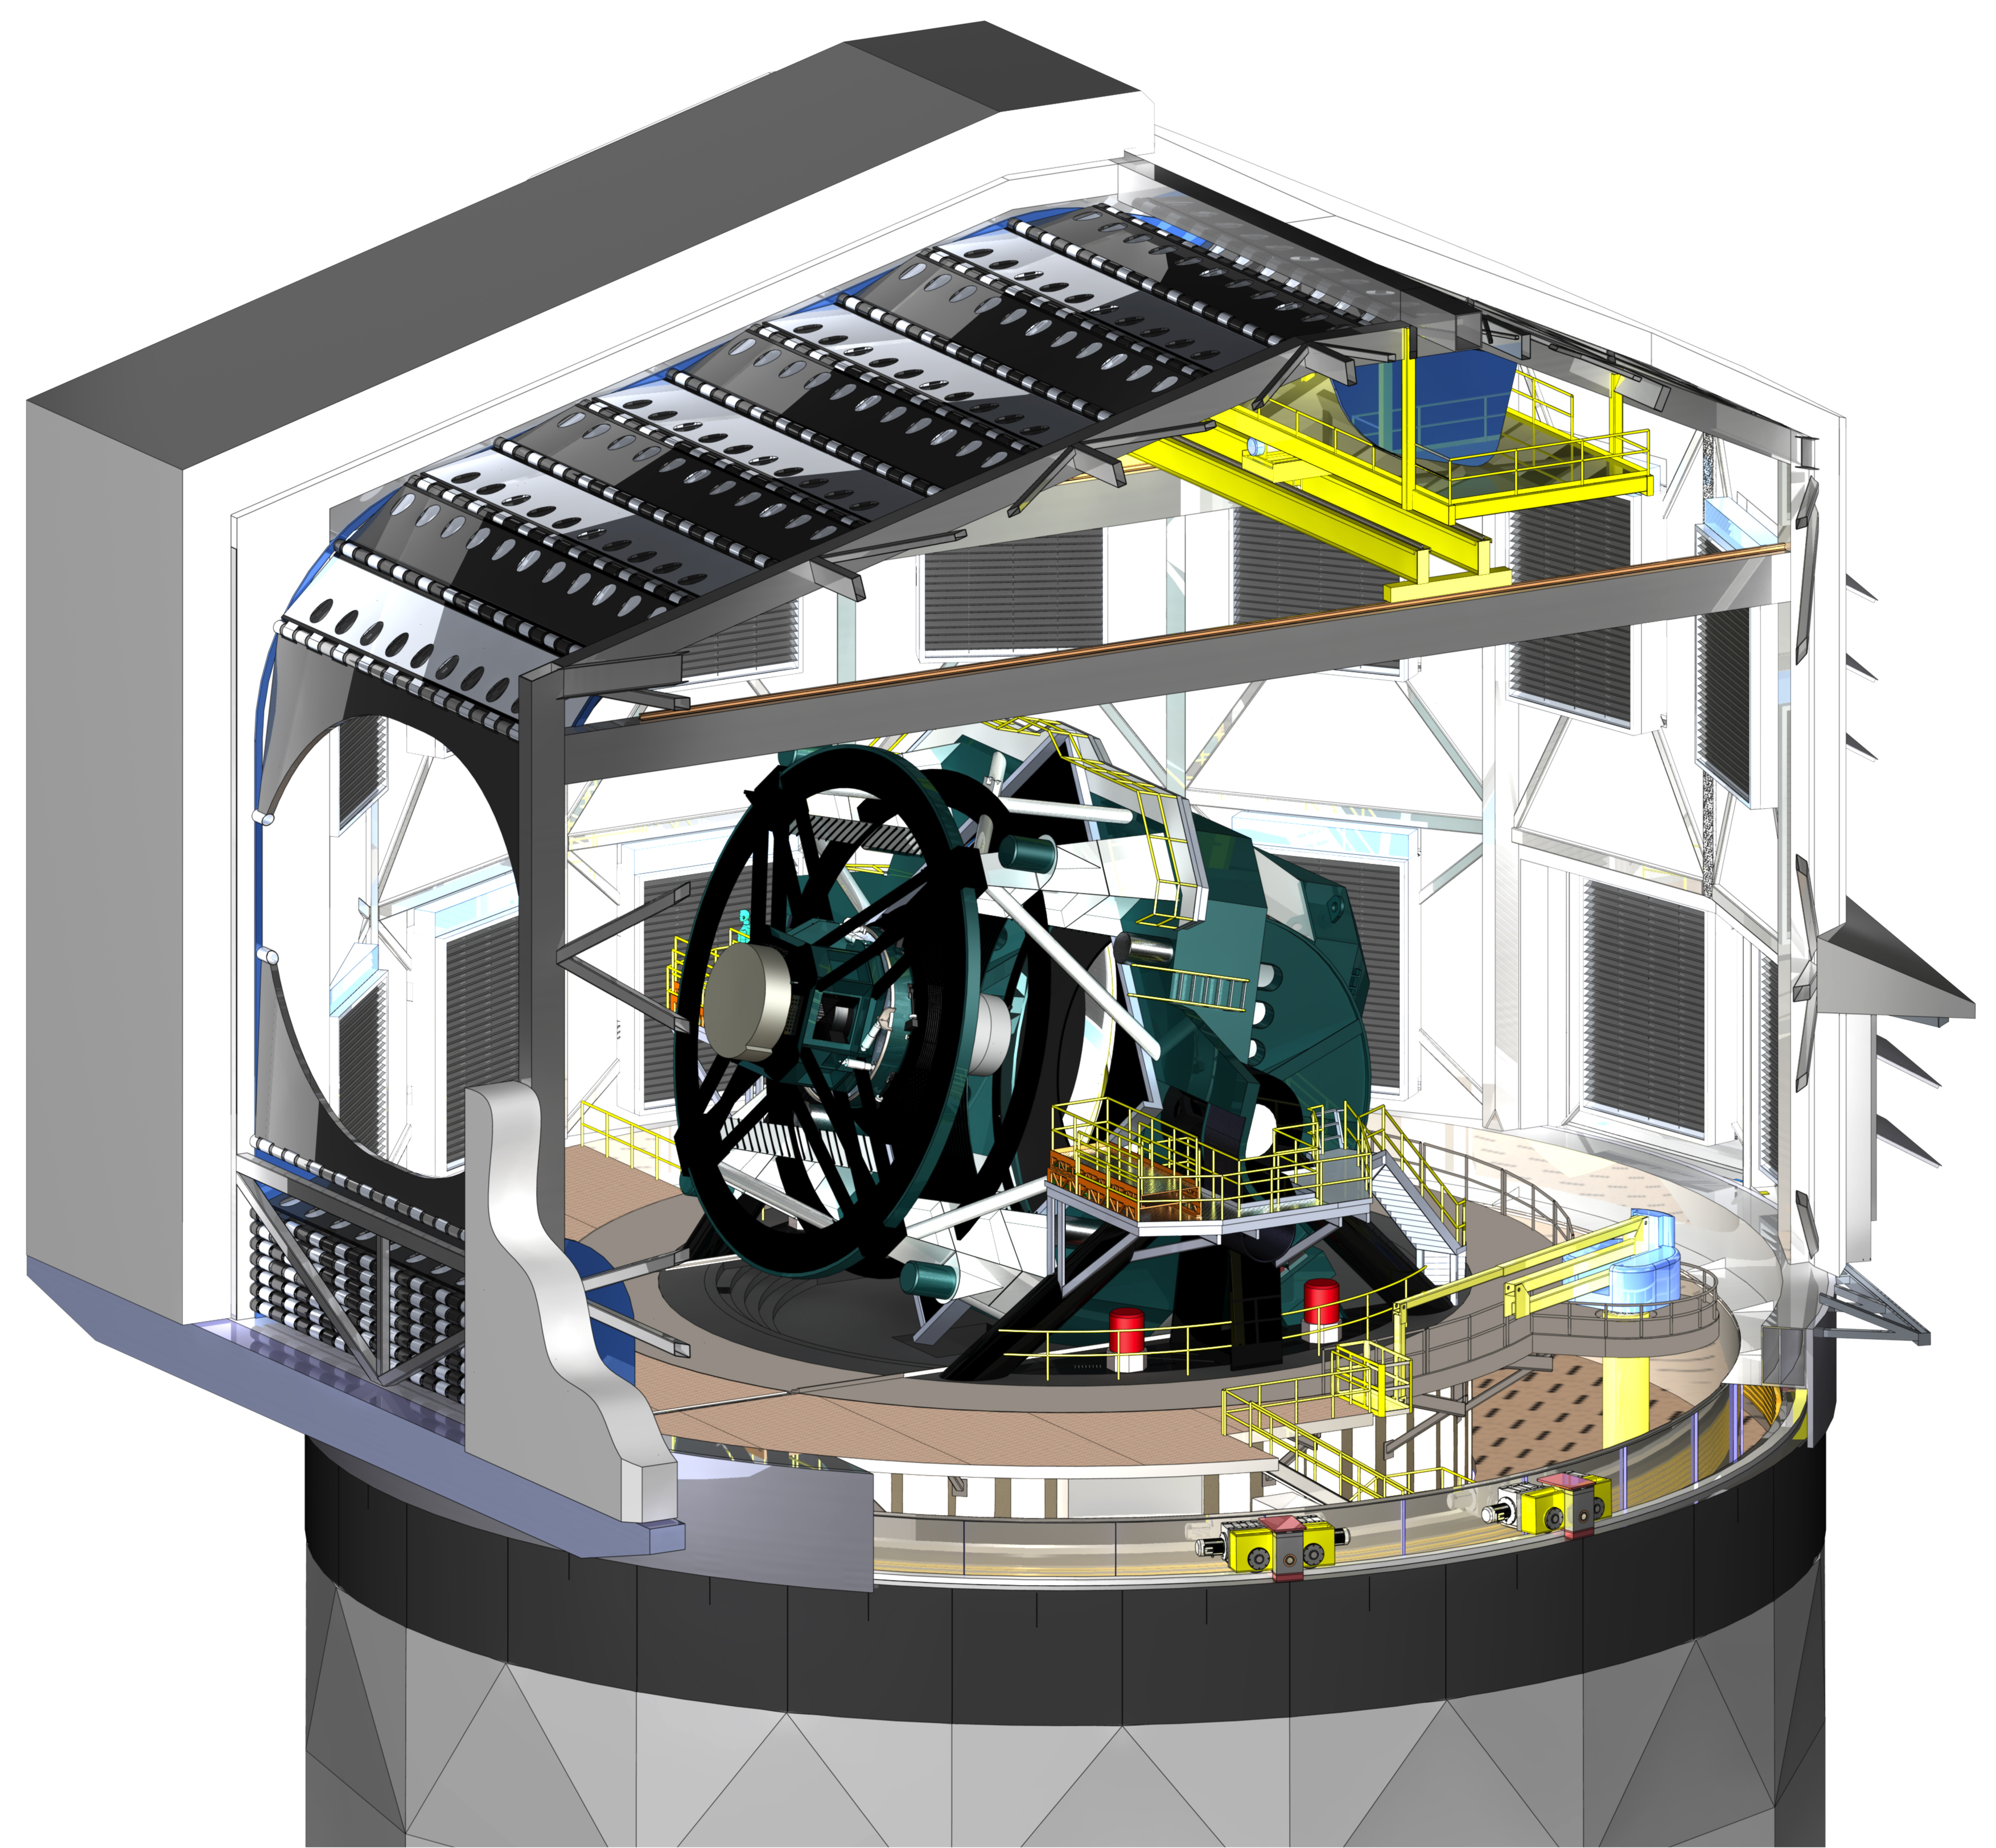
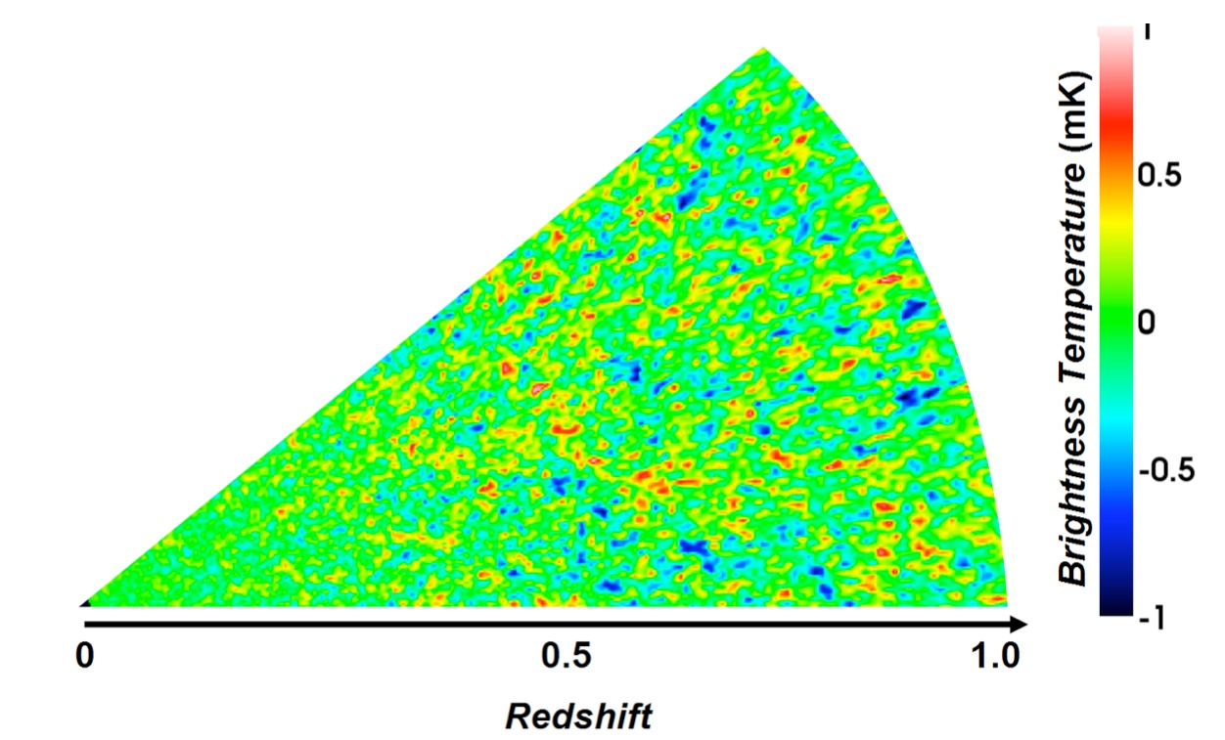
X-Ray Astrophysics,
Observational Cosmology
…to the Physics of the entire Cosmos
X-Ray detection in space – micro-calorimetry
Cosmic Microwave Background studies
Large scale structure studies with sky-surveys
Large Synoptic Survey Telescope
with Gigapixel Camera in construction in Chile
mK fluctuations in CMB Temperature using 21-cm H-line
Microcalorimeter to measure X-Rays
McCammon | Timbie | Bechtol (new)

Slide 11
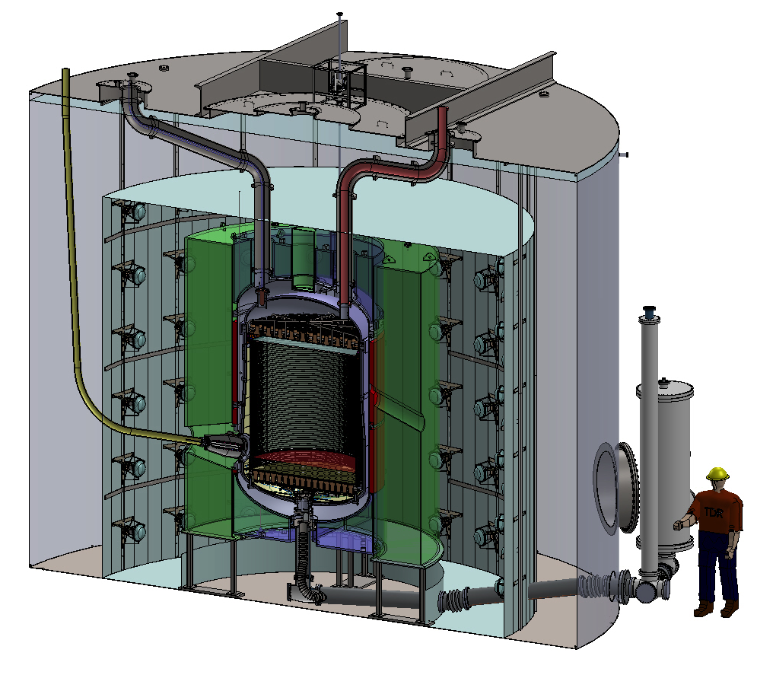

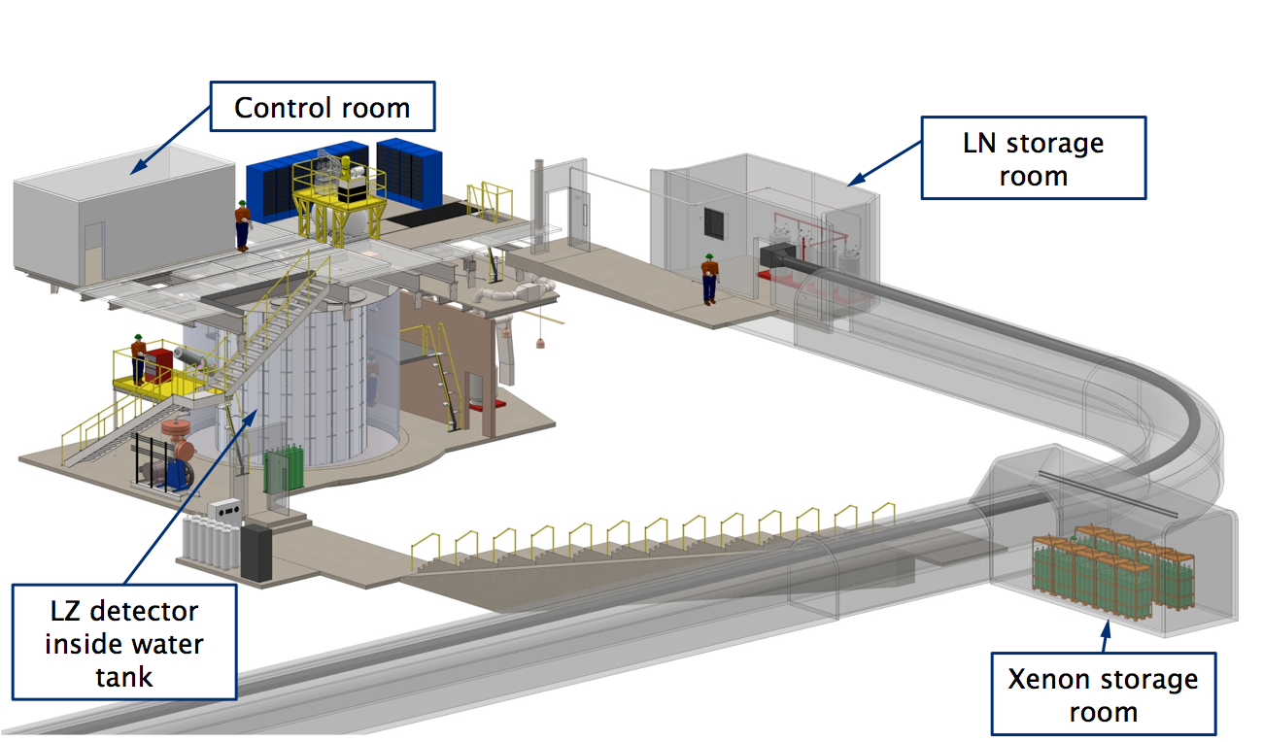

Deep Underground searches …
Dark Matter is 27% of our Universe. SM has no DM candidate
LZ Experiment
About one mile underground in South Dakota
Xe TPC
UW playing a lead role in construction
UW searching for DM @ LHC, IceCube, HAWC
Latest effort is to look for DM interactions in its feeble interaction with Xenon, deep underground
Palladino + Existing ATLAS, CMS, IceCube & Theory Efforts

Slide 12
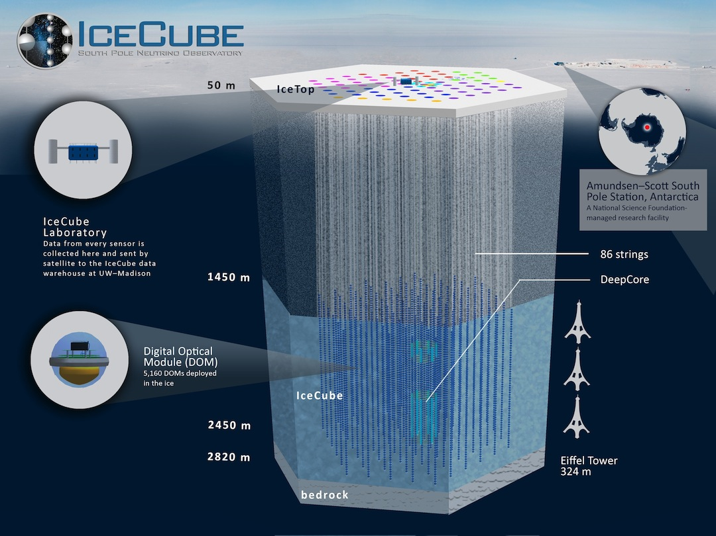
… To Deep Antarctic Ice Discoveries
Halzen | Hanson | Karle | Vandenbroucke | Westerhoff

Slide 13
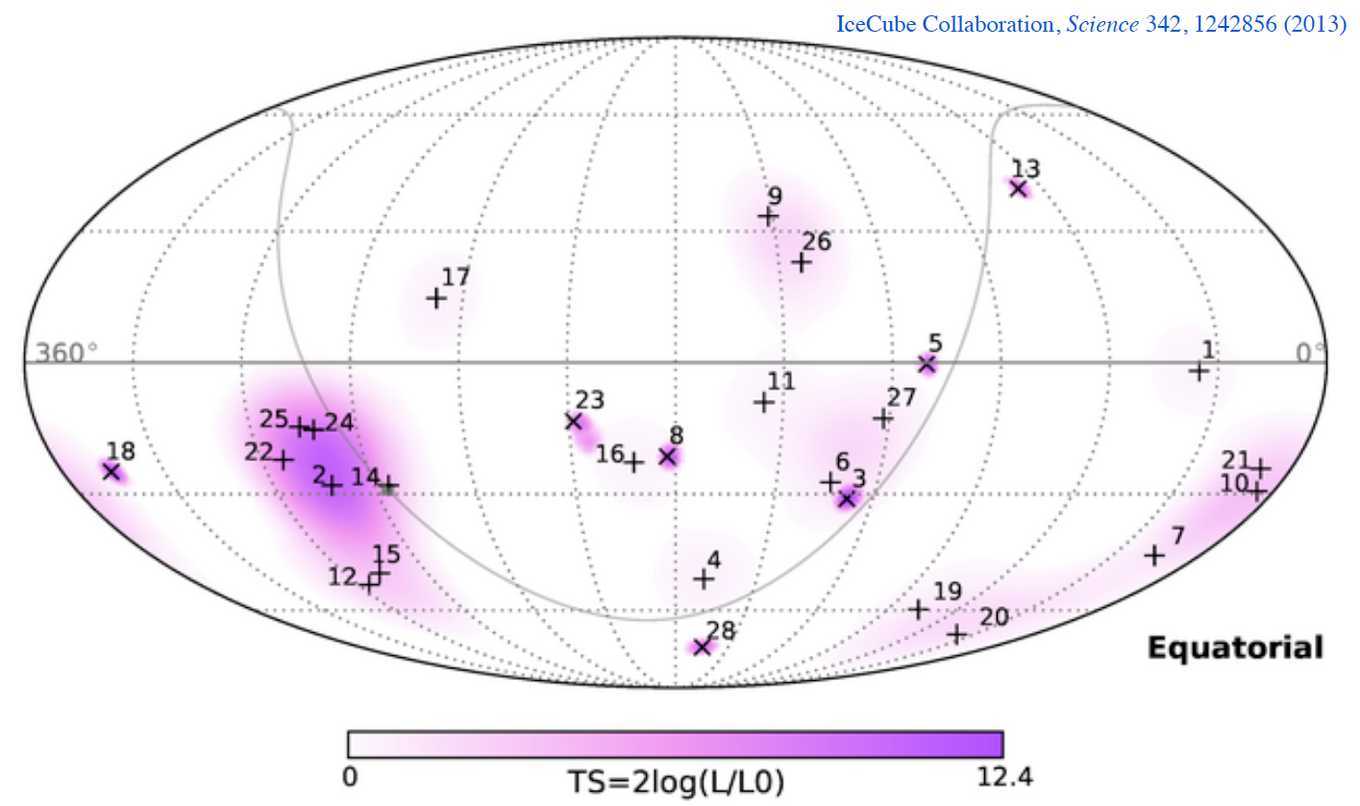
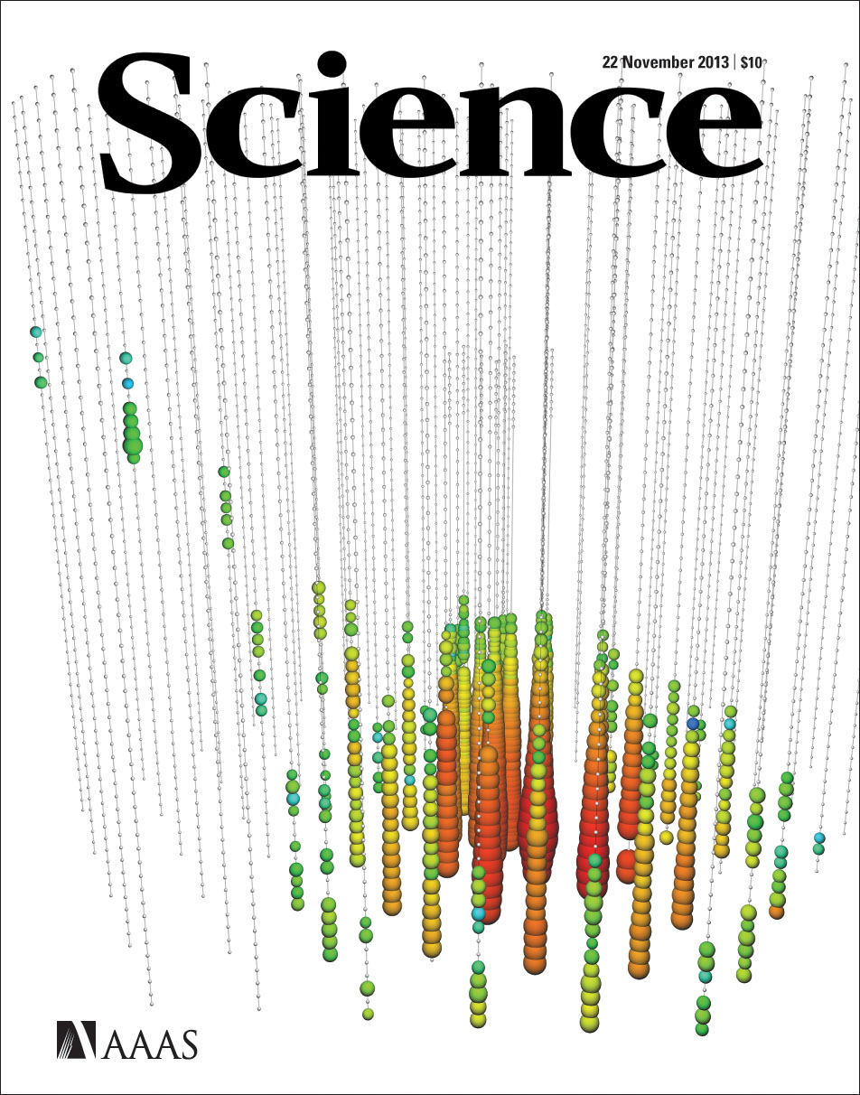
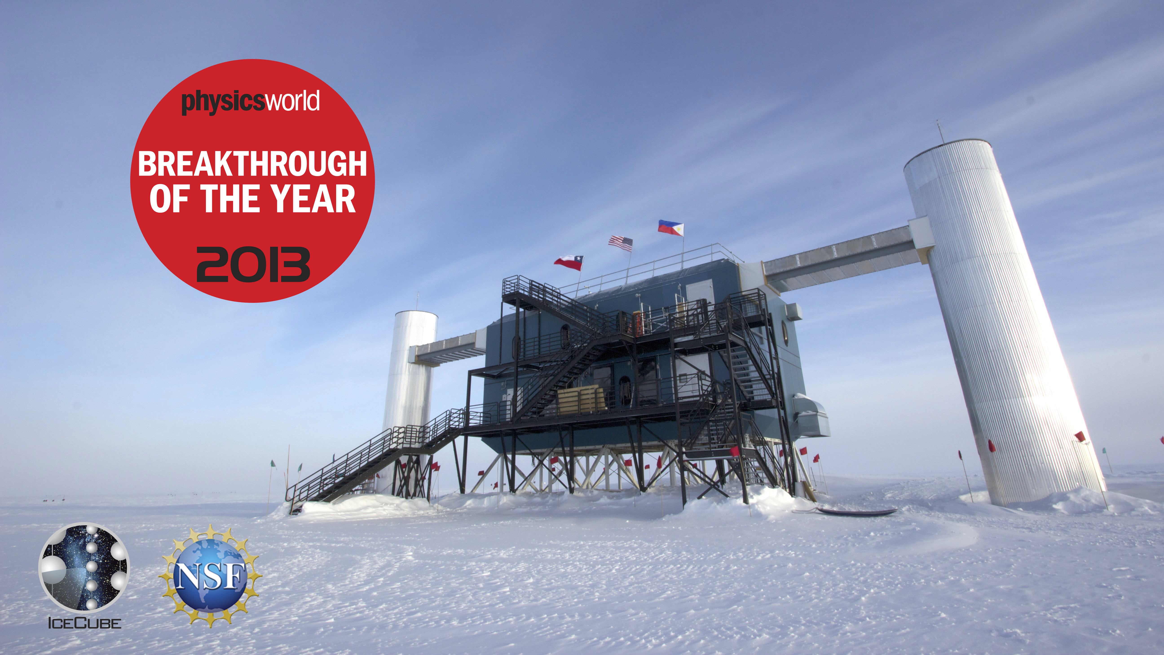
Discovery of cosmic neutrinos of very high energy
… To Deep Antarctic Ice Discoveries
5 Physics Faculty members involved
In IceCube and astroparticle physics.
Univ. Wisconsin is the lead institution,
for construction and operation.
More than 100 cosmic neutrinos by now,including events with energies of more than 10^15 eV
(really high energy)
For science and the experimental accomplishment of building IceCube
Halzen | Hanson | Karle | Vandenbroucke | Westerhoff

Slide 14

Biophysics
Understanding Details of Natural Materials
Biomineralization, cancer therapy, protein misfolding and aggregation
  Nacre (Pearls, inner surfaces of shells)
  Sea Urchin Teeth
  Organic – Mineral Interface
    Studies using Synchrotron Radiation
    Spectroscopy
    Spectromicroscopy
    PIC Mapping
Pupa Gilbert, Susan Coppersmith

Slide 15
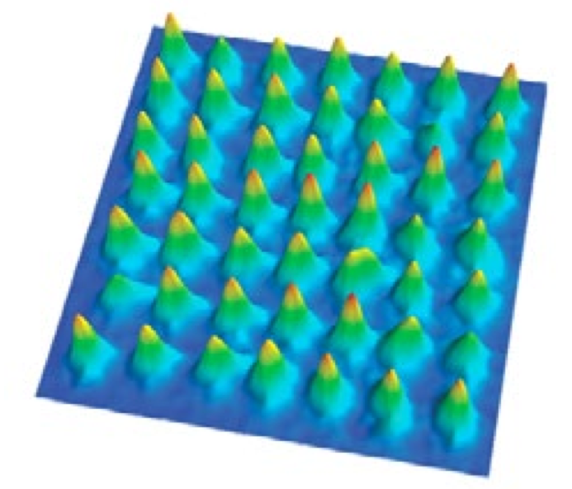
Atomic, Molecular & Optical Physics
Enabling next gen quantum technologies
Manipulation of quantum systems at the level of individual atoms.
Advances in the control capability of quantum physics in small systems opens fundamental new insights.
Future development from quantum information to quantum computing within reach.
Madison is at the forefront of this development.
49 laser cooled atoms are lined
up, waiting to be manipulated further
in Saffman’s lab.
Saffman | Walker | Yavuz | Lawler | Kolkowitz (new)

Slide 16
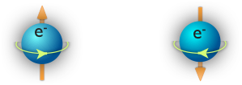



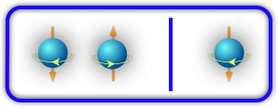
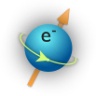

  The Hybrid Quantum Dot Qubit:
  How three electrons can be better than one or two
Enabling next gen quantum technologies
Shi et al., Phys. Rev. Lett. 108, 140503 (2012).
Any bit — classical or quantum — can be a zero or one, up or down.
A single electron spin is the simplest qubit. It can be manipulated using the same techniques as MRI imaging, but this method is slow: the spin must be rotated.
Spin up
Spin down
or
Professor Coppersmith and collaborators proposed that three electrons could offer much greater speed:
Only a quantum bit can be both at the same time.
Exchanging electrons is intrinsically fast.
Brar (new)| Eriksson | McDermott | Rzchowski | Coppersmith | Levchenko | Joynt | Vavilov | Ioffe (new)

Slide 17
Enabling next gen energy sources
Wisconsin Plasma Physics Laboratory (WiPPL)
Boldyrev | Egedal | Forest | Sarff | Terry | Zweibel

Slide 18
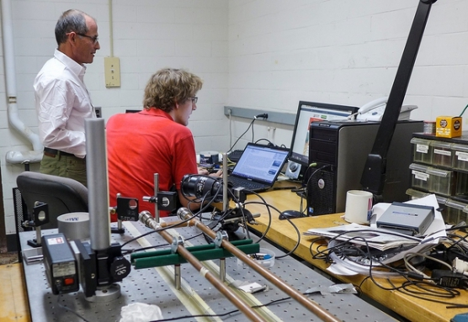
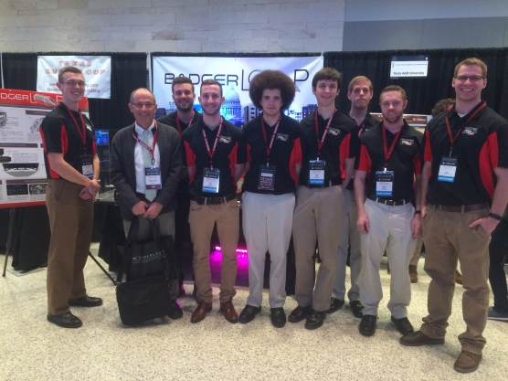
Research opportunities for undergraduates
Involving Young Minds in Research …
Garage Physics
Badgerloop team develops maglev technology and wins 3rd place in the SpaceX Hyperloop competition featured on international news
Carlsmith

Slide 19
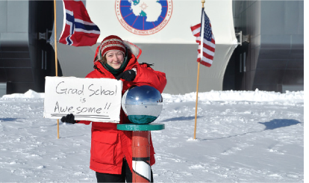
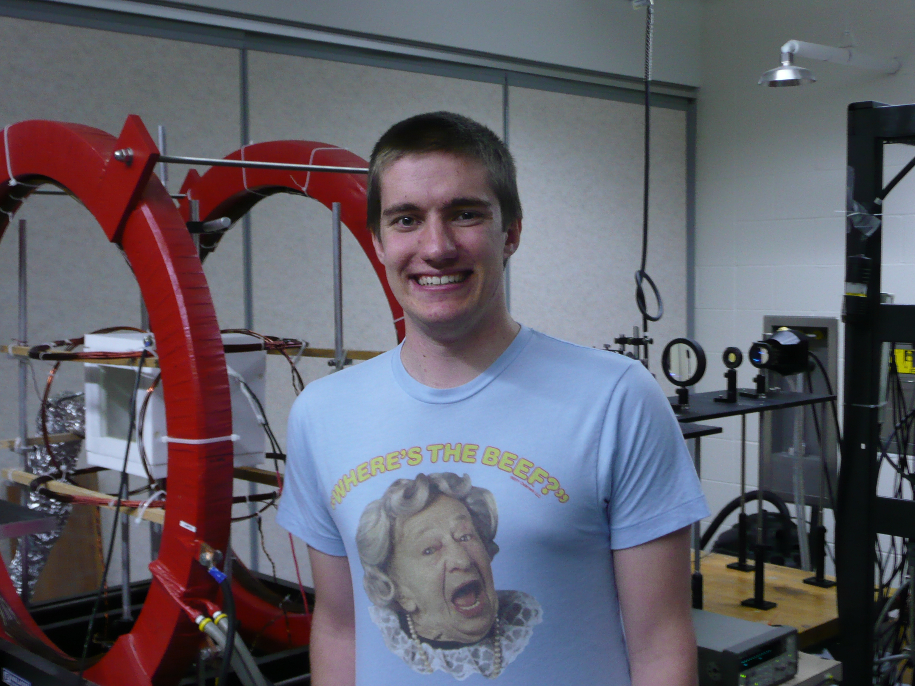
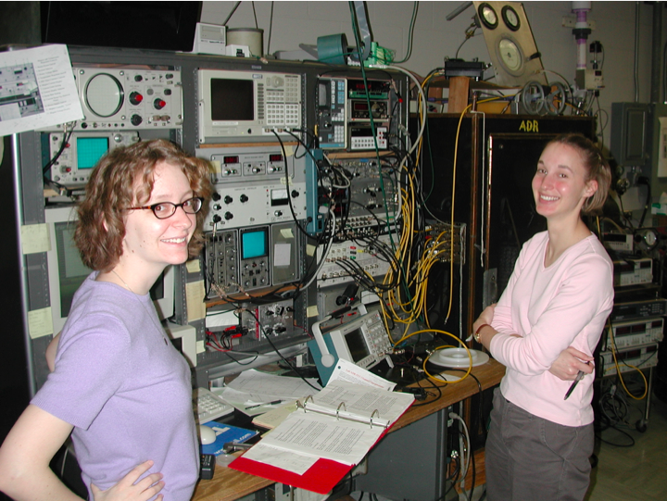
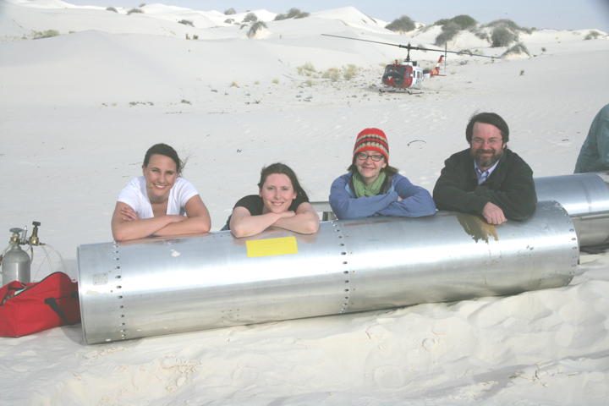
… Training Next Gen of Scientists

Slide 20


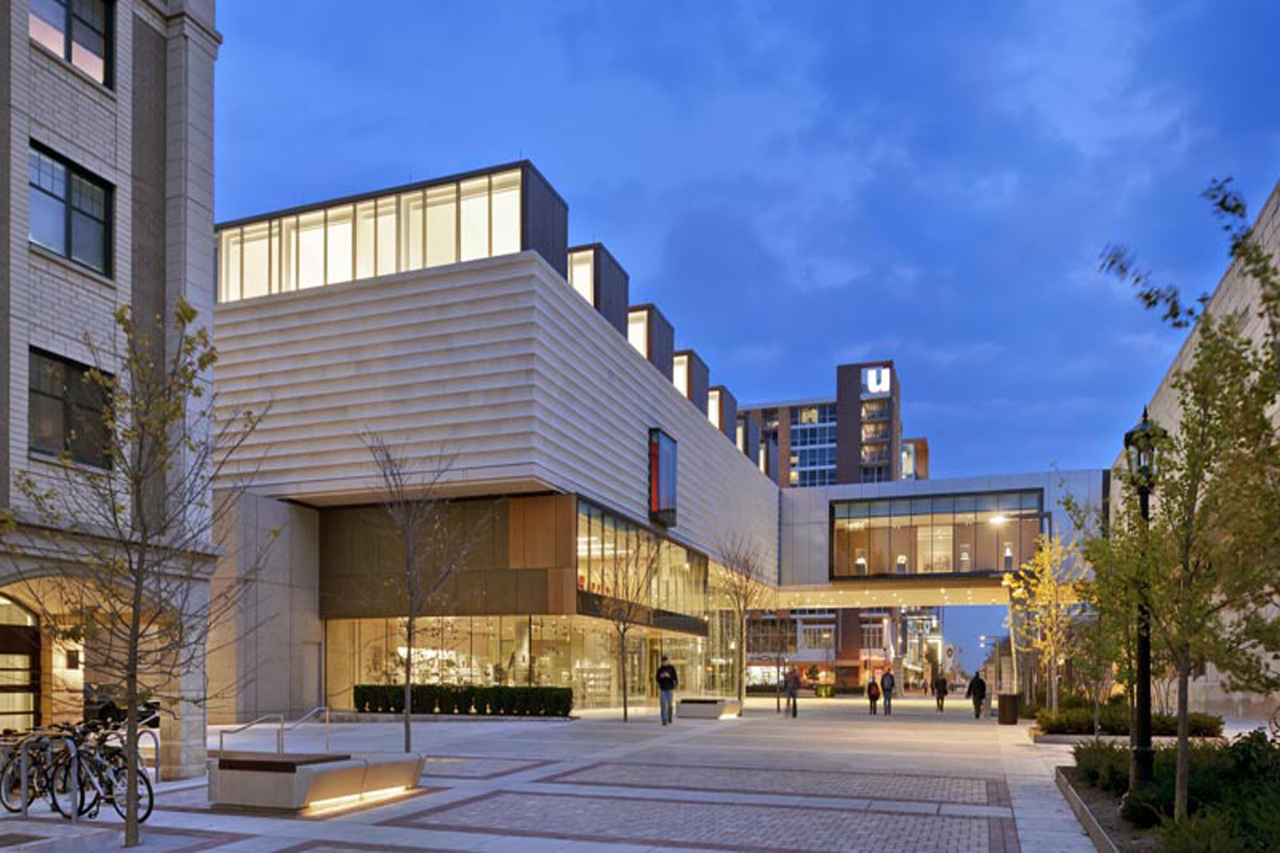
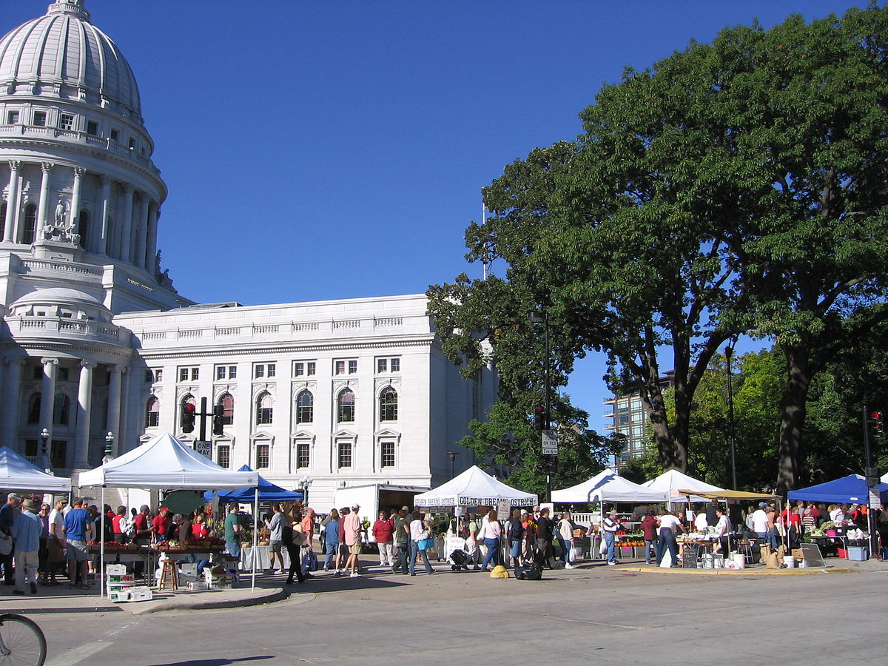
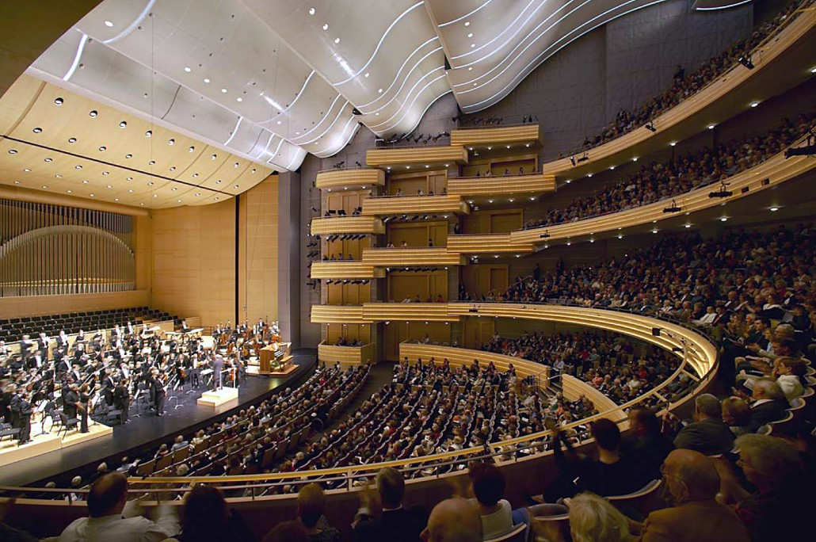
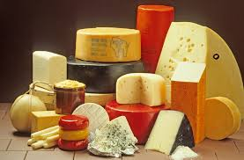
Enjoy our campus/downtown
Capitol building
Spring in the Capitol
Chazen Art Museum
Farmer’s market
Overture center for the arts
Wisconsin Cheese

