Slide 1
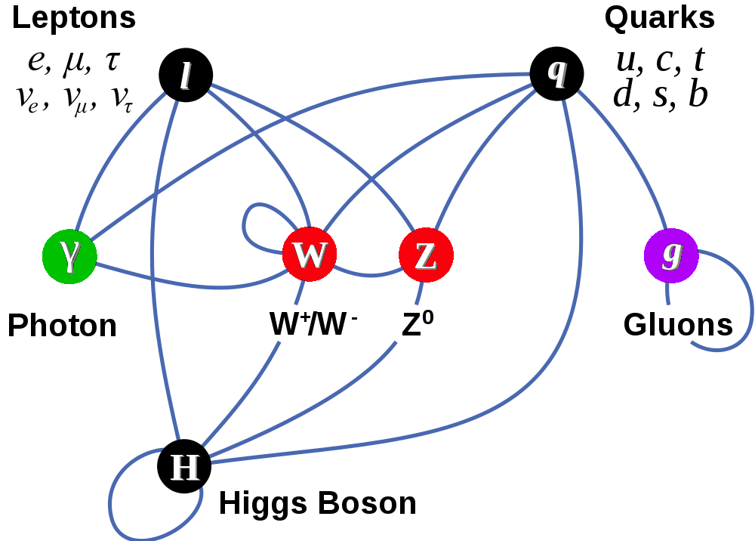
Neutrino Properties Masses and Mixing
Matter Particles (fermions)
Only left-handed fermions
Interactions by exchange of vector bosons
Scalar boson – remnant of mass giver
?

Slide 2
SM Particle Content : Neutrinos

Slide 3
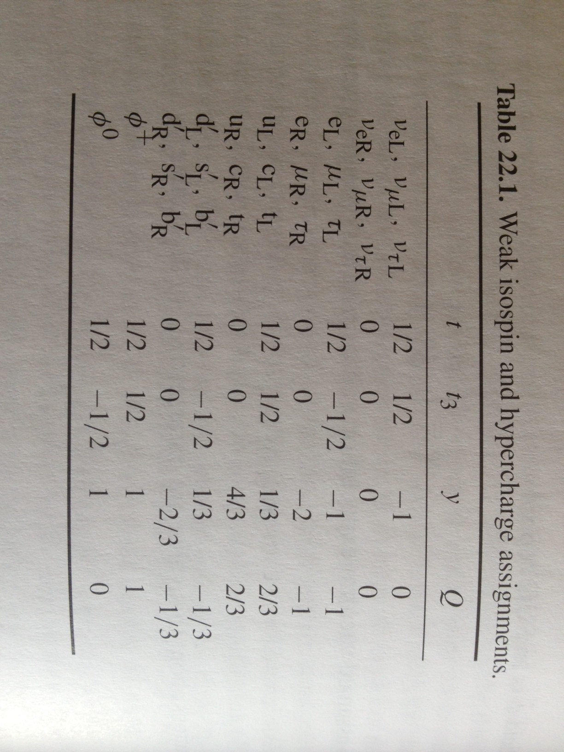
Weak Isospin & Hypercharge

Slide 4
Yukawa Couplings
With no right-handed neutrinos, there is no Yukawa coupling and no mass for neutrinos.
If you add right-handed neutrinos, the coupling is ridiculously small.

Slide 5
EWK Results: Beta Decay
Neutrinos are consistent with being massless

Slide 6
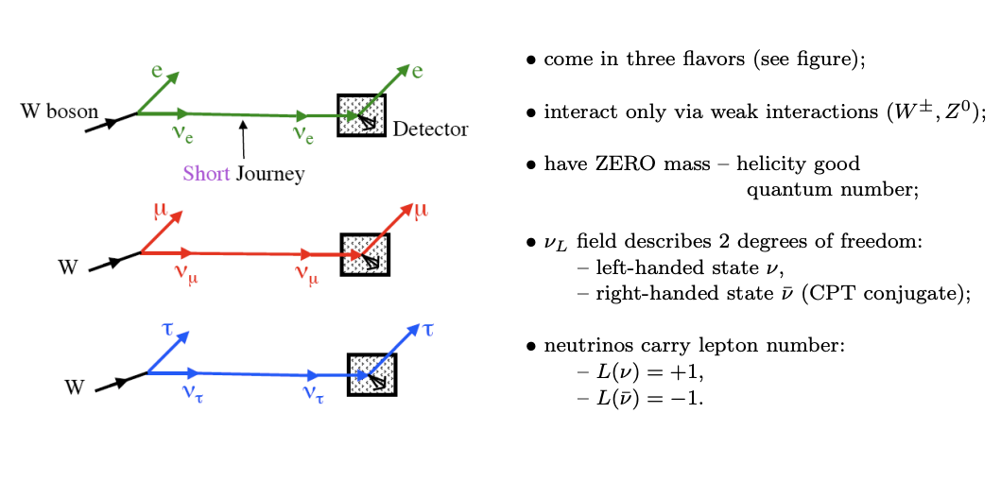
Neutrino Flavors

Slide 7
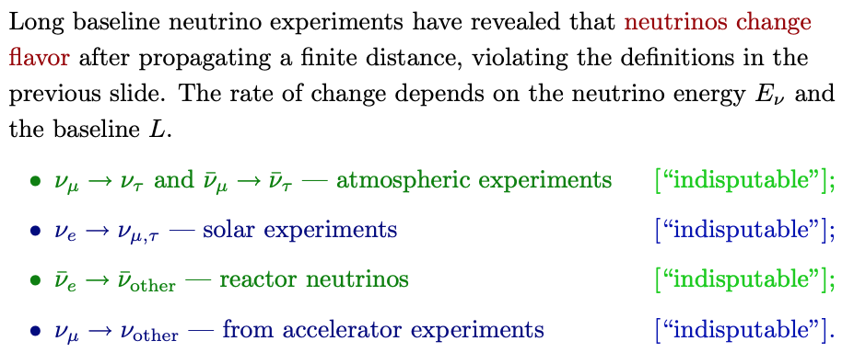
Neutrino Flavor Change : Long Baselines
Mixing of neutrino flavors ➔ Mass-square differences are non-zero
At least two of the three neutrinos should have non-zero mass

Slide 8
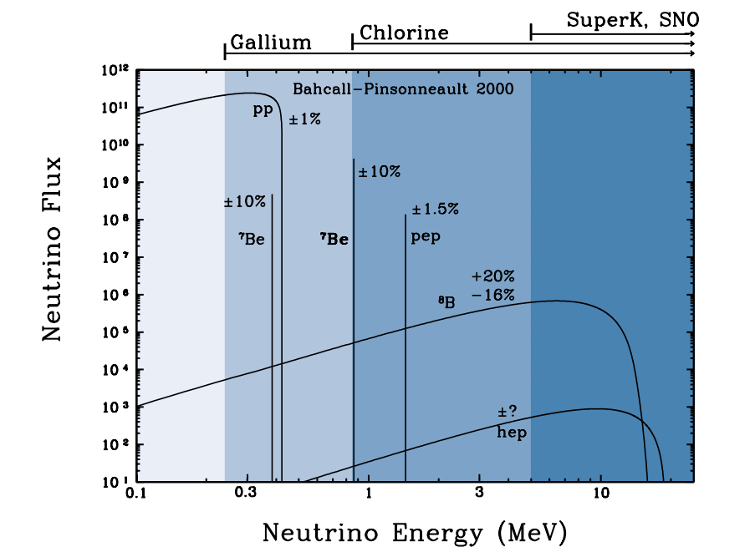
Solar Neutrinos: Very Long Baseline
Standard Solar Model – nuclear physics of the Sun

Slide 9
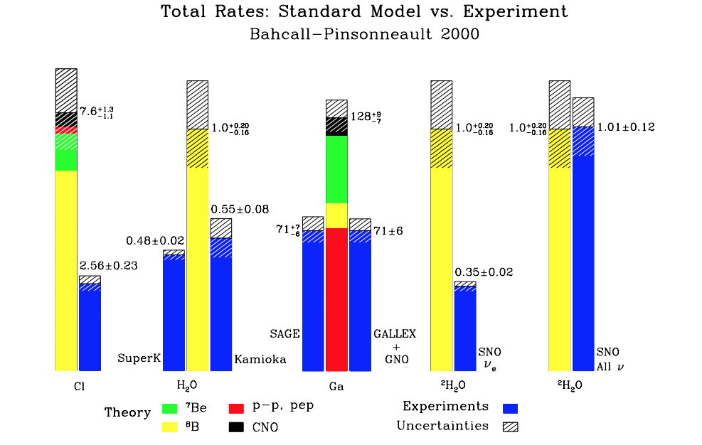
Neutrino Mixing: Where have all the neutrinos gone?

Slide 10
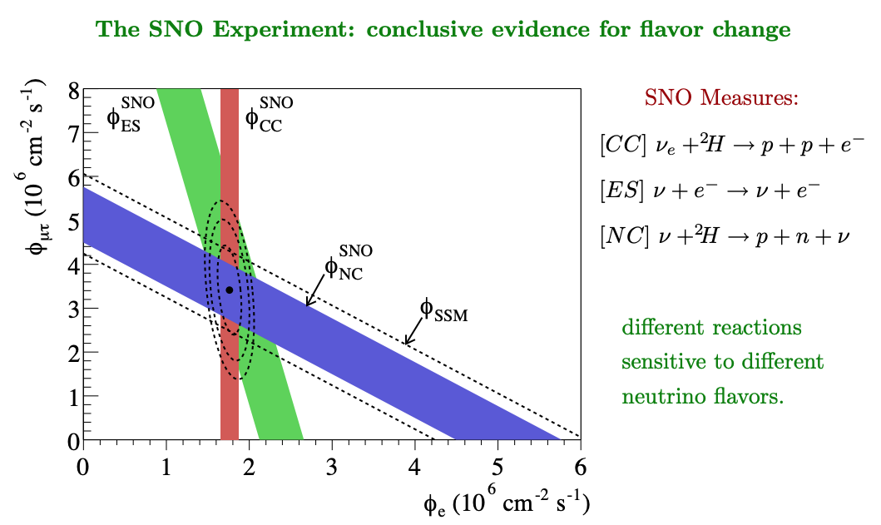
Solar Neutrino Flavor Change

Slide 11
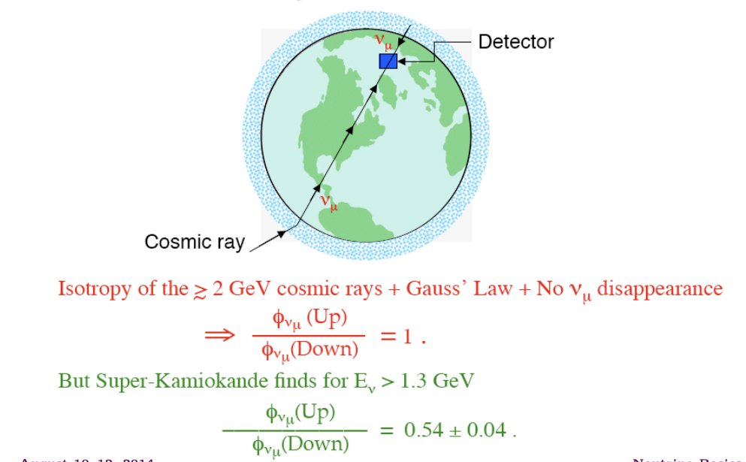
Atmospheric Neutrinos

Slide 12
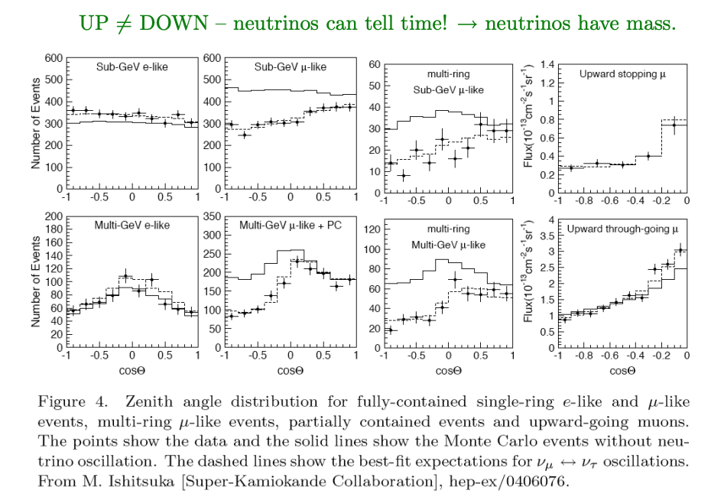
Neutrino Oscillations

Slide 13
Mass-Induced Flavor Oscillations

Slide 14
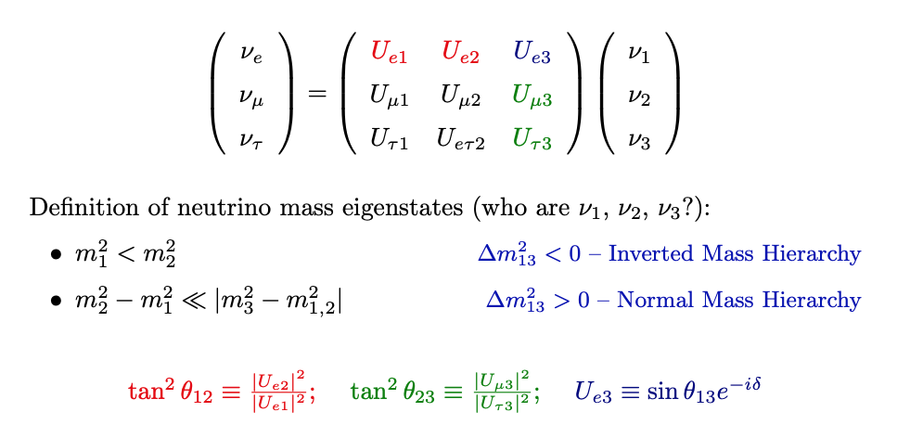
Neutrino Mixing

Slide 15
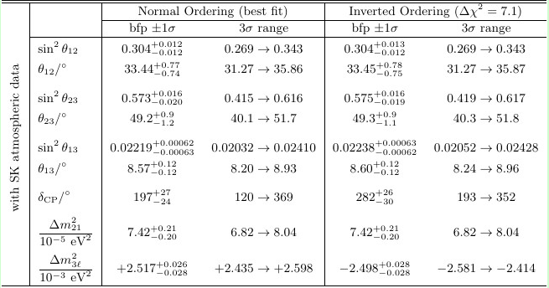
NuFit

Slide 16
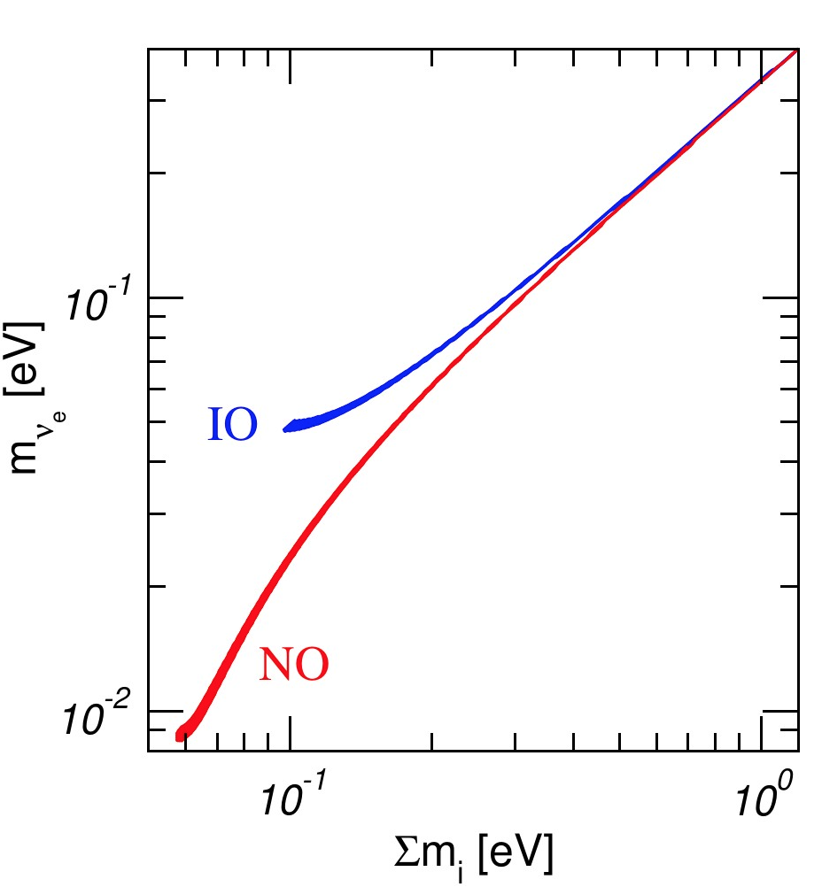
Neutrino Mixing Matrix
One needs to measure ν masses at sub-eV level!

Slide 17
Neutrino Mass and Beta Decay

Slide 18
https://indico.cern.ch/event/356420/contributions/1764064/attachments/1130571/1615811/KATRIN_Project8_Fraenkle.pdf

Slide 19
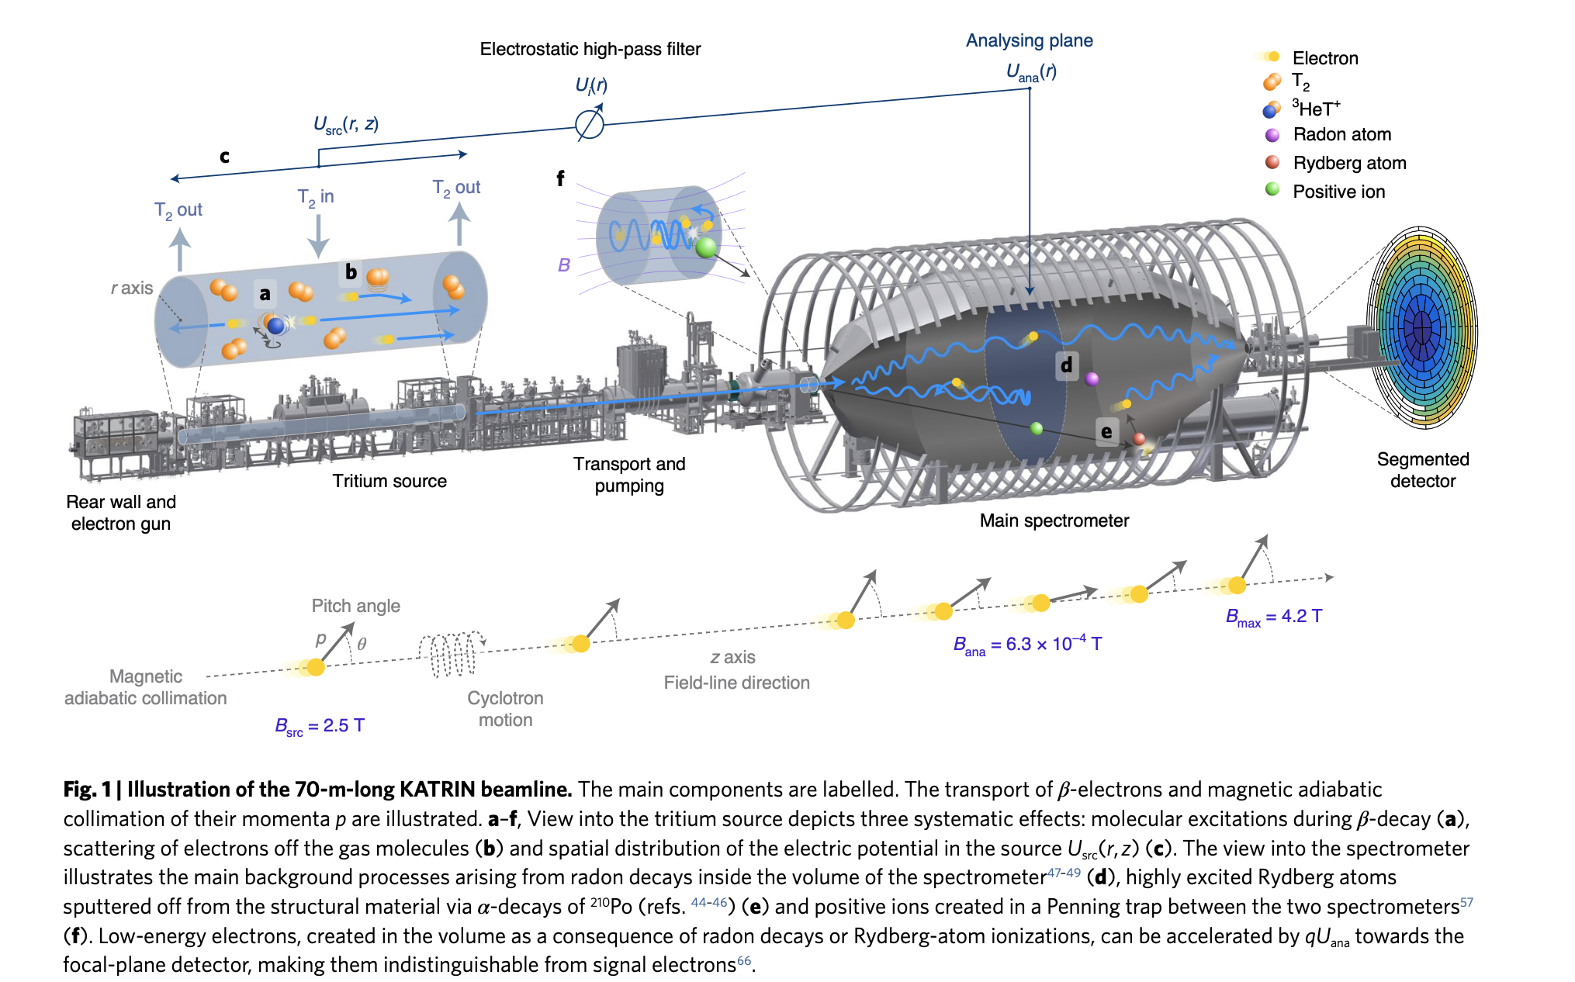
KATRIN T₂-Decay Experiment

Slide 20
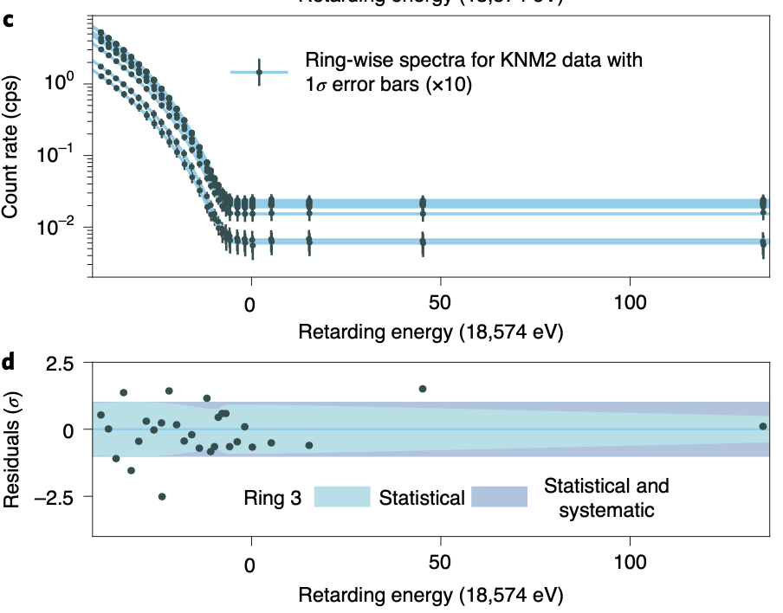
Endpoint Rate Measurements
By measuring the count rate of transmitted electrons for a set of qU values, the integral β-decay spectrum is obtained.
qU_{i} ∈ [E₀ − 40 eV, E₀ + 135 eV]
Expected Sensitivity: $m_{ν}<0.7$ eV from KNM2
Latest KATRIN Results

Slide 21
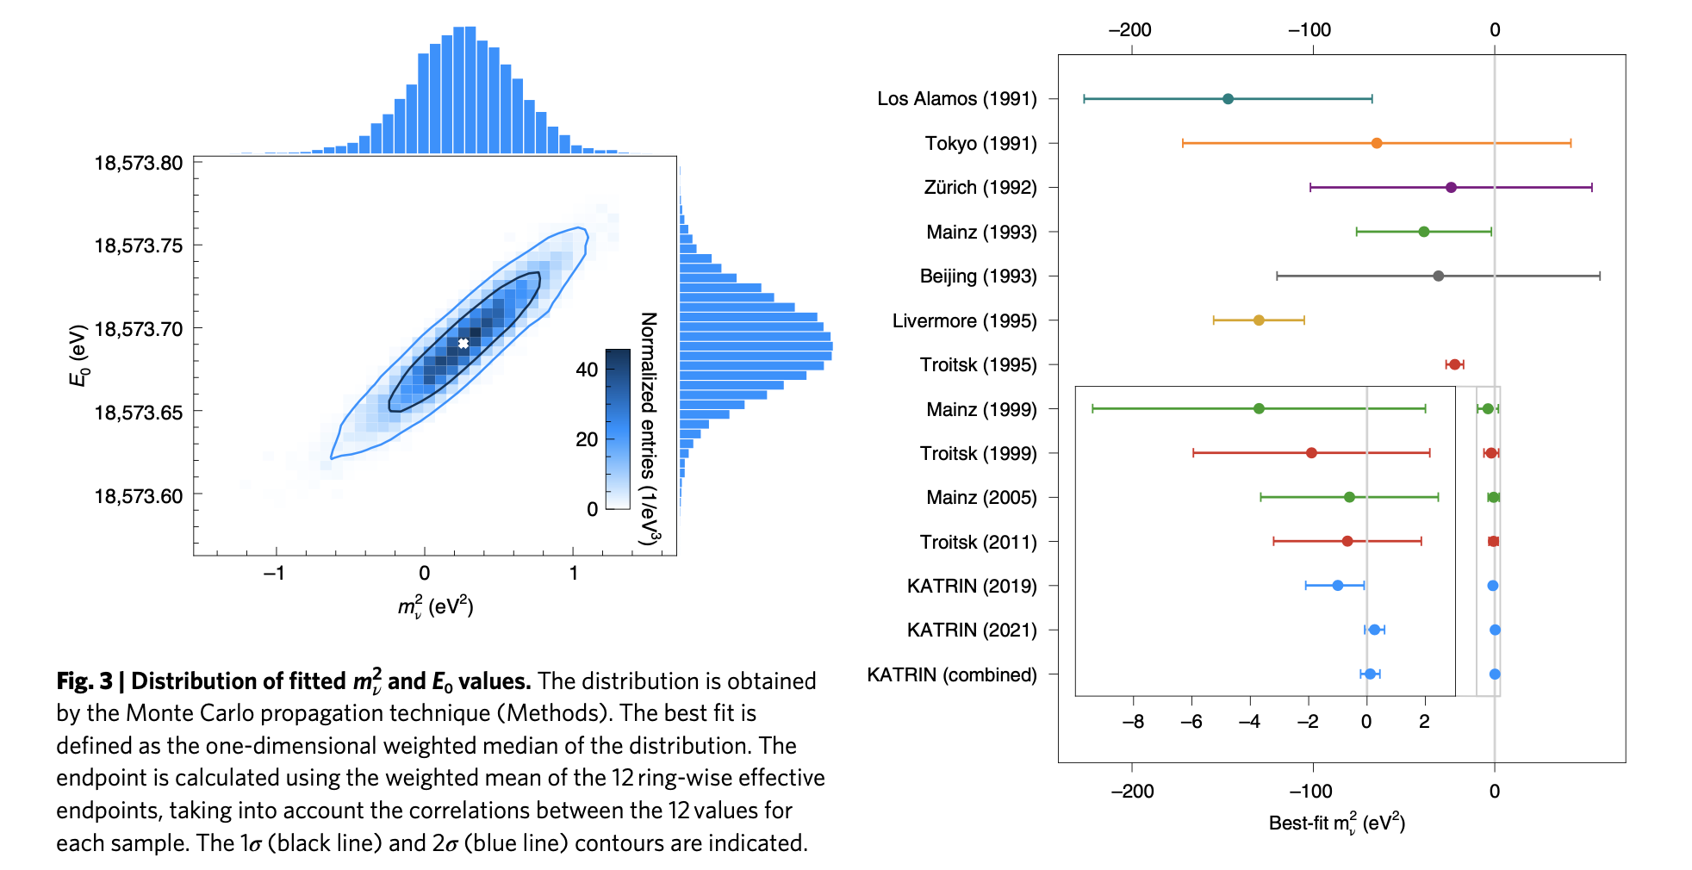
Neutrino Mass Limit: $m_{ν}<0.8$ eV @ 90% c.l.

Slide 22
More On Neutrinos
Andre de Gouvea, Northwestern University, Lectures at SSI:
Boris Kayser Lectures
https://indico.cern.ch/event/544672/contributions/2366664/attachments/1389154/2115407/BorisKayser1612.pdf
Joachim Kopp Lectures
https://indico.fnal.gov/event/19346/contributions/51604/attachments/32059/39327/lecture-notes.pdf
KATRIN results
https://www.nature.com/articles/s41567-021-01463-1.pdf
CUORE & EXO experiment pages (Neutrinoless Double Beta Decay)
https://cuore.lngs.infn.it/
https://www-project.slac.stanford.edu/exo/

