Slide 1
U. Wisconsin, Physics 535: Introduction to Particle Physics
Goal
To be conversant with particle physics phenomena:
To begin research this summer
To use particle physics tools-of-the-trade
To appreciate formal Quantum Field Theory (P831/832) & Elementary Particle Physics (P735/835) courses later
Lectures
Mon/Wed 2:30-3:45 PM, In-person, 2104 Chamberlin
Will only enable Zoom for those in isolation as needed
I will be using PPT with animation and annotation to slow the pace
Augment extensively with work on board – will be not so good on Zoom
Feel free to interrupt often to further slow down and clarify material
Again, difficult to do for those connected on Zoom
Assessment
Homework (algebraic & computational), self-paced (20%)
Three One-on-One Zoom Meetings, by-appointment (60% each)
Final exam, conceptual quiz May 3 – 07:45-09:45, (20%)

Slide 2
Course Materials
Textbook
Concepts of Elementary Particle Physics, Michael Peskin, Oxford University Press, ISBN 9780198812197
Supplementary material
Modern Particle Physics, Mark Thomson, Cambridge University Press, ISBN 9781107034266
http://pdg.lbl.gov
Computing resources
Generic python-based analysis tools: numpy, pandas, jupyter
Particle physics code: Madgraph aMC@NLO, Pythia, Delphes
JupyterHub Notebook Servers of the department to conveniently access the pre-configured software repositories (in preparation)
Class github repository for instructions and exercises (in preparation):
Presently you can browse documentation links above.
https://github.com/SridharaDasu/Physics535.git

Slide 3
Other Information
Web presence: http://canvas.wisc.edu/
Syllabus – subject to modification
Help shape it
Lectures
The textbook is new to me too …
I will use materials from my old lecture slides – and any new stuff coming from my readings
Old lecture slides are on P535 Canvas site
Office Hours (Prefer virtual only through Feb 15)
By appointment: https://calendly.com/dasu/30min
Besides the three mandatory one-on-one meetings

Slide 4
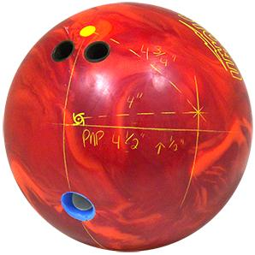
Cartoon of Relativistic Collisions
Quantum Mechanics that you learn in P447/448 nor P531 can explain these collisions.
Particle collisions at very high energies produce many particles, some much more massive than initial particles (unlike in this cartoon, collisions obey specific quantum rules)
Physics of elementary and composite particles discovered and studied in great detail over the past 50 years will be summarized in this course.

Slide 5
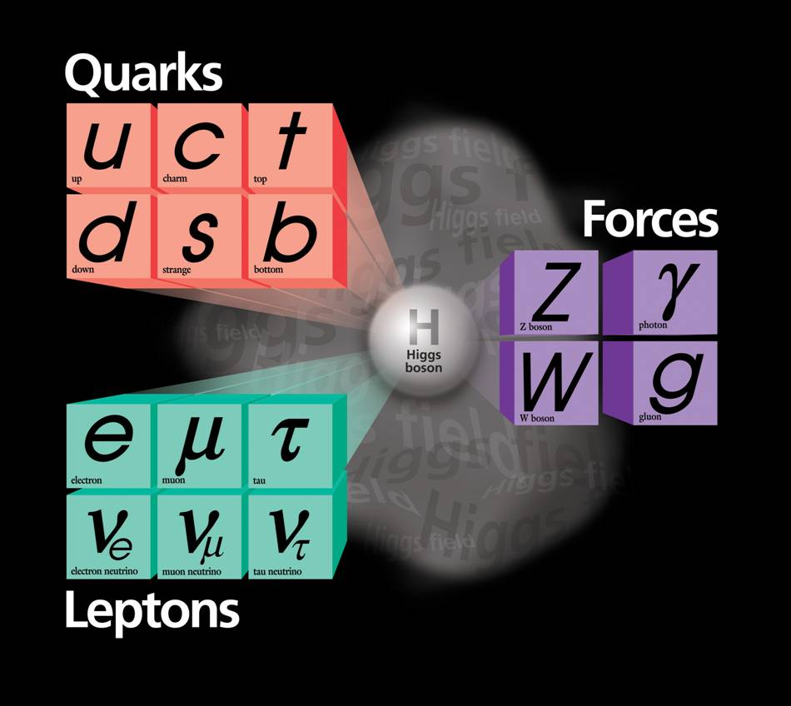
The Periodic Table of Relativistic Quantum World
Elementary (point-size) Particles & Fields:
Matter constituents
Quarks
up, down, charm, strange, top, bottom
Leptons
Electron, muon, tau, corresponding neutrinos
Force carriers
Electromagnetism: Photon
Weak interactions: W±/Z
Strong interactions: Gluons
Higgs field – grand idea!
Omnipresent → non-zero field strength everywhere!!
Explains how elementary particles become massive
1300
170000
~5
91000
4500
100
0
106
?
0
0.5
1776
80000
~10^{–5}
MeV
Wildly varying masses for matter particles
Very troublesome: masses for force carriers

Slide 6
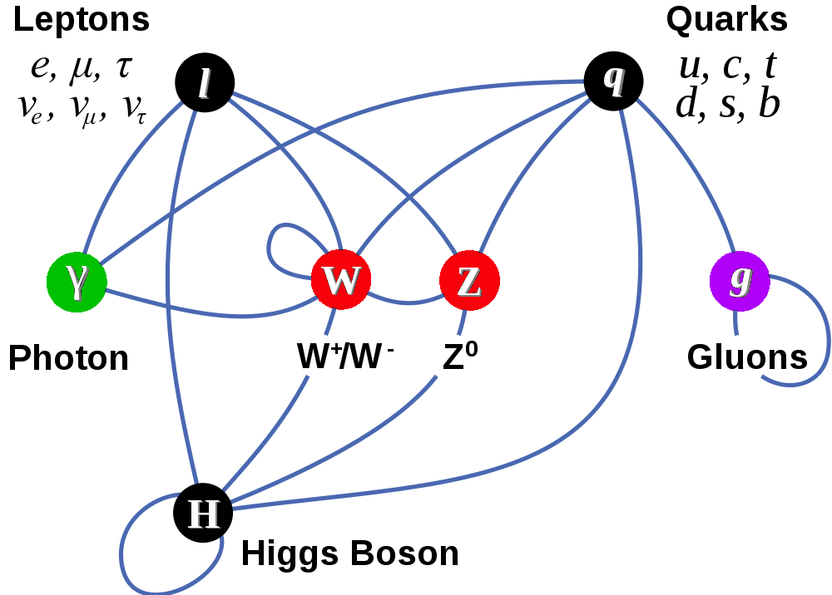
Completion of The Standard Model
Matter Particles (fermions)
Interactions by exchange of vector bosons
Higgs boson is the edifice on which castle called the Standard Model is built

Slide 7
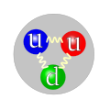
Particle Interactions
1
Quarks bound in hadrons via strong interactions
Baryons (spin-1/2)
3-quark states
Protons, neutrons
Mesons (scalars, vectors …)
quark-antiquark states
pions, kaons
Atoms bound together via electromagnetic interactions
Weak force responsible for radioactive decay
BUT, weak force is only active at short distances
W and Z should be massive and decay quickly
Electro-weak interactions have unified description at high energies
10⁻²
Proton
Pion
10⁻⁷
Relative
force strength
In this course, we will focus on high energy phenomena almost exclusively.

Slide 8
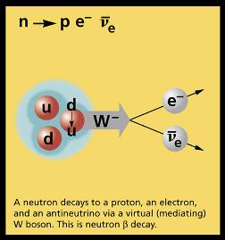
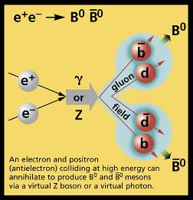
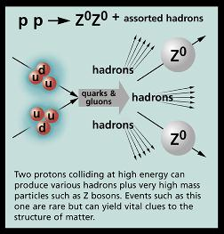
Particle Interactions
TeV-scale
MeV-scale
GeV-scale

