Slide 1
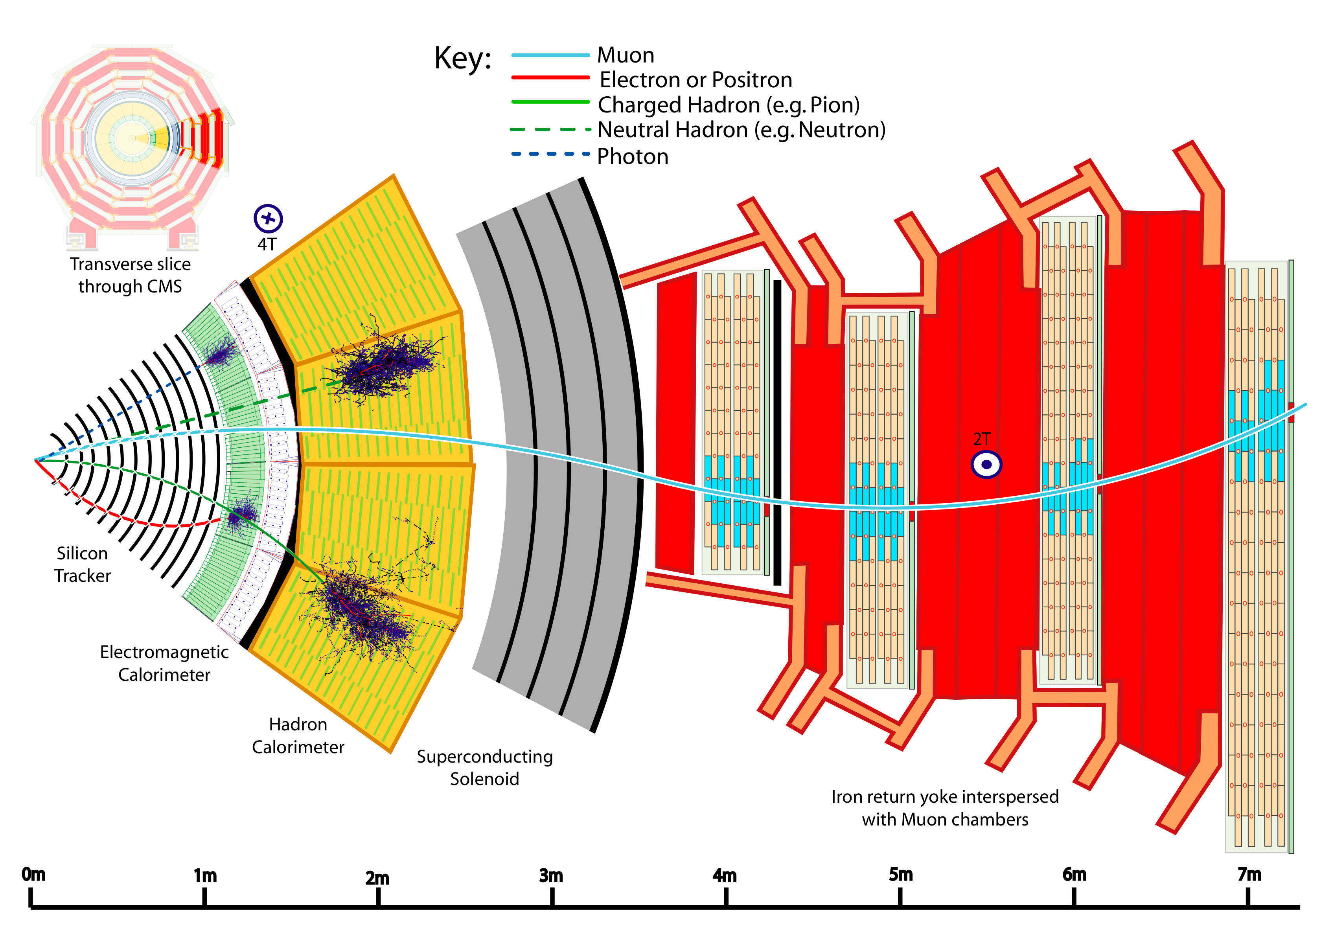
Physics 535
Particles & Detectors
Passage of Particles Through Matter

Slide 2
True or False?
A high energy (~1GeV) photon is traversing vacuum – could it convert to an electron-photon pair?:
True or False ?
A high-energy (~1 GeV) electron is traversing vacuum in a straight line – could it lose energy by emitting photons?:
True or False ?
A high-energy (~1 GeV) electron is traversing vacuum in a circular synchrotron – could it lose energy by emitting photons?:
True or False ?

Slide 3
True or False?
A high energy (~1GeV) photon impinges on a chunk of metal – could it convert to an electron-photon pair?:
True or False ?
A high-energy (~1 GeV) photon impinges on a chunk of metal – it converts to an electron and positron each with energy equal to ~0.5 GeV?:
True or False ?
A 100-MeV electron impinges on a crystal – could it lose energy by emitting photons?:
True or False ?

Slide 4
True or False?
Both 100 MeV and above electrons and photons produce a cascade of electrons and photons?:
True or False ?
The photons stop converting to electron-positron pairs when they have E < 2m_{e}:
True or False ?
Muon is a heavier lepton compared to an electron. Its electromagnetic interactions with matter occur at the same rate as that of an electron?:
True or False ?

Slide 5
Interaction of Particles in CMS

Slide 6
Scattering Cross Section for
Heavy Charged Particle w/ Electrons
For particles with charge, ze, and mass, m>>m_{e,} speed, v=βc, energy, E, is lost in a collision due to ionization, atomic or collective excitation

Slide 7
Moments of Cross Section

Slide 8
Energy Loss of Muons

Slide 9
Energy loss for
Muons, Pions, Protons

Slide 10
Material Dependence of dE/dx

Slide 11
Range of Relativistic Particles
For 1 GeV muons
range in Fe is
~5000 g-cm⁻² / 8 g-cm⁻³
~6 meters!

Slide 12
Energy Loss Distribution

Slide 13
Energy Loss Distributions of π±

Slide 14
Restricted Energy Loss
Most Probable Energy Loss
In thin detector elements, probability of large losses is low
  So, restricted (T_{cut} < T_{max}) energy loss is useful
  Most probable energy loss (Δ_{p}/x) is much smaller than dE/dx

Slide 15
Energetic Knock-On Electrons δ-rays
Although rare, high energy, i.e. much greater than mean energy loss, T>>I, electrons can be knocked out of the material, with distribution:
δ rays of even modest energy are rare.
For a β ≈ 1 particle, on average only one collision with T_{e}>10 keV will occur along a path length of
90 cm of Ar gas.

Slide 16
Multiple Coulomb Scattering
Charged particle scattering from nuclear EM field

Slide 17
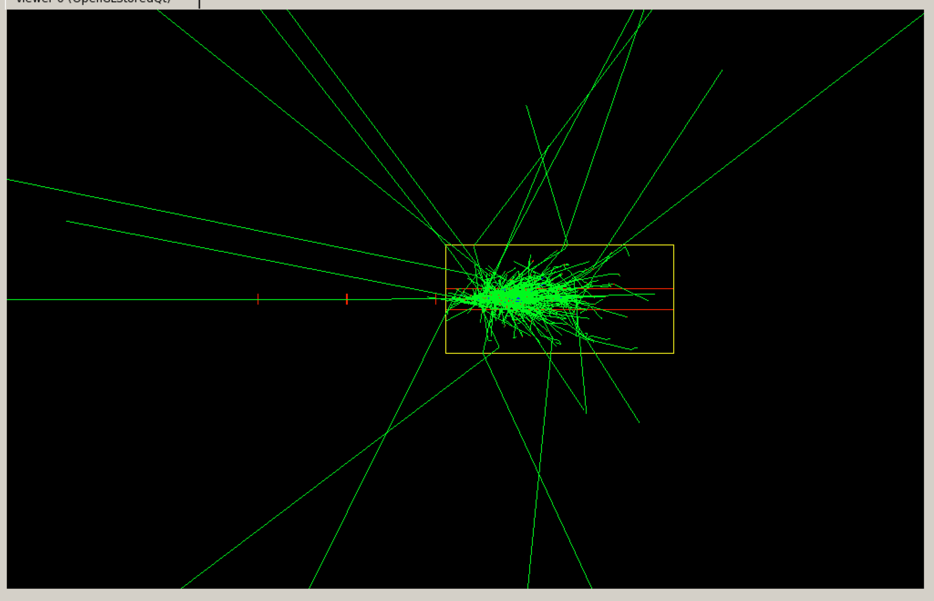
Particle Detectors

Slide 18
Interaction of Particles in Detectors (CMS)
Which of the following particle types are able to ionize the detector material?
  Photons
  Neutral Hadrons
  Charged Hadrons
  Electrons & Positrons
  Muons
The momentum of charged pions can be measured using?
  Tracker and the magnet
  Calorimeters and the magnet
  Tracker and the calorimeters
  Tracker, the magnet and the gas chambers in the iron return yoke
  Gas chambers and the magnet
Which of these particles is not measurable in CMS?
  Photons
  Hadrons
  Electrons & Positrons
  Muons
  Neutrinos

Slide 19
Charged Particle Trackers
Magnetic Field
  Solenoidal field from 1 to 4 Tesla field
  Lengths from 0.6 to 6 m
Tracking Detectors measure “hits” recorded along helical path
  Ionization energy in gases measured in wire chambers
  Ionization energy in silicon using strip (or pixel) diodes
Resolution of track momentum depends on B and L

Slide 20

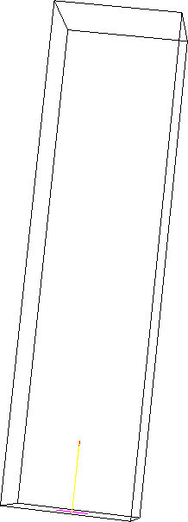
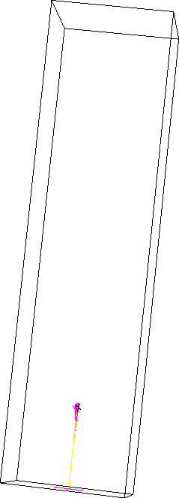
Electromagnetic Showers
From
Sven Menke

Slide 21
Radiation Length
High-energy electrons predominantly lose energy in matter by bremsstrahlung, and high-energy photons by e⁺e⁻ pair production
The characteristic amount of matter traversed for these related interactions is called the radiation length X₀, usually measured in g cm⁻²
  The mean distance over which a high-energy electron loses all but
  1/e of its energy by bremsstrahlung
  7/9 of the mean free path for pair production by a high-energy photon

Slide 22
Electron Energy Loss Fractions
E_{c}

Slide 23
Photon Scattering Cross Sections

Slide 24
Electromagnetic Shower
E_{γ} >1.5 MeV

Slide 25
Longitudinal Shower Development

Slide 26
Moliere Radius
Transverse development of EM showers is fit using
  Moliere Radius:
  On average only ~10% of energy is outside R_{M}
  On average only ~1% of energy is outside 3.5R_{M}
  Distribution:

Slide 27
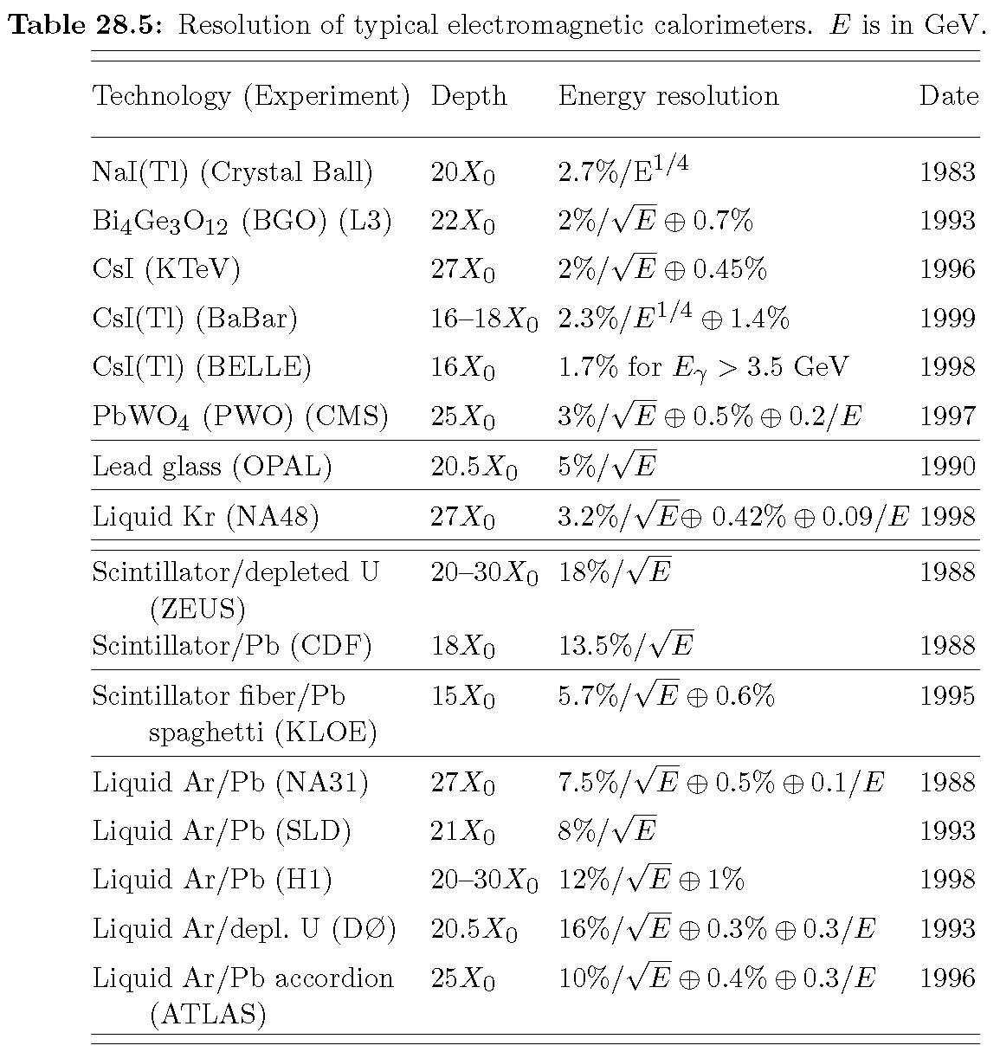
EM Calorimeters
Better than 1% energy resolution possible for
100 GeV electrons & photons

Slide 28
Hadronic Interaction Length
The length scale appropriate for hadronic cascades is the nuclear interaction length, given very roughly by
  Length to first interaction
    Typically π⁰ created (decays to photons) with EM shower (Interaction probability in one λ_{I} is 63%)
    Hadronic debris continues to develop showers
    Spreads more longitudinally & transversely
    Hadronic shower maximum:

Slide 29
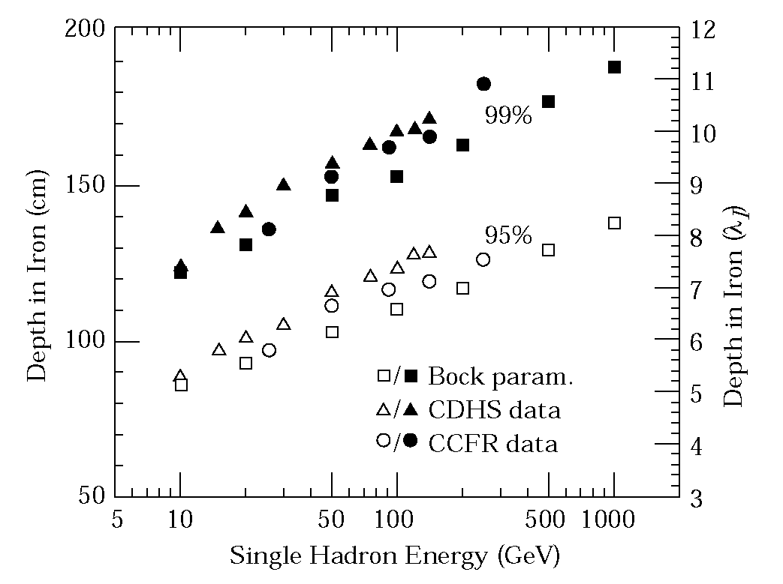
Hadronic Calorimeter Thickness
Containment of hadronic showers takes large calorimeters
Energy resolution depends on the thickness ratio of active/passive, light-yield, photo-detector …
Energy resolutions vary between 50%/√E and 100 % /√E

Slide 30
Muon Systems
Muon systems are usually large magnetized steel structures interspersed with gas chambers
  Drift tubes
  Resistive plate chambers
  Cathode strip chambers
Sparse point measurements sufficient
  Occupancy is usually low
Matching of muon system tracks to the inner tracks provides good measurement
  Multiple scattering needs to be taken account

Slide 31
CMS Muon/Tracker Resolution

Slide 32
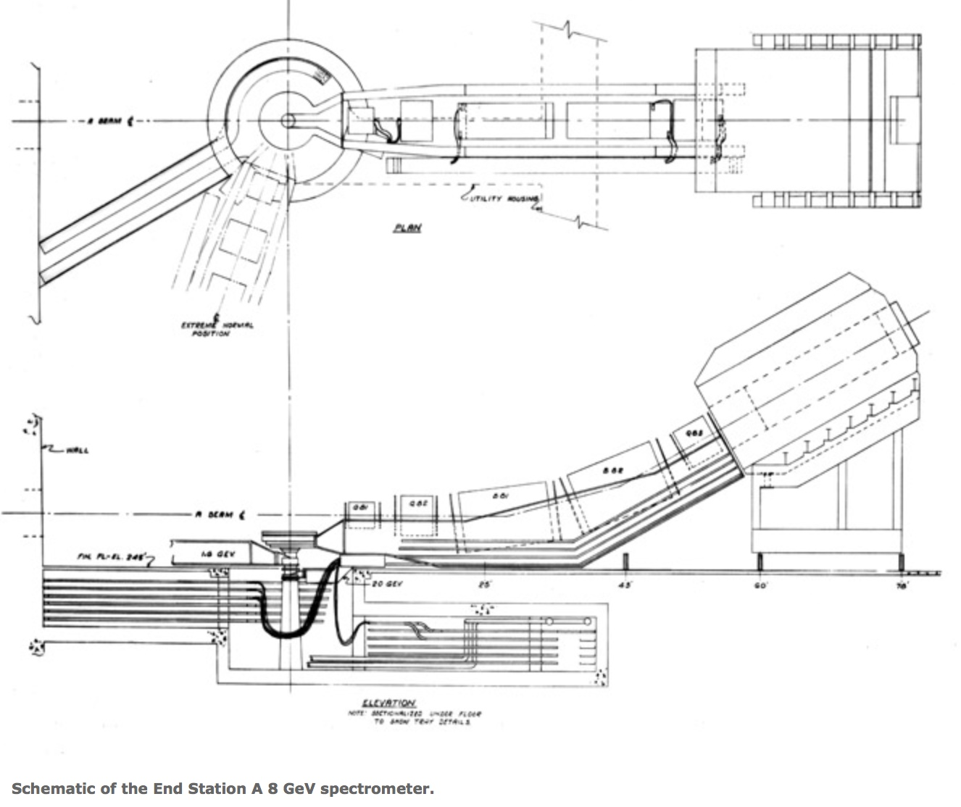
8-GeV Spectrometer @ SLAC
Deep Inelastic Scattering (eP)

Slide 33
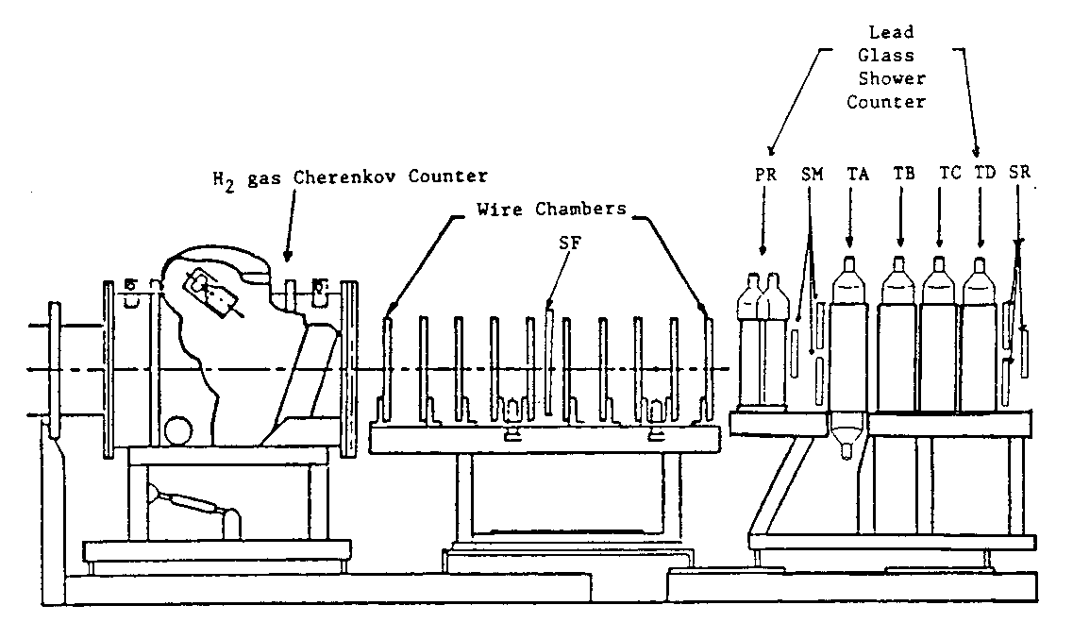
The Detectors in the
8-GeV Spectrometer
June – September 1985
Calibration of toroids (for beam energy)
Spectrometer survey, Cherenkov & Calorimeter rebuilt
New electronics, data acquisition, software …
online display of cross section result!
(MWPC from E139)

Slide 34
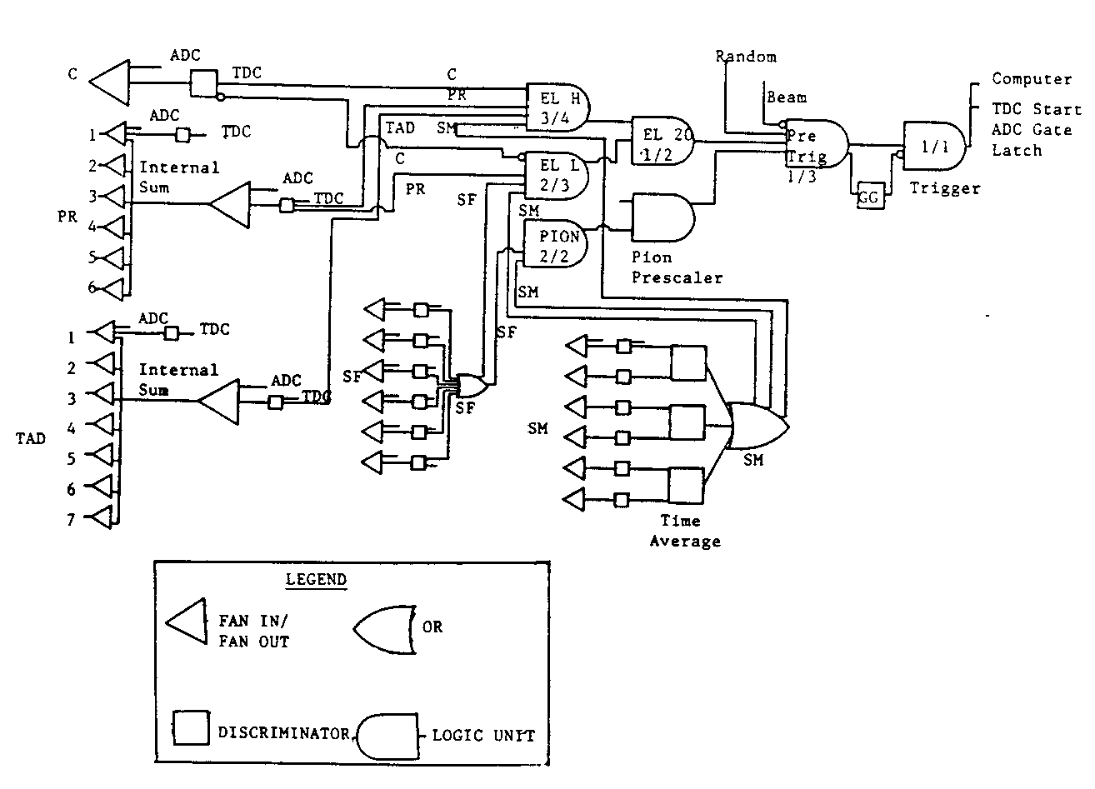
Electronics
Le Croy ADC/TDCs & Cable Delay Lines

Slide 35
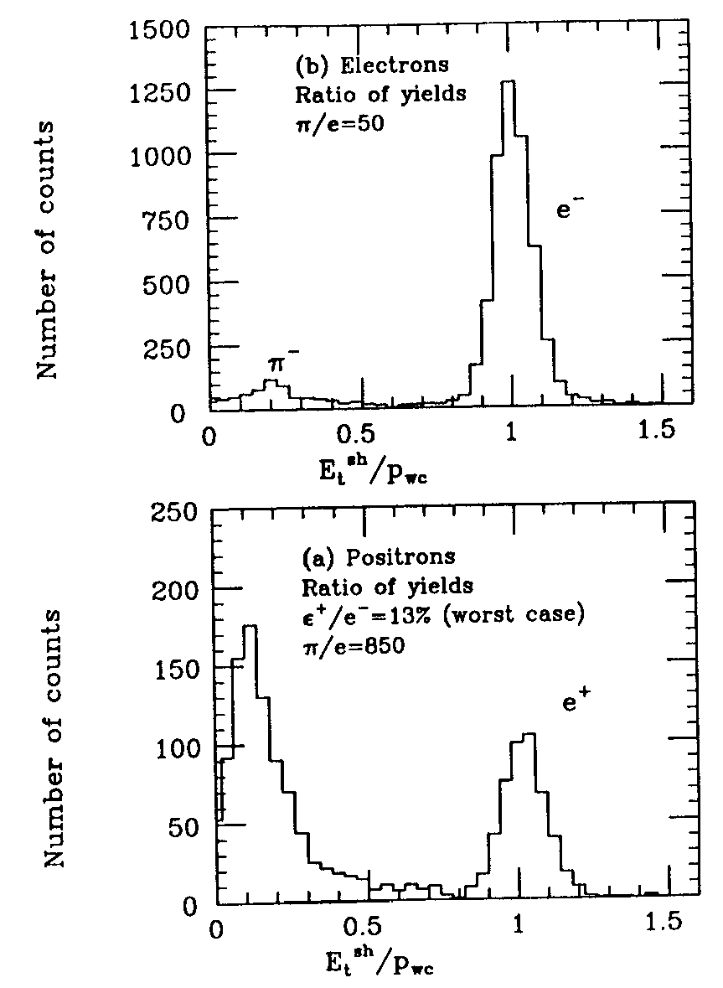
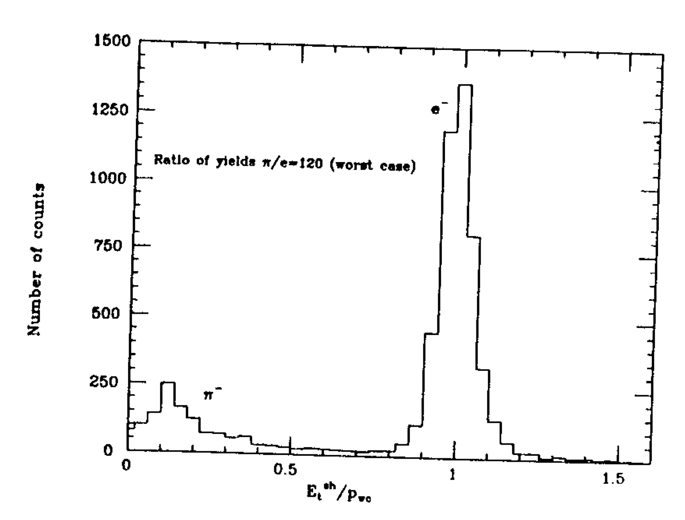
The e-π Discrimination

Slide 36
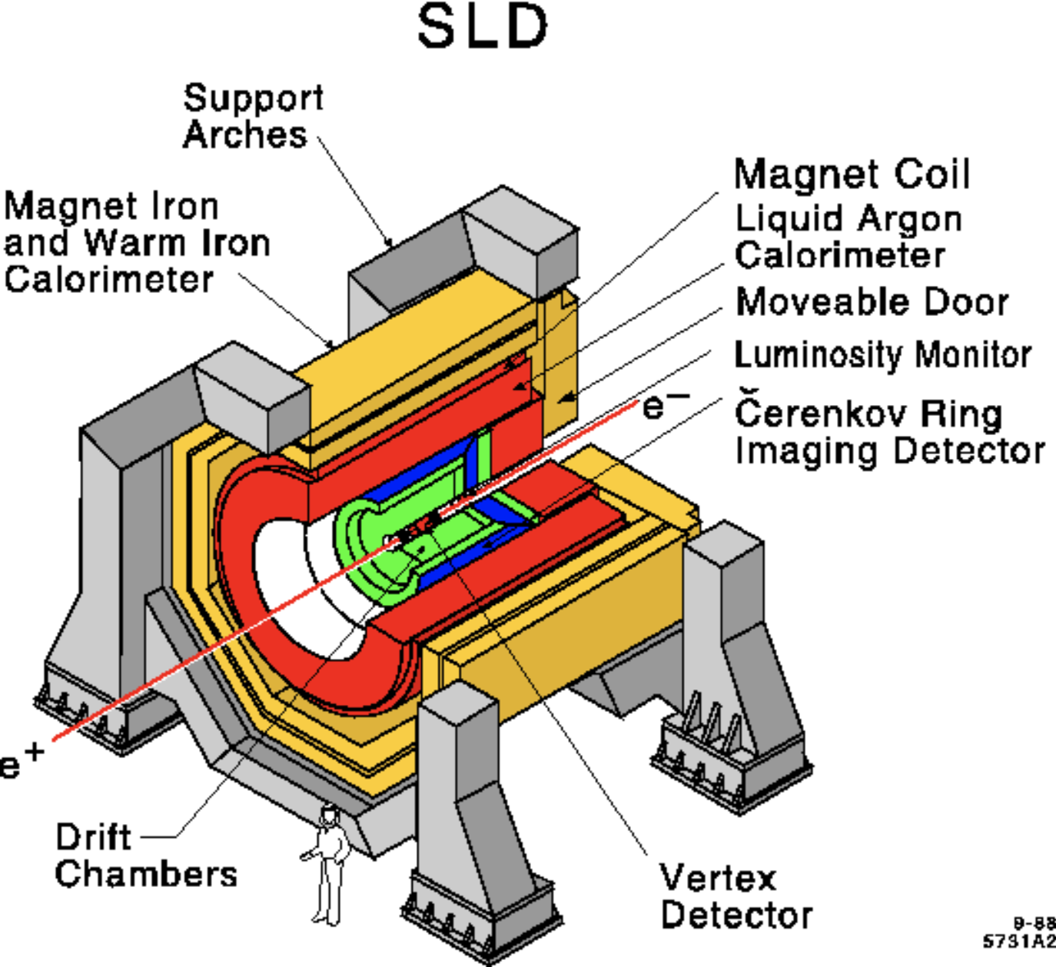
SLD Detector on SLC (e+e-)

Slide 37
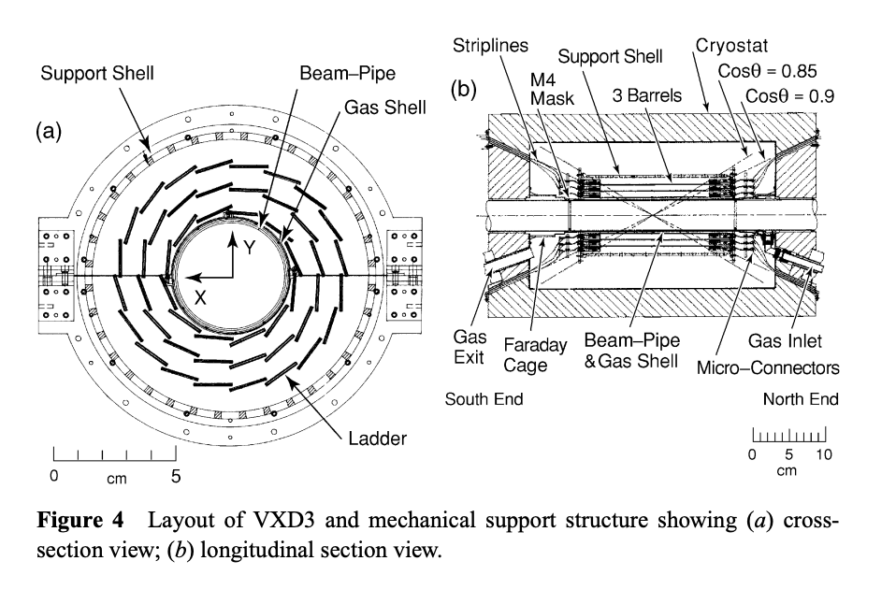
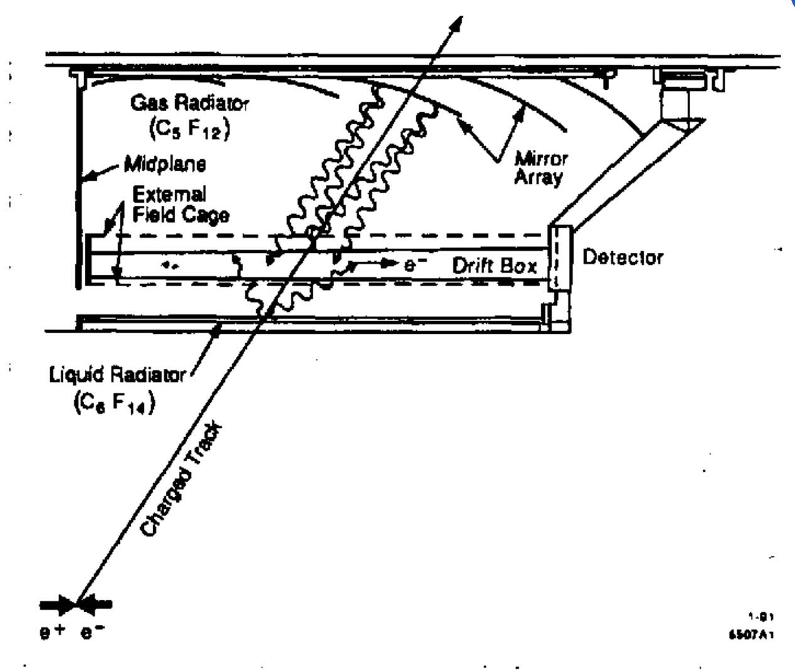
CCD Pixel Vertex Detector +
Cerenkov Ring Imaging Detector

Slide 38
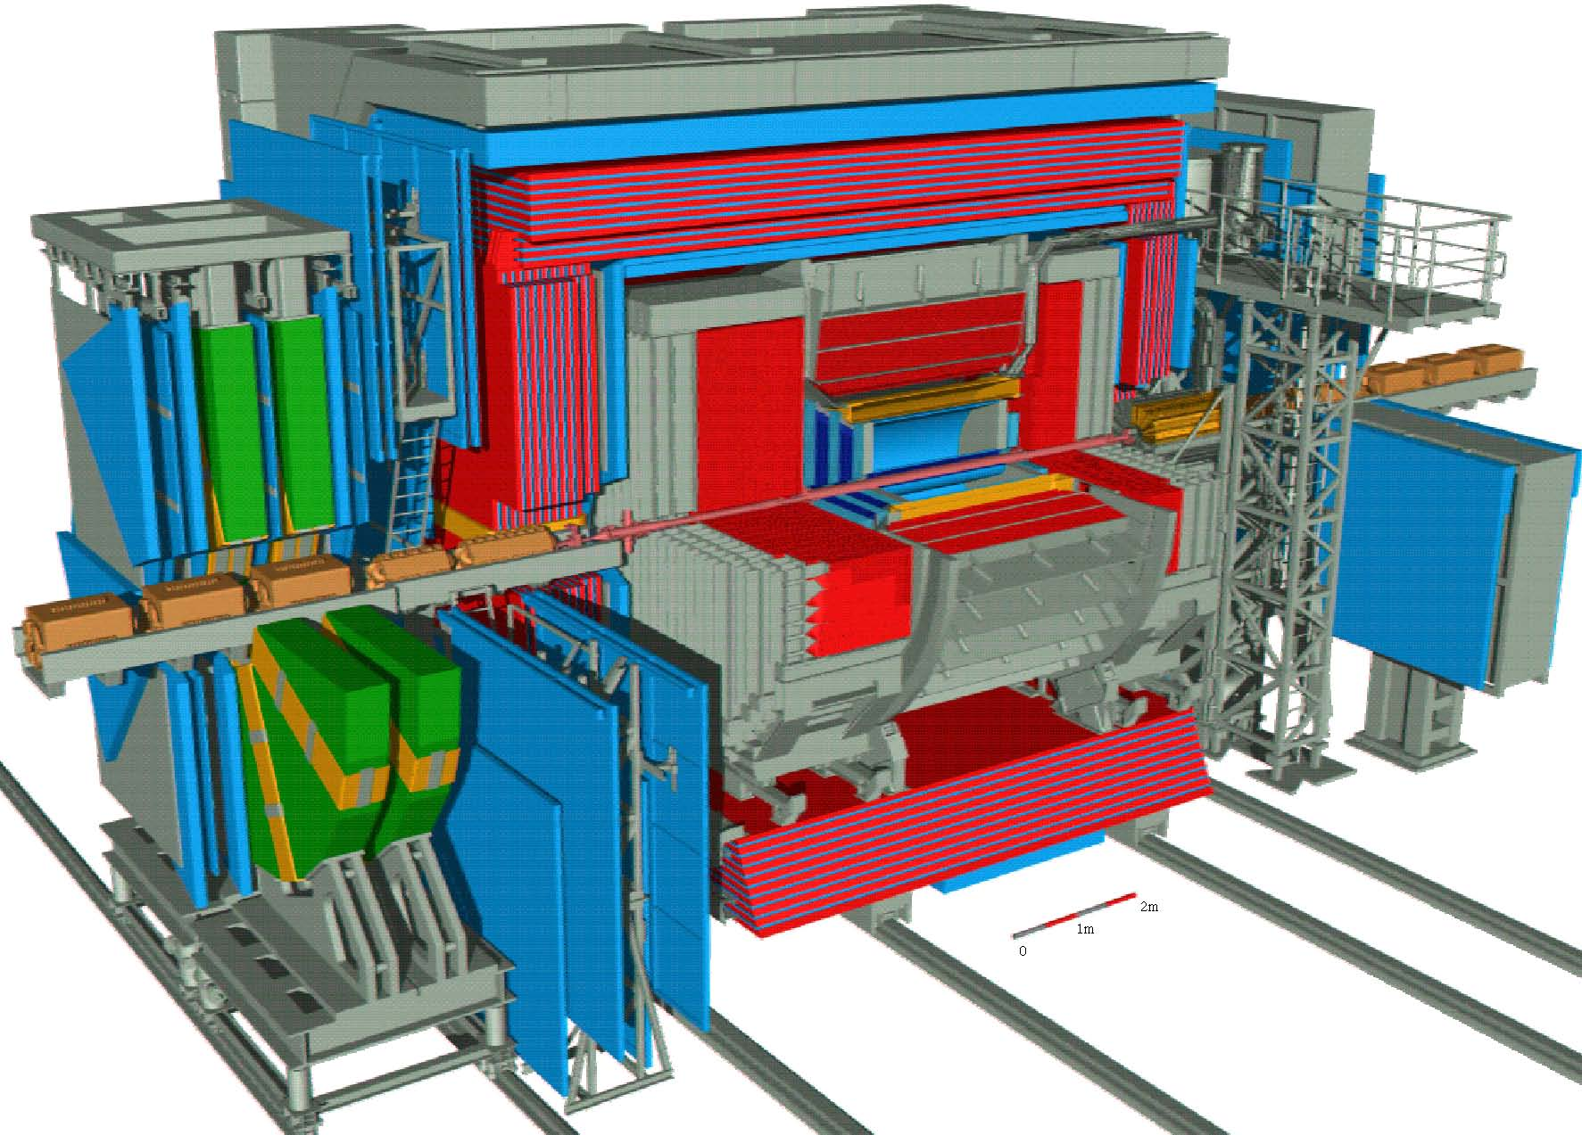
ZEUS Detector @ DESY

Slide 39
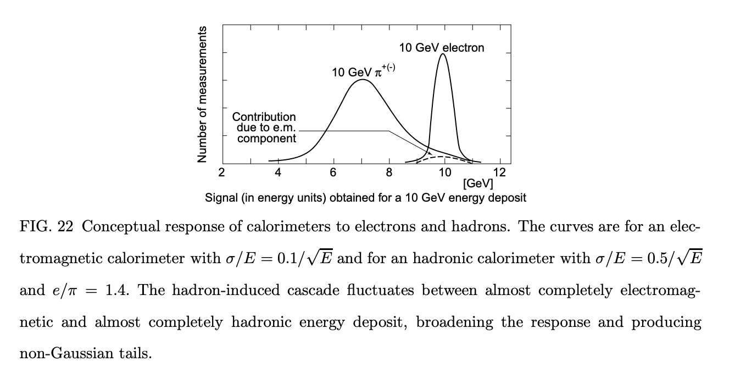
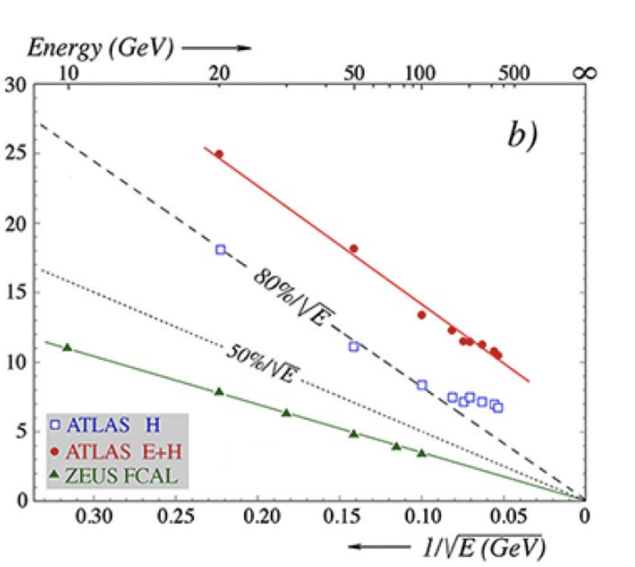
ZEUS U-Scintillator Calorimeter

Slide 40
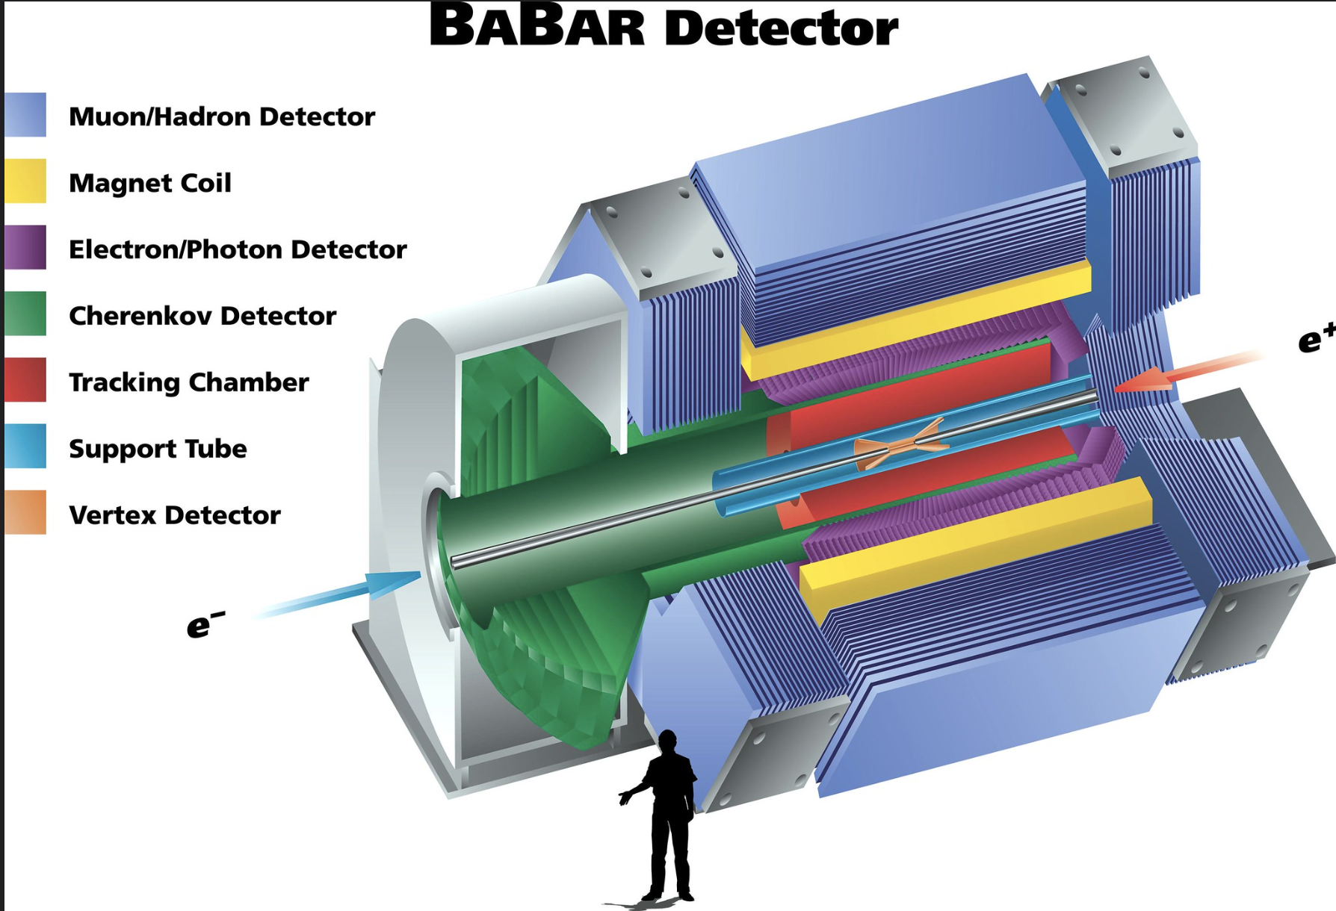
BaBar Detector at SLAC

Slide 41
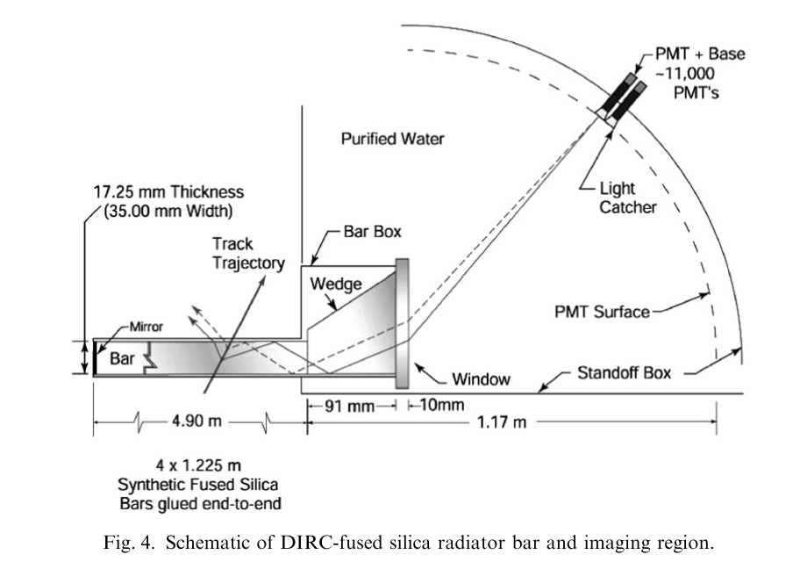
BaBar - DIRC

Slide 42
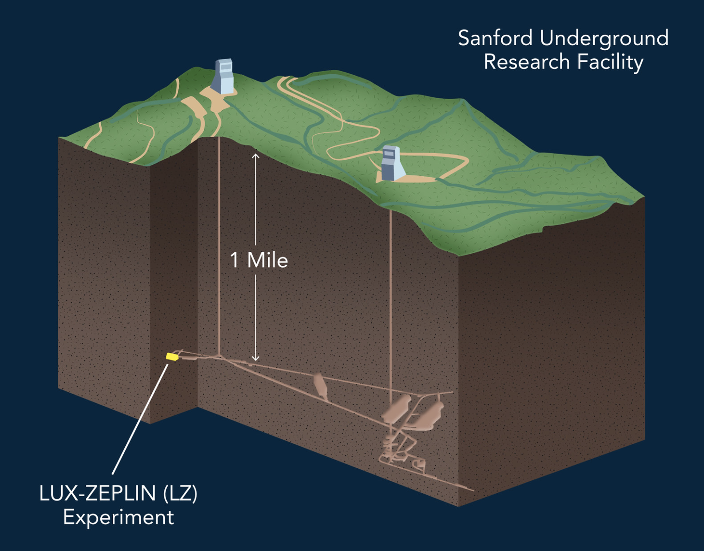
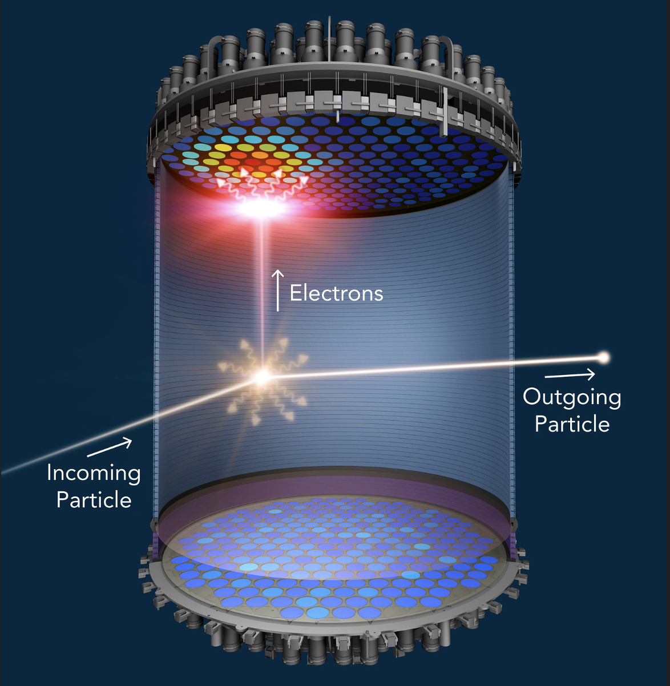
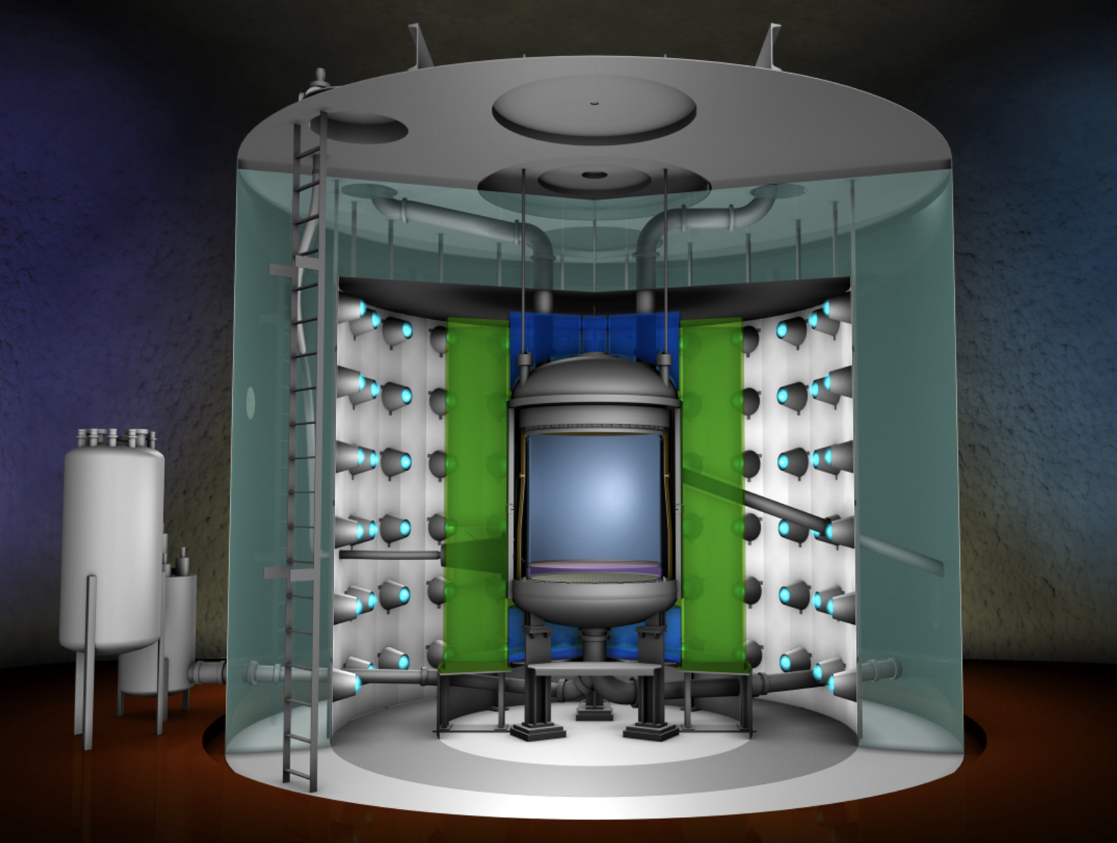
The LZ TPC in Sanford (SD) for Dark Matter Searches

