Slide 1
Physics 535 :
Waves, Particles, Anti-Particles and Fields
Electromagnetic Waves
Schrodinger Matter Wave Function → Matter Field
Discovery of anti-matter
Matter Currents

Slide 2
Maxwell’s Equations in
Manifestly Covariant Form
Classical Electrodynamics
Using Heaviside-Lorentz system of units, which avoids 4π factor
And, c=1!

Slide 3
Scalar & Vector Potentials

Slide 4
Gauge Invariance
In classical electrodynamics E & B fields are physical
  Potentials are mathematical constructs
    They make homogeneous equation automatic
  But, potentials are not uniquely defined
    Gauge transformation preserves field value
    Gauge invariance → Conservation of Charge
    This is global gauge invariance

Slide 5
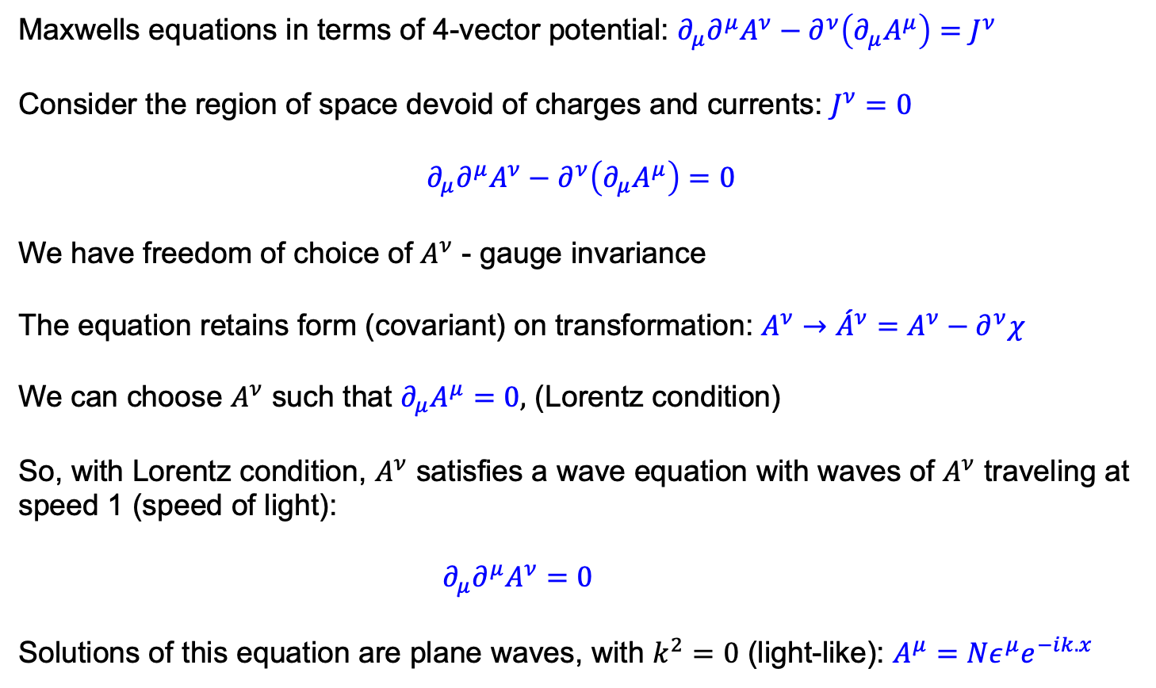
Electromagnetic Waves
Maxwells equations in terms of 4-vector potential: $∂_{μ}∂^{μ}A^{ν}−∂^{ν}\left(∂_{μ}A^{μ}\right)=J^{ν}$
Consider the region of space devoid of charges and currents: $J^{ν}=0$
$$∂_{μ}∂^{μ}A^{ν}−∂^{ν}\left(∂_{μ}A^{μ}\right)=0$$
We have freedom of choice of $A^{ν}$ - gauge invariance
The equation retains form (covariant) on transformation: $A^{ν}→{\acute{A}}^{ν}=A^{ν}−∂^{ν}χ$
We can choose $A^{ν}$ such that $∂_{μ}A^{μ}=0,$ (Lorentz condition)
So, with Lorentz condition, $A^{ν}$ satisfies a wave equation with waves of $A^{ν}$ traveling at speed 1 (speed of light):
$∂_{μ}∂^{μ}A^{ν}=0$
Solutions of this equation are plane waves, with $k^{2}=0$ (light-like): $A^{μ}=Nε^{μ}e^{−ik.x}$

Slide 6
Matter Waves:
Schrodinger Equation
Non-relativistic quantum mechanics
Solutions again are plane waves, with massive particles: $ψ=Ne^{−ik.x}$
When properly normalized, probability interpretation of ρ works!

Slide 7
Quantum Mechanics +
Special Relativity
Klein-Gordon attempt
  Start from relativistic energy momentum and quantize
  Negative energy solutions are a problem
    Cannot be simply ignored as we need a complete set of states in a quantum system ☹
  Incompatible with probability interpretation for φ
    It can take negative values ☹ for negative energy solutions

Slide 8
Probability Density/Flux 4-Vector
For moving particles, particle count conservation implies continuity equation relating probability and flux density:

Slide 9
Negative Energy & Probability
Consider plane-wave solutions
Problematic negative energy solutions also end up with negative probability density (ρ = –2m|N|² for stationary negative energy case) ☹
Solution was offered by the quantum field theory, where we abandoned the probabilistic interpretation.

Slide 10
Pauli-Weisskopf Prescription
In field theory context we abandon the probability density interpretation
  We interpret the continuity equation as the charge-current density a la E&M
  Number of particles is no longer conserved!
  However, we have a conserved vector current!
  Fields φ and φ* represent scalar particle and anti-particle
Historically, Dirac noted that it is the second derivative in time that caused the problem, and sought a relativistic equation which is linear in derivatives

Slide 11
Fermionic Matter Field
Dirac Equation
"God used beautiful mathematics in creating the world.”
– Paul Dirac
“It seems that if one is working from the point of view of getting beauty in one's equations, and if one has really a sound insight, one is on a sure line of progress.”
– Paul Dirac

Slide 12
Pauli-Weisskopf Prescription
Klien-Gordon Field (Last week)
  Pesky negative energy solutions and negative probability
  Mitigation: Fields describing charged scalars (particle + anti-particle) by interpreting the continuity equation as the charge-current density a la E&M
  A conserved vector current!
Historically, Dirac noted that it is the second derivative in time that caused the problem, and sought a relativistic equation which is linear in derivatives

Slide 13
Linear Relativistic
Quantum Equation
Dirac figured he needed first derivative in space-time

Slide 14
Dirac’s Gamma Matrices
In long form

Slide 15
Dirac Equation
A 4x4 matrix equation
is a “Dirac Spinor”
It is not a four-vector, i.e., length Ψ² is not an invariant

Slide 16
Solutions to Dirac Equation
First consider position independent case
Stuckleberg & Feynman: We can interpret anomalous time dependent solutions as anti-particles with positive energy!

Slide 17
Dirac Spinors
The four position-independent particle solutions
Spin-Up Electron
Spin-Down Electron
Spin-Down Positron
Spin-Up Positron

Slide 18
Including the spatial part

Slide 19
Computing (k.σ)²

Slide 20
u_{A} and u_{B} Possibilities

Slide 21
Normalization

Slide 22
Dirac Spinors
The four solutions
Momentum space Dirac equations
Not spin states

Slide 23
Spin Eigen States

Slide 24
S_{z} Eigen State Spinors
Spin-Up Electron
Spin-Down Electron
Spin-Down Positron
Spin-Up Positron

Slide 25
Probability/Flux Density

Slide 26
Pauli-Weisskopf Prescription
Dirac Field
  Pesky negative energy solutions and negative probability
  Mitigation: Fields describing charged fermion pairs (particle + anti-particle) (spin-up and spin-down), by interpreting the continuity equation as the charge-current density a la E&M
  A conserved vector current!

