Slide 1
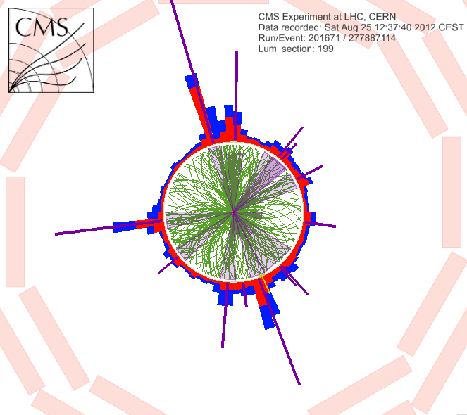
Physics 535
Quantum Chromodynamics

Slide 2
Deep Inelastic Scattering
p, p
Unobserved hadrons
X, p’
q
e, k
e, k’

Slide 3
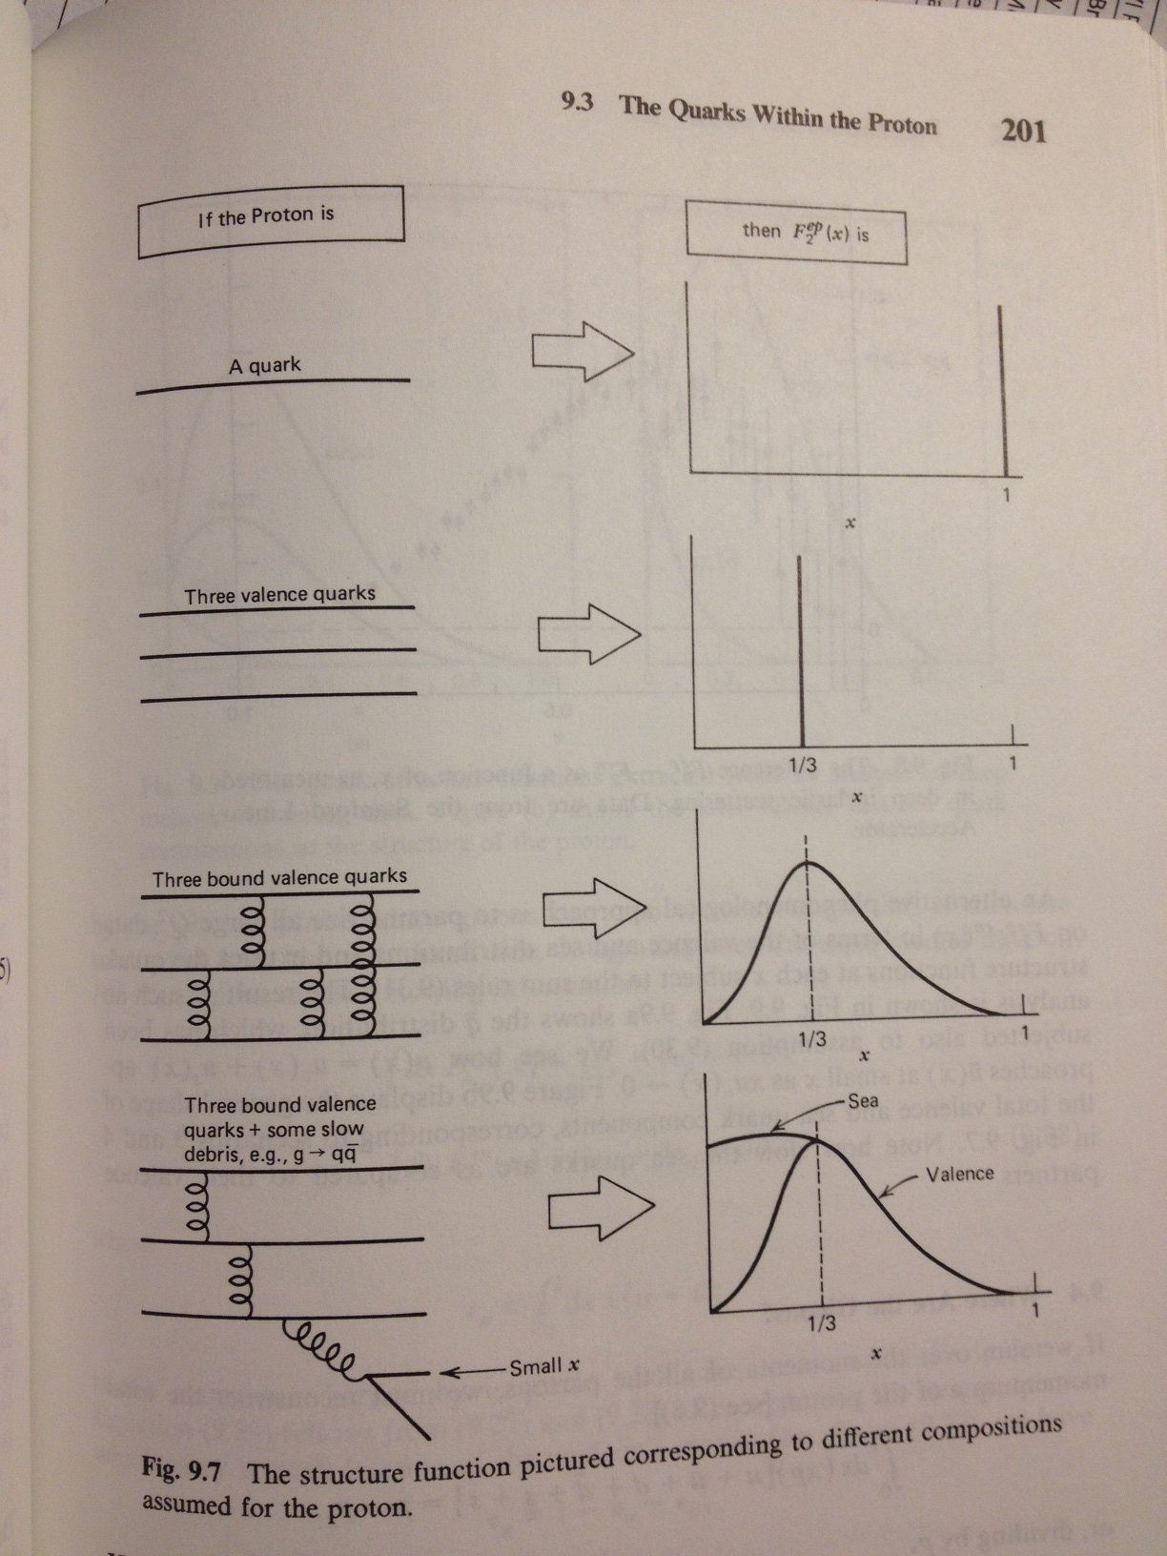
Proton
Structure
High Q² virt. photons – probe short distance
  Q² independence at “high” Q² implies that the partons are essentially free scattering sites
  However, this scaling is only approximate
  Large scaling violation at small x

Slide 4
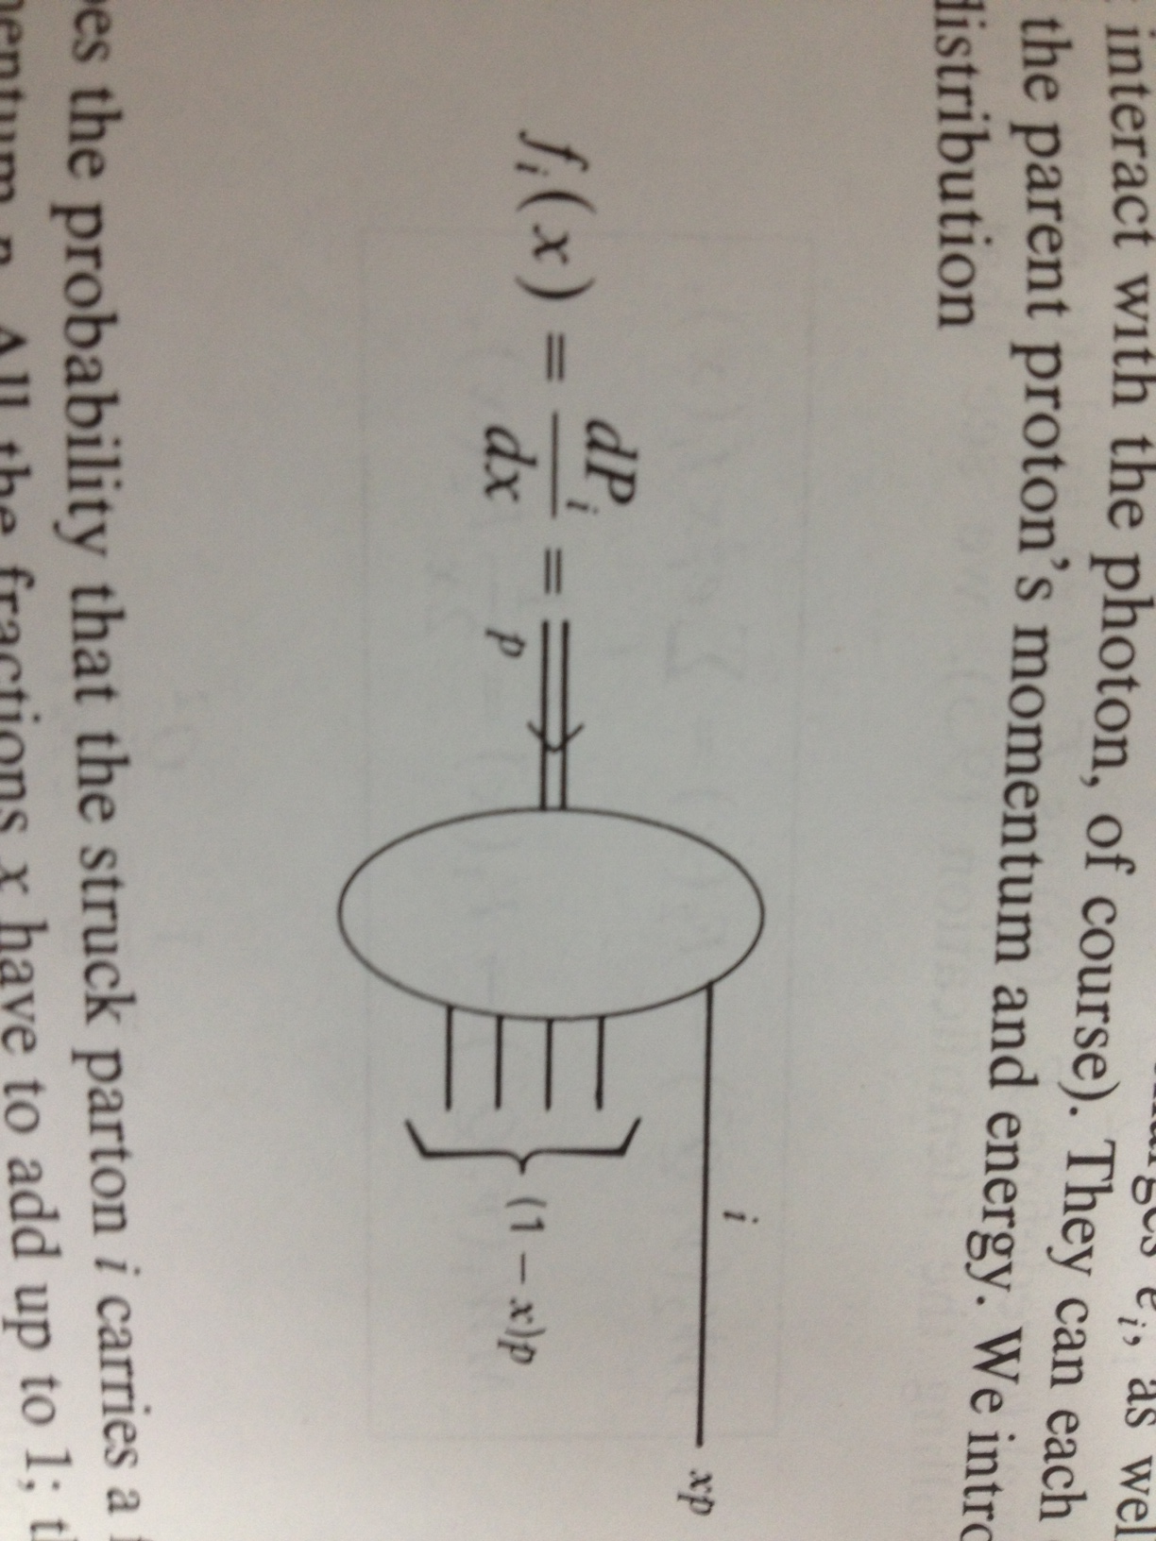
Quark-Parton Model
Proton | Parton
E | xE
p_{L} | xp_{L}
p_{T}=0 | p_{T}=0
M | m=xM
Experimentally the above sum rule using f_{i}(x) from measured F₂(x) ended up to be ~0.5 indicating that there is lot of neutral “stuff” in proton that carries half of its momentum. Stuff not interacting with photon is now interpreted as gluons.

Slide 5
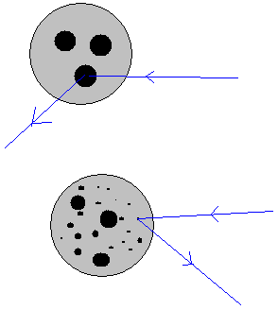
F₂(x,Q²) Measurements
Increasing Q²
Fit these and other (neutrino) data to separate out quark (by flavor) and gluon distributions.

Slide 6
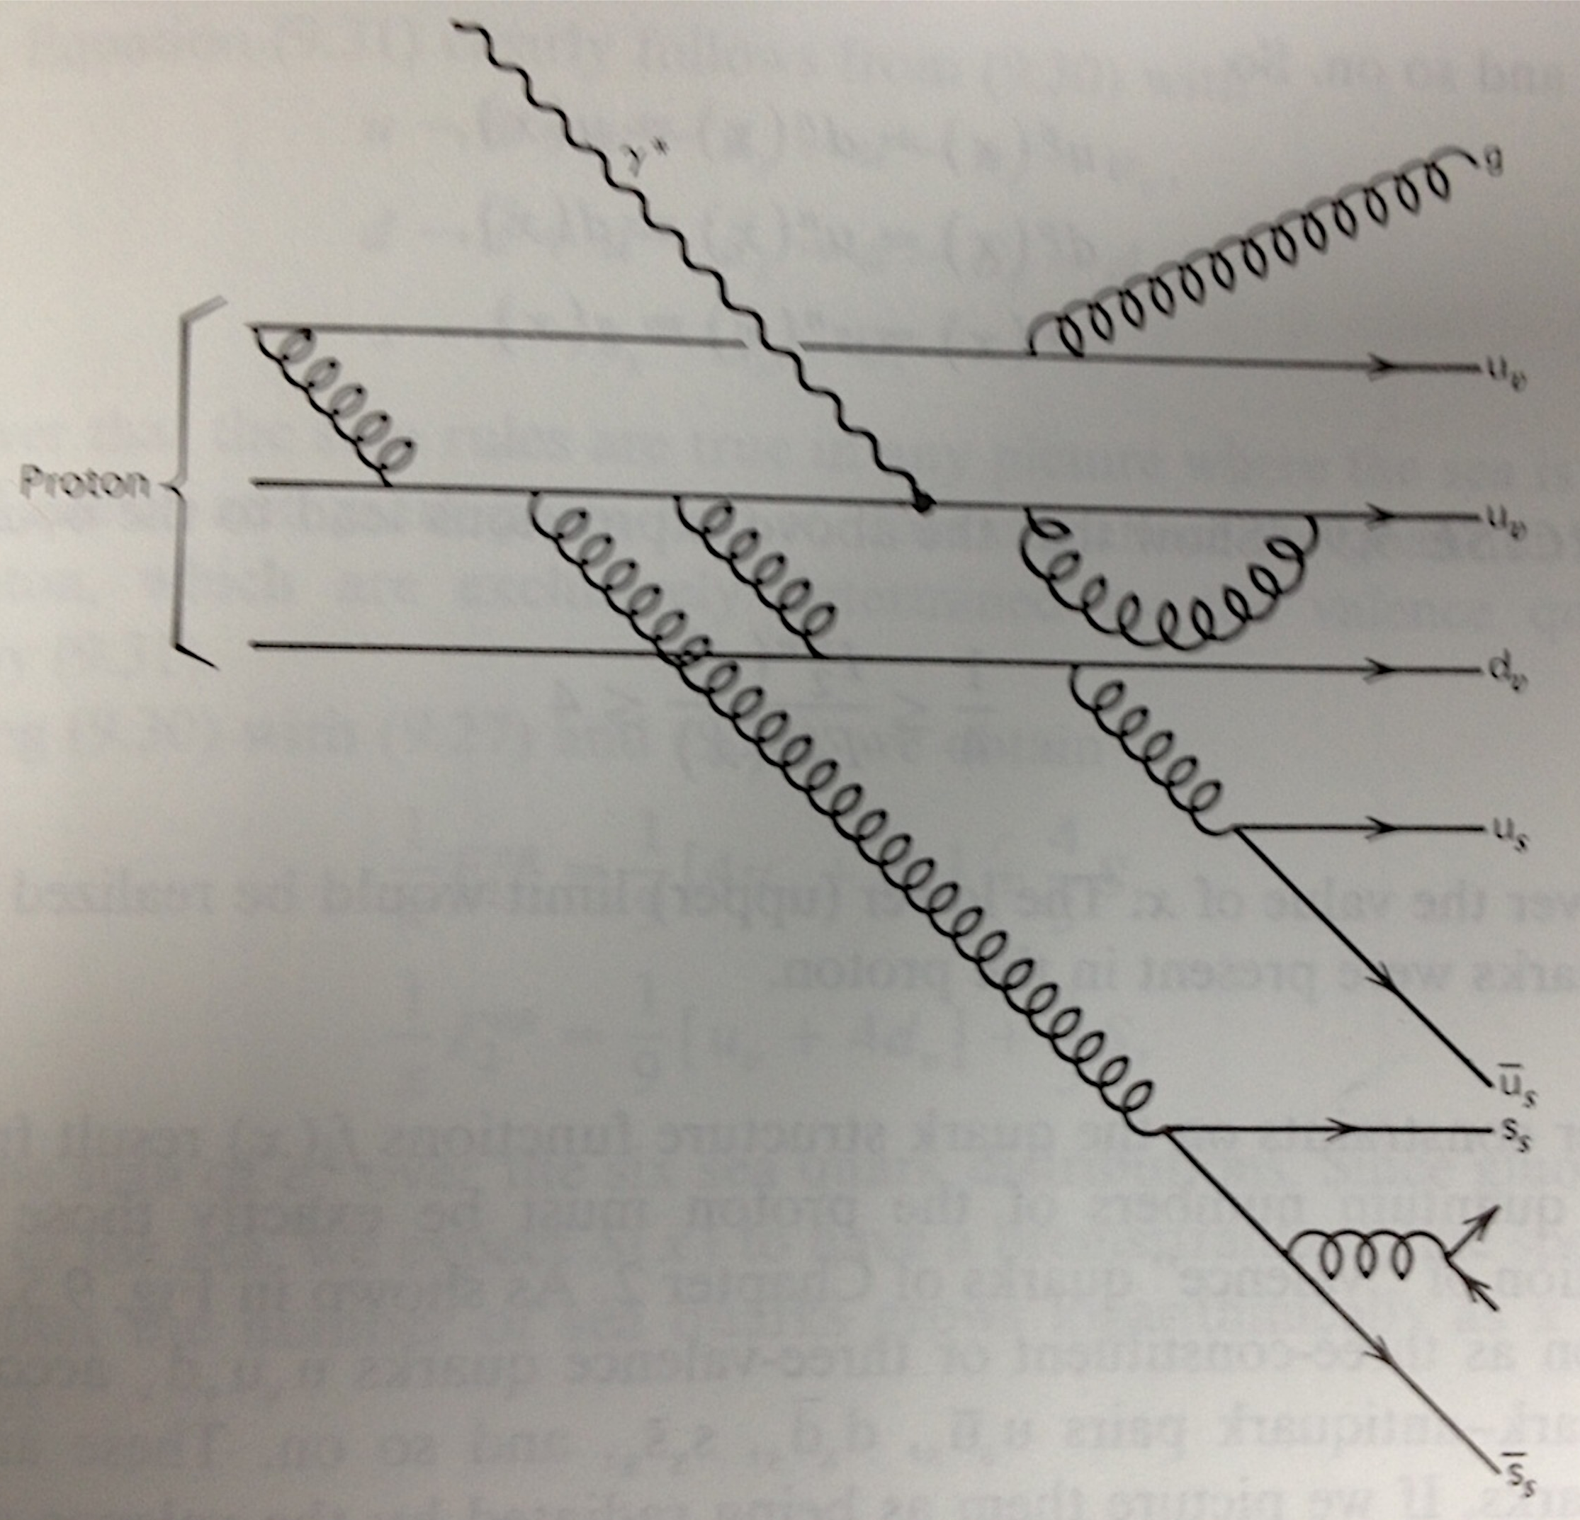
Proton As seen by Virtual Photon!

Slide 7
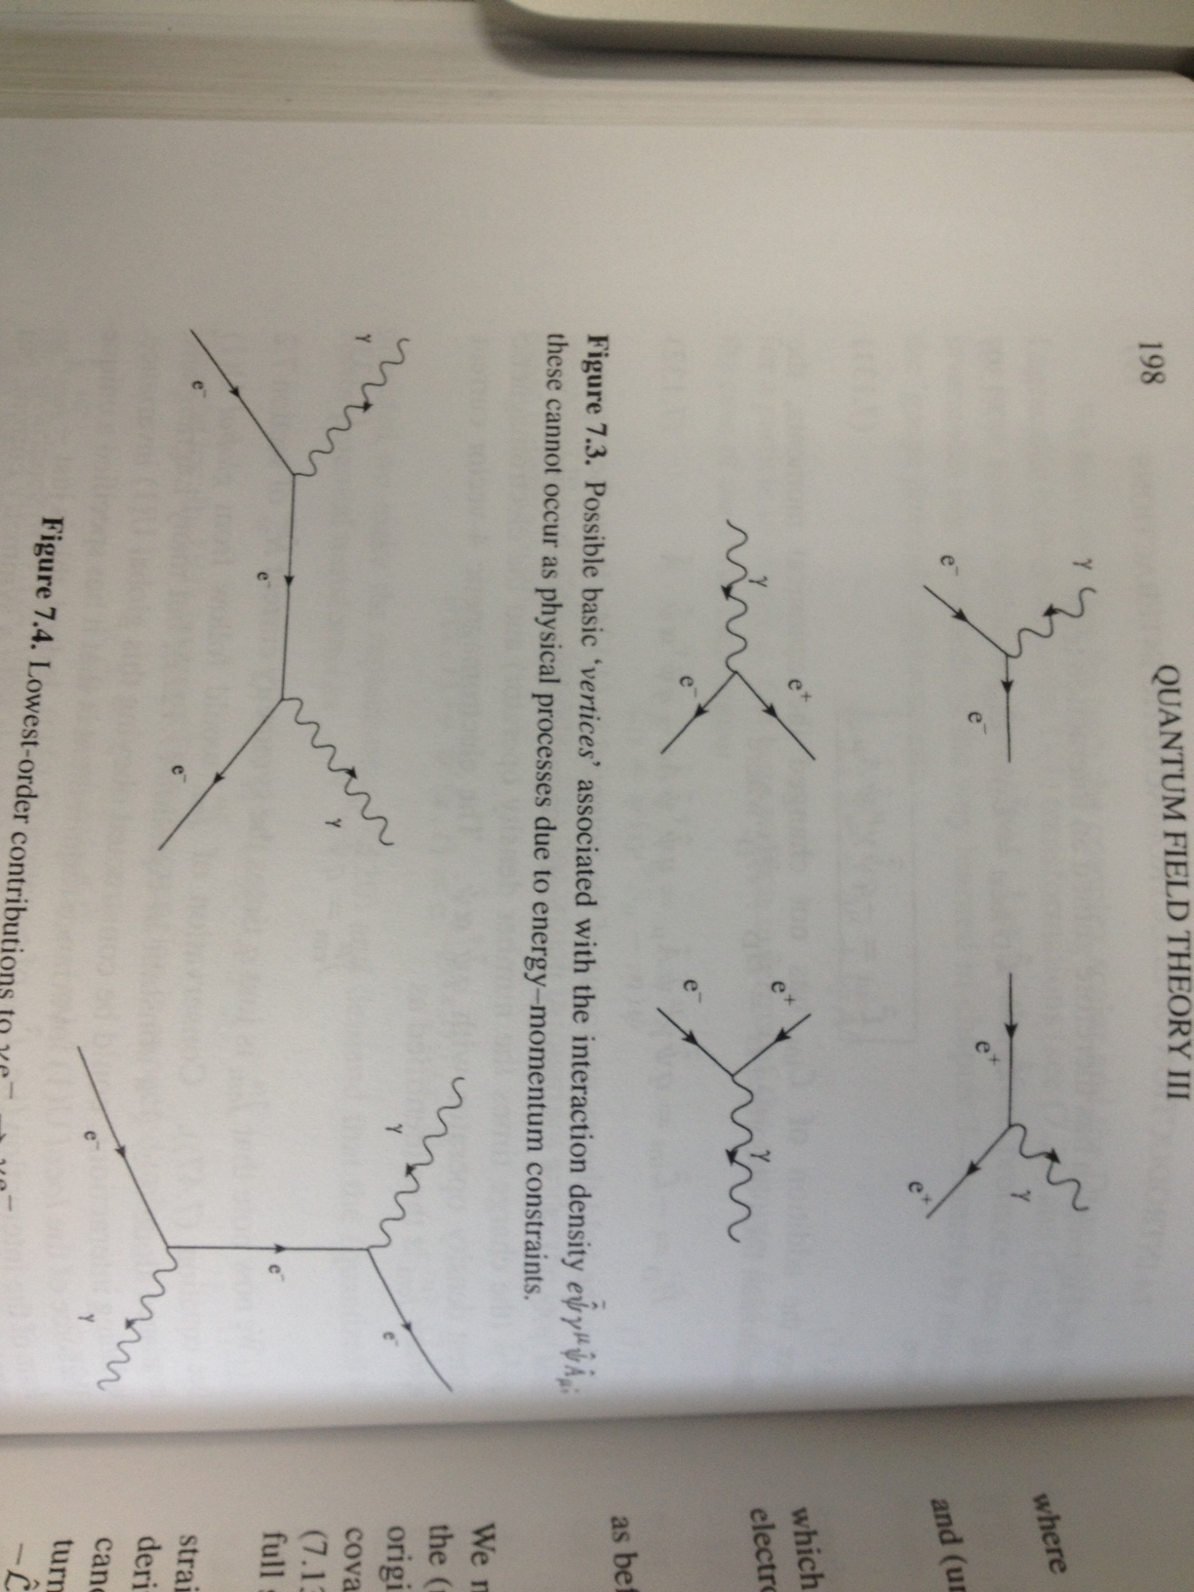
QED Gauge Principle

Slide 8
Dirac Lagrangian for Quarks

Slide 9
Non-abelian SU(3) Group

Slide 10
Properties of Gellman Matrices

Slide 11
Gauge Principle –
Extention to Non-abelian Case

Slide 12
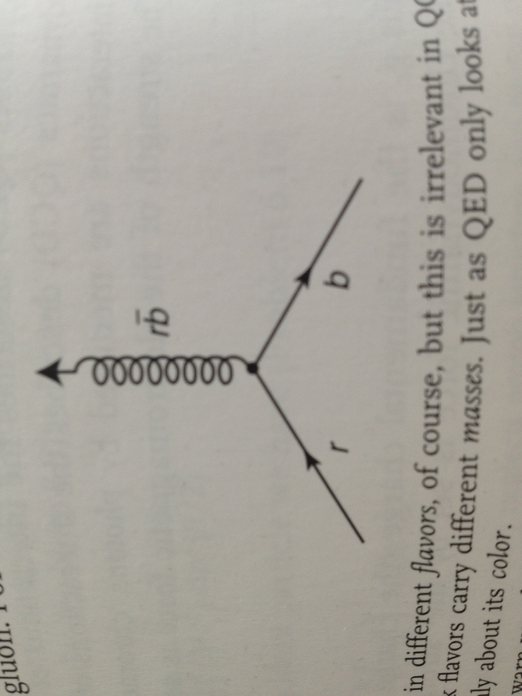
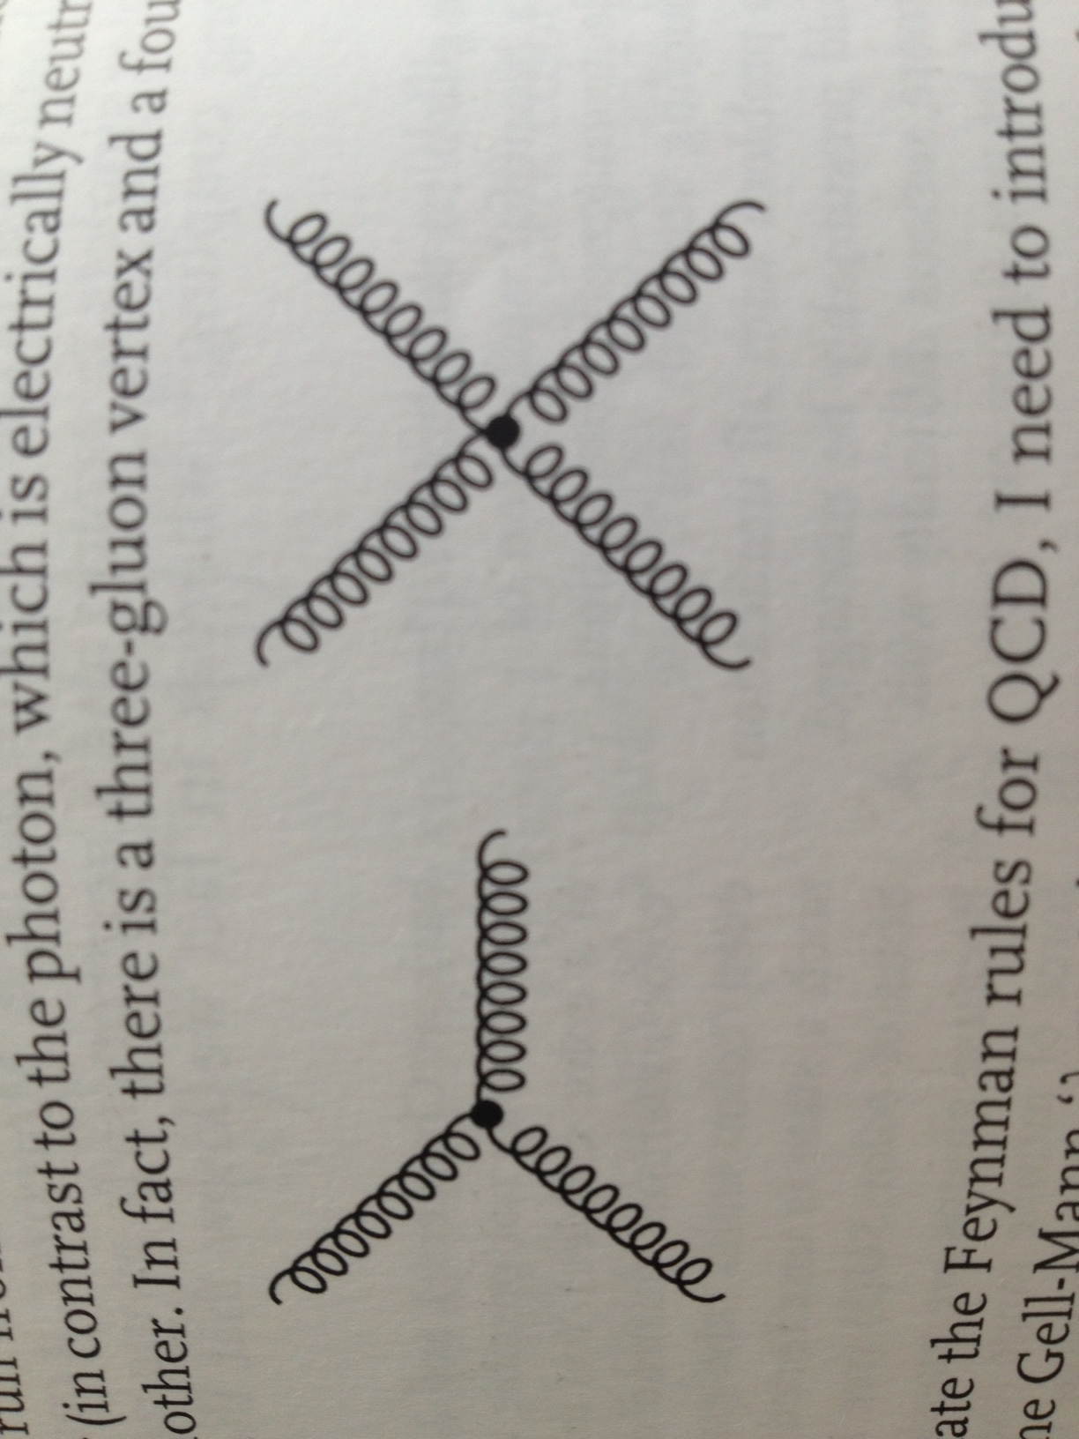
QCD Interactions

Slide 13
Quark and Gluon States

Slide 14
Diquark System

Slide 15
Feynman Rules

Slide 16
Feynman Rules 2
α,μ
α,μ
γ,σ
β,ν
α,μ
γ,ρ
β,ν
δ,σ

Slide 17
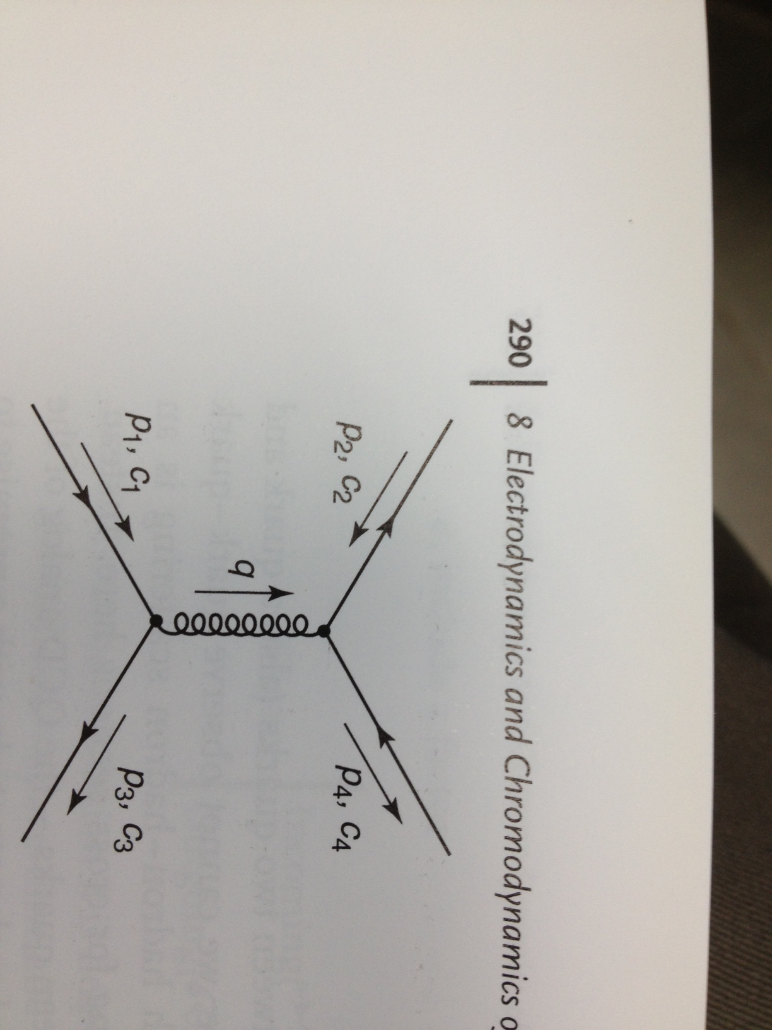
Quark – Antiquark Interaction
β,ν
α,μ

Slide 18
Octet qqBar Color Factor
Repulsive force!

Slide 19
Singlet qqBar Color Factor
Attractive force!
Quark-Antiquark form tight bound colorless singlet states!

Slide 20
Binding of Three Quarks
Singlet, Octect and Decuplet states are feasible
  Singlet – completely anti-symmetric
  Decuplet – completely symmetric
  Two octets – mixed symmetry
The color SU(3) octet & decuplet have mixed or repulsive V(r)
  Fortuitously, the color SU(3) singlet has attractive potential favoring colorless 3-quark bound states
Baryons (qqq) must be Color SU(3) singlets
  Every combination contains all three colors

Slide 21
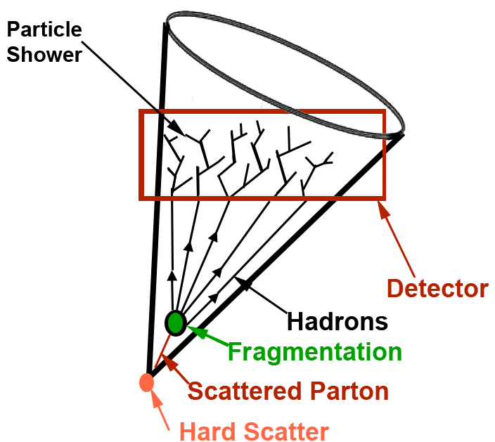
Physics 535 : Lecture 21
Fragmentation and Jets

Slide 22
Yes or No?
Can the calculation of amplitude for lowest order q₁q₂ → q₁q₂ scattering diagram be factorized into a part that can be taken from QED and a color-factor?:
Yes or No ?
Can the process of quark scattering create a gluon-pair,
i.e, q₁q₂ → gg ?:
Yes or No ?
Can a QED process help in estimating that diagram factoring out the color-factor contribution?:
Yes or No ?

Slide 23
Yes or No?
Can the calculation of amplitude to next order for q₁q₂ → q₁q₂ scattering diagram be factorized into a part that can be taken from QED and a color-factor?:
Yes or No ?
Are there same number of diagrams at the one-loop level for q₁q₂ → q₁q₂ and eμ → eμ?:
Yes or No ?
Can a QED process help in estimating that diagram factoring out the color-factor contribution?:
Yes or No ?

Slide 24
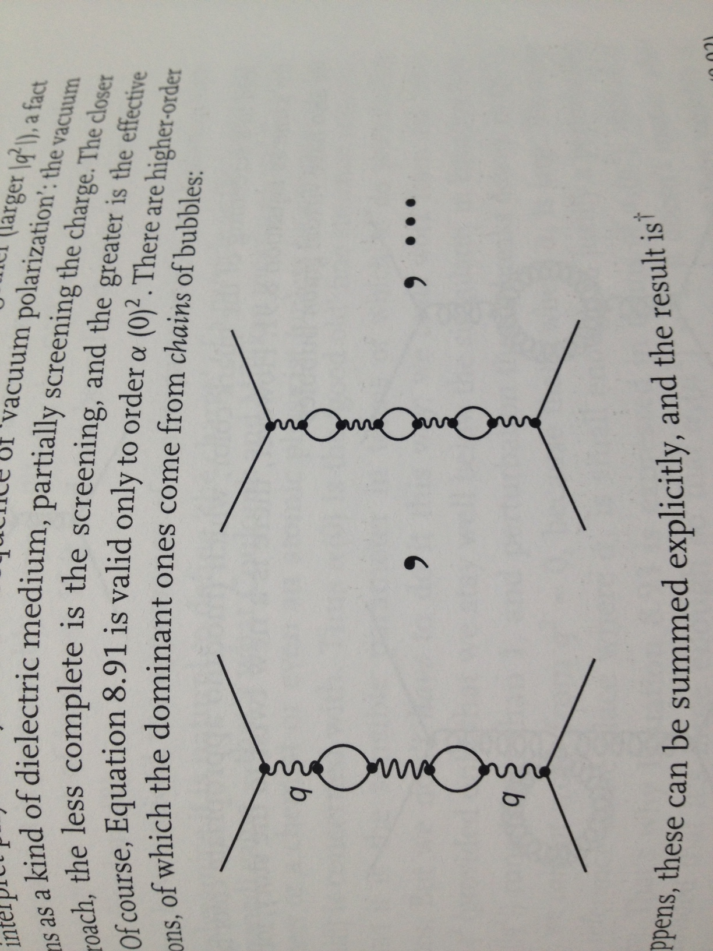
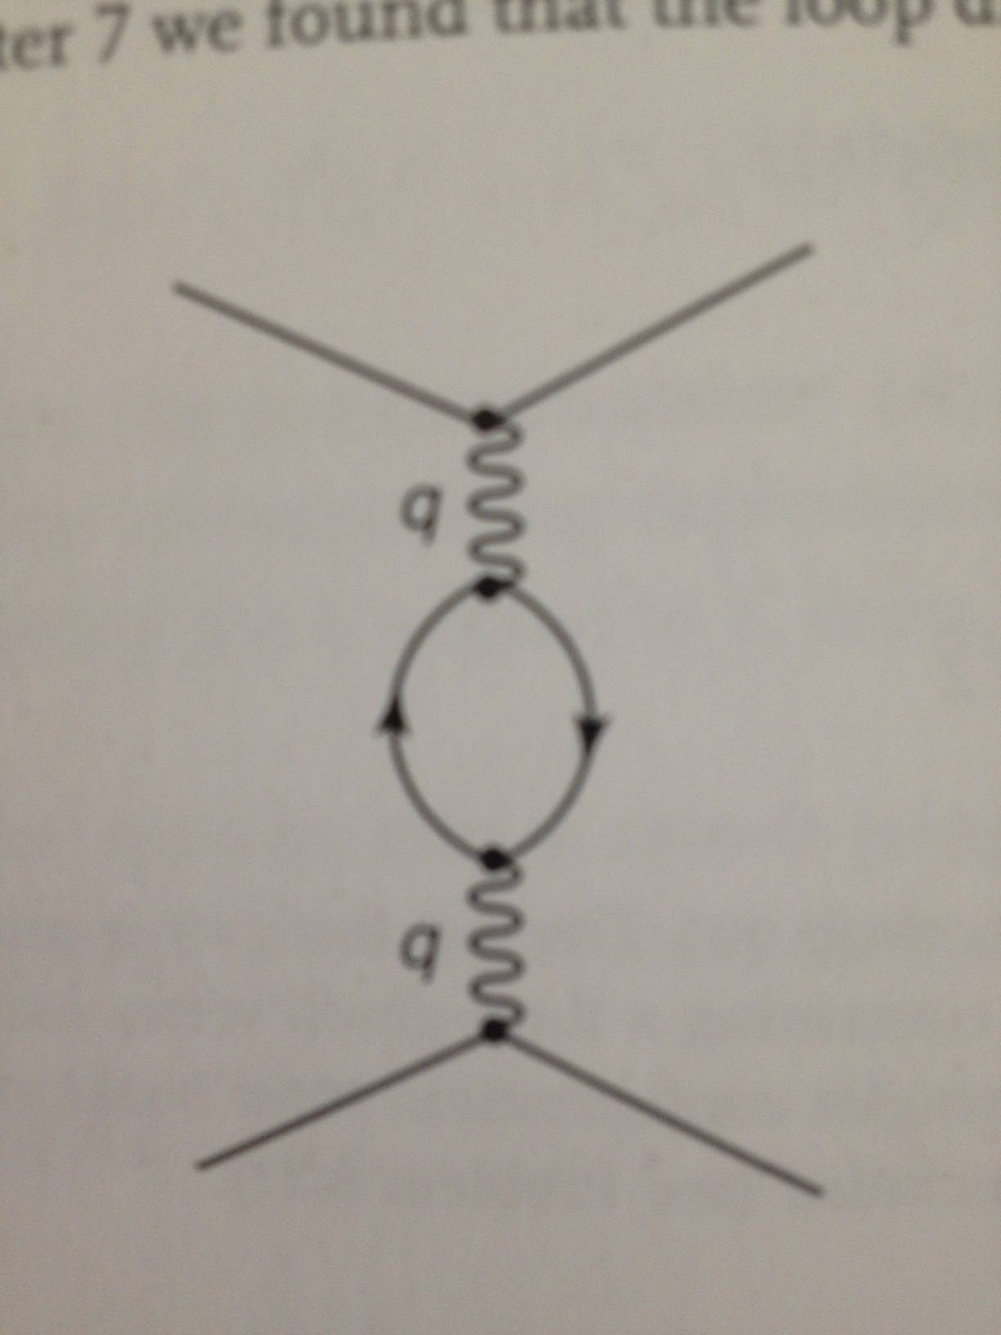
Loop Effects – Coupling Strength
Coupling strength evolves with the scale
  Look at QED first
    Coupling strength increases as the charges get closer

Slide 25
Strong Force – Colored Gluons

Slide 26
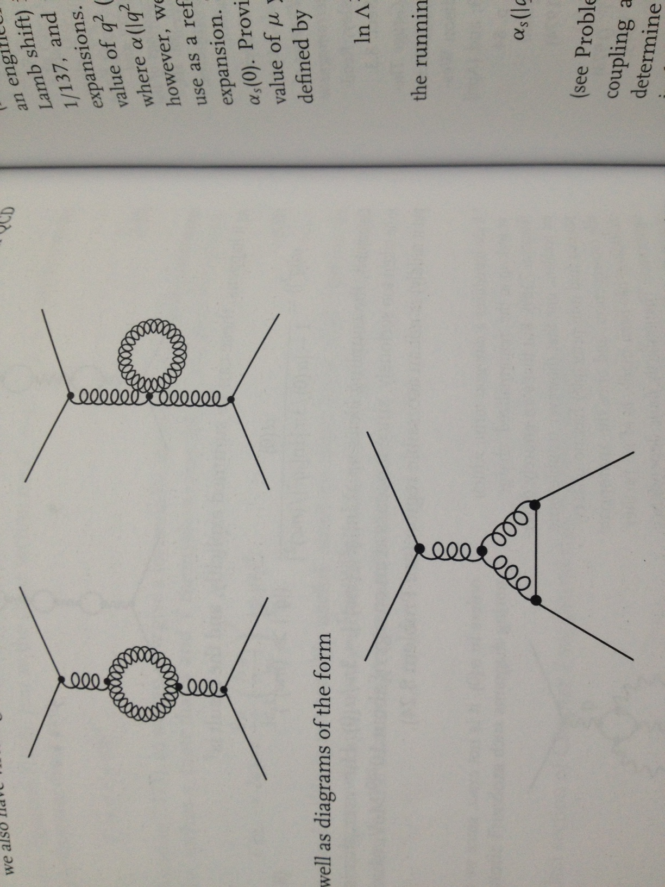
Coupling Strength : QCD
QCD has additional diagrams as gluons self-interact
  Coupling strength decreases with increasing Q²

Slide 27
Consequences
Asymptotic Freedom
  For Q² >> Λ² probes penetrate hadrons to scatter quarks
    Hard process calculated using Feynman diagrams
  At lower Q², coupling strength increases
    Soft gluon emission dominates
    Higher order processes – difficult calculations
  At very Q² < Λ², non-perturbative effects take over
    Quark confinement in hadrons → Hadronization
    Analytic techniques non-existent (Use Lattice QCD)
    Phenomenological models used for more involved problems – match with measured fragmentation functions (probability of a quark resulting in a hadron)

Slide 28
Detector Manifestation
High energy quarks and gluons make jets
FastJet
GEANT4
Lund String Model (Pythia …)
Pythia, Madgraph, POWHEG …

Slide 29
Jet Algorithms
Cones algorithm is ~trivial
  But, the boundary of the cone is entirely arbitrary
Which particles should be included in a jet and which not?
  Are there other ways to associate particles to jets?
  There is no unique prescription – spatial separation? k_{T}
Infrared and Collinear Safety
  How do you ensure that emission of soft particles does not change the jet definitions?
  How do you ensure that splitting of energy that is emitted collinearly does not change jets?
  How do you minimize sensitivity to hadronization, underlying event, pileup?

Slide 30
Sequential Clustering
Based on distance measure
Algorithm finds the smallest d_{ij}, and combines them, updates distances and proceeds, until the value is d_{iB}, when it labels the combination excluding particle i, a jet
Parameter D defines separation between jets
Parameter p: 2=kT, 0=Cambridge/Aachen, -2 = Anti-kT

Slide 31
Benefits of Anti-kT Algorithm
http://fastjet.fr/repo/fastjet-doc-3.0.3.pdf

Slide 32
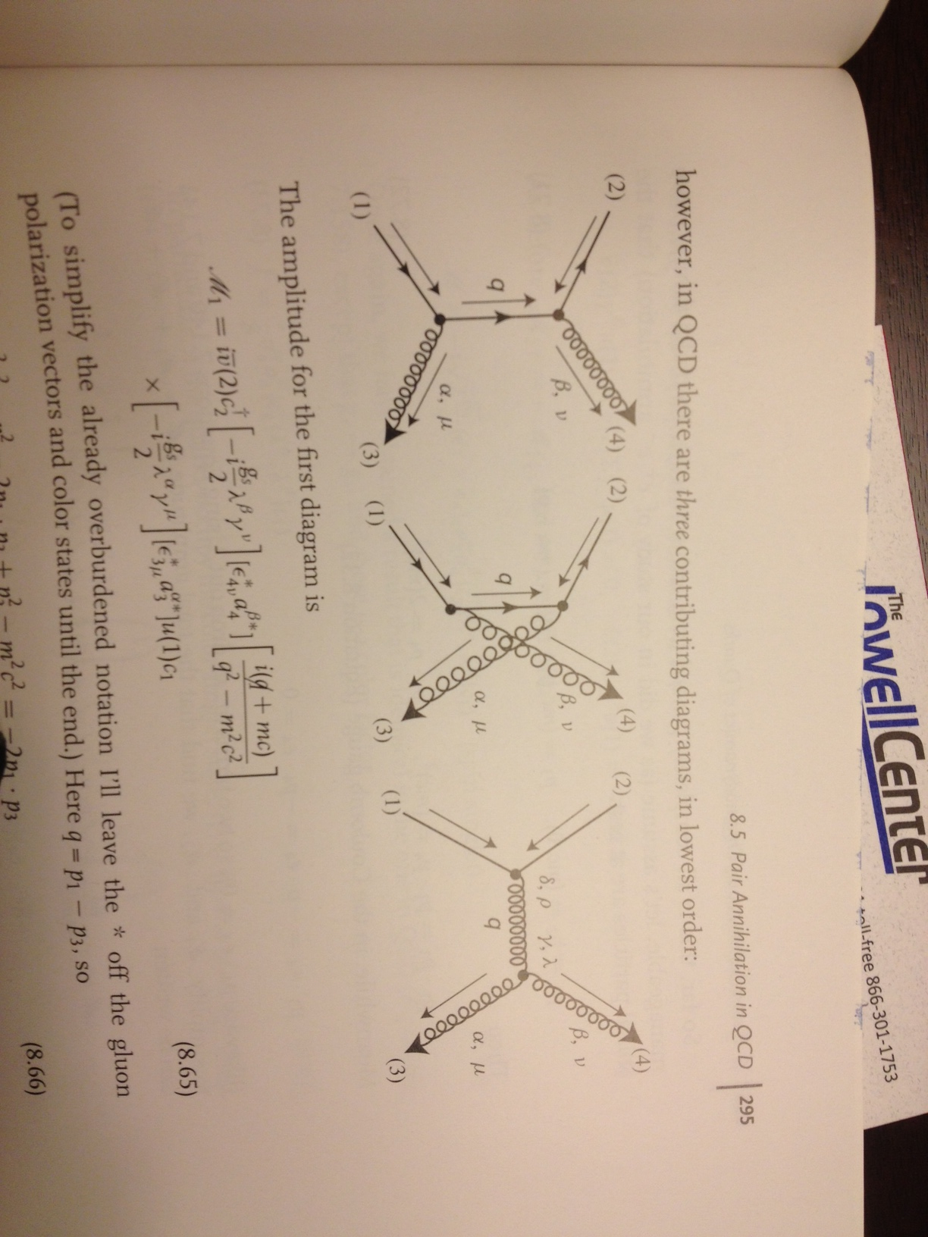
Quark-Antiquark Pair
Annihilation to Gluons
Similar to positronium annihilation (Ex.7.8 we skipped)

Slide 33
Triple Gluon Vertex Diagram

Slide 34
All Three Diagrams

Slide 35
Kinematics

Slide 36
Putting Them Together

Slide 37
Manipulations of γ & ε
A bit more algebra to put the answer in terms of commutators and anti-commutators gives the result in previous page.

Slide 38
Taking Account of Spin

Slide 39
Taking Account of Spin

Slide 40
Polarization Factor

Slide 41
Color Factor for Singlet
If the q-pair occupy color singlet state – observed hadrons are colorless!

Slide 42
Cross Section for
Annihilation at Rest

Slide 43
Rho Decay
We are considering heavy quark state, to get to a non-relativistic situation.
We don’t know wave function, but with measured spectrum of ccBar states we can “guess” the potential and do the problem.
Ratio to purely EM case, i.e., 2-photon decay cancels the wavefunction!

Slide 44
Rho Decay 2-Gluons to 2-Photons
Ratio to purely EM case, i.e., 2-photon decay cancels the wavefunction!

Slide 45
True or False?
Strong interactions can tell apart up-type quarks with electric charge 2/3 from down-type quarks with electric charge -1/3.:
True or False ?
Strong interactions can tell apart (d, s, b), which all have the same electric charge -1/3.:
True or False ?
Strong interactions are not able to tell apart neither quark flavor nor quark charge because the strong interaction strength depends on the mass, which are all different for quarks.:
True or False ?

Slide 46
True or False?
All quark flavors behave similarly when it comes to strong interactions.:
True or False ?
Quarks interact strongly because of a gauge symmetry amongst their “colors”.:
True or False ?
Electron-positron annihilation and creation of hadronic final states helped determine the number of colors as 3.:
True or False ?

