Slide 1
Physics 535 : Lecture 14
Quantum Electrodynamics
“Maxwell could say, when he was finished with his discovery, 'Let there be electricity and magnetism, and there is light!' "
– Richard Feynman
in The Feynman Lectures on Physics, vol. 1, 28-1.

Slide 2
QED Feynman Rules
The interaction term is
Obtained by demanding local gauge invariance
Conserved current coupled to the photon field
We quantize by promoting the field variables and conjugates to operators
Commutators for photon field
Anti-commutators (a la Dirac) for fermion field
Normal mode expansion → ladder operators
S-matrix expansion, Wick’s theorem, … lead to Feynman rules as shown for the ABC toy-model earlier
Here, we simply state the Feynman rules now

Slide 3
Dirac Field Anti-commutators

Slide 4
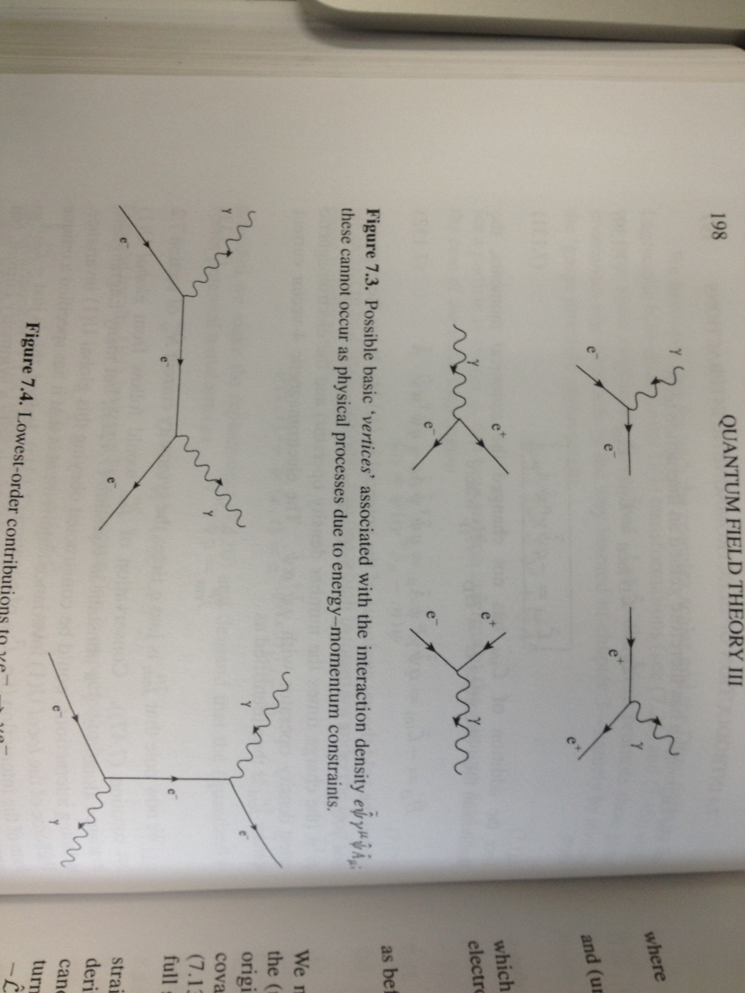
Feynman Rules for QED

Slide 5
External Lines
External fermion lines contribute the spinors
External photon lines contribute polarization vector

Slide 6
More rules …

Slide 7
Two Body Scattering Formula

Slide 8
Mott Scattering
μ, p₂
μ, p₄
q
e, p₁
e, p₃

Slide 9
Averaging over spins

Slide 10
Averaging over spins

Slide 11
For Mott Scattering
μ, p₂
μ, p₄
q
e, p₁
e, p₃

Slide 12
For Mott Scattering
μ, p₂
μ, p₄
q
e, p₁
e, p₃

Slide 13
Electron-Electron Scattering
e p₂
e p₄
e p₂
e, p₄
q
q
e, p₃
e, p₁
e, p₃
e, p₁
Identical particles: S=0.5
As opposed to S=1 for eμ scatter

Slide 14
Electron-Positron Scattering
e⁺ p₂
e⁺ p₄
e⁺ p₂
e⁺ p₄
q
q
e—, p₁
e—, p₃
e—, p₁
e—, p₃

Slide 15
Electron-Positron Scattering
Should we add or subtract?
Interchange incoming positron and the outgoing electron in the second diagram and redrawing gives:
e⁺ p₂
e⁺ p₄
e⁺ p₂
e⁺ p₄
q
→
q
e—, p₁
e—, p₃
e—, p₁
e—, p₃

Slide 16
Electron-Positron Scattering
e⁺ p₂
e⁺ p₄
e⁺ p₂
e⁺ p₄
Anti-symmetrization rule:
Include minus sign between diagrams that differ only in interchange of identical particles in/out, or in particle and out anti-particle.
q
q
e—, p₁
e—, p₃
e—, p₁
e—, p₃

Slide 17
Compton Scattering
p₂
e– p₄
e– p₄
p₂
q
q
p₃
e—, p₁
p₃
e—, p₁

Slide 18
Physics 535 : Lecture 15
QED Process:
e⁺ p₂
μ⁺ p₄
q
e—, p₁
μ—, p₃

Slide 19
Matrix Element : Feynman Rules
QED Process:
e⁺ p₂
μ⁺ p₄
q
e—, p₁
μ—, p₃

Slide 20
Averaging over Spins
Four possible helicity combinations

Slide 21
Surviving Helicity Combinations

Slide 22
Cross section for : e⁺e–→μ⁺μ–

Slide 23
In Terms of Lorentz Invariants

Slide 24
Mott Scattering ←→Annihilation
Crossing symmetry
μ, p₂
μ, p₄
e⁺ p₂
μ⁺ p₄
q
q
t-channel ←→ s-channel
e—, p₁
μ—, p₃
e, p₃
e, p₁
←→

Slide 25
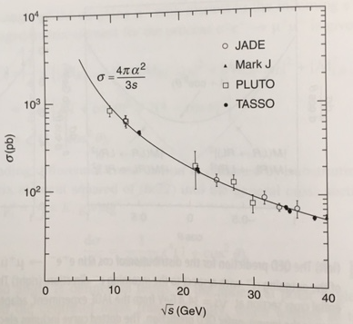
QED Connecting to the Experiments

Slide 26
QED Feynman Rules: External Lines
External fermion lines contribute the spinors
External photon lines contribute polarization vector

Slide 27
QED Feynman Rules: Propagators…

Slide 28
Hadron Production in e⁺-e– Collisions
Hard QED process produces quarks
Question 2: Which of the spinors does the matrix element involve?
$$a) u\left(p2\right)$$
$$b) \overline{u}\left(p2\right)$$
$$c) v\left(p2\right)$$
$$d) \overline{v}(p2)$$
Question 4: Which of the spinors does the matrix element involve?
$$a) u\left(p4\right)$$
$$b) \overline{u}\left(p4\right)$$
$$c) v\left(p4\right)$$
$$d) \overline{v}(p4)$$
e⁺ p₂
f⁺ p₄
q
Question 1: Which of the spinors does the matrix element involve?
$$a) u\left(p1\right)$$
$$b) \overline{u}\left(p1\right)$$
$$c) v\left(p1\right)$$
$$d) \overline{v}(p1)$$
Question 3: Which of the spinors does the matrix element involve?
$$a) u\left(p3\right)$$
$$b) \overline{u}\left(p3\right)$$
$$c) v\left(p3\right)$$
$$d) \overline{v}(p3)$$
e—, p₁
f—, p₃
Question 5: Current term for electrons is $q_{e}\overline{v}(p2)γ^{μ}u(p1)$?
$$a) True$$
$$b) False$$

Slide 29
Hadron Production in e⁺-e– Collisions
Hard QED process produces quarks
e⁺ p₂
f⁺ p₄
q
Question 7: Propagator is $\frac{−ig_{μυ}}{q^{2}}$
$$a) True$$
$$b) False$$
Fractional charge for quarks
e—, p₁
f—, p₃
Question 6: Current term for quarks is $q_{q}\overline{u}(p3)γ^{ν}v(p4)$?
$$a) True$$
$$b) False$$

Slide 30
Hadron Production in e⁺-e– Collisions
Hard QED process produces quarks
e⁺ p₂
f⁺ p₄
q
Fractional charge for quarks
$$q=p_{1}+p_{2}$$
e—, p₁
f—, p₃

Slide 31
Quarks to Hadrons
Strong interaction between colored quarks

Slide 32
Cross Section at High Energy
Factor of 3 to account for three colors of each flavor of quark
Experimental result is more robust taking ratio to σ(μ-pair)

Slide 33
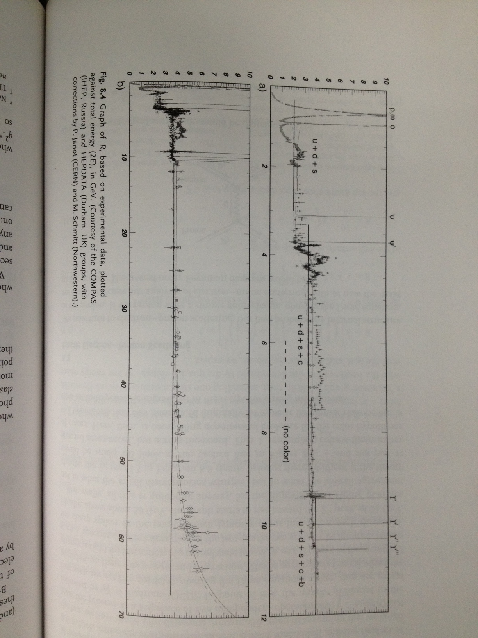
Graph of R

Slide 34
Electron-Proton Elastic Scattering
p, p₂
p, p₄
q
e, p₁
e, p₃

Slide 35
Mott Scattering
μ, p₂
μ, p₄
q
e, p₁
e, p₃

Slide 36
Mott Scattering (eμ)
μ, p₂
μ, p₄
q
$${ℳ=\left(…\right)j}_{electron}^{μ}g_{μν}j_{muon}^{ν}$$
e, p₁
e, p₃
$${{\left|ℳ\right|}^{2}=\left(…\right)L}_{electron}^{μν}L_{μν}^{muon}$$

Slide 37
Electron-Proton Elastic Scattering
p, p₂
p, p₄
q
Lorentz invariance dictates what terms tensor K can admit – combinations of p^{μ}, q^{μ}, g^{μν} are possible for spin averaged case.
Anti-symmetric terms do not contribute as L^{μν} is symmetric
e, p₁
e, p₃

Slide 38
Electron-Proton Elastic Scattering
Form factors K₁ and K₂ are not easily calculable – but are phenomenological functions that account for the “structure” of proton.

Slide 39
Electron-Proton Elastic Scattering

Slide 40
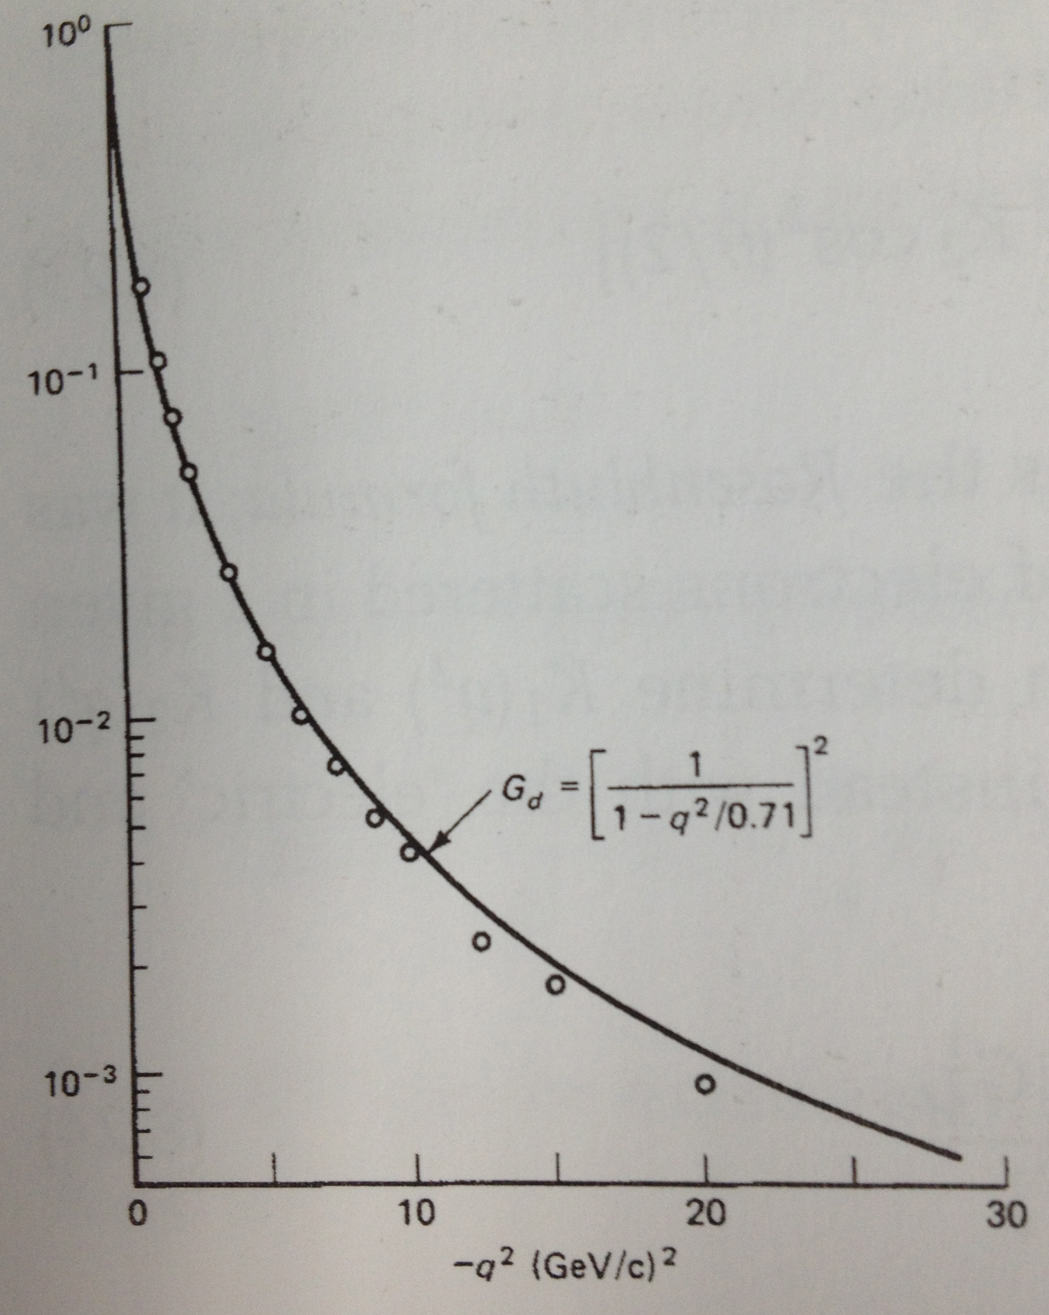
eP Elastic Form Factors

Slide 41
Deep Inelastic Scattering
p, p
Unobserved hadrons
X, p’
q
e, k
e, k’

Slide 42
Proton Structure Functions
What is the form of W₁ and W₂ as a function of x and Q²?

Slide 43
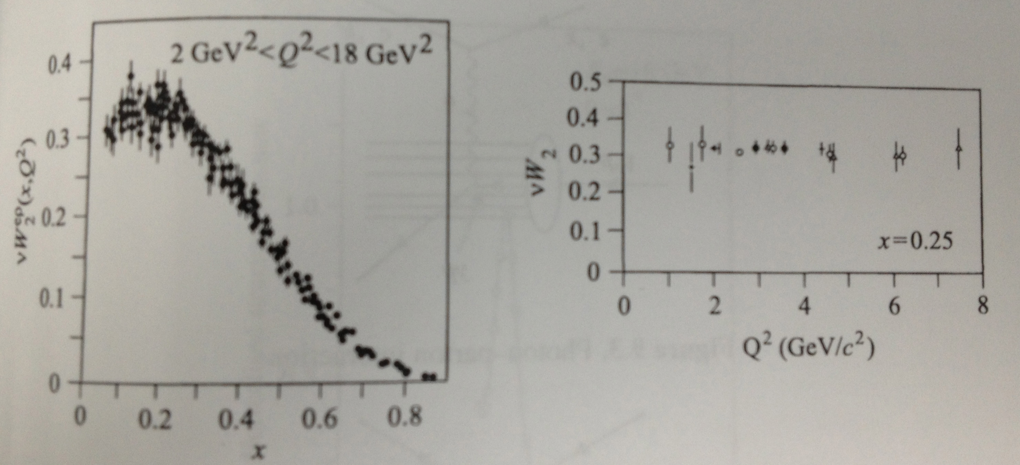
Discovery of ~Free Point Particles within Proton
Asymptotic Freedom!
“Weakly Interacting”

Slide 44
Quark-Parton Model
In fact partons do interact, resulting in scaling violation.
Scaling violation can be calculated in perturbation theory due to asymptotic freedom.
Momentum distribution sum does not add to 1 → some of the momentum is carried by neutral content of the proton – Gluon distribution!
Measuring the structure function in eP scattering gives sum of charged weighted parton distributions. To separate the distributions, one needs to do multiple measurements, ep, en, νp, νn

