Slide 1
Physics 535 : QFT Lite
Elementary Particle Dynamics
Quantum Field Theory
All the fifty years of conscious brooding have brought me no closer to the answer to the question, “What are light quanta?” Of course, today every rascal thinks he knows the answer, but he is deluding himself.
– Albert Einstein (1951)

Slide 2
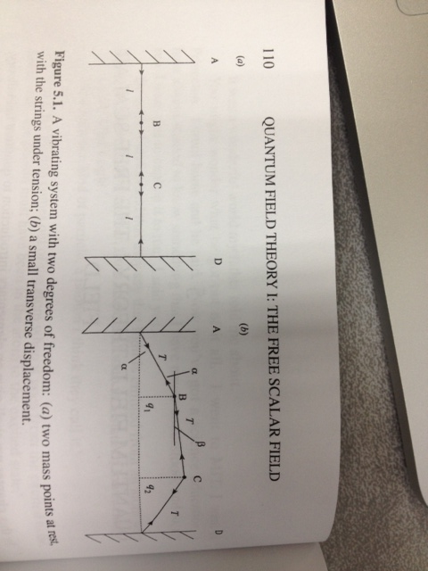
Two Body System
Classical two body oscillation system

Slide 3
True or False?
Can we write generalized coordinates which decouple the oscillation modes?:
True or False ?
To decouple we need to lose the cross term?:
True or False ?
All we need is a change of variables with a linear combinations of q₁ and q₂: True or False ?

Slide 4
Normal Modes of Oscillation
Simple combinations of coordinates makes the solution easy
Non-interacting modes are the result of lack of >quadratic terms in V.
In this example because of small oscillation assumption.
Higher order “corrections” produce couplings of modes.

Slide 5
Example Oscillation
For specific initial conditions chosen

Slide 6
Two to Many
Straight-forward extension to N bodies with N degrees of freedom.
There will be N normal frequencies
Sum of N single-mode energies → N separate non-interacting oscillators
Normal mode coordinates are the relevant degrees of freedom
(rather than the original particle displacements)

Slide 7
True or False?
Classically the oscillation frequencies can take any real value, satisfying the total energy constraint?:
True or False ?
If oscillators obey the laws of QM, the energies are discrete?:
True or False ?
By the laws of QM, there is a minimum non-zero energy the oscillations can have: True or False ?

Slide 8
Quantization
If oscillators obey laws of QM, energies are quantized
The system is characterized by this variable number of quanta n_{r}, rather than the fixed N degrees of the freedom, subject to the total energy constraint.
In this example, quanta are the phonons for “1-D crystal”

Slide 9
Harmonic Oscillator Quantization
Creation and annihilation operators method

Slide 10
Generalization to N oscillators
Independent oscillators (as used in the examples)

Slide 11
Back to Classical Case N to ∞
Consider the string; N goes to infinity & inter-body spacing, a, goes to zero, such that Na=L, the length of the string
Transverse vibrations are now described by a field, φ(x,t)
At each x, φ(x,t) is the displacement
The discrete r earlier now became continuous x

Slide 12
Many to Infinite
The field φ(x,t) describes the transverse motion of the string
Small displacement assumption which limited potential energy to quadratic terms in the discrete case
The analog of it for continuous case is that φ(x,t) obeys the wave equation
First, consider the classical treatment of the string system

Slide 13
Motion of the string
General motion of the string is superposition of all modes

Slide 14
Quantizing the Field
Total energy is the sum of infinite modes of oscillator
The excited states of the quantized field are characterized by determining number of modes (phonons) of each frequency.
For systems of interest to us, the field, e.g., EM field extends everywhere. So, L goes to infinity. For this case the sum over r is replaced by an integral over continuous frequency variable.
If we considered electromagnetic field, ignoring that 3D world and the vector nature of that field …, we will have the (non-interacting) quanta of that field following this procedure! These are the light quanta – the photons!

Slide 15
Classical Field Theory Revisited
Lagrange-Hamilton approach for a field
Use Lagrangian density
Continuous infinite degrees of freedom

Slide 16
Free Scalar Field in 1-Dimension
Infinite length string analog considered earlier
Now we want to quantize this field (canonically)

Slide 17
Quantizing Free Scalar Field
Analogous to discrete case, now with Kronecker delta δ_{rs} becoming Dirac delta function δ(x–y) with properties:

Slide 18
General solution
Fourier expansion in terms of all modes as before

Slide 19
True or False?
Scalar field energies are discrete.:
True or False ?
Given an energy E, only the mode that is excited will have corresponding frequency, $E=ℏω$will be excited.:
True or False ?
The ground state energy is non-zero, in fact it is in principle infinite.: True or False ?

Slide 20
Free Scalar Field Spectrum
Using the commutation relations change to normal ordering
Not too surprising as the quantized single oscillator had a non-zero ground state energy – infinite number of them should yield infinity.
We ignore this infinity, arguing only differences matter,
and continue merrily.
We can pop arbitrary number of quanta given sufficient energy.
Quantized scalar field equation describes infinite number of particles

Slide 21
Fields ←→ Quanta
Field | Quanta
Molecular oscillations in a crystal | Phonons
Plasma oscillations | Plasmons
Magnetic oscillations | Magnons
Electromagnetic Field | Photons
What about electrons, muons, neutrinos, quarks, gluons …
QFT goes ahead assuming electron field, …
Symmetry properties of φ(x,t) will then determine if the field is representing a boson or a fermion …
So far, these are non-interacting, what about interactions?

Slide 22
Physics 535 : Lecture 11
Elementary Particle Dynamics
Interacting Scalar Fields
Like silicon chips of more recent years, the Feynman diagram was bringing computation [of quantum field theory amplitudes]
to the masses.
– Julian Schwinger

Slide 23
True or False?
Quantum field theory normal mode operators $\left(a^{†}\left(k\right) \text{and} a(k)\right)$ increase or decrease the energy of the particles:
True or False ?
Quantum field theory normal mode operators $\left(a^{†}\left(k\right) \text{and} a(k)\right)$ create or annihilate the particle states:
True or False ?
Given sufficient energy states with any number of particles may be realized subject to the conservation principles embedded in the Lagrangian density of the theory.: True or False ?

Slide 24
Free Scalar Field in 1-Dimension
Infinite length string analog considered earlier
Now we want to quantize this field (canonically)

Slide 25
Quantizing Free Scalar Field
Analogous to discrete case, now with Kronecker delta δ_{rs} becoming Dirac delta function δ(x–y) with properties:

Slide 26
General solution
Fourier expansion in terms of all modes as before

Slide 27
Free Scalar Field in 3+1D
We generalize the 1+1D scalar field theory to 3+1D with mass:

Slide 28
In Terms of Ladder Operators
Fourier expansion in terms of normal modes as before
Dropping the annoying infinity ☹

Slide 29
Question?
The Lagrangian density of a quantum field theory is given by $ℒ=\frac{1}{2}\sum_{i=1}^{3}{\left(∂^{μ}∂_{μ}φ_{i}−m_{i}^{2}φ_{i}^{2}\right)}.$ It describes a system of:
Three free spinor fields
Three free vector fields
Three free scalar fields
Three interacting scalar fields
None of the above
Which of the following could be result in interactions amongst the fields?
A. $φ_{i}^{3}$ B. $φ_{i}^{4}$ C. ${μφ}_{i}^{3}+λφ_{i}^{4}$ D. $φ_{1}φ_{2}φ_{3}$
E. None of the above

Slide 30
Anharmonic Oscillator
Crucial to normal mode expansion, resulting in non-interacting fields, is that potential energy was quadratic
Need to go beyond this harmonic approximation for modes to interact
So, how does this work in QFT?

Slide 31
Interaction - Perturbation
We introduce interaction amongst modes by adding non-quadratic terms, ex:
There are restrictions on what terms make sense
Only λφ³ and μφ⁴ terms work in this case
Coupling strength given by the parameters λ, μ
Even λφ³ term has problem as for large λ, V(φ) diverges to –∞
Coupling parameters have dimension, because L is [m]^{–4}
We treat the interaction term perturbatively in the Interaction Picture
Operators are time dependent as in Heisenberg P. (normal modes)
States are also time dependent as in Schrodinger P., but using free part of the Hamiltonian, H₀

Slide 32
Interaction Picture Commutators
Free field commutation relations hold for IP fields:
So, all other commutators, a_{I}(k), …, are also retained

Slide 33
Interaction Picture Hamiltonian
Interaction Hamiltonian effects are computed perturbatively, using the free field dynamics (SP states, HP operators & commutation relations) in IP

Slide 34
True or False?
For a single harmonic oscillator the ladder operator $a$ acting on the state $|\left.1\right\rangle$ lowers the energy by $ω$ to the ground state $|\left.0\right\rangle$ with energy $\frac{ω}{2}$.
True or False ?
The operator $a$ may not lower the energy further, so we define $\left.a|0\right\rangle =0$:
True or False ?
The operator $a^{†}$ acting on $|\left.0\right\rangle$ raises it to the state $|\left.1\right\rangle$.: True or False ?

Slide 35
One Oscillator to Many to a Field
$\left.a|0\right\rangle =0$, $a^{†}|\left.0\right\rangle =|\left.1\right\rangle$
Single oscillator ladder operators
$\left.ar|0\right\rangle =0$, $a_{r}^{†}|\left.0\right\rangle =|\left.0, 0, …,r,0,…,0\right\rangle$
A set of oscillators, label r annihilates/creates r^{th} oscillator quantum, with the rest in ground state
$a\left(k\right)\left|\left.0\right\rangle =0, { a}^{†}\left(k\right)\right|\left.0\right\rangle =|\left.k\right\rangle$
Annihilates to vacuum/creates a wave-particle state with momentum , k

Slide 36
Wave function <–> Quantized Field
A state with a single particle with momentum $k$, $|\left.k\right\rangle$
Field $φ(x)$ has operators that raise or lower state (normal mode expansion)
Then, the non-zero matrix element, $$\left\langle 0 | φ(x) | k\right\rangle =\left\langle 0 | \int_{−∞}^{∞}{\frac{d^{3}k}{{\left(2π\right)}^{3}\sqrt{2ω}}\left[a\left(k\right)e^{ik.x}+a^{†}\left(k\right)e^{−ik.x}\right]} | k\right\rangle$$
$$=( )e^{ik.x}$$
Similarly,
$$\left\langle k | φ^{†}(x) | 0\right\rangle =\left( \right)e^{−ik.x}$$
These can be interpreted as wave functions of the particle of momentum k, at the time of its creation or annihilation.

Slide 37
S-Matrix
Describes evolution of initial state |i> to final state |f>
Long before collision |i> is described as a free field
Long after collision |f> is described as a free field
The interaction (S-Operator) is effective in converting |i> to |f>

Slide 38
Calculating S-Matrix Elements
Solve integral equation of perturbation iteratively

Slide 39
Dyson Expansion of S-Operator
Rewrite in more covariant way:

Slide 40
Physics 535 : Lecture 13
Computing Decay Rates & Cross Sections
"If anybody says he can think about quantum physics without getting giddy, that only shows he has not understood the first thing about them.”
– Niels Bohr
"Nobody understands quantum mechanics."
– Richard Feynman
Yet, we plug along …

Slide 41
Toy ‘ABC’ Theory
A world with just three kinds of particles A, B, C with masses m_{A}, m_{B}, m_{C}

Slide 42
Matrix Element for C→A,B
Assuming m_{C} > m_{A}+m_{B}, decay rate can be computed (to lowest order in g)

Slide 43
Feynman Rule for ABC vertex
First consider the φ_{C} part
Feynman rule for vertex: -ig
A
}
C
B
Conservation of energy-momentum

Slide 44
Matrix Element for C→A,B
Zero^{th} term is 0 because:
$a^{†}|\left.0\right\rangle =0$
$a\left|0\right\rangle =0$
$φ\left|0\right\rangle =0$
$π\left|0\right\rangle =0$
None of the above
Feynman rule for vertex: -ig
A
{
Conservation of energy-momentum
C
B

Slide 45
Dyson Expansion of S-Operator

Slide 46
Scattering → More Feynman Rules
Consider A + B → A + B scattering
Zero^{th} term of S-Matrix – no interaction case
(We will compute this next)
First term of S-Matrix – does not contribute (no C in initial/final state)
Second term of S-Matrix – several terms can contribute – (Monday)
Use Wick’s theorem
Surviving terms have a “propagator”

Slide 47
Zero^{th} Term

Slide 48
Second Term
C-quanta created at x₁ and x₂ are destroyed x₂ and x₁

Slide 49
Non-zero contractions

Slide 50
The Surviving Terms

Slide 51
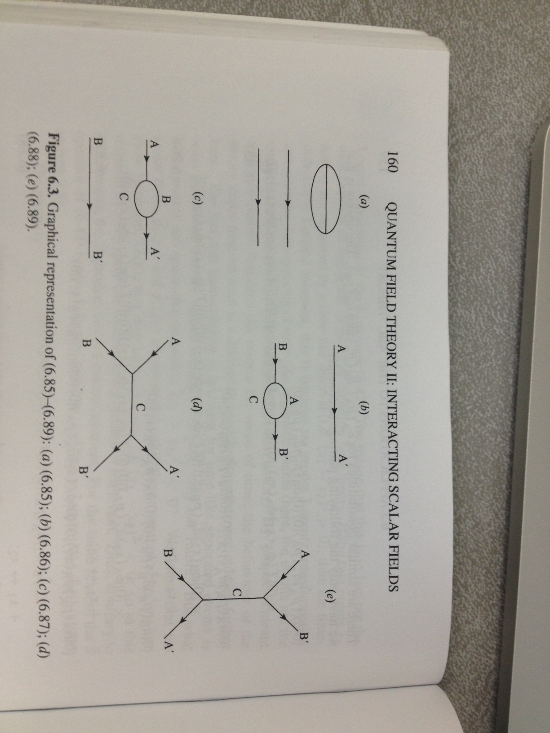
Corresponding Diagrams

Slide 52
One Contributing Term

Slide 53
Feynman Rules for ABC Theory

Slide 54
Decay Rate – Life Time

Slide 55
Golden Rule for Decays

Slide 56
Completing the p⁰ Integral

Slide 57
Decay to Two Particles

Slide 58
Completing the Integral

Slide 59
C → A + B Decay

Slide 60
Golden Rule for Scattering

Slide 61
Completing the p⁰ Integral

Slide 62
Two Body Scattering in CM Frame
Cross Section for A + B → A + B

Slide 63
Reducing Using Delta Functions

Slide 64
Two Body Scattering Formula

Slide 65
Two Body Scattering Formula

Slide 66
A + B → A + B

Slide 67
Simplifies at High Energy
$$θ=θ_{AB^{′}}$$
–
–
–
–
–
Differential cross section drops with the sixth power of energy involved!

Slide 68
Identical particles : A + A → B + B
Identical final state particles

Slide 69
True or False?
Under the assumption that m_{C} >> m_{A} or m_{B}, can we have C decays to multiple As and Bs, with the ${gφ}_{A}φ_{B}φ_{c}$ interaction?:
True or False ?
If A+B scattering has enough center of mass energy, can it produce C particles?:
True or False ?
If the particles are fermions, could they have an interaction term, ${gψ}_{A}ψ_{B}ψ_{c}$?: True or False ?

Slide 70
Higher Order Diagrams

Slide 71
Taming the Infinities
This sounds dubious, but it turns out that the effects are observable – decreasing coupling strength for QCD with scale is a stark example!

