Slide 1
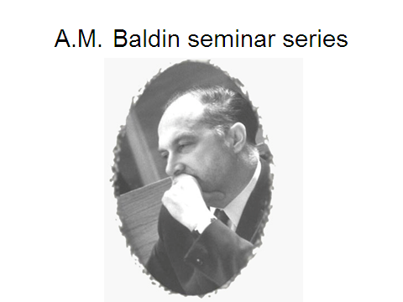

XXII International Baldin Seminar

Slide 2
The Beginning of Dubna
Sources:
Igor Golovin’s biography of Igor Kurchatov
V. P. Dzhelepov’s article in HISAP ‘96 “when Dubna was not on the map”
B. L. Ioffe’s article in HISAP ‘96 “Why the ‘tube’ did not proceed, the heavy water reactor at ITEF”

Slide 3
Veksler and Phase Stability
Soon after Veksler’s discovery in 1944, Kurchatov became convinced that a high energy proton accelerator could and should be built in the USSR.
In 1946 Kurchatov proposed to the government that such a facility be constructed.

Slide 4
Beria takes control
The Soviet government in 1946 authorized the construction of a synchrocyclotron of 500-700 MeV.
A site selection committee was chosen by Beria.
A. I. Mintz gave the selection committee recommendation to Beria.

Slide 5
Mintz’s recommedation
Two sites were deemed suitable.
The Kryukovo region about 40 km from Moscow (in the direction of Dubna, but closer, near Sheremetevo airport.)
A site near the village of Novo-Ivankovo, 125 km from Moscow, where Dubna now is.
Mintz preferred the Kryukovo site.

Slide 6
Site selection
Beria chose Novo-Ivankovo, near the first locks of the Volga-Moscow canal, on the banks of the Volga River.
Mintz said the place was swampy. Beria said we will drain it. Mintz said there was no railroad. Beria said we will build one. Mintz said there was not enough electric power. Beria said we will build a new power station.

Slide 7
Beria wins
One important factor in the choice was the remoteness of the site. Another was that cooling water was available from the Volga. A third was the proximity of a prison camp which supplied construction labor.
Kurchatov chose two of his best co-workers for the cyclotron construction – V. P. Dzhelepov and M.S. Kozodaev.
The laboratory was called the Hydrodynamics Laboratory of the USSR Academy of Sciences.The director was M.G. Mesheryakov.

Slide 8
Construction goal was met
The synchrocyclotron, with a magnet diameter of 5 m, was commissioned in December, 1949, in time for Stalin’s 70th birthday.
Dubna remained a secret town until the mid ‘50’s.
All nuclear research in the USSR was classified.

Slide 9
W pair production at the Tevatron
Lee Pondrom
University of Wisconsin
For the CDF Collaboration

Slide 10
Data analyzers
The WW analysis presented here was performed by Matt Herndon and Will Parker of the University of Wisconsin. Will Parker presented the results at ICHEP 2014 in Valencia, Spain.

Slide 11
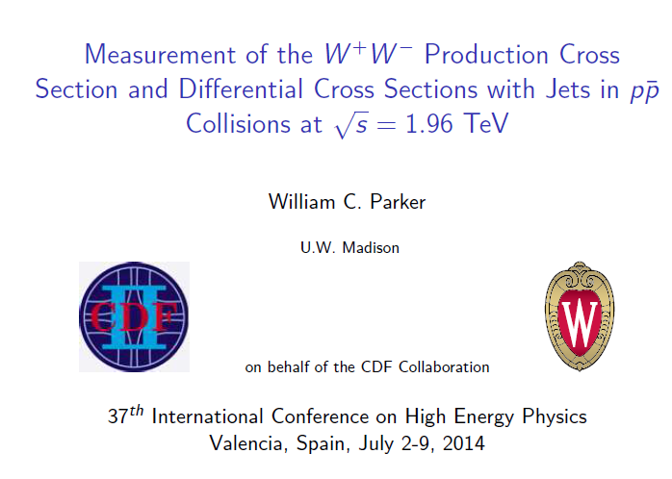
Will Parker’s talk

Slide 12
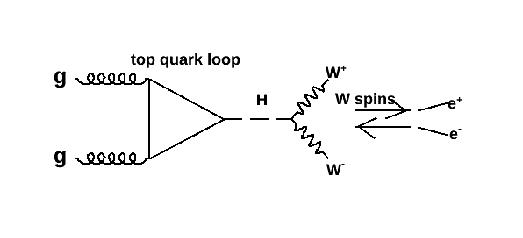
W pair analysis started by Higgs search
Spin 0 H -> parallel charged leptons

Slide 13
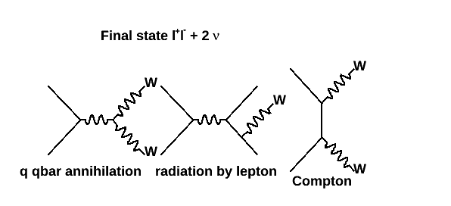
Higgs decay is one source of W pairs other sources: off quarks s & t channel

Slide 14
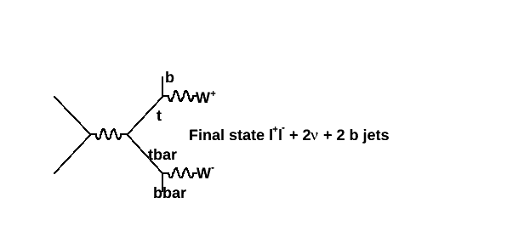
Another source ttbar pairs

Slide 15
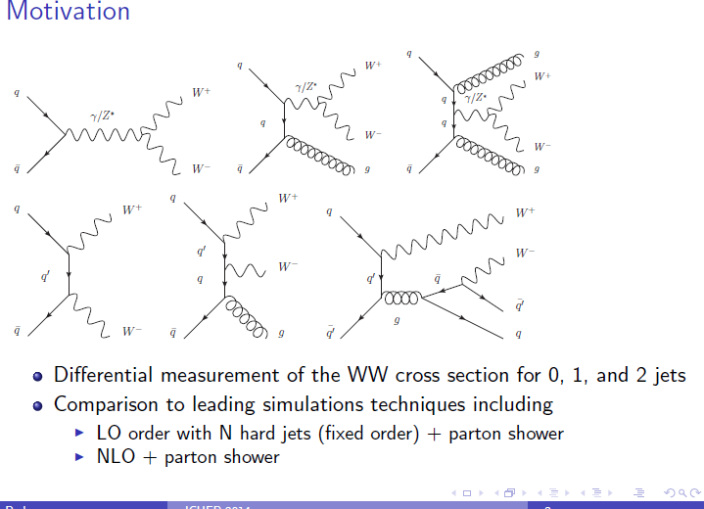
WW + jets Diagrams

Slide 16
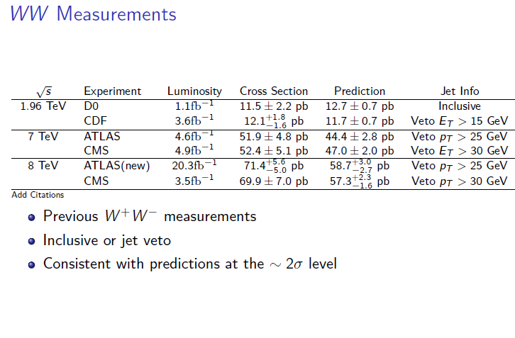
Previous measurements

Slide 17
W decays
We restrict the final state to leptonic decays
W⁺ -> μ⁺ ν_{μ}
W⁺ ->e⁺ ν_{e}
W⁺ ->τ⁺ ν_{τ} ; τ⁺ -> μ⁺ ν_{μ} (e⁺ν_{e}) ν_{τ} - smaller acceptance
Charge conjugates for W⁻ . So the final state is
l⁺l⁻ + 2 ν’s (missing E_{T}) + possible jets from initial state radiation, or from top quarks(background).

Slide 18
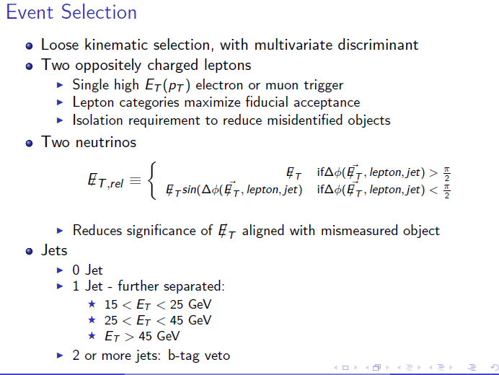
Data sets

Slide 19
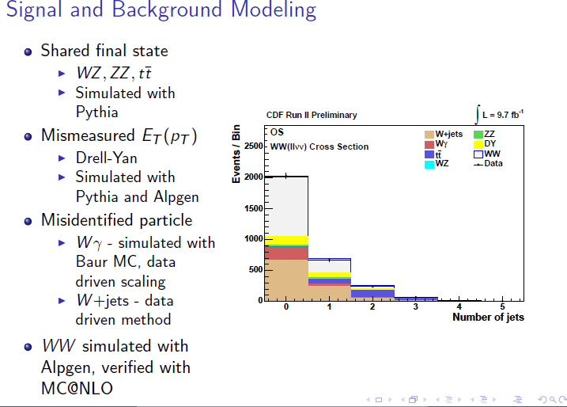
Signal and background

Slide 20
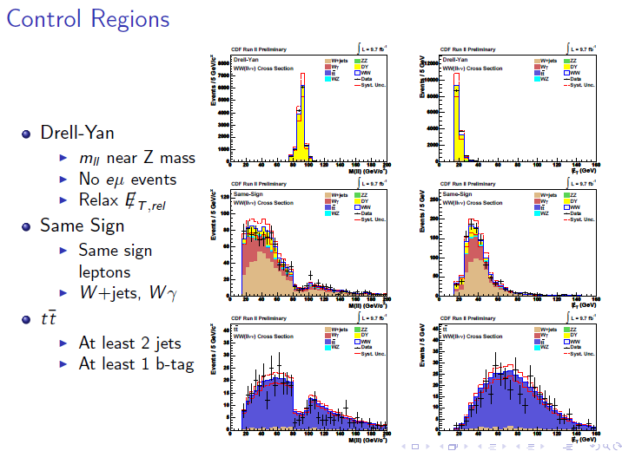
Control regions

Slide 21
Top quarks
σ(pbar p -> tbar t) at 1.96 TeV ∼ 2/3 σ(WW)
tbar t -> W⁻ W⁺ + bbar b (two heavy flavor jets)
Therefore tbar t is a big problem in any measurement of σ(WW + jets)
Handles: secondary vertex b tagger veto leaves about 25% untagged; and the total E_{T} in the event ∼ 300 GeV, twice that of WW.

Slide 22
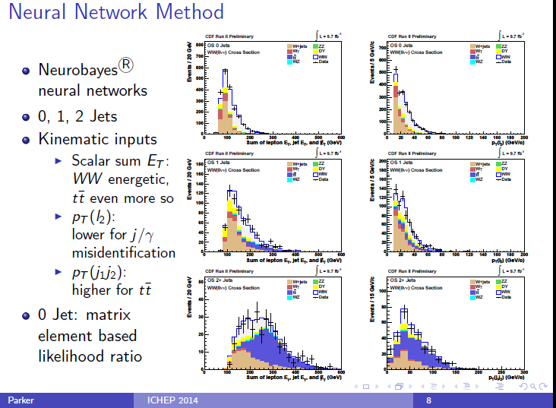
Neural network

Slide 23
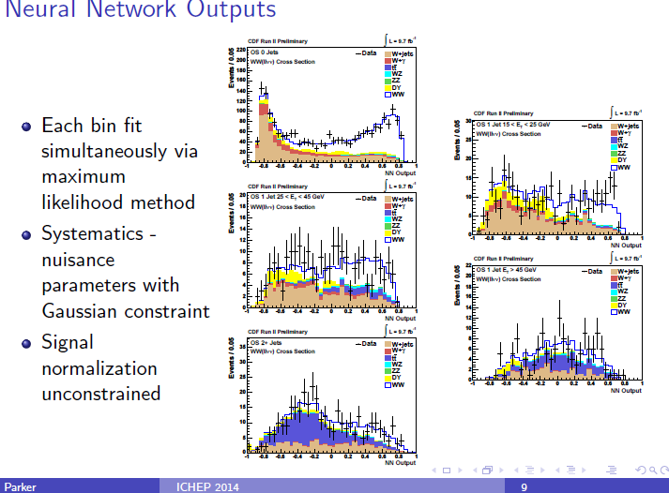
Neural Net output

Slide 24
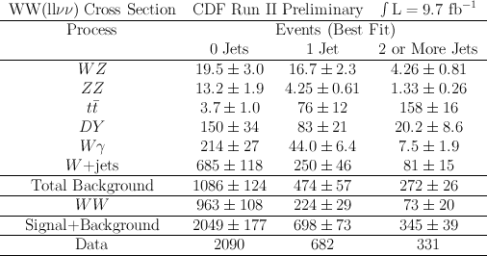
WW events + background

Slide 25
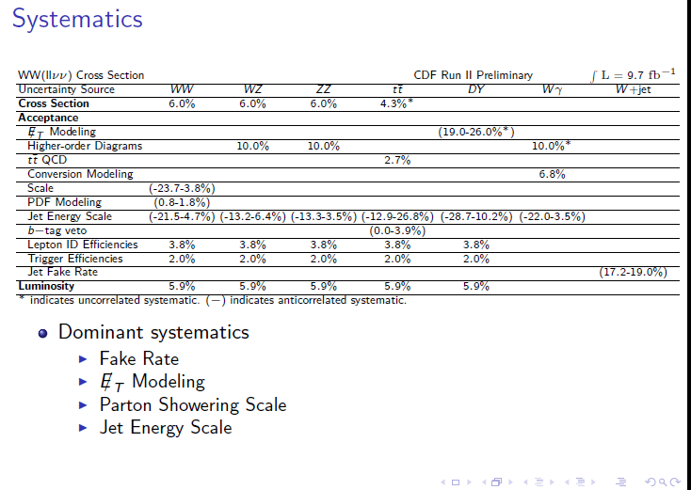
Systematic uncertainties

Slide 26
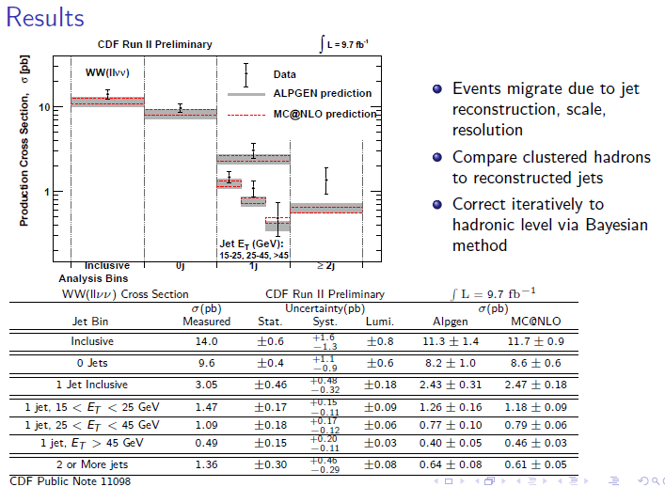
Results

Slide 27
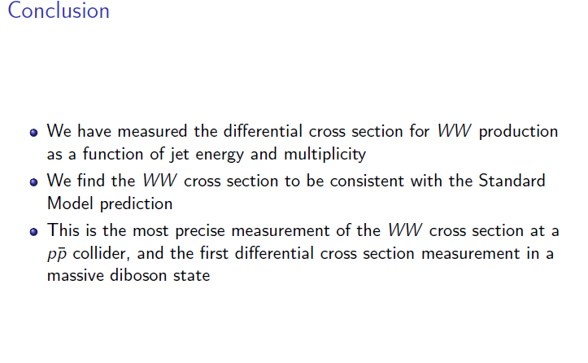
conclusions

Slide 28
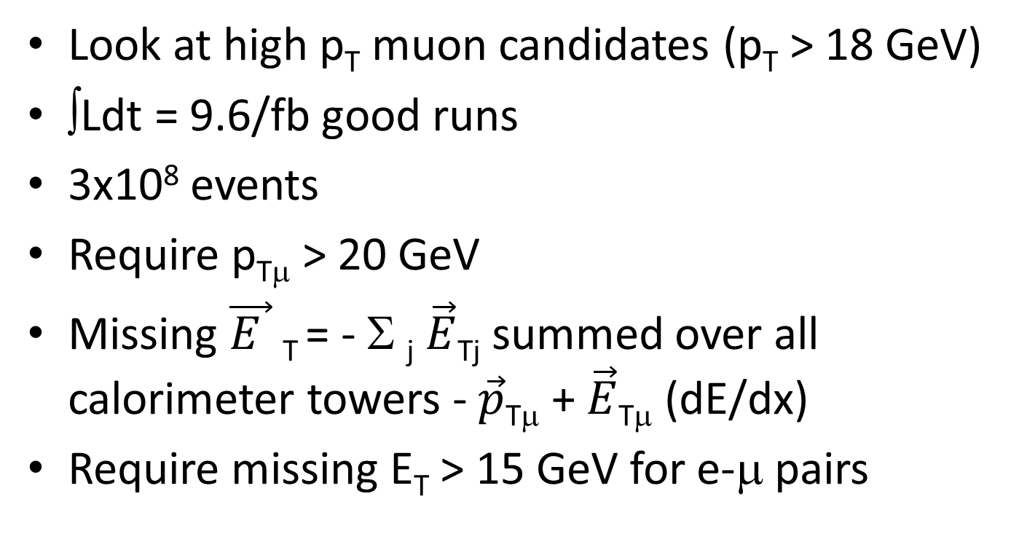
Simplified analysis check
Look at high p_{T} muon candidates (p_{T} > 18 GeV)
∫Ldt = 9.6/fb good runs
3x10⁸ events
Require p_{Tμ} > 20 GeV
Missing $\vec{E }$_{T} = - Σ _{j} $\vec{E}$_{Tj} summed over all calorimeter towers - $\vec{p}$_{T}$$ + $\vec{E}$_{Tμ} (dE/dx)
Require missing E_{T} > 15 GeV for e-μ pairs

Slide 29
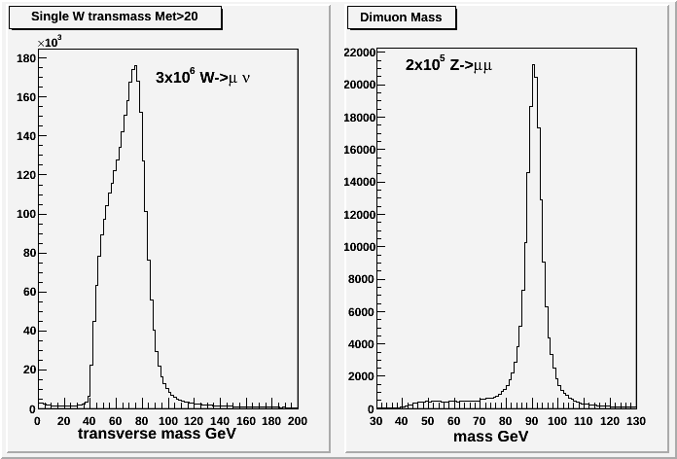
High p_{T} Muon candidates 9.6/fb
CDF Preliminary
3x10⁸ events

Slide 30
Look for WW candidates in μe events with missing E_{T}
Eliminates Drell-Yan background, like Z plus missing E_{T} from mismeasured jet activity.
Major backgrounds are W + jets, where a jet fakes an electron, and t-tbar pairs. There are 3x10⁶ W’s. σ(t-tbar) ∼ σ(WW)/2.
Smaller backgrounds are Wγ (σ∼ 2xWW), and WZ (σ∼WW/3), where one e leg is lost.
Approximate cancellation by like sign subtraction.

Slide 31
Pythia Monte Carlo comparison
Pythia pbar+p -> W⁺ + W⁻, each W decays e or μ or τ. Branching fraction 0.105.
Pythia pbar+p-> tbar + t, again each W decays e or μ or τ.
Data sample should be 65% WW, and 35% ttbar.

Slide 32
Data
300x10⁶ high p_{T} muon triggers
658 opposite sign μ e pairs passing all cuts.
248 like sign μ e pairs passing all cuts (38% like sign background).
3x10⁶ single W’s -> ∼300,000 W+jets, so jet -> fake electron ∼0.001.
410 events like sign subtracted.

Slide 33
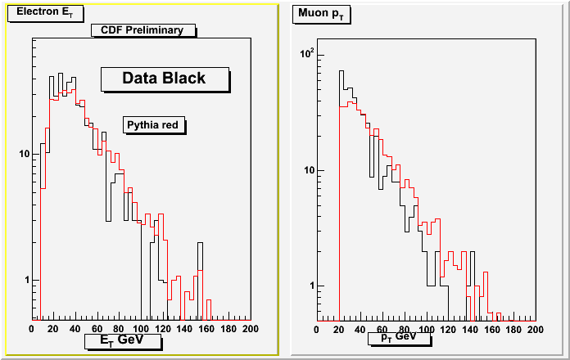
(Opp – like sign) data compared to Pythia 65%WW + 35% ttbar

Slide 34
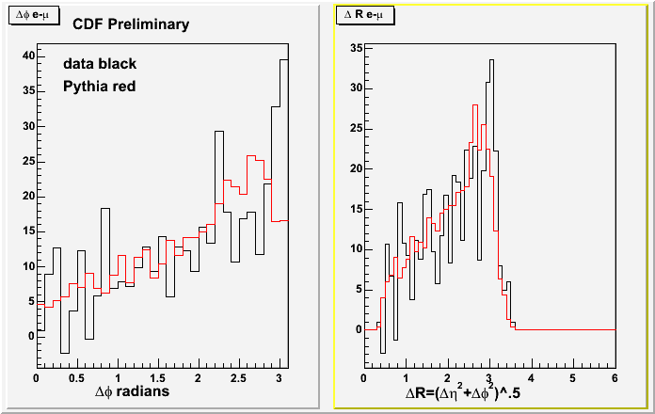
Data-Pythia comparison

Slide 35
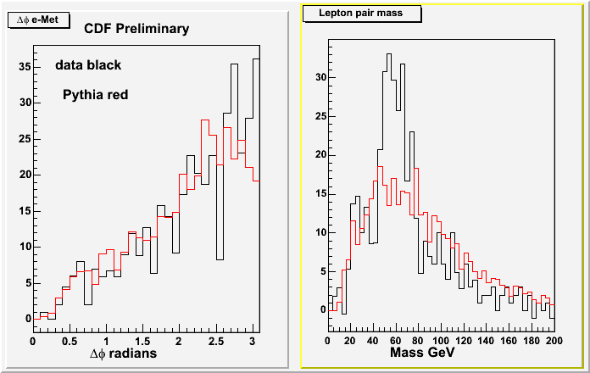
data –Pythia comparison

Slide 36
Preliminary cross section
Using Pythia to calculate the acceptance, assuming σ (ttbar) = 7.6 ±0.6 pb (D0 Tevatron)
And floating σ(WW) gives 410 opp sign events in 9.6/fb for
σ(pbar+p->WW+X) at 1.96 TeV = 17.6±1.8 pb
Neural net analysis gave σ = 14.0±2.0 pb using a larger data sample (2000 events, 1000 background).

Slide 37
ДОПОЛНИТЕЛЬНЫЙ МАТЕРИАЛ
Мой доклад кончается.
Спасибо для внимания

Slide 38
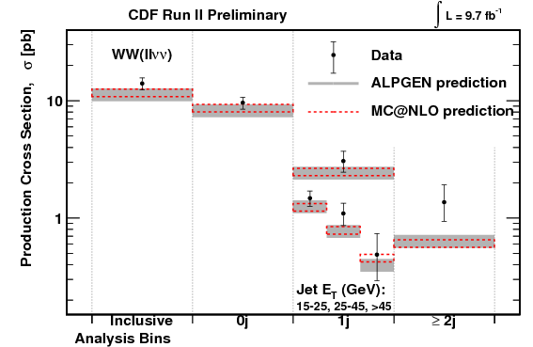
WW inclusive

Slide 39
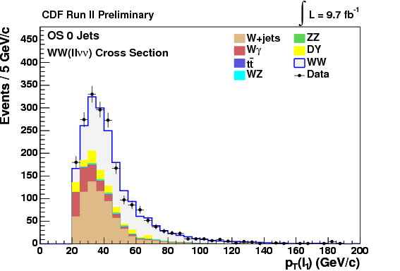
WW kinematic variables p_{T} of leading lepton

Slide 40
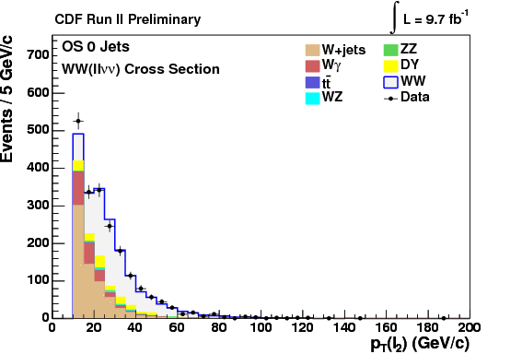
WW kinematic variables p_{T} of second lepton

Slide 41
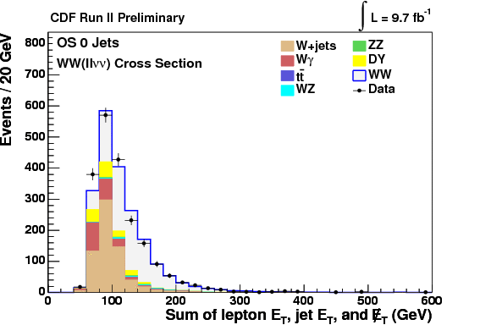
WW kinematic variables
Sum E_{T} leptons + jets + MeT

Slide 42
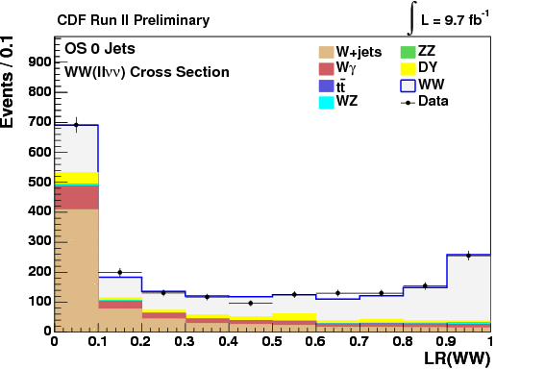
WW kinematic variables liklehood ratio

Slide 43
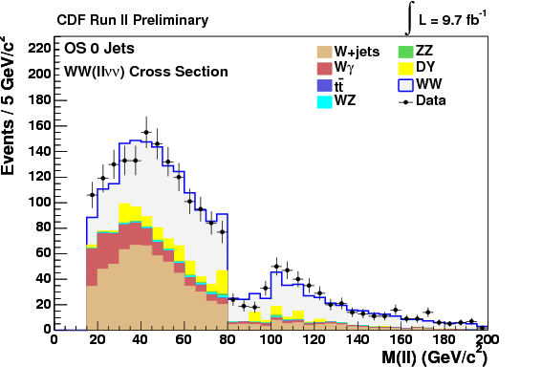
WW kinematic variables lepton pair mass

Slide 44
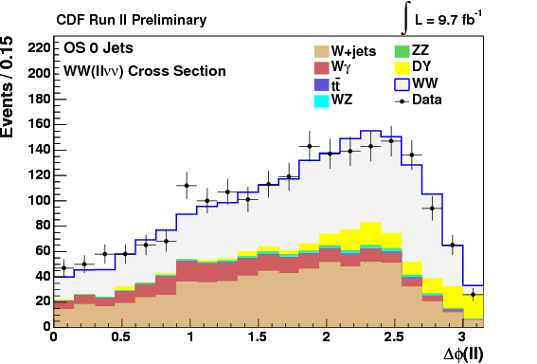
WW kinematic variables
Δϕ lepton pair

Slide 45
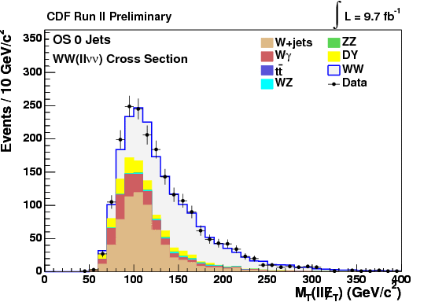
WW kinematic variables transverse mass lepton pair + Met

Slide 46
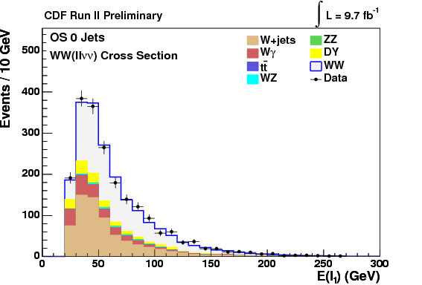
WW kinematic variables
Energy of leading lepton

Slide 47
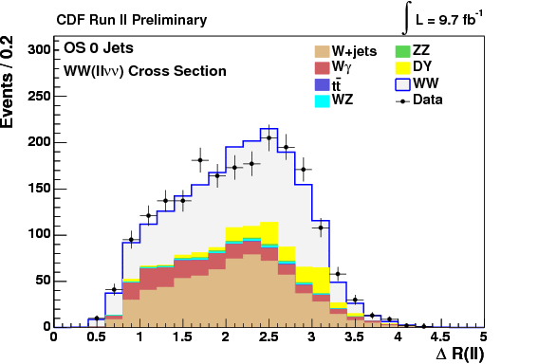
WW kinematic variables
ΔR lepton pair

Slide 48
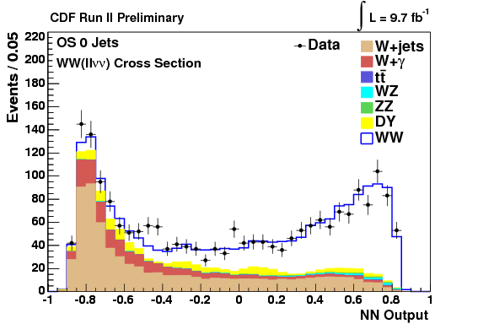
Neural net output
WW no jets with E_{T}>15 GeV

Slide 49
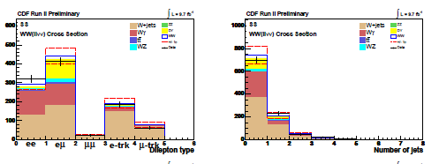
Like sign background

Slide 50
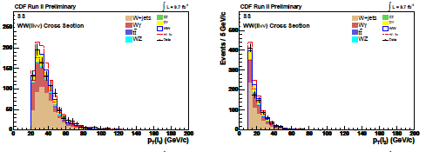
Like sign background distributions

Slide 51
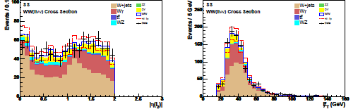
Like sign background distributions

Slide 52
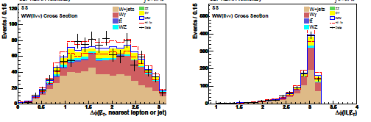
Like sign background distributions

Slide 53
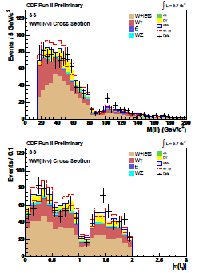
Like sign background distributions continued

Slide 54
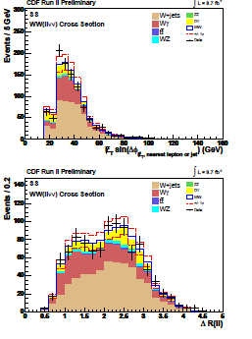
Like sign background distributions contued

Slide 55
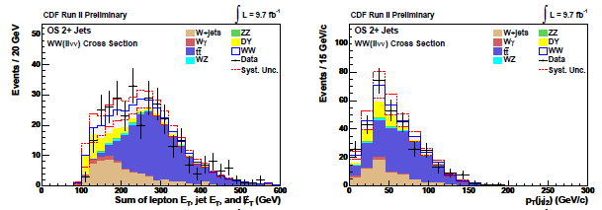
WW + two or more jets

Slide 56
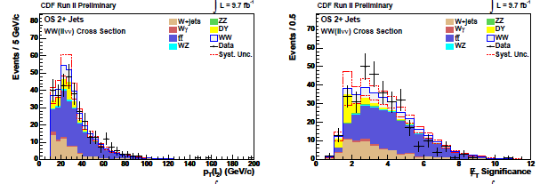
WW + two or more jets

Slide 57
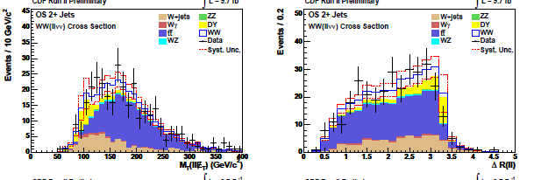
WW + two or more jets

Slide 58
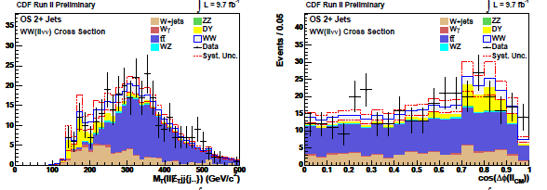
WW + two or more jets

Slide 59
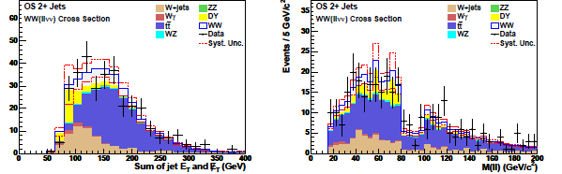
WW + two or more jets

Slide 60
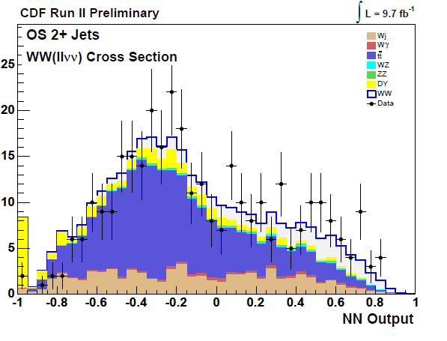
WW + 2 or more jets NN output

